Slide 1



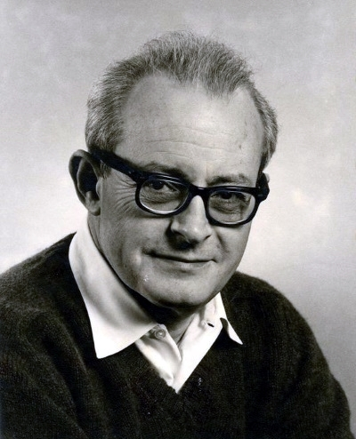
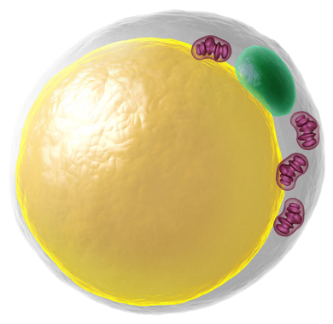
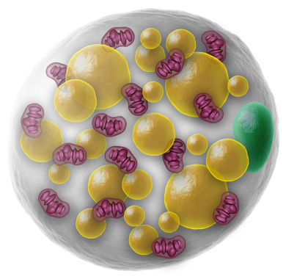



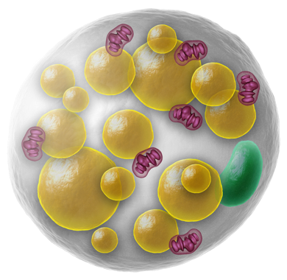


Slide 2








Slide 3



Slide 4
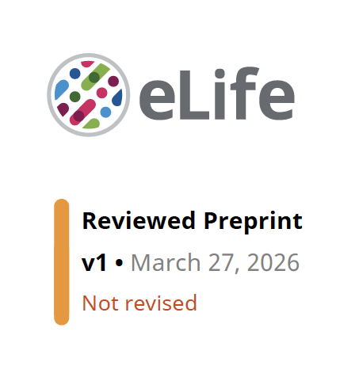


Slide 5
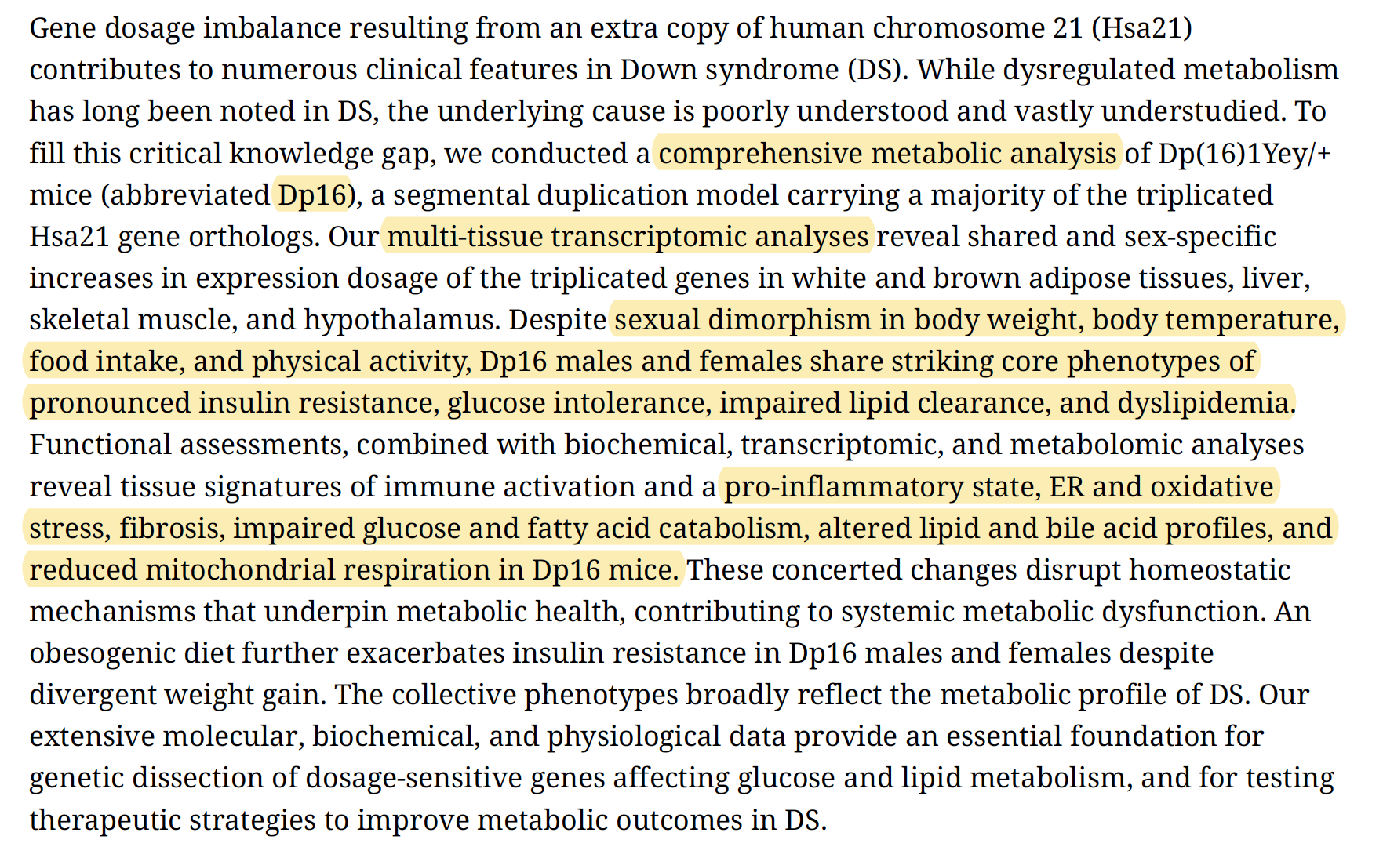

Slide 6
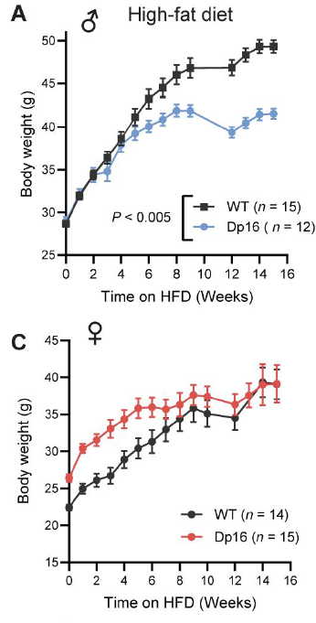
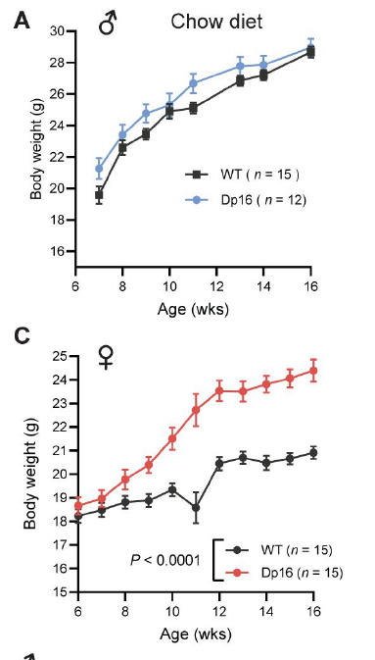

Slide 7




Slide 8
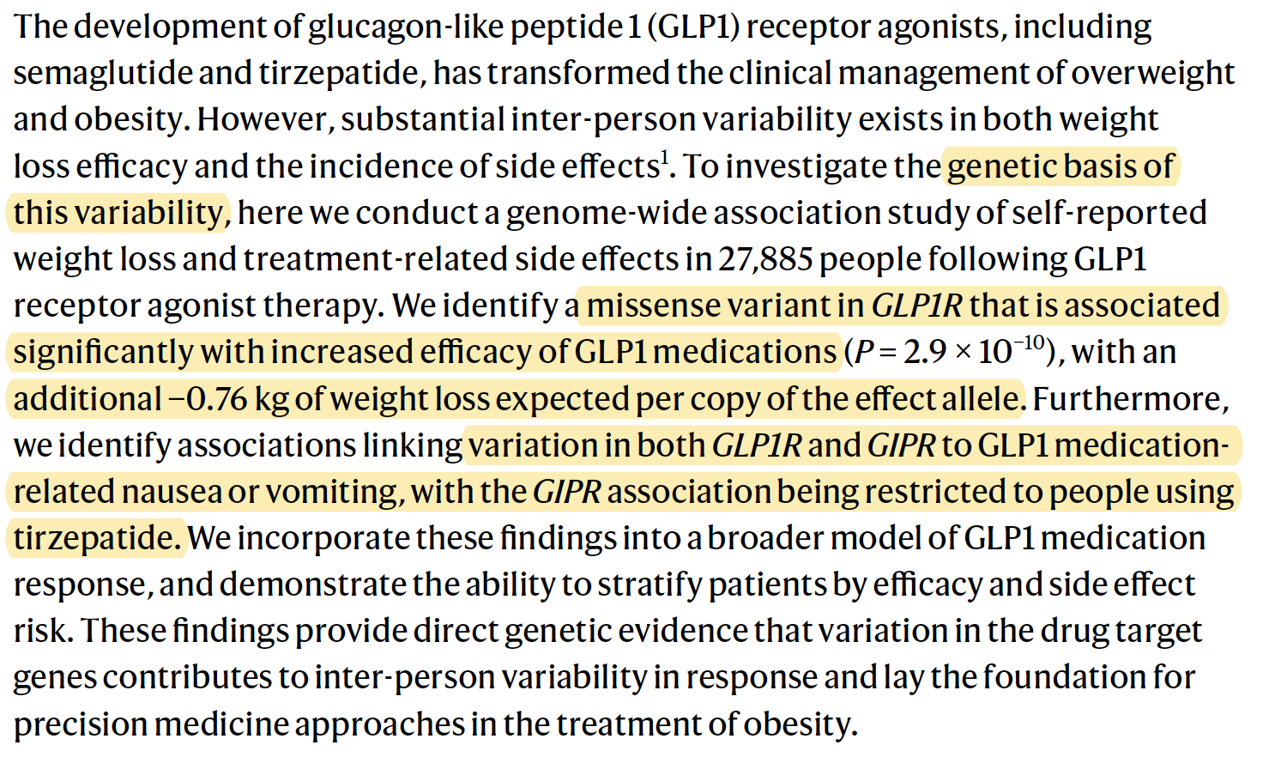

Slide 9
The main coding variants highlighted in the paper
are GLP1R p.Pro7Leu (rs10305420) and
GIPR p.Glu354Gln (rs1800437).
The GLP1R variant is the one tied to greater
BMI/weight loss on GLP-1 drugs, while the GIPR
variant is tied to higher vomiting risk on tirzepatide;
A knock-in mouse carrying these variants could
be useful to test receptor signaling, trafficking, and
whether the GIPR change really reduces anti-nausea
buffering. But it is a weaker way to screen for
“better weight-loss drugs with fewer side effects,
” because the human side-effect phenotype is not
modeled in mice. Tell me what you are thinking.

Slide 10

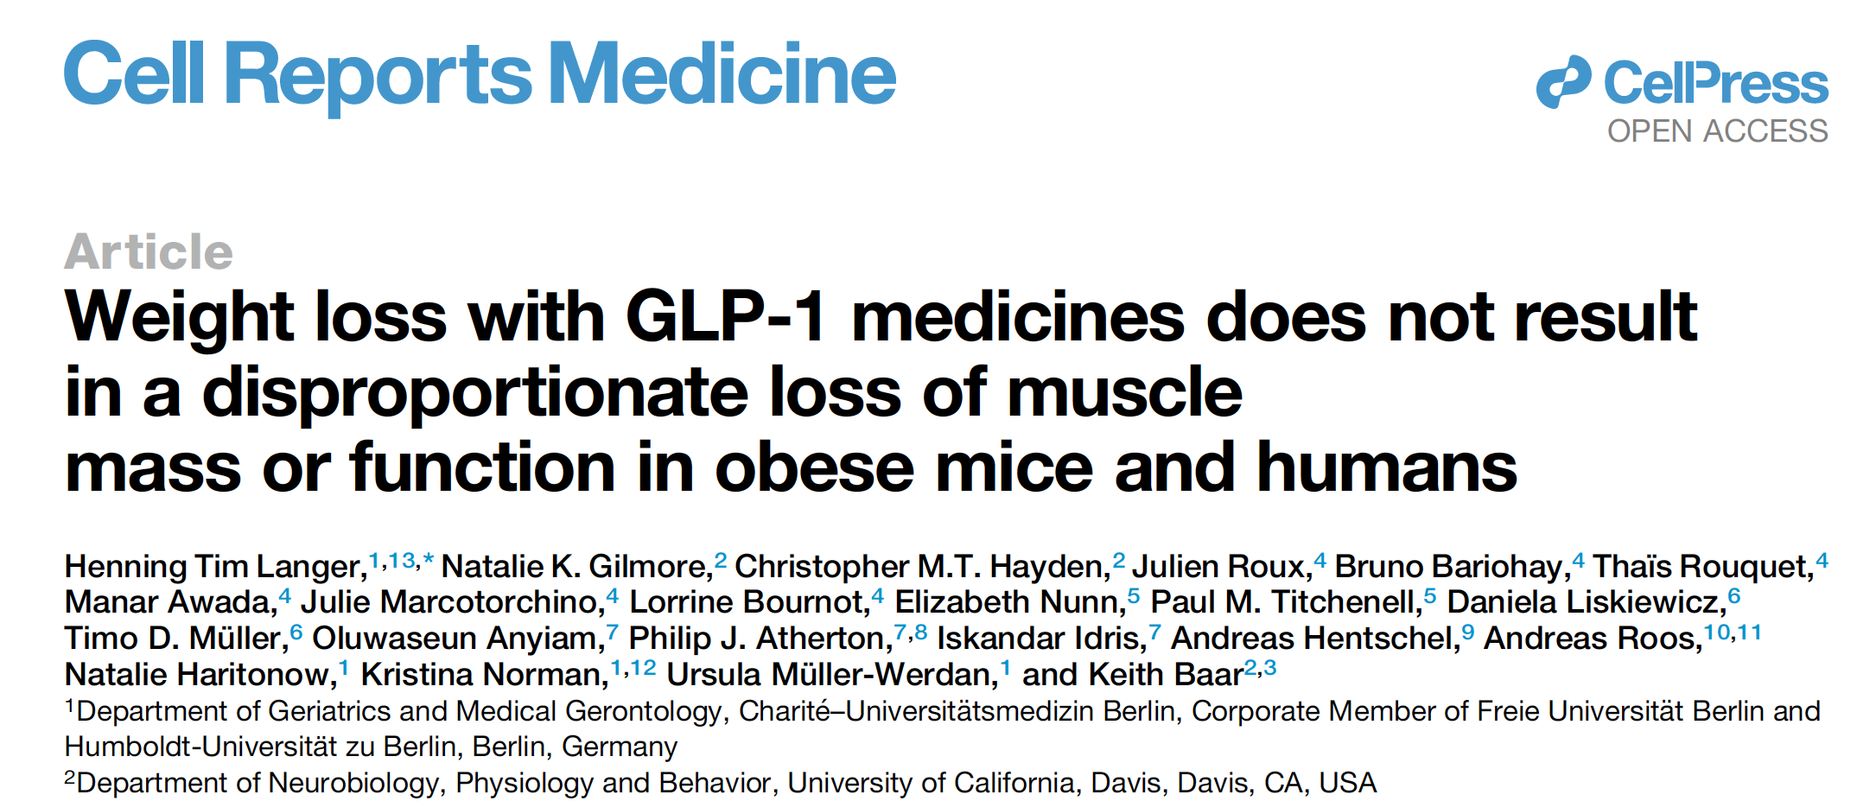

Slide 11
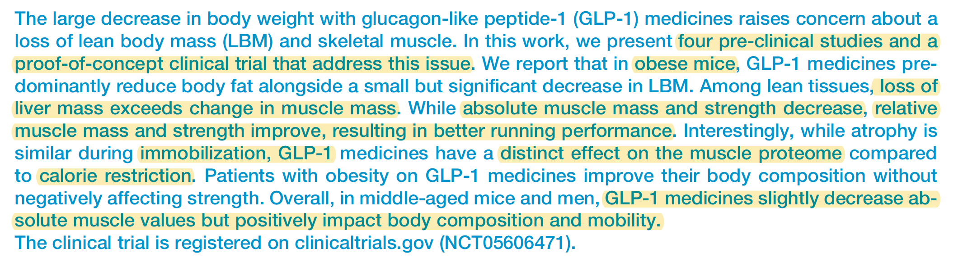

Slide 12
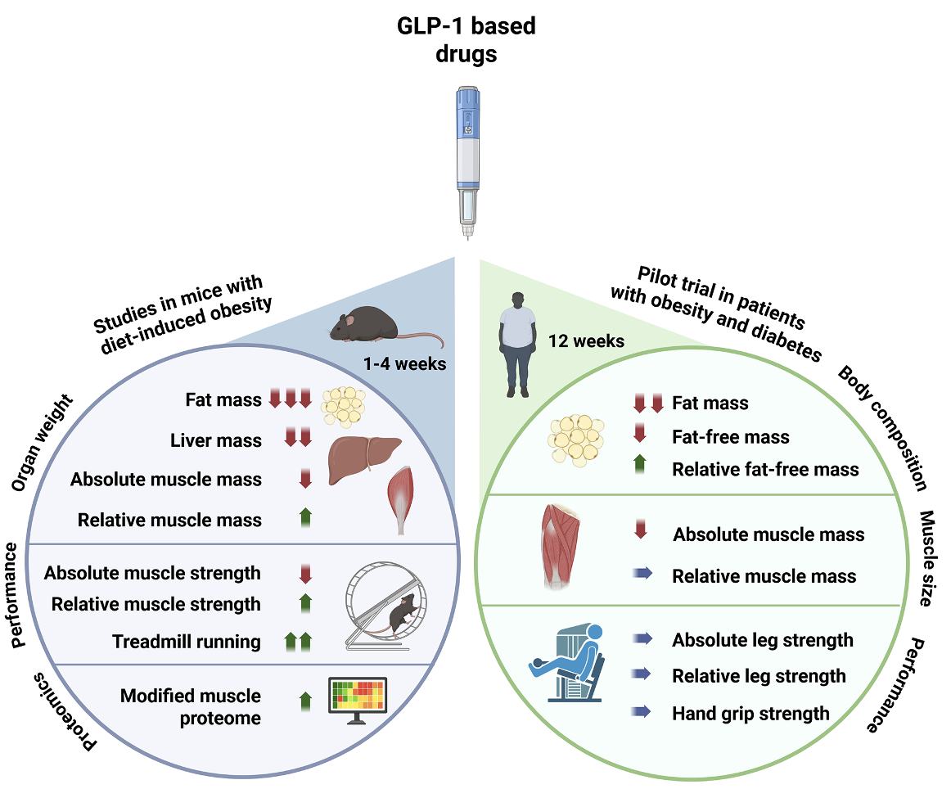
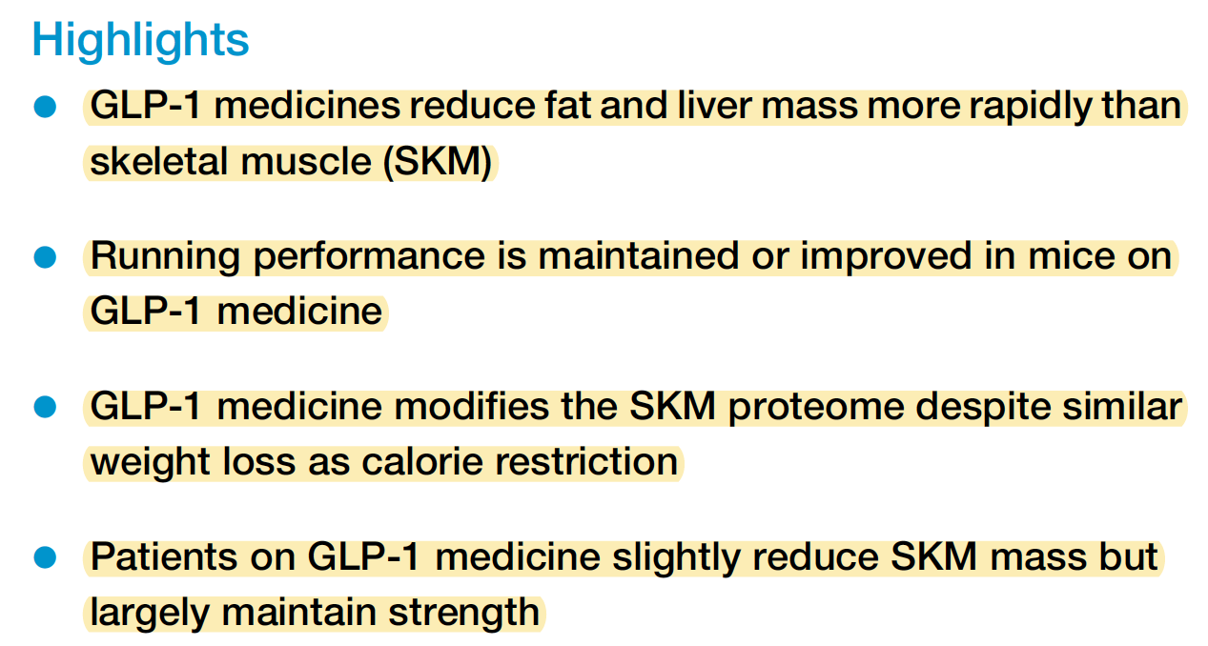

Slide 13
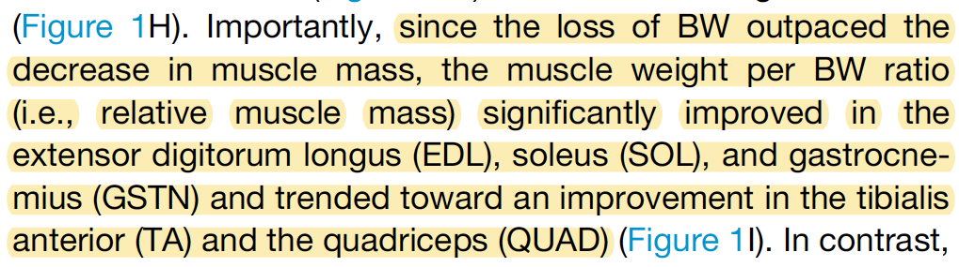
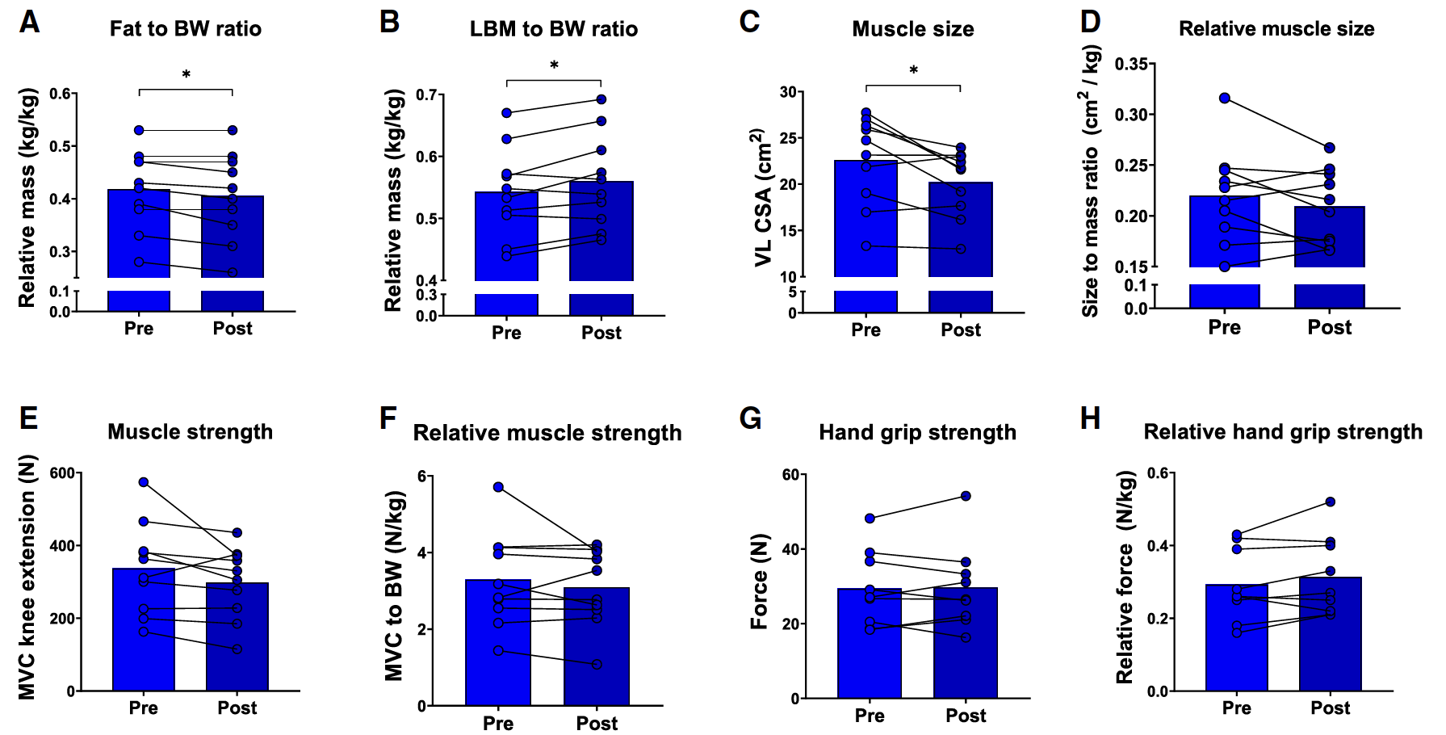

Slide 14
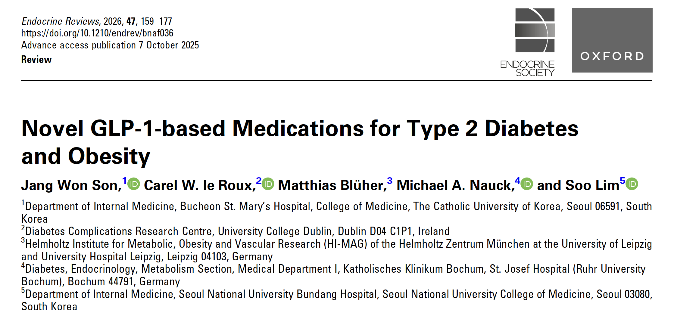

Slide 15
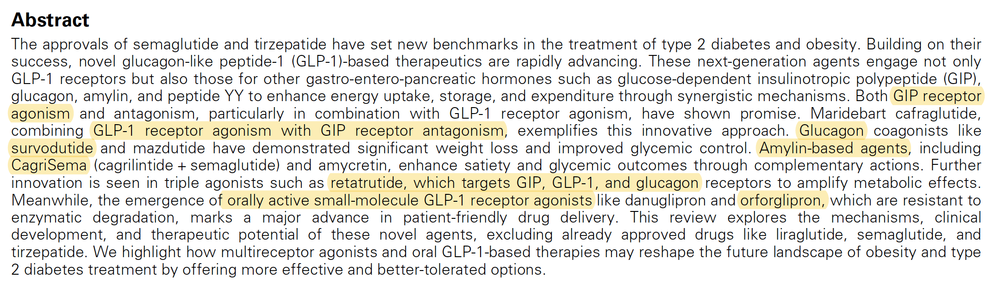
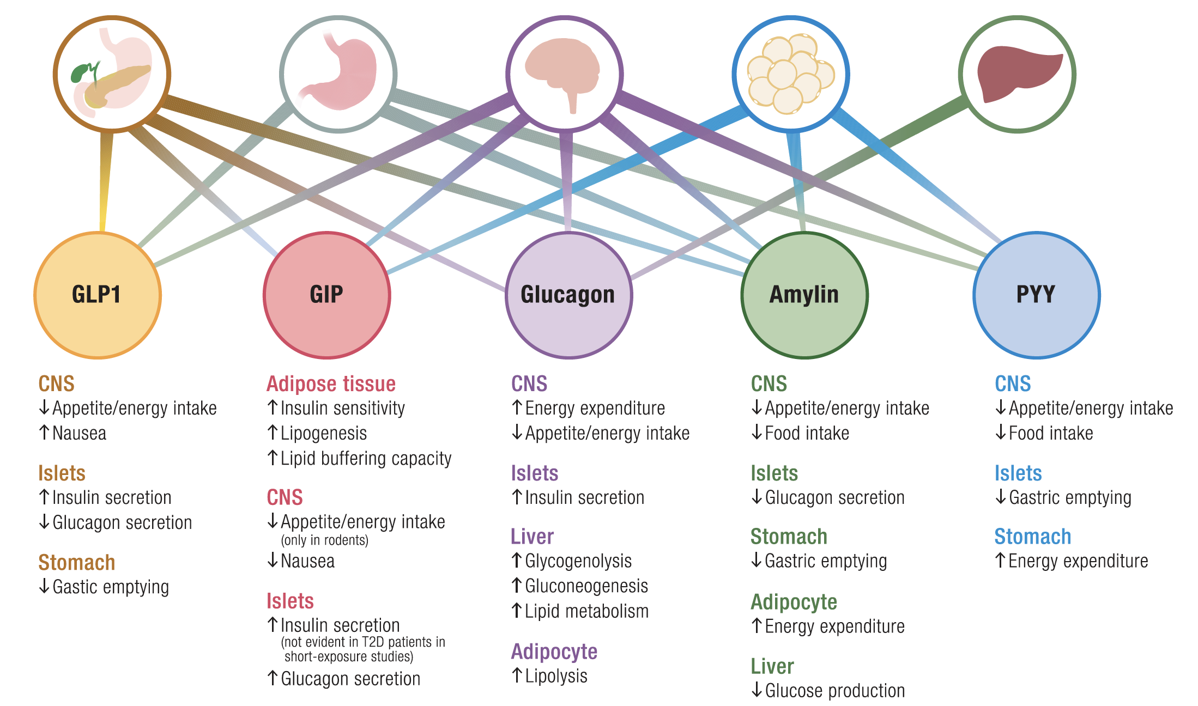

Slide 16
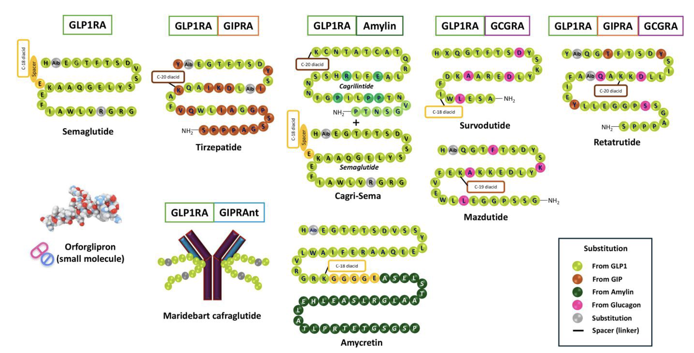

Slide 17
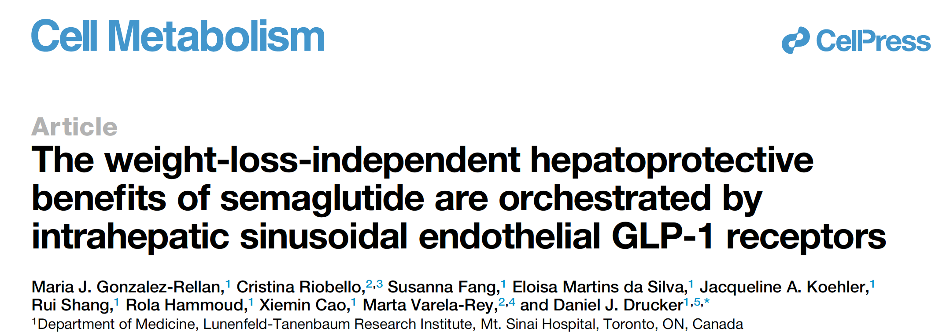

Slide 18
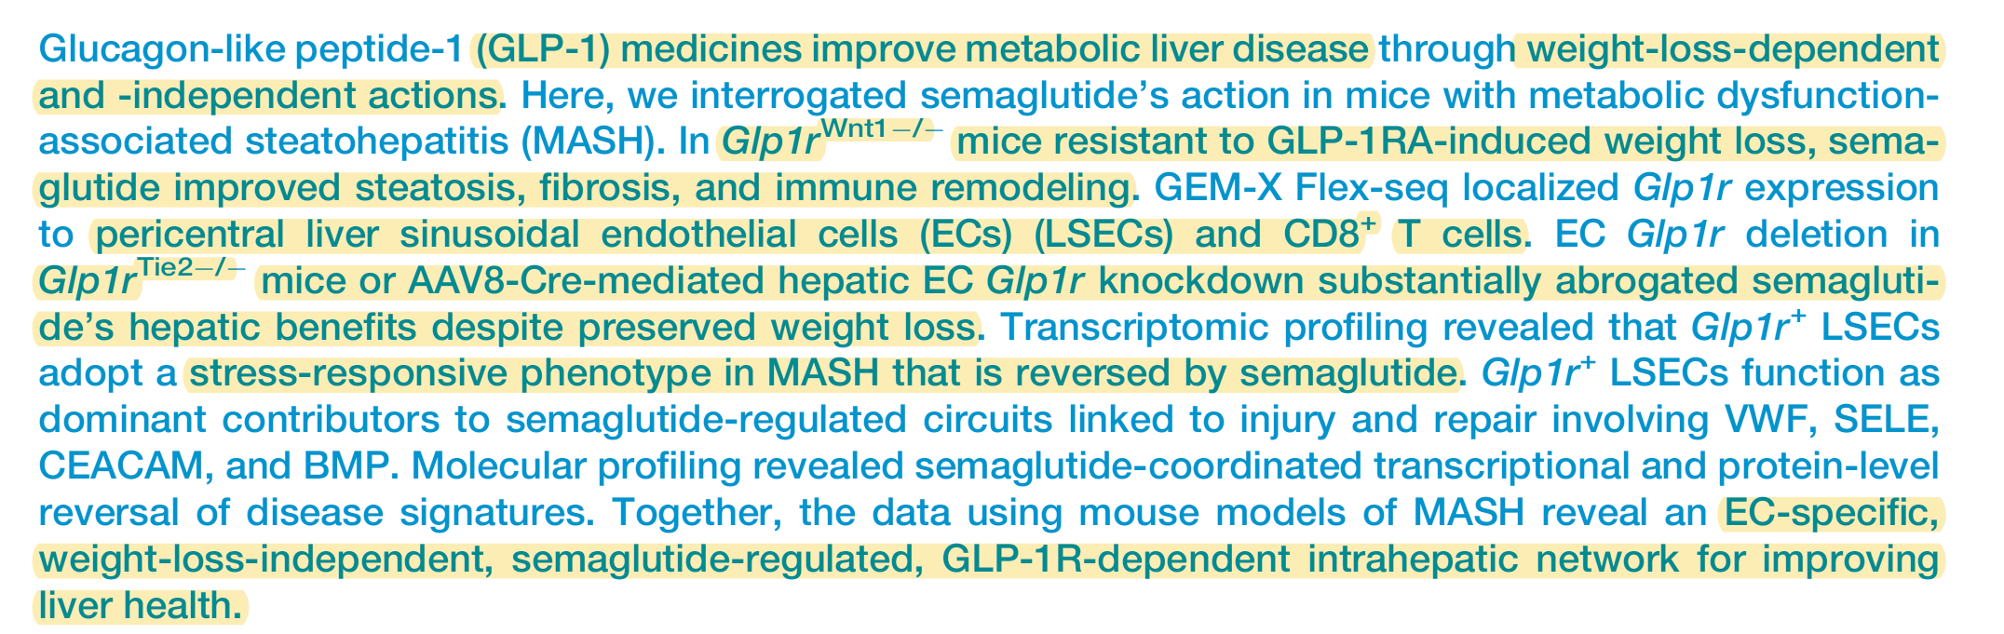
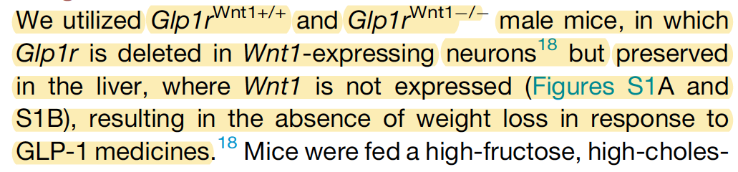

Slide 19
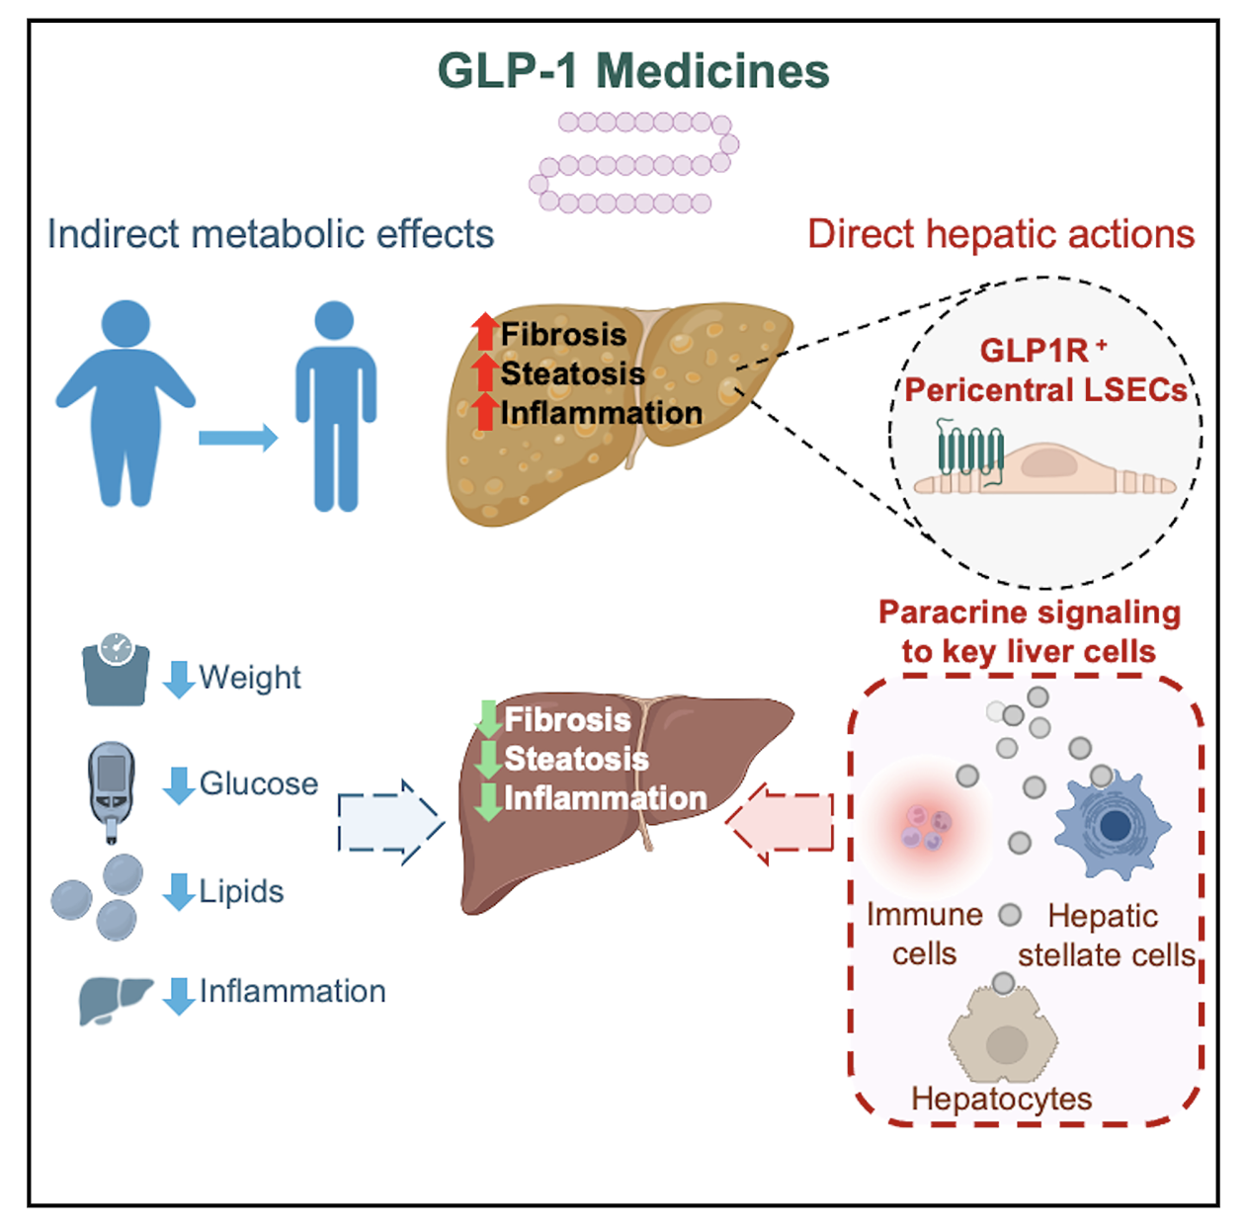
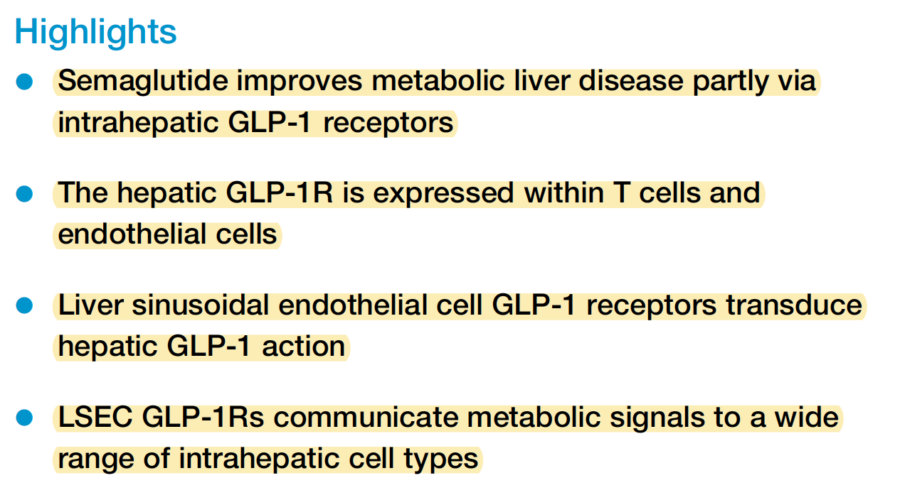

Slide 20
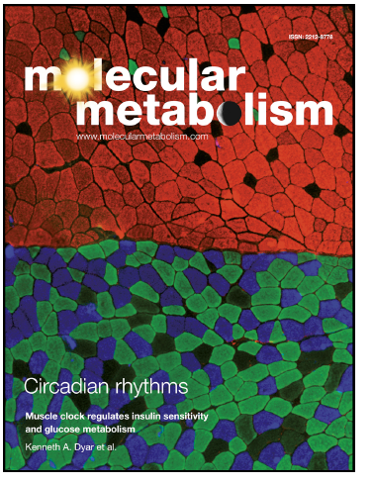
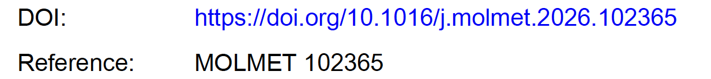

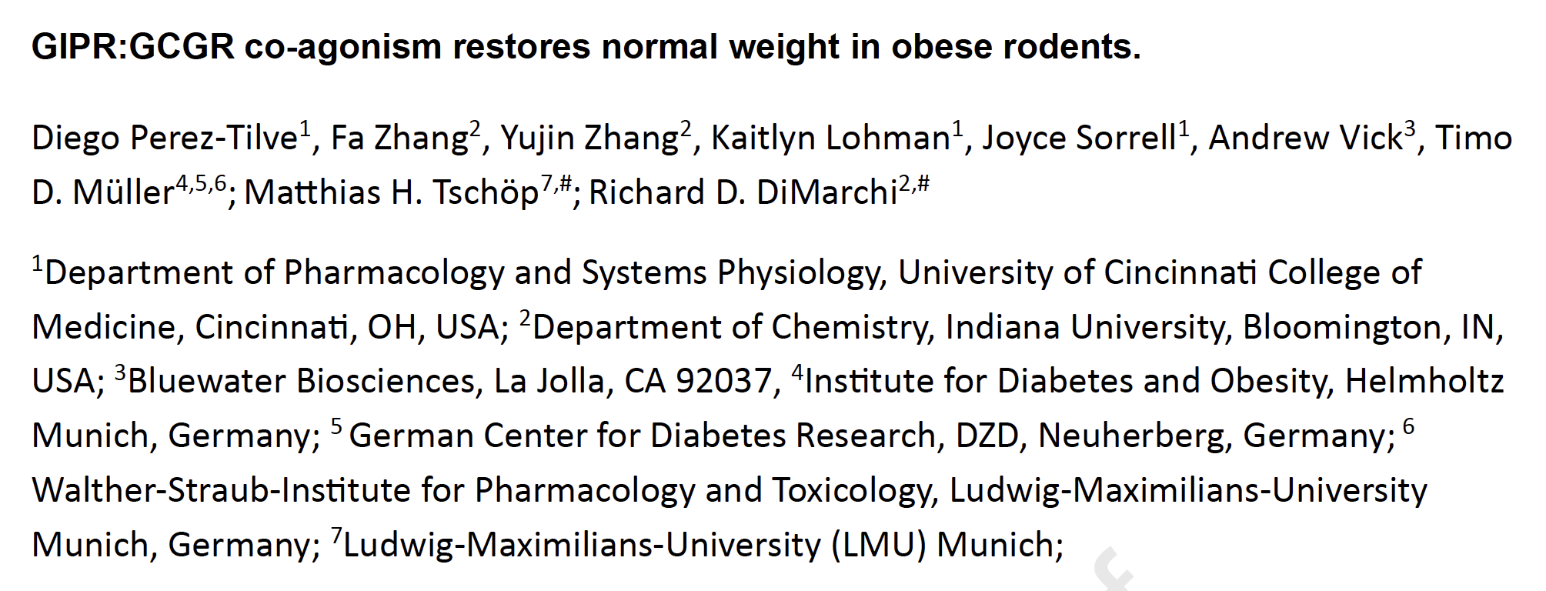

Slide 21
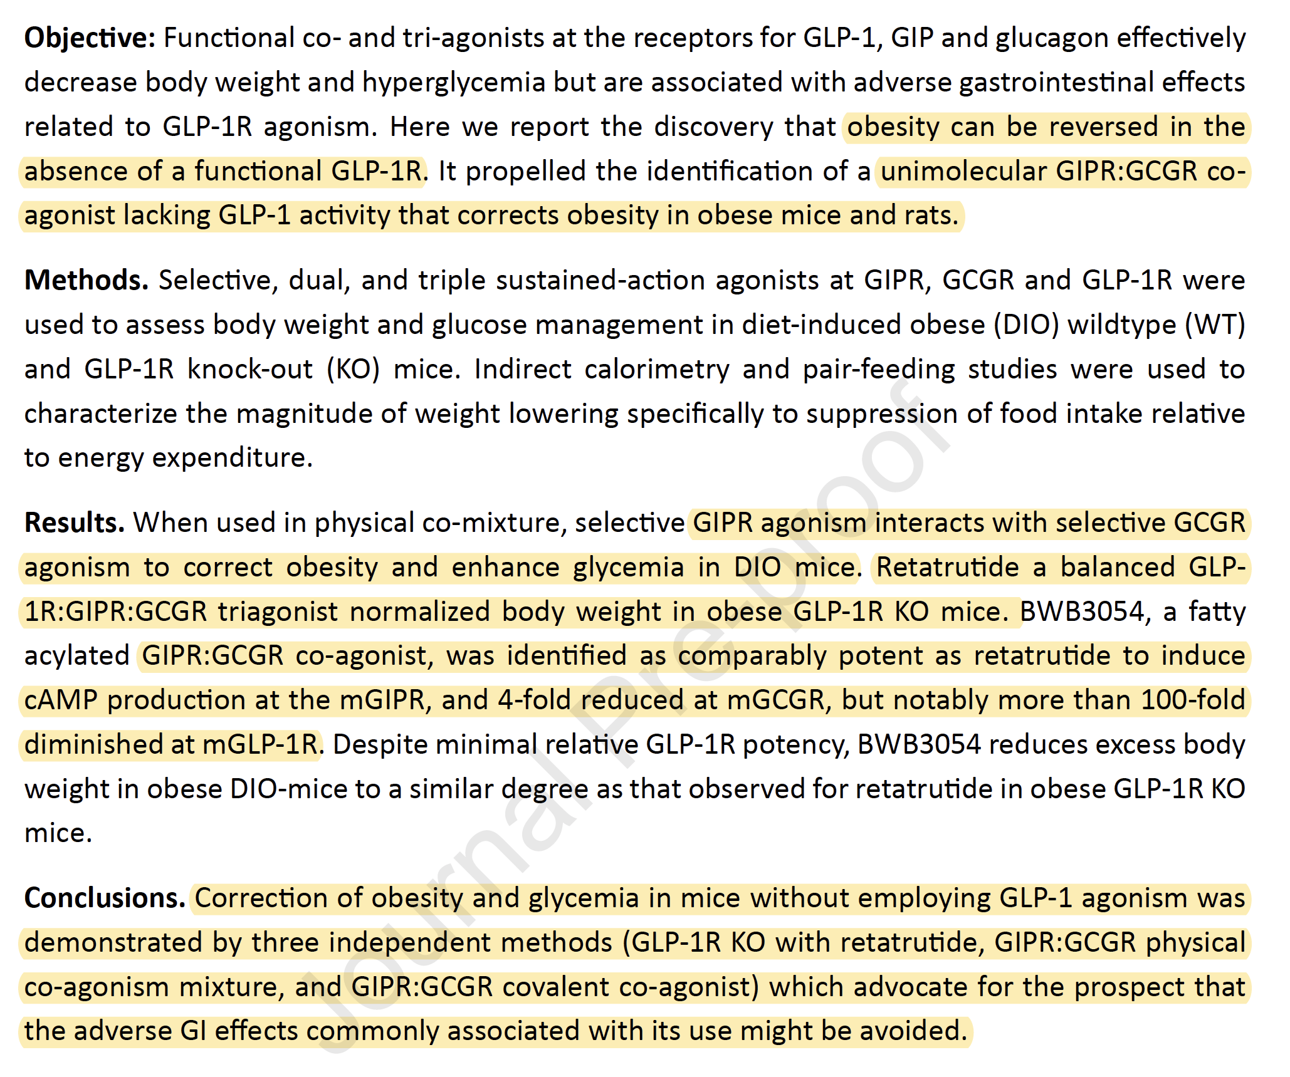

Slide 22
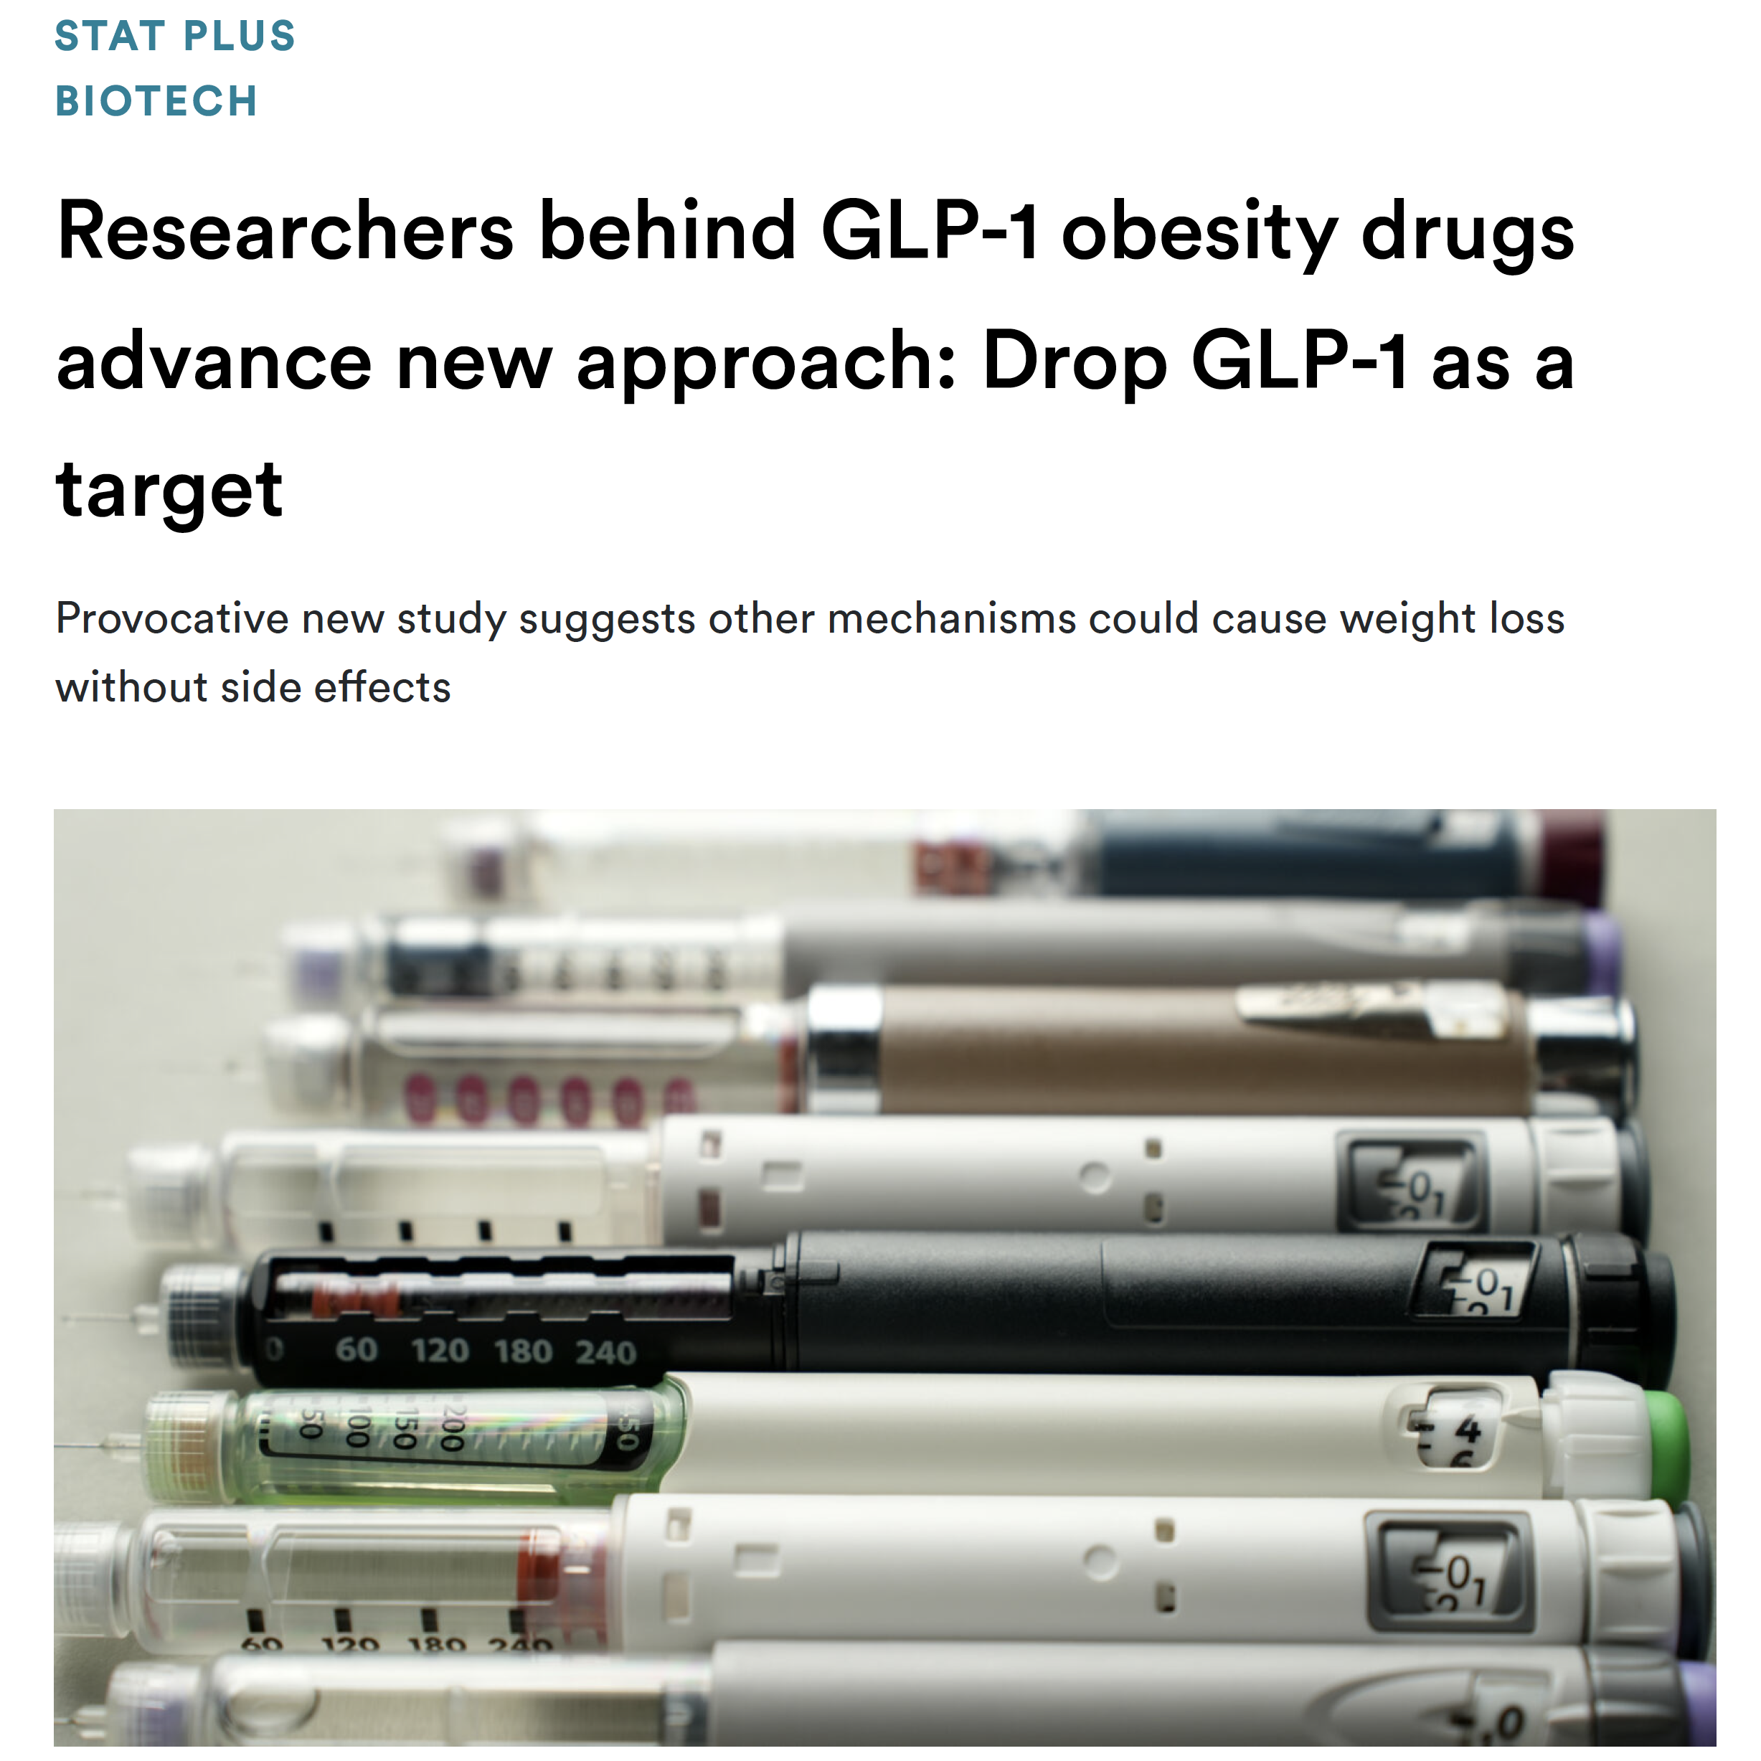
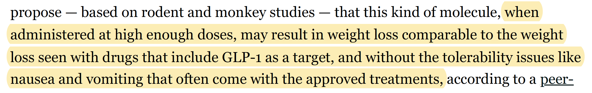

Slide 23

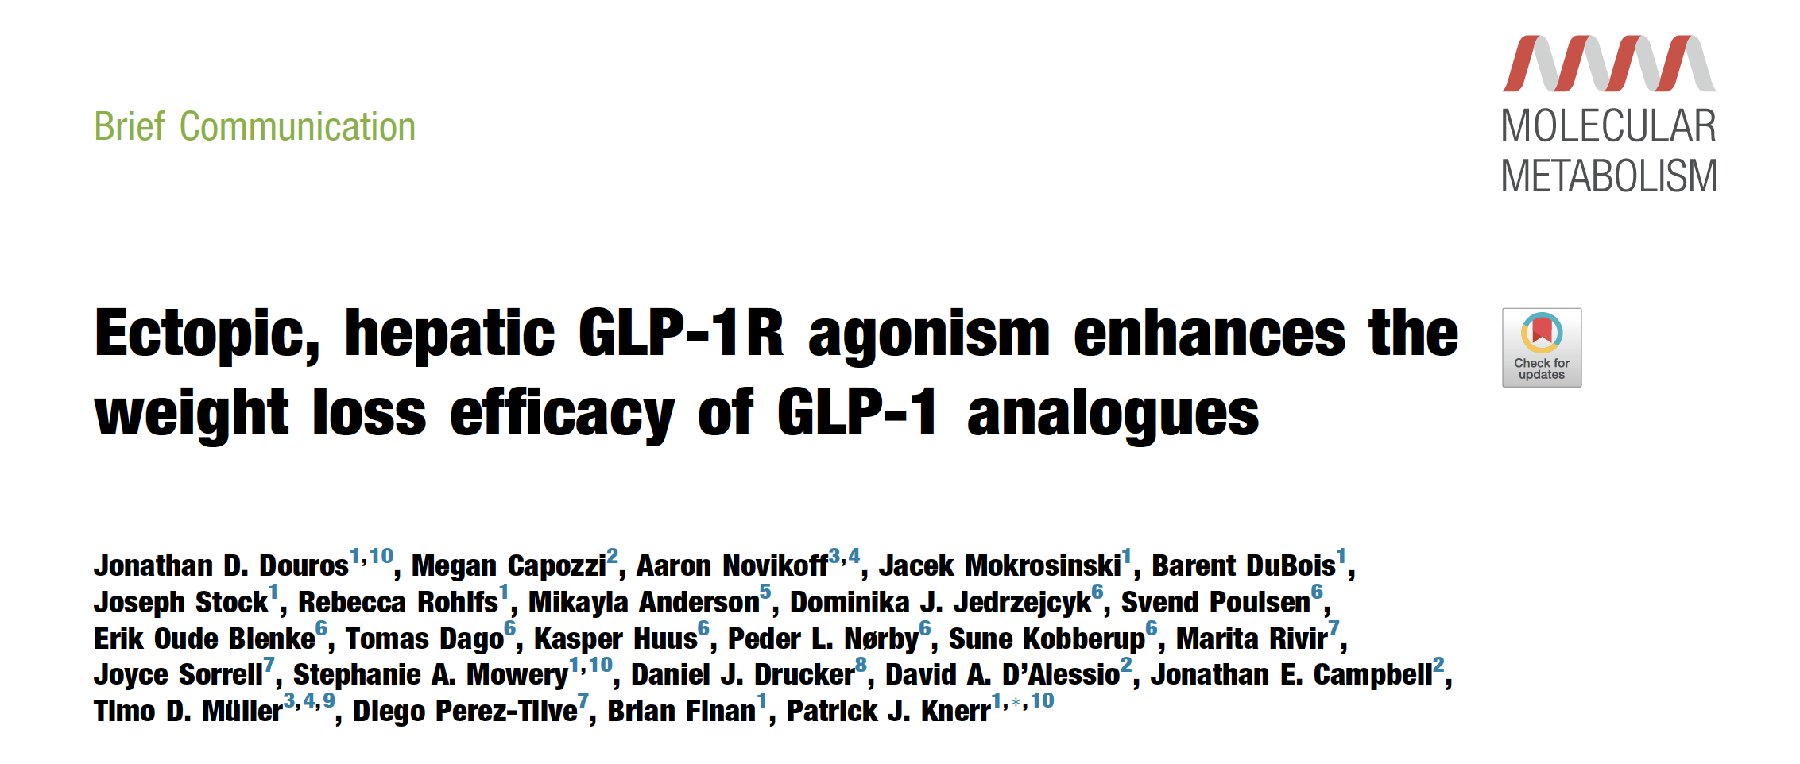

Slide 24
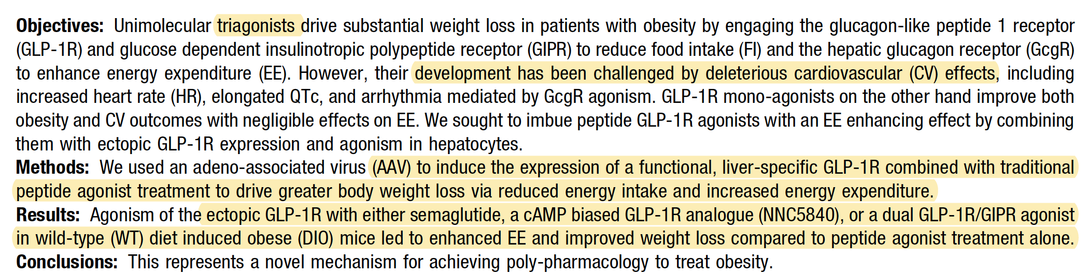

Slide 25
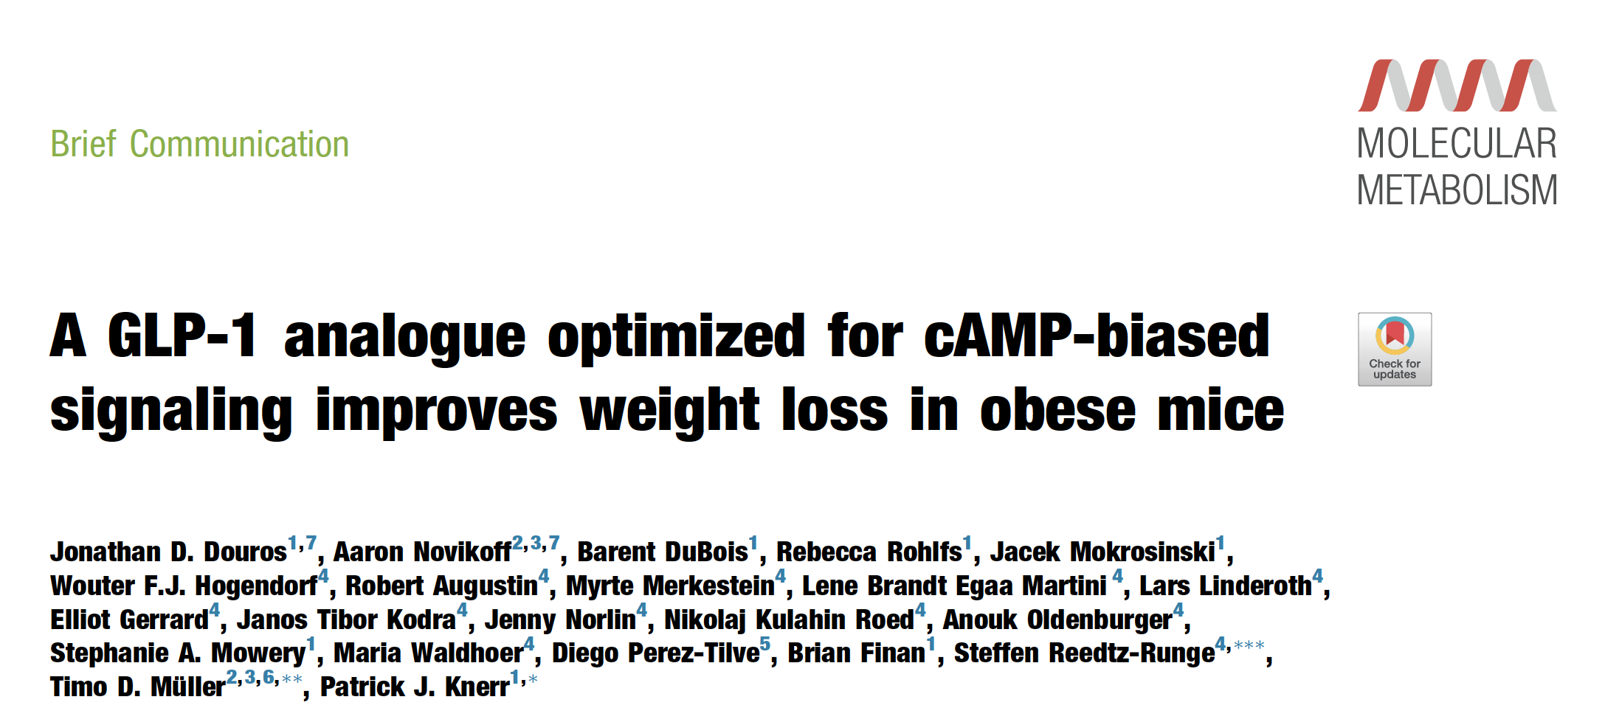

Slide 26
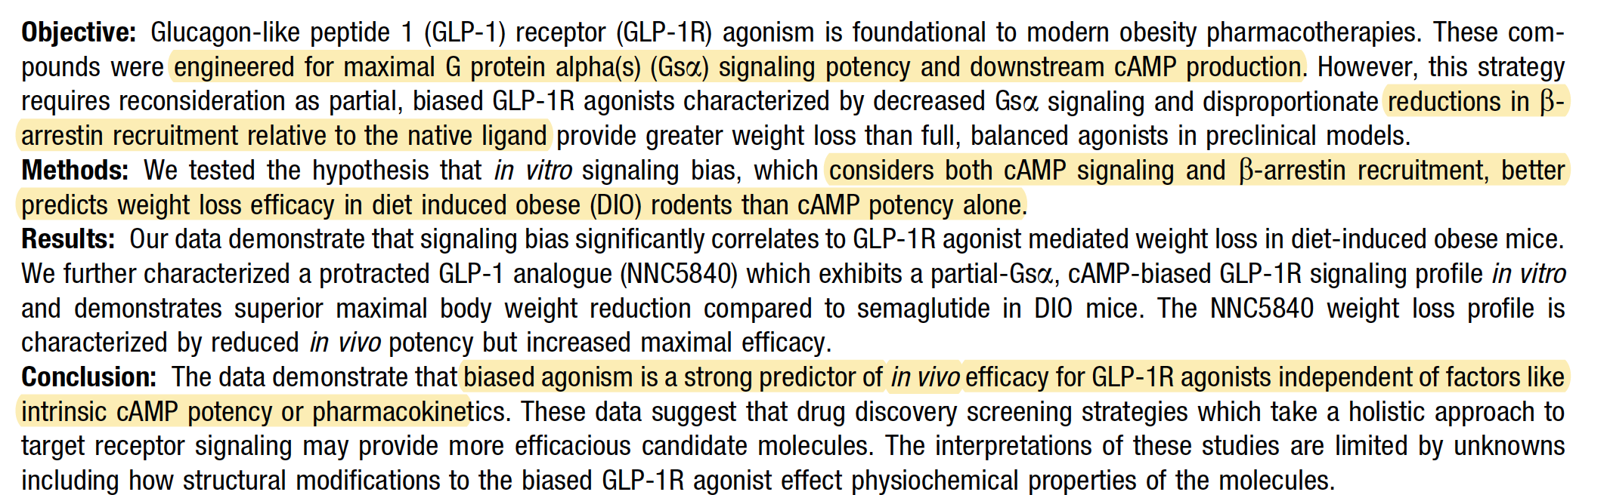

Slide 27
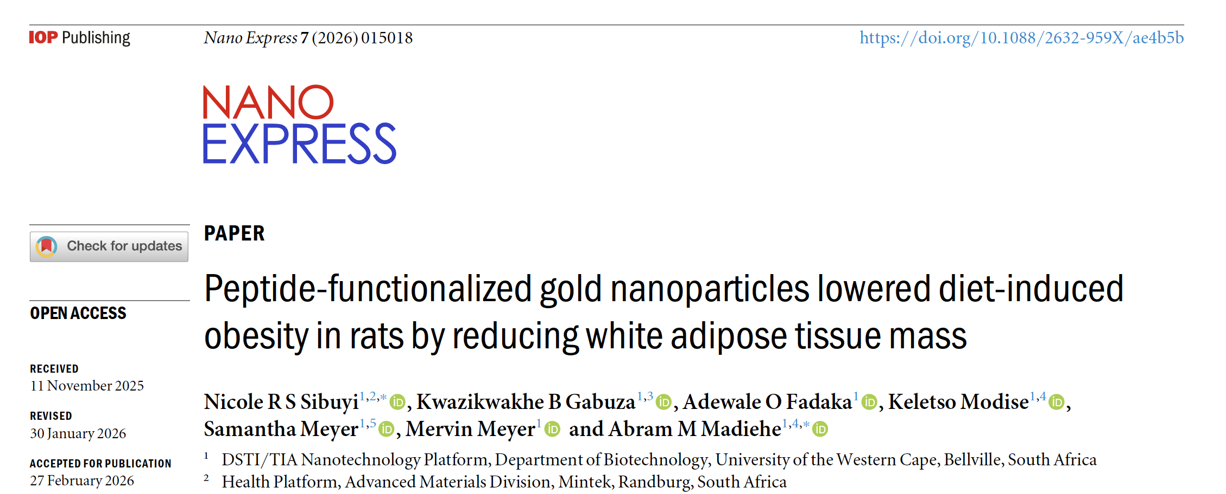

Slide 28
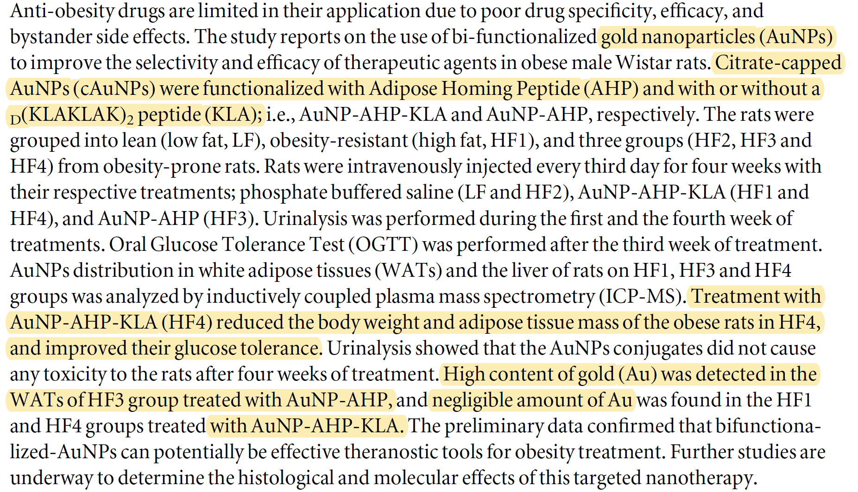

Slide 29
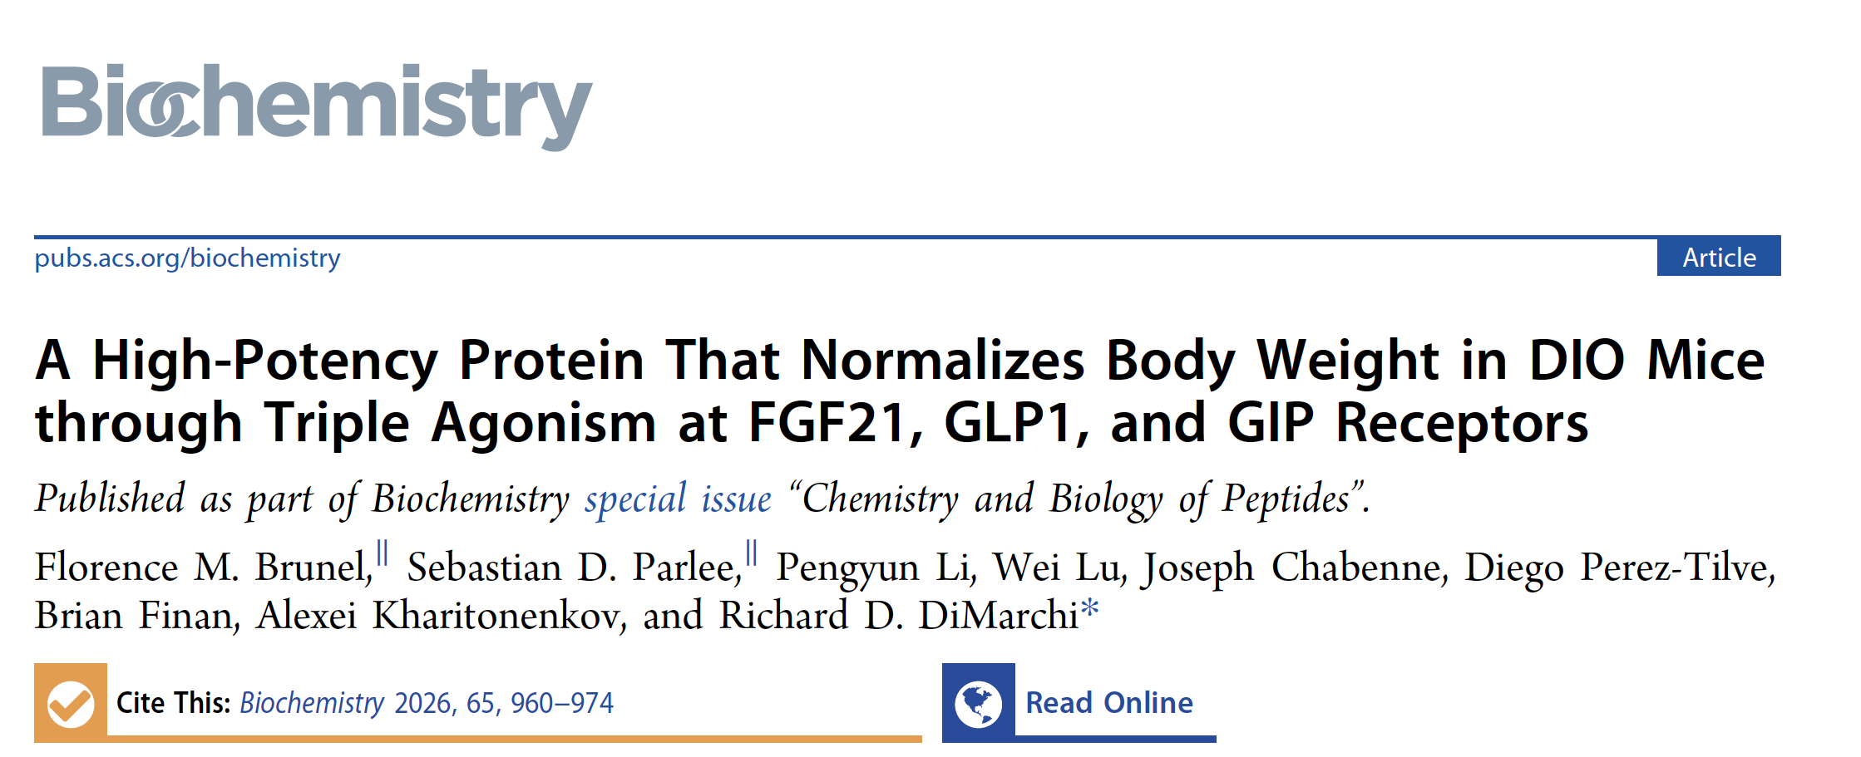

Slide 30
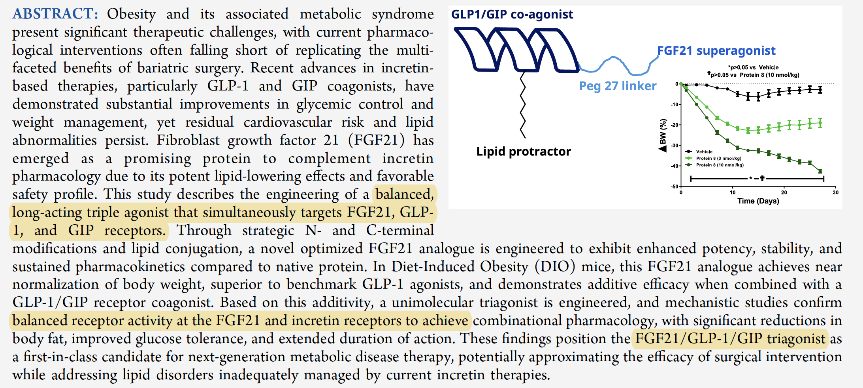

Slide 31
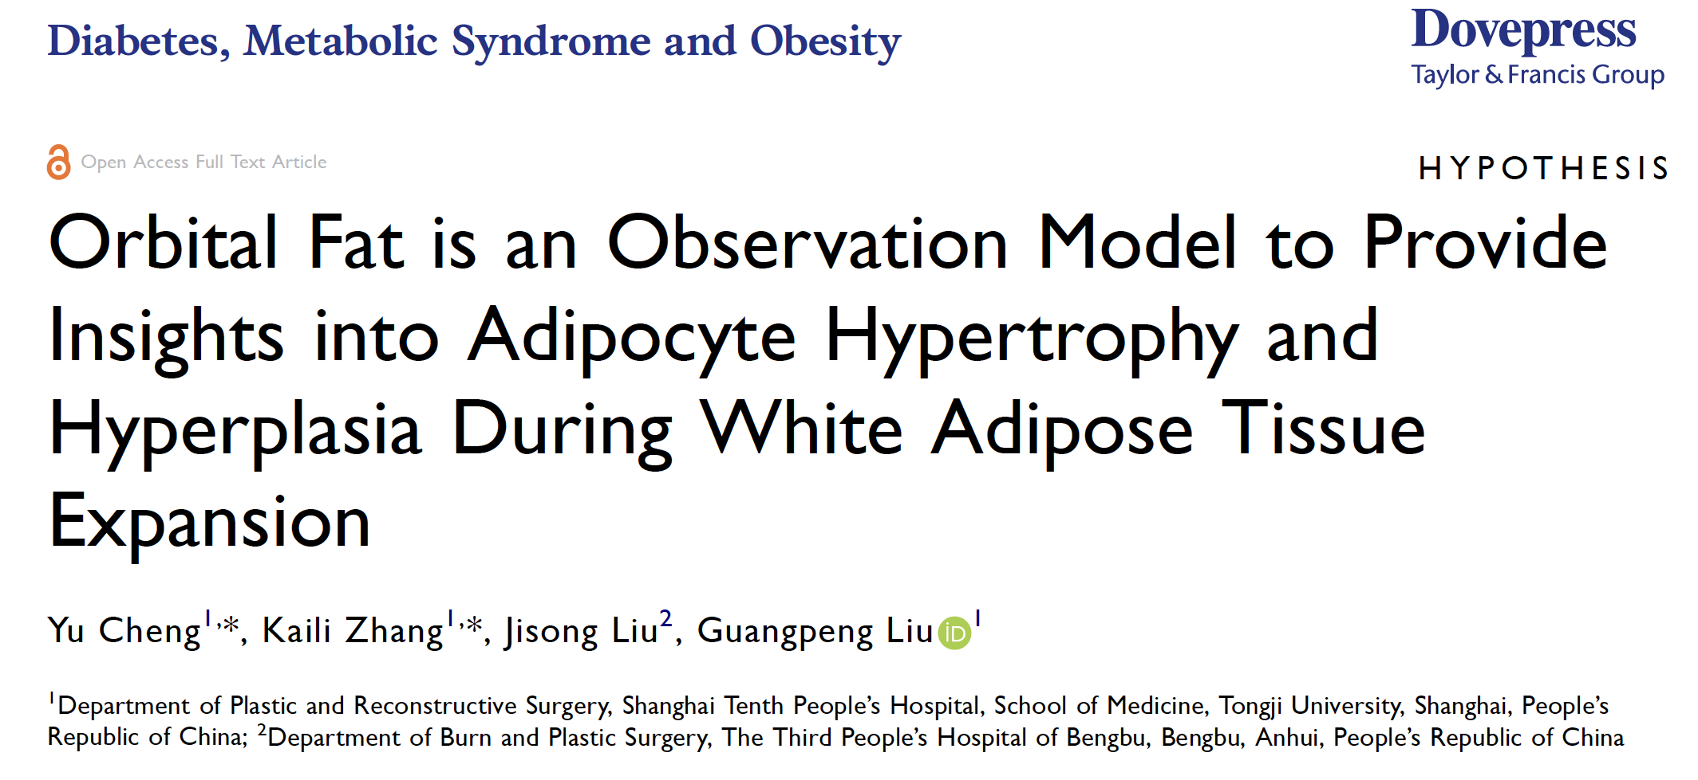

Slide 32
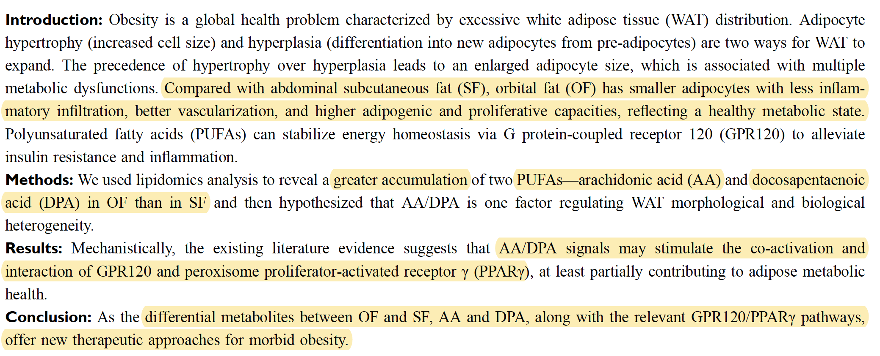

Slide 33
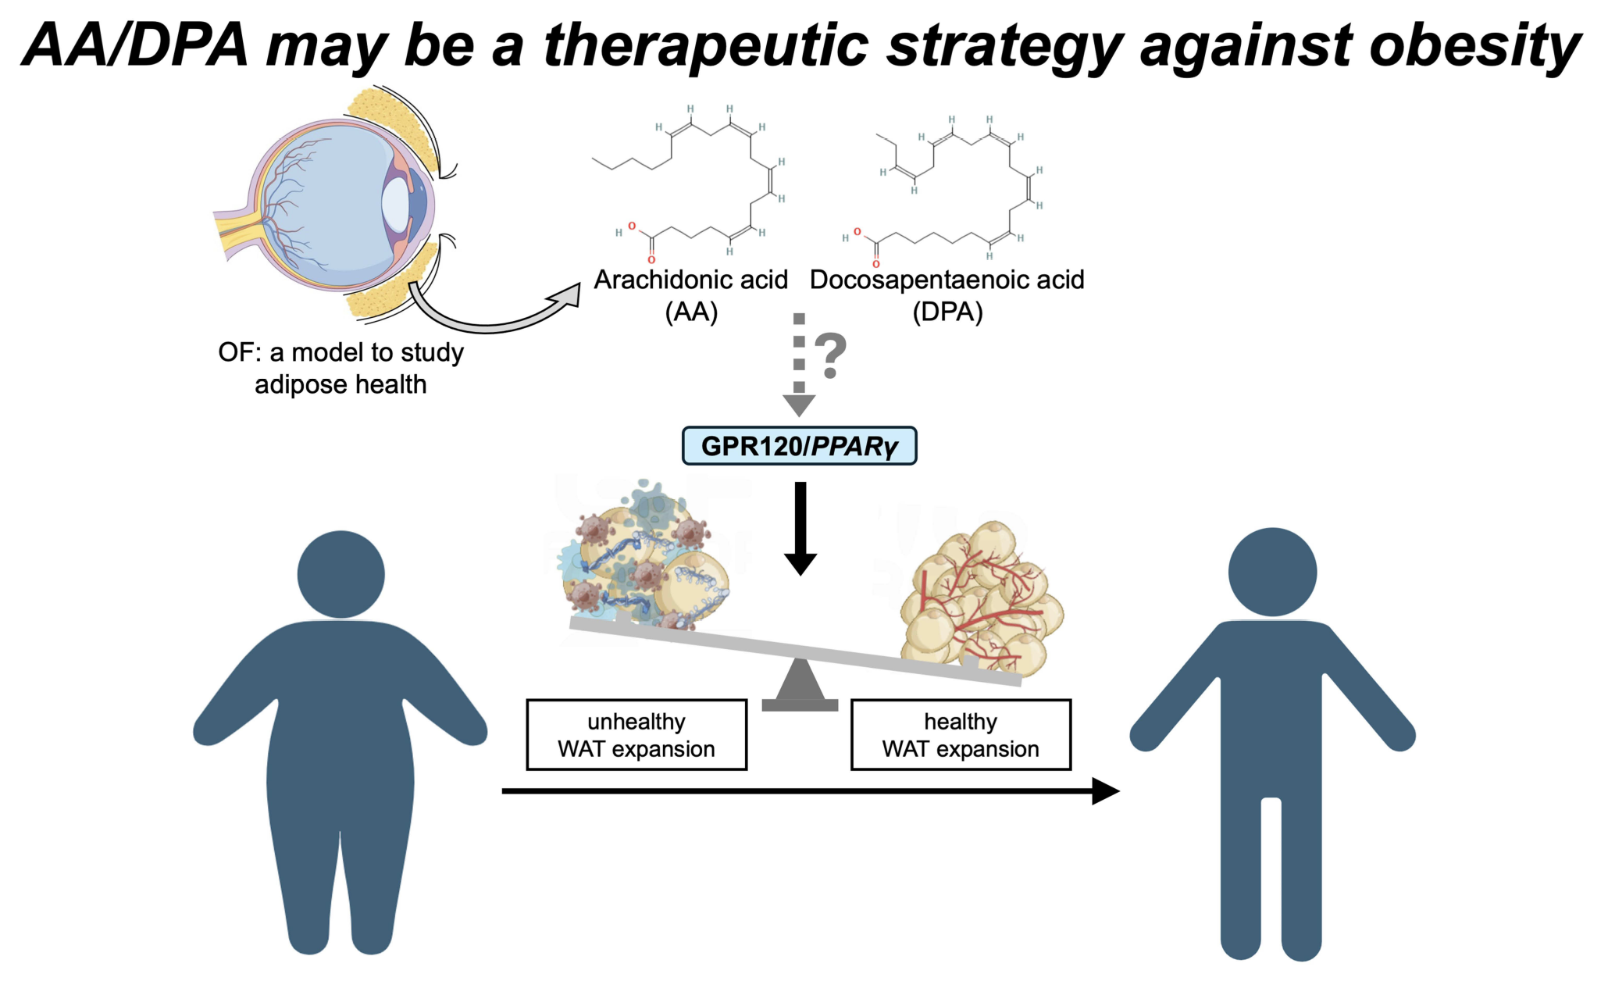

Slide 34
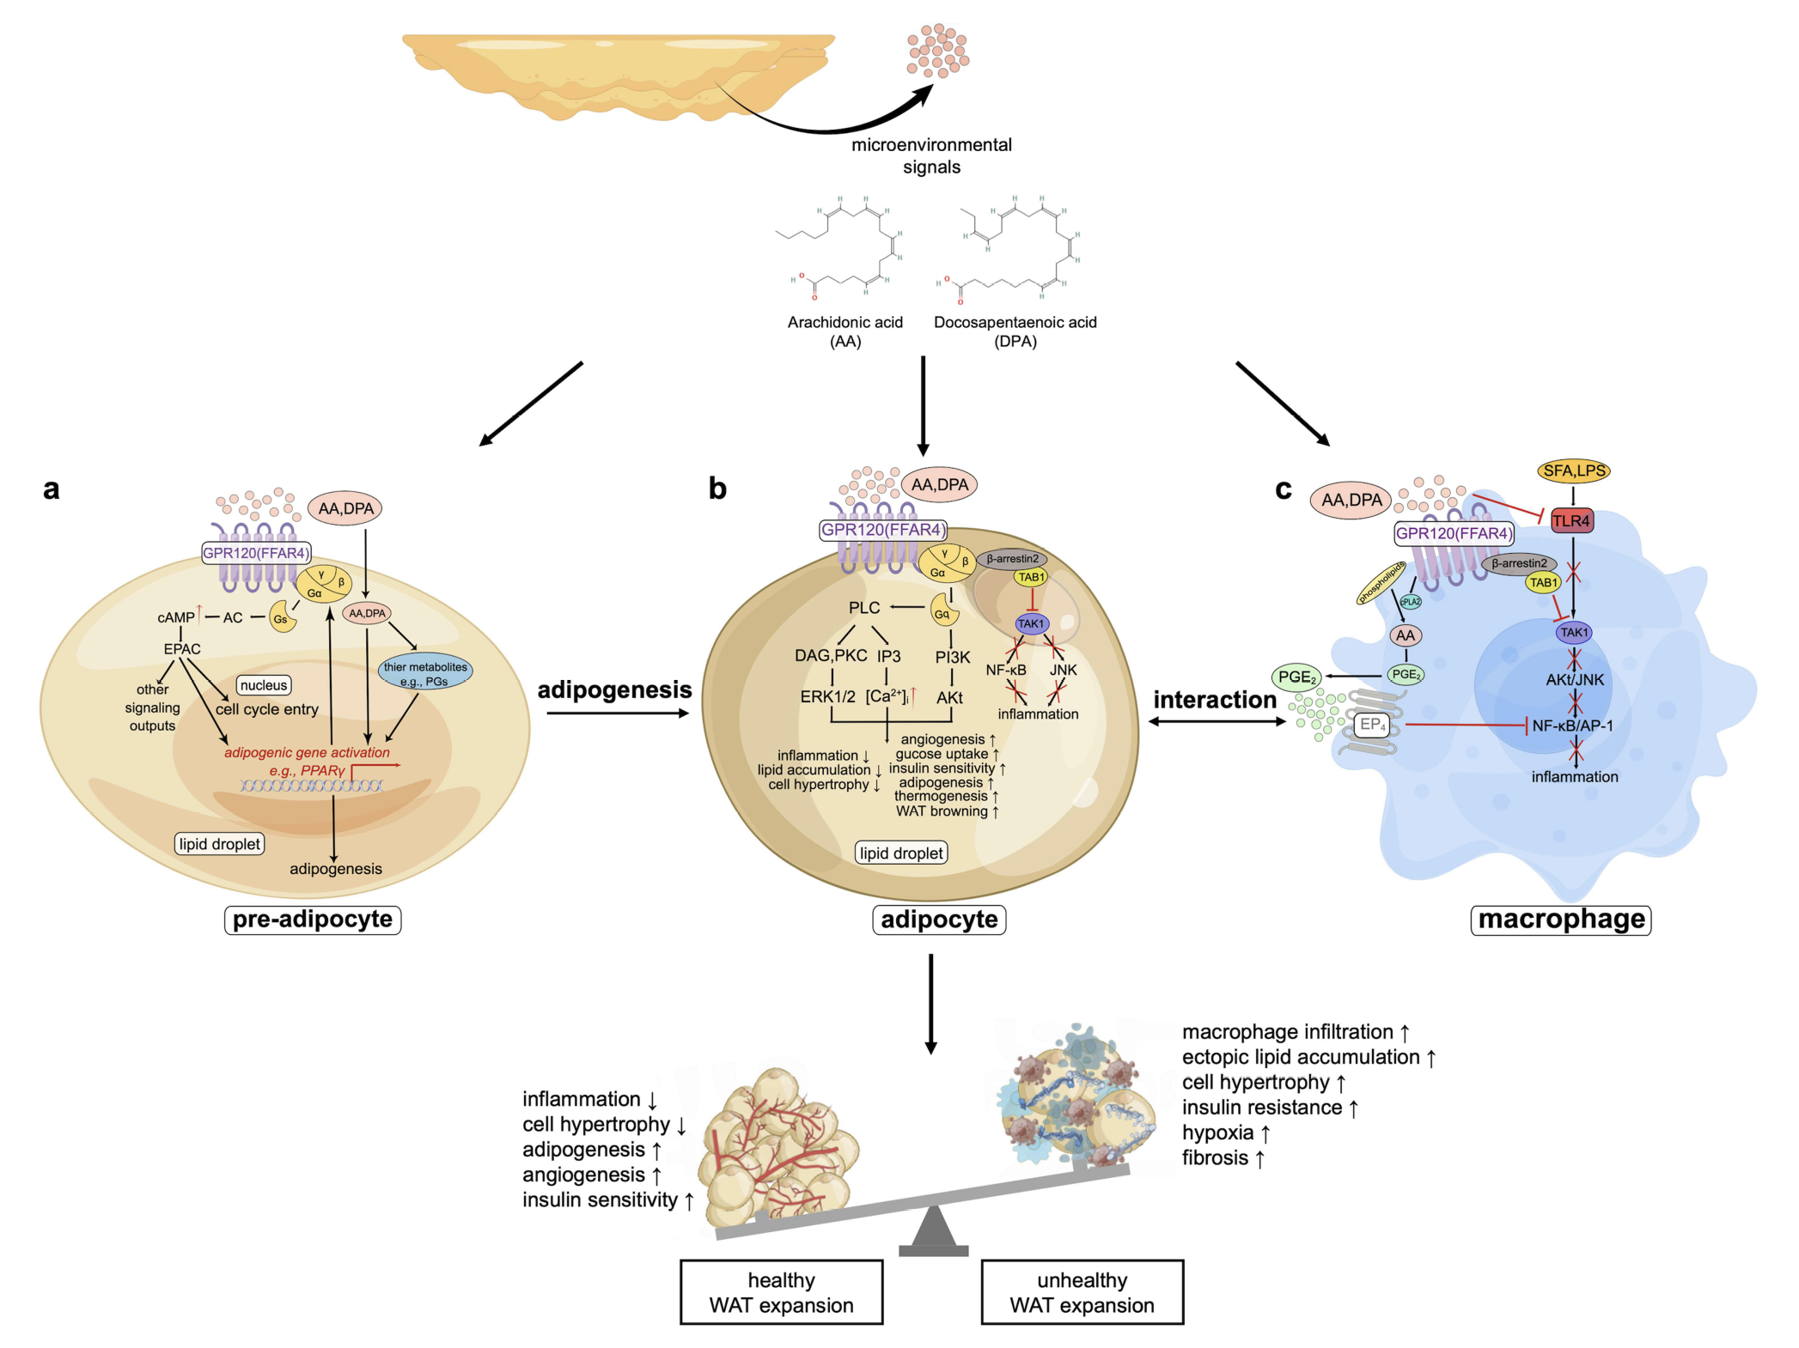

Slide 35
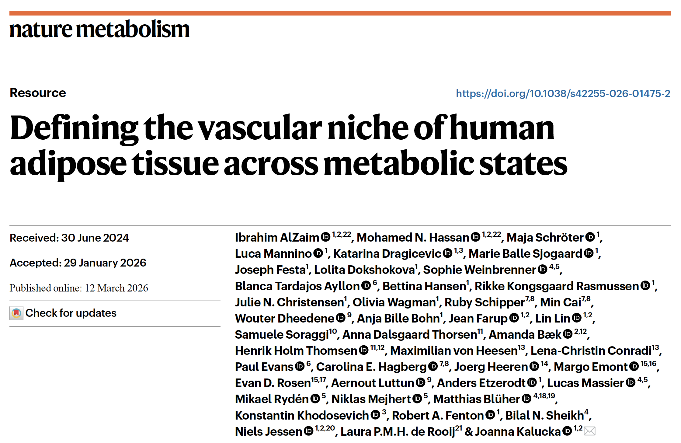

Slide 36
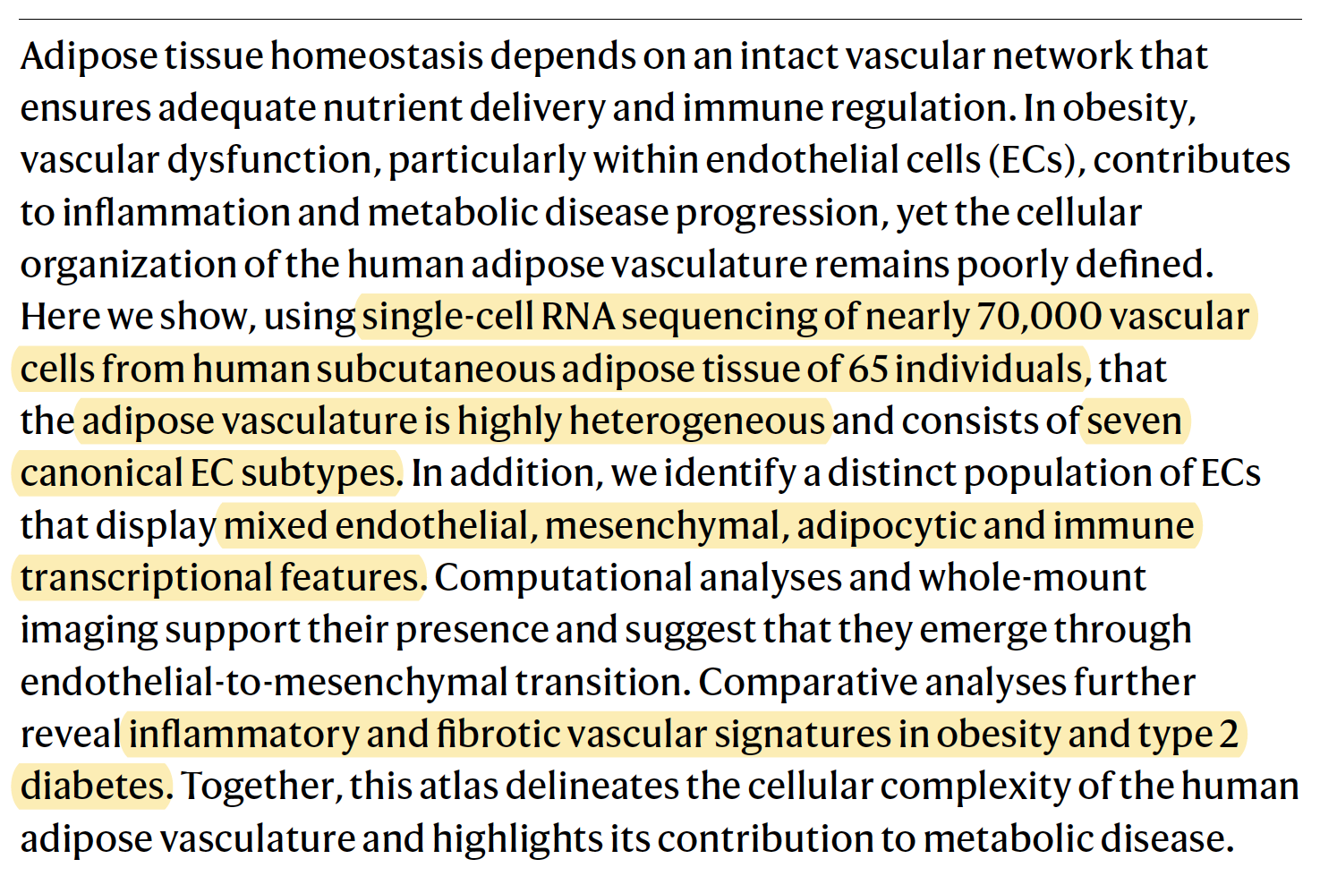

Slide 37
Human adipose tissue vasculature is highly diverse, with multiple endothelial cell (EC) subtypes and supporting cells identified via single-cell analysis.
A novel EC population (“sub-AdECs”) shows mixed endothelial, immune, mesenchymal, and adipocyte-like features, likely arising via endothelial-to-mesenchymal transition.
Obesity and type 2 diabetes cause vascular dysfunction, including inflammation, fibrosis, and altered immune interactions.
These vascular changes contribute to metabolic disease progression and reveal potential therapeutic targets.

Slide 38
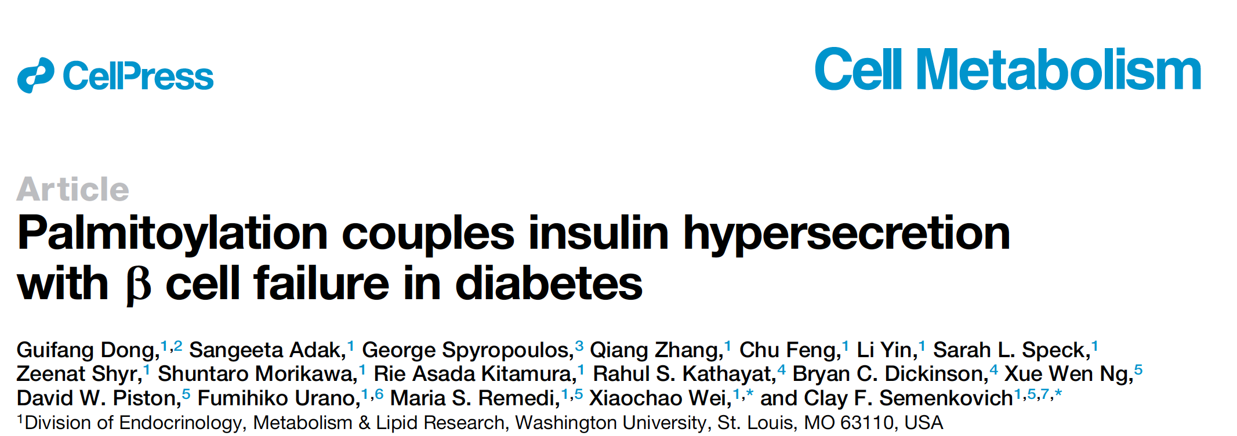

Slide 39
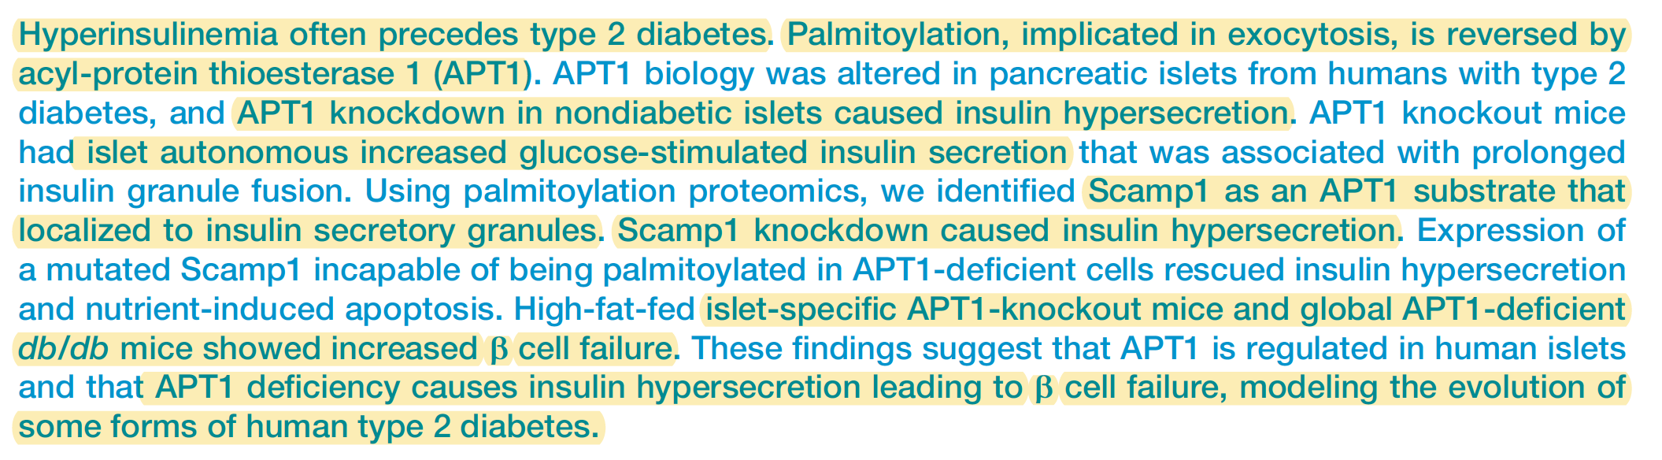

Slide 40
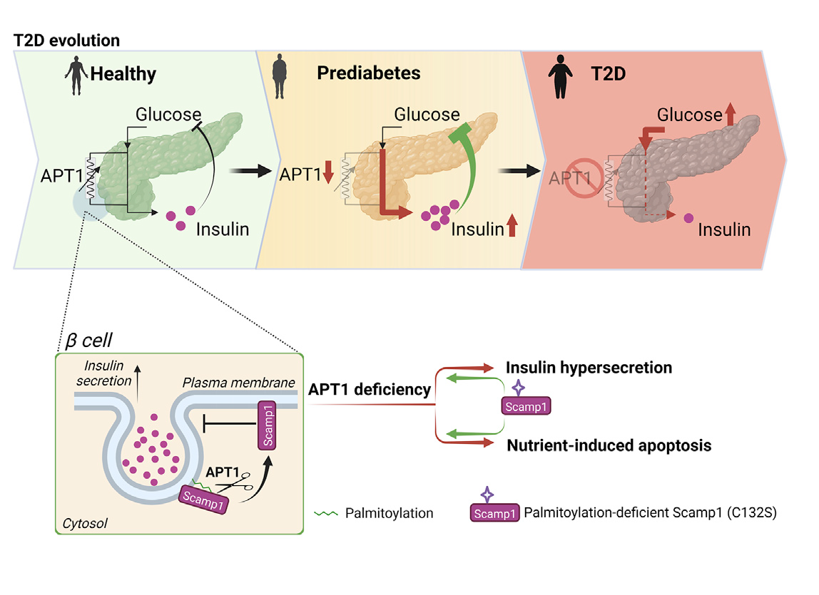
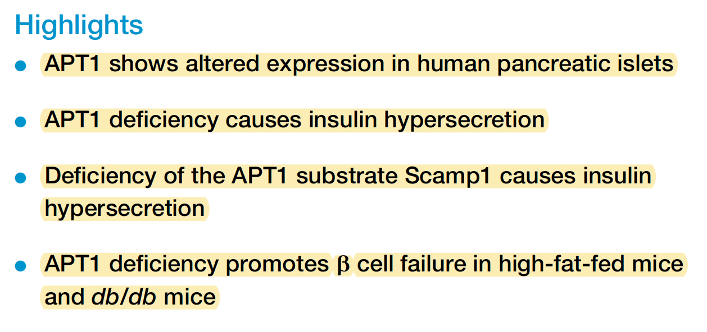

Slide 41
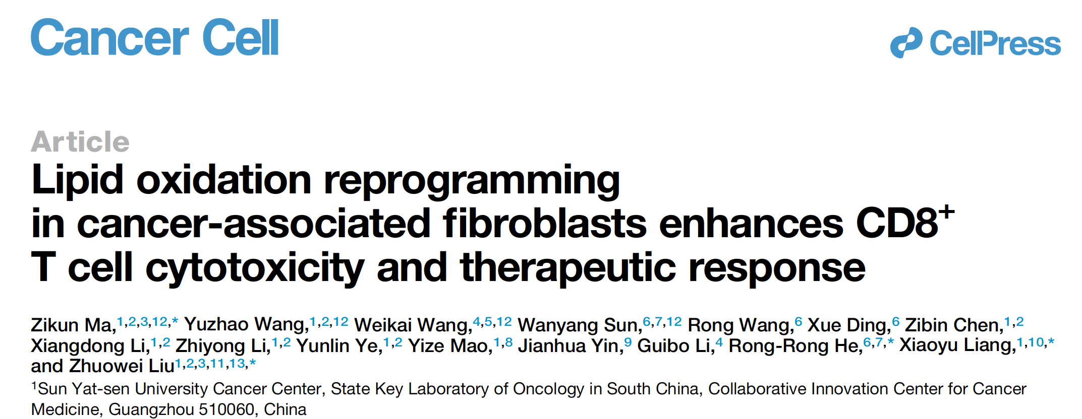

Slide 42
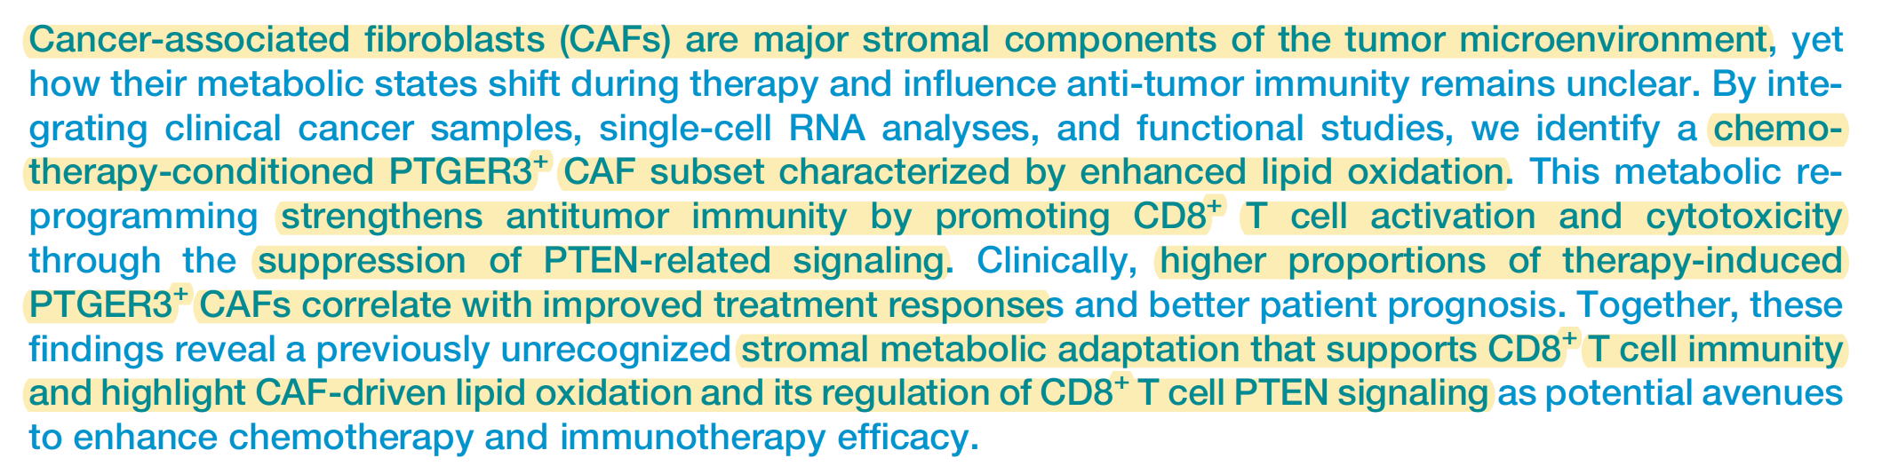

Slide 43


PTGER3 stands for Prostaglandin E Receptor 3
11-HETE (11-hydroxyeicosatetraenoic acid) is a metabolite of arachidonic acid
Reported to act on prostaglandin receptors, including EP receptors (like PTGER3 / EP3)

Slide 44




Slide 45


Slide 46



Slide 47



Slide 48


Slide 49


Slide 50


Slide 51


Slide 52


Slide 53


Slide 54


Slide 55


Slide 56


Slide 57





Slide 58


