Slide 1

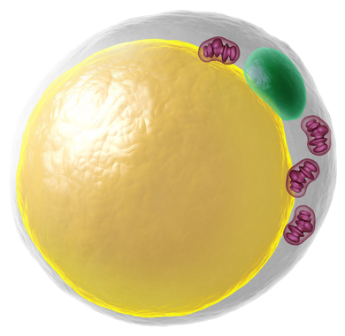
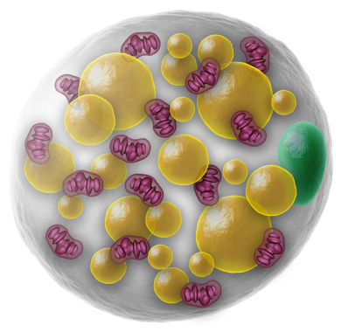



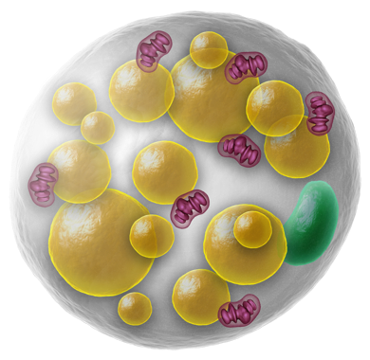
Literature Overview Touchstone Diabetes Center UTSW Medical Center 12/22/2025

Slide 2
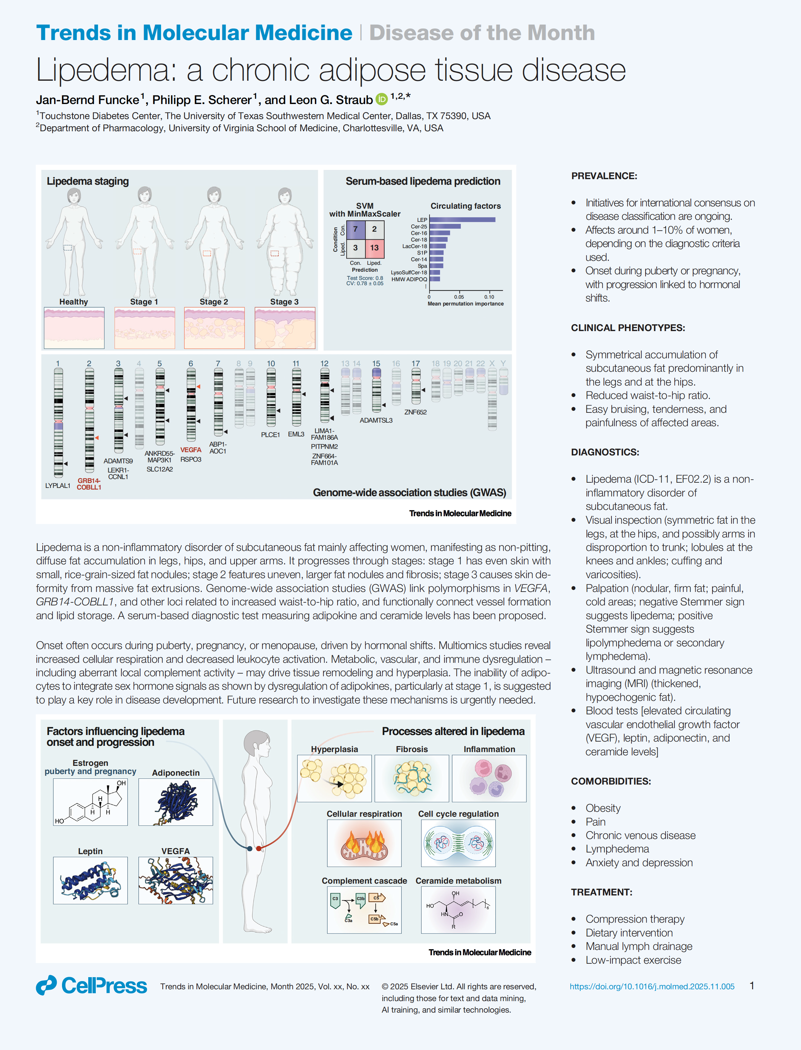
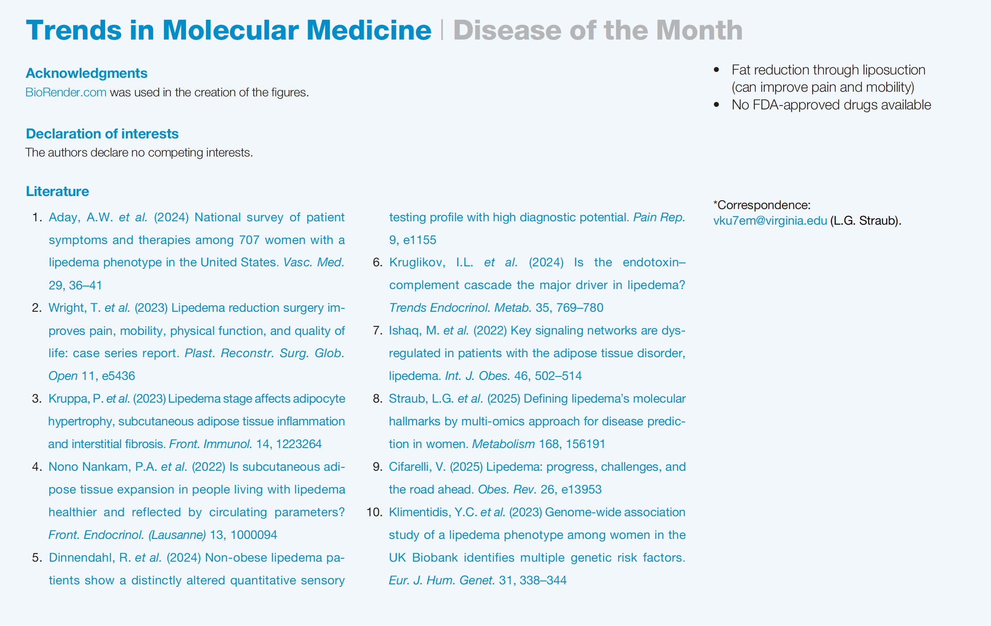

Slide 3
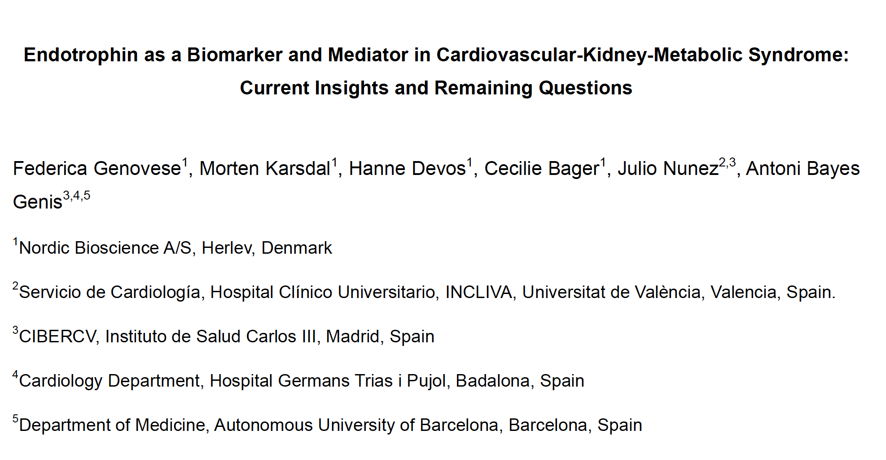

Slide 4
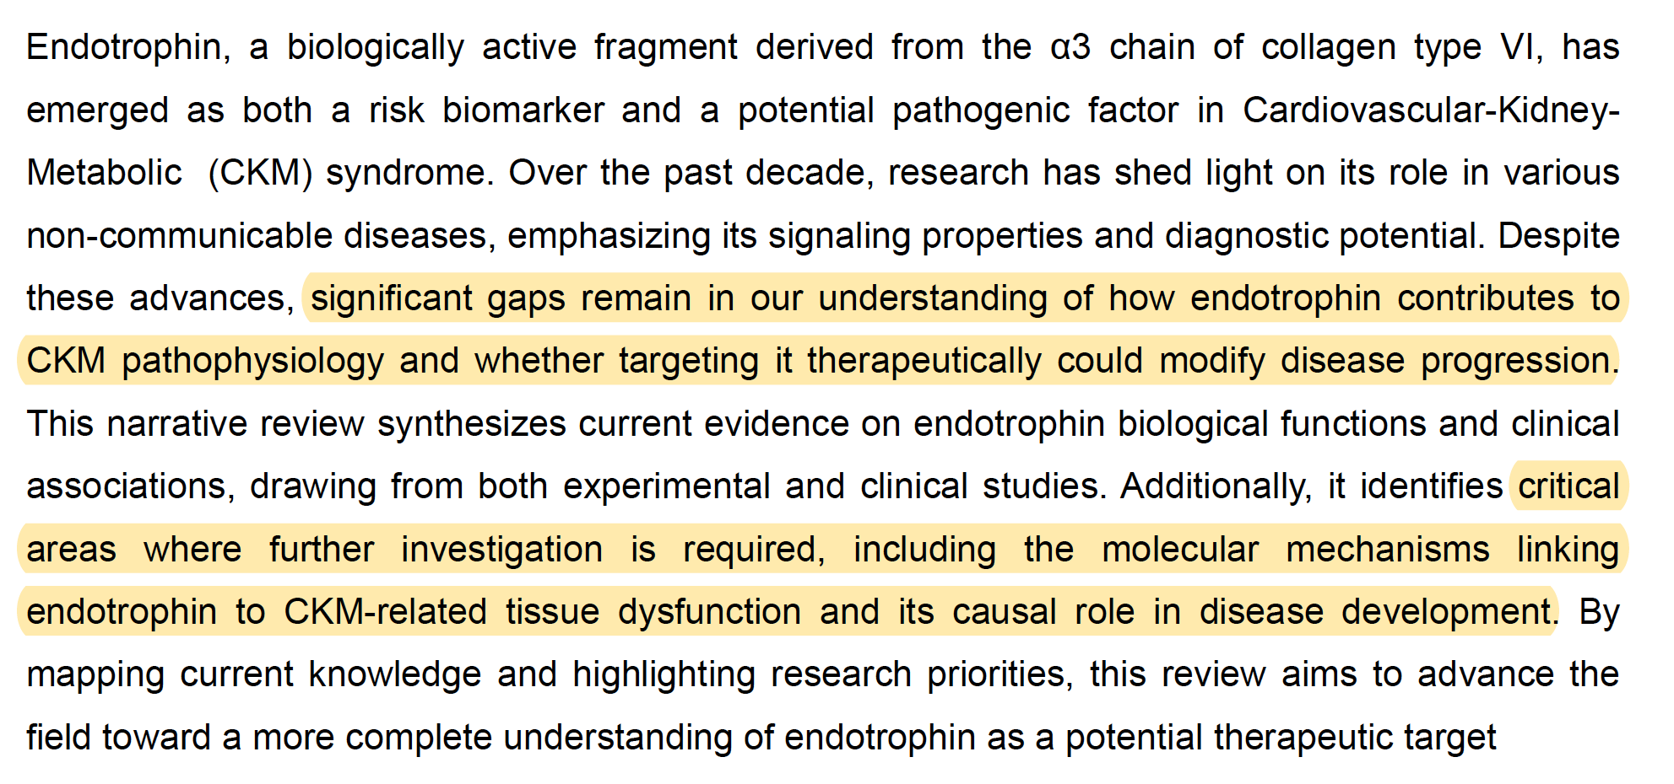

Slide 5
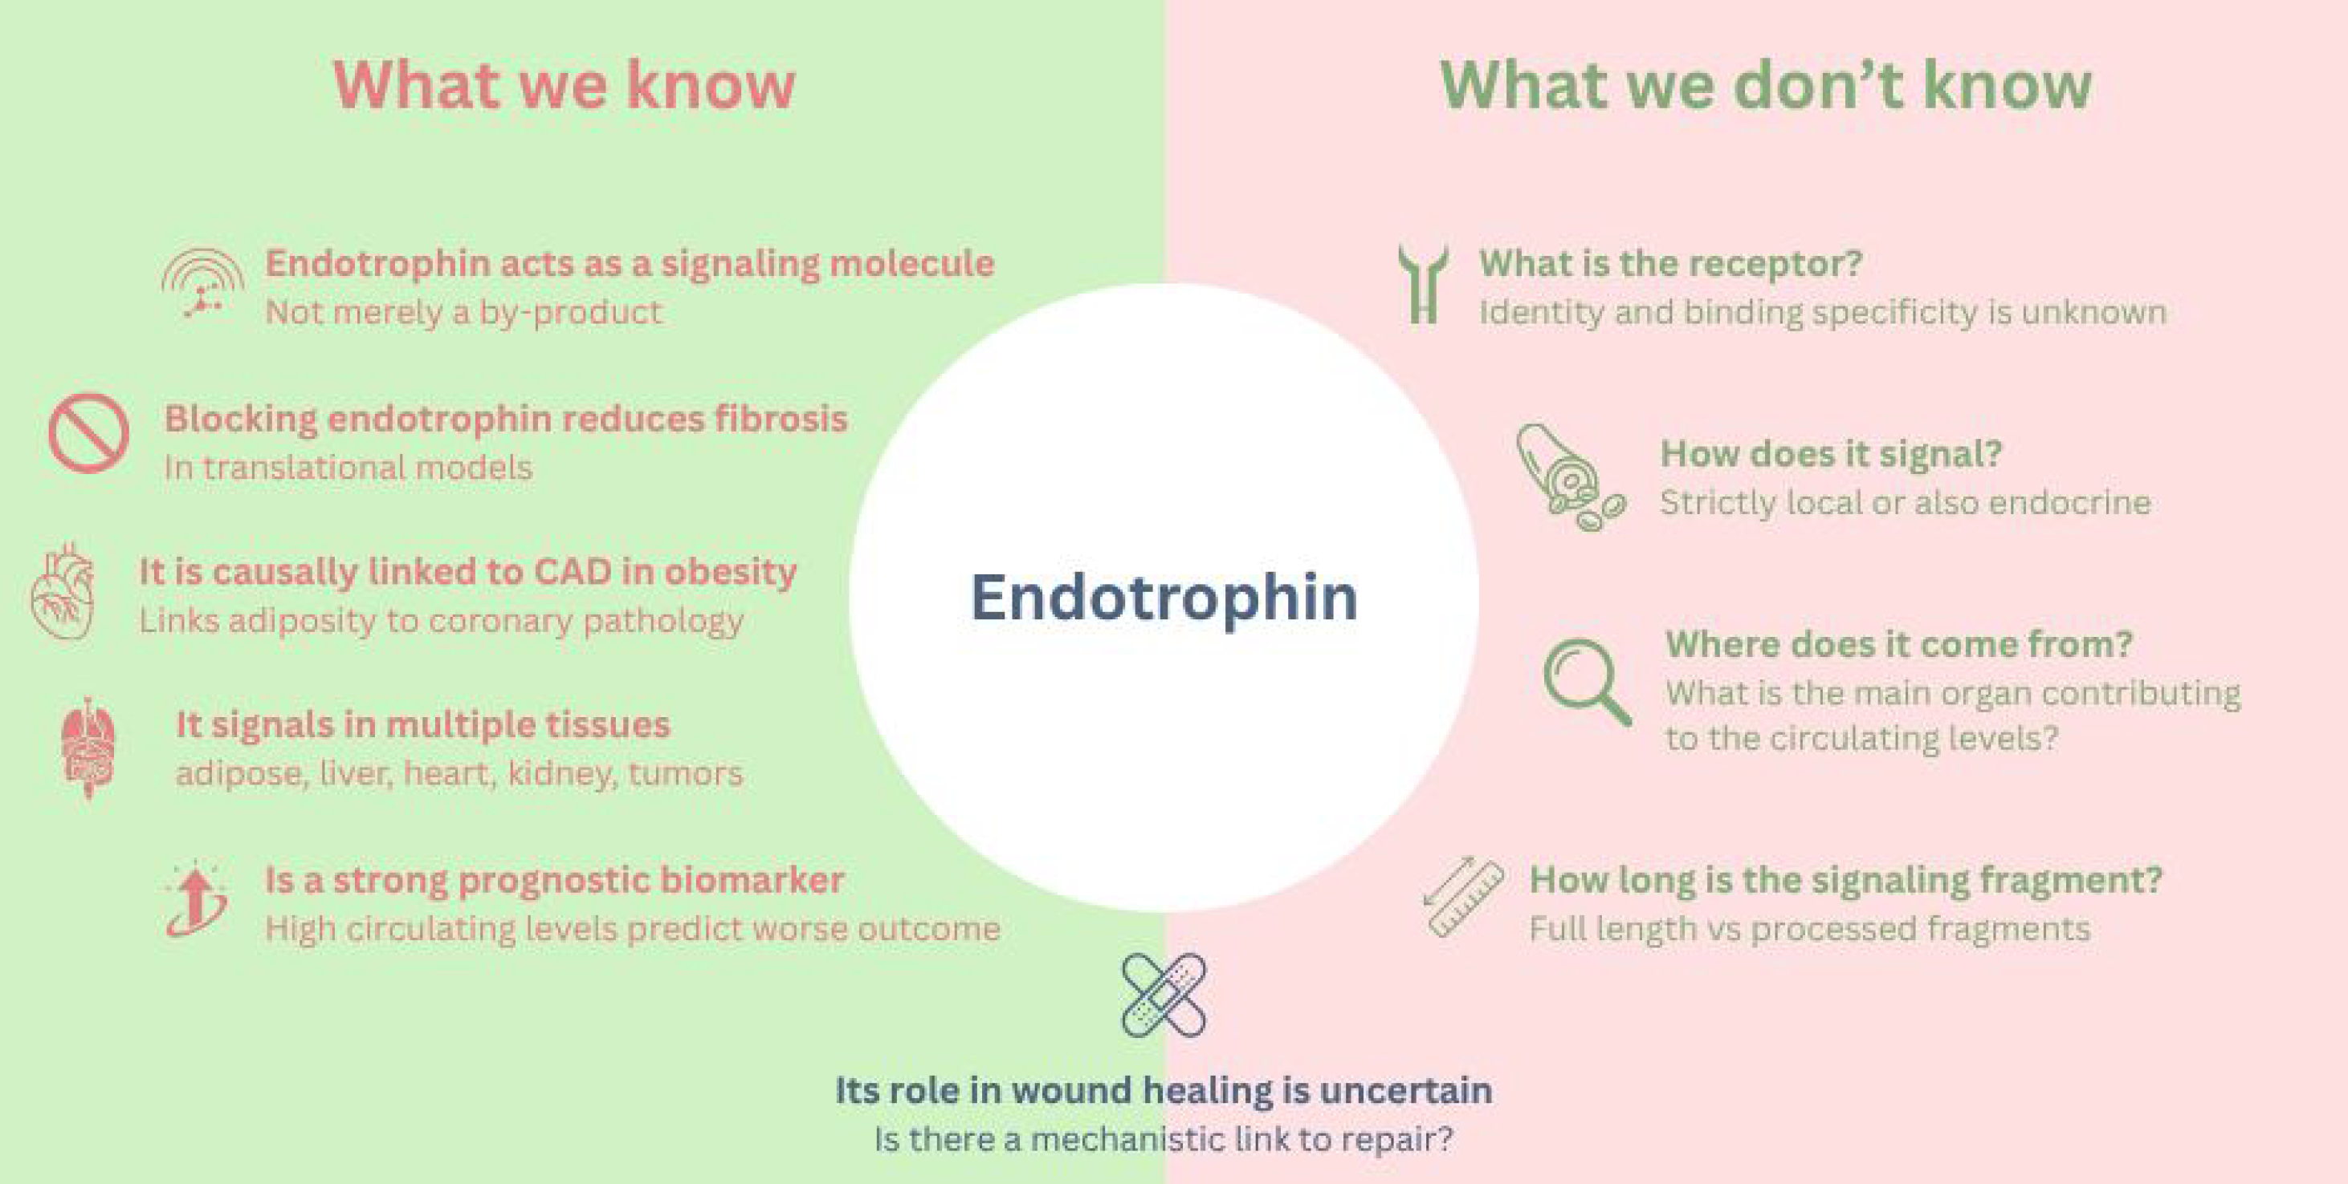

Slide 6



Slide 7
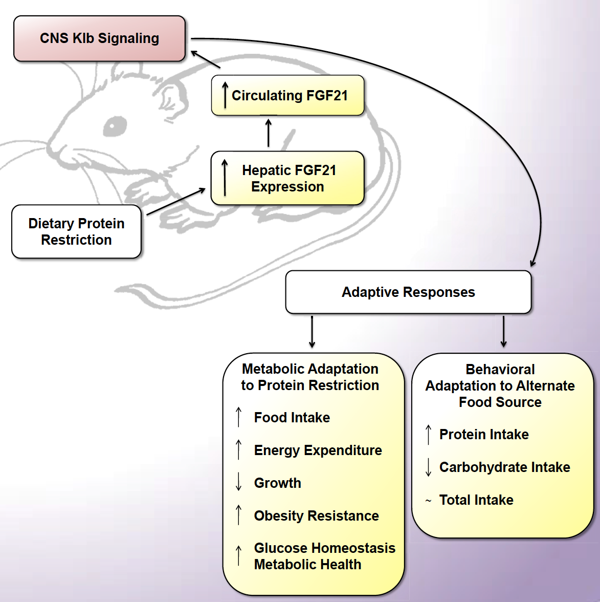
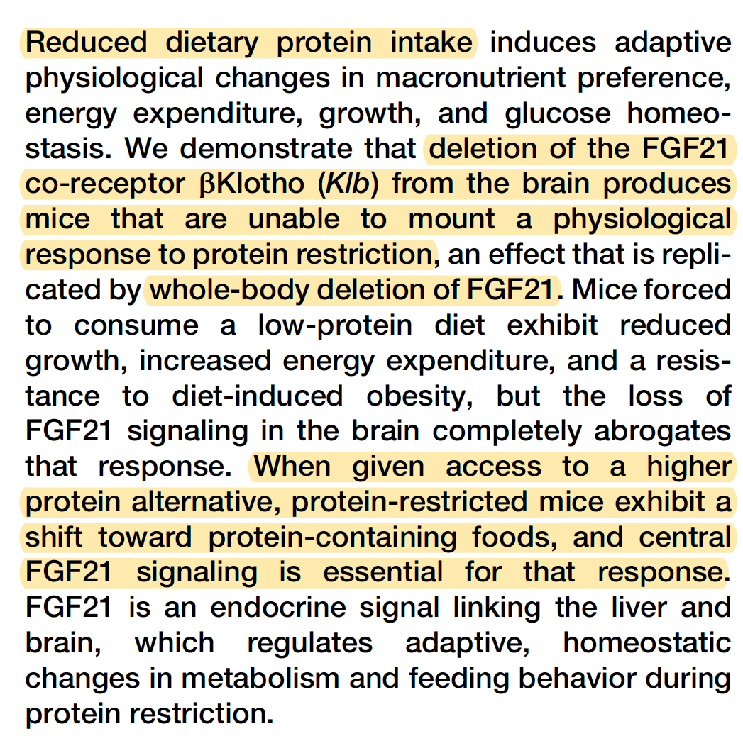

Slide 8
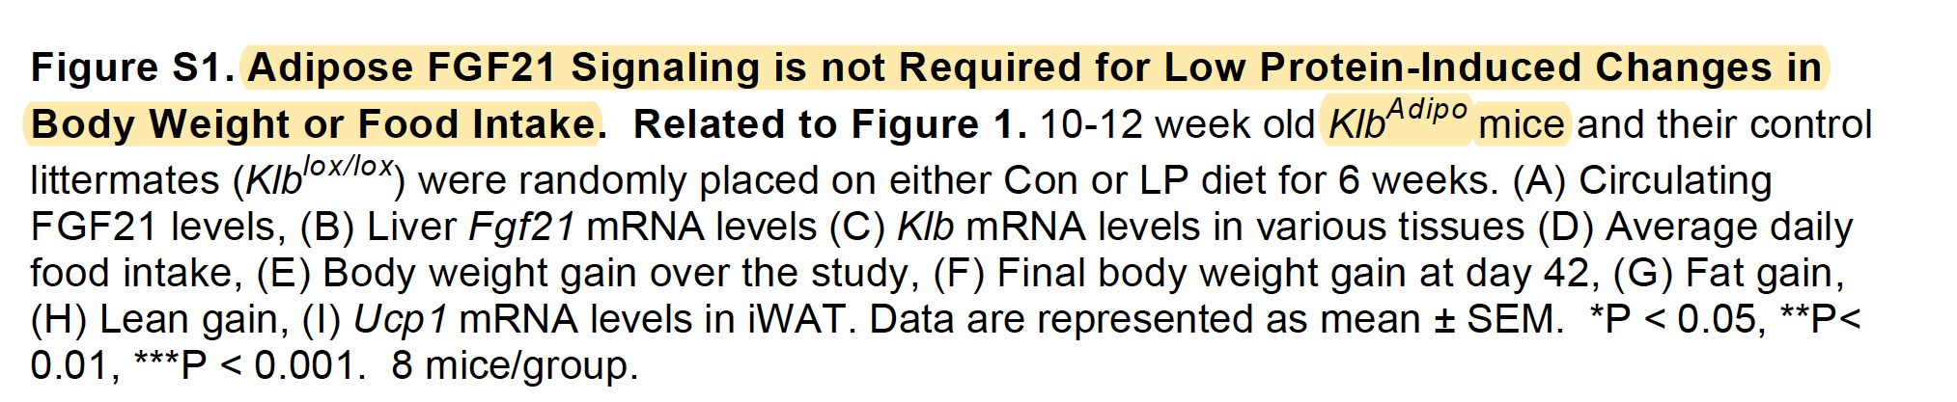
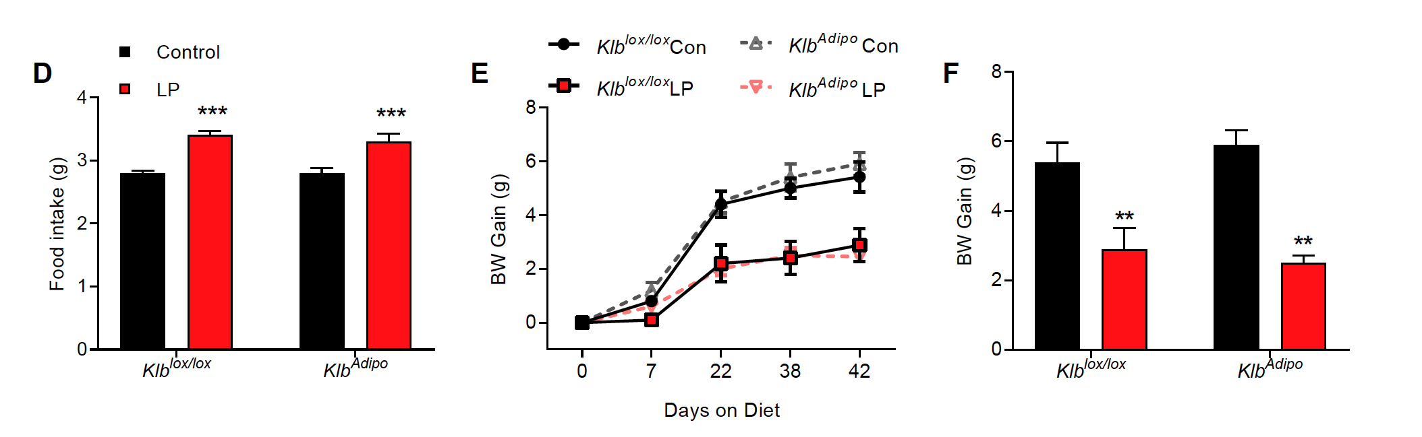

Slide 9



Slide 10


Slide 11

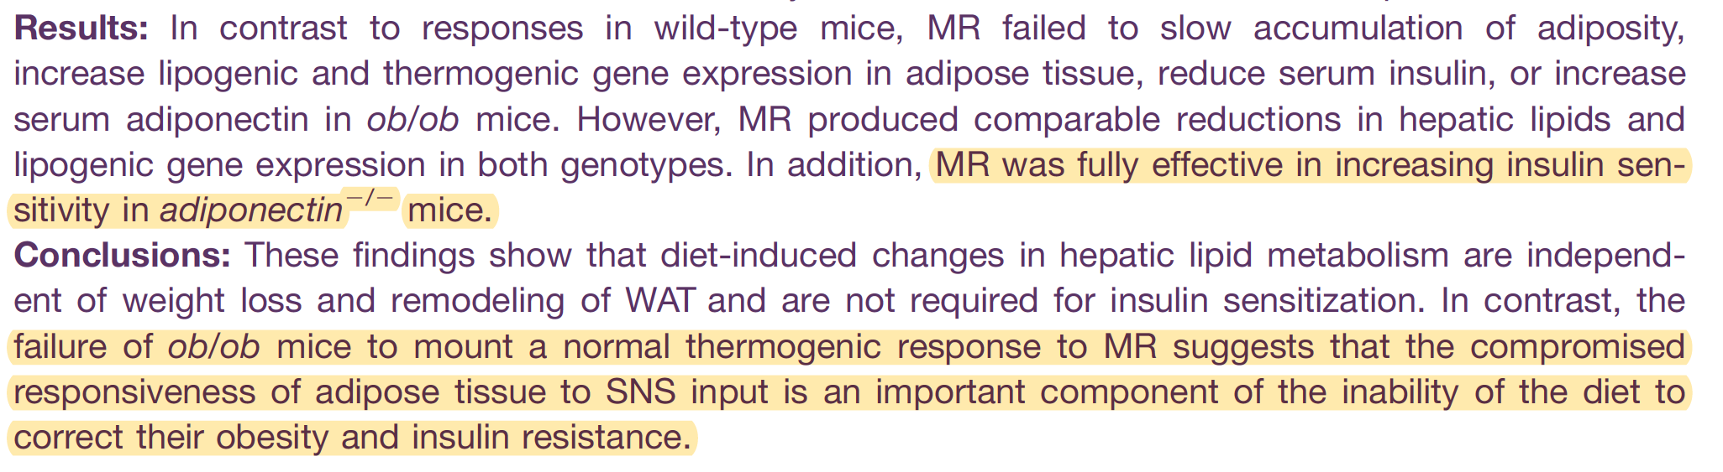

Slide 12



Slide 13
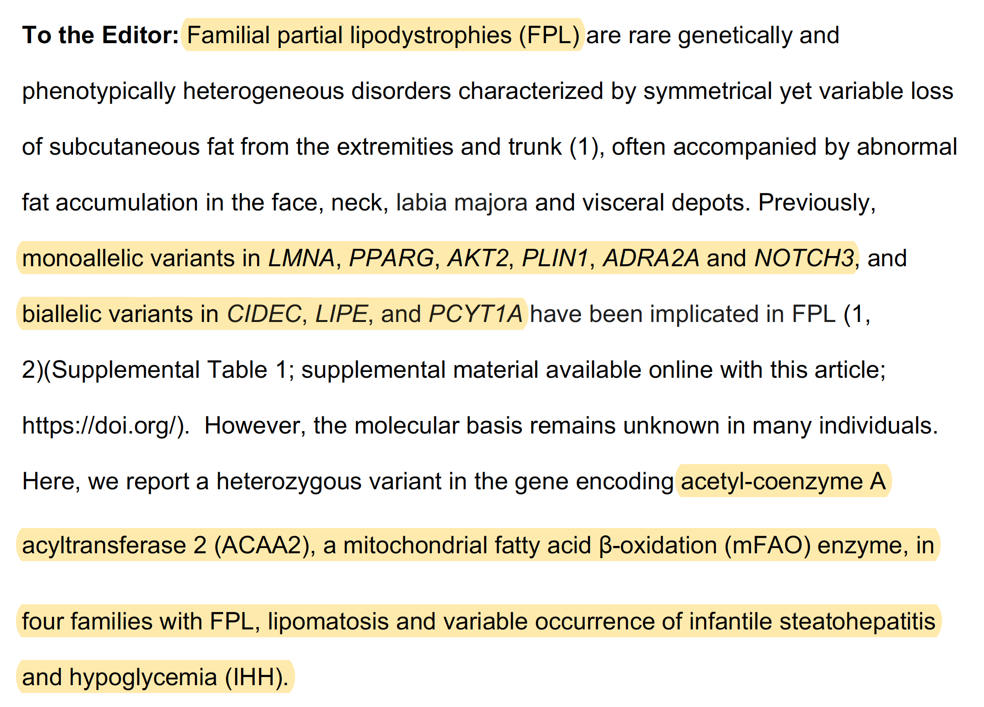

Slide 14
Lipomatosis means having multiple benign (noncancerous) fatty growths (lipomas) on the body, often appearing as soft, rubbery lumps under the skin, which can occur in clusters or specific patterns, sometimes linked to genetics or underlying conditions like Madelung's disease or steroid use, impacting quality of life due to size or location but generally requiring only observation unless painful or cosmetically bothersome

Slide 15
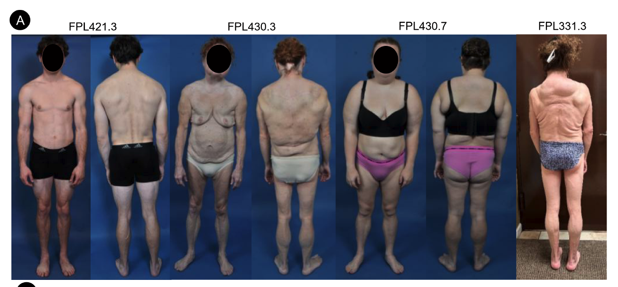
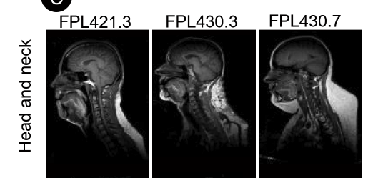

Slide 16



Slide 17
Laron syndrome, also known as growth hormone insensitivity, is named after Zvi Laron, an Israeli pediatric endocrinologist who first described the condition in 1966, a rare genetic disorder where the body can't properly use growth hormone, leading to dwarfism. Laron syndrome, a condition resulting from a genetic defect in the growth hormone receptor.

Slide 18
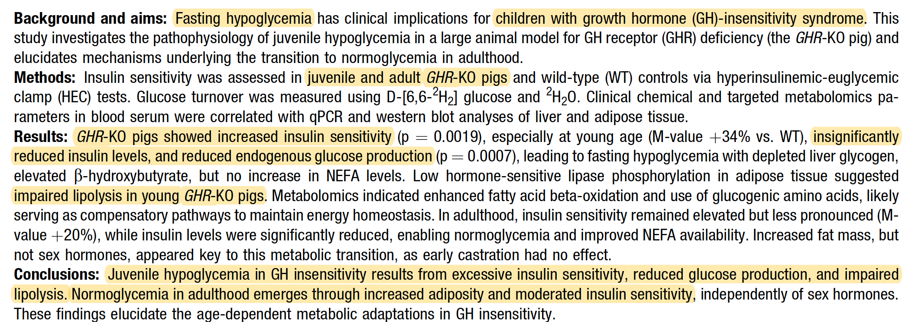

Slide 19


Slide 20
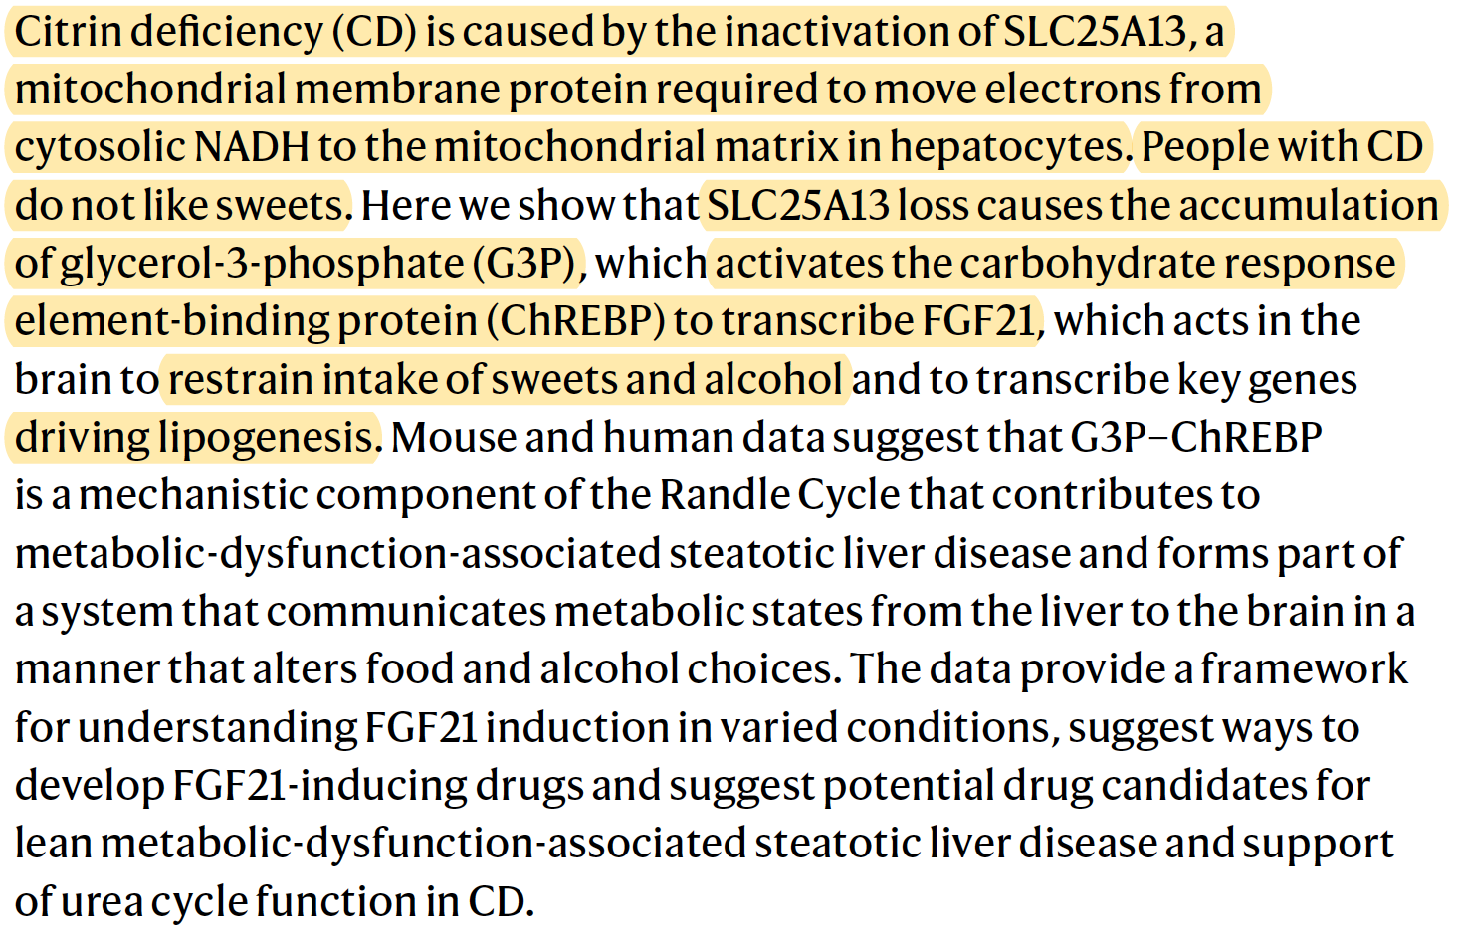

Slide 21
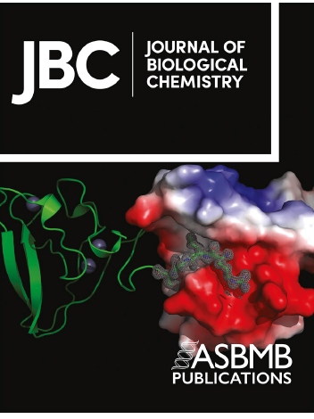
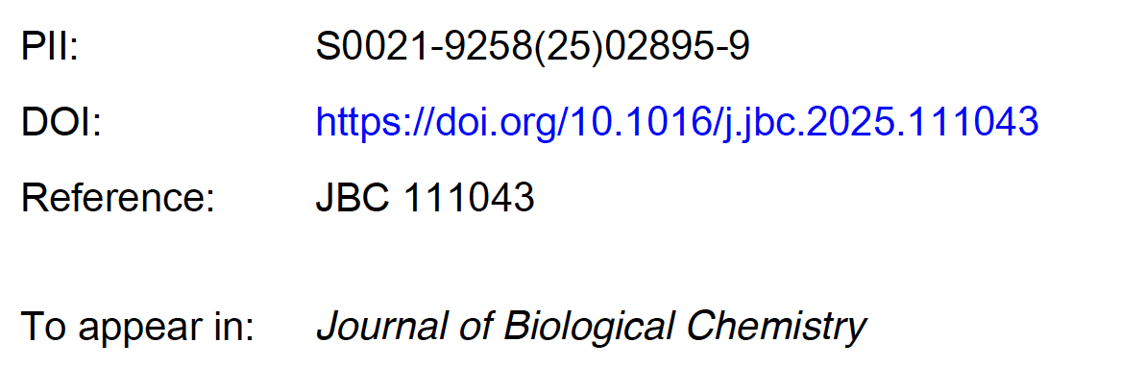
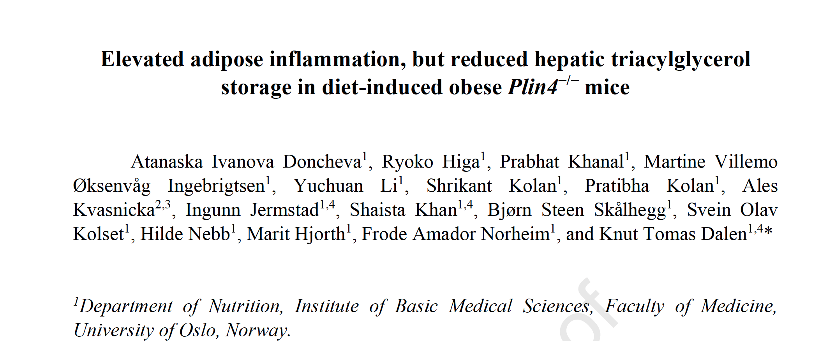

Slide 22
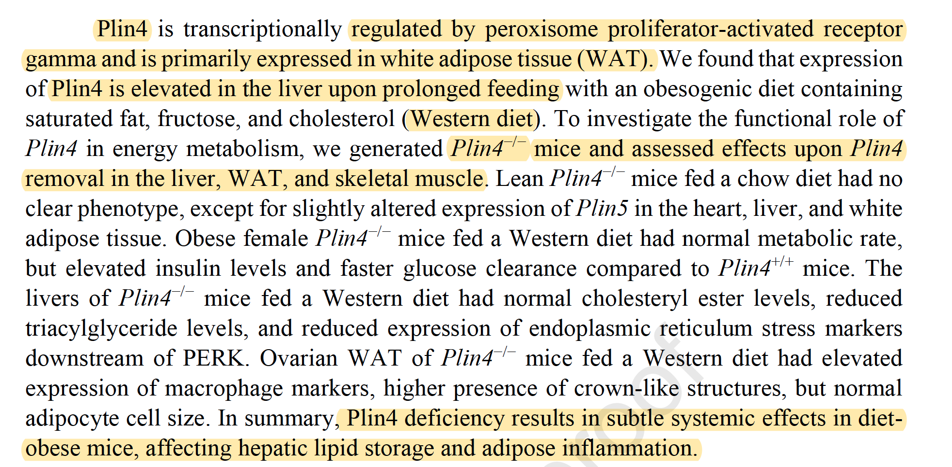

Slide 23
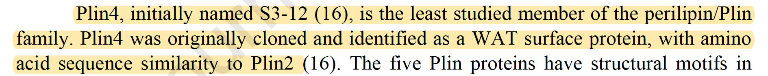

Slide 24
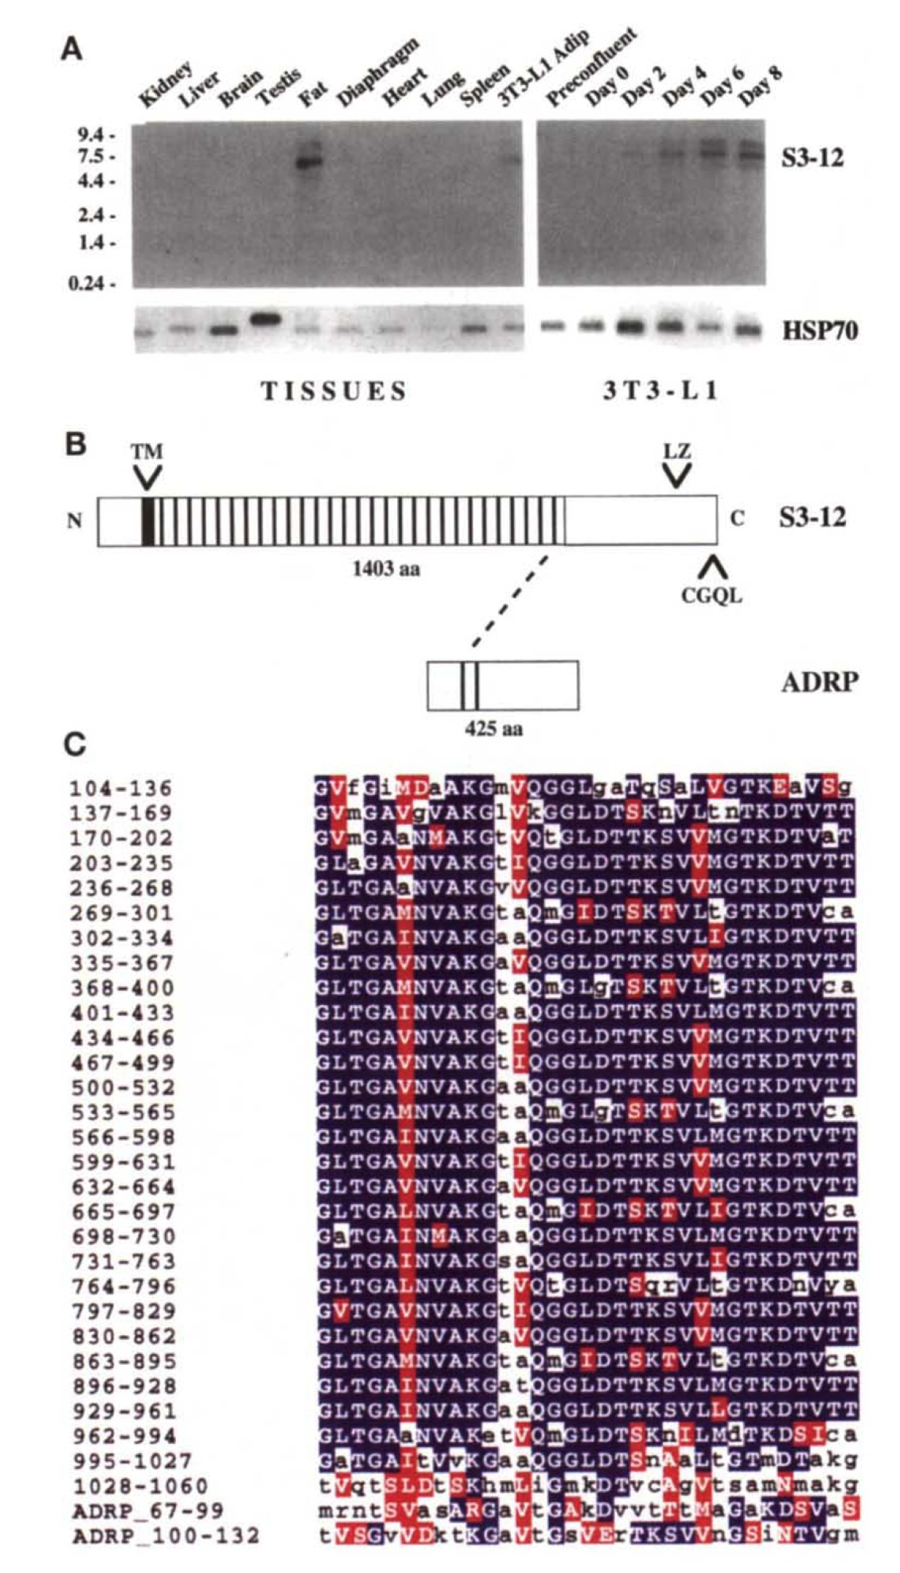

Slide 25

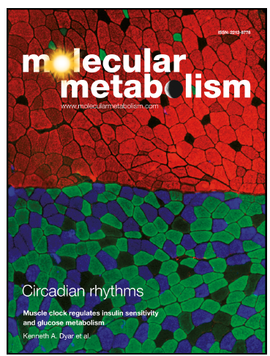


Slide 26
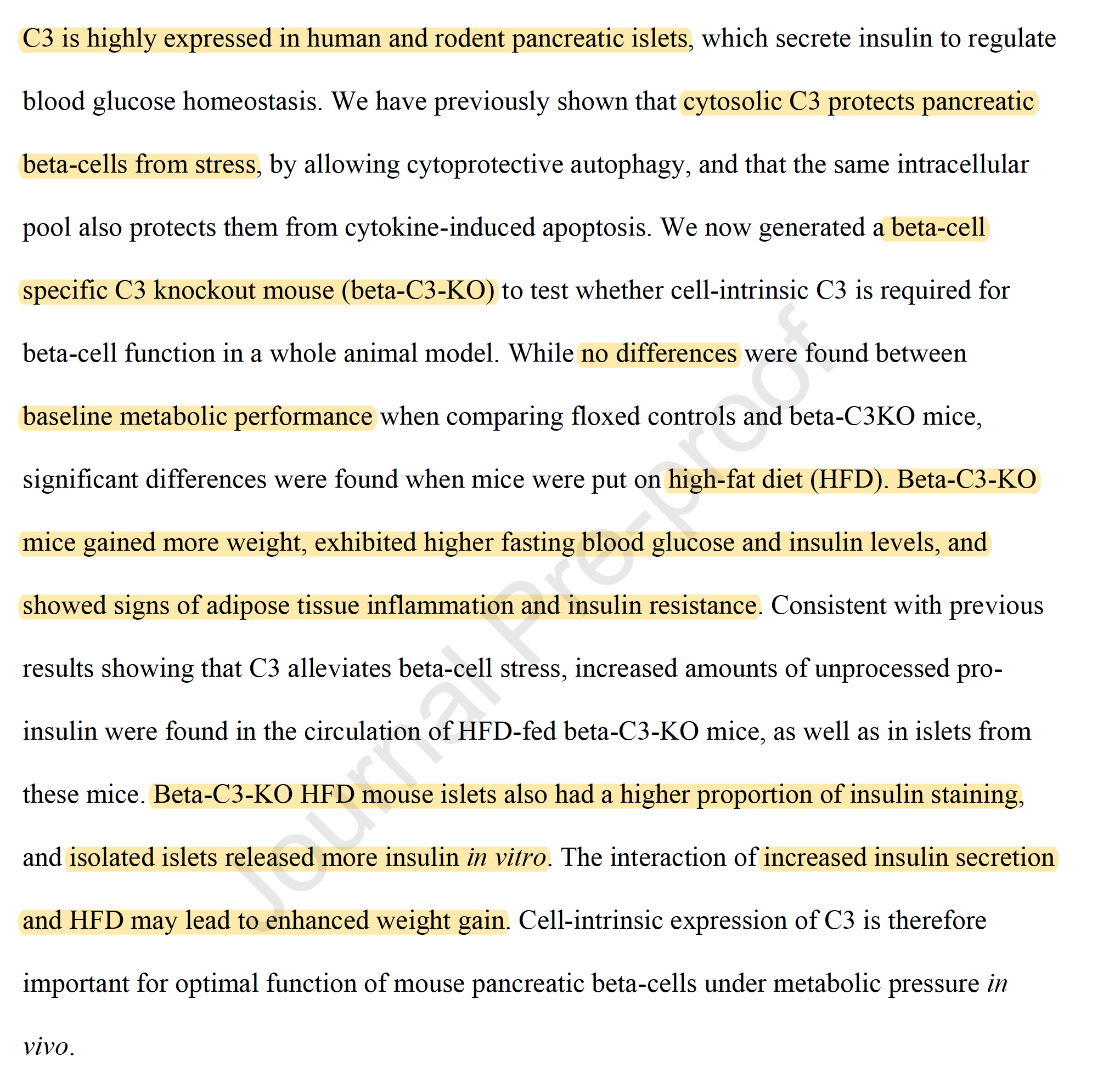

Slide 27
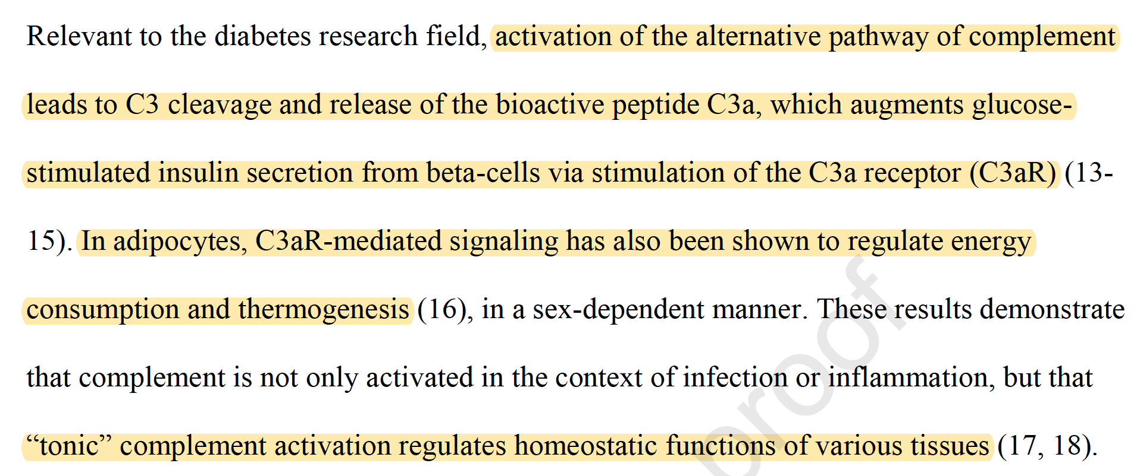
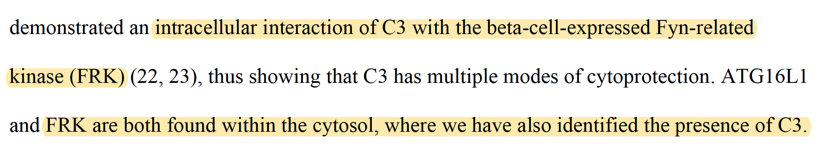
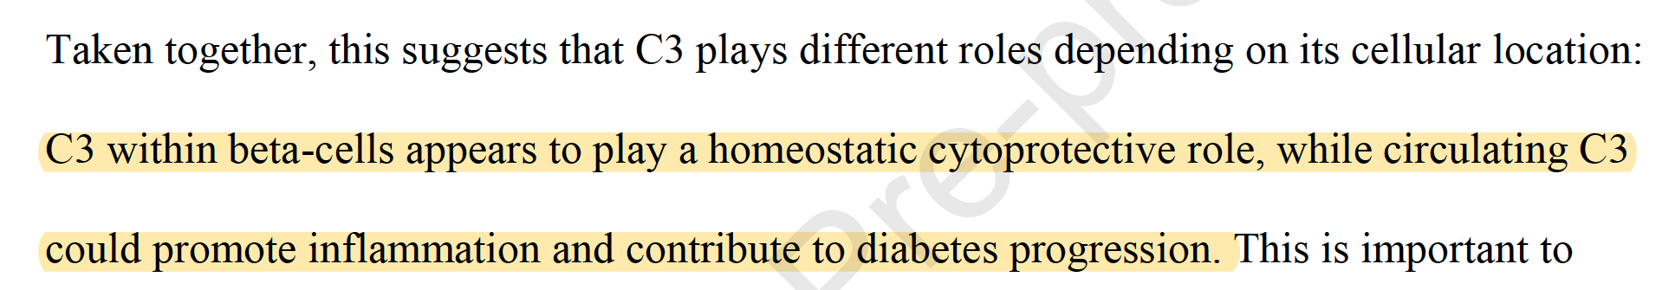

Slide 28
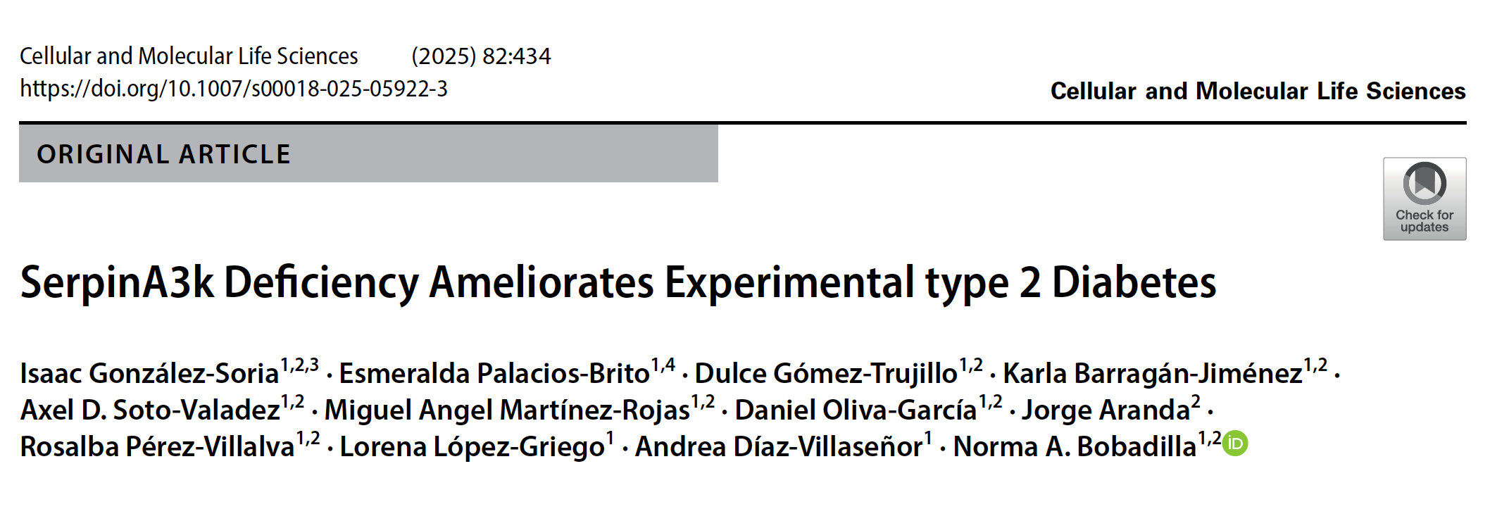

Slide 29
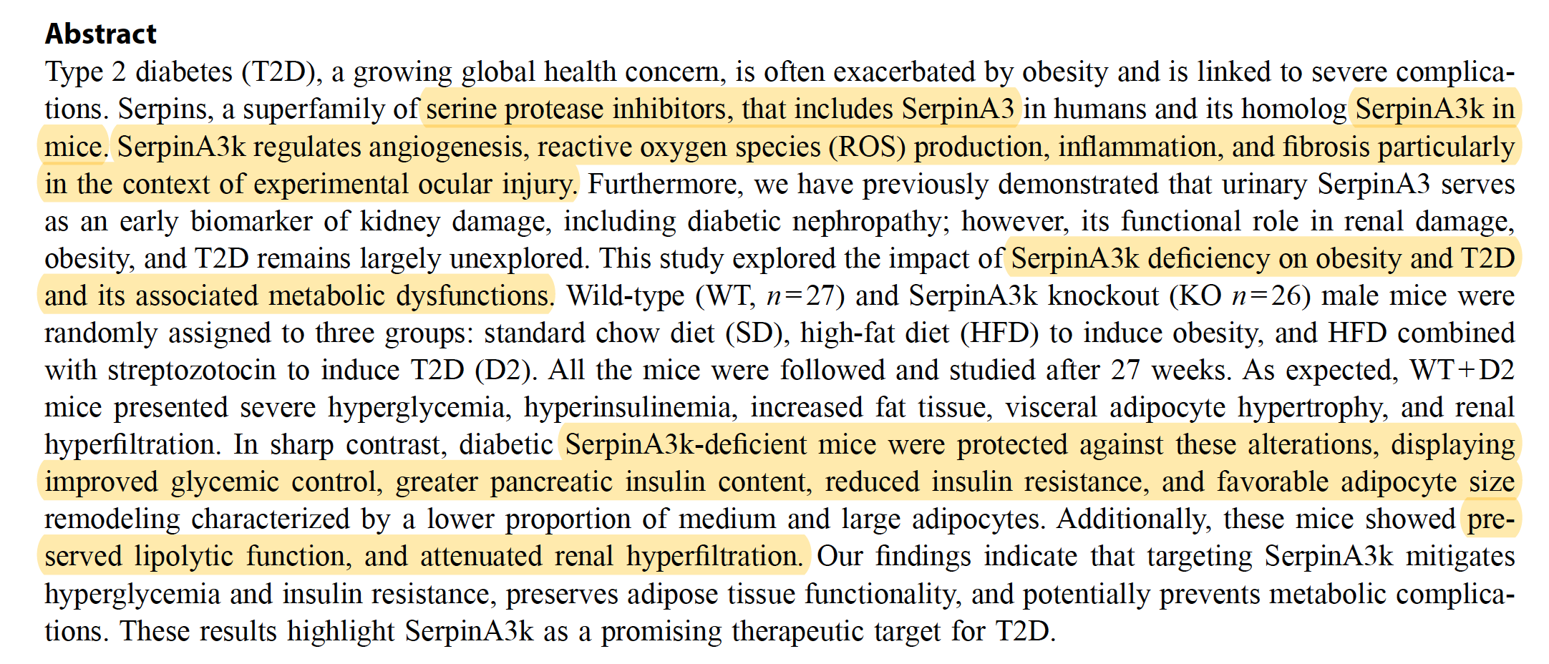

Slide 30


Slide 31
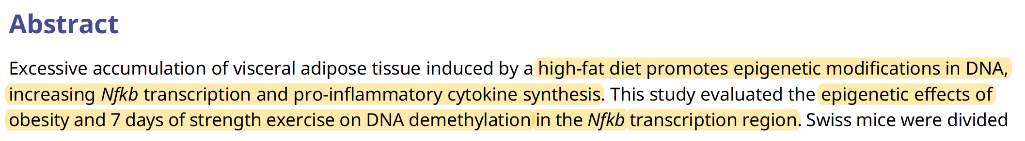
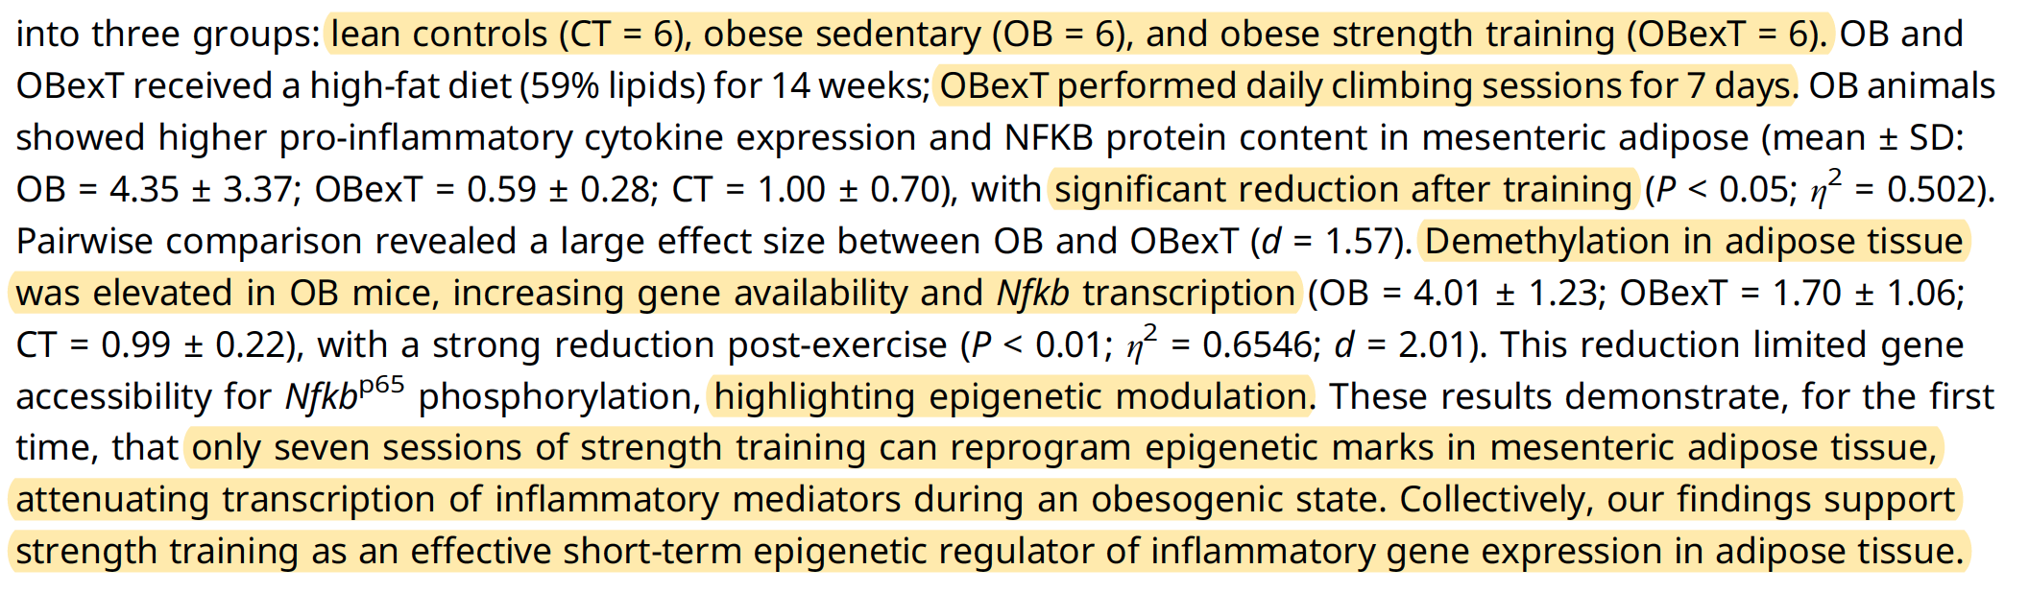

Slide 32
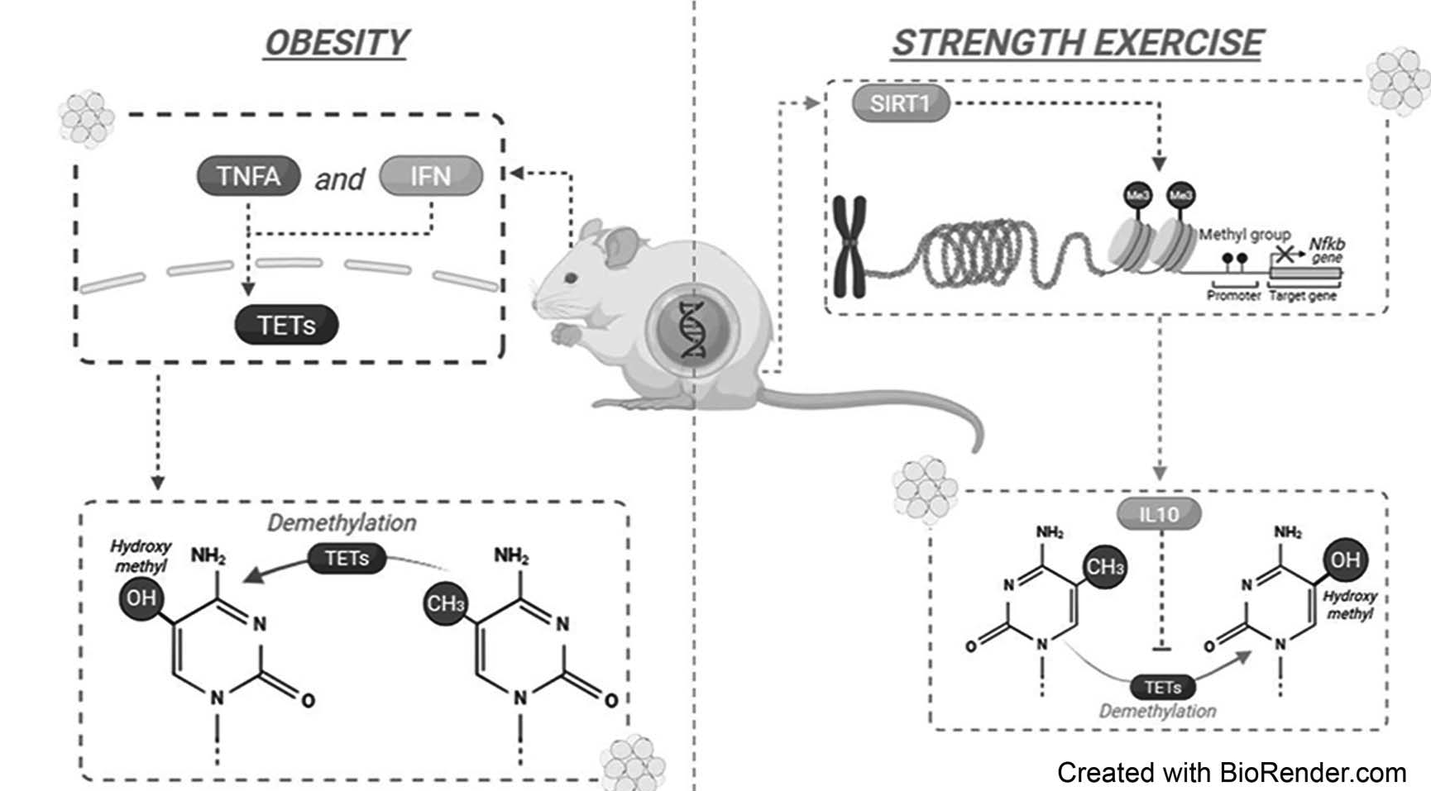

Slide 33
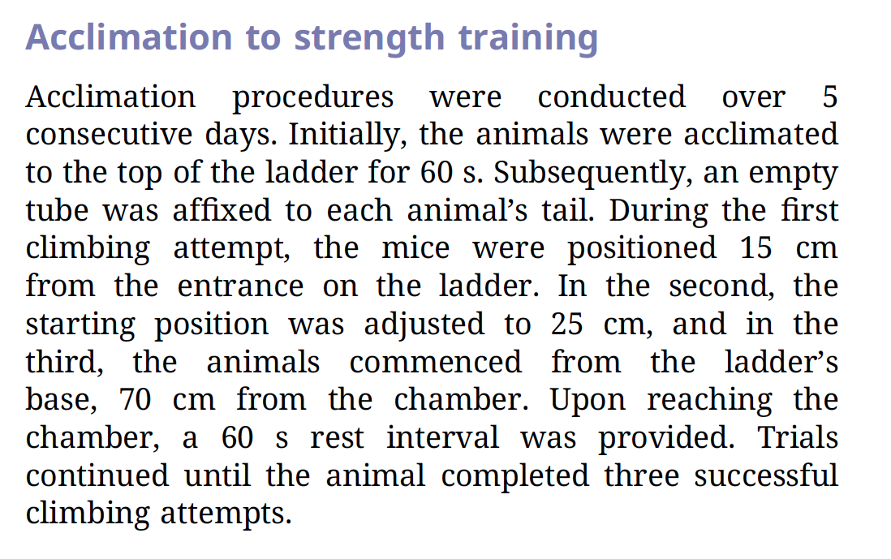

Slide 34



Slide 35


Slide 36
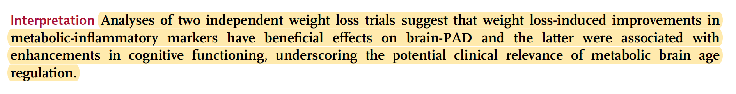

Slide 37


Slide 38
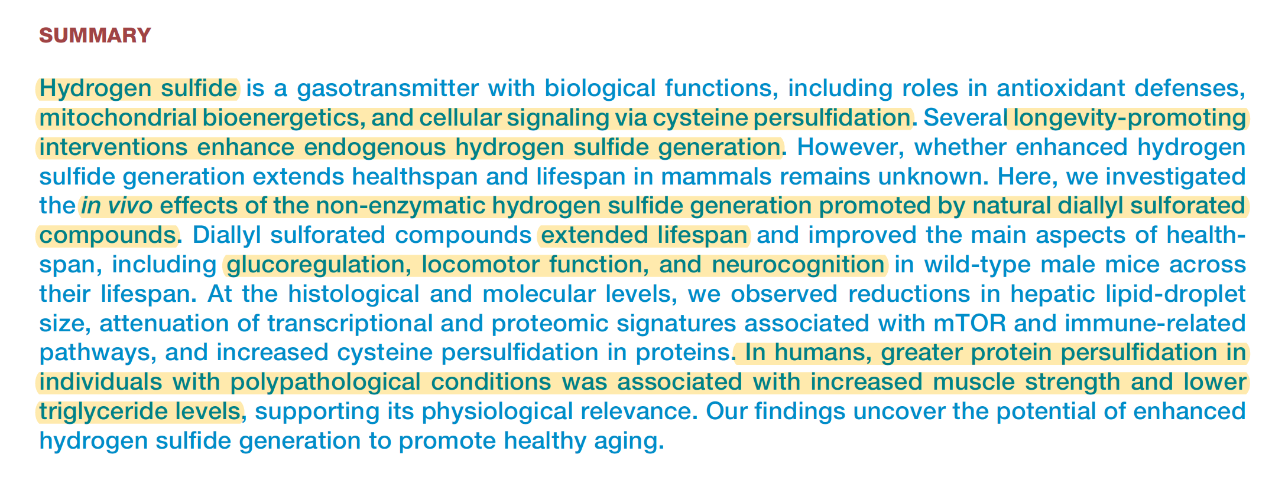

Slide 39
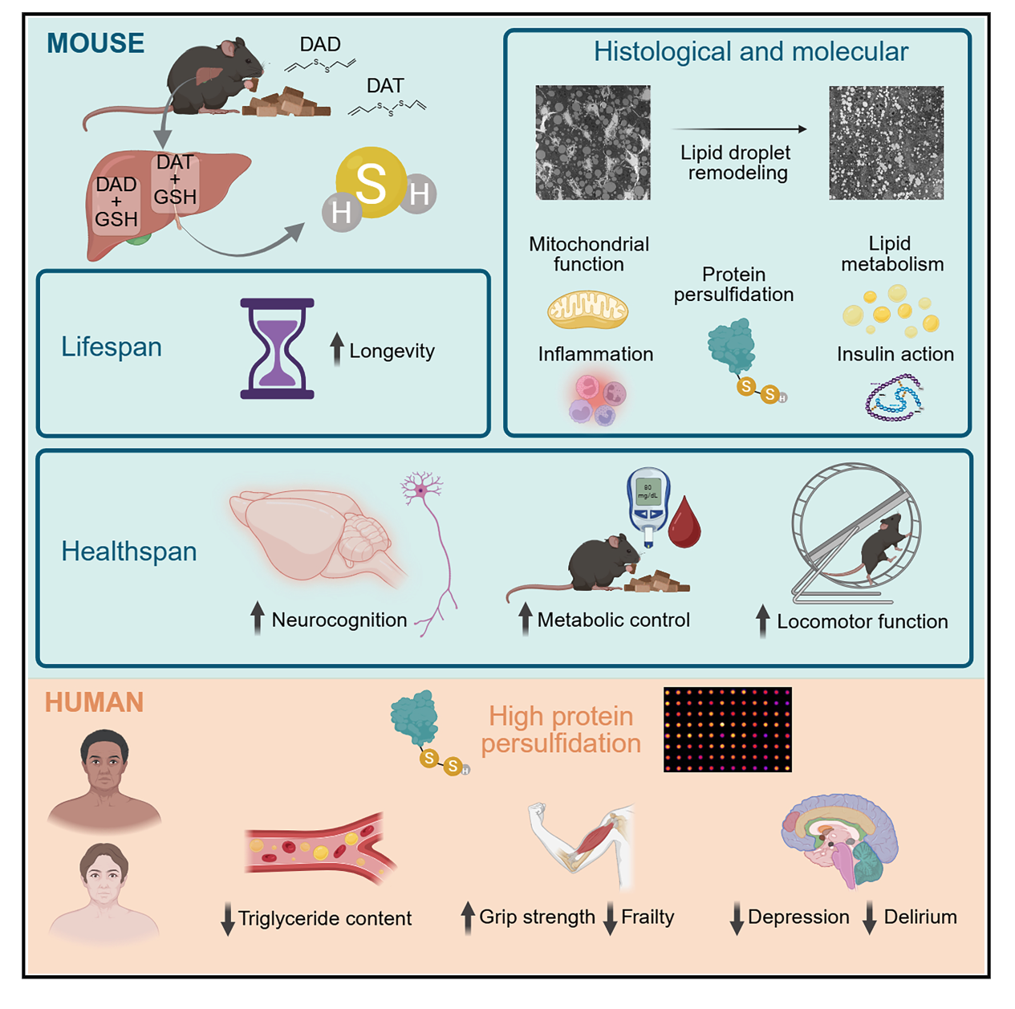
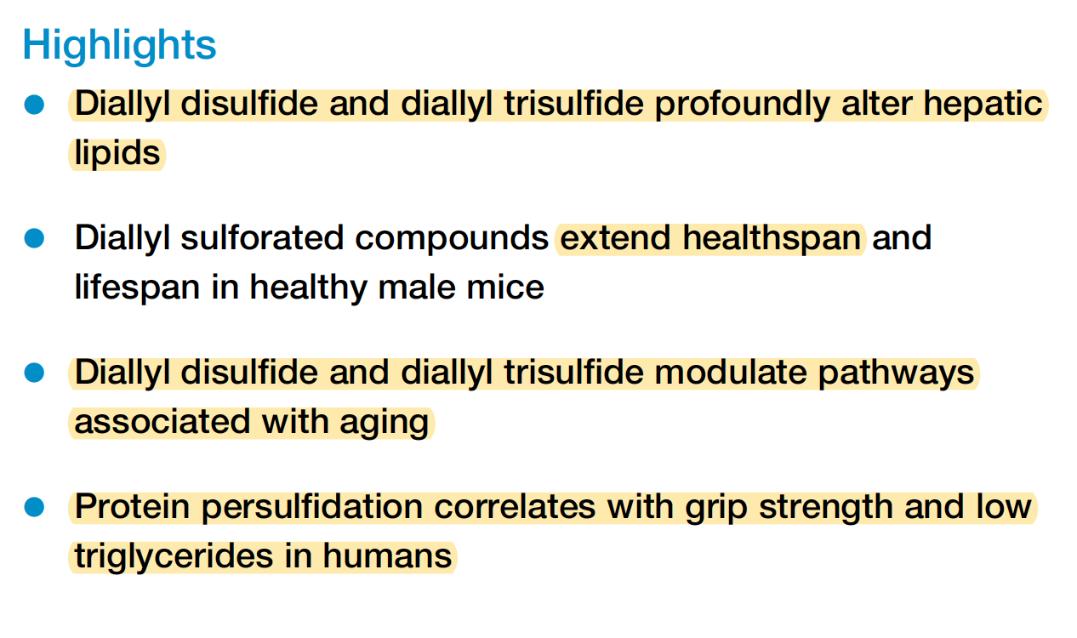

Slide 40
The consumption of diallyl sulfide compounds, commonly found in foods like garlic and onions, is associated with unpleasant body odor and breath.The strong, pungent odors associated with these compounds are due to the presence of volatile sulfur compounds (VSCs). Diallyl sulfide compounds, like diallyl disulfide (DADS) and allyl methyl sulfide (AMS), are the primary culprits behind "garlic breath" and body odor after consumption of Allium family plants. These compounds have their own distinct strong, unpleasant smell, which is different from the pure rotten-egg smell of allyl methyl sulfide (AMS) is particularly "mischievous" because it is metabolized slowly and can linger in the body for a long time, seeping into sweat and breath.

Slide 41
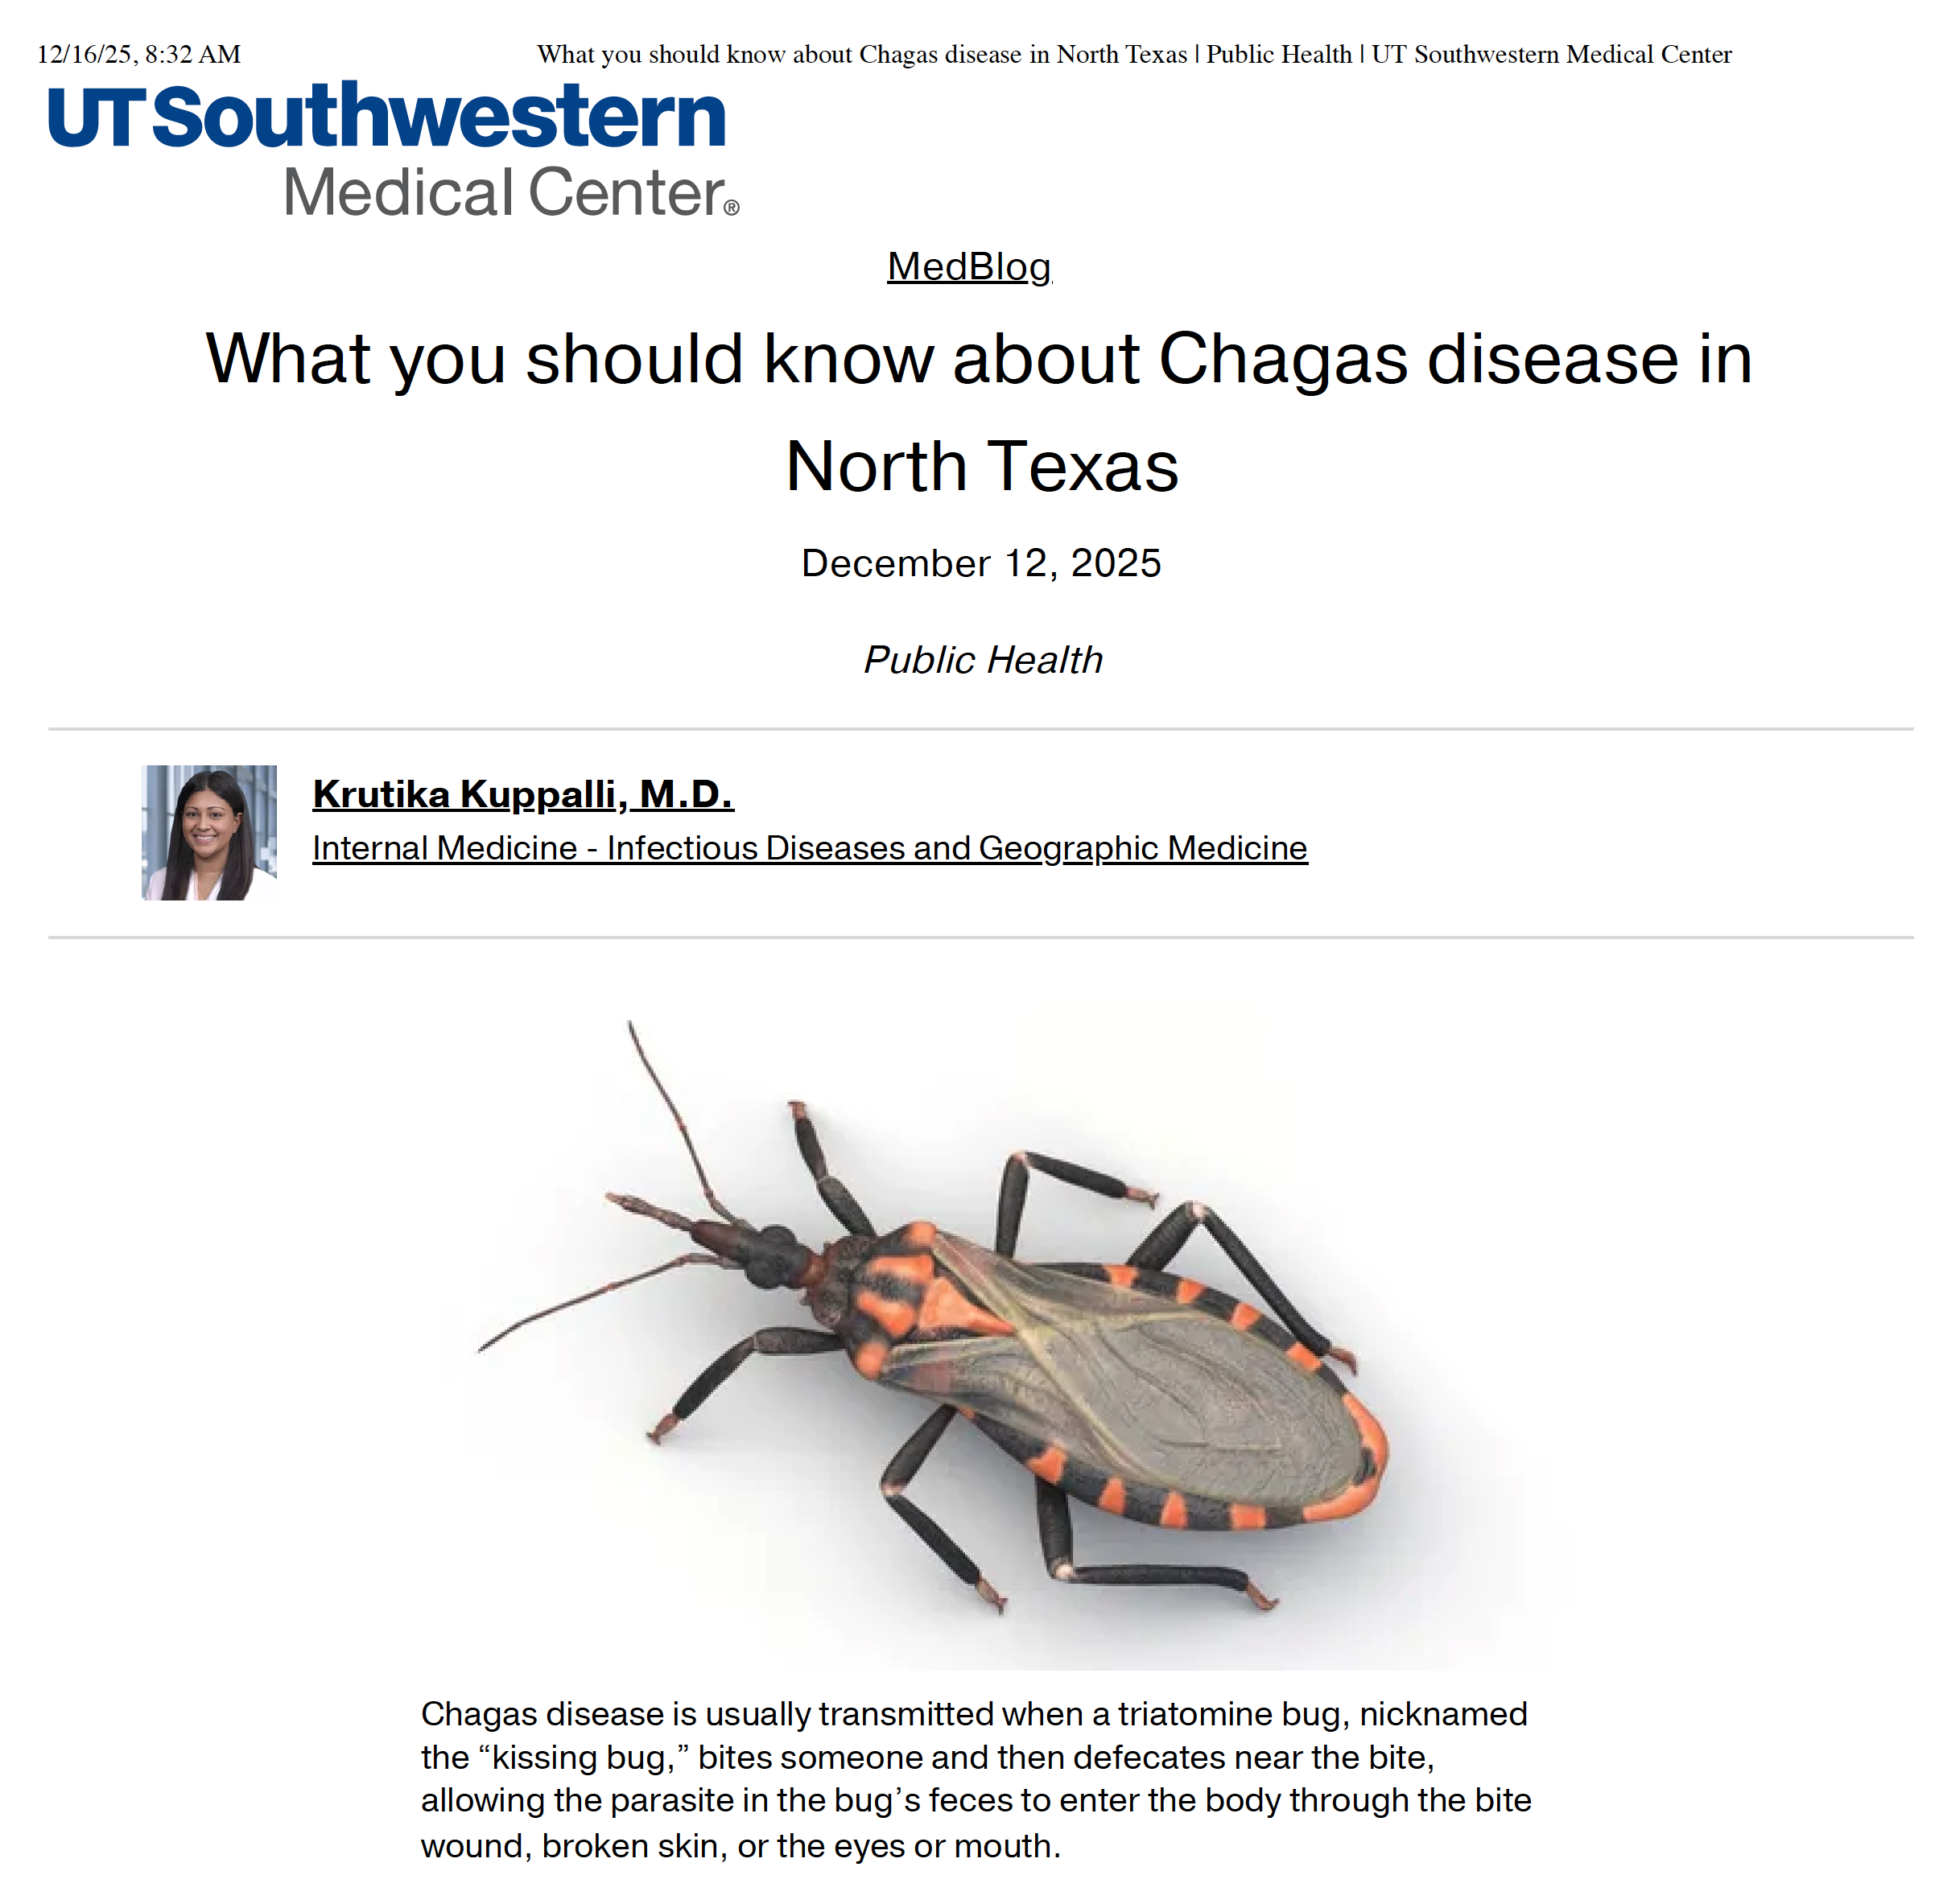

Slide 42
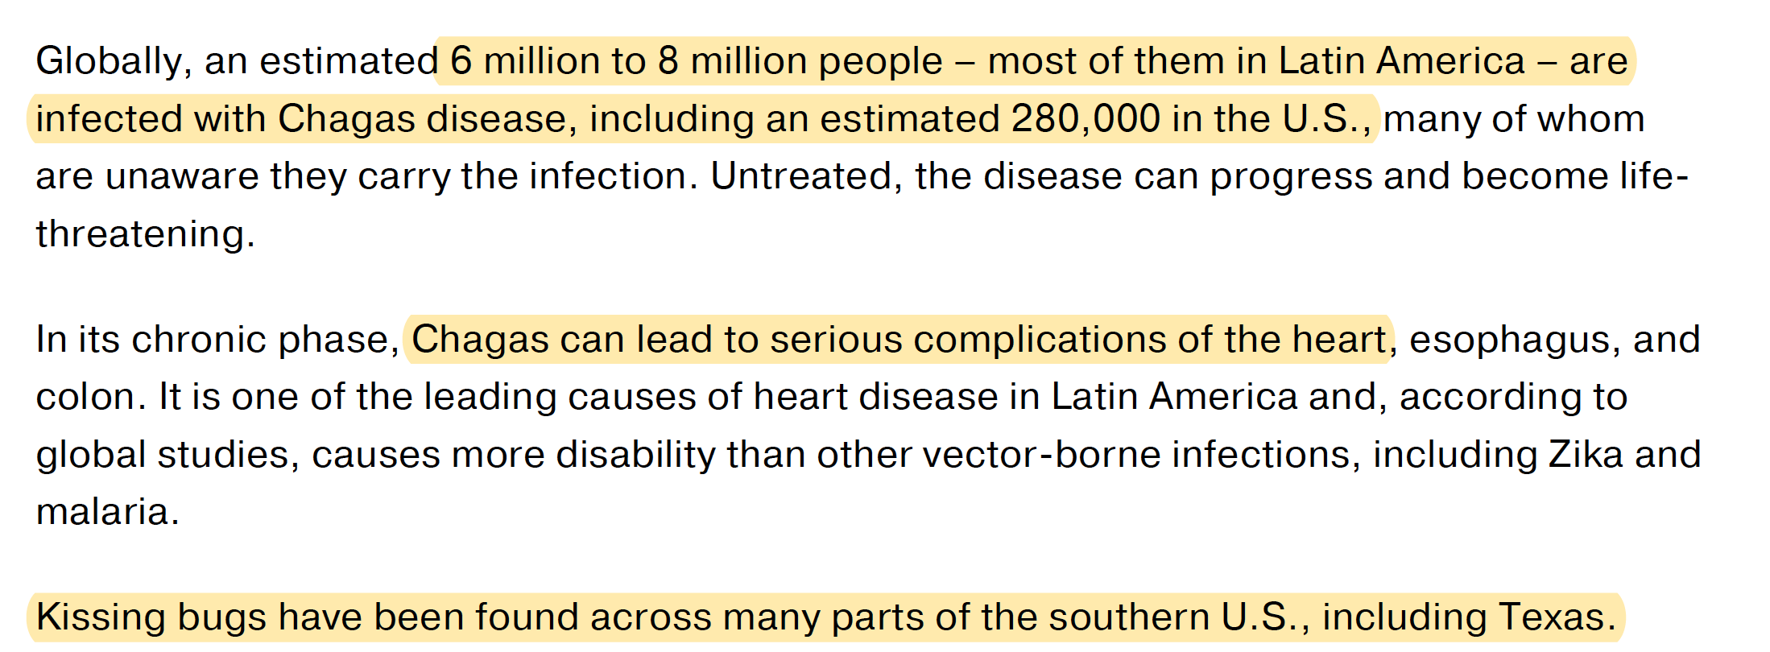
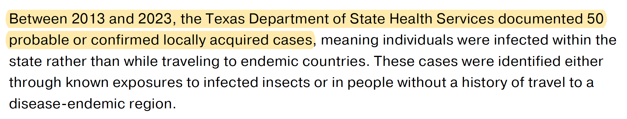

Slide 43
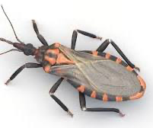
There is substantial evidence for Chagas disease in dogs in Texas, with studies showing significant prevalence rates (around 9-20% in shelter dogs, higher in kennels) and documented cases across the state, making dogs a major domestic reservoir for the parasite (Trypanosoma cruzi) transmitted by kissing bugs. Texas was even the only state where it was a reportable disease for a time, highlighting its endemic nature and concern for both animal and public health.

Slide 44
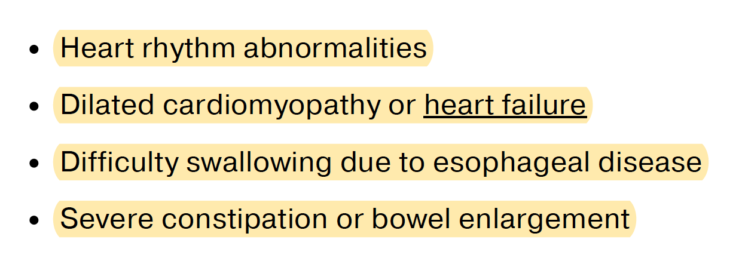

Slide 45
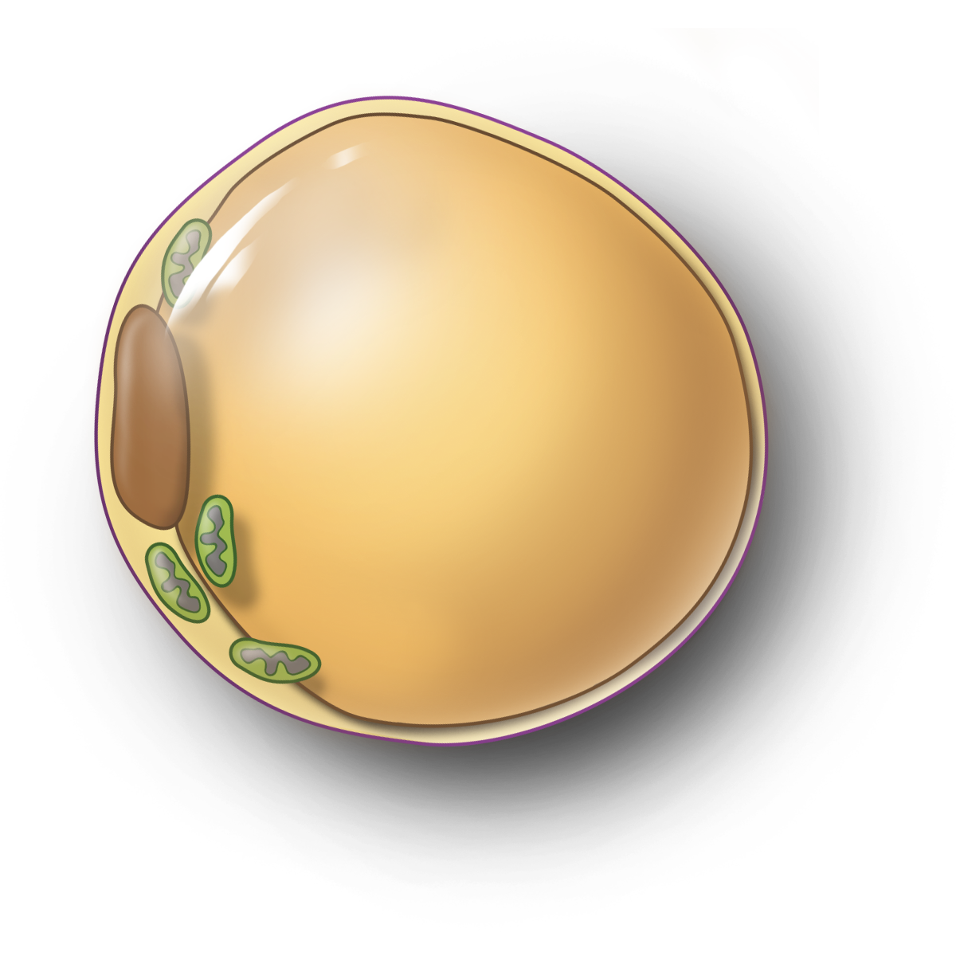
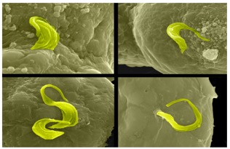
Metabolism
Metabolism
Metabolism
Heart
Pancreatic α and β cells
Heart
Pancreatic α and β cells
Heart
Pancreatic α and β cells
Liver
Kidney
Liver
Kidney
Liver
Kidney
Muscle
Muscle
Muscle
Vascular
Vascular
Vascular
Angiogenic Factors
Endothelium
Endothelium
Endothelium
Growth Factors
Brain
Brain
Brain
Cytokines
ECM Modulators
FFAs
Tumor
Cell
Interactions
Uridine
Infectious Disease
Infectious Disease

Slide 46

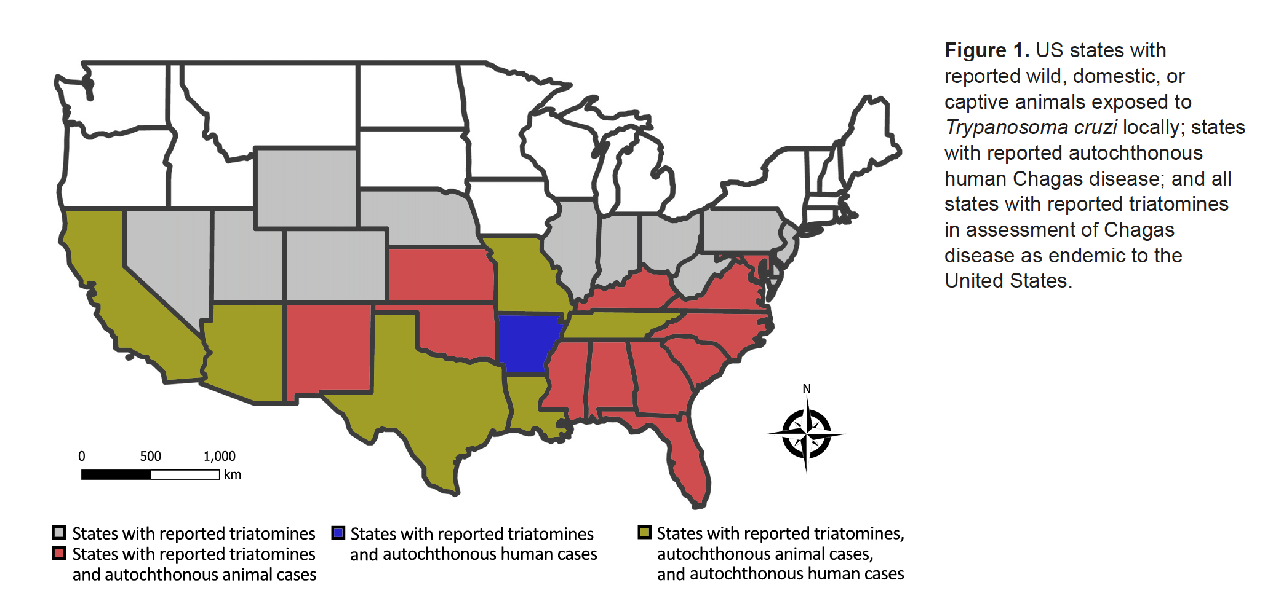

Slide 48


