Slide 1



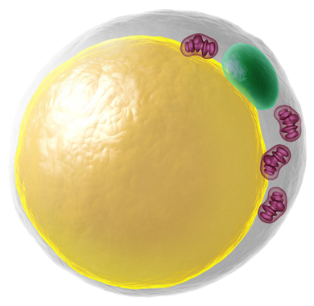
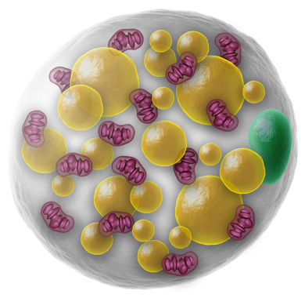

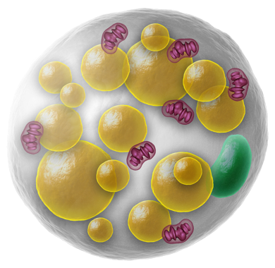


Literature Overview Touchstone Diabetes Center UTSW Medical Center 12/8/2025

Slide 2
Diabetes Podcast Bergman on altering lipid localization and adipose tissue cellular composition through weight loss
https://youtu.be/oyMSF9wEf7g

Slide 3
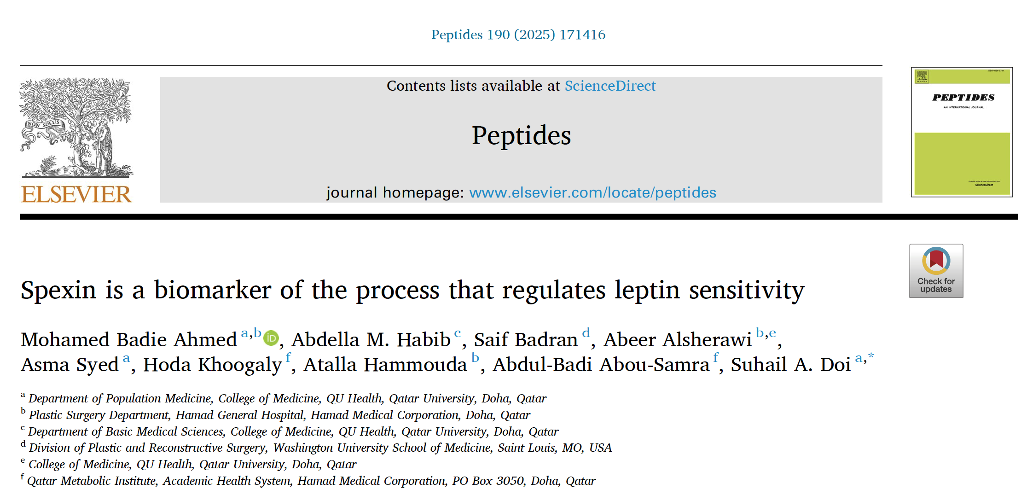

Slide 4
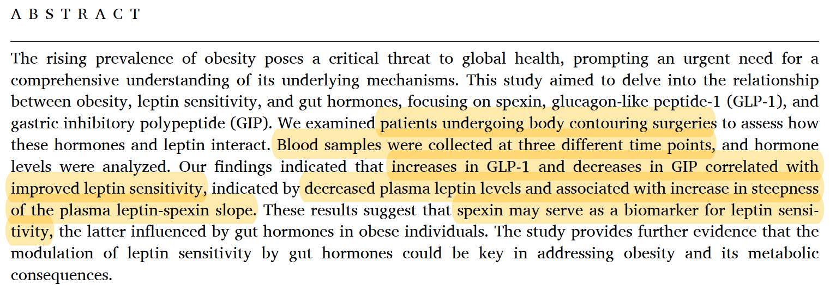
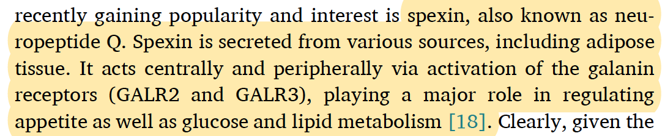

Slide 5
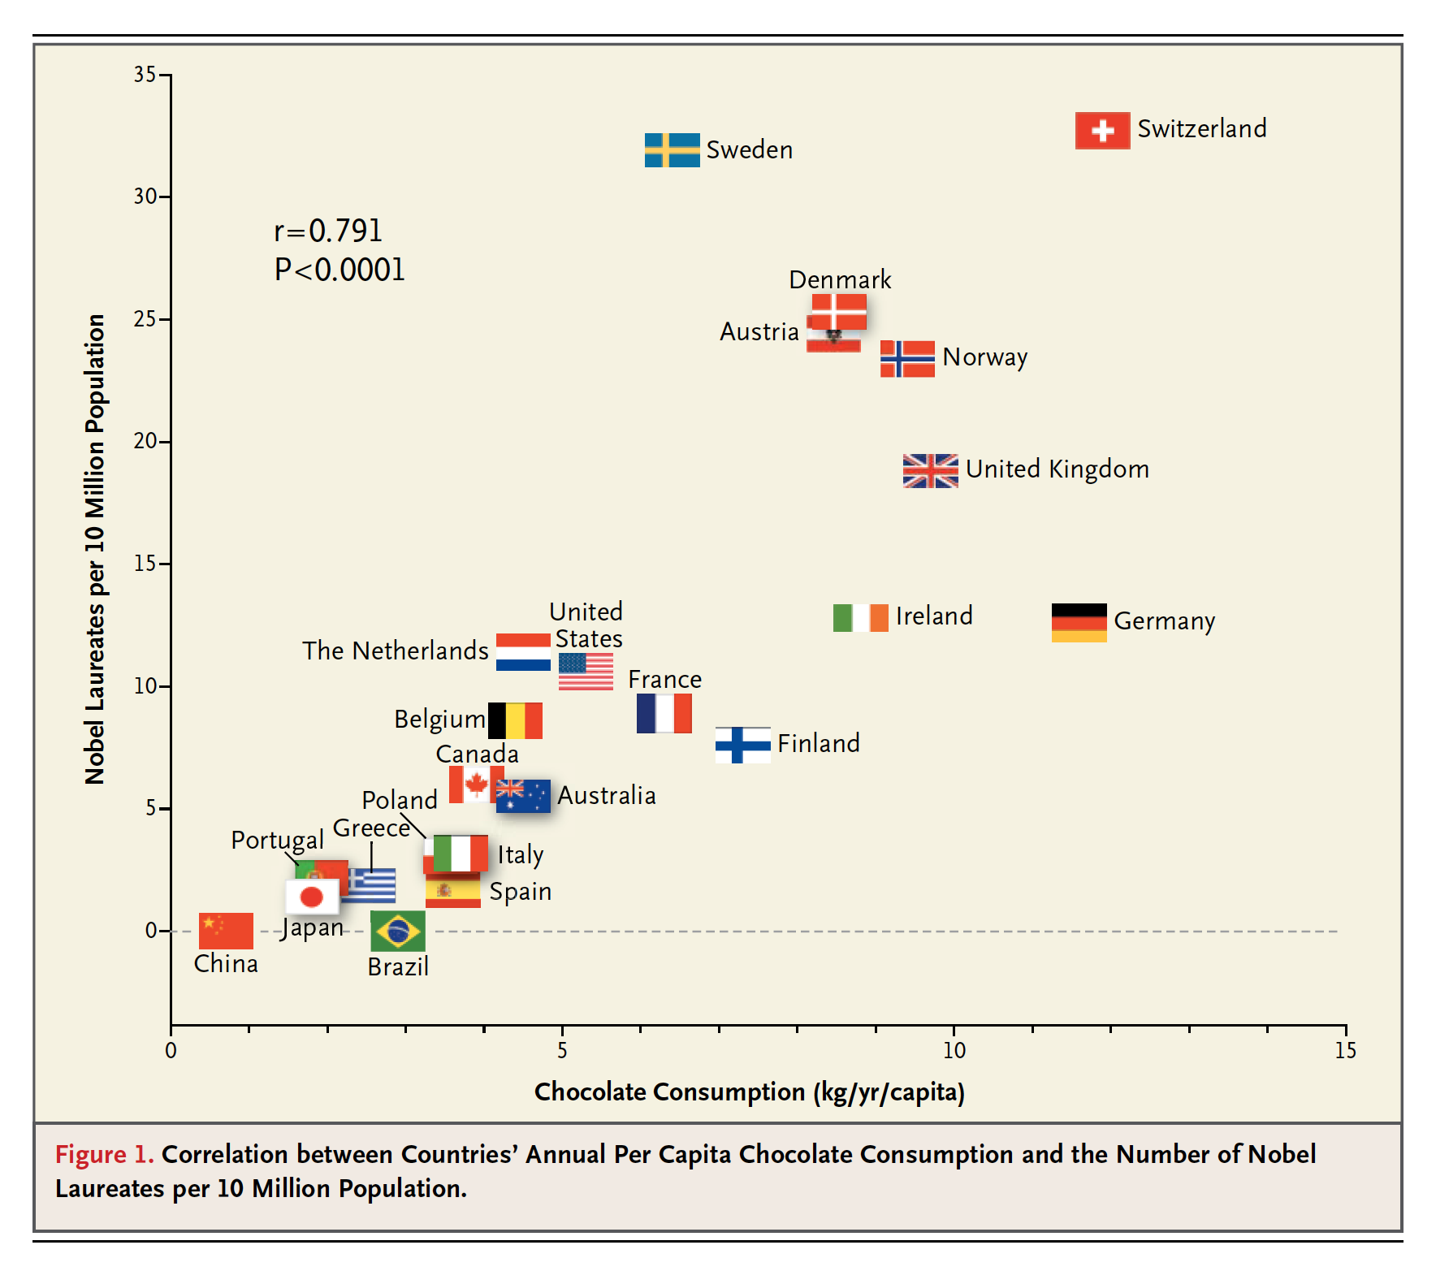


Slide 6
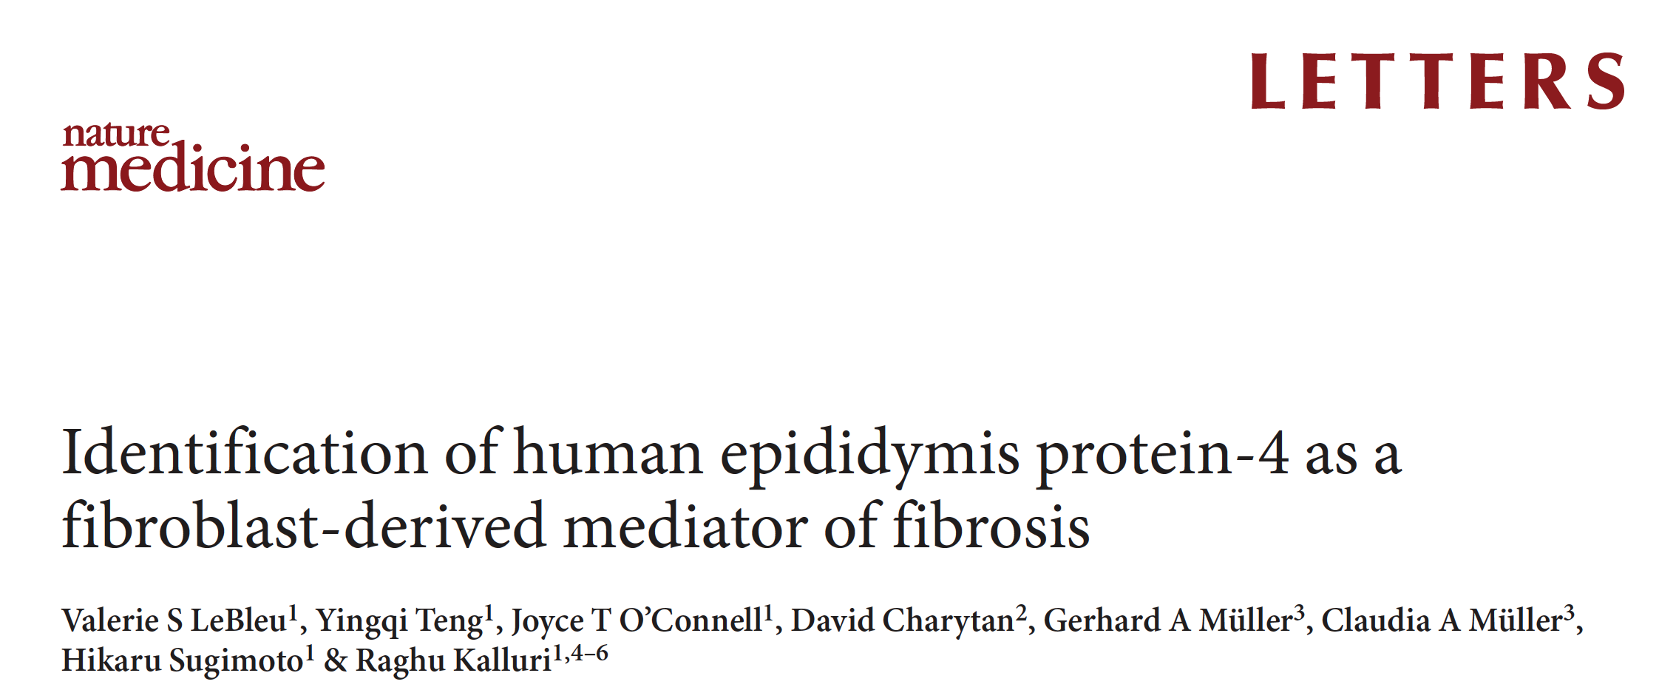


Slide 7
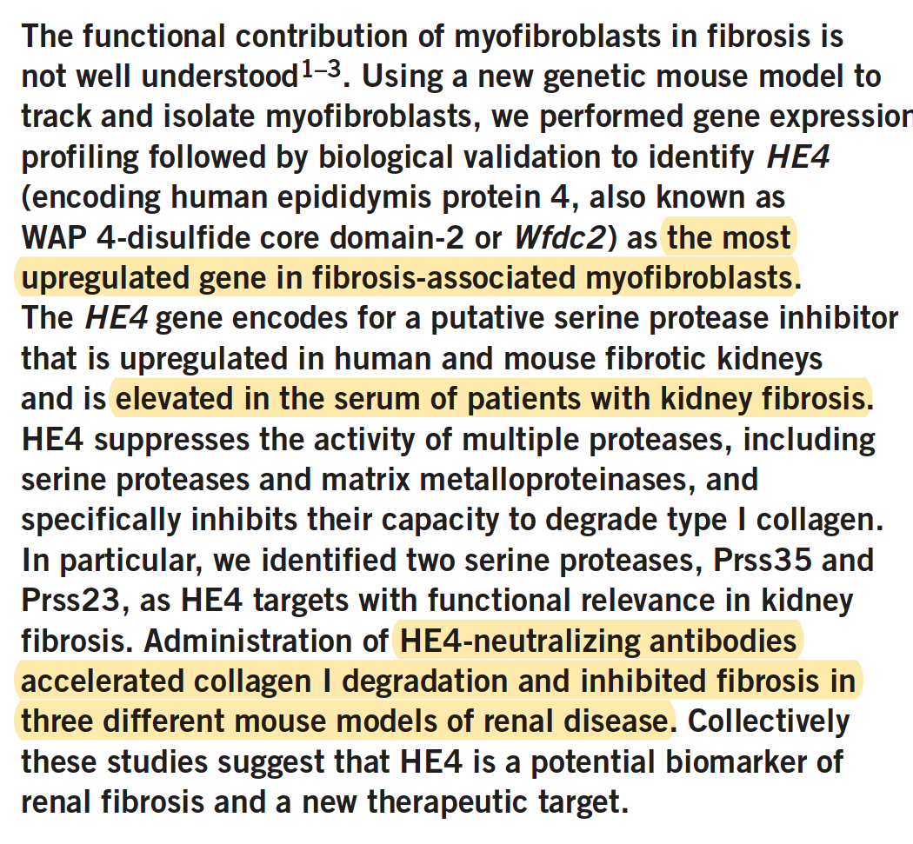

Slide 8
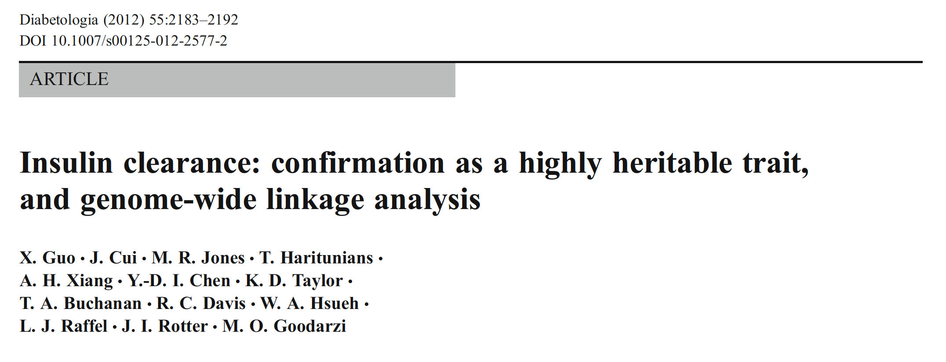

Slide 9
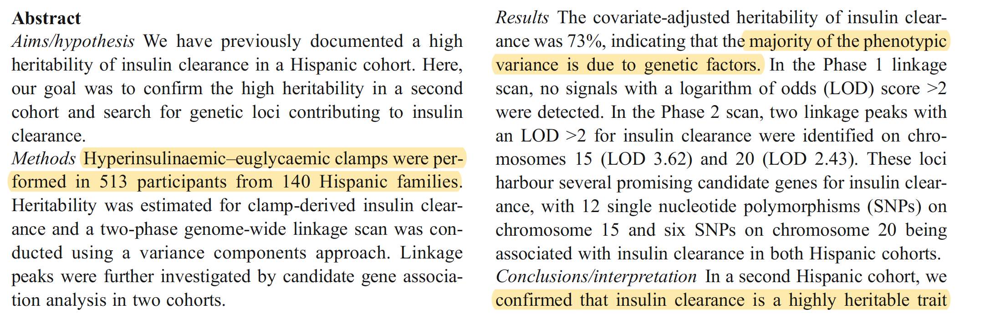
One is on chromosome 20 where the majority of the human WFDC genes are located in one cluster, including WFDC2
HE4 significantly suppressed the activities of MMP2 and MMP9 to degrade type I collagen (Fig. 2g). Further, we found that
HE4 directly interacts with MMP2 and MMP9, as assessed by immunoprecipitation using antibody to HE4 and
subsequent western blotting analysis (Fig. 2h). HE4 also inhibited the degradation of type I
collagen by bacterial collagenase, a collagenase that shares an activity profile with many
mammalian MMPs (Supplementary Fig. 3d).

Slide 10





Slide 11
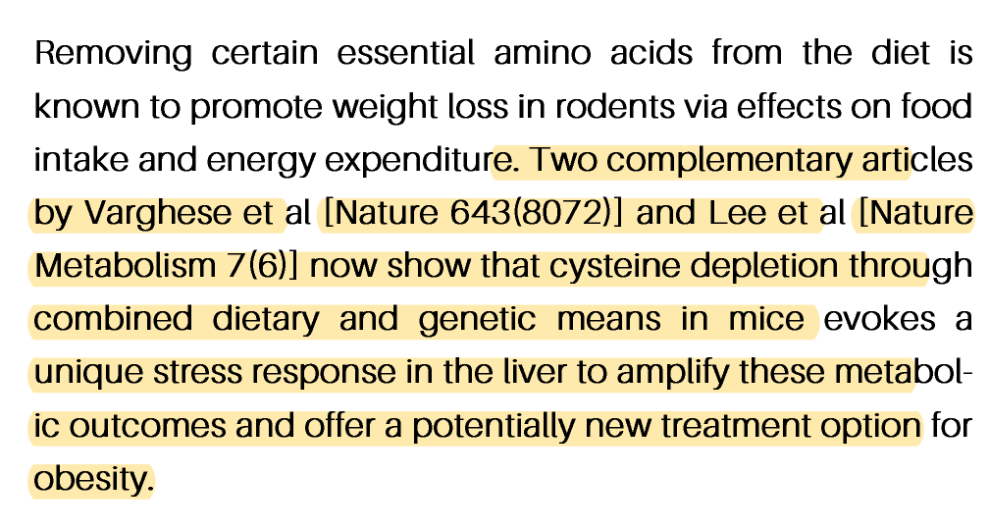
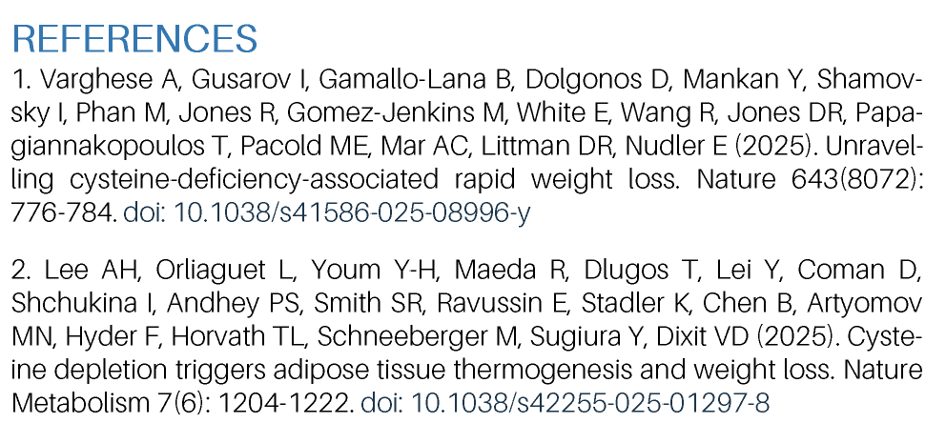

Slide 12
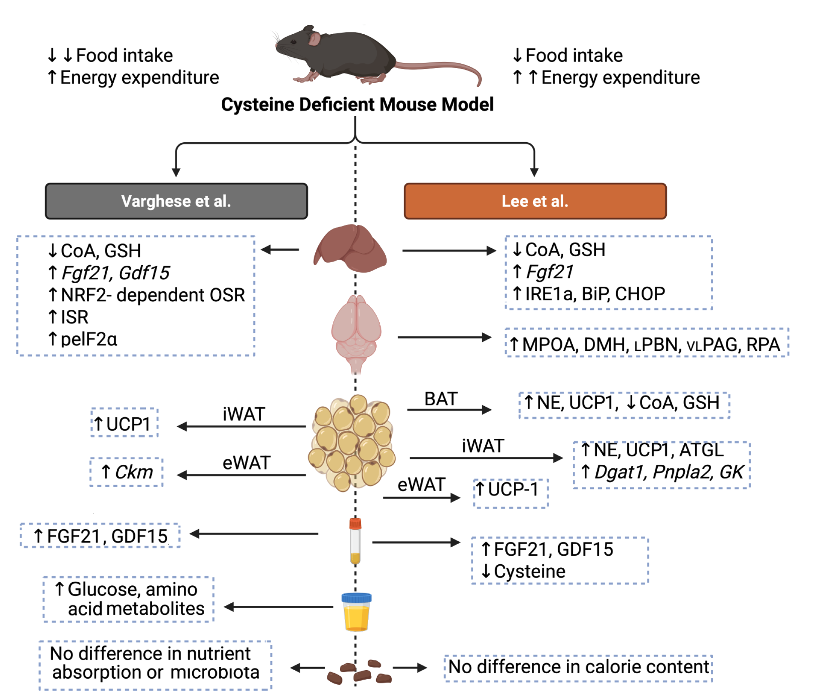

Slide 13


Slide 14
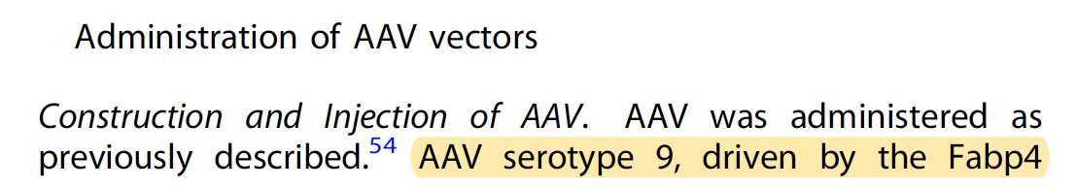
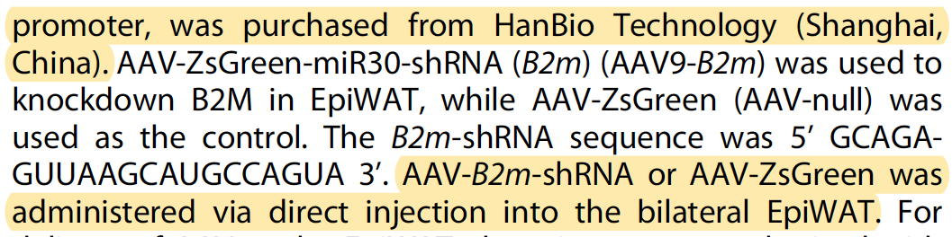

Slide 15


Slide 16
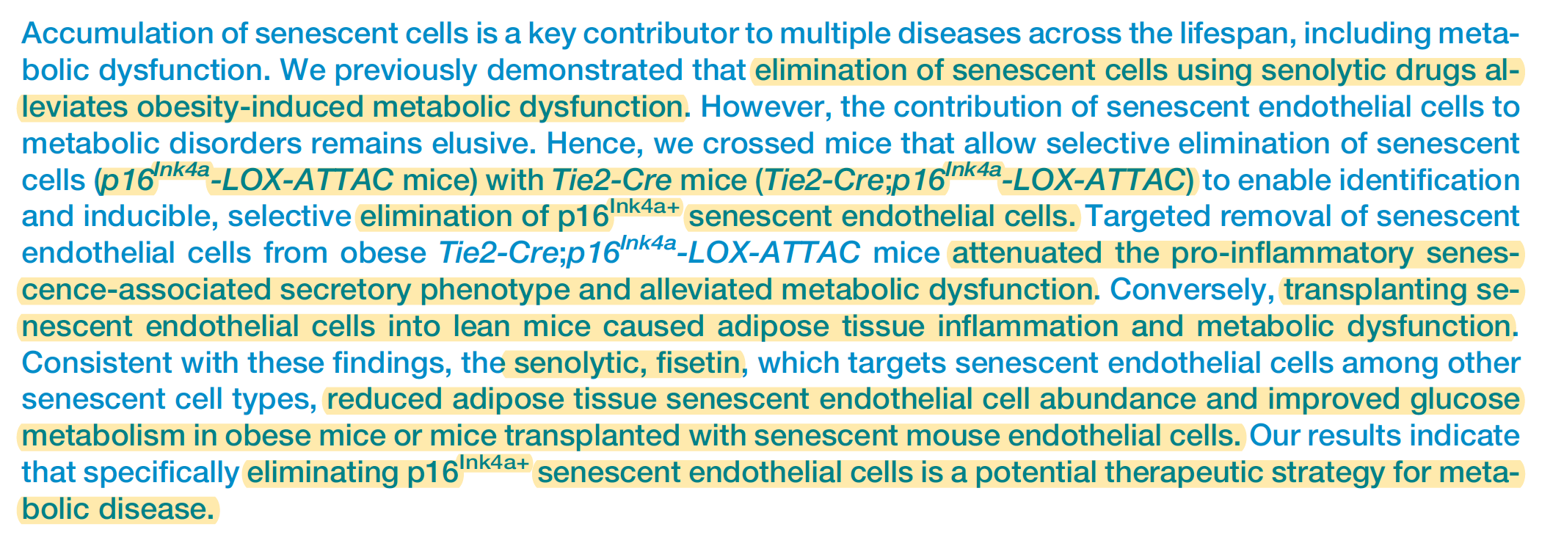

Slide 17
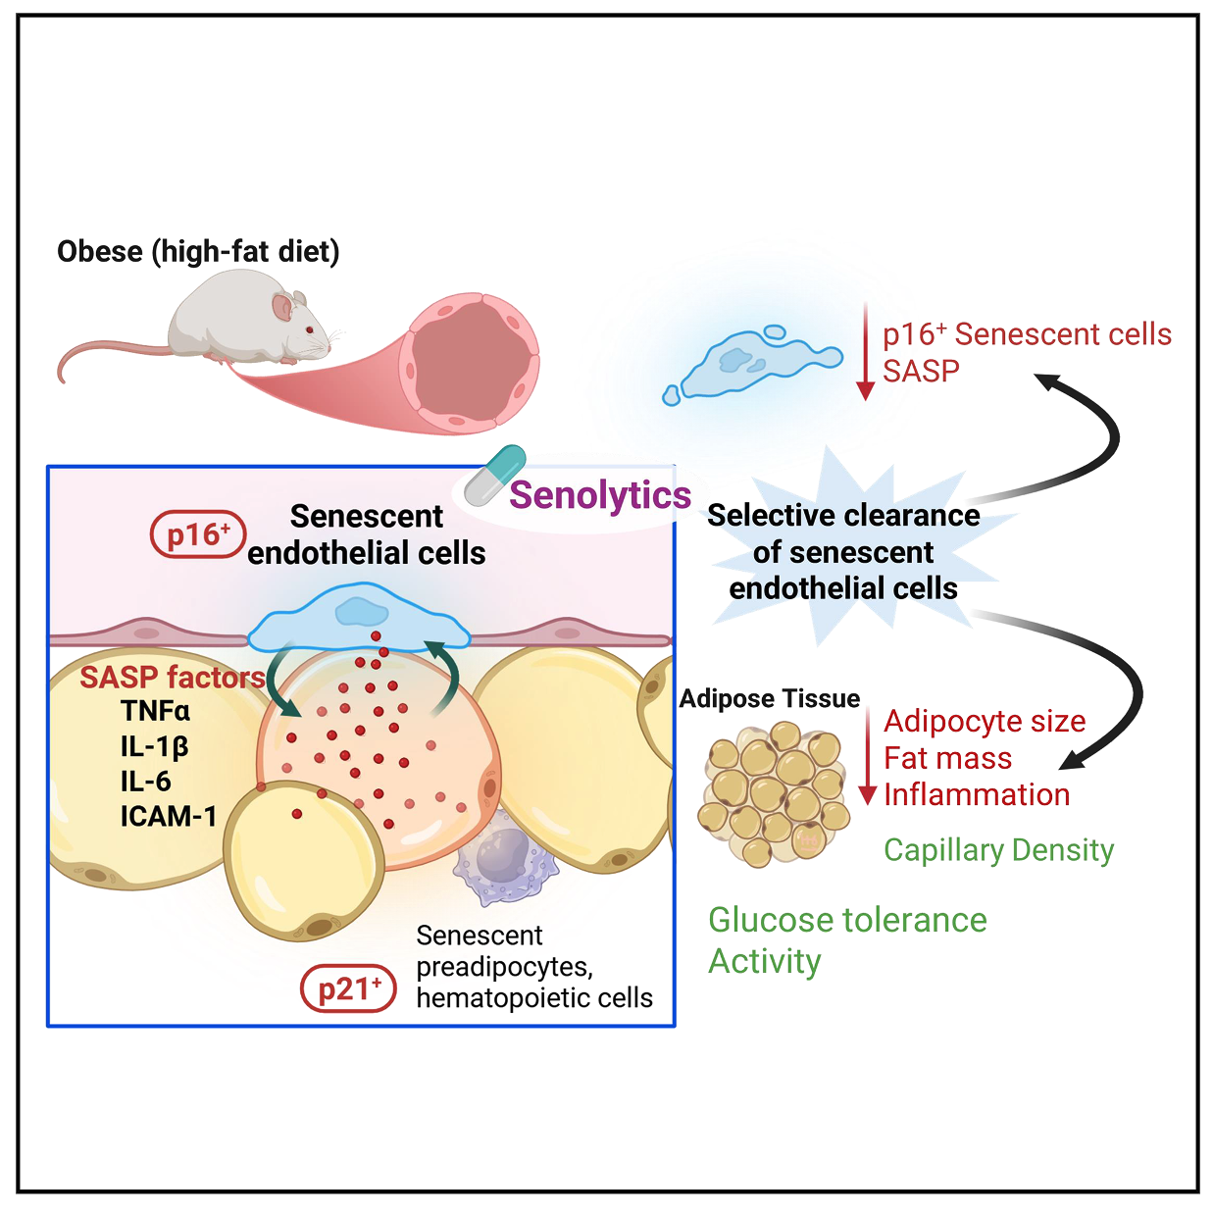
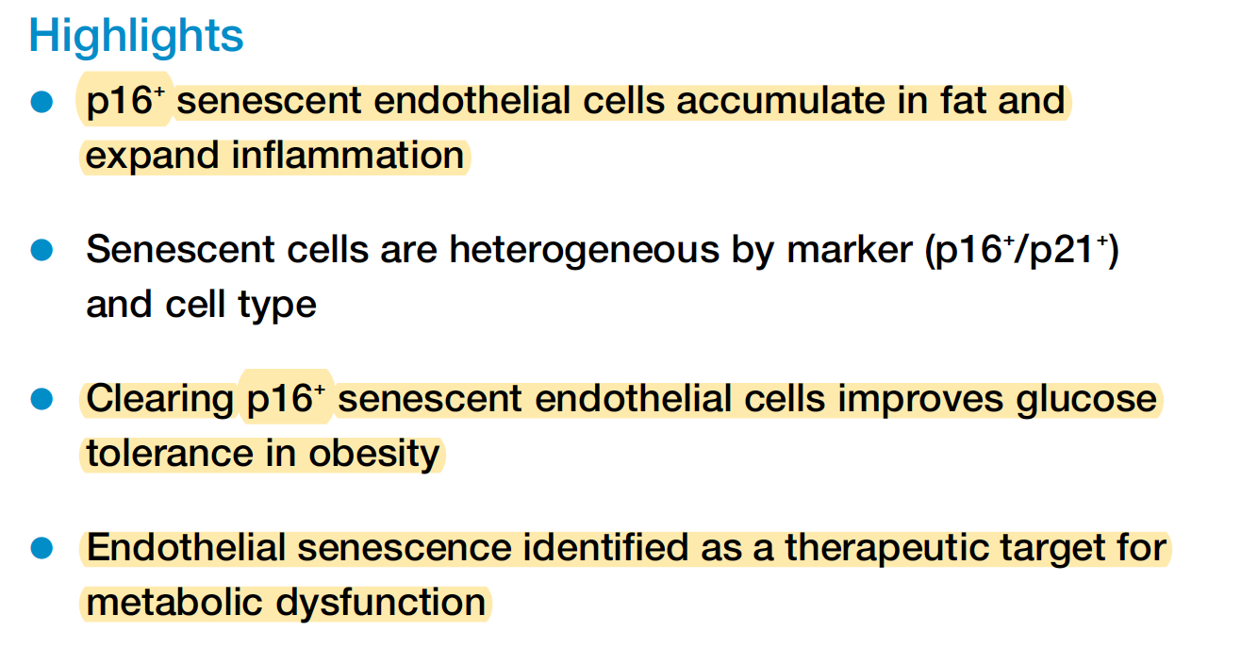

Slide 18
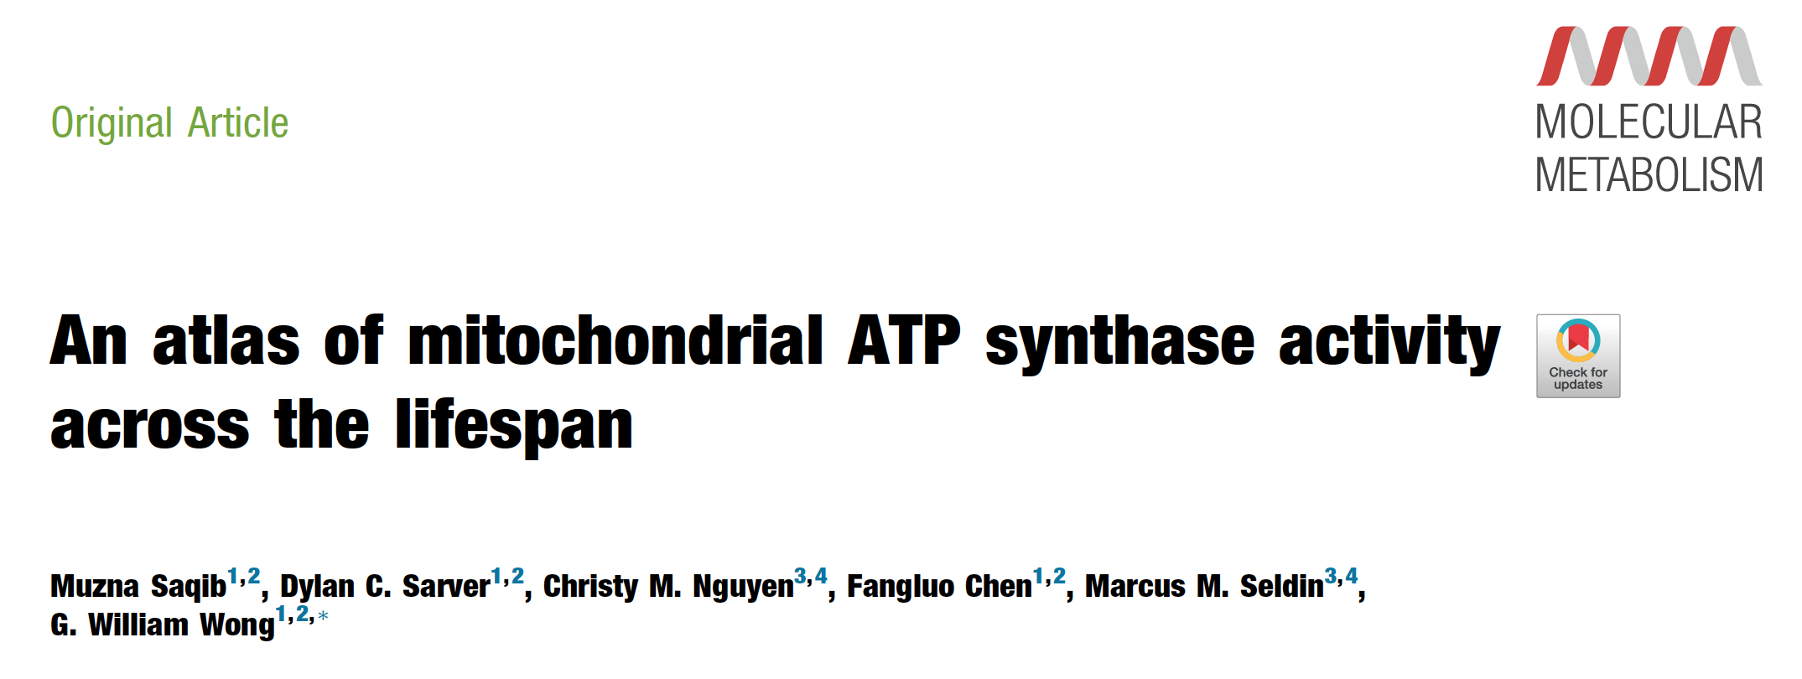


Slide 19
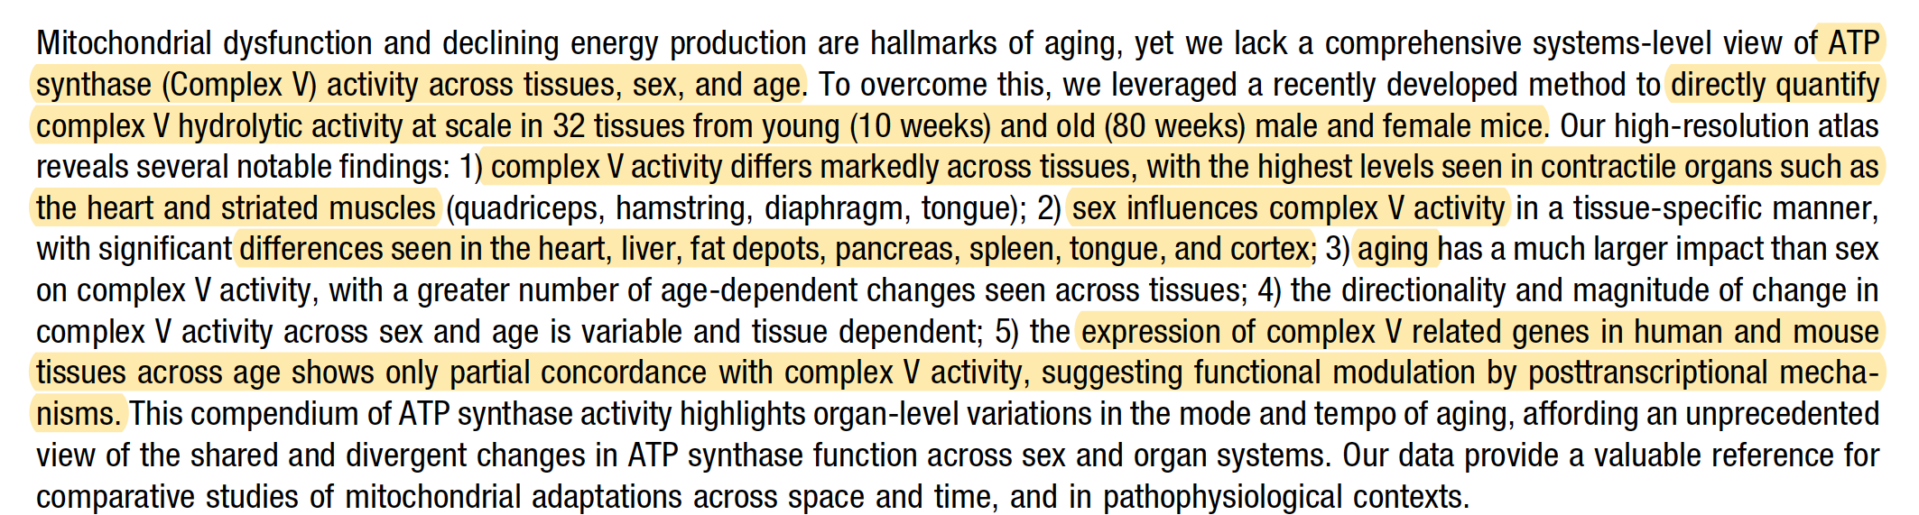
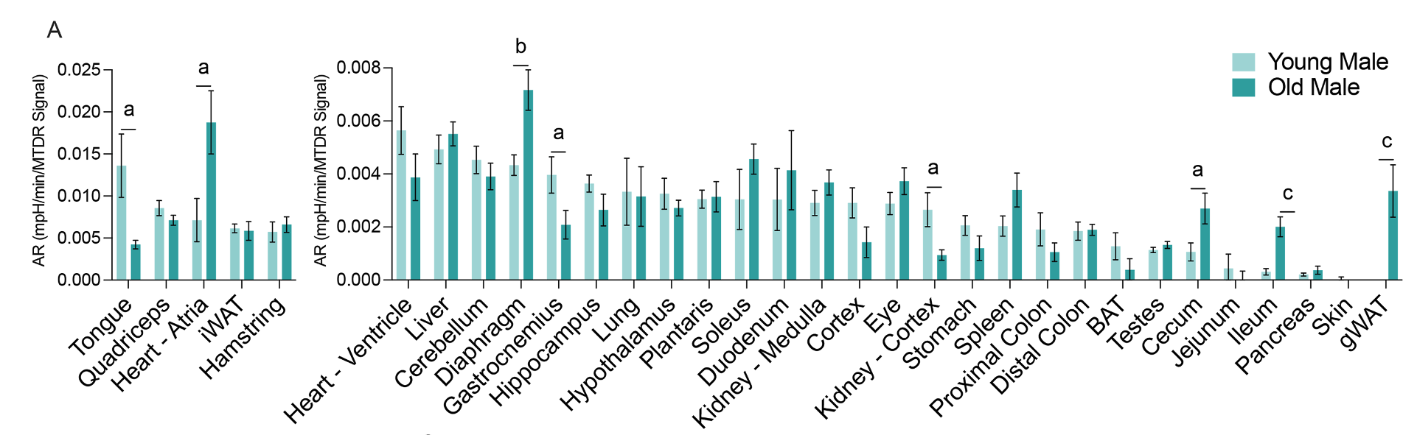

Slide 20
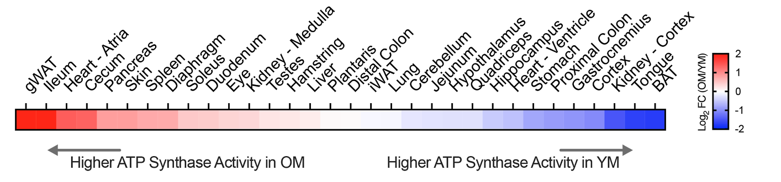
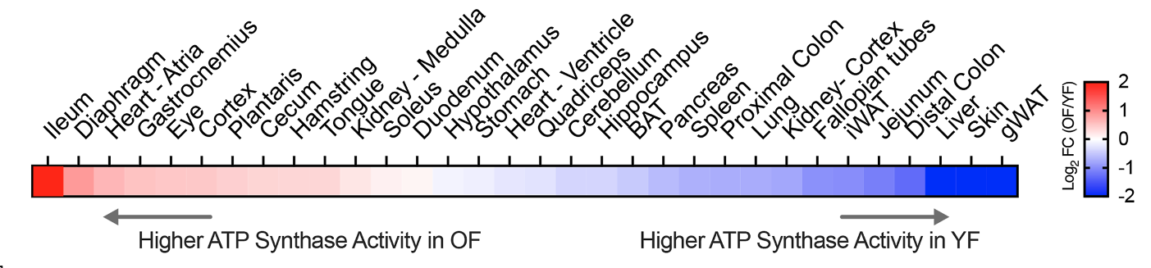

Slide 21

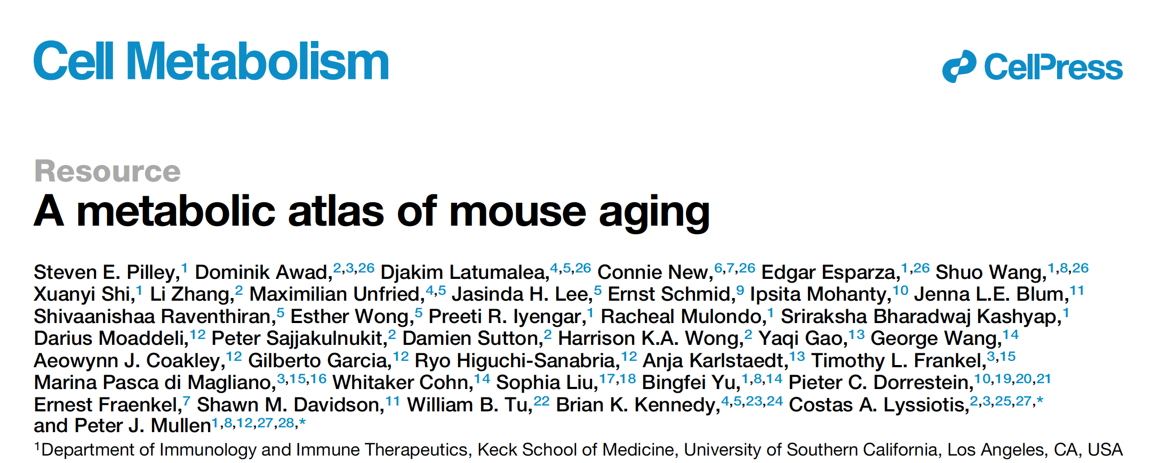

Slide 22
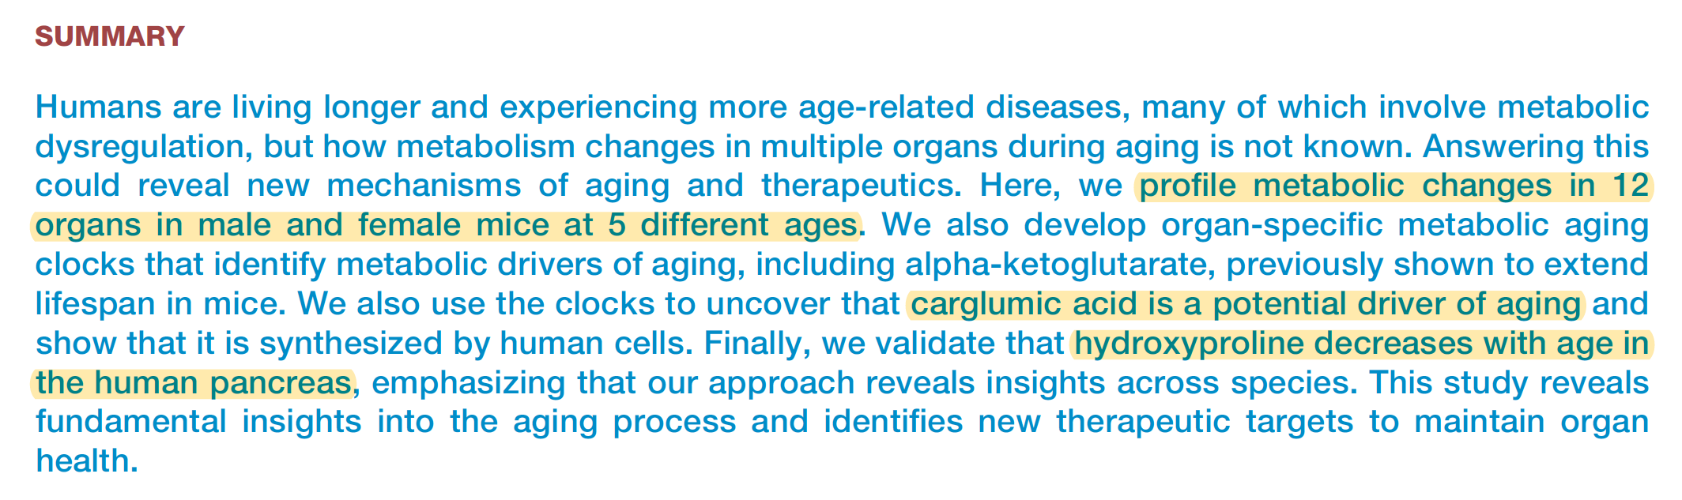

Slide 23
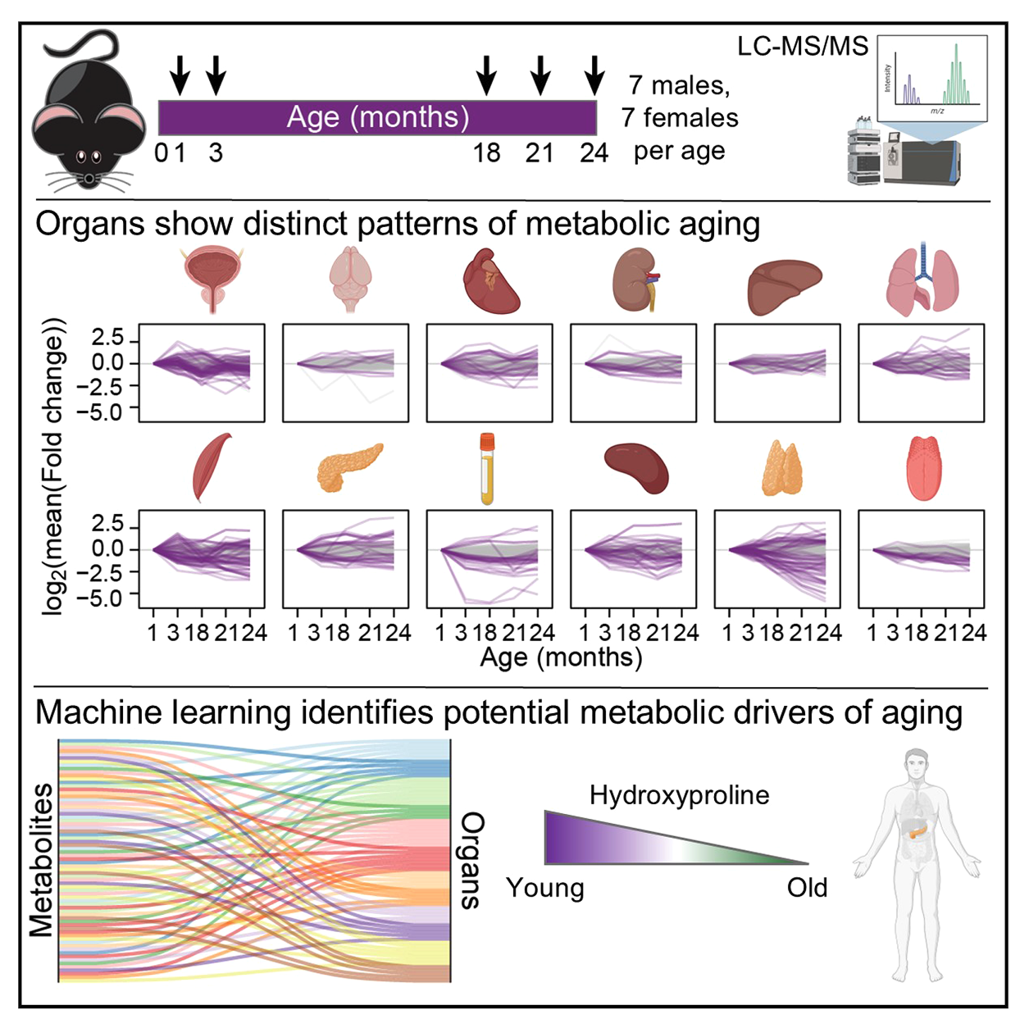
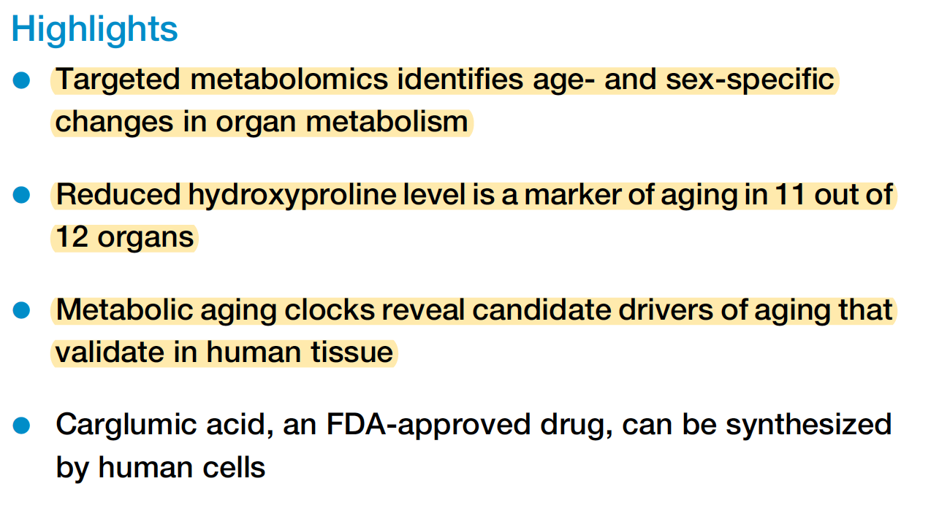

Slide 24
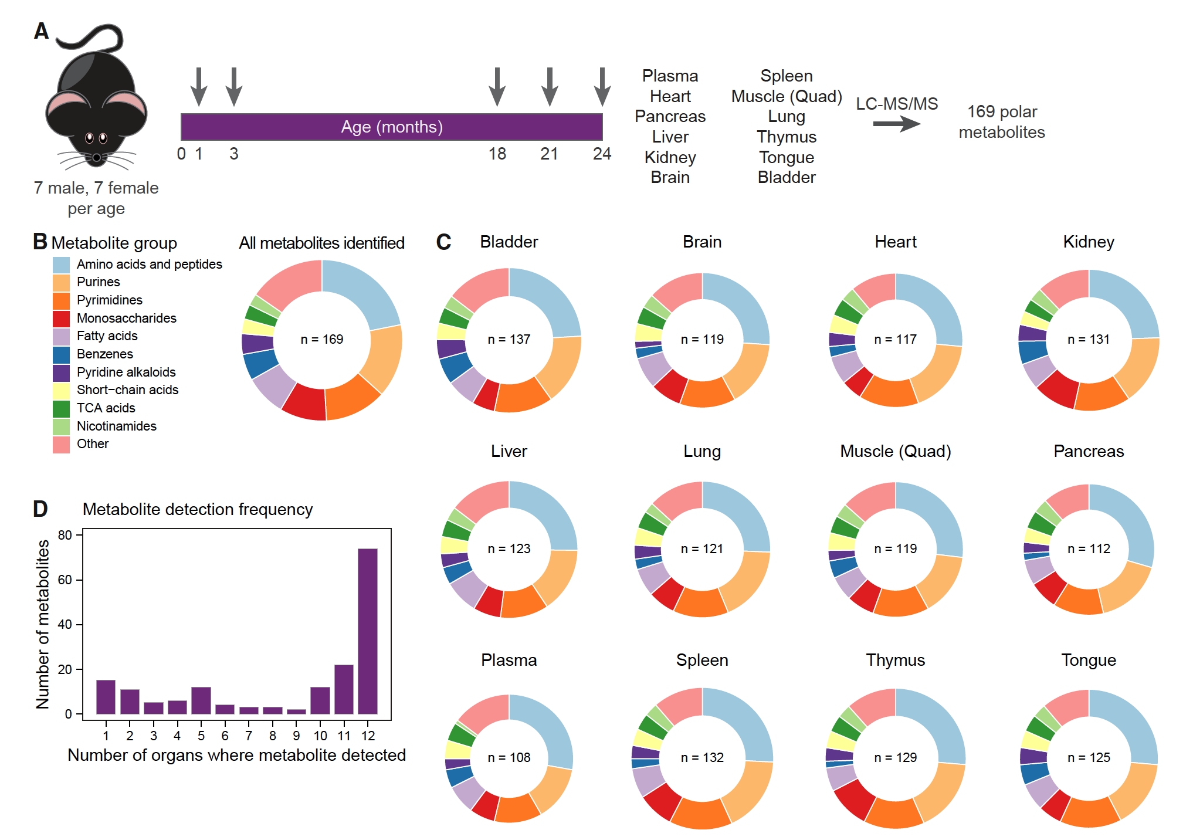

Slide 25
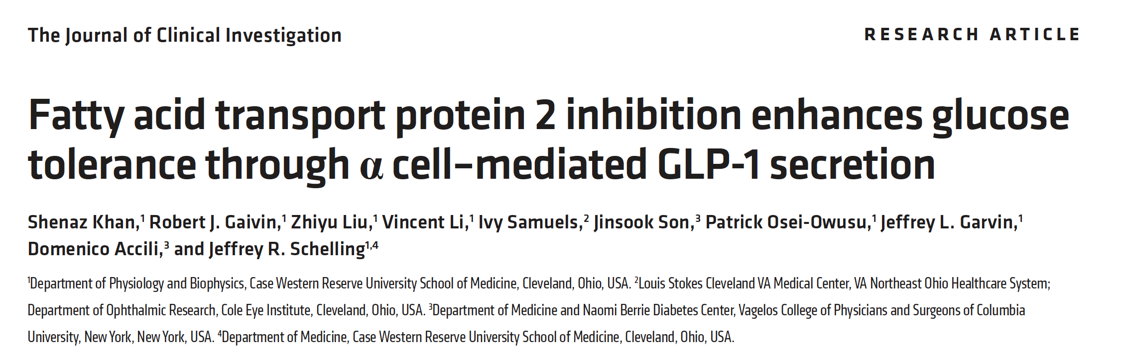


Slide 26
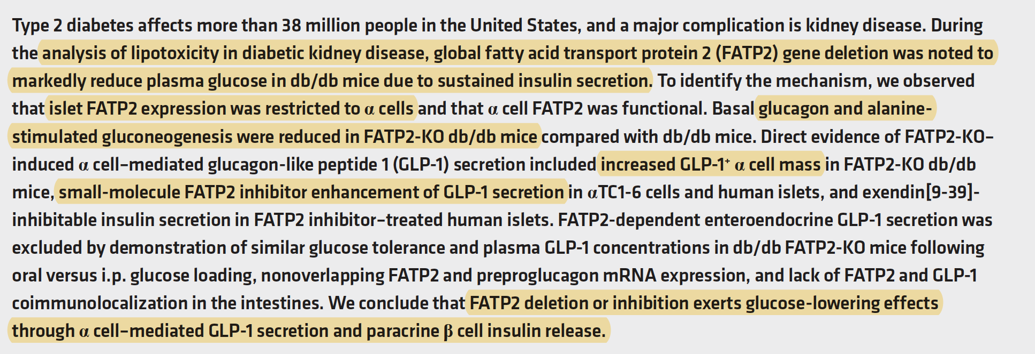

Slide 27
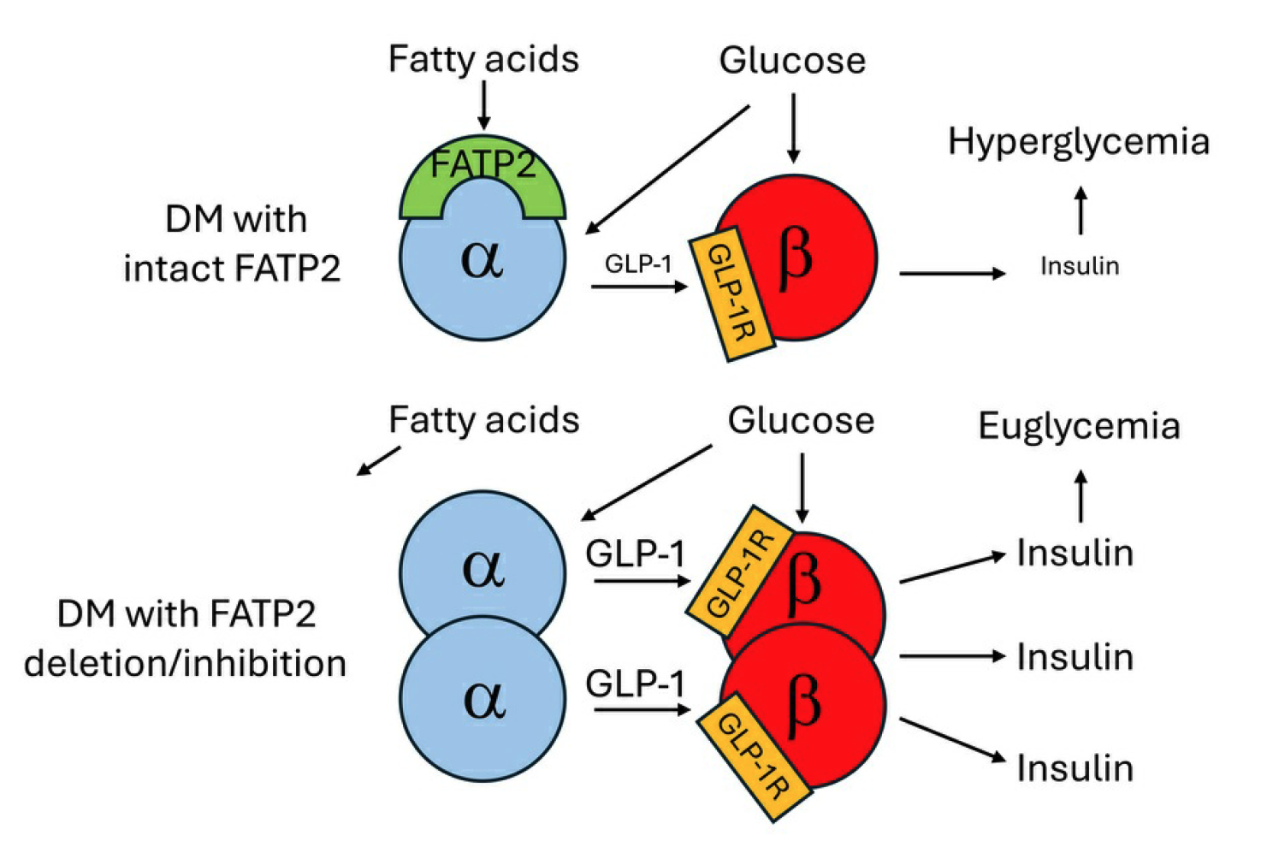

Slide 28
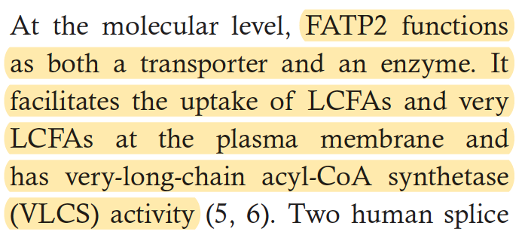

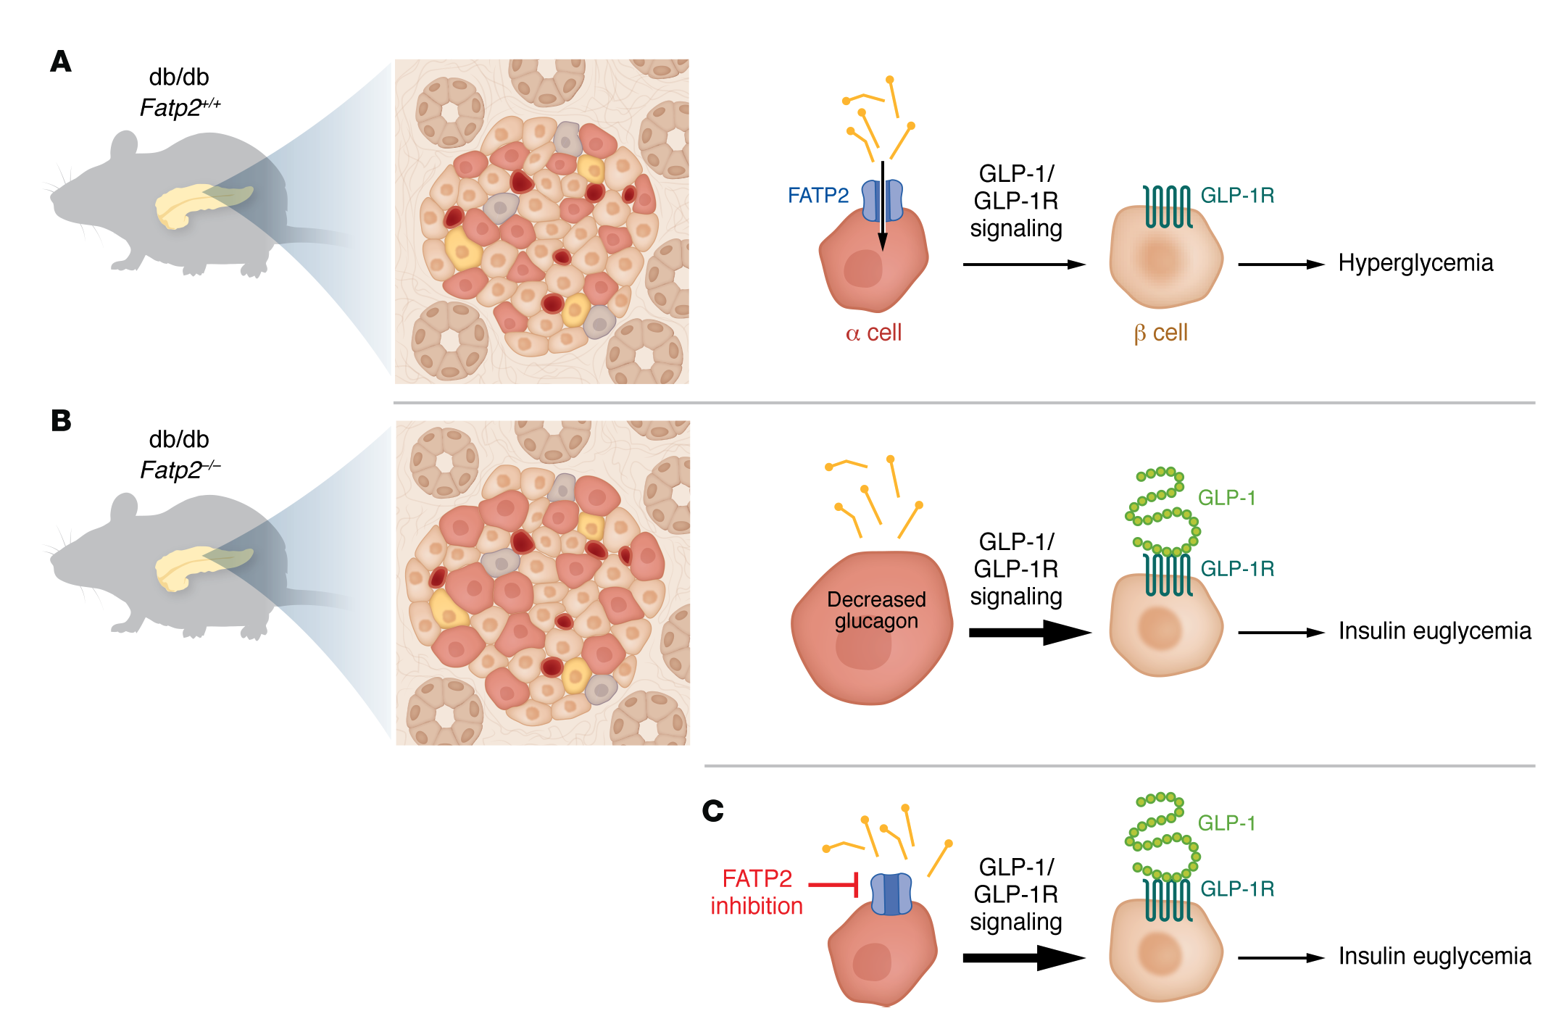
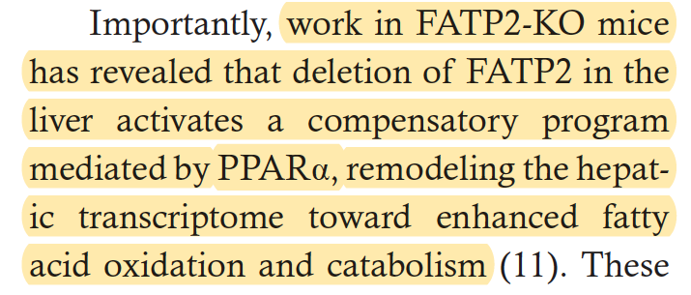

Slide 29
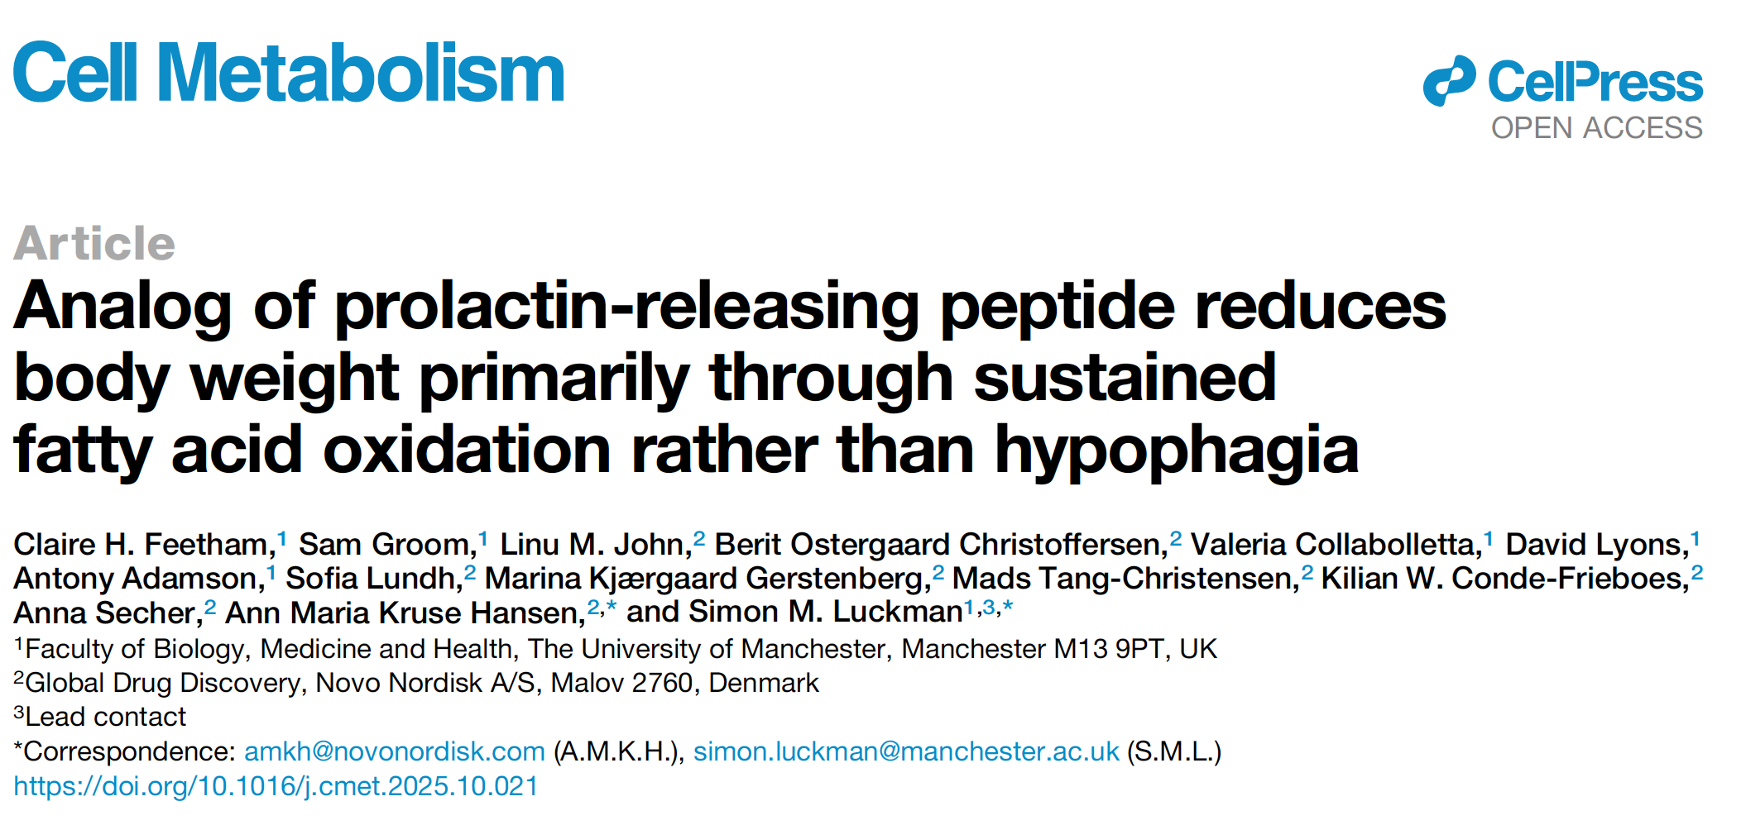

Slide 30
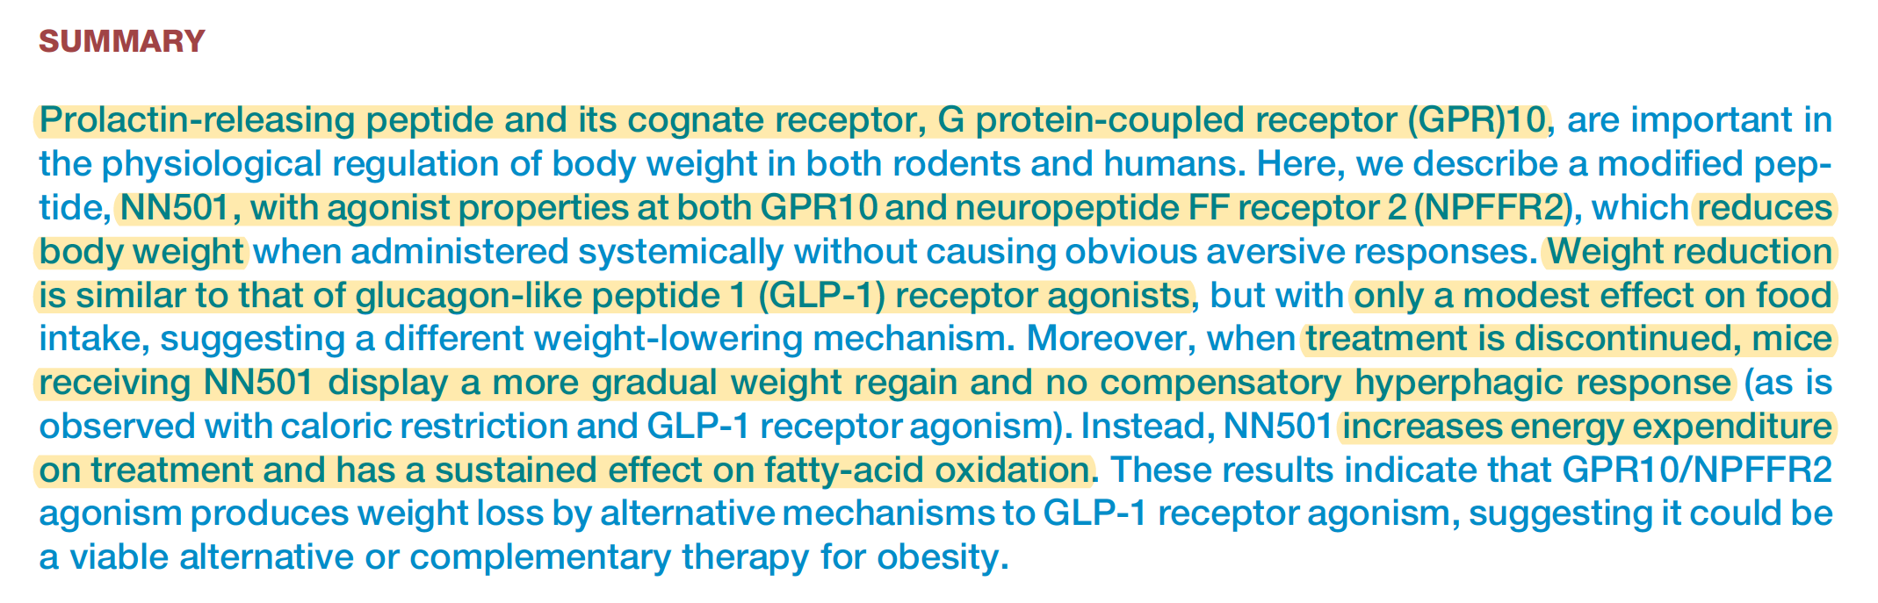
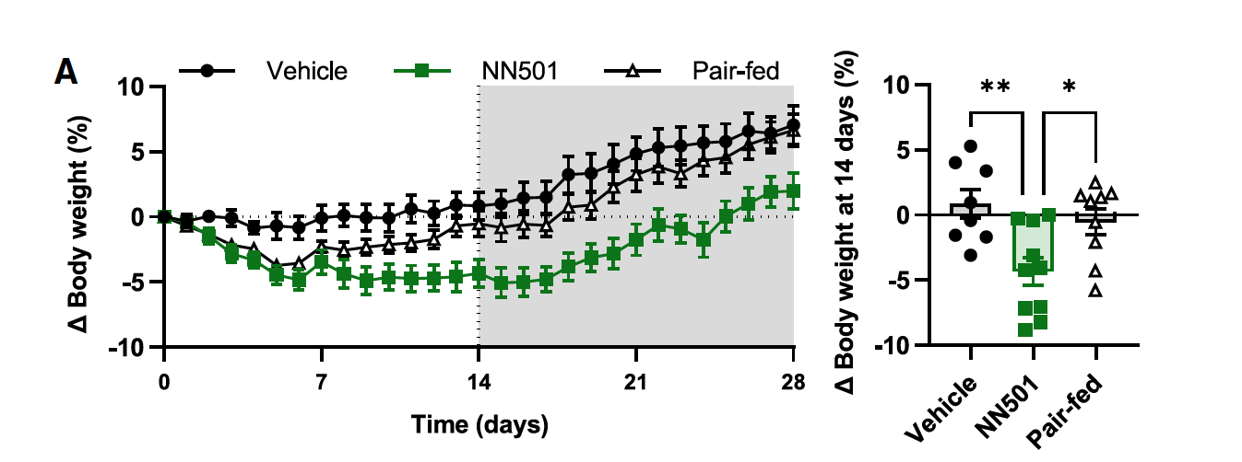

Slide 31
prolactin-releasing peptide increases prolactin
High prolactin levels (hyperprolactinemia) disrupt reproductive hormones, causing irregular or absent periods, infertility, and milky breast discharge (galactorrhea) in women, while men experience erectile dysfunction, low sex drive, and breast enlargement (gynecomastia)

Slide 32
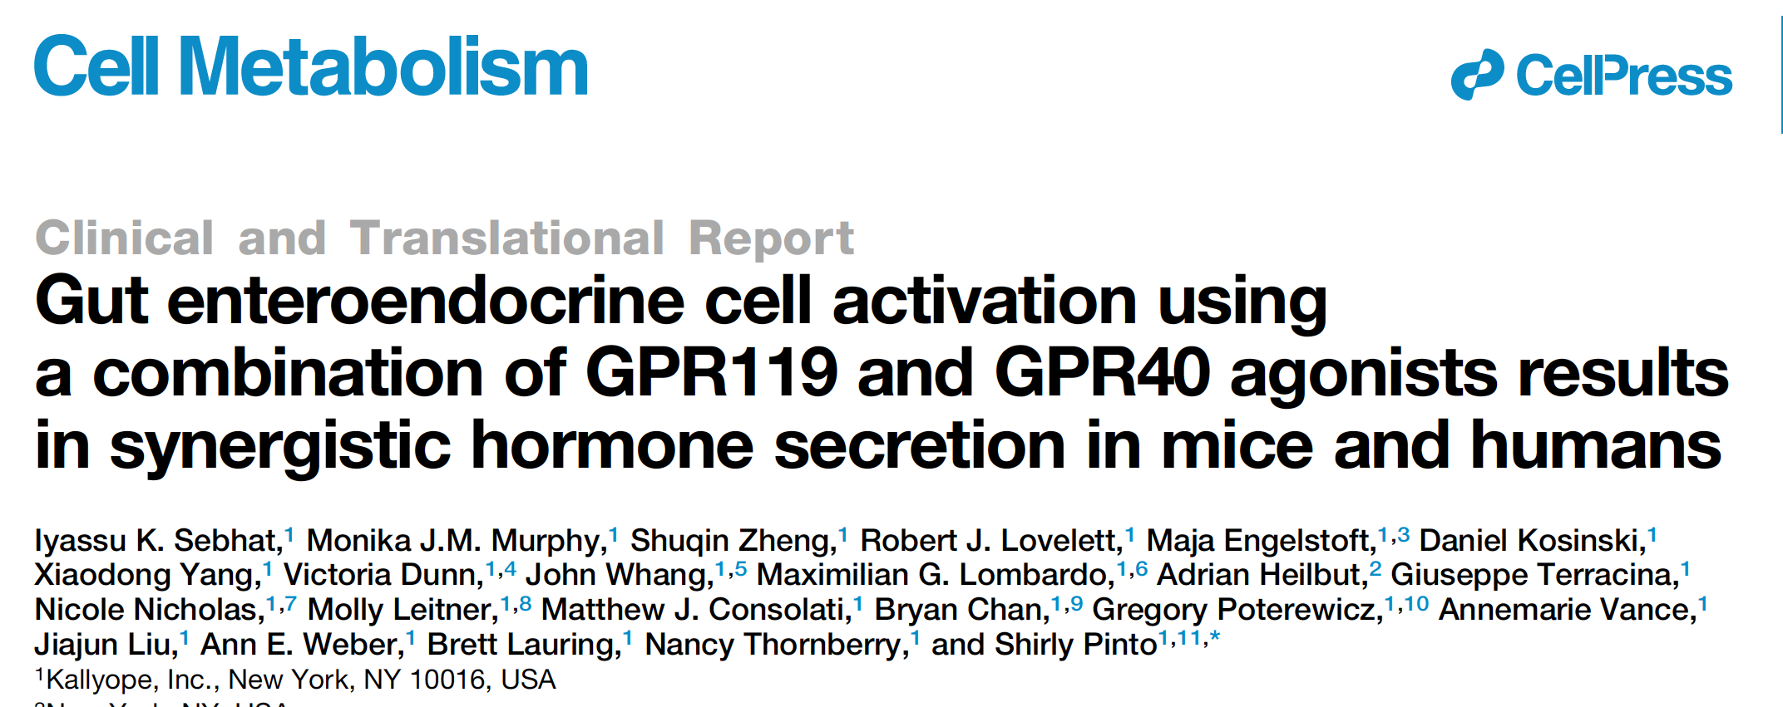

Slide 33
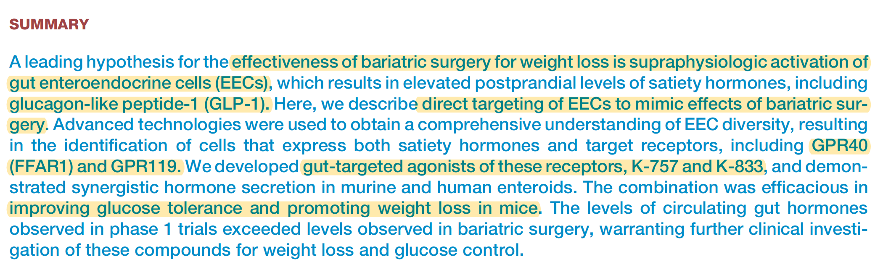

Slide 34
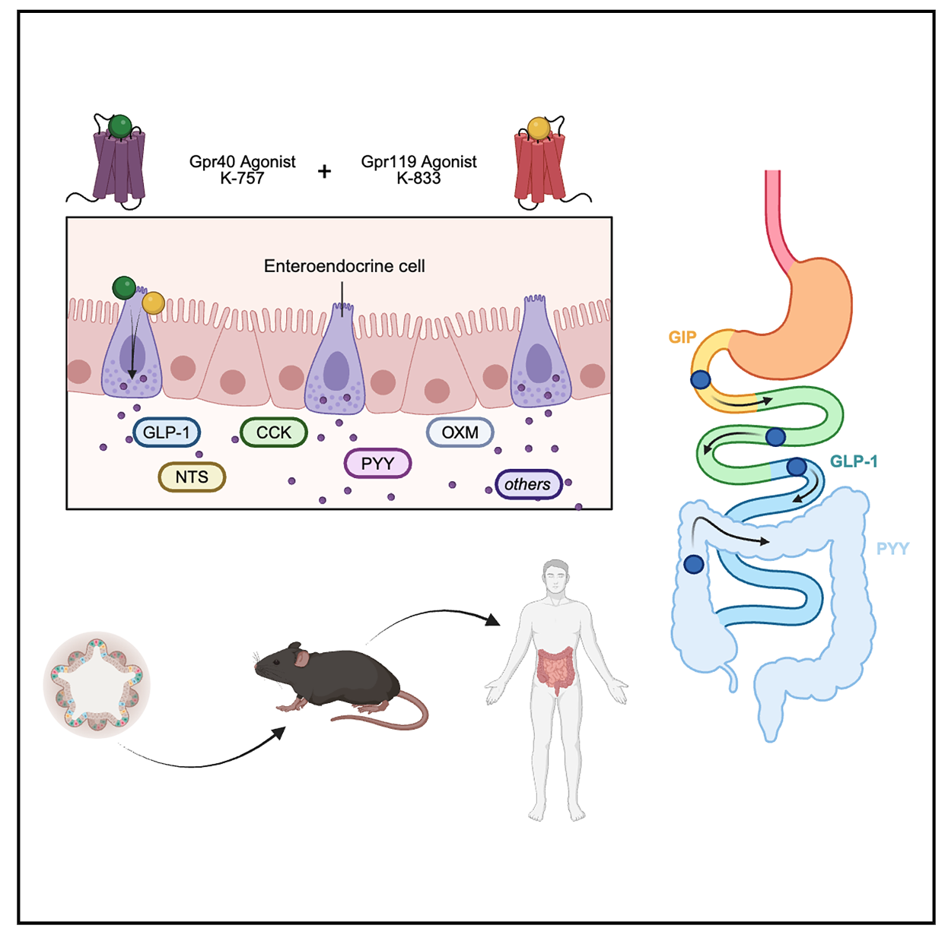
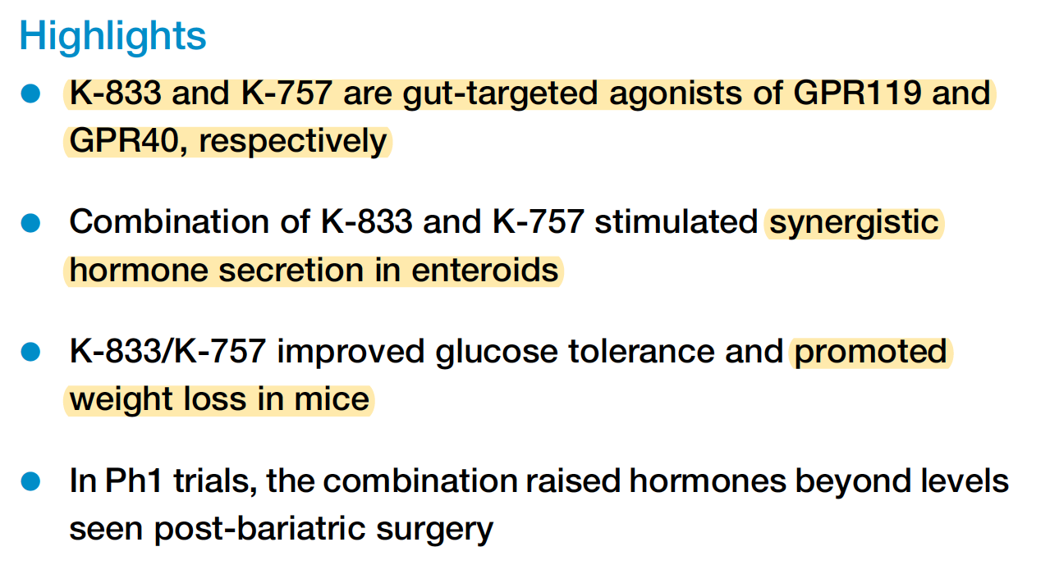

Slide 35
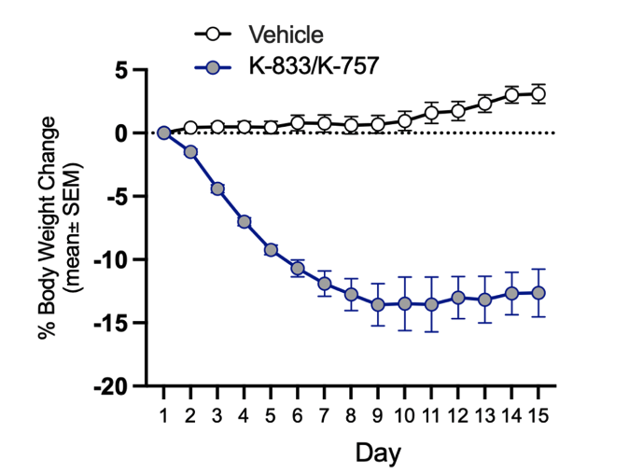
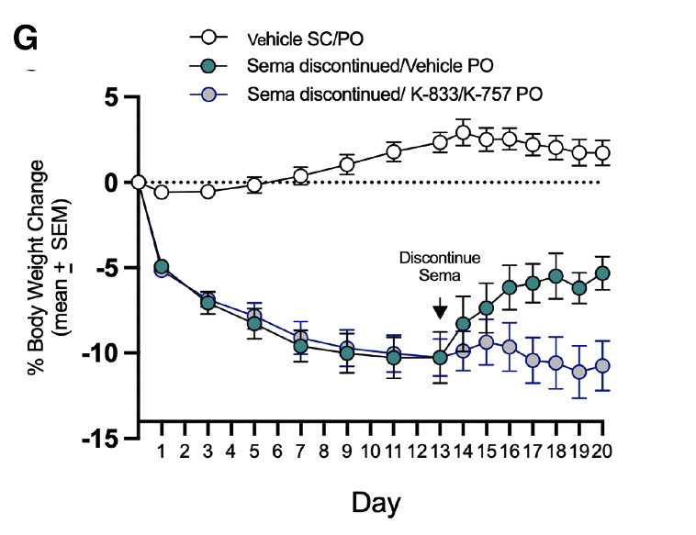

Slide 36
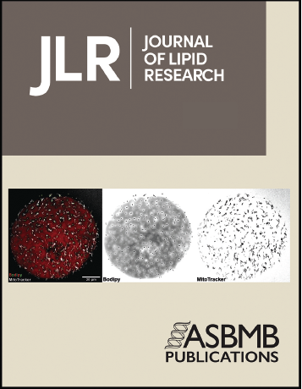
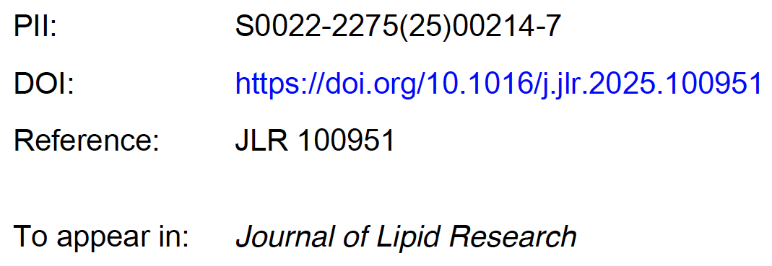
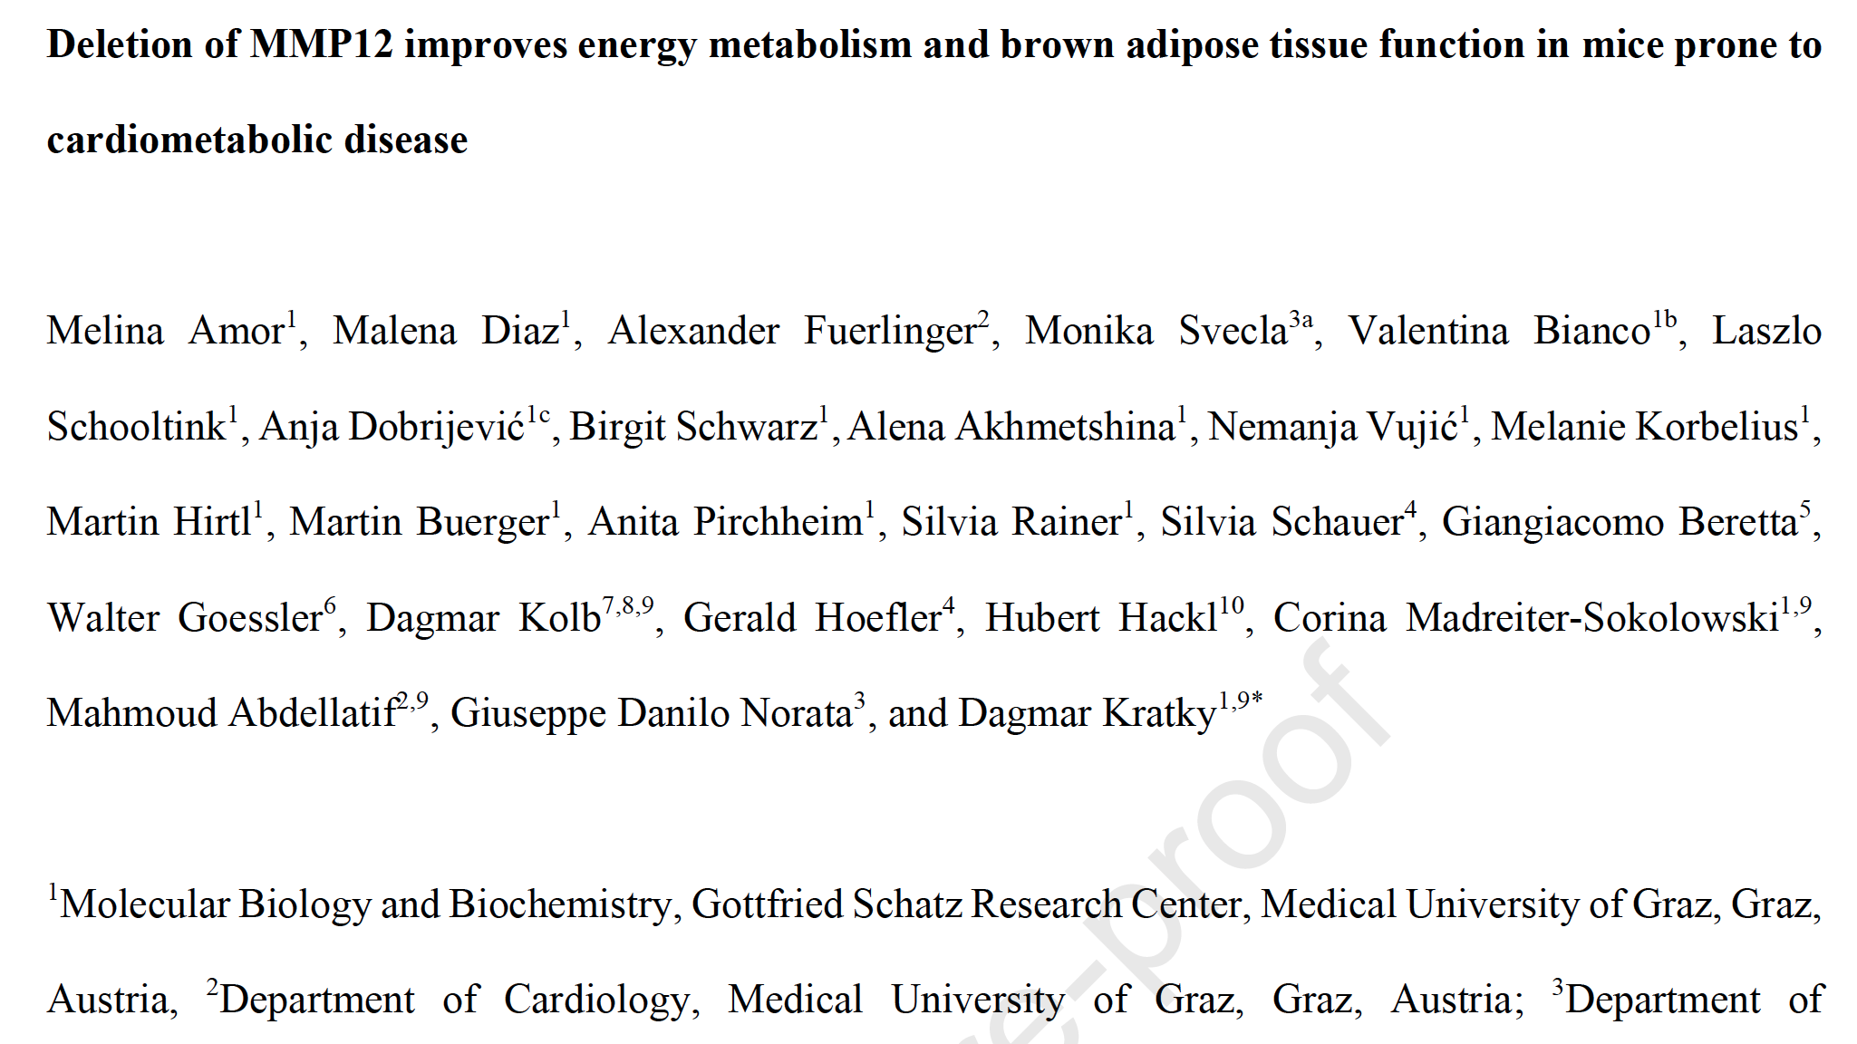

Slide 37
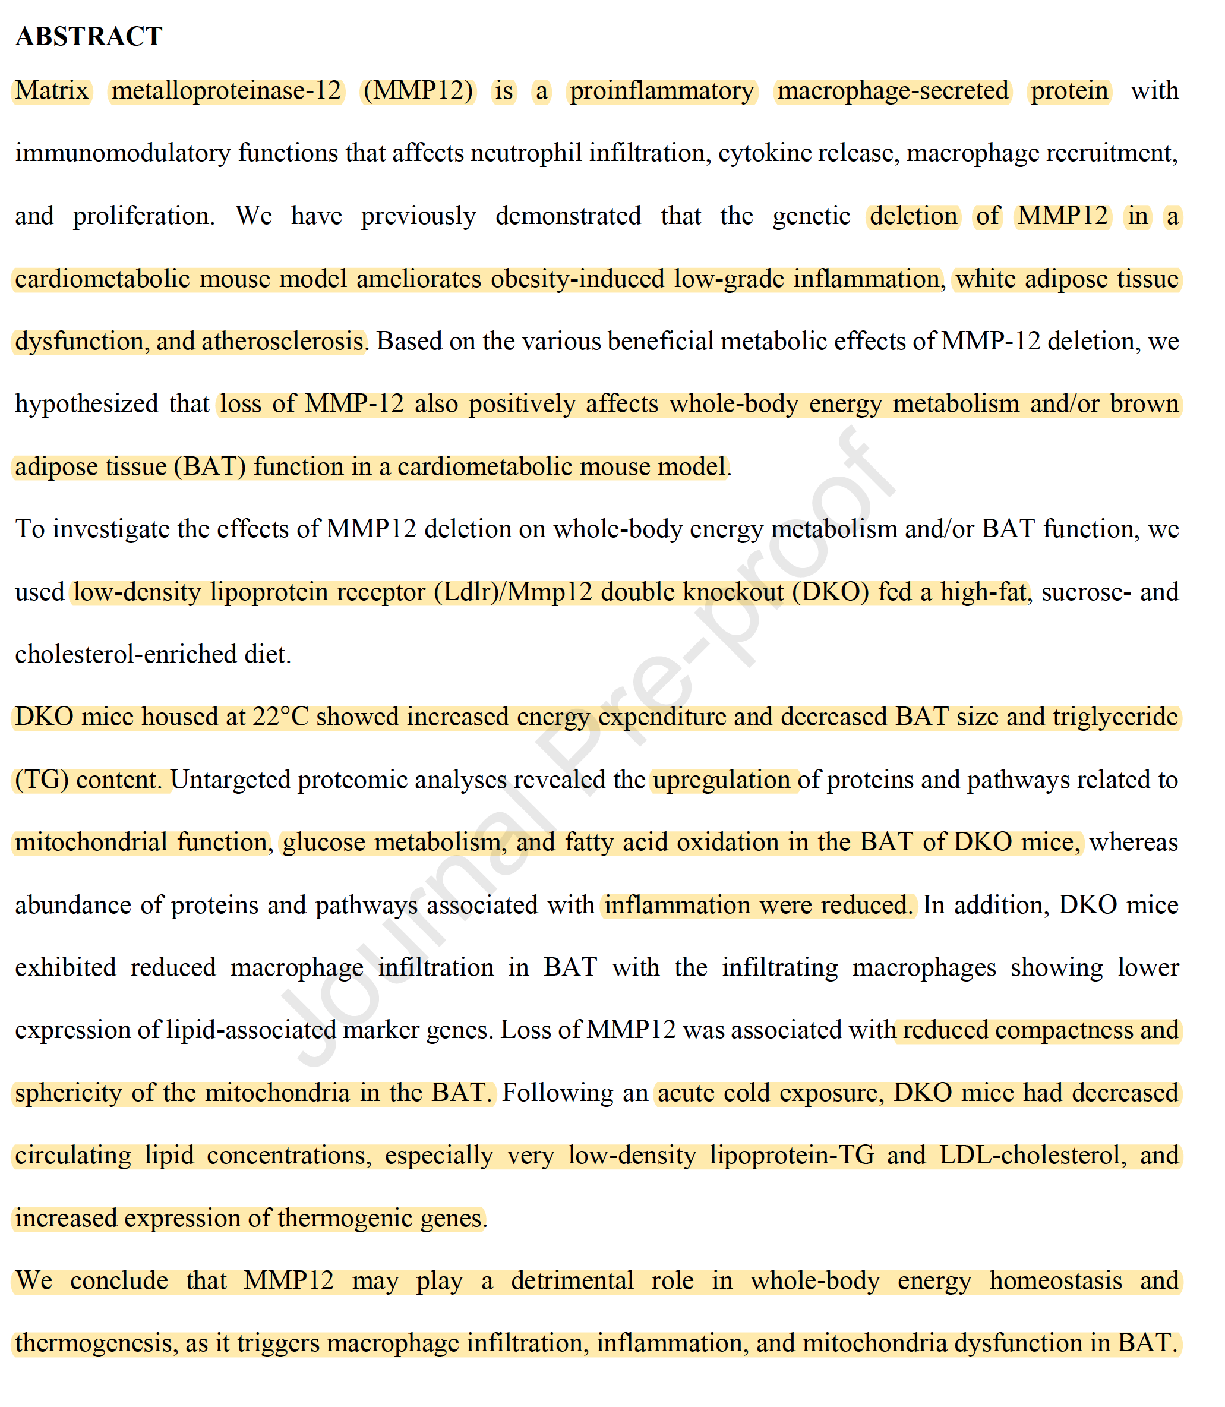

Slide 38
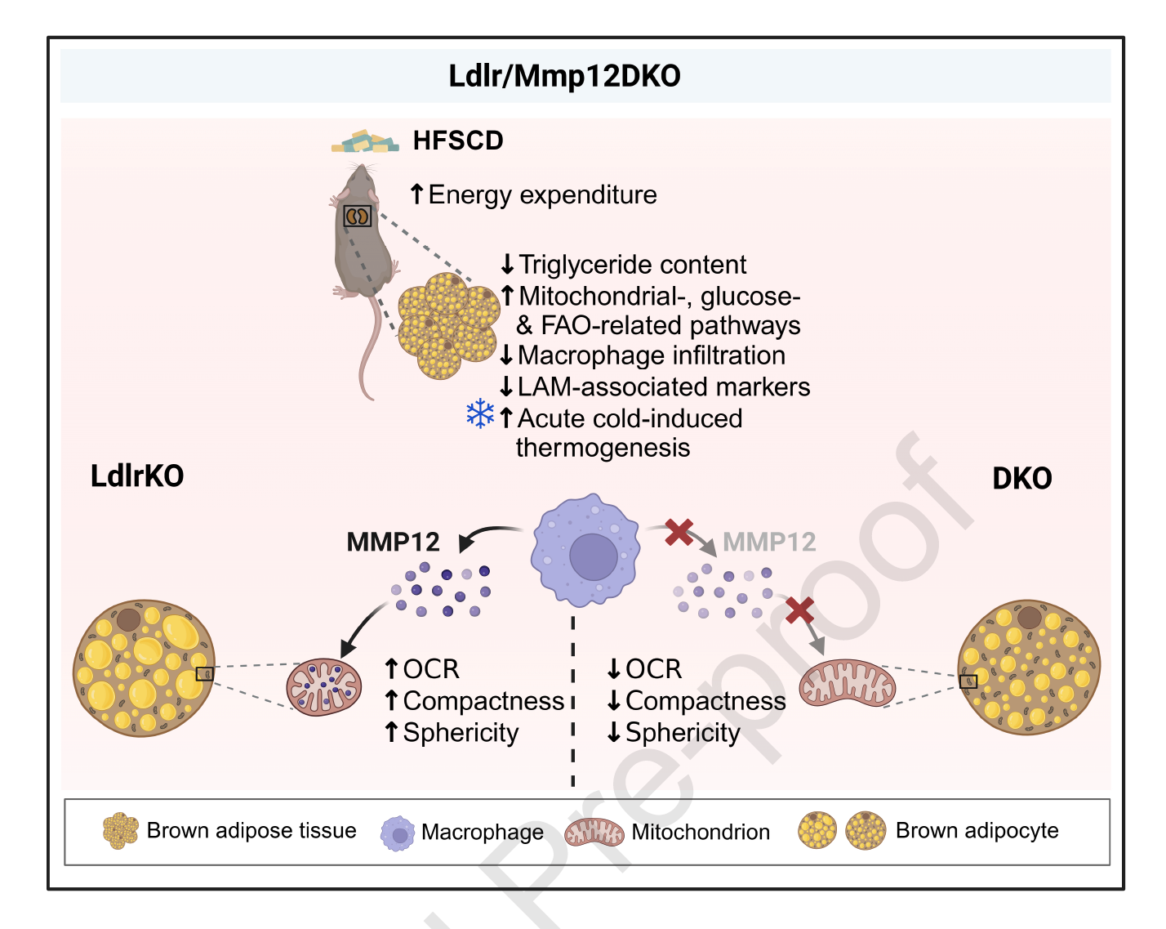

Slide 39


Slide 40
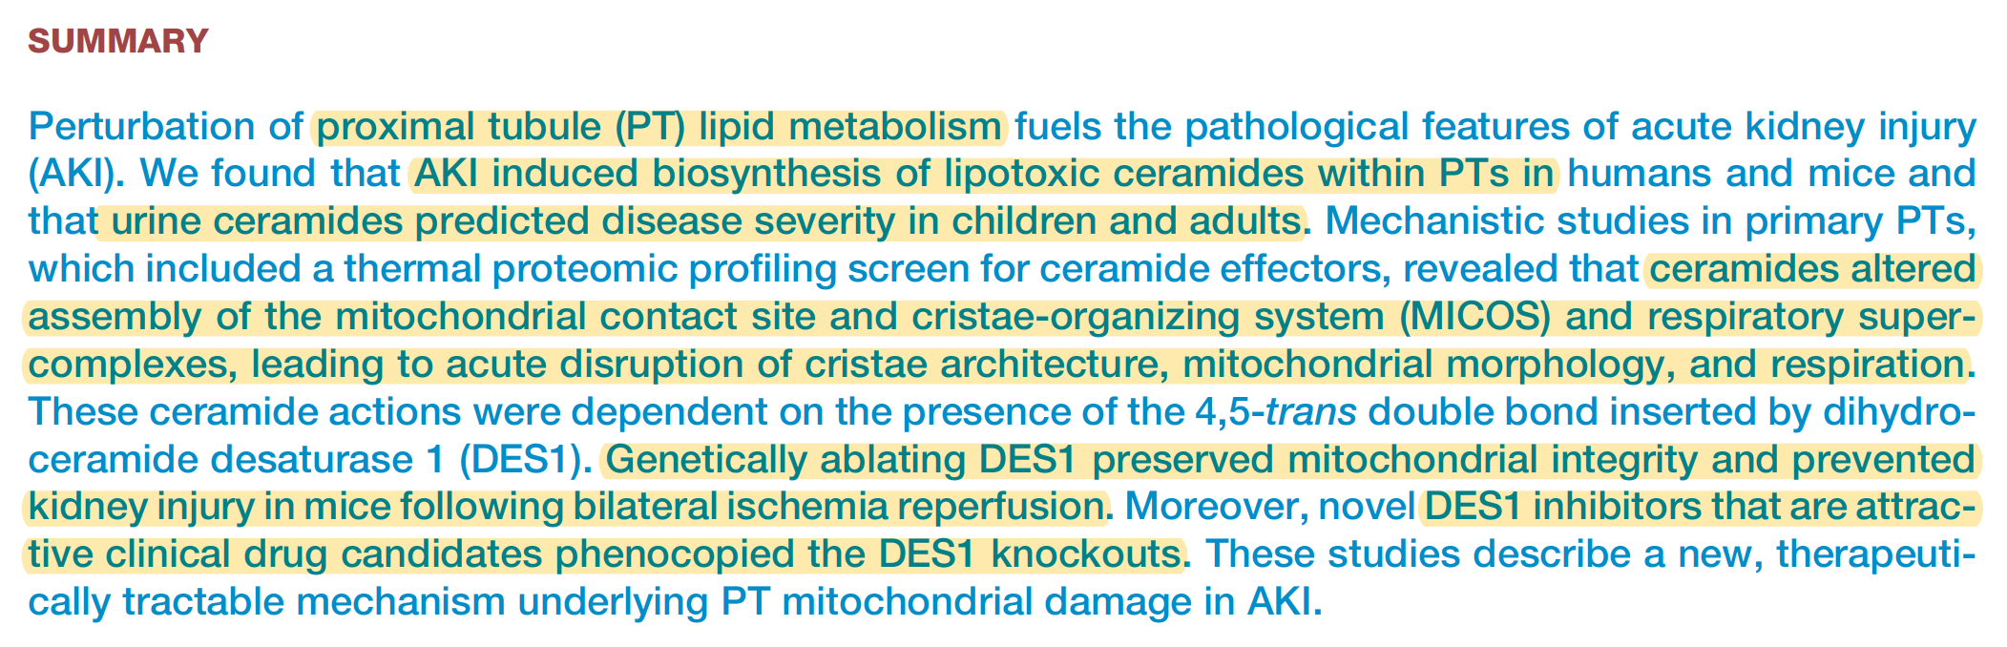

Slide 41



Slide 42


Slide 43


Slide 44



Slide 45


Slide 46





Slide 47


Slide 48


Slide 49



Slide 50


Slide 51


Slide 52



Slide 53


Slide 54


