Slide 1

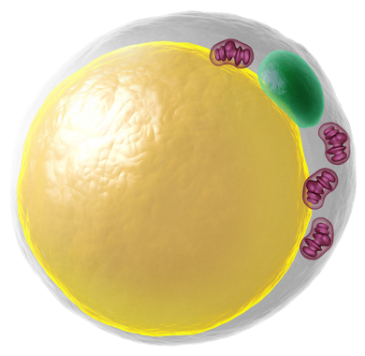
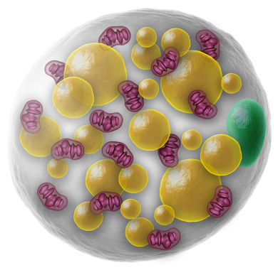
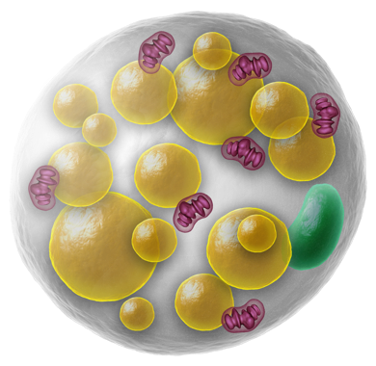
Literature Overview
Touchstone Diabetes Center
UTSW Medical Center 2/16/2026

Slide 2

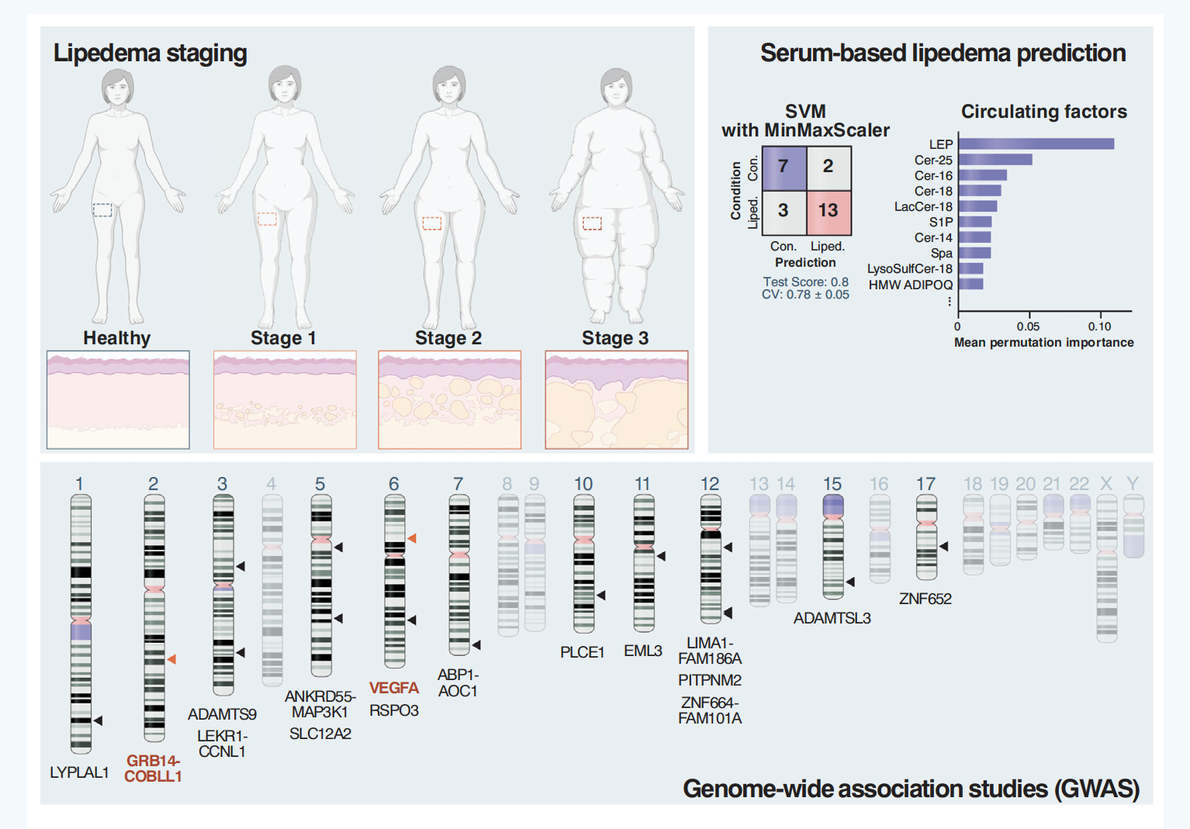

Slide 3
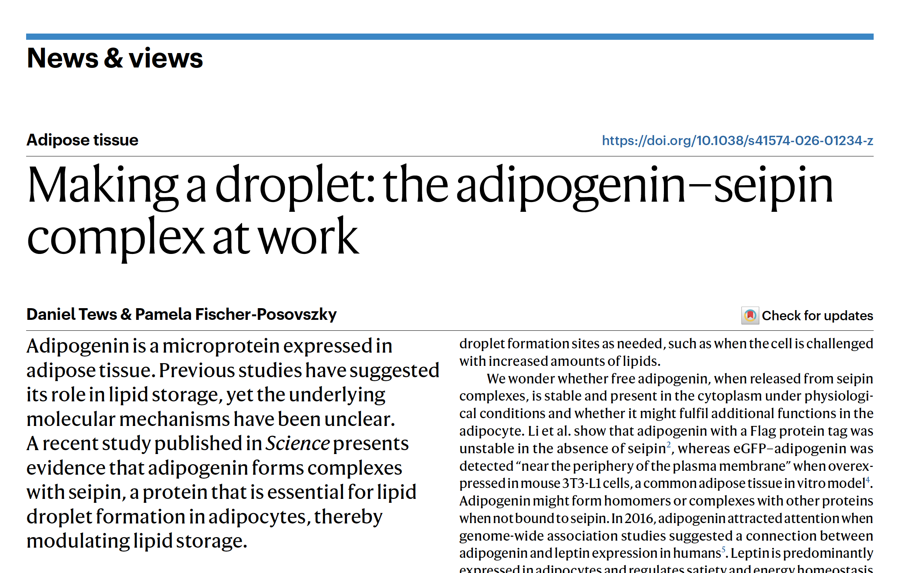


Slide 4
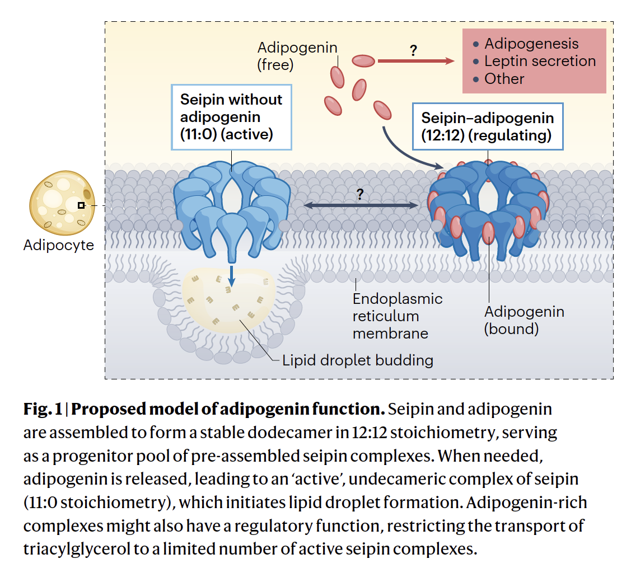

Slide 5
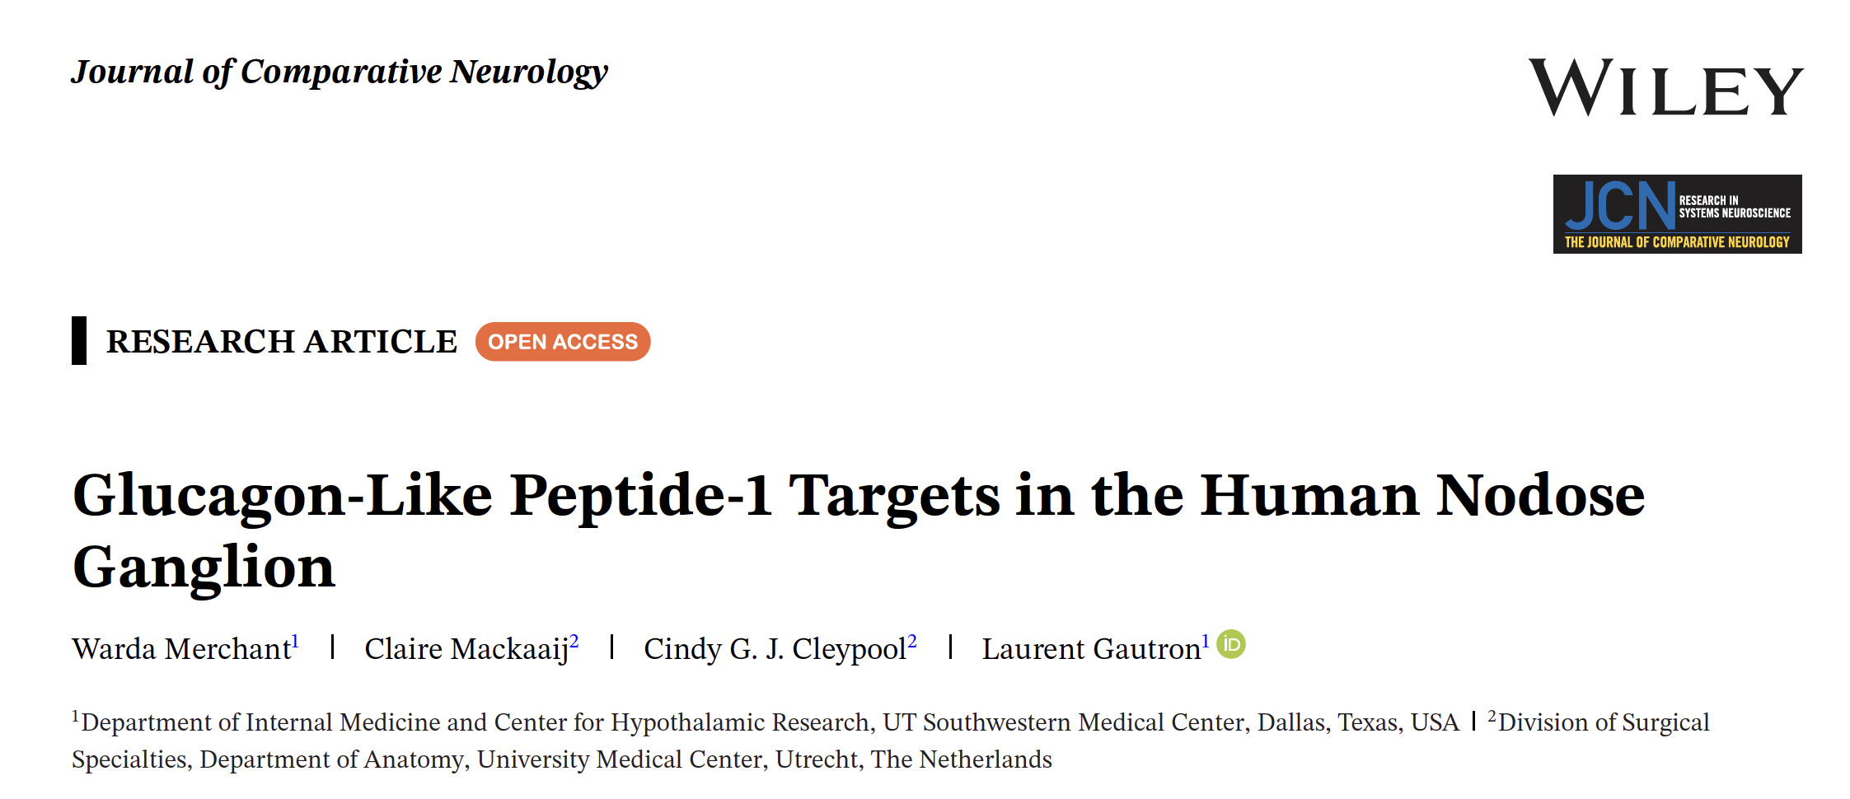

Slide 6
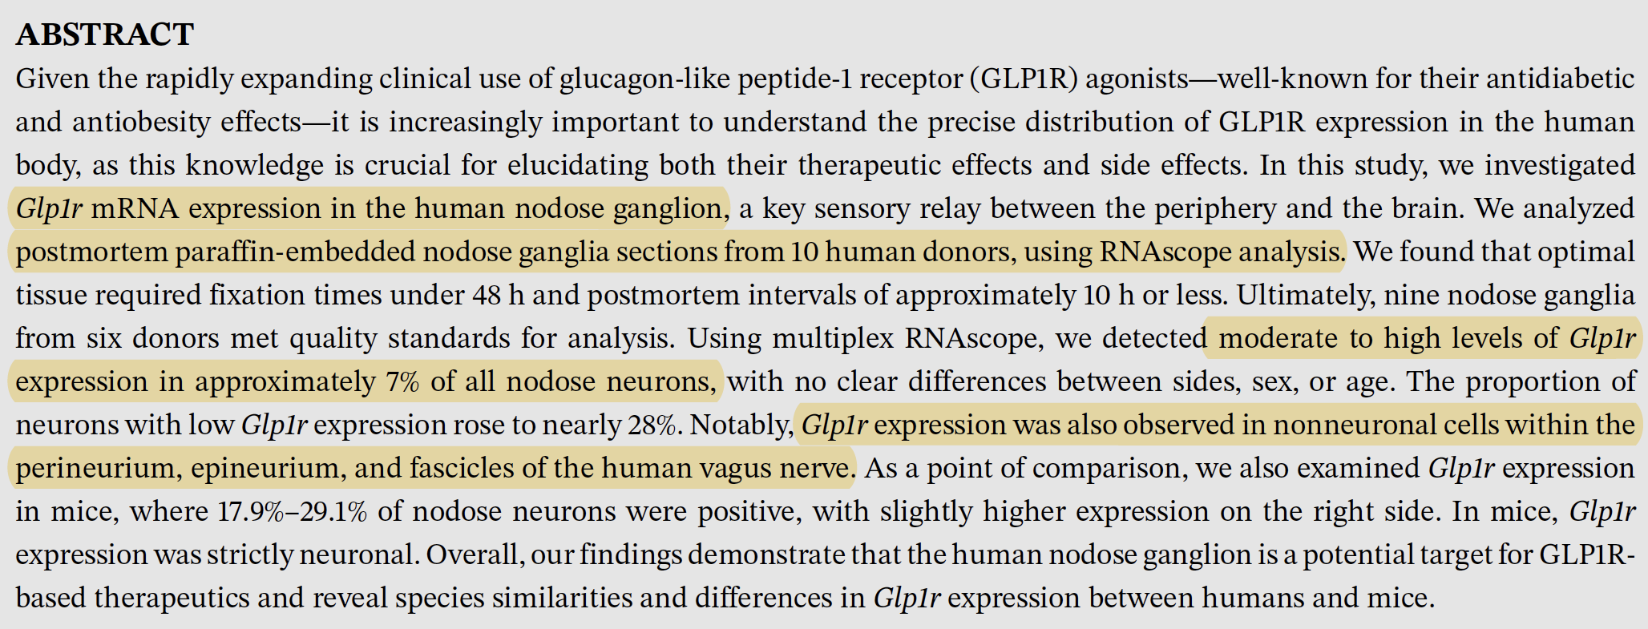

Slide 7
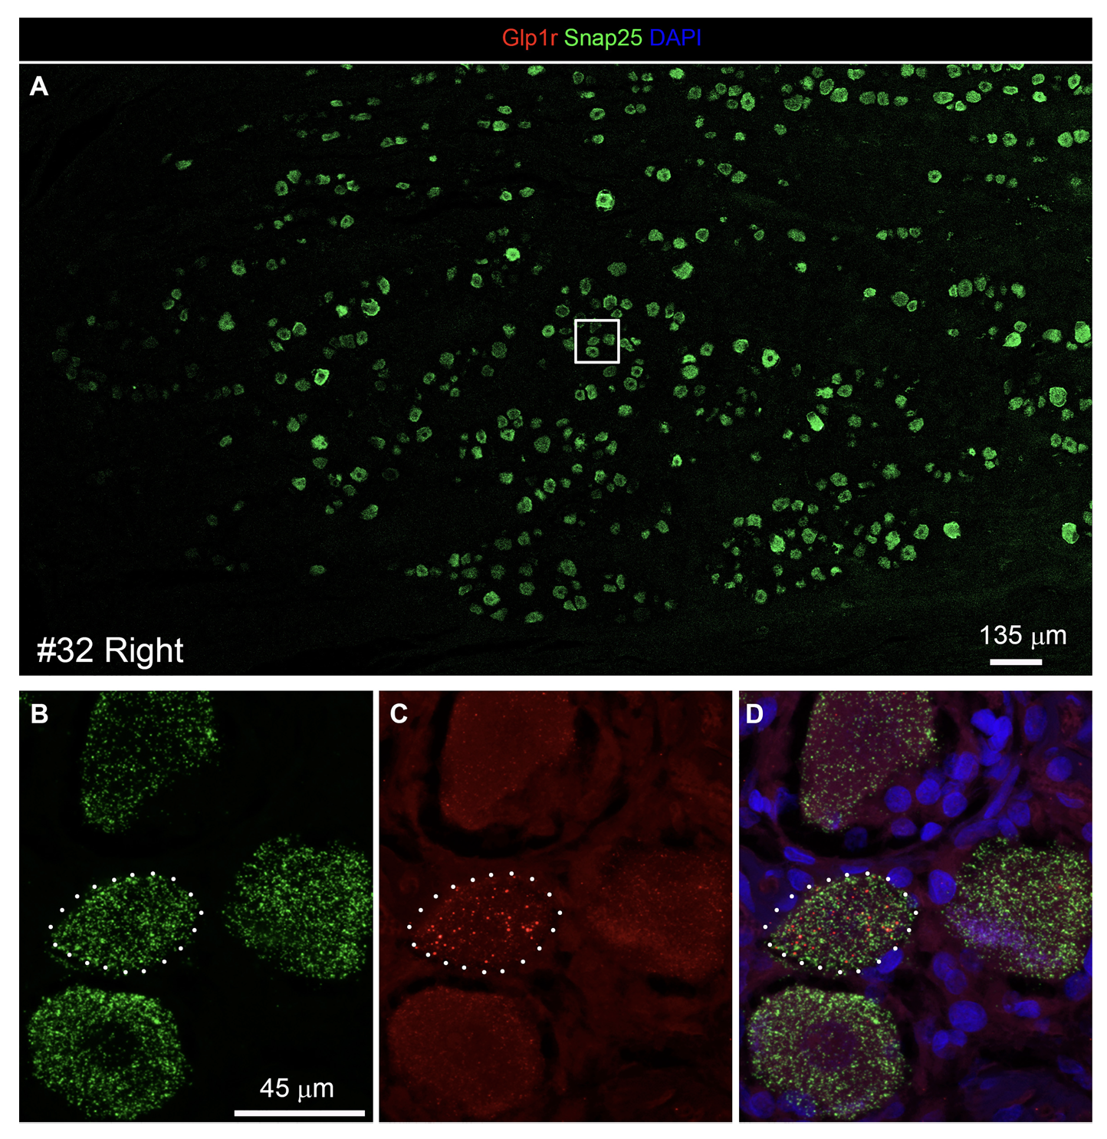

Slide 8

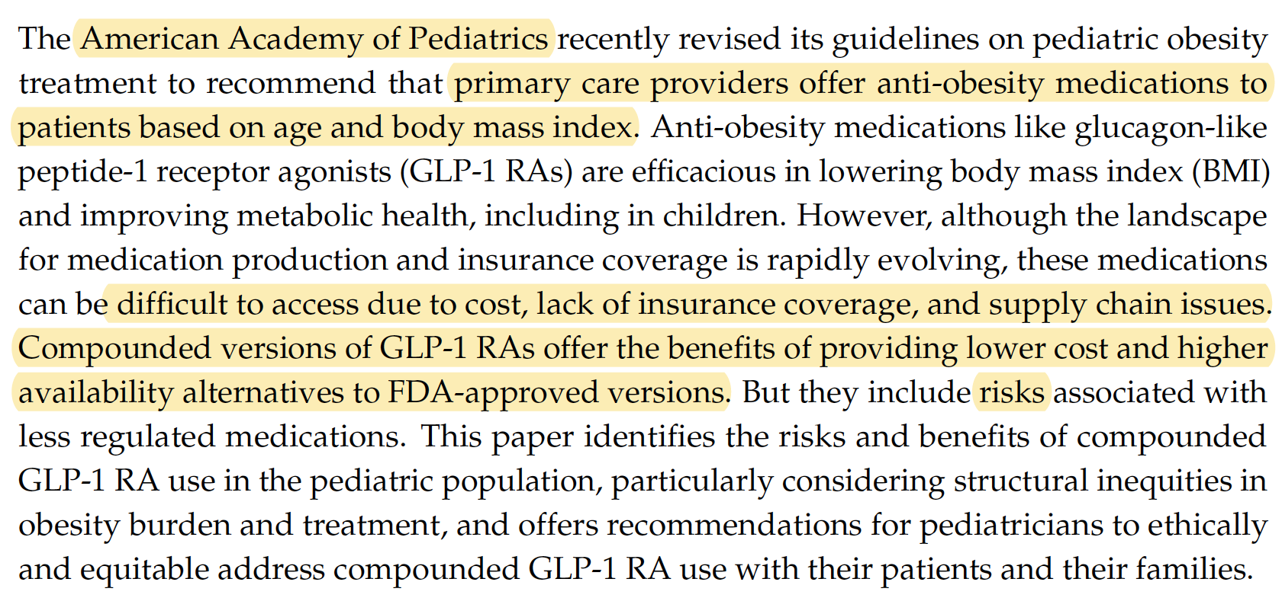

Slide 9
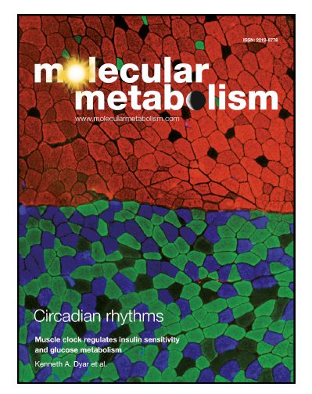
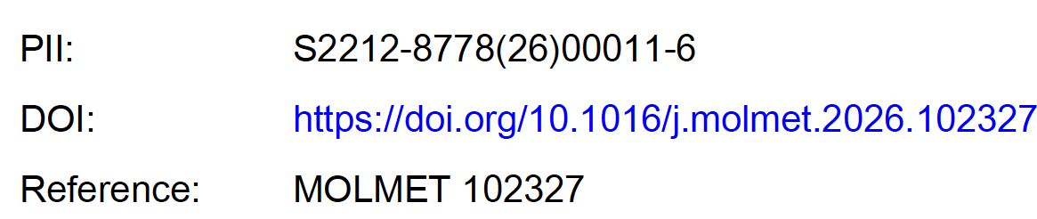
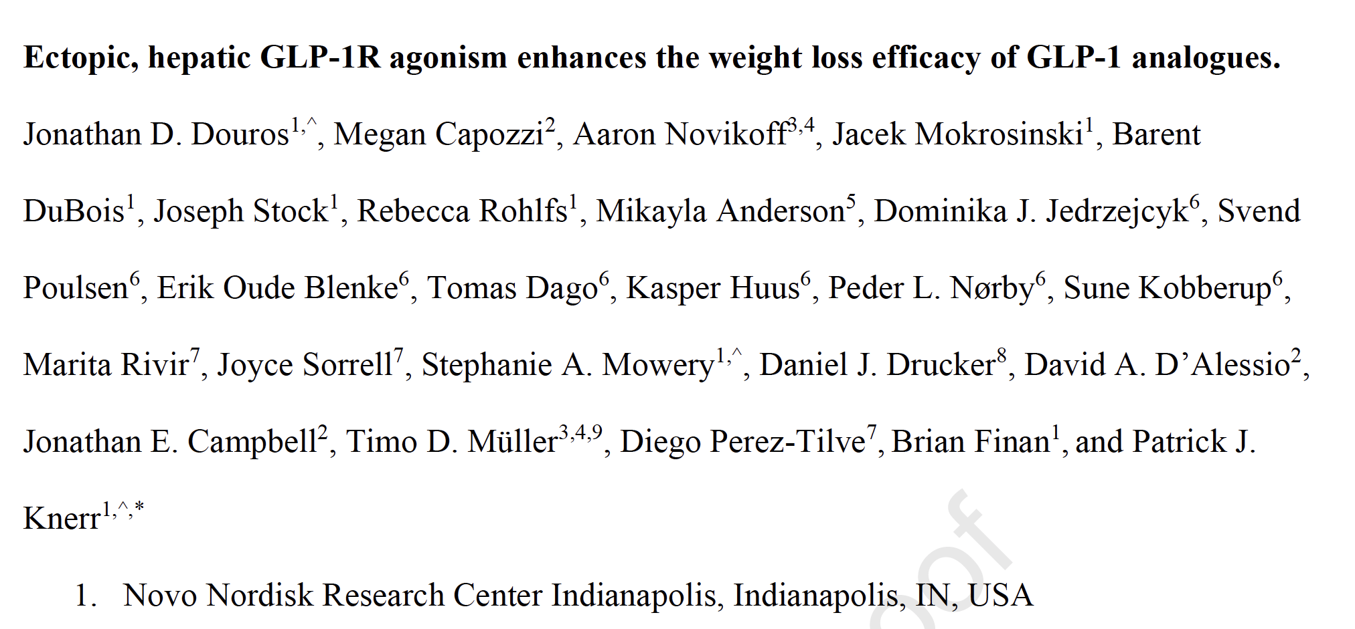

Slide 10
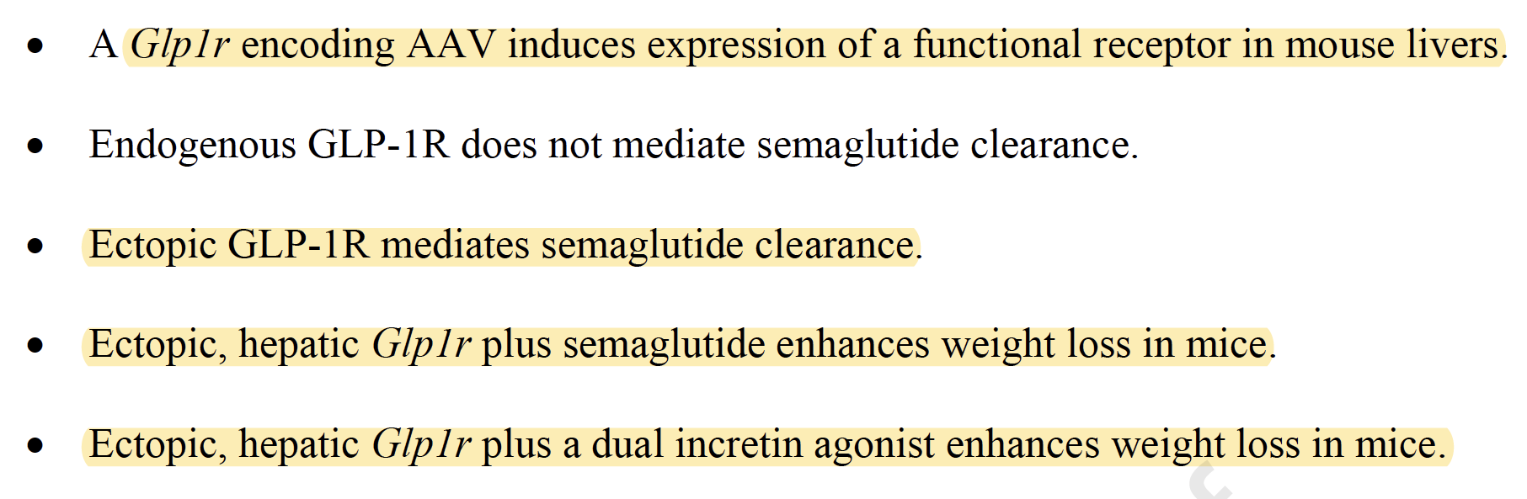
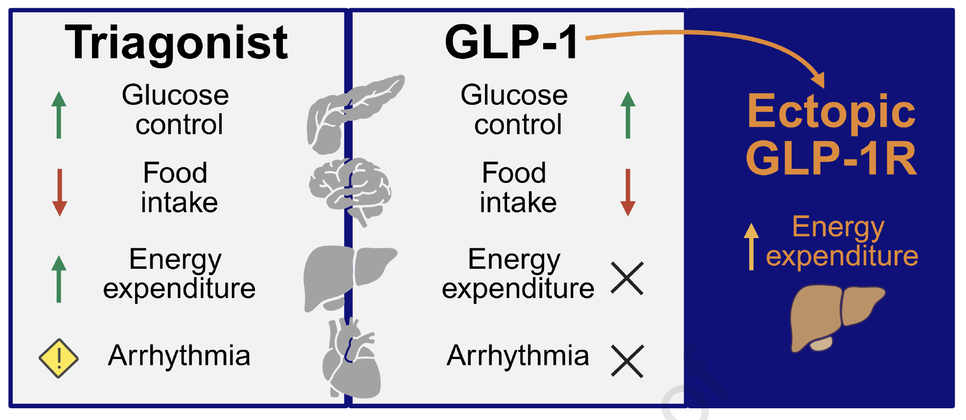

Slide 11
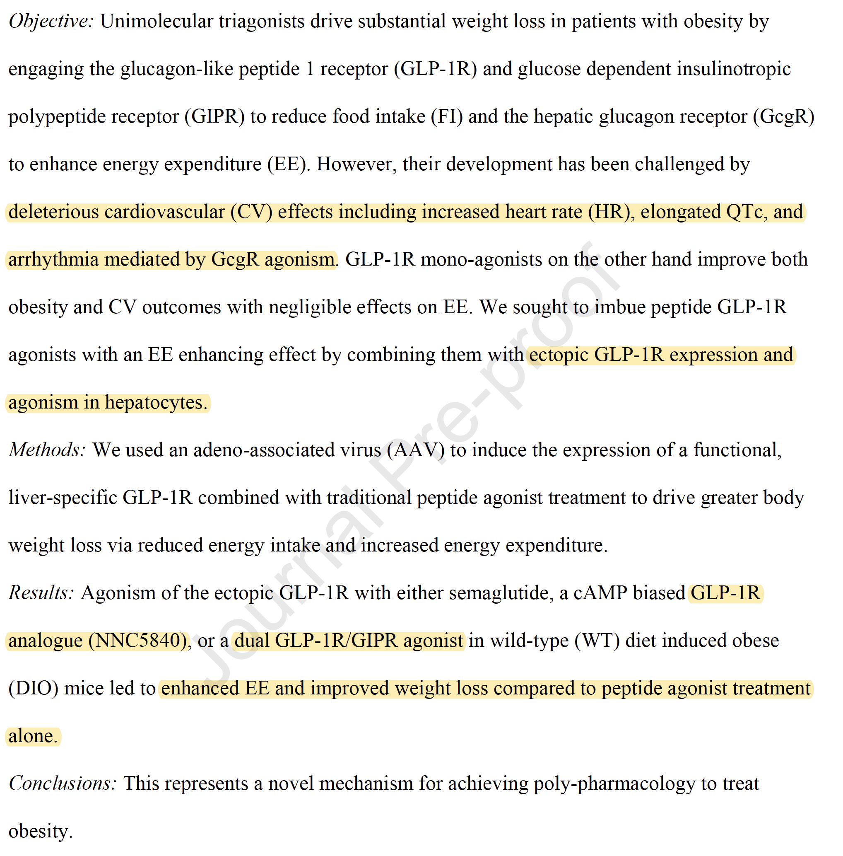

Slide 12
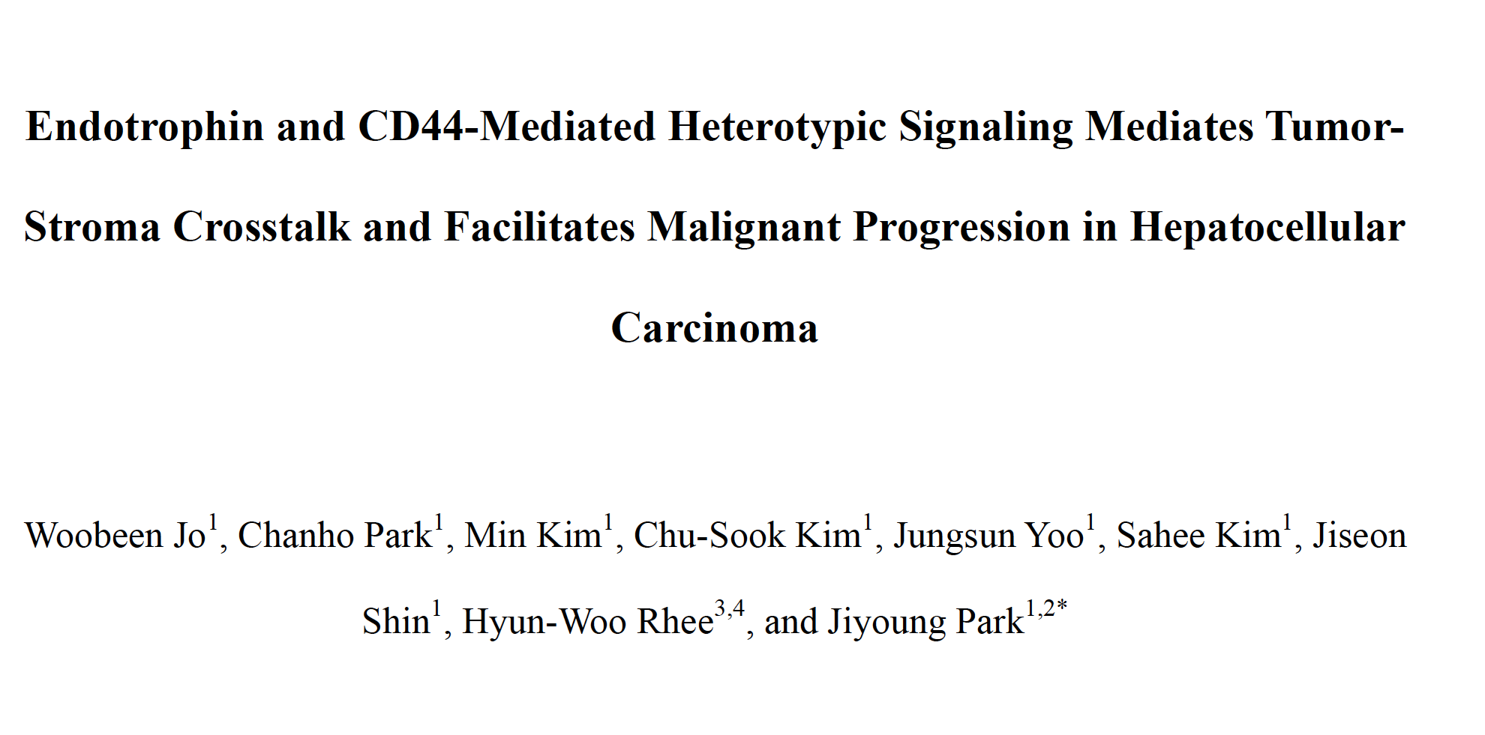
Cancer Research, in press
https://aacrjournals.org/cancerres/article-abstract/doi/10.1158/0008-5472.CAN-25-3657/774501/Endotrophin-and-CD44-Mediated-Heterotypic?redirectedFrom=PDF

Slide 13
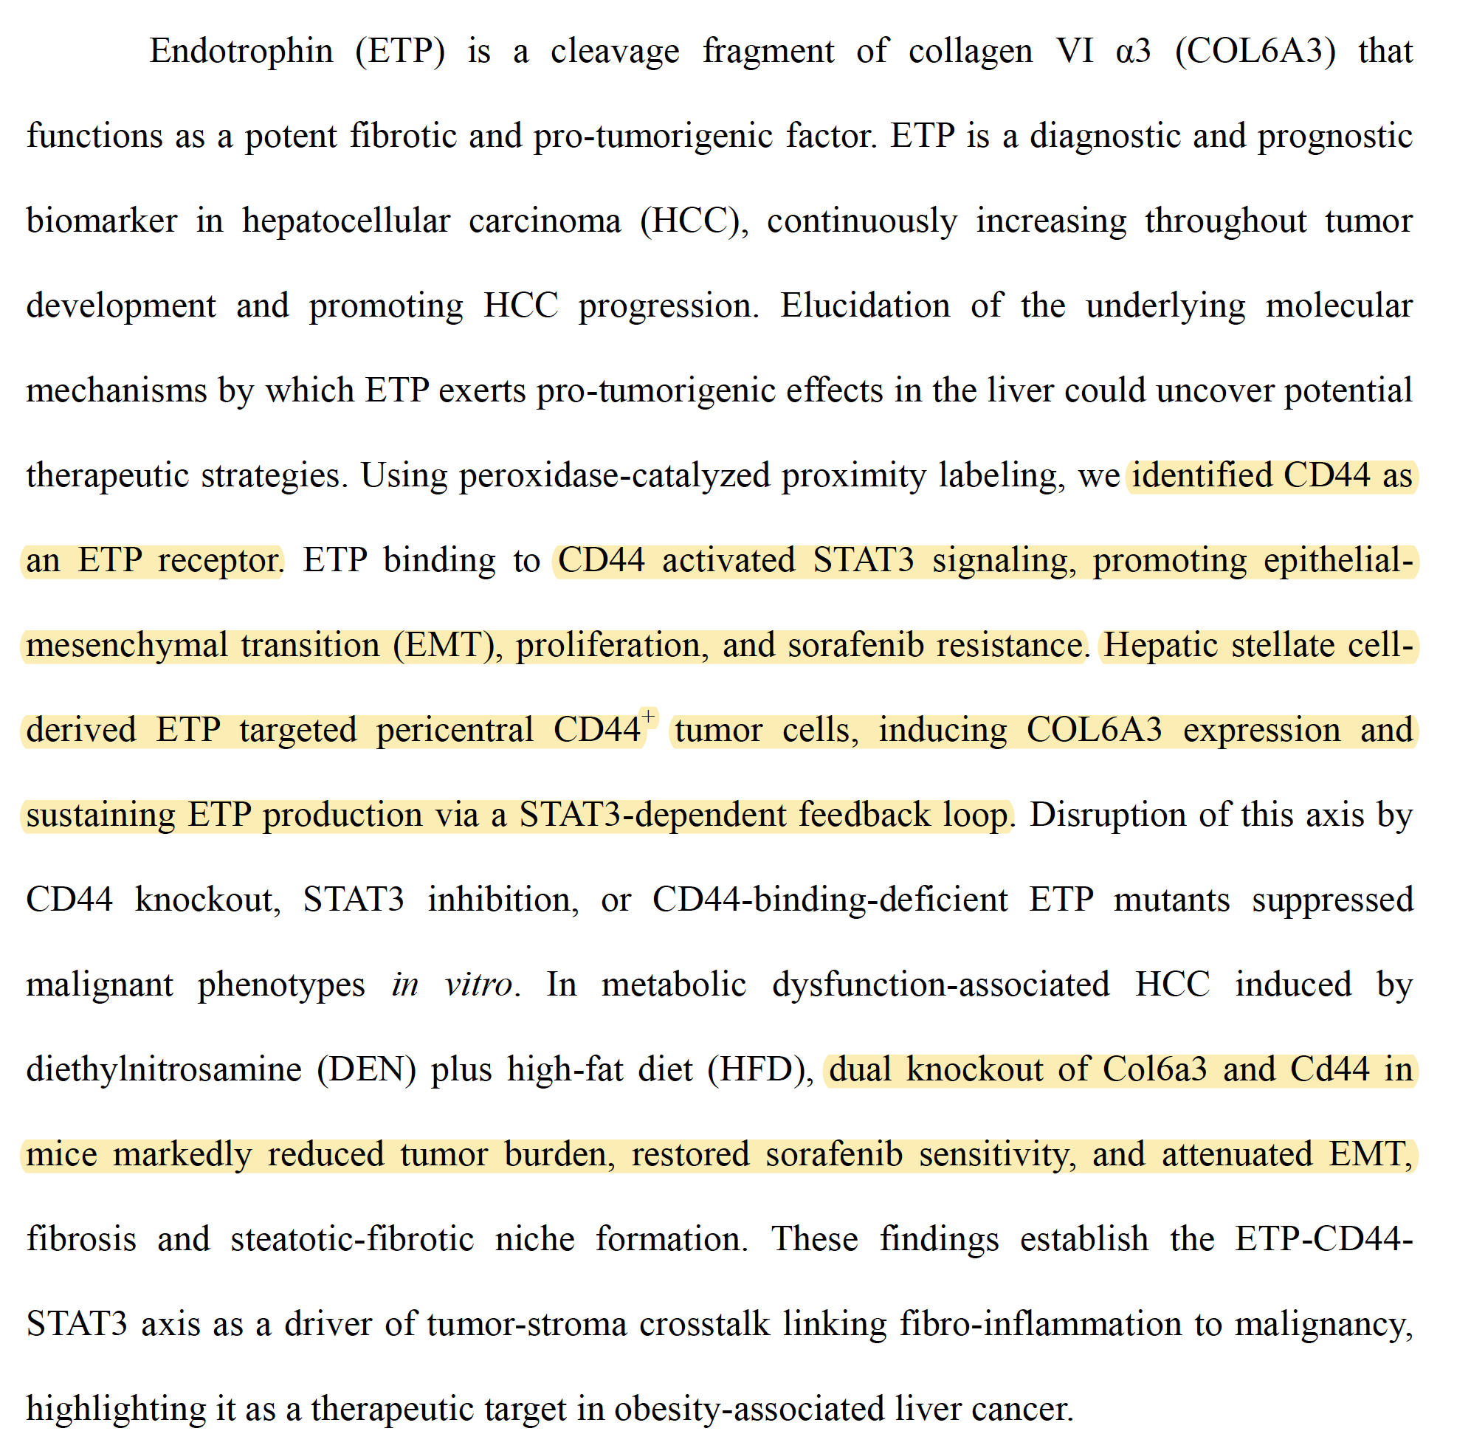

Slide 14
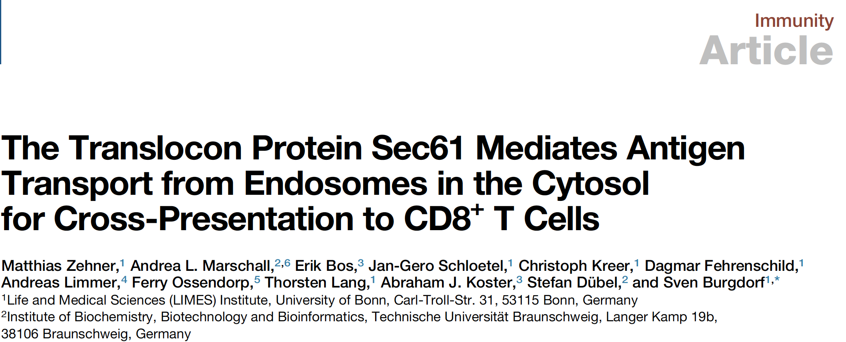

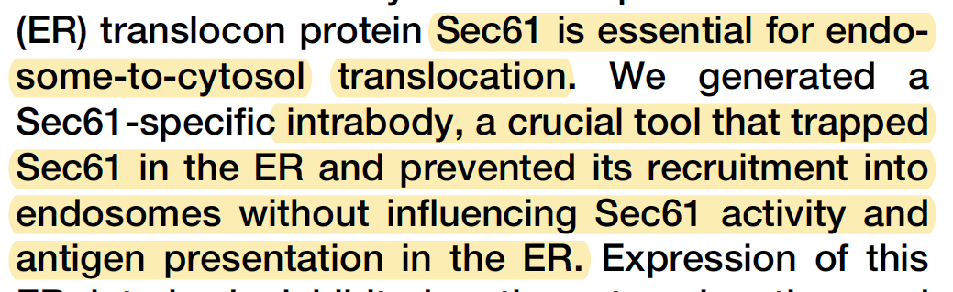

Slide 15
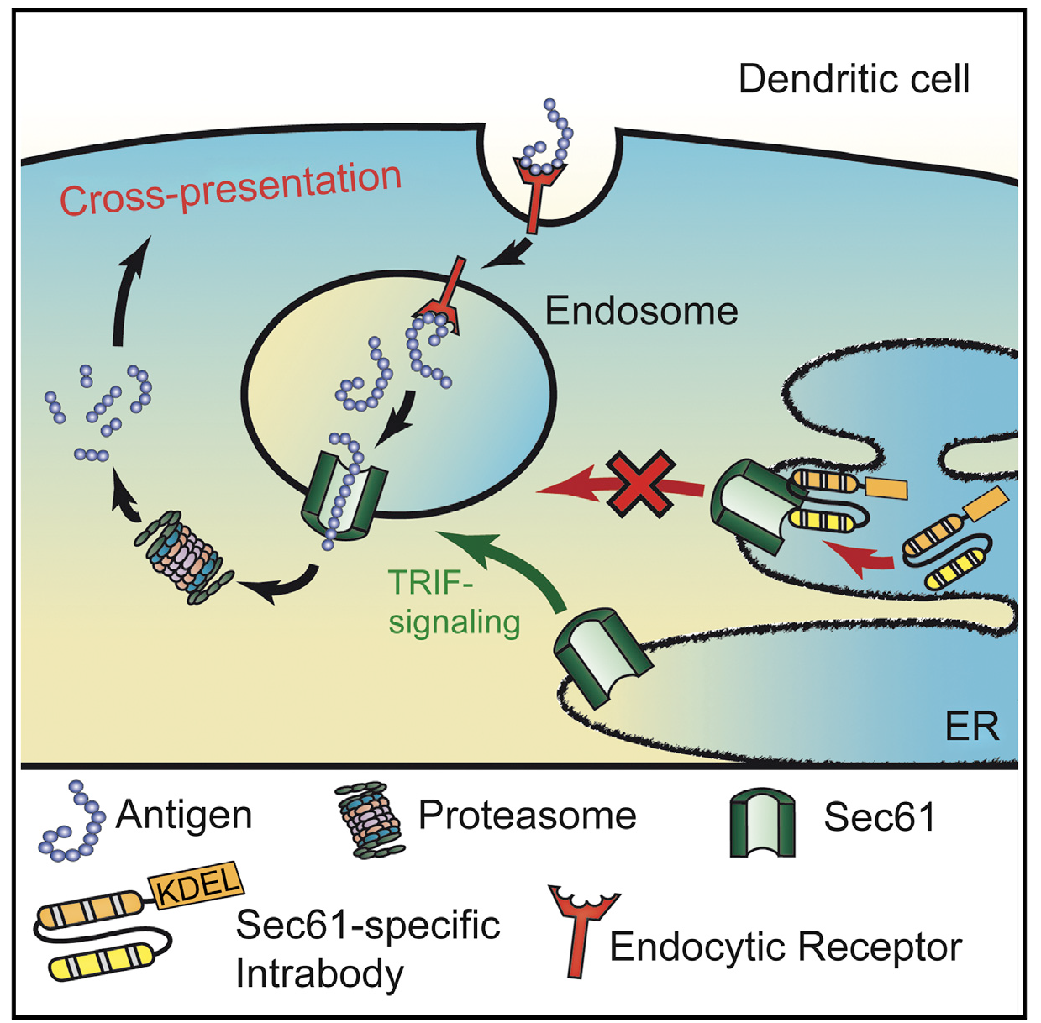
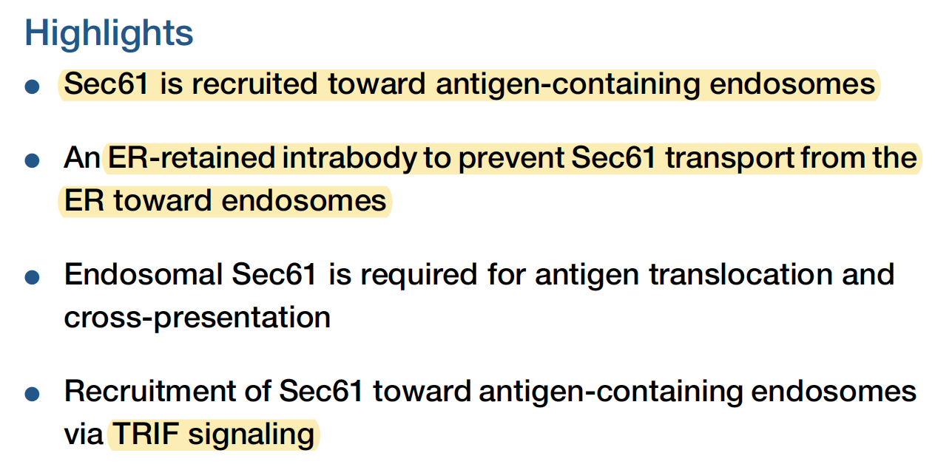

Slide 16
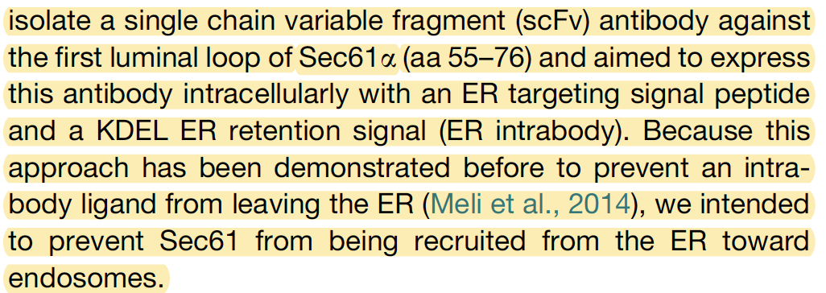

Slide 17

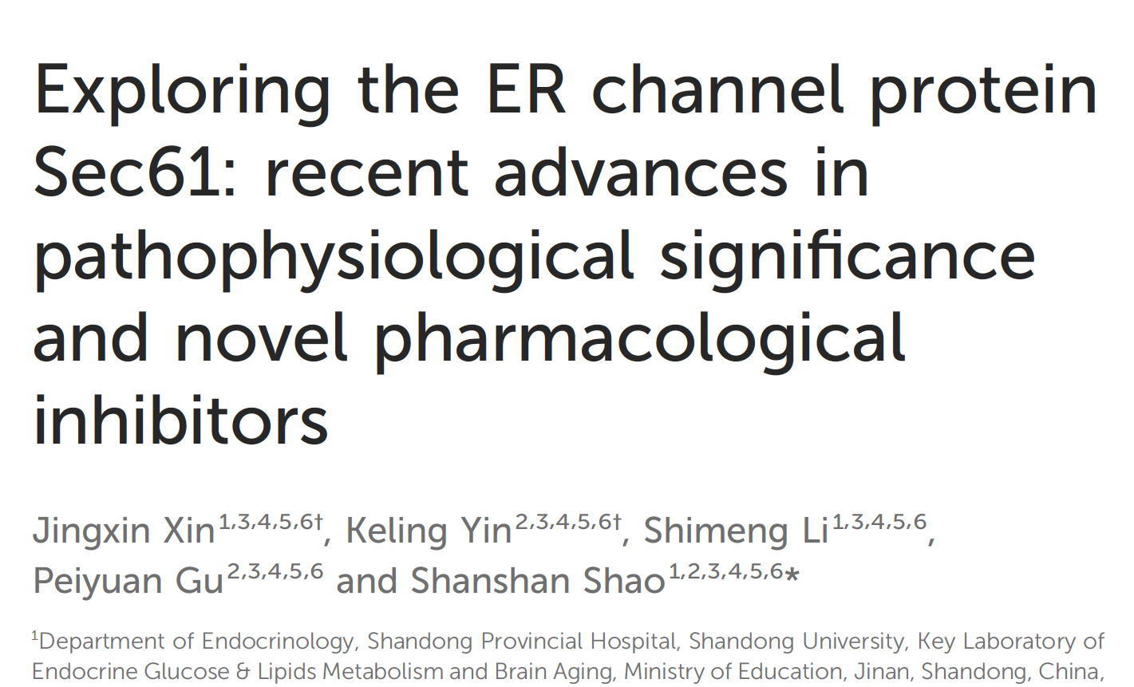

Slide 18
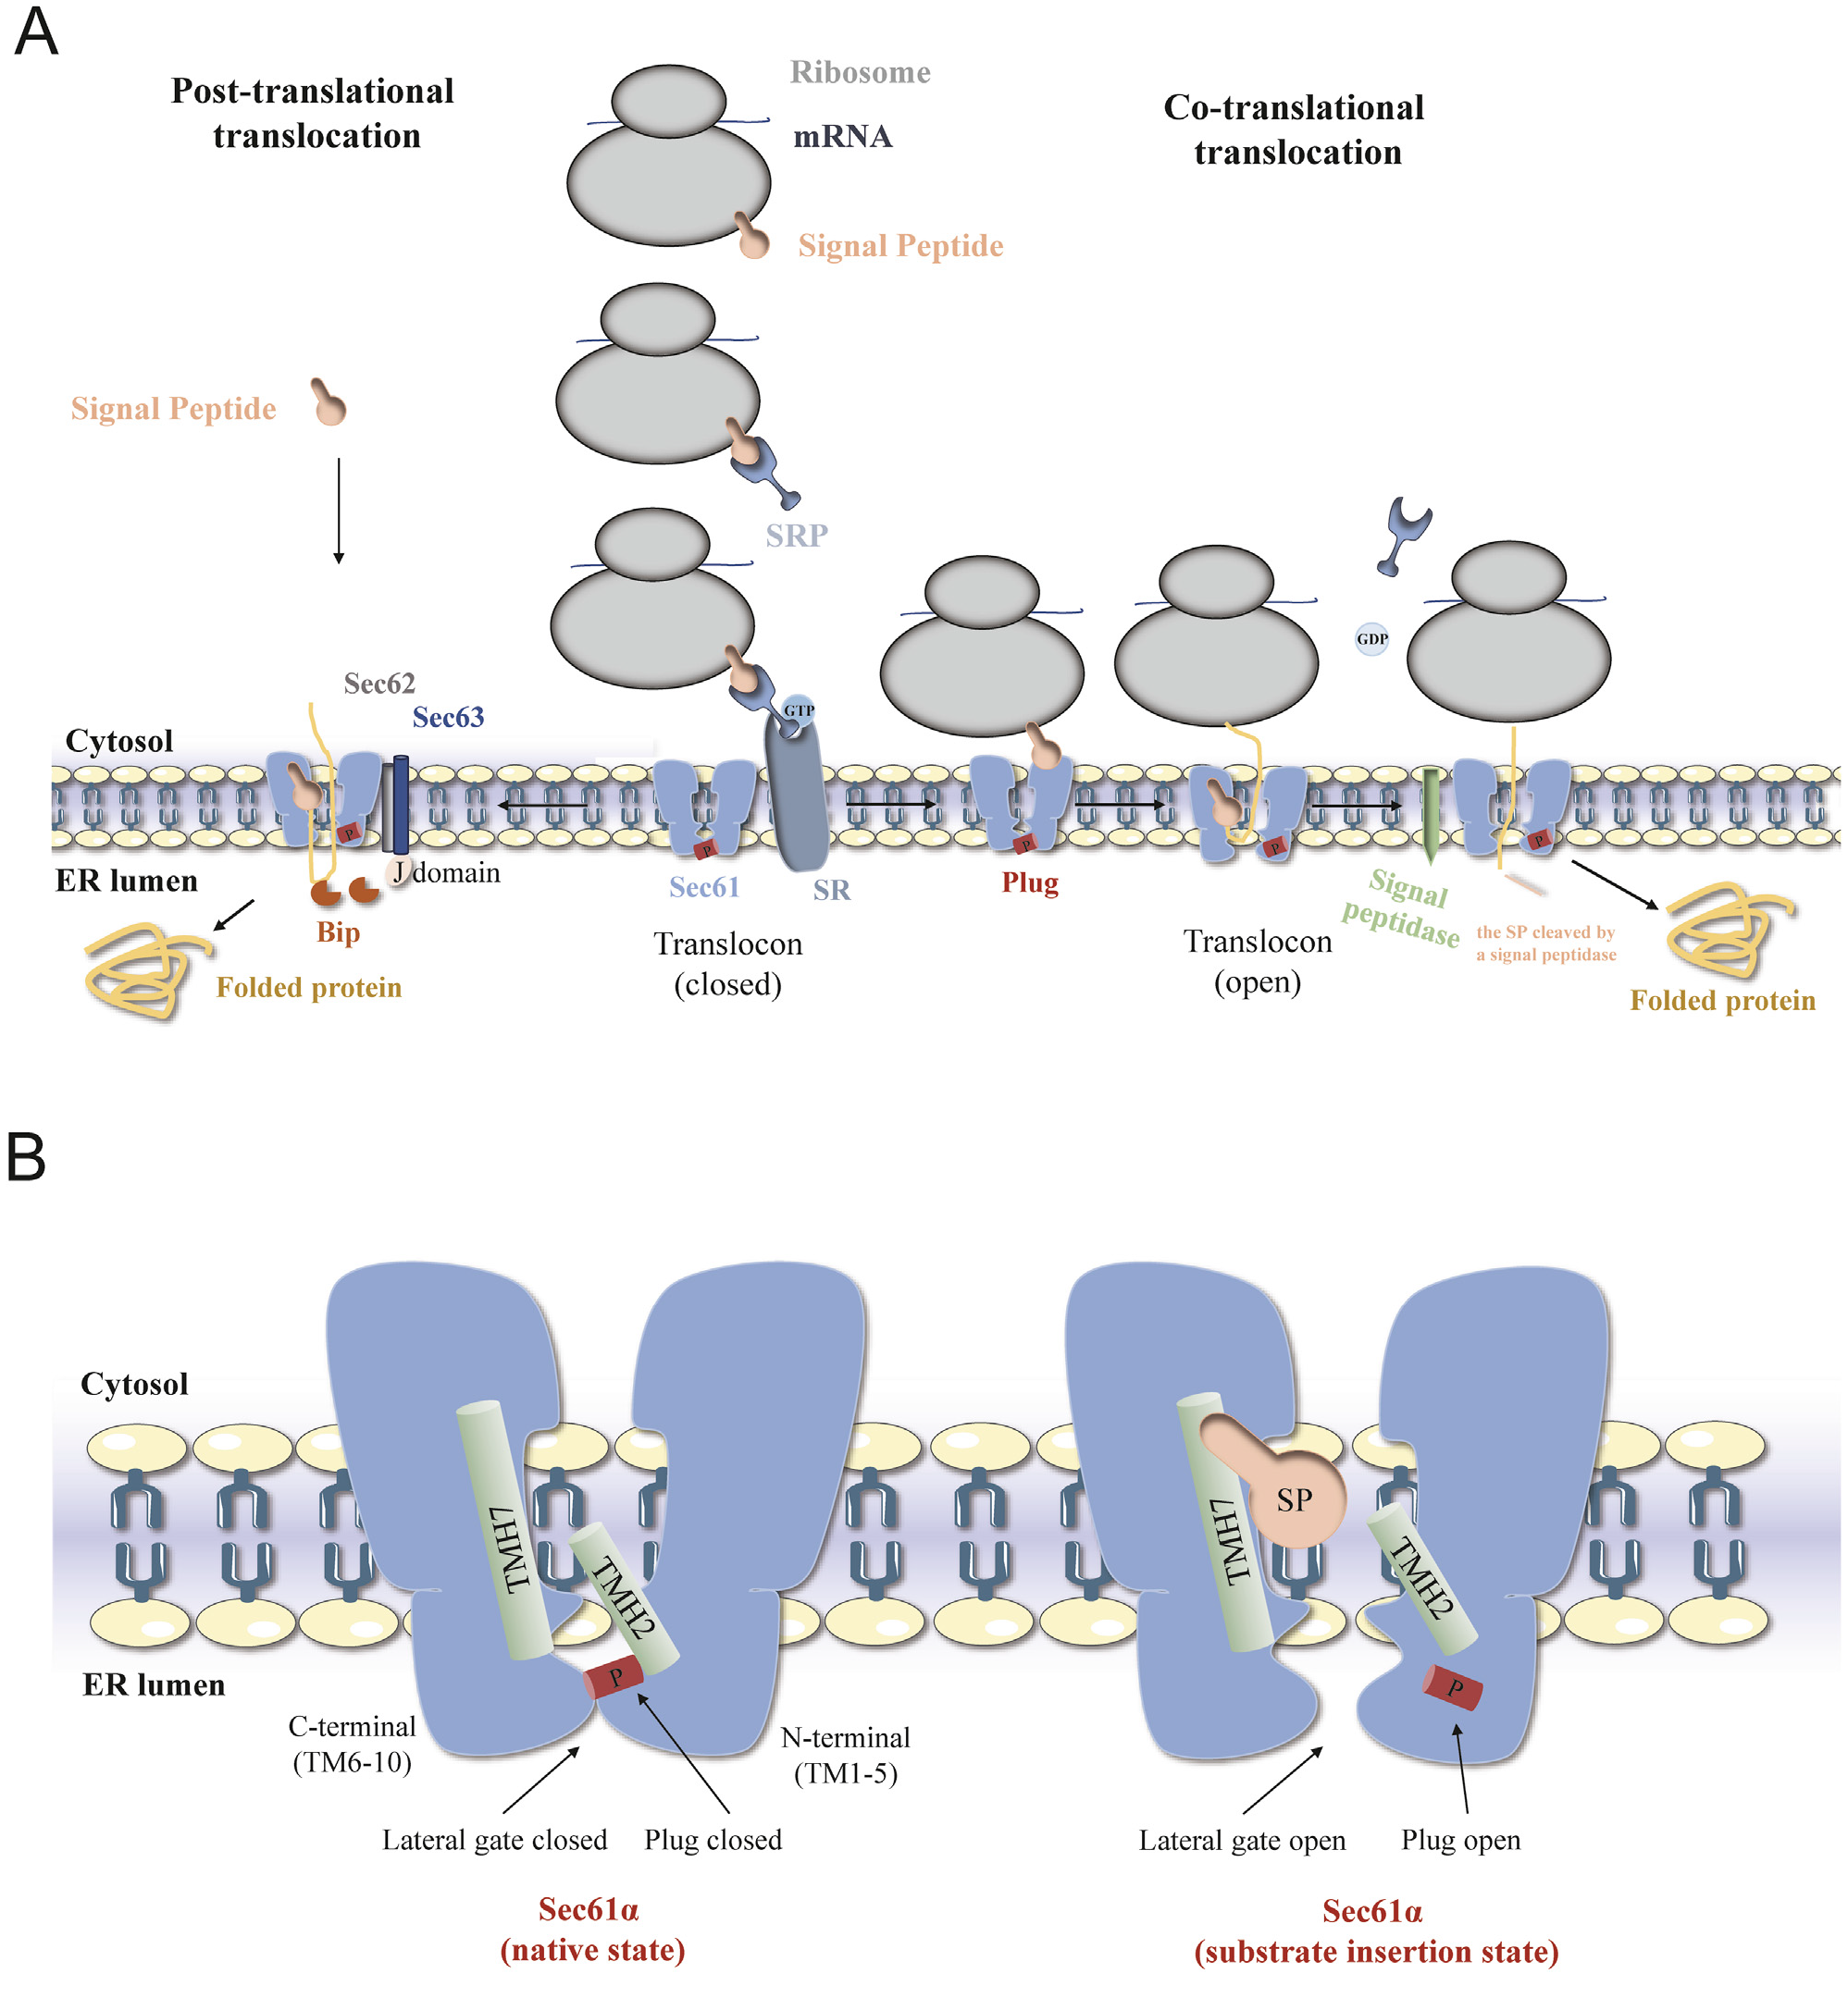

Slide 19
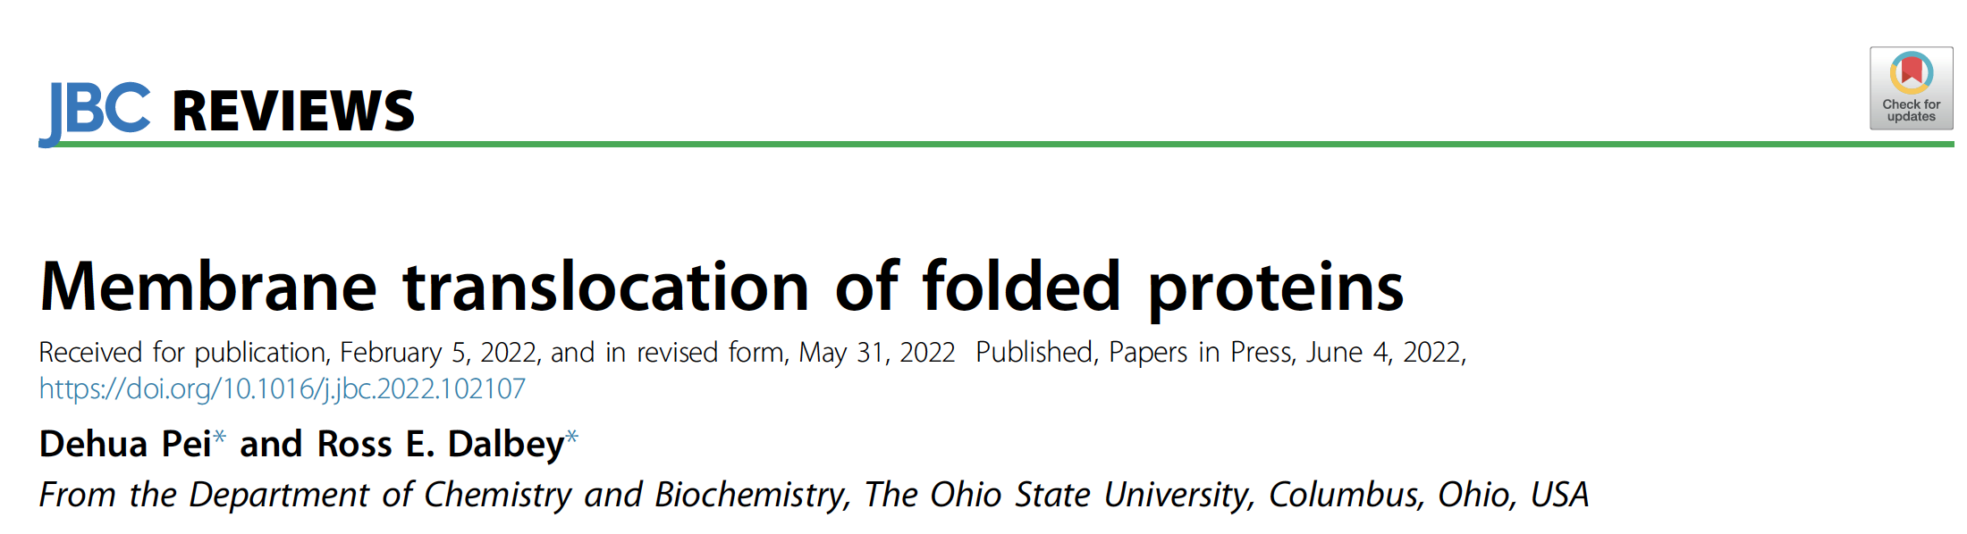


Slide 20
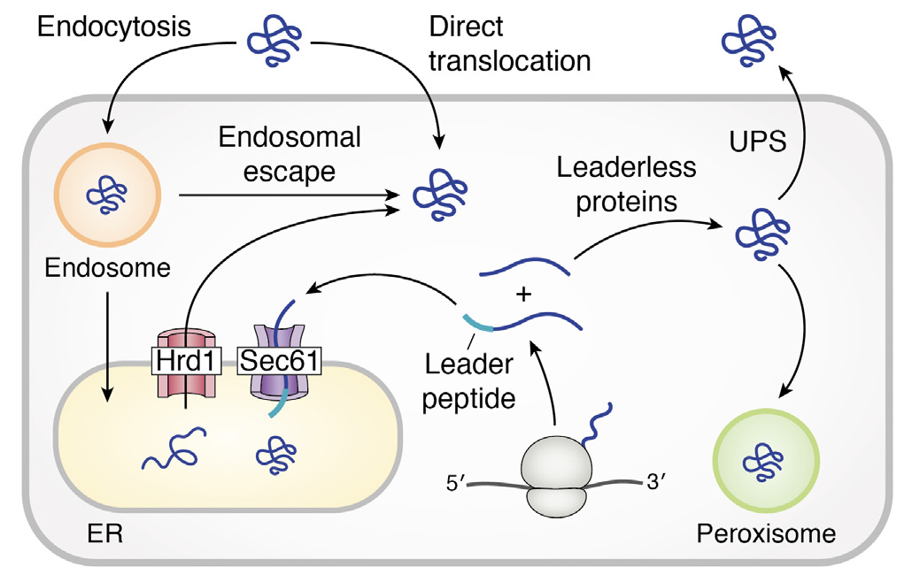
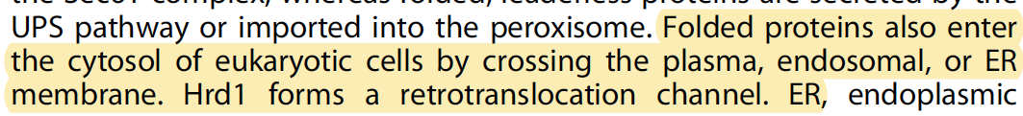

Slide 21

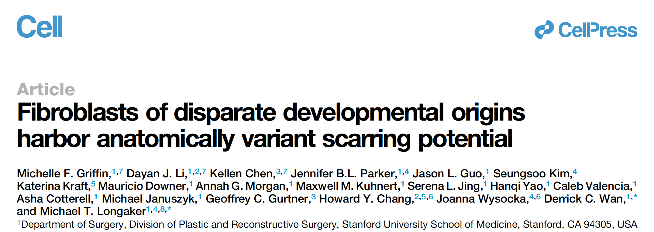

Slide 22
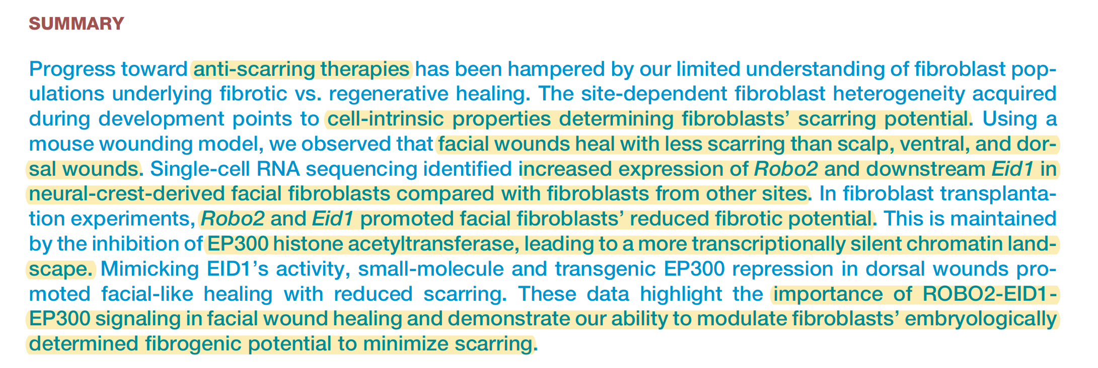

Slide 23
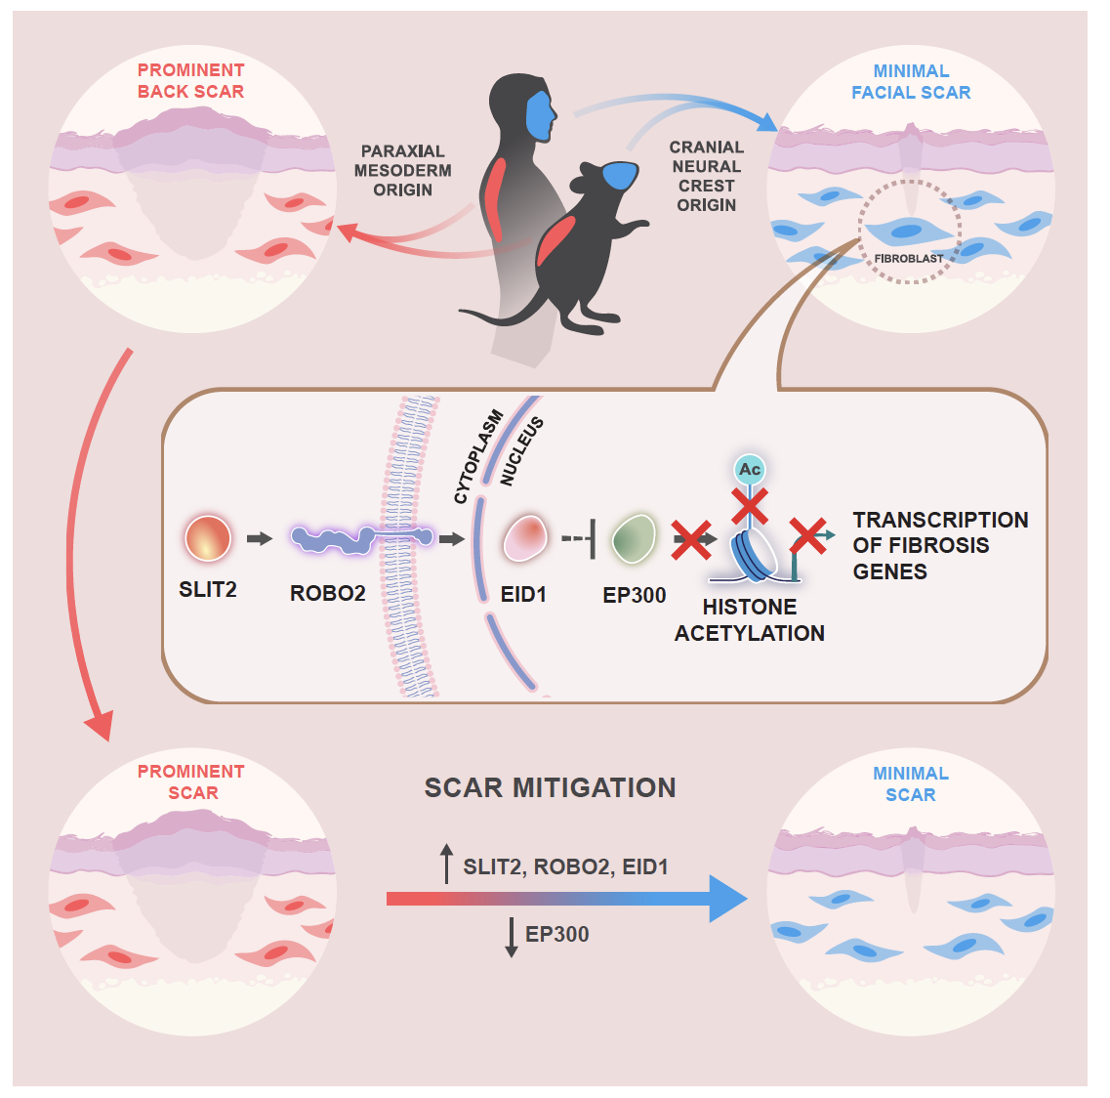
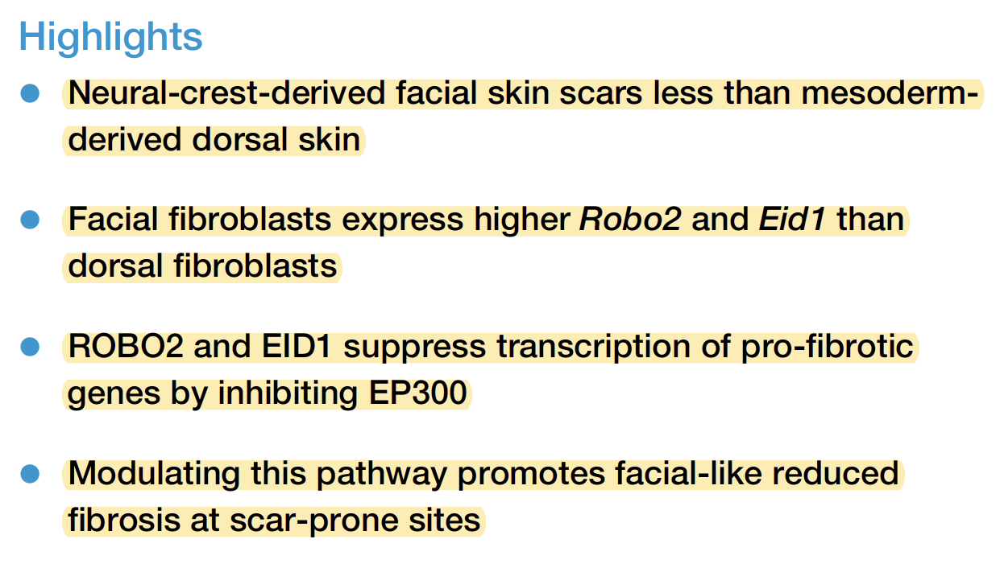

Slide 24



Slide 25
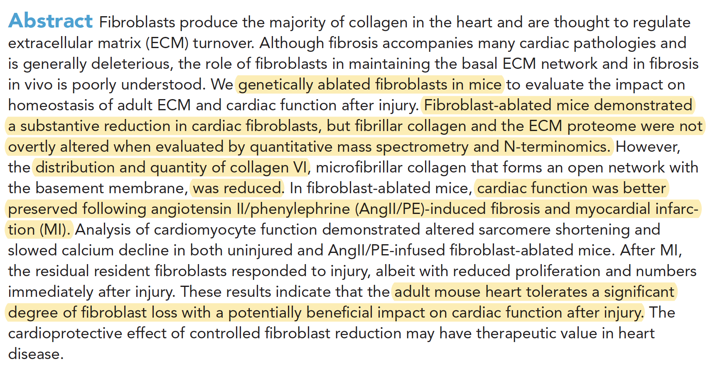

Slide 26
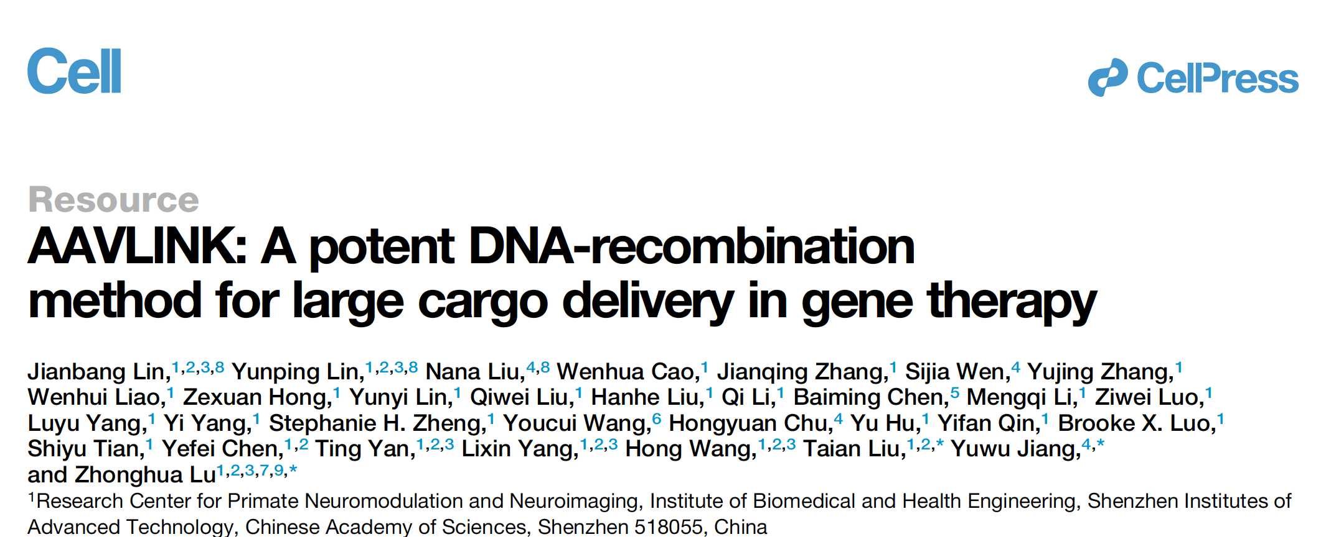


Slide 27
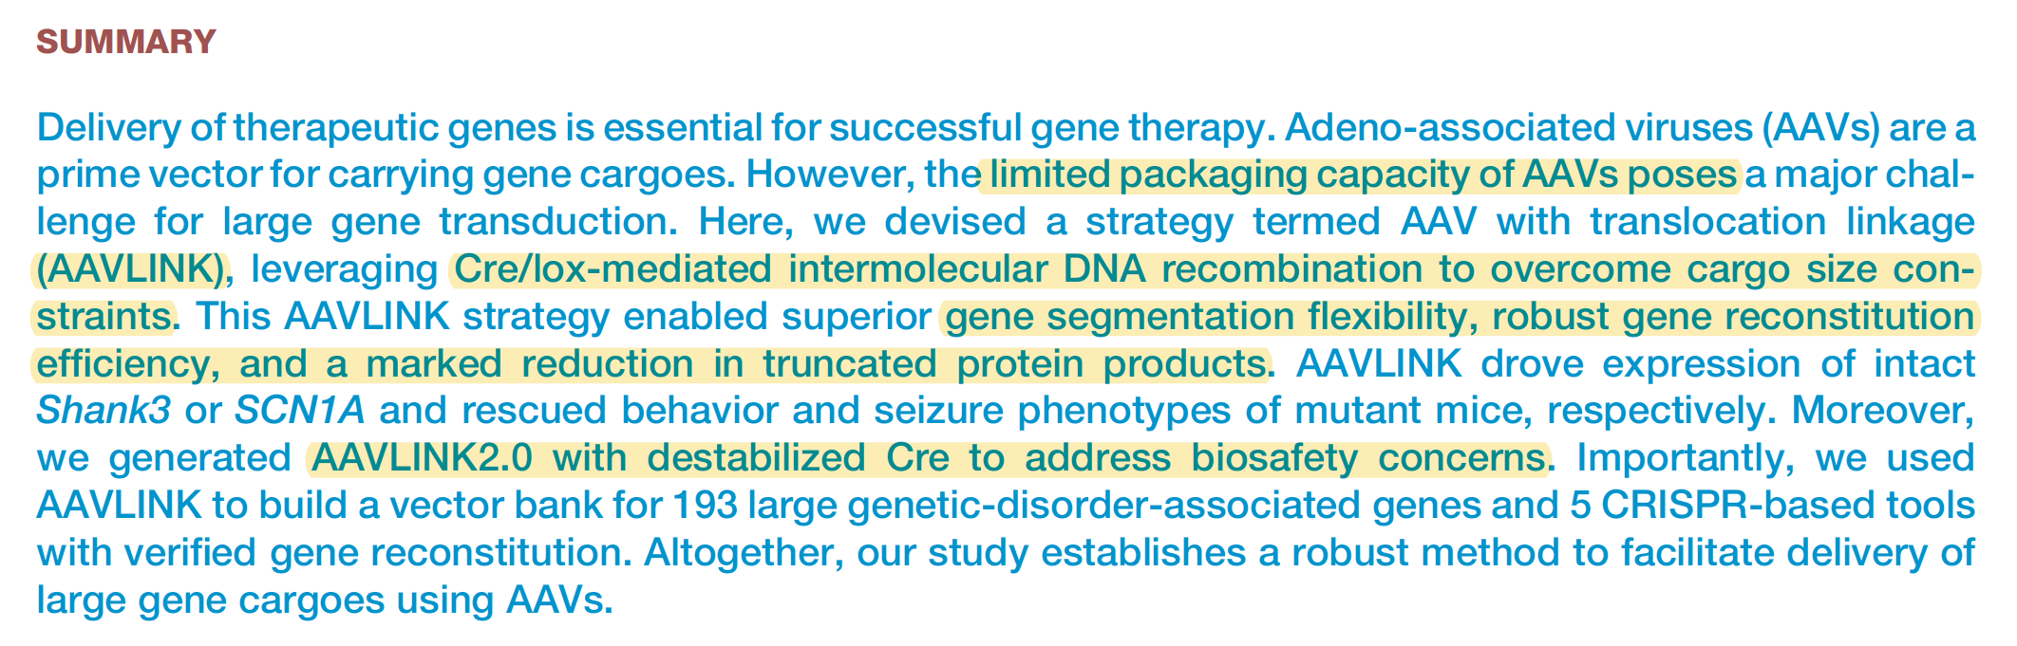

Slide 28
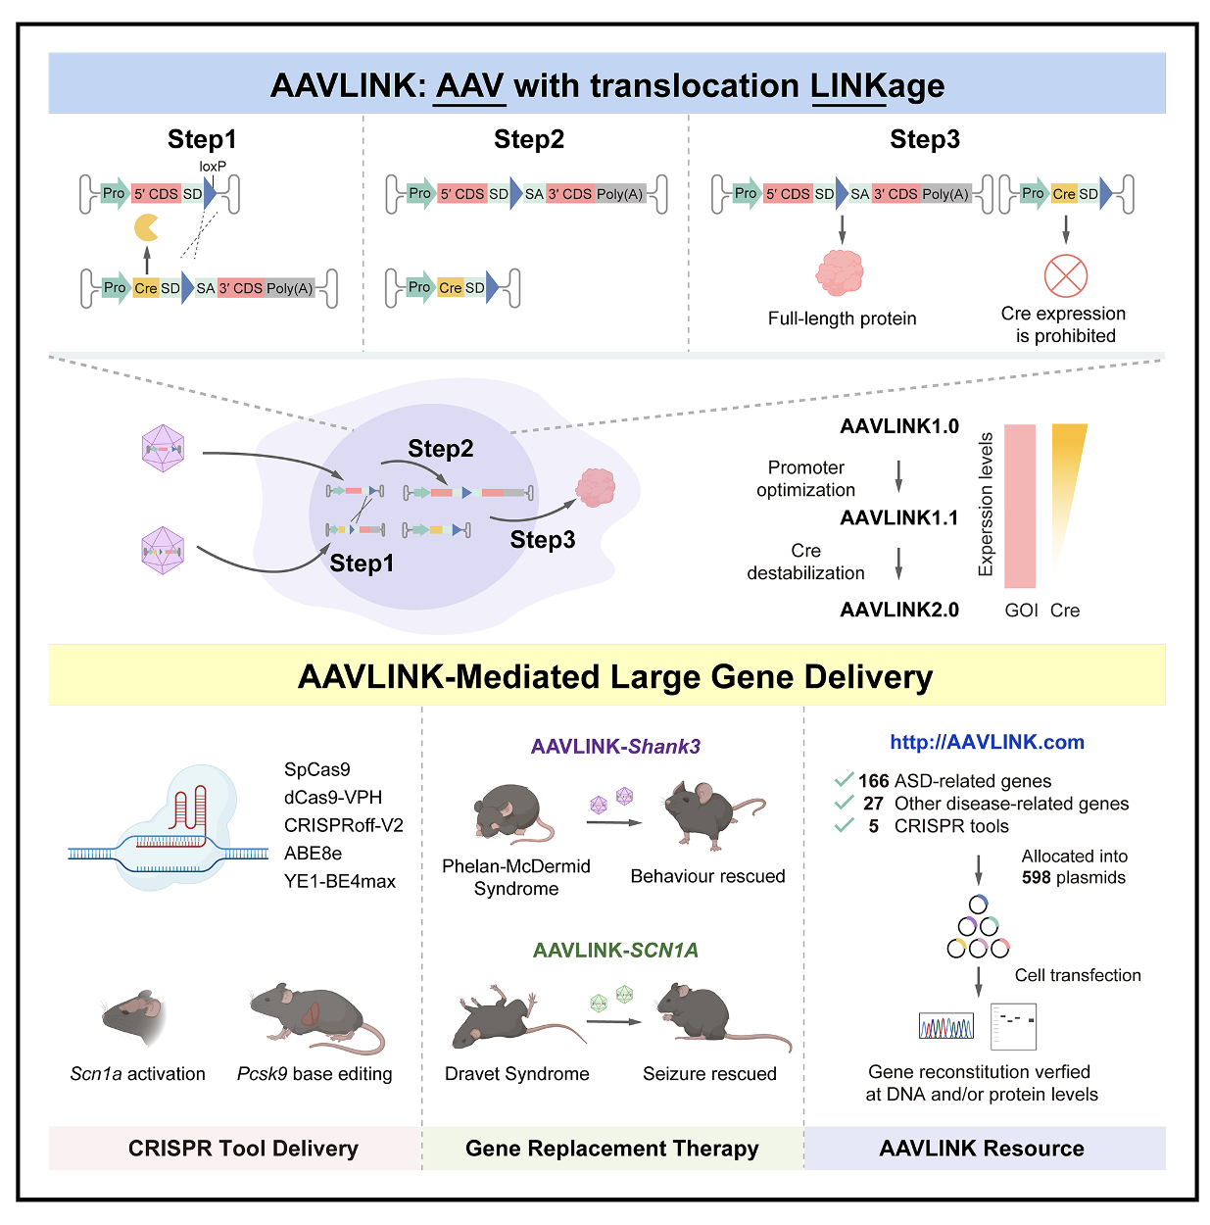
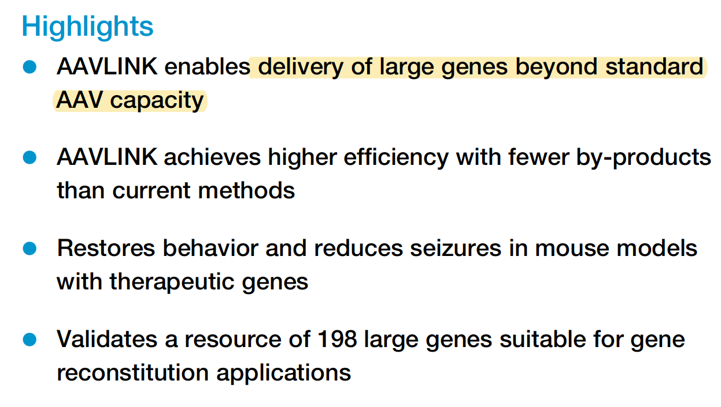

Slide 29
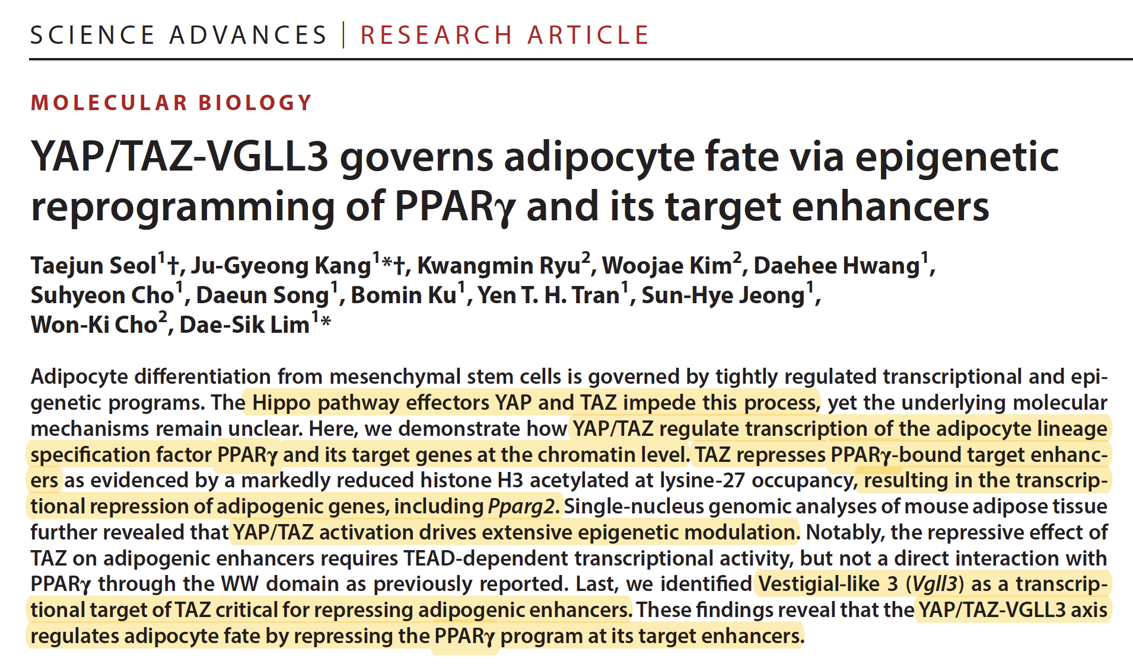


Slide 30
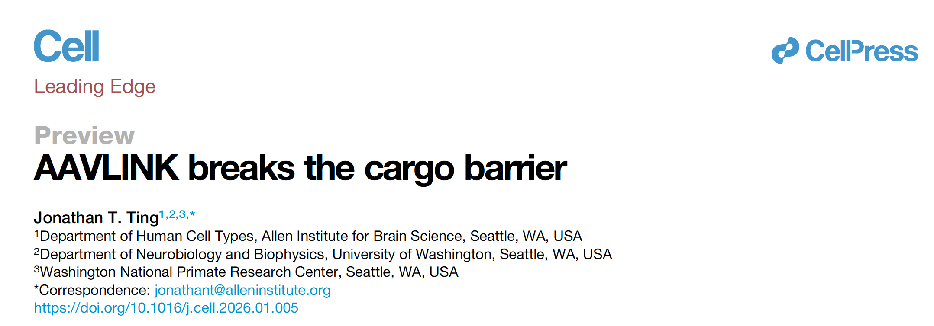

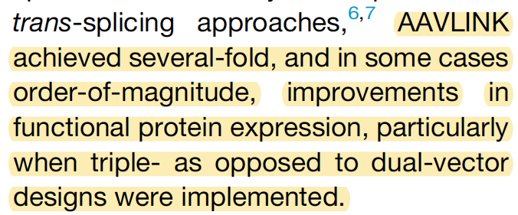
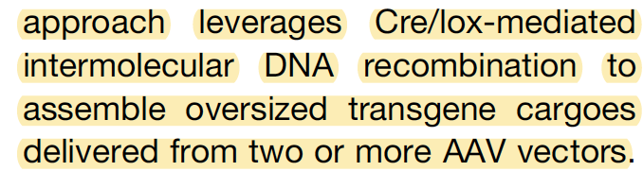
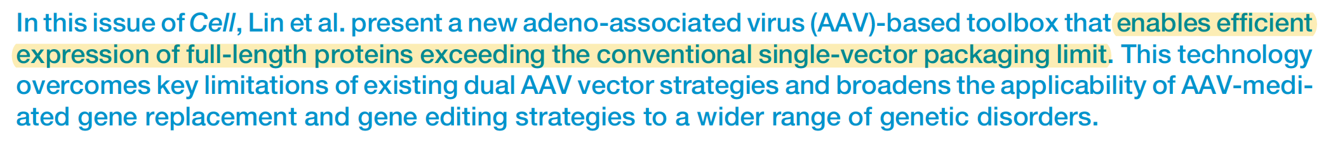

Slide 31
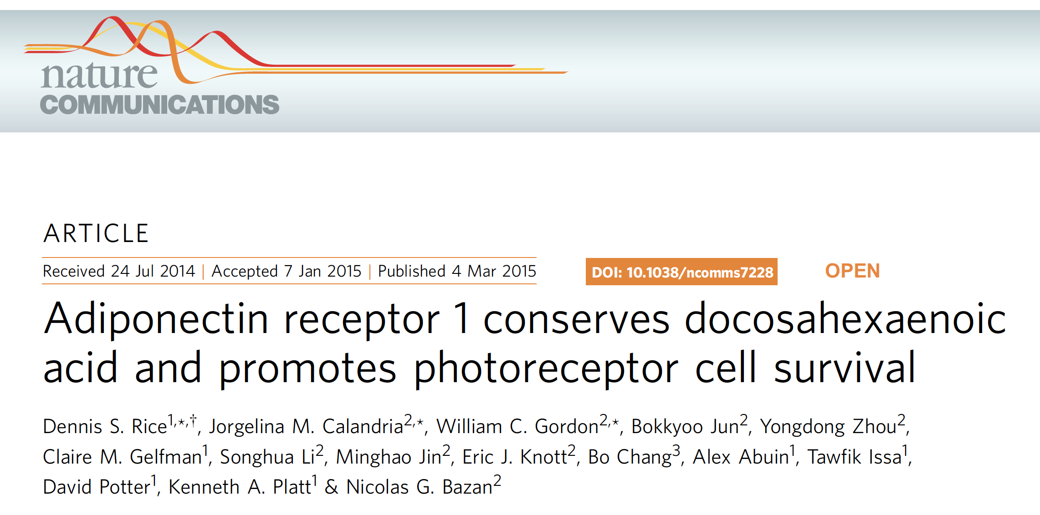

Slide 32
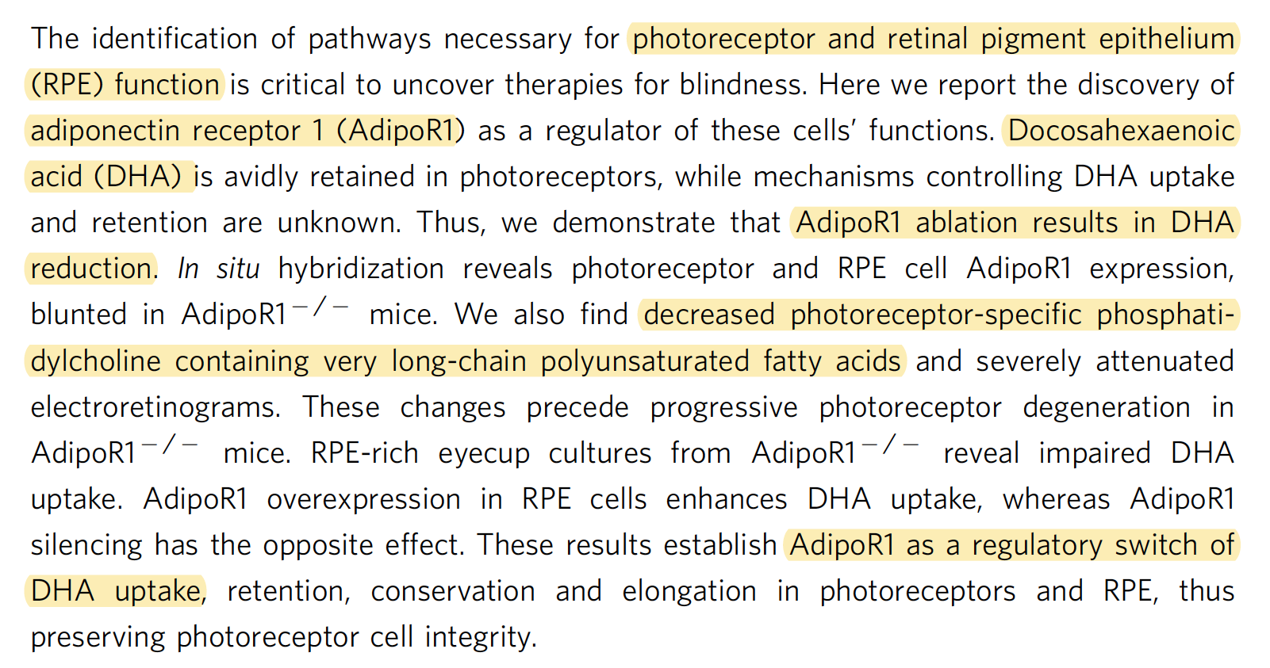

Slide 33
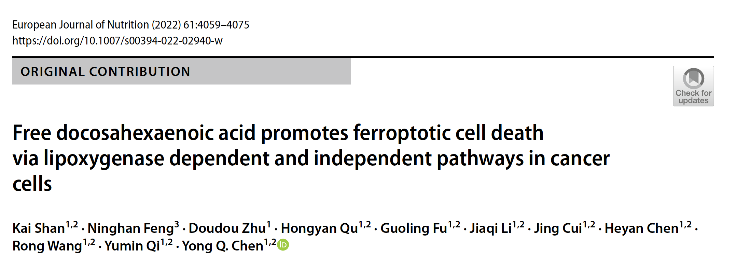
DHA (docosahexaenoic acid) has been shown to increase and induce ferroptosis, a type of iron-dependent, oxidative cell death, particularly in cancer cells. DHA promotes this process by increasing intracellular lipid peroxidation, raising Reactive Oxygen Species (ROS), reducing glutathione (GSH) levels, and decreasing glutathione peroxidase 4 (GPX4) activity.

Slide 34
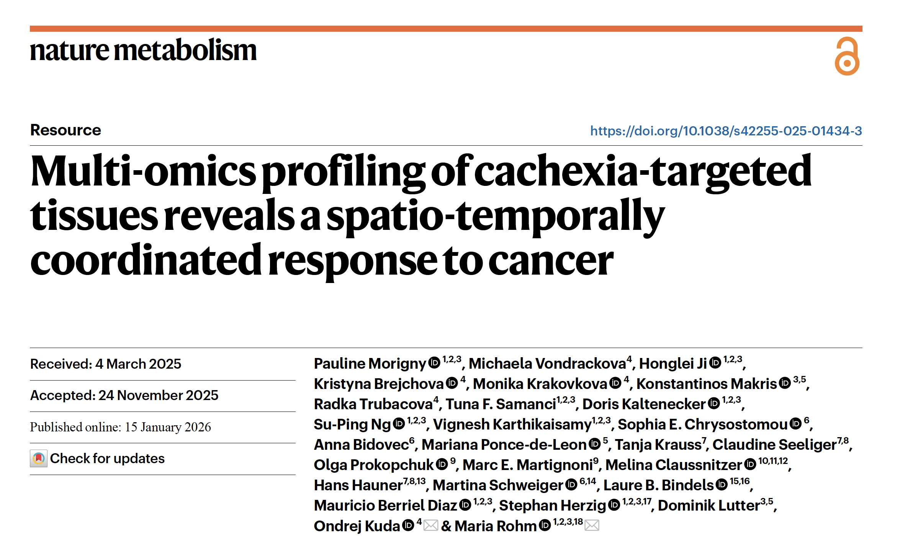

Slide 35
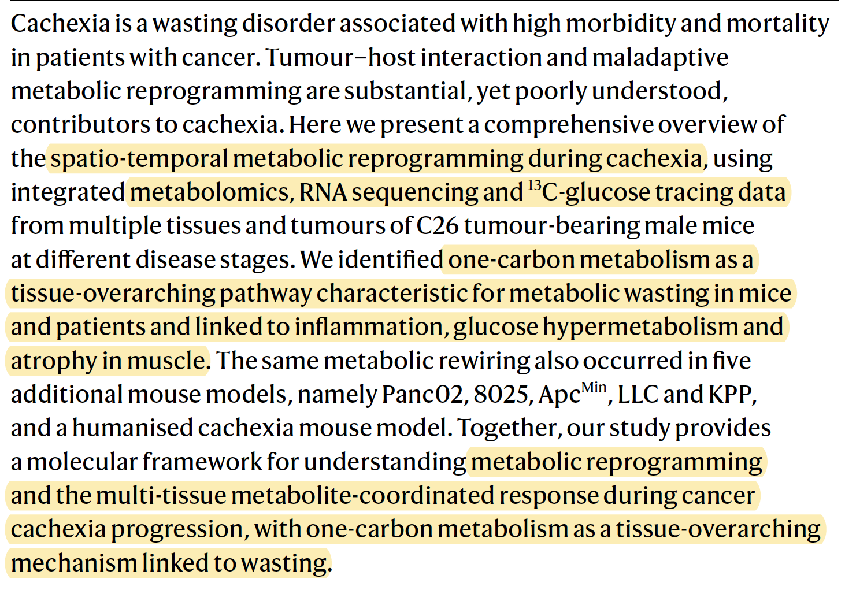

Slide 36
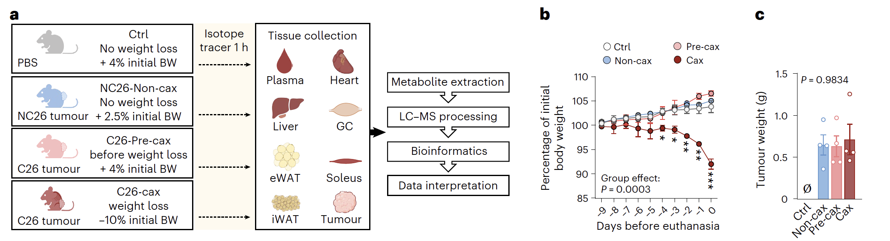
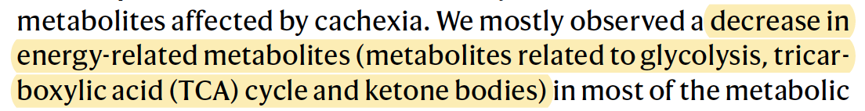
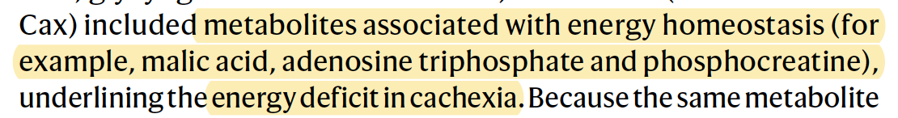


Slide 37



Slide 38


Slide 39


Slide 40


Slide 41


Slide 42



Slide 43


Slide 44



Slide 45



Slide 46


Slide 47


Slide 48



Slide 49


Slide 50




Slide 51

Statins
Ezetimibe: Dietary cholesterol uptake inhibitor (NPC1L1)
PEPCK AB
Bempedoic Acid: ATP-citrate lyase inhibitor –cholesterol biosynthesis inhibitor
Lomitapide: inhibiting microsomal triglyceride transfer protein (MTP)
Evinacumab: inhibiting ANGPTL3 (LPL inhibitor)

Slide 52


Slide 53


Slide 54



Slide 55


Slide 56


Slide 57



Slide 58


Slide 59


Slide 60


Slide 61


Slide 62


Slide 63





Slide 64


Slide 65



Slide 66


Slide 67


