Slide 1
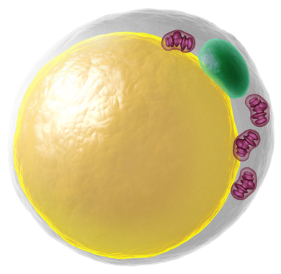
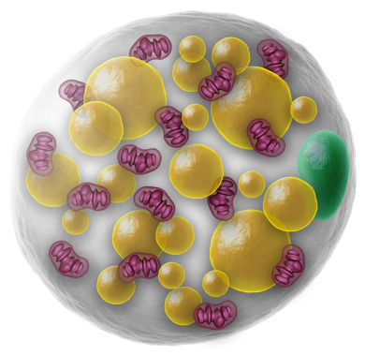
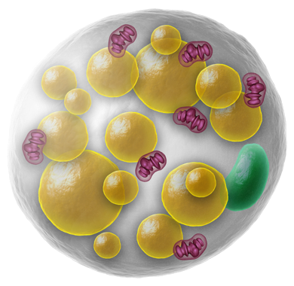
Literature Overview
Touchstone Diabetes Center
UTSW Medical Center 2/2/2026

Slide 2
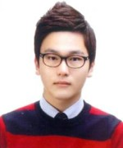
Monday, February 2
9:15 AM – K5.600 - in person
Touchstone Center Meeting
Tuesday, January 20
9 AM – virtual meeting
Touchstone Center Seminar
Woobeen Jo, PhD
Department of Biological Sciences,
Ulsan National Institute of Science and Technology (UNIST), Ulsan,
Postdoctoral Candidate https://utsouthwestern-edu.zoom.us/j/91635812230

Slide 3
Tuesday, February 3
12 Noon – JA5.110 – hybrid meeting
GI Research Conference
Paul Monga, M.D.
Professor of Pathology & Medicine
University of Pittsburgh
"Liver Metabolic Zonation and Repair"

Slide 4
Wednesday, February 4
9:00 AM – L4.220 - in person
Touchstone Center
Mouse Genetics SubGroup Meeting
12 Noon – NL12.125
Children’s Research Institute Seminar
Sagar Bapat, M.D., Ph.D.
Adjunct Assistant Professor,
Department of Pathology,
University of California, San Francisco
“Ecoimmunology: How nutritional cues instruct immune circuits in inflammatory disease"

Slide 5
Thursday, February 5
12 Noon – L4.176 – in person
Biochemistry Seminar Series
Samir M. Parikh, M.D.
Professor of Internal Medicine
Division of Nephrology
UT Southwestern Medical Center
"Kidney as a Window into Mammalian Aging."

Slide 6
Friday, February 6
8 AM – D1.502 – in person
Internal Medicine Grand Rounds
Robert Kushner, M.D., M.S.
Professor Emeritus
Feinberg School of Medicine
Northwestern University
"Breaking New Ground in the Science and Practice of Obesity"
9:00 AM – L4.220 - in person
Touchstone Center
Cancer Fibrosis SubGroup Meeting
12 Noon – virtual meeting
Touchstone Center
Adipoinsular SubGroup Meeting

Slide 7
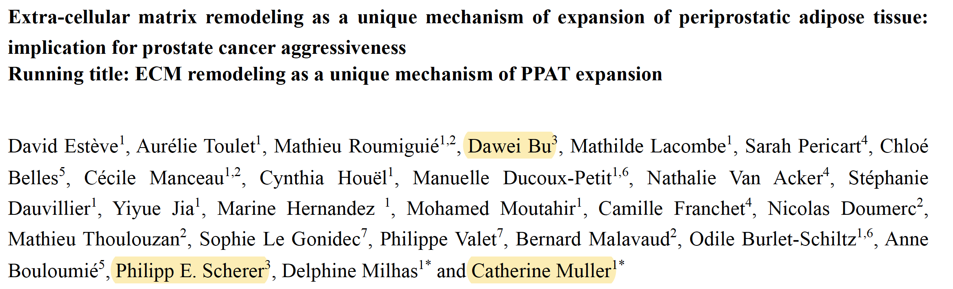
The Journal of Pathology, in press

Slide 8
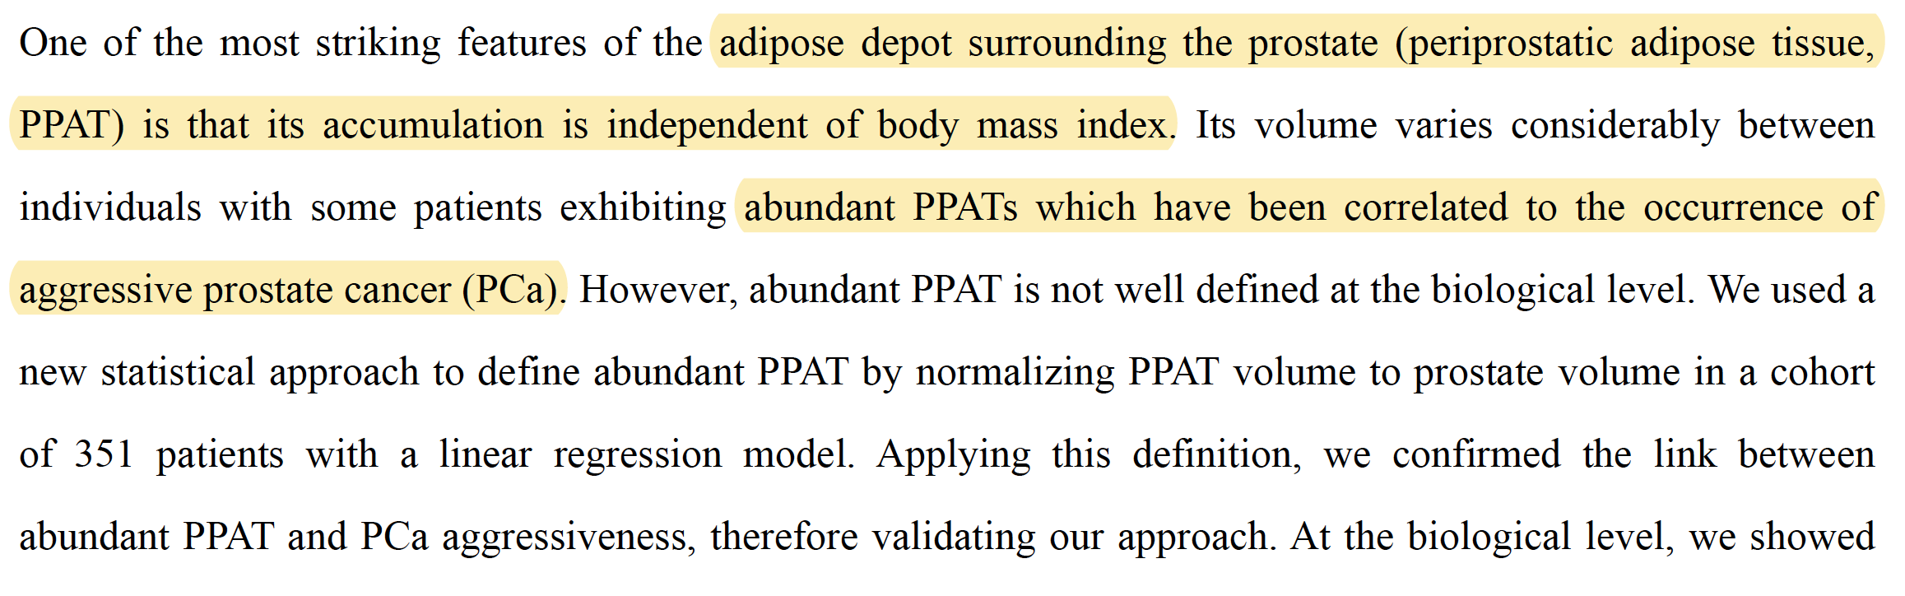
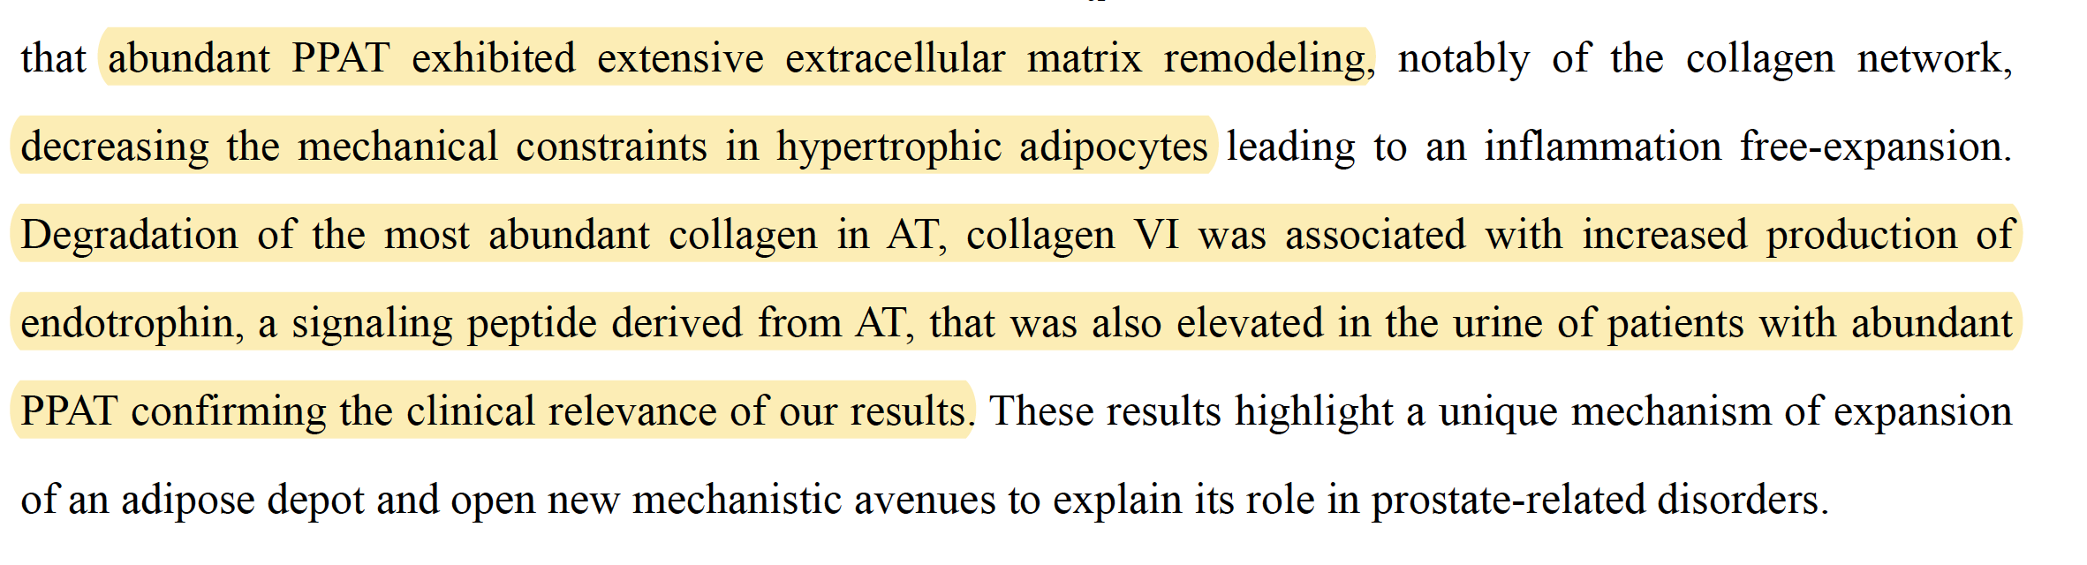

Slide 9
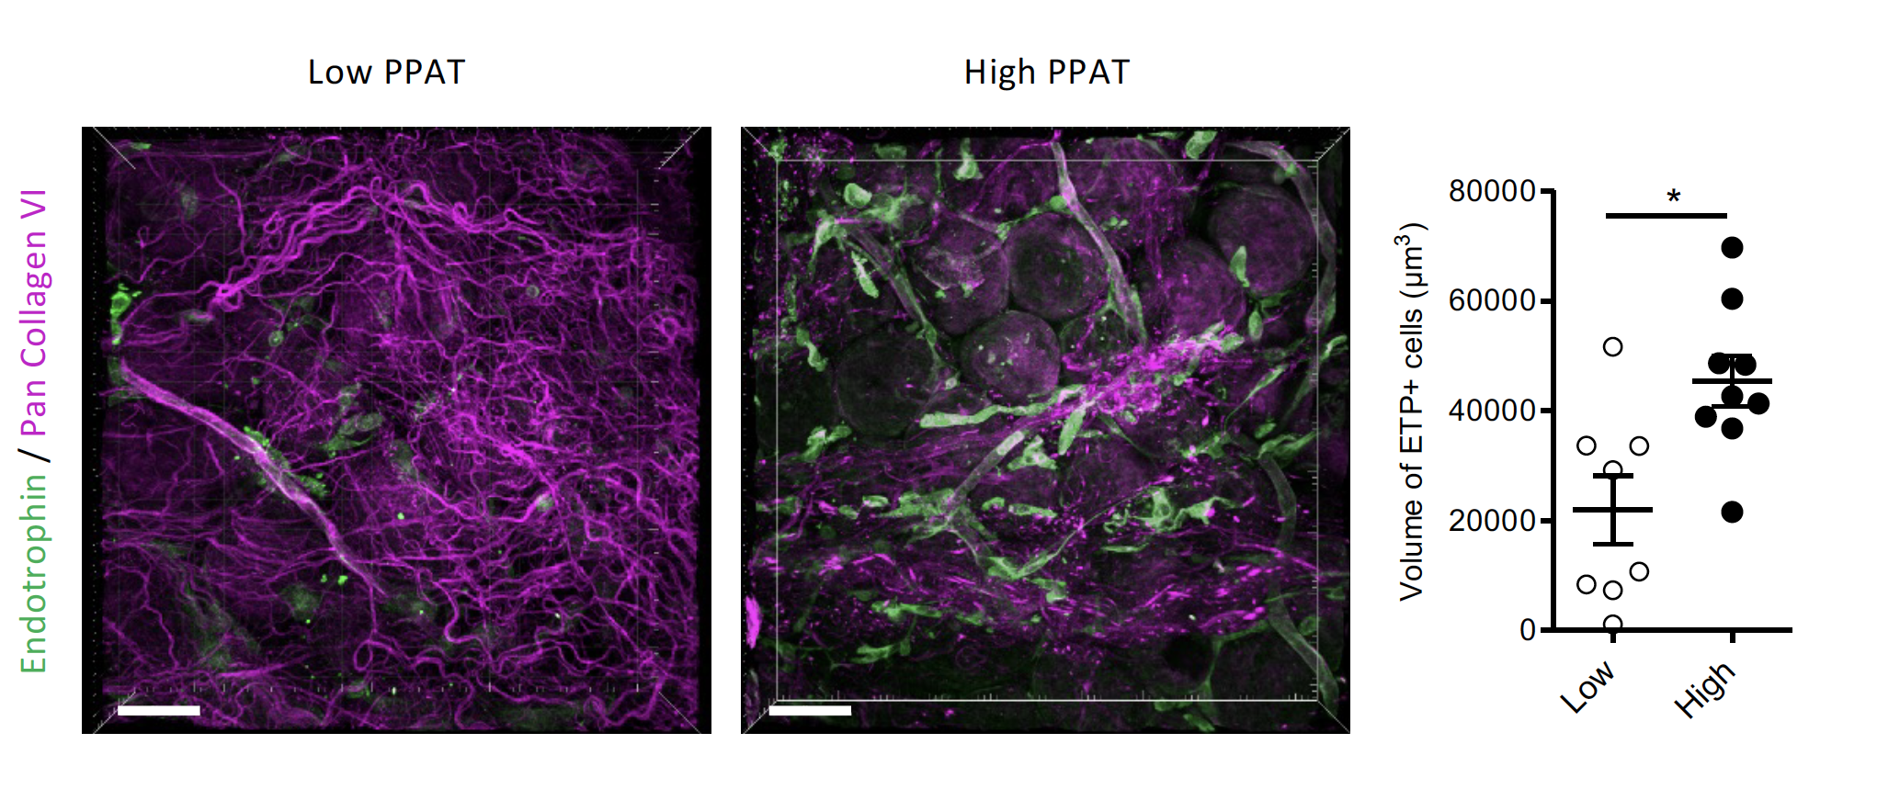

Slide 10
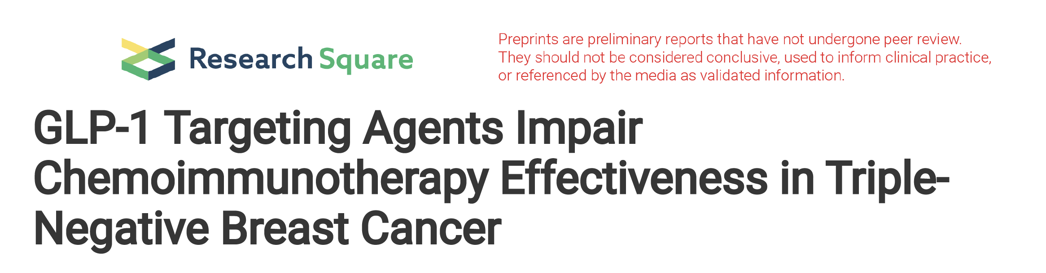
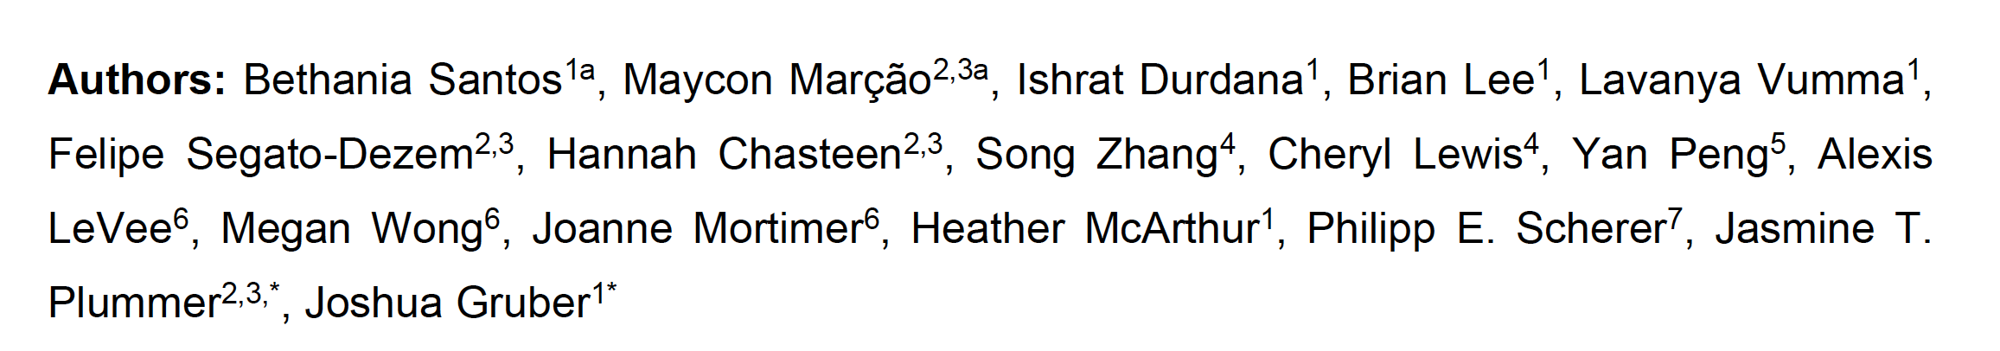
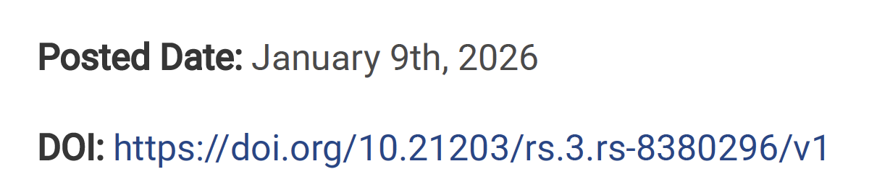

Slide 11
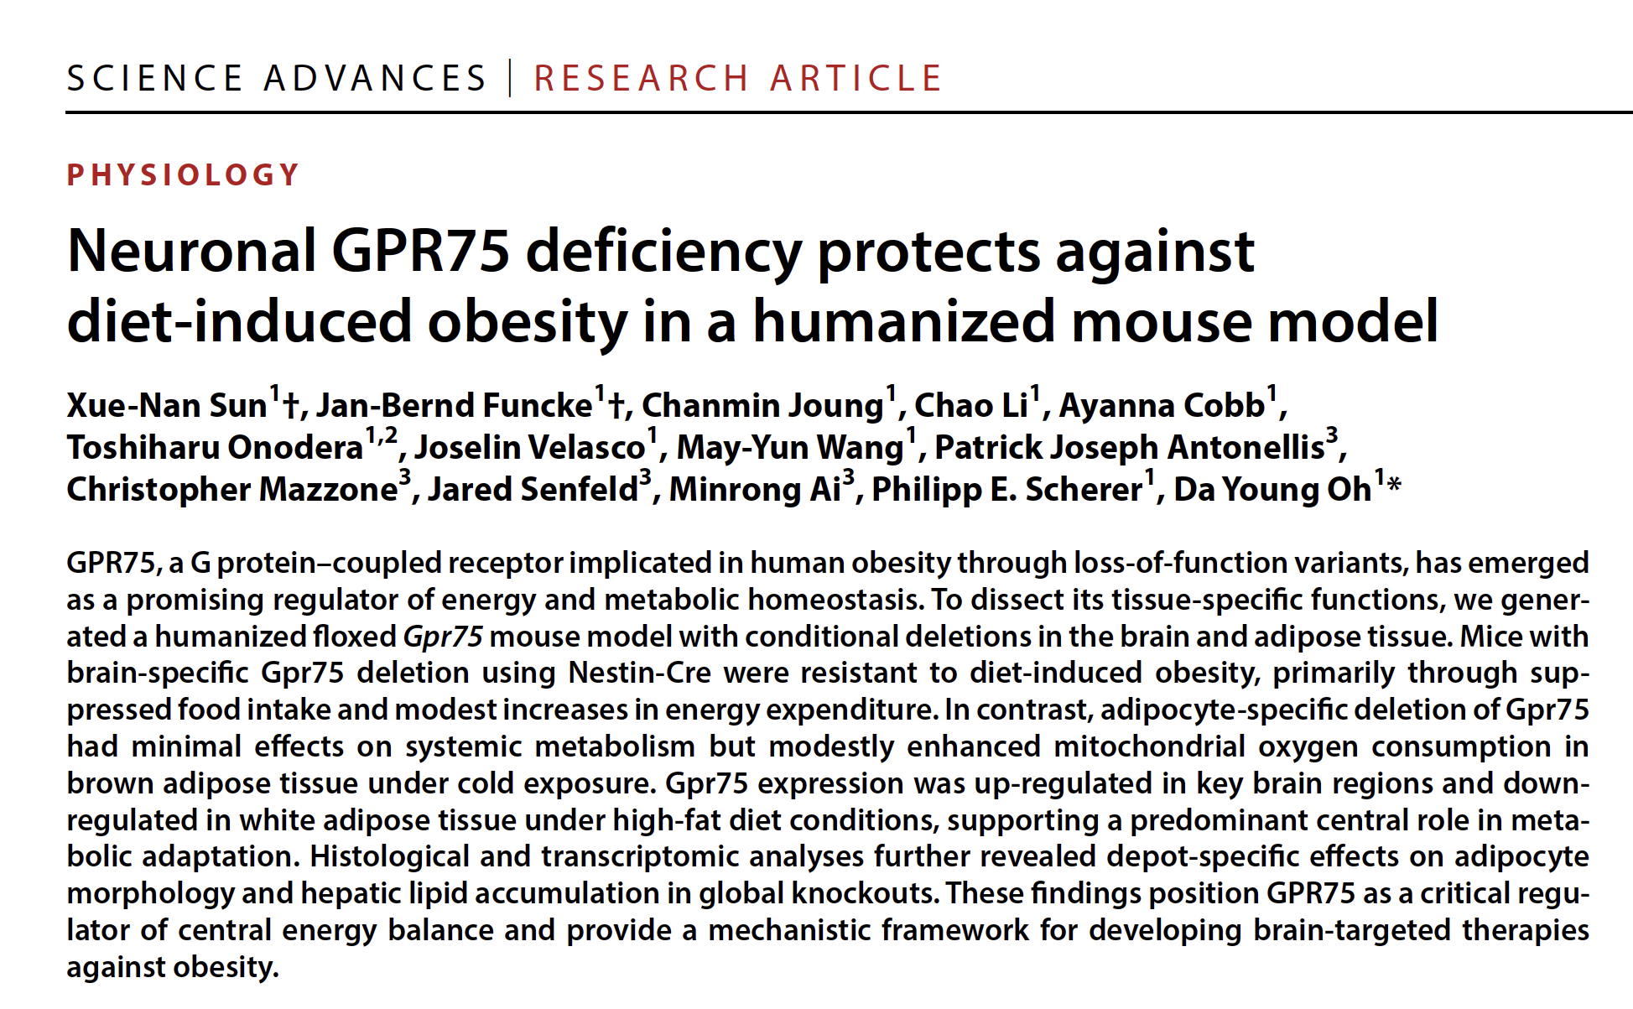
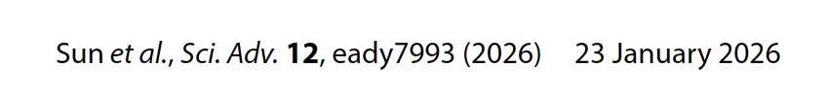

Slide 12
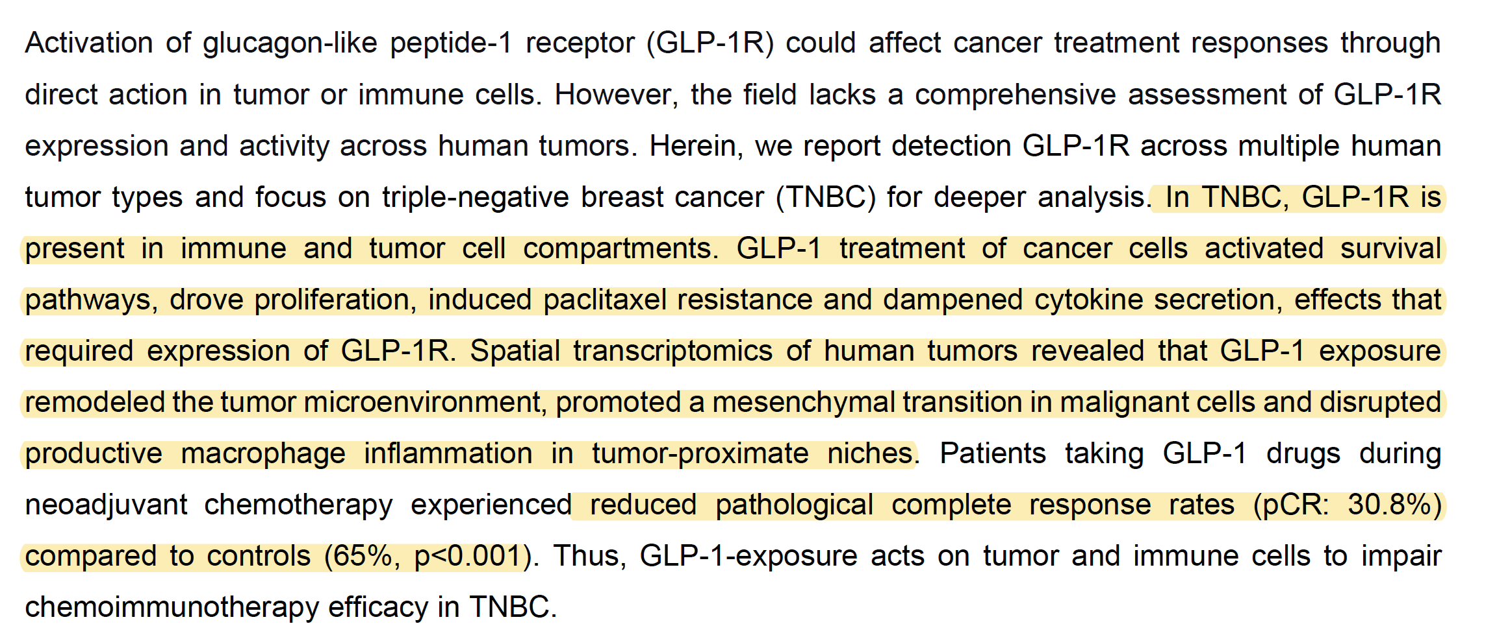

Slide 13
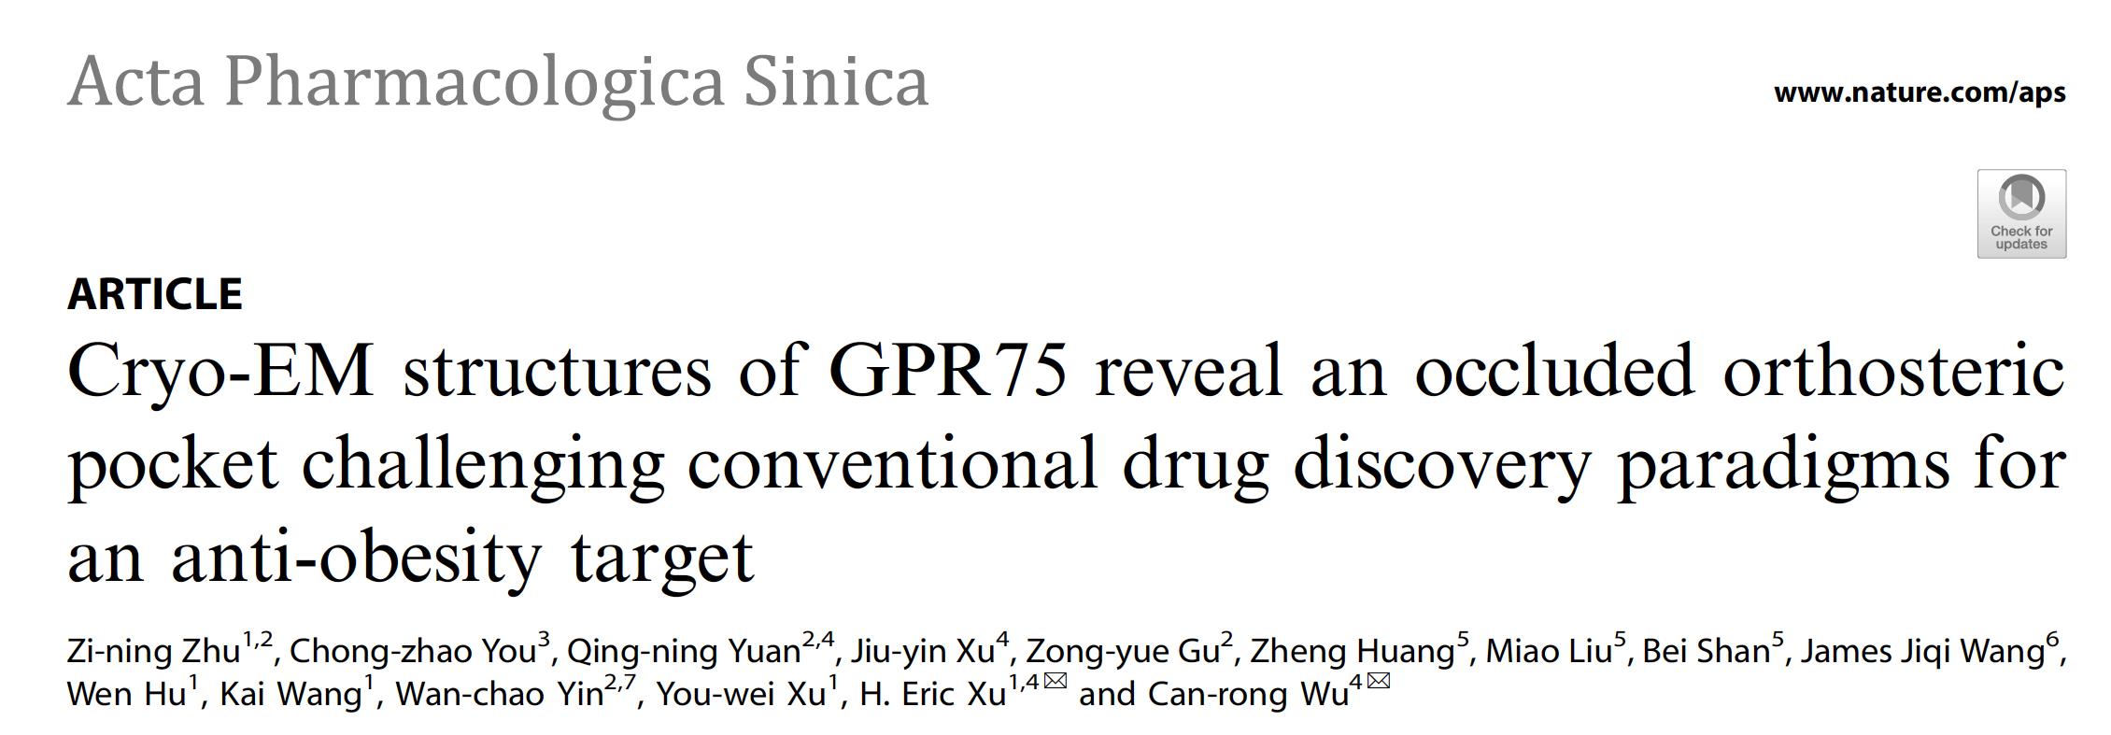
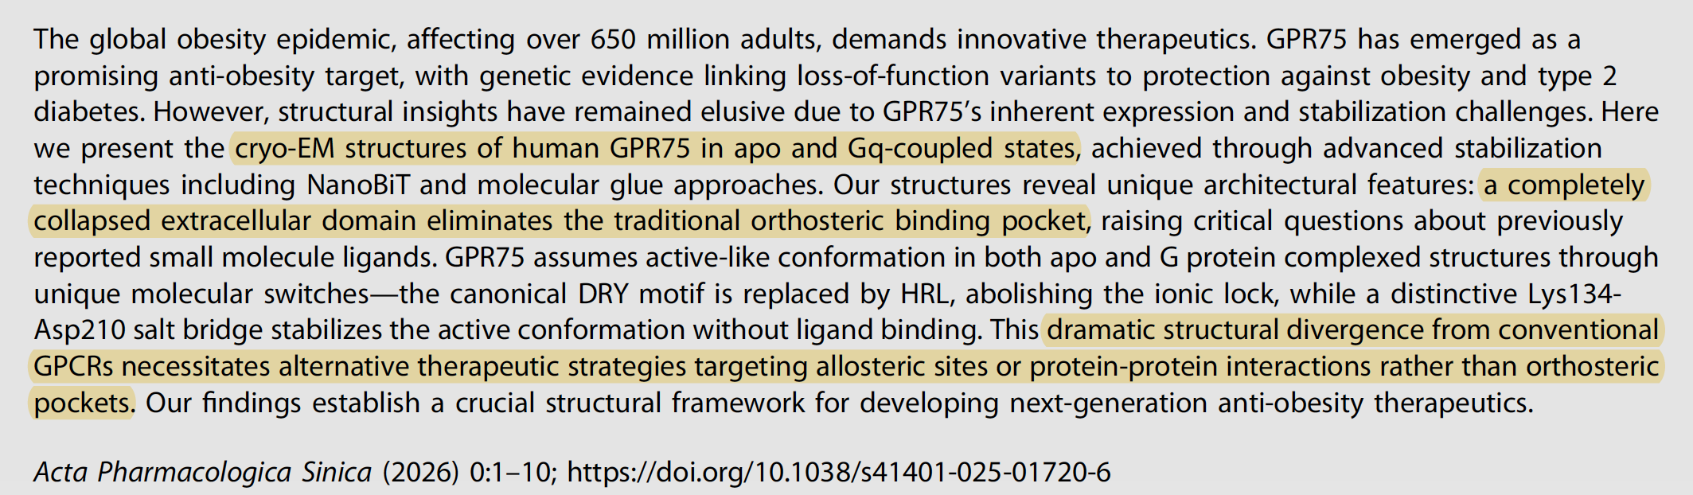

Slide 14
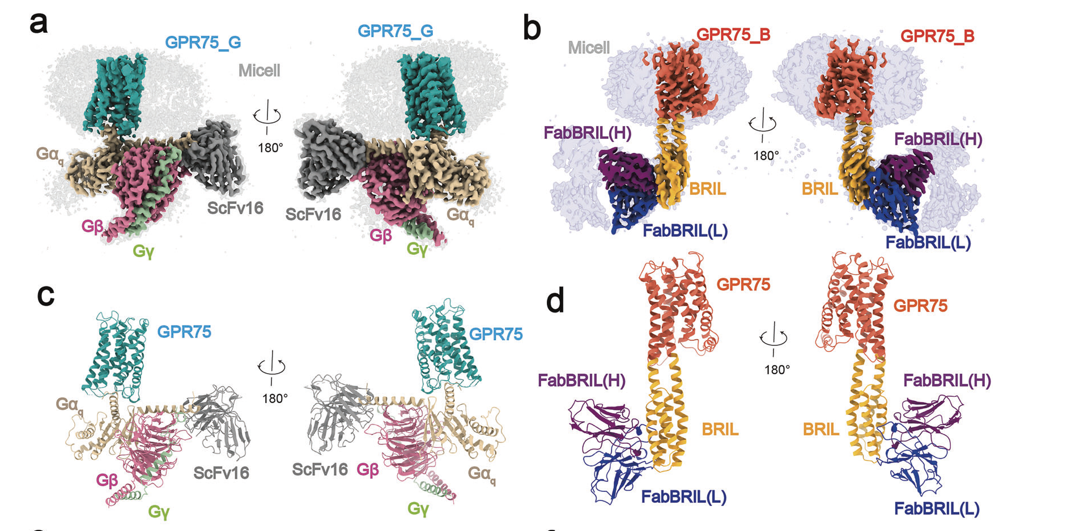

Slide 15
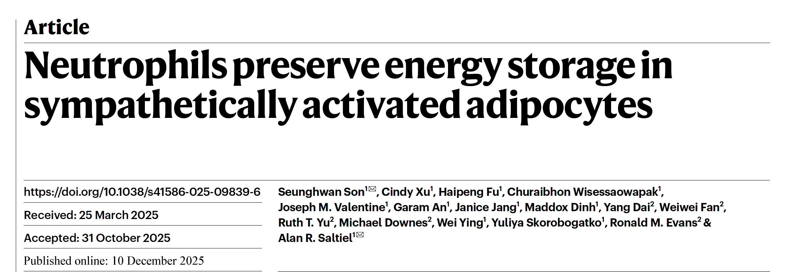


Slide 16
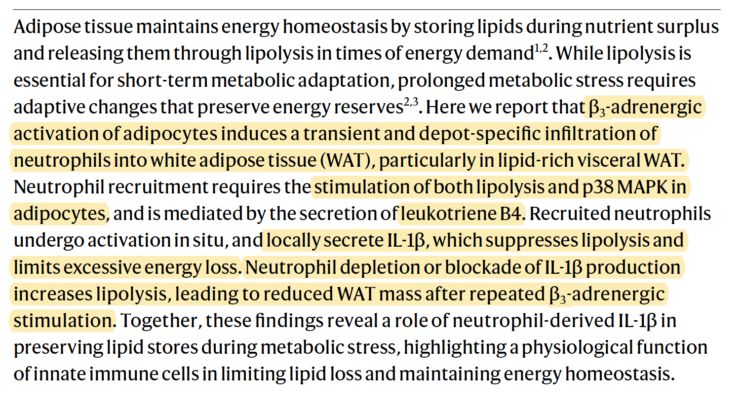

Slide 17

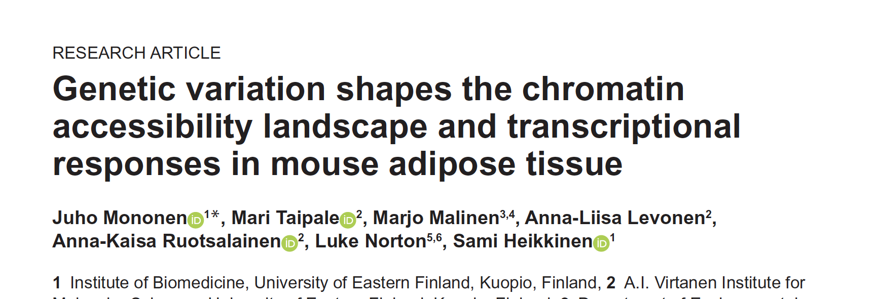

Slide 18
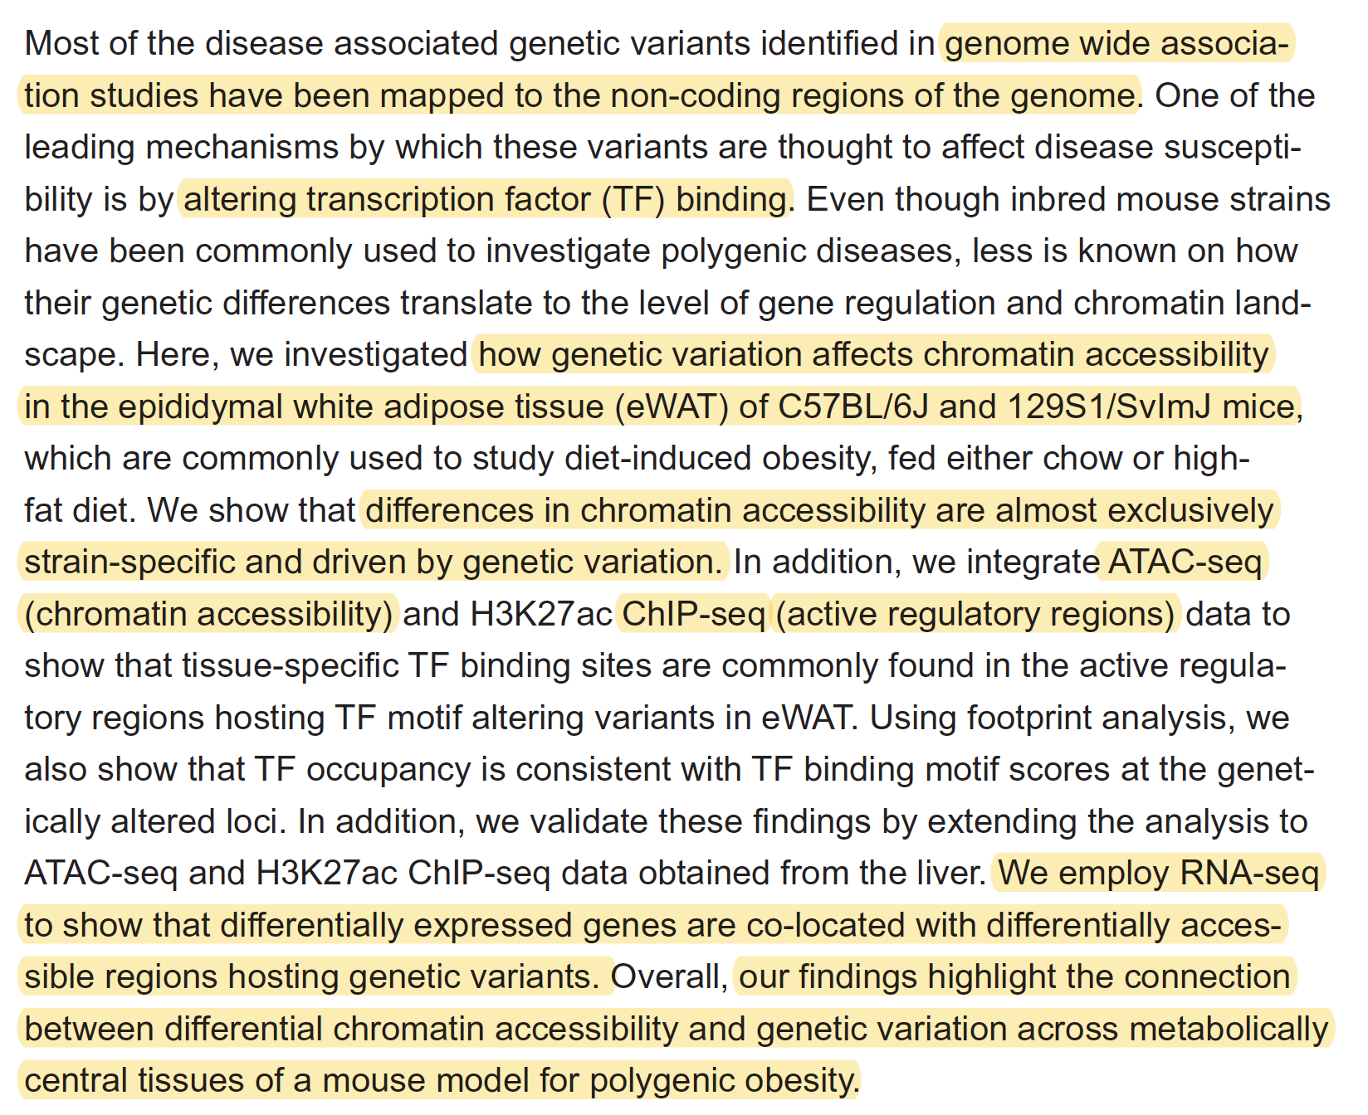

Slide 19
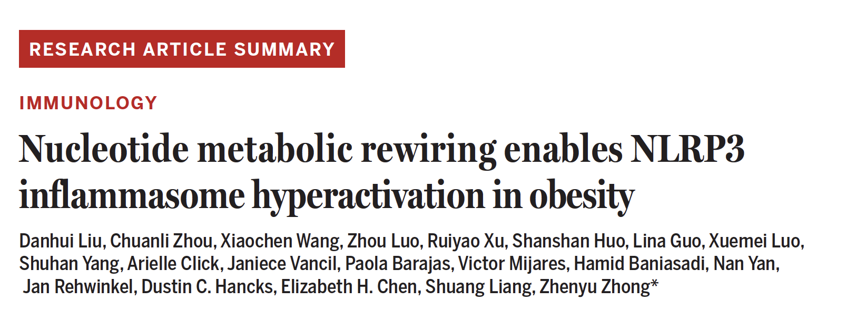

Slide 20
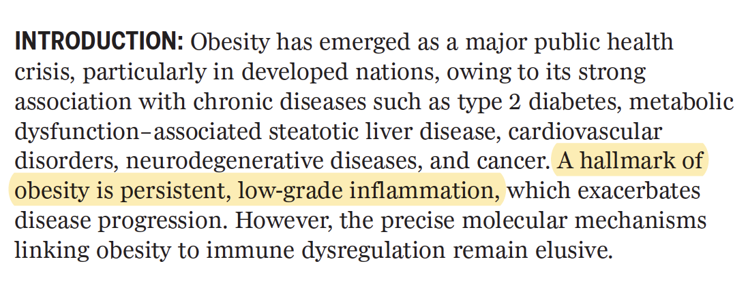
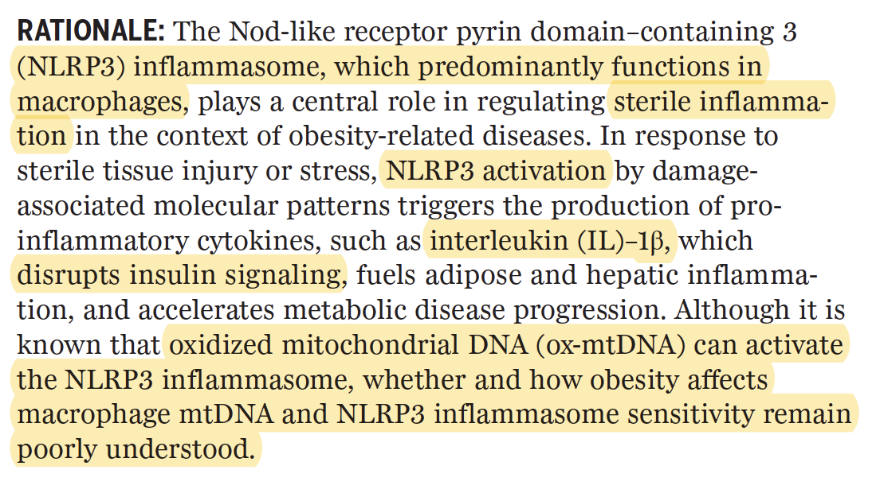

Slide 21
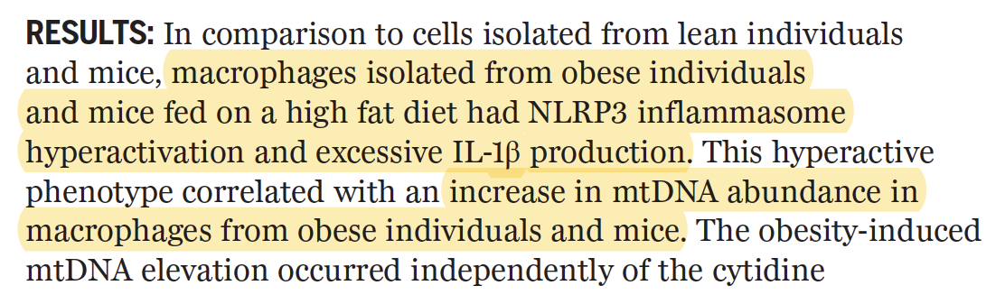
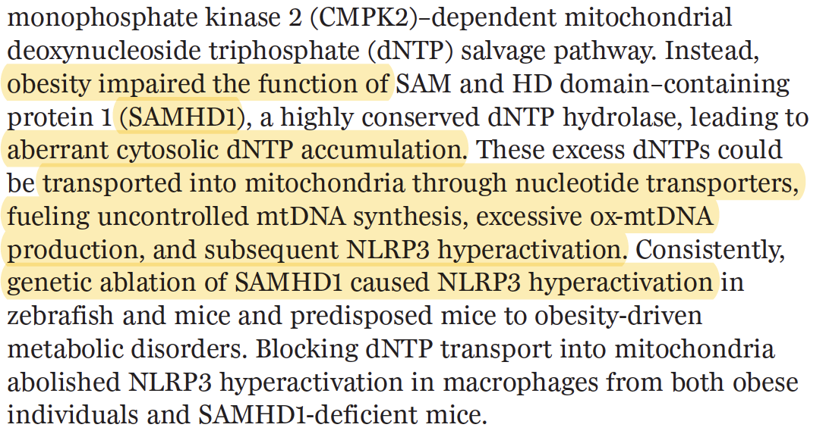
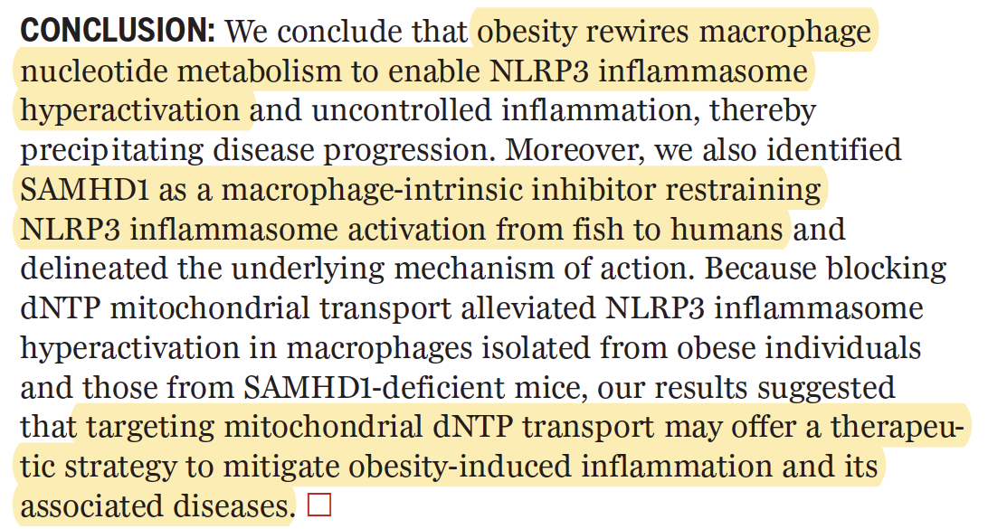

Slide 22
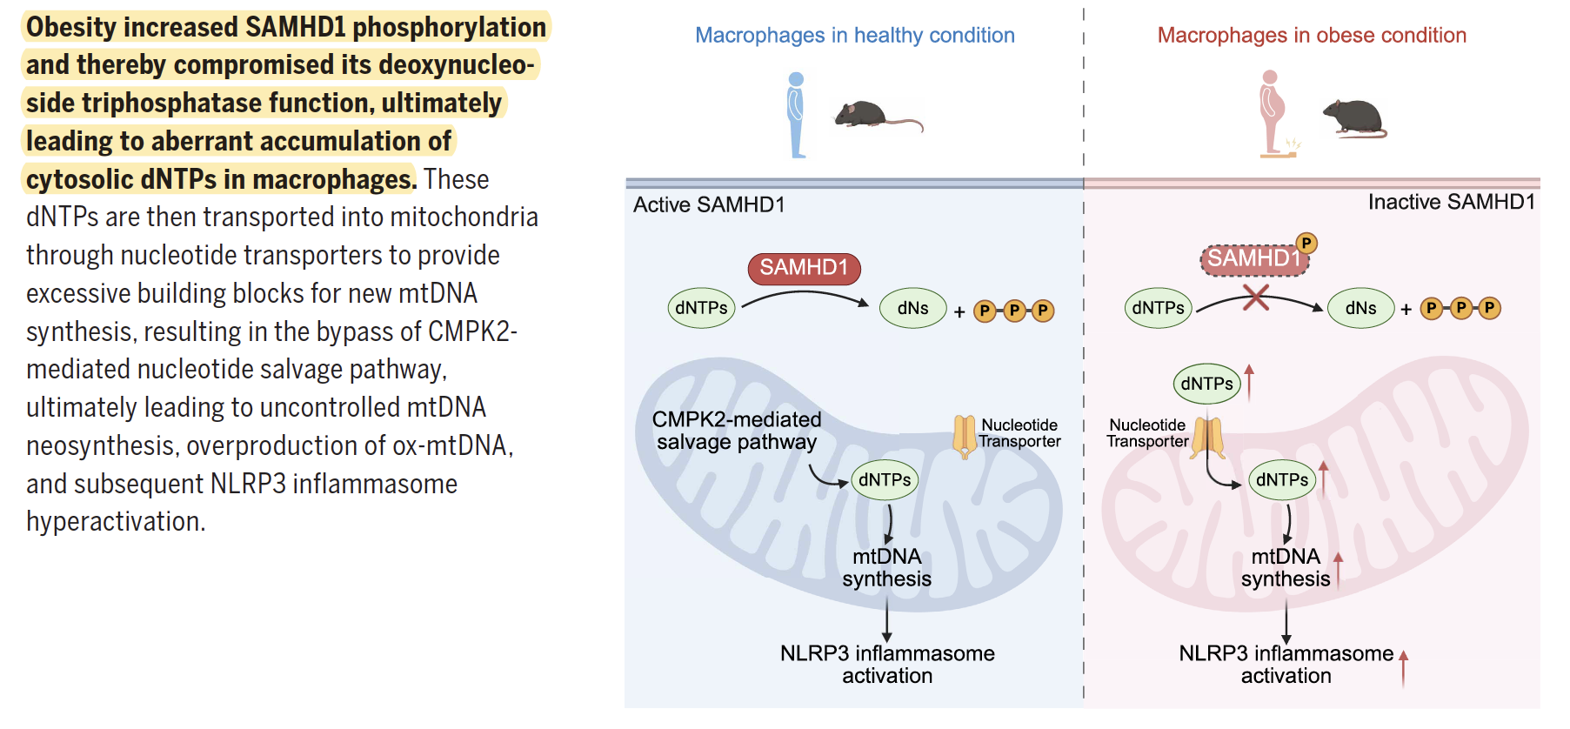

Slide 23

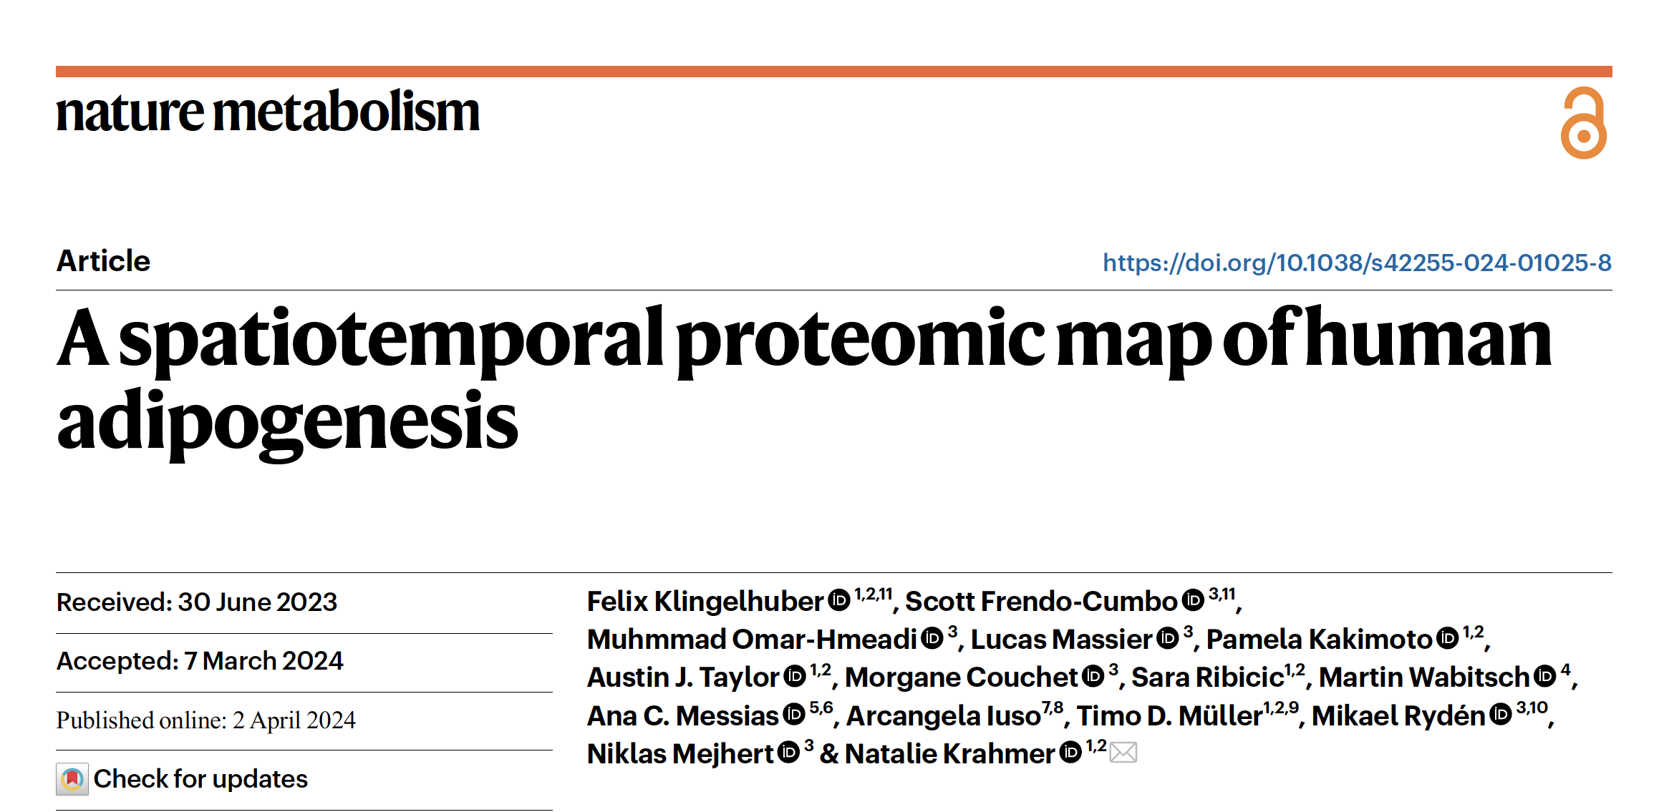

Slide 24
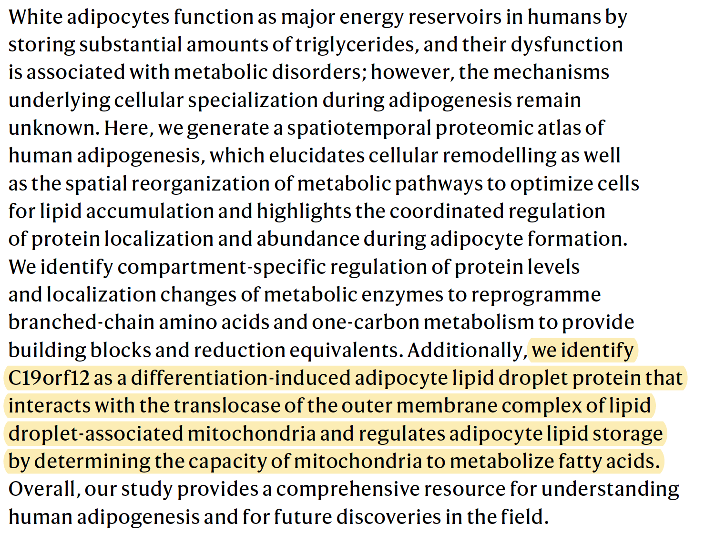

Slide 25
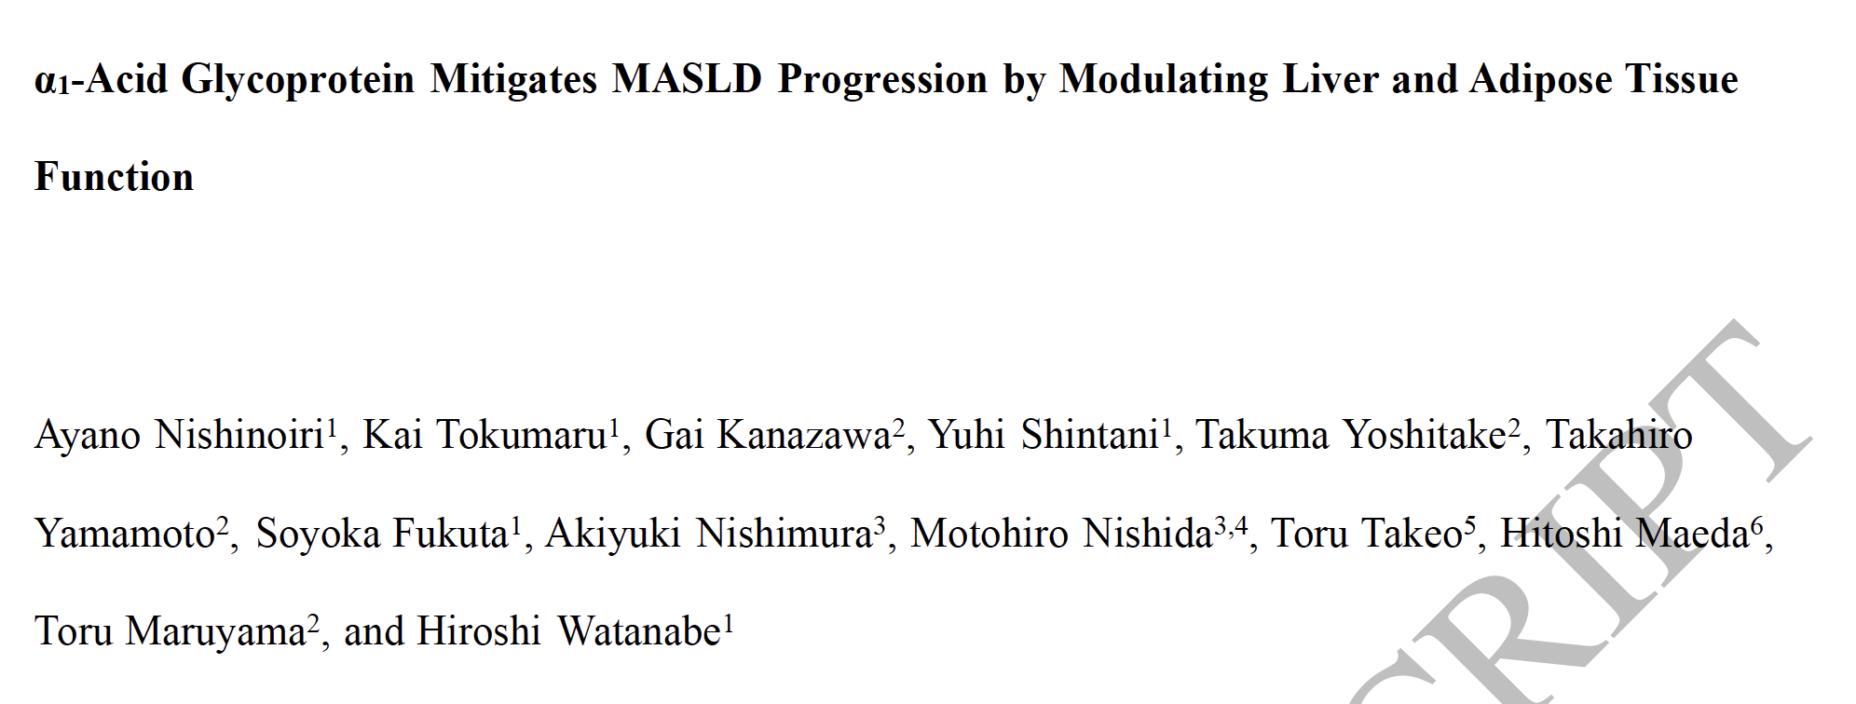
Endocrinology, bqag009, https://doi.org/10.1210/endocr/bqag009
Published: 14 January, 2026

Slide 26
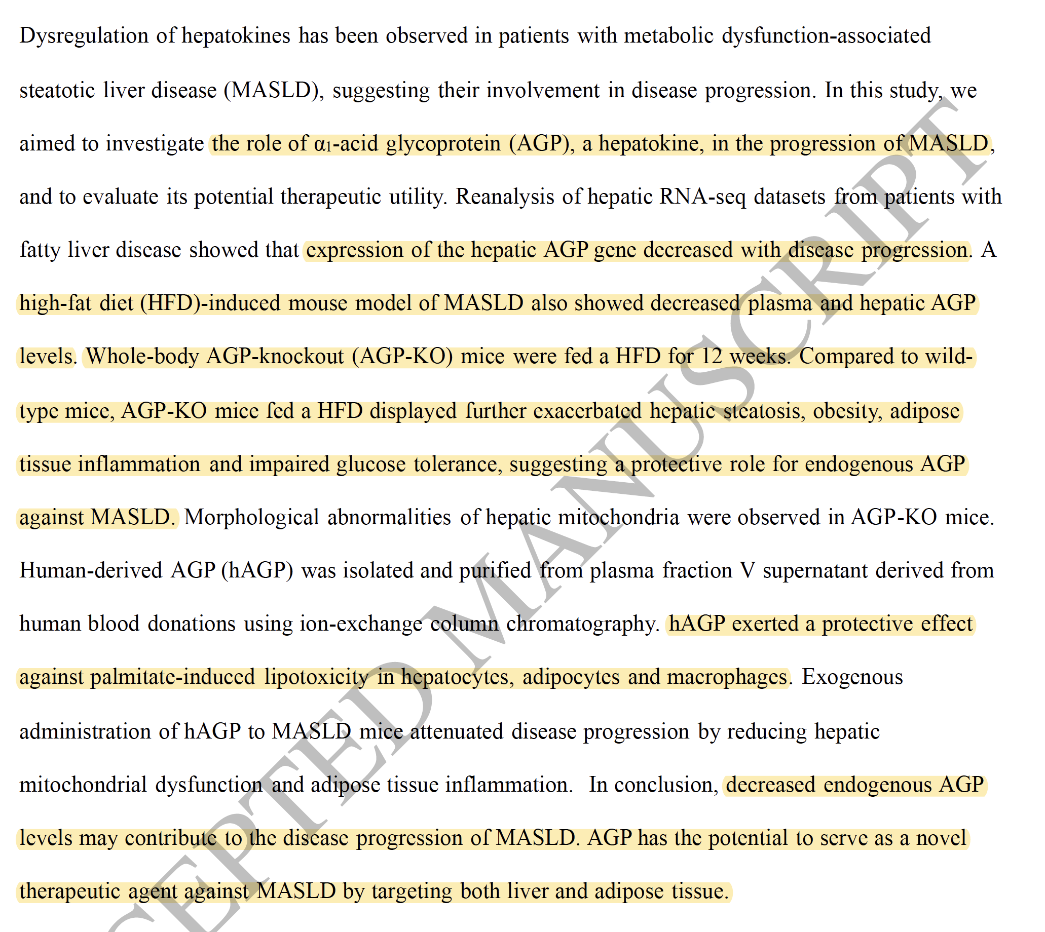

Slide 27
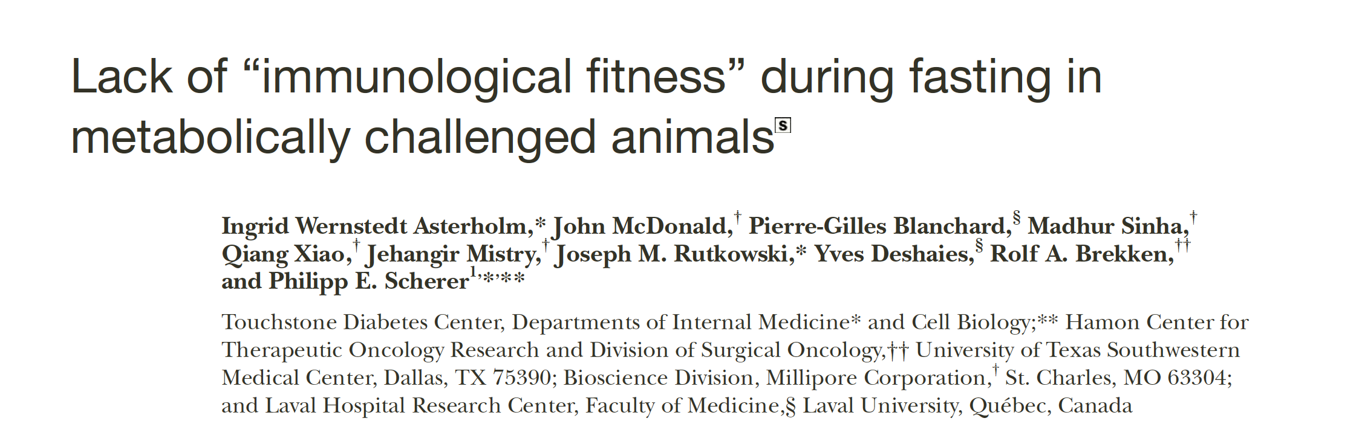

Slide 28
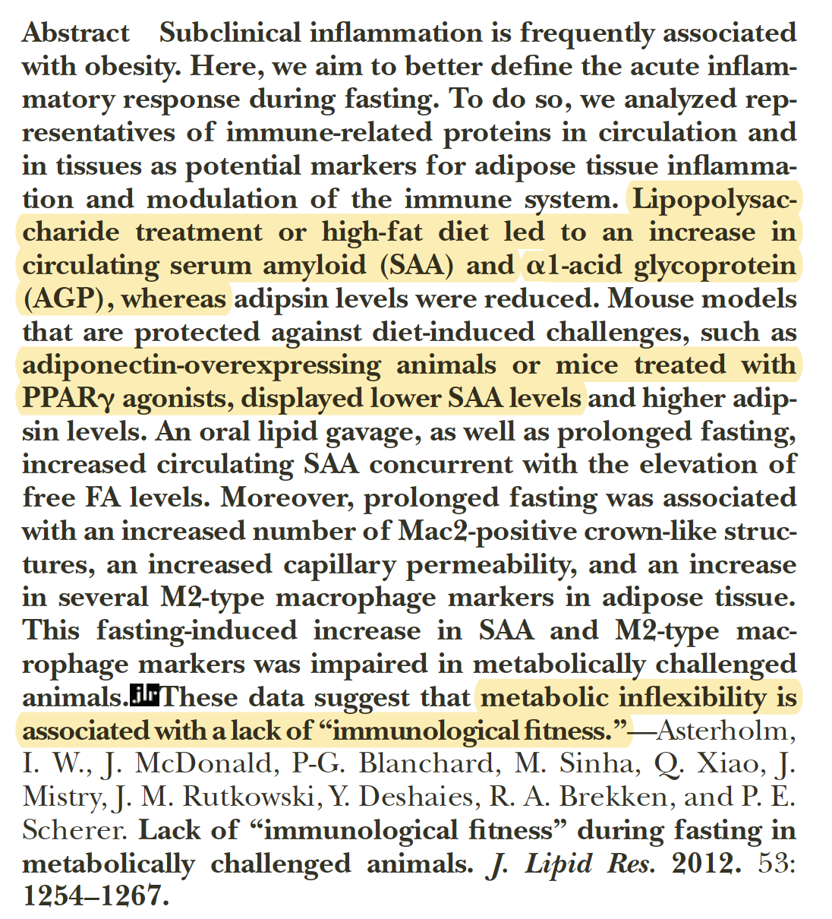

Slide 29
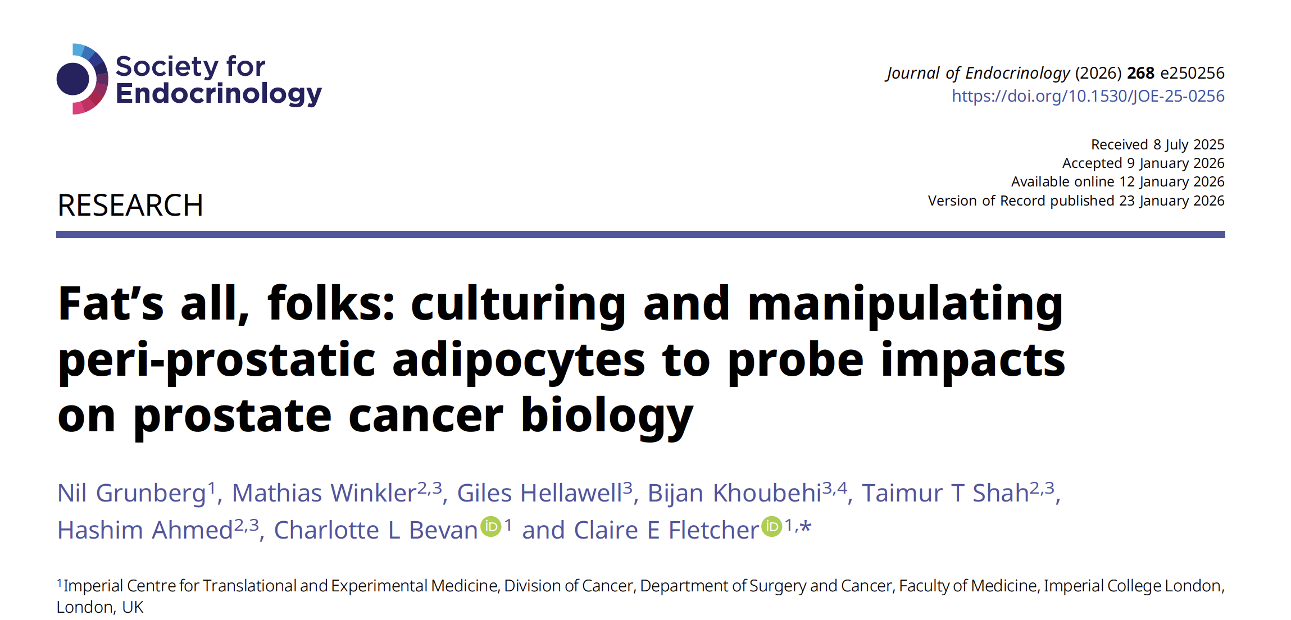

Slide 30


Slide 31
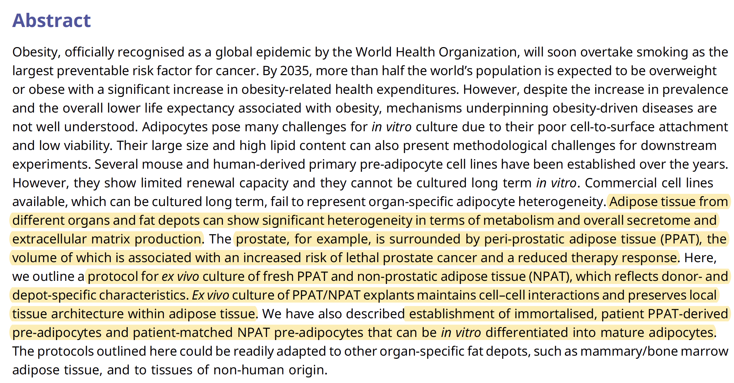
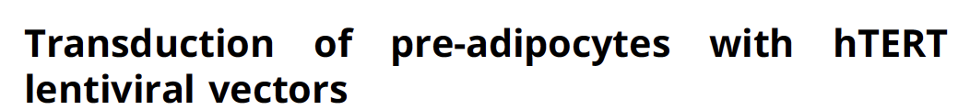

Slide 32
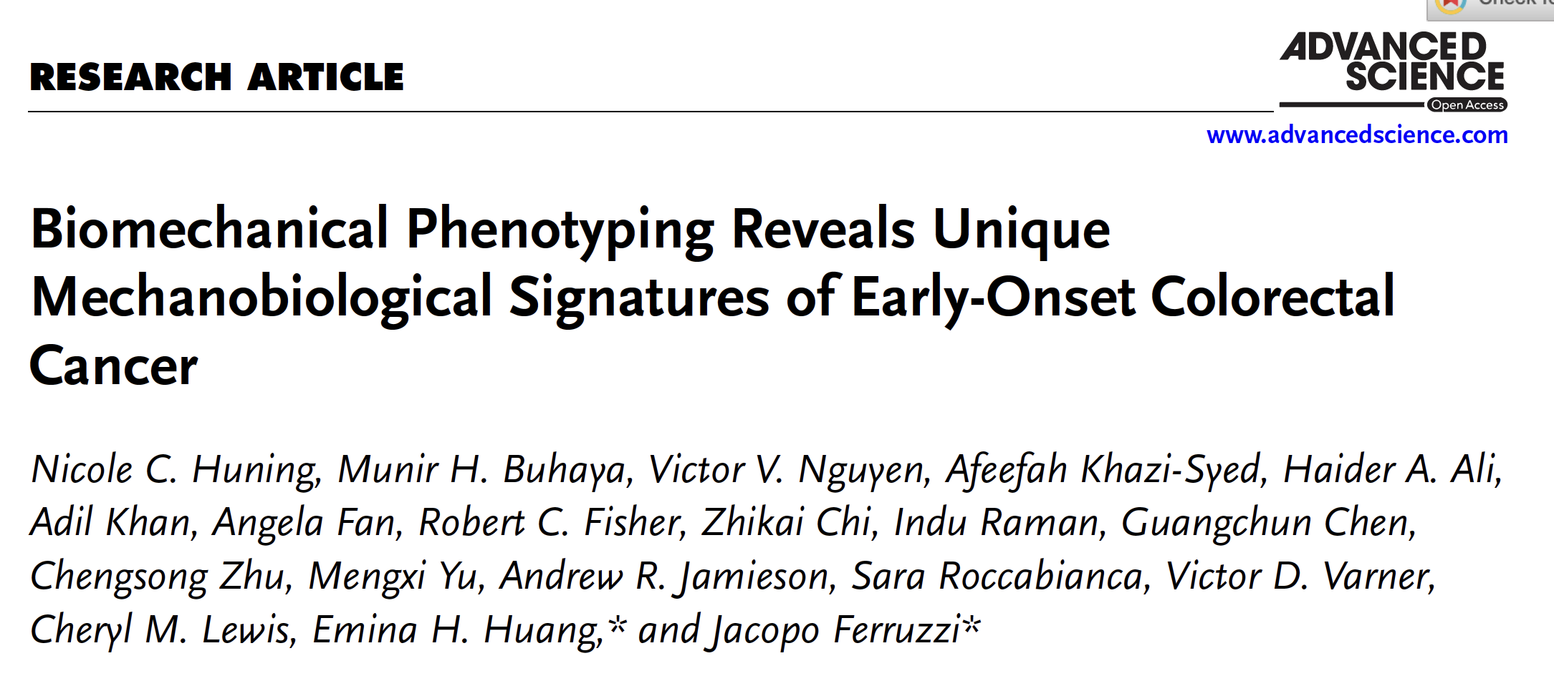


Slide 33
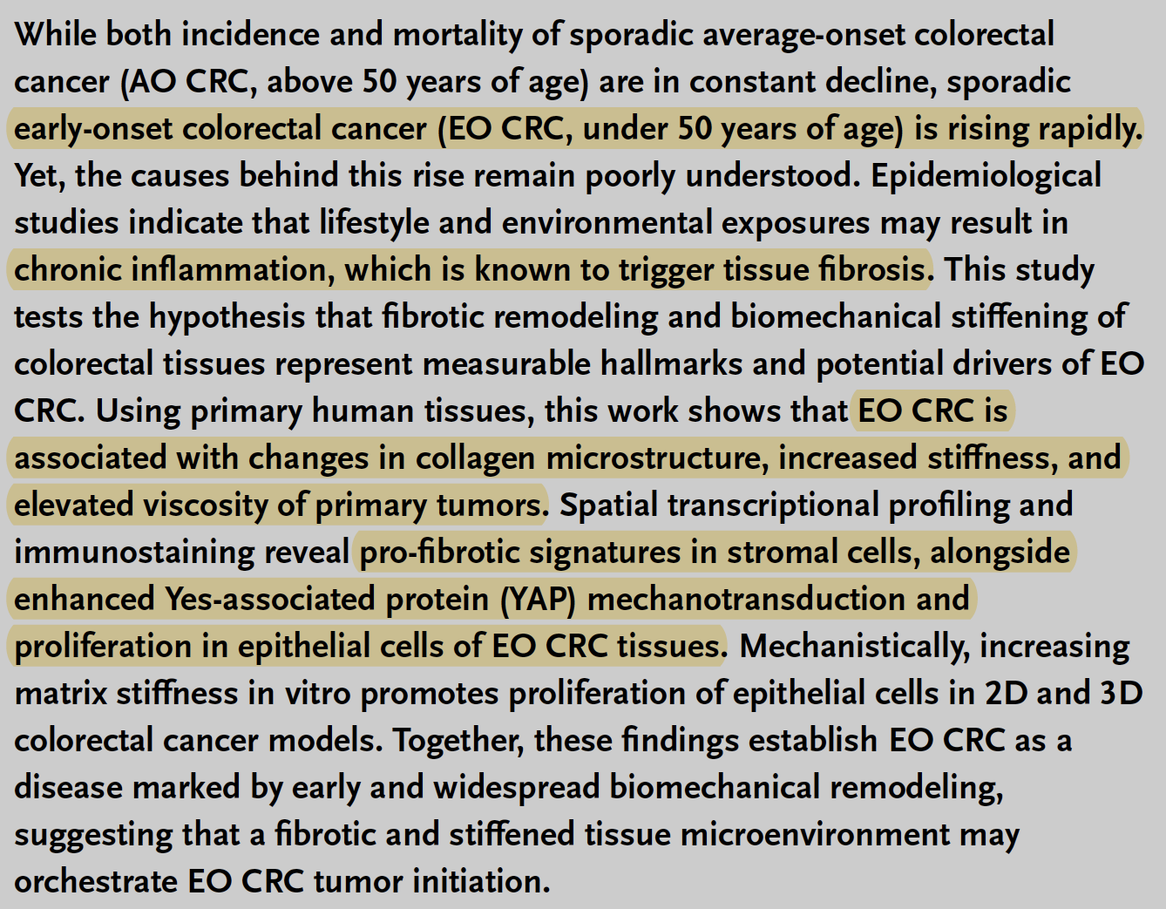

Slide 34
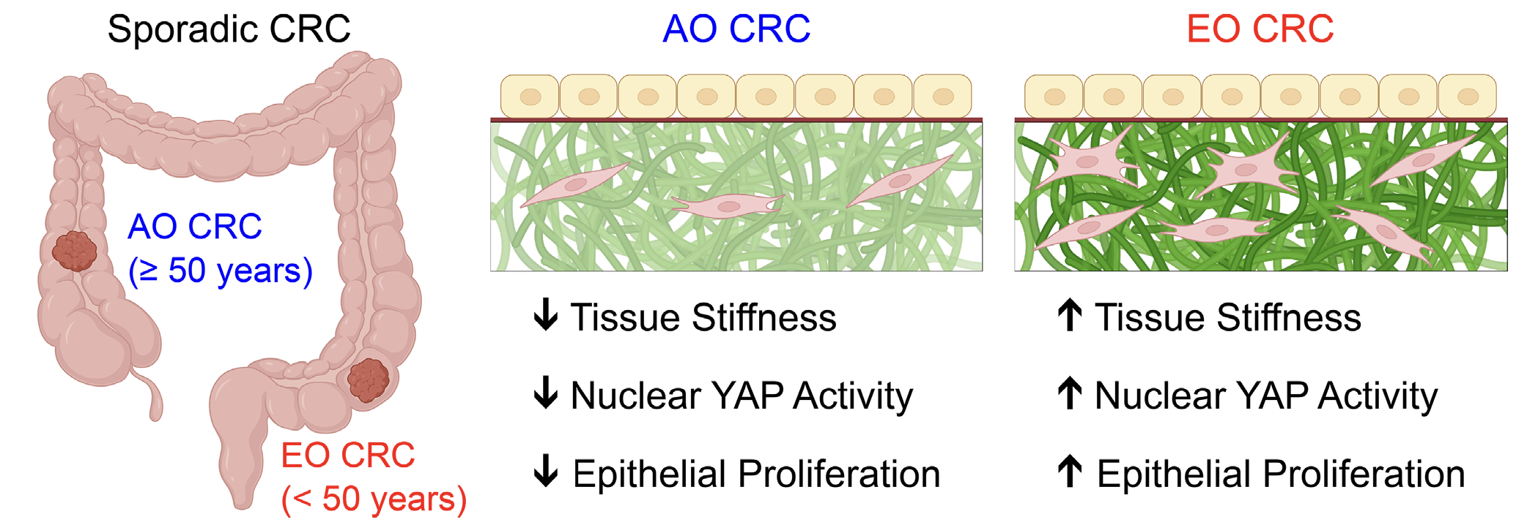

Slide 35
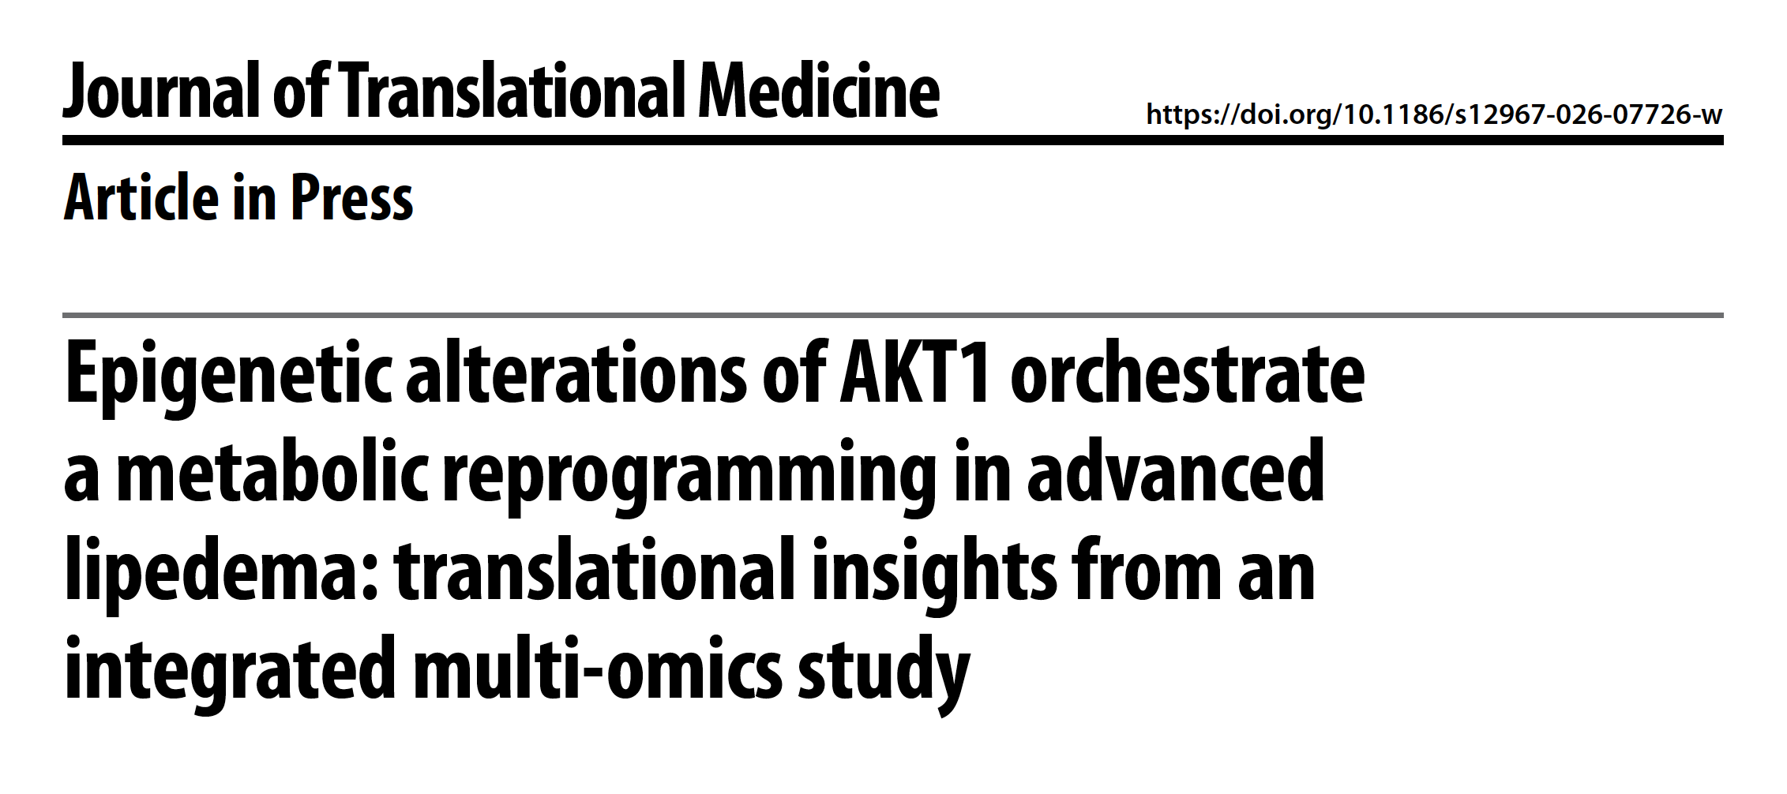
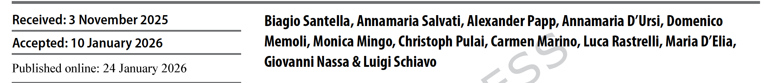

Slide 36
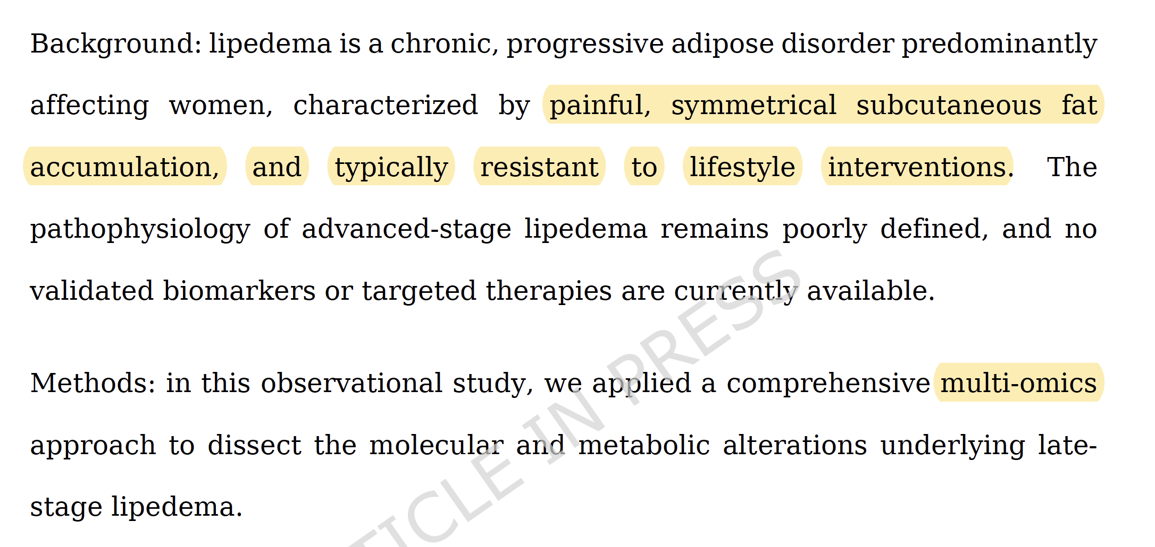

Slide 37
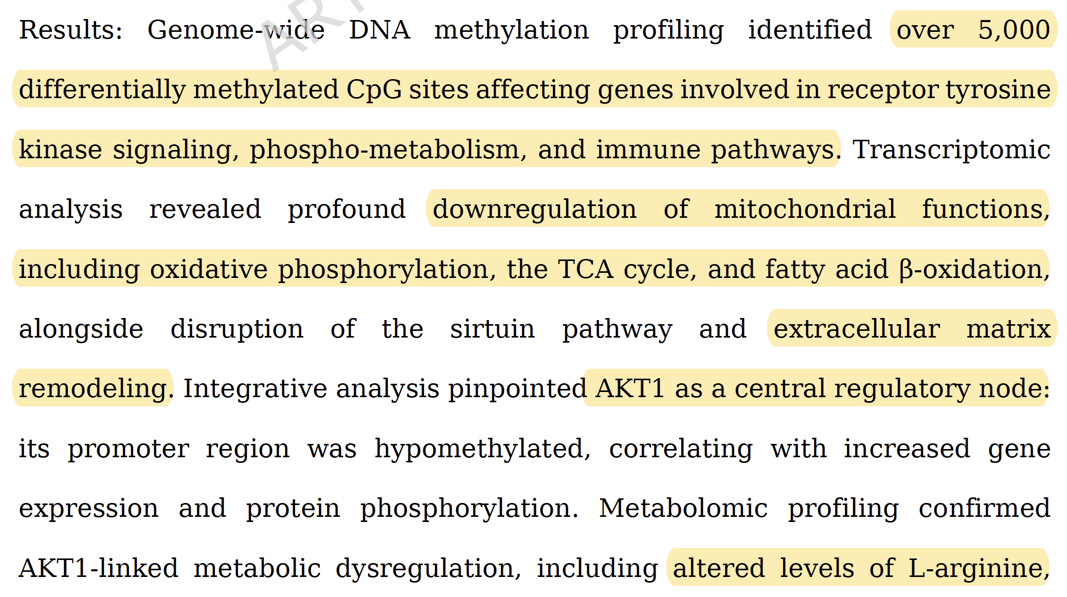
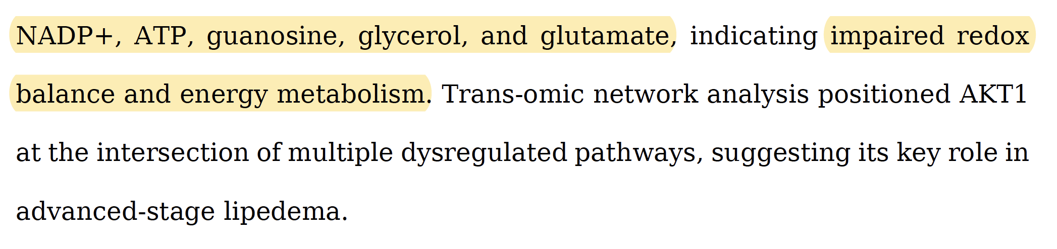

Slide 38
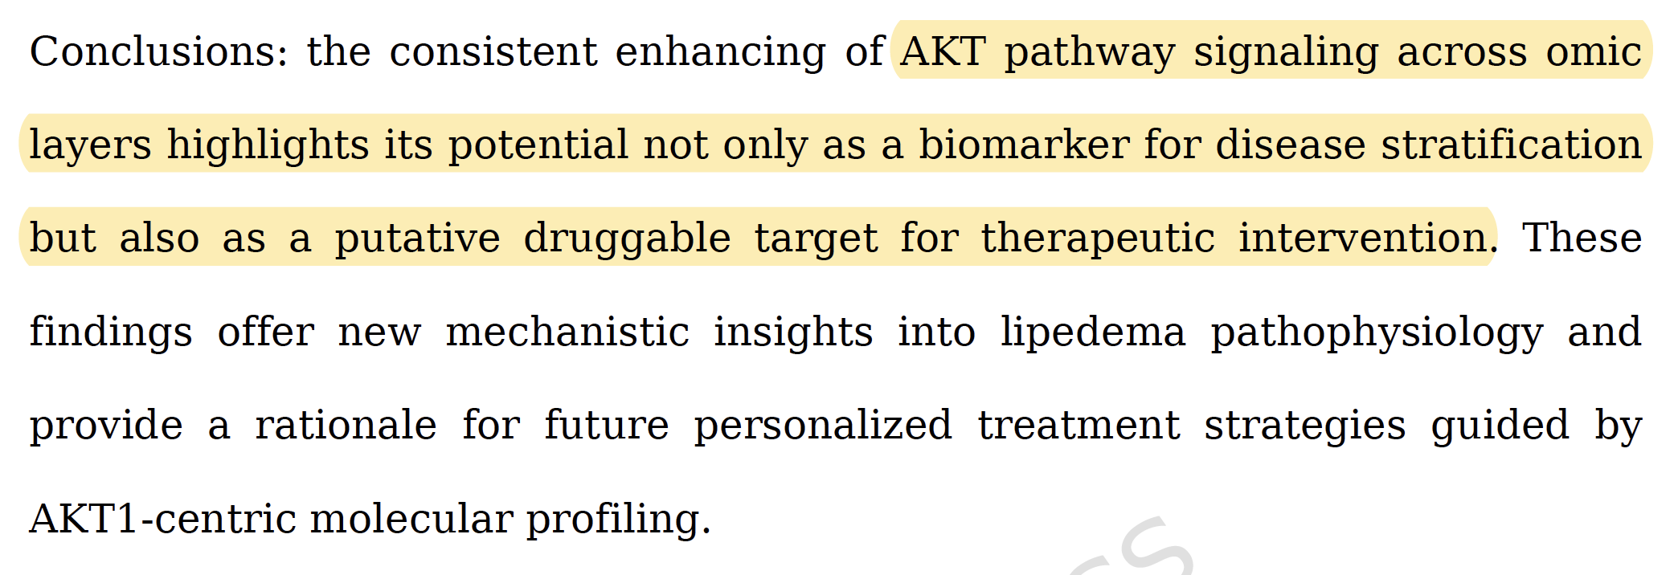

Slide 39
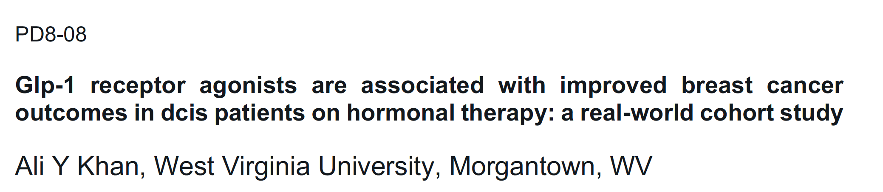
San Antonio Breast Cancer Conference: Abstracts

Slide 40
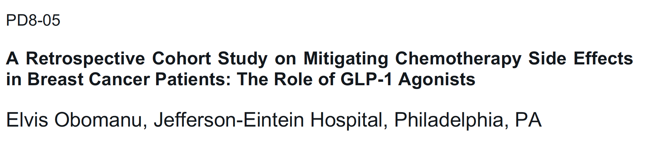
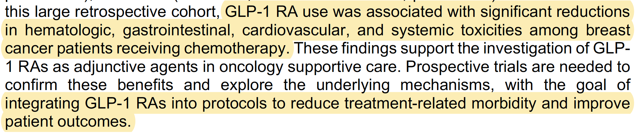
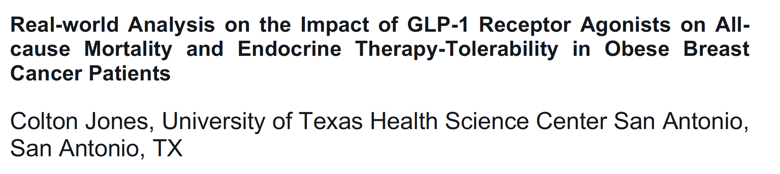


Slide 41


Slide 42




Slide 43


Slide 44


Slide 45


Slide 46



Slide 47


Slide 48


Slide 49


Slide 50


Slide 51


Slide 52


Slide 53

G0S2 (G0/G1 Switch Gene 2) is a potent protein inhibitor of Adipose Triglyceride Lipase (ATGL), the rate-limiting enzyme in triglyceride breakdown (lipolysis). It binds to ATGL to inhibit fatty acid mobilization. Catabolism of stable Colored Bone Marrow Adipose Tissue (cBMAT) occurs via downregulating G0S2, enabling ATGL-driven lipase activation independent of typical catecholamine signaling.

Slide 54



Slide 55


Slide 56


