Slide 1

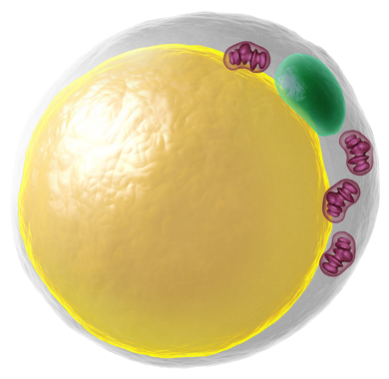

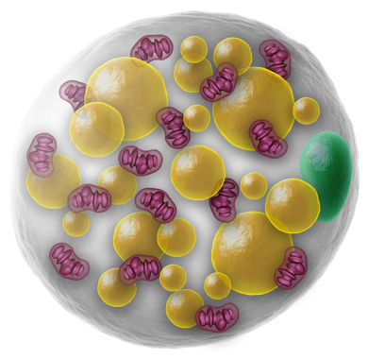
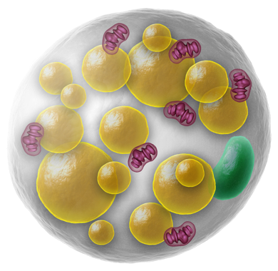
Literature Overview
Touchstone Diabetes Center
UTSW Medical Center 7/6/2026

Slide 2
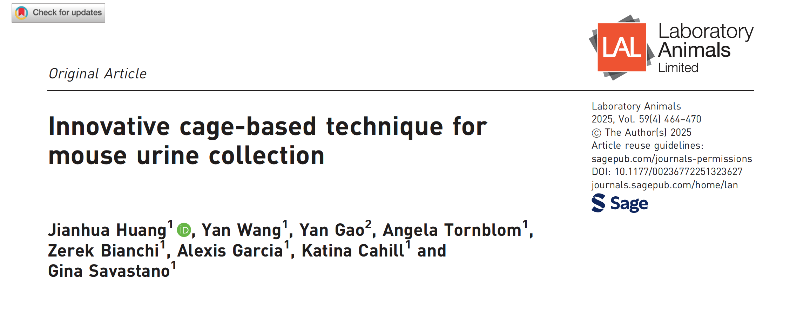
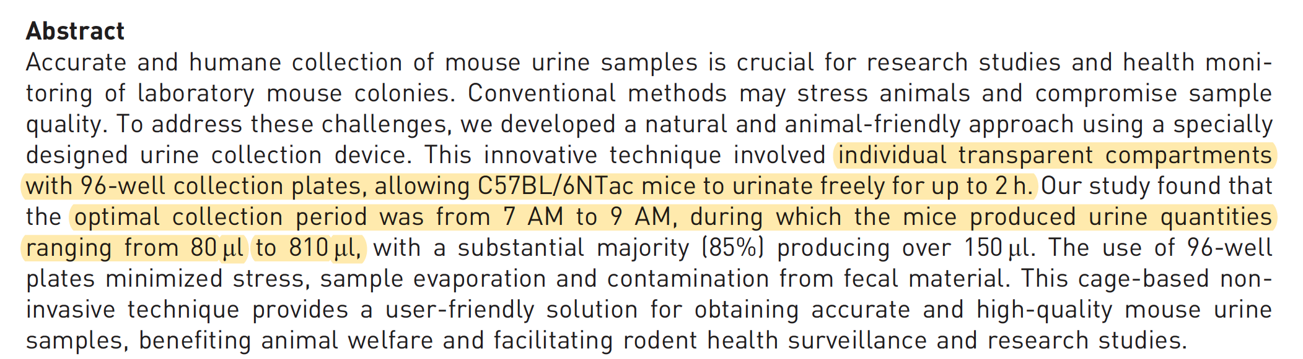

Slide 3
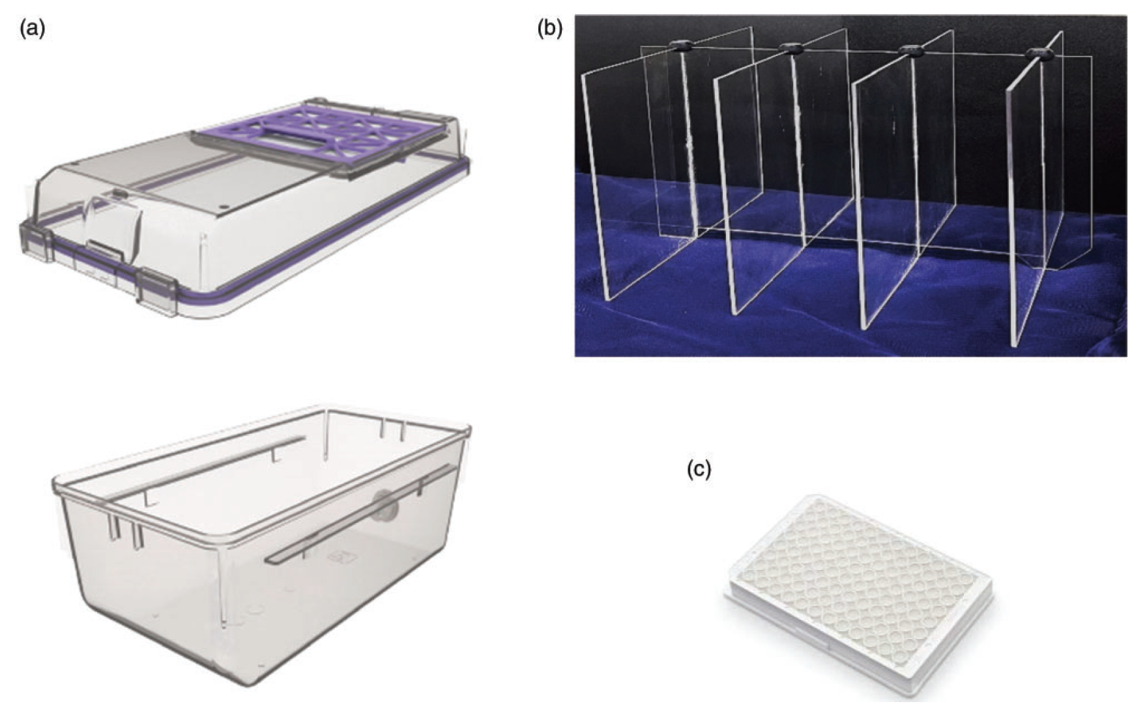
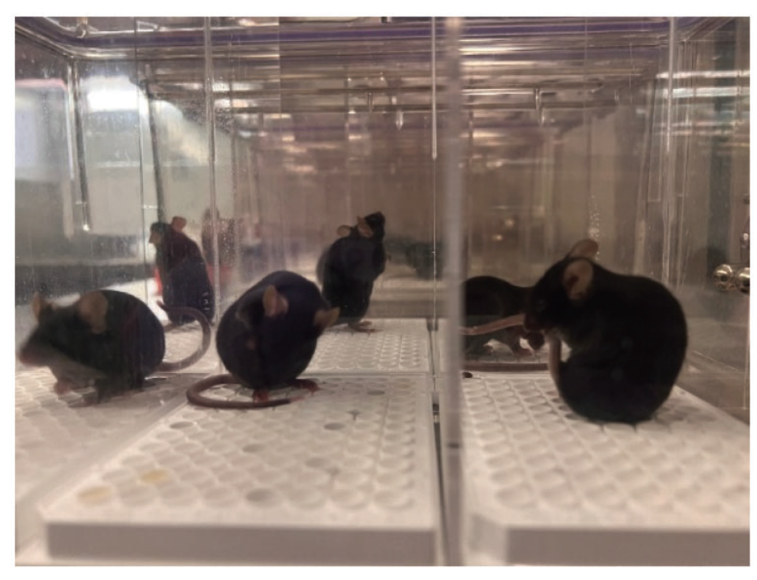
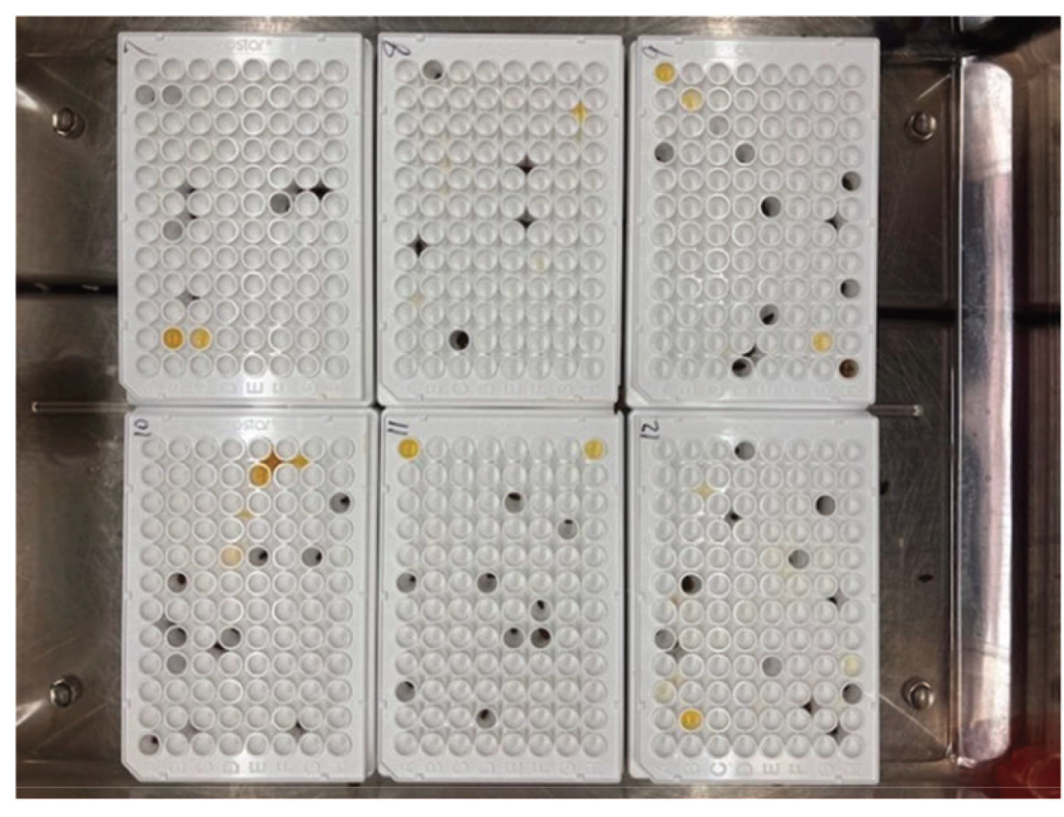

Slide 4
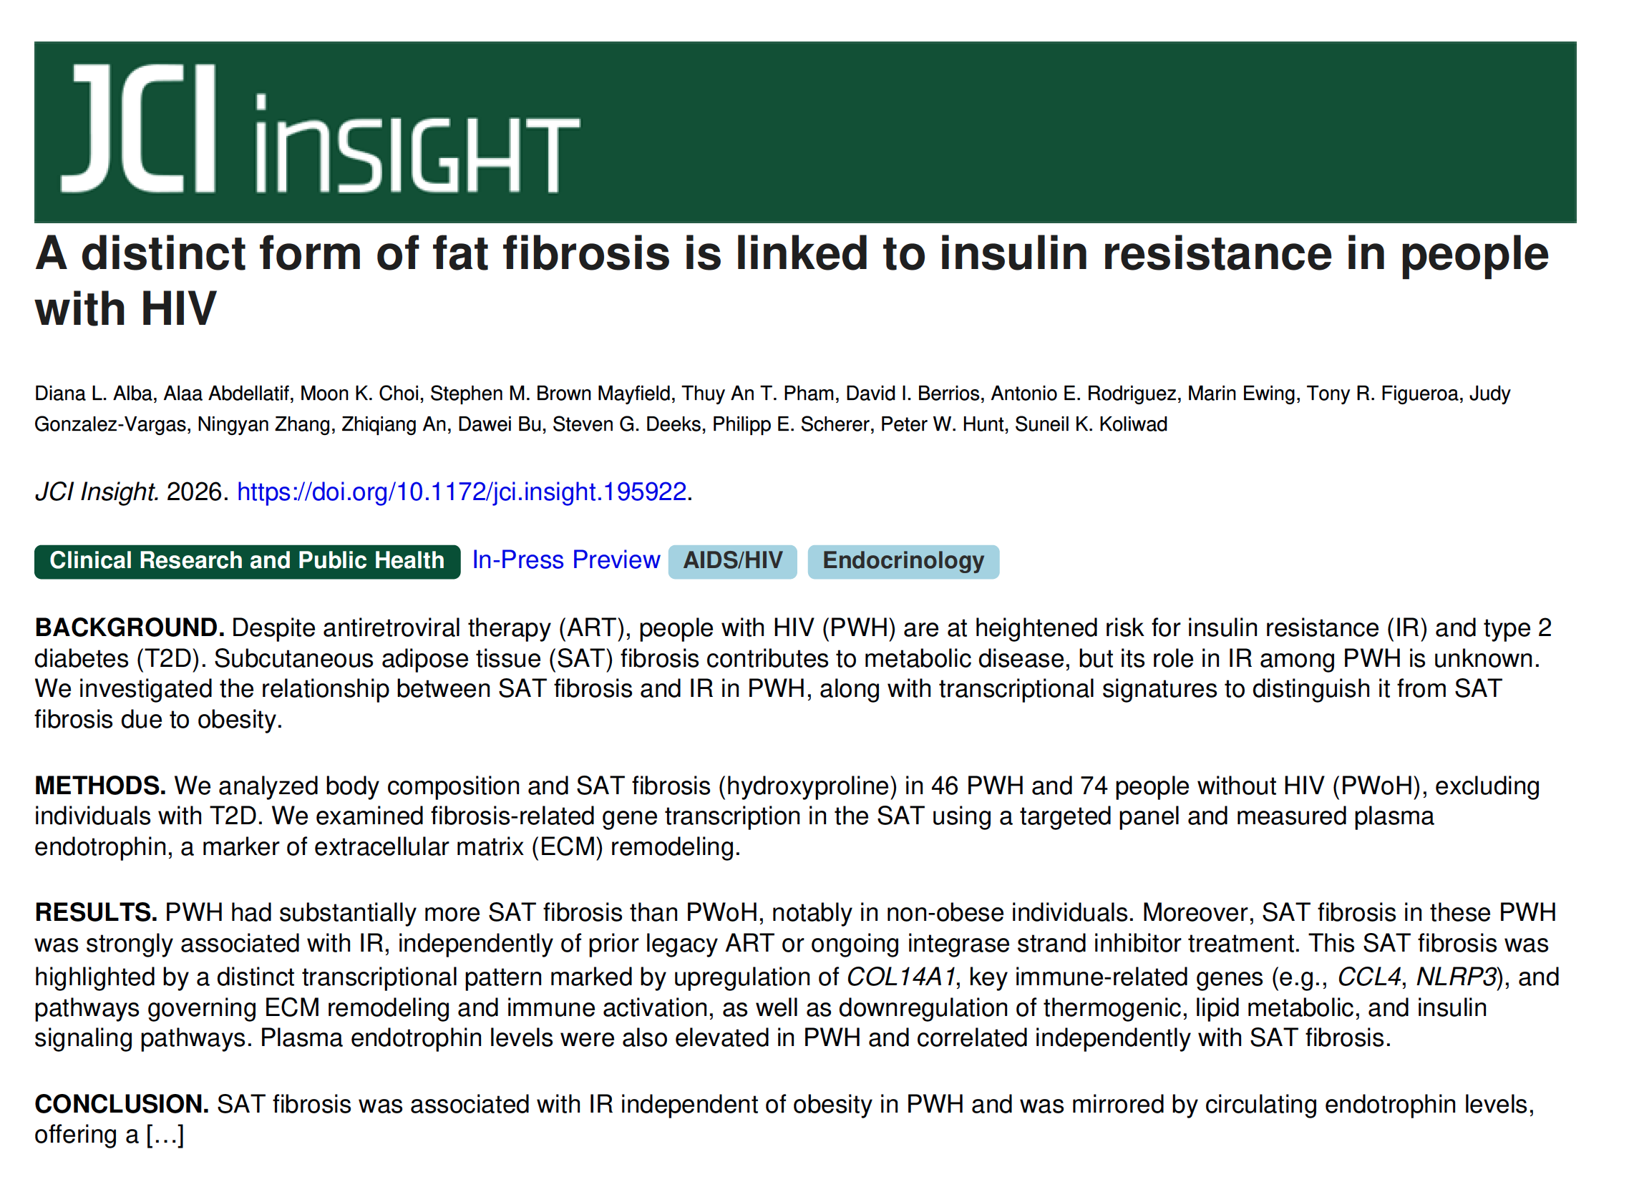

Slide 5
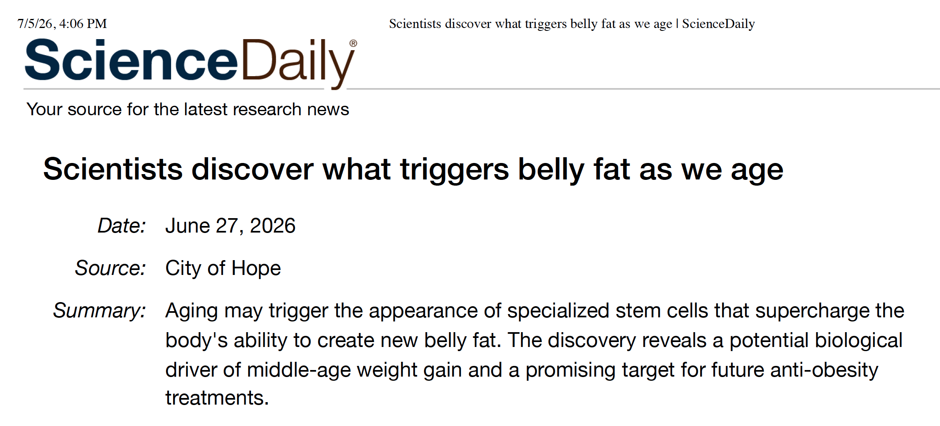
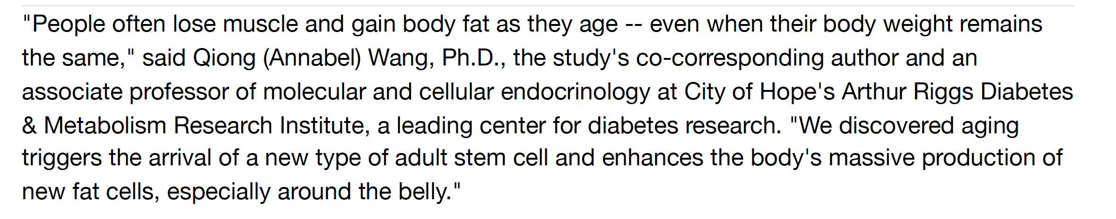

Slide 6
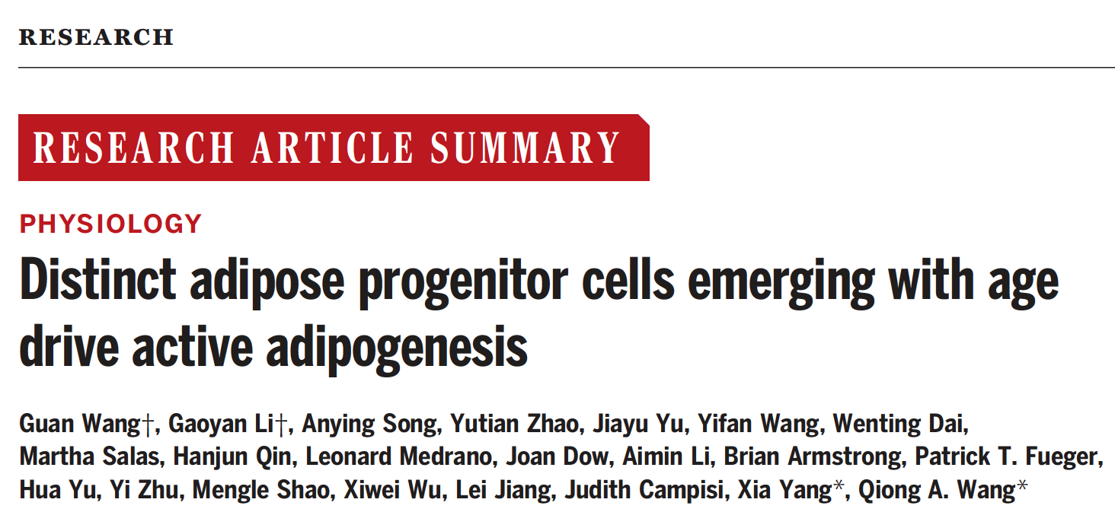


Slide 7
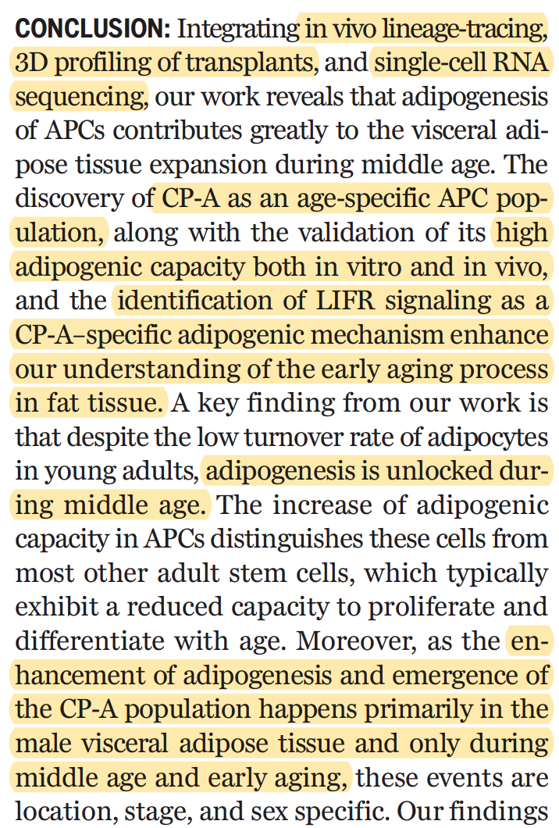
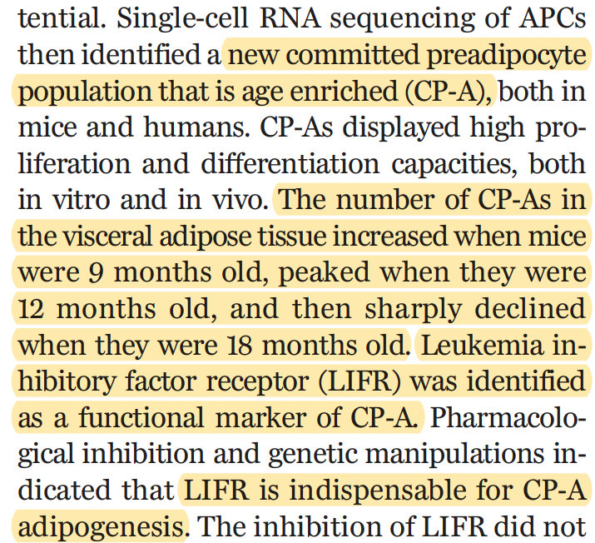

Slide 8
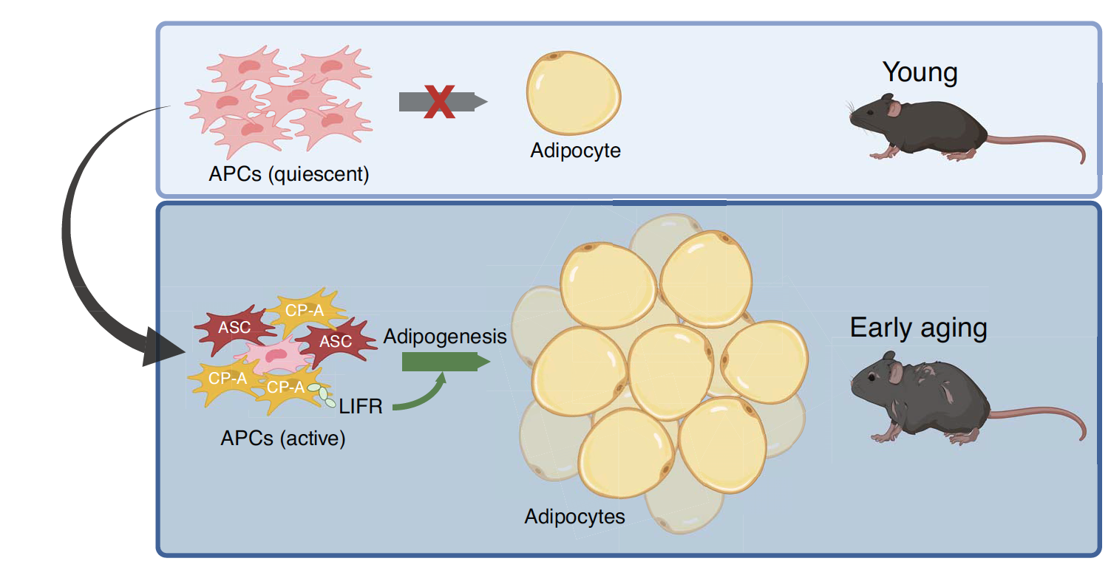

Slide 9
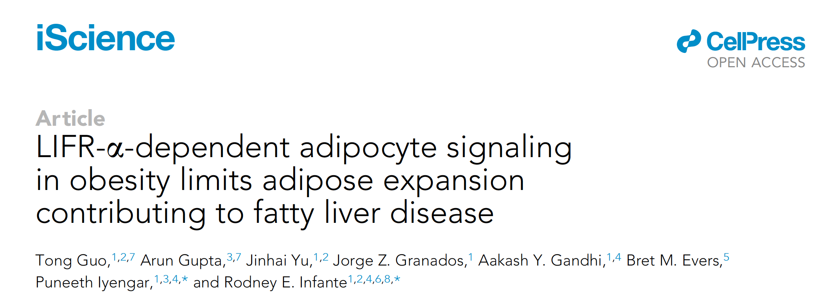

Using purified LIF, Dr. Infante and his group found that they could induce cachexia in animals
and study it without the confounding influence of cancer. What they learned is that LIF activates
triglyceride lipolysis in adipocytes via the JAK/STAT3 signaling pathway. It also alters the
expression of other cytokines such as IL-6 and leptin. Together, these changes affect the
JAK/STAT3 pathway in the hypothalamus, which can cause an anorexic-like phenotype,
adding to the patient’s weight loss. UTSW Press Release, March 4, 2022.

Slide 10
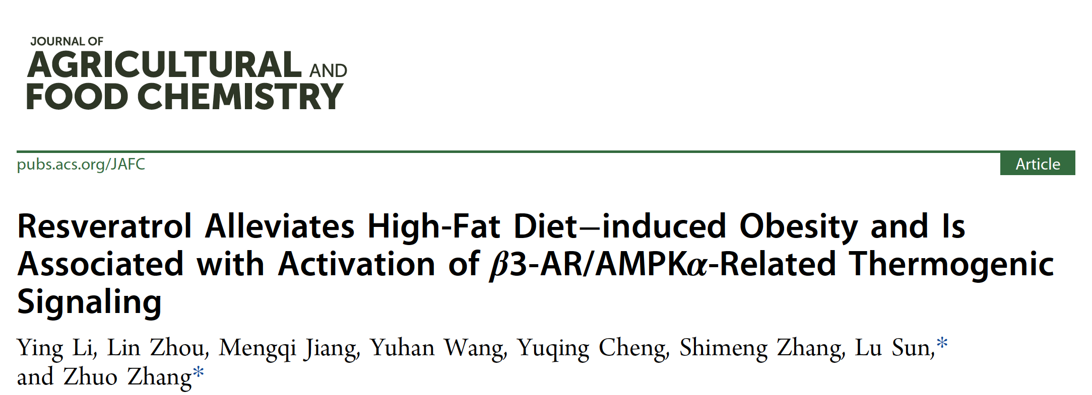


Slide 11
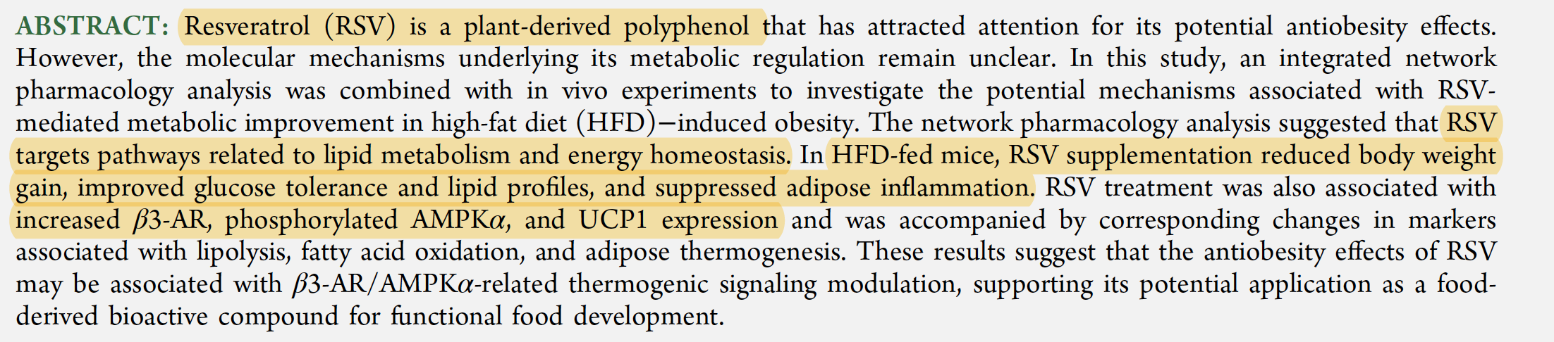
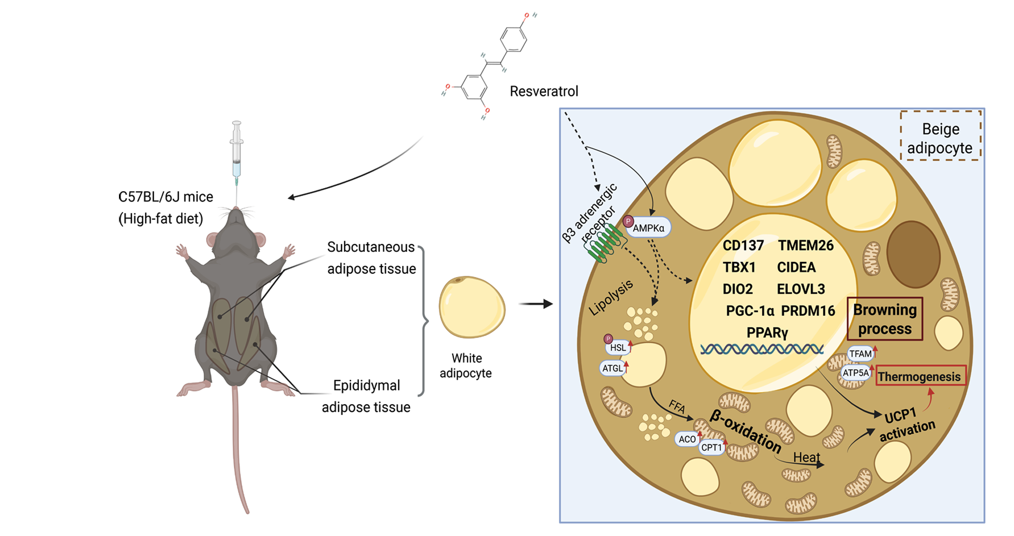

Slide 12

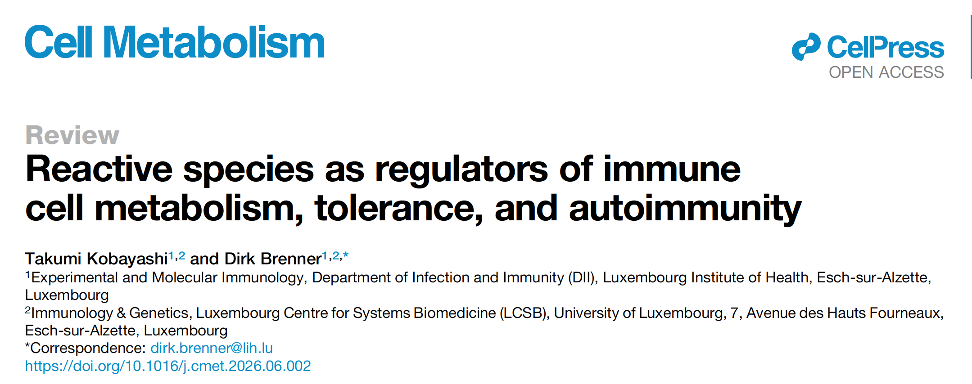

Slide 13
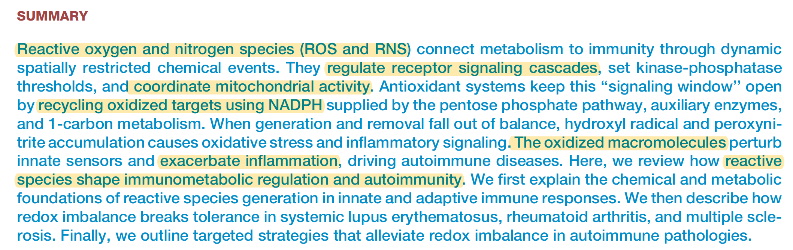

Slide 14
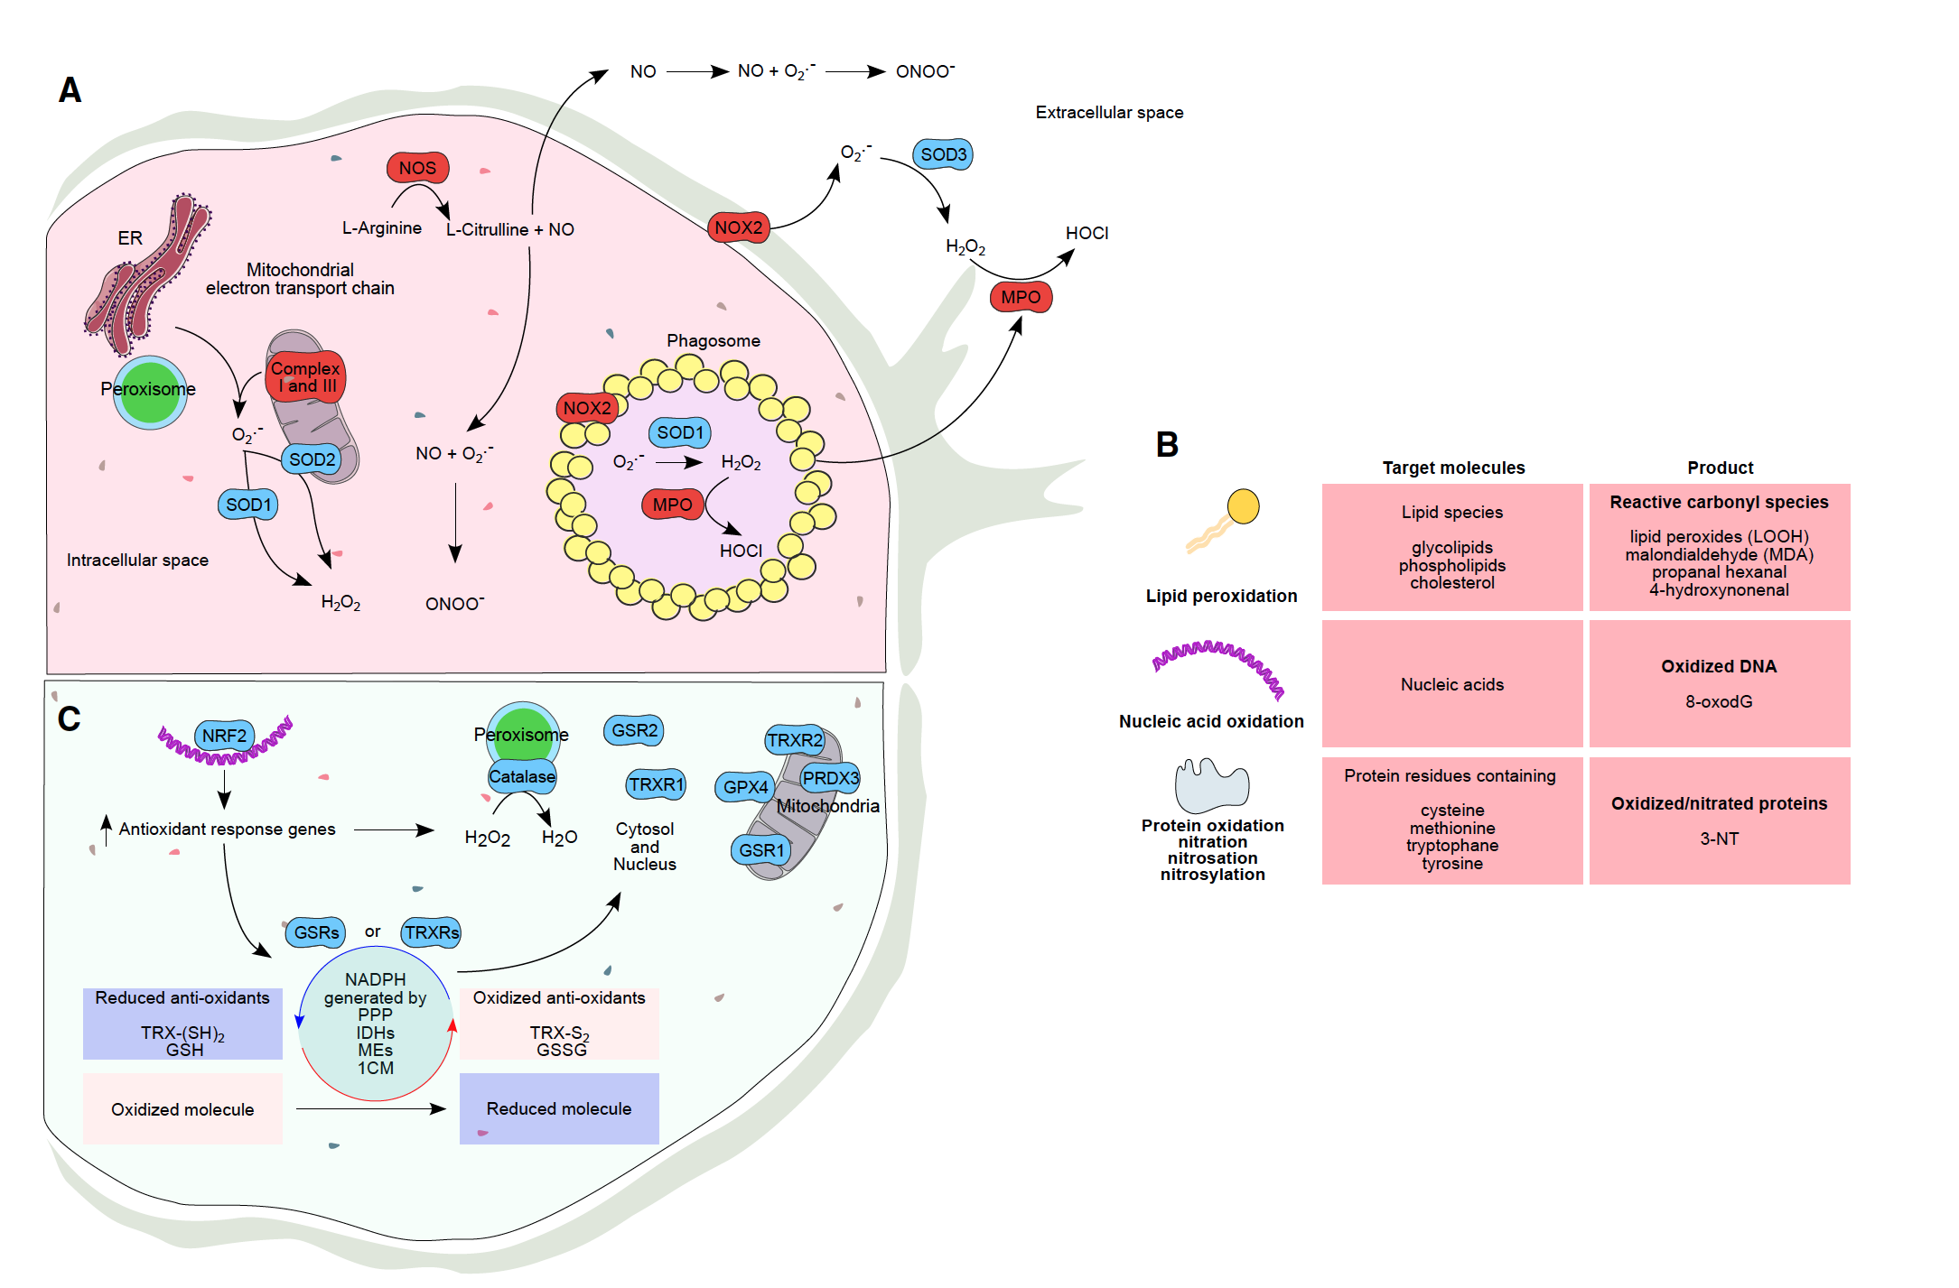

Slide 15
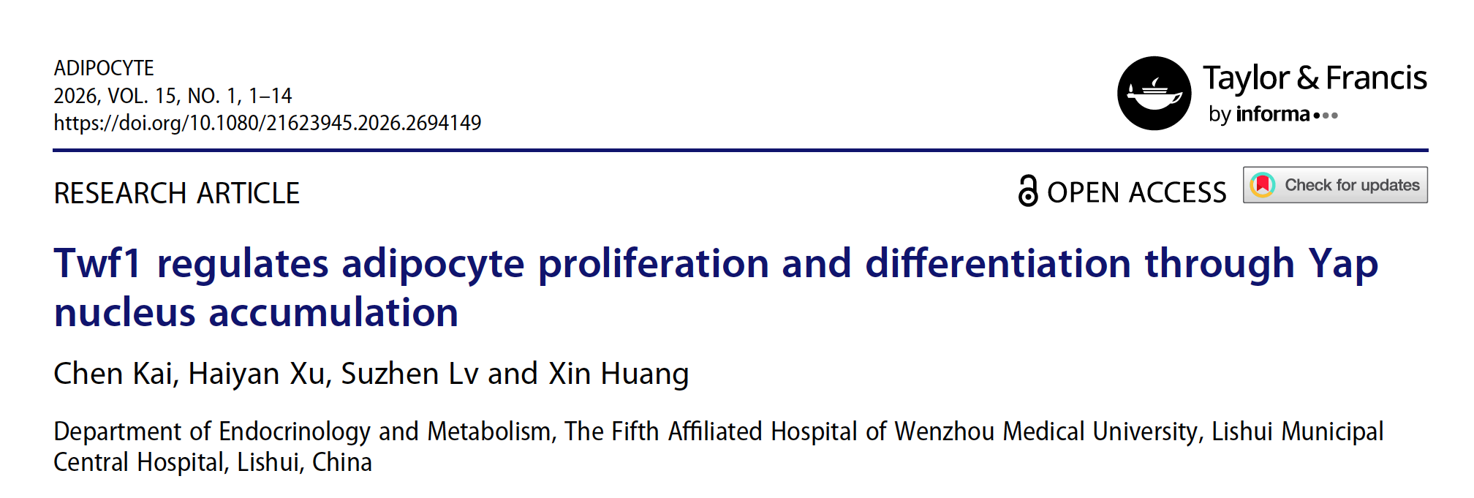

Slide 16
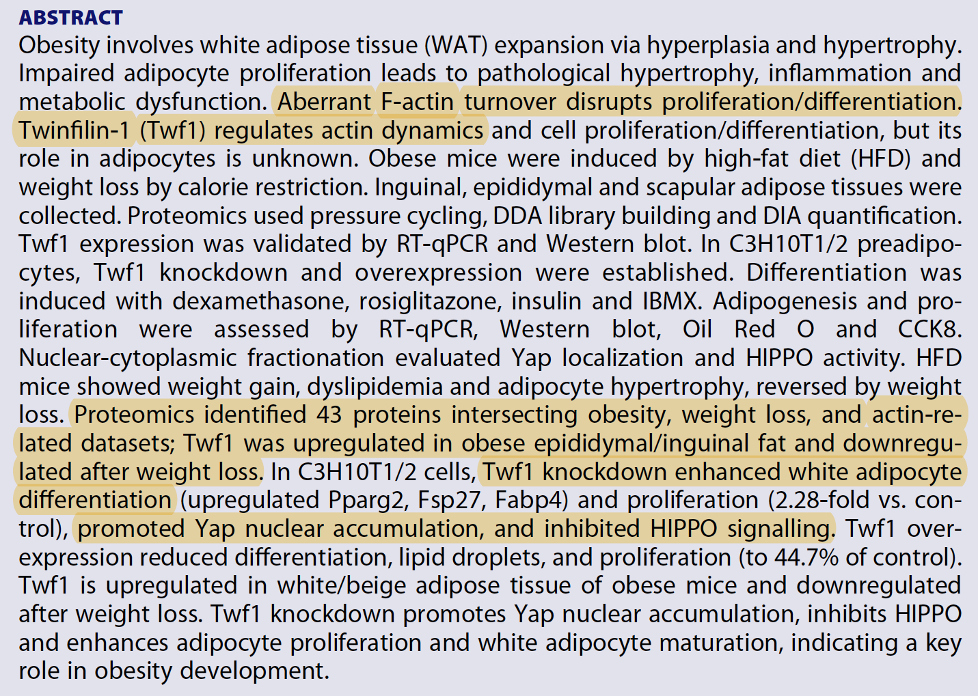

Slide 17

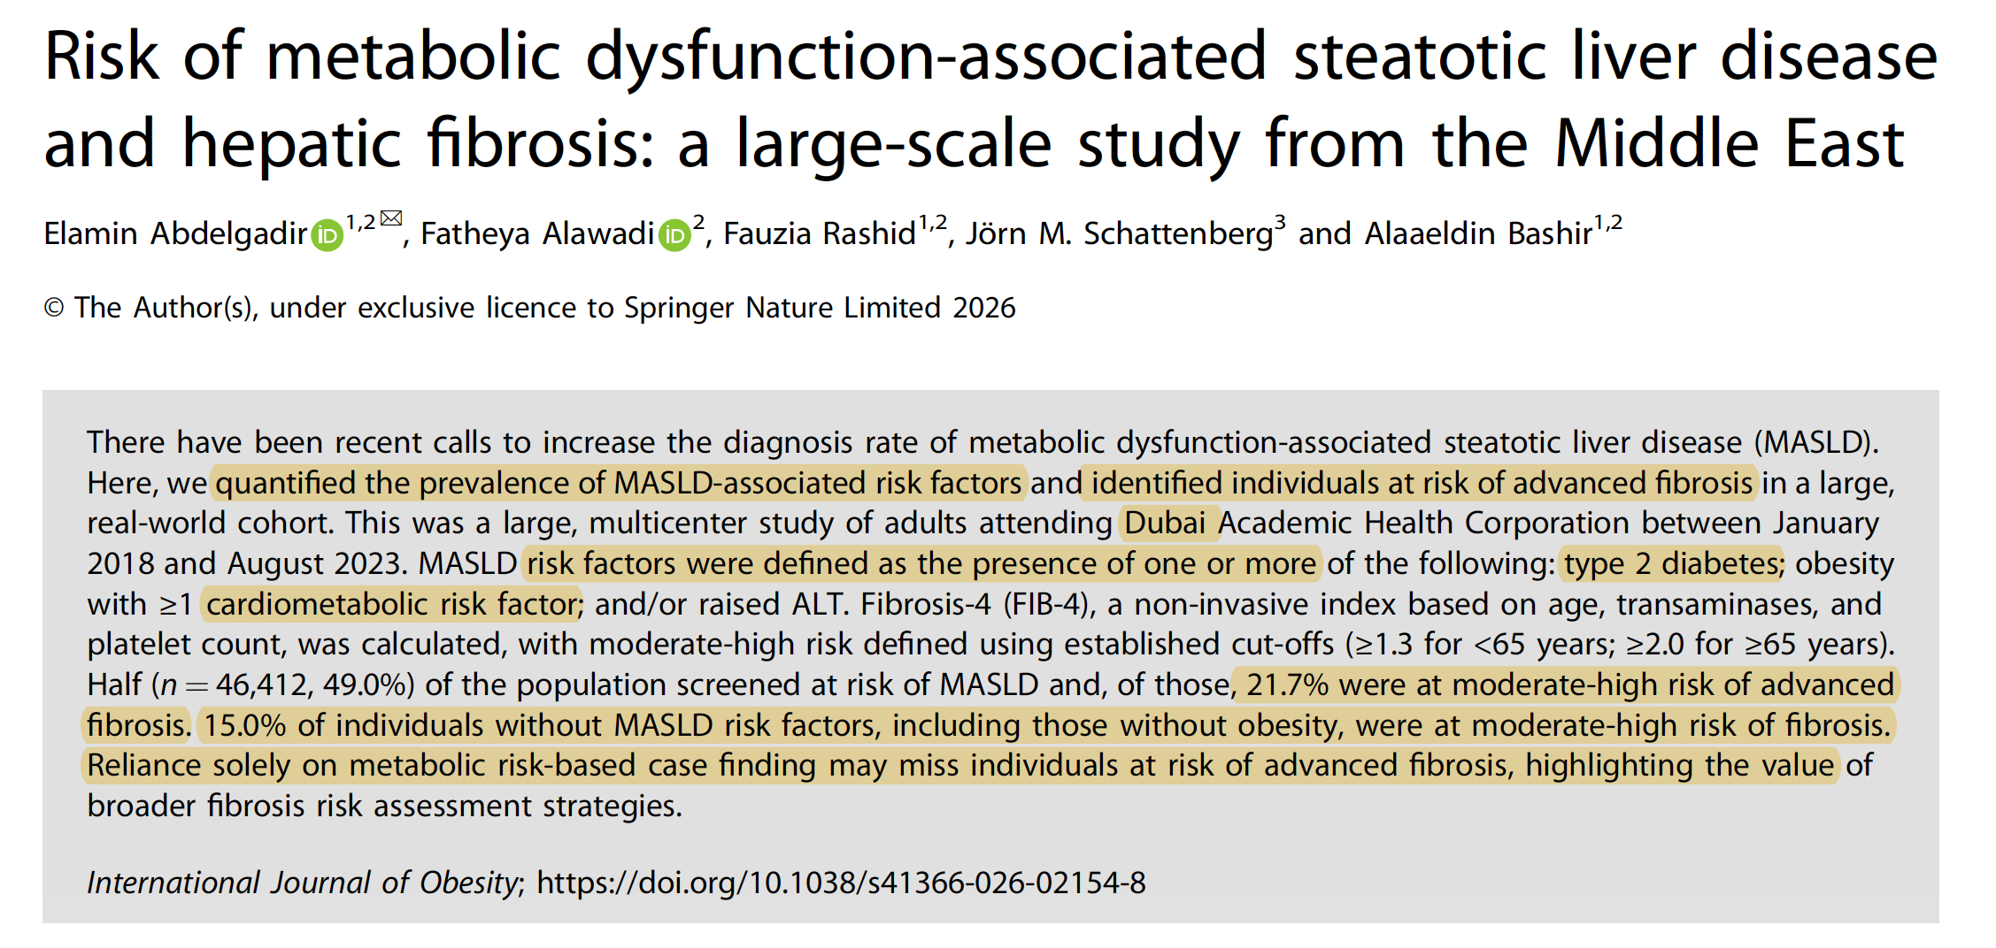

Slide 18
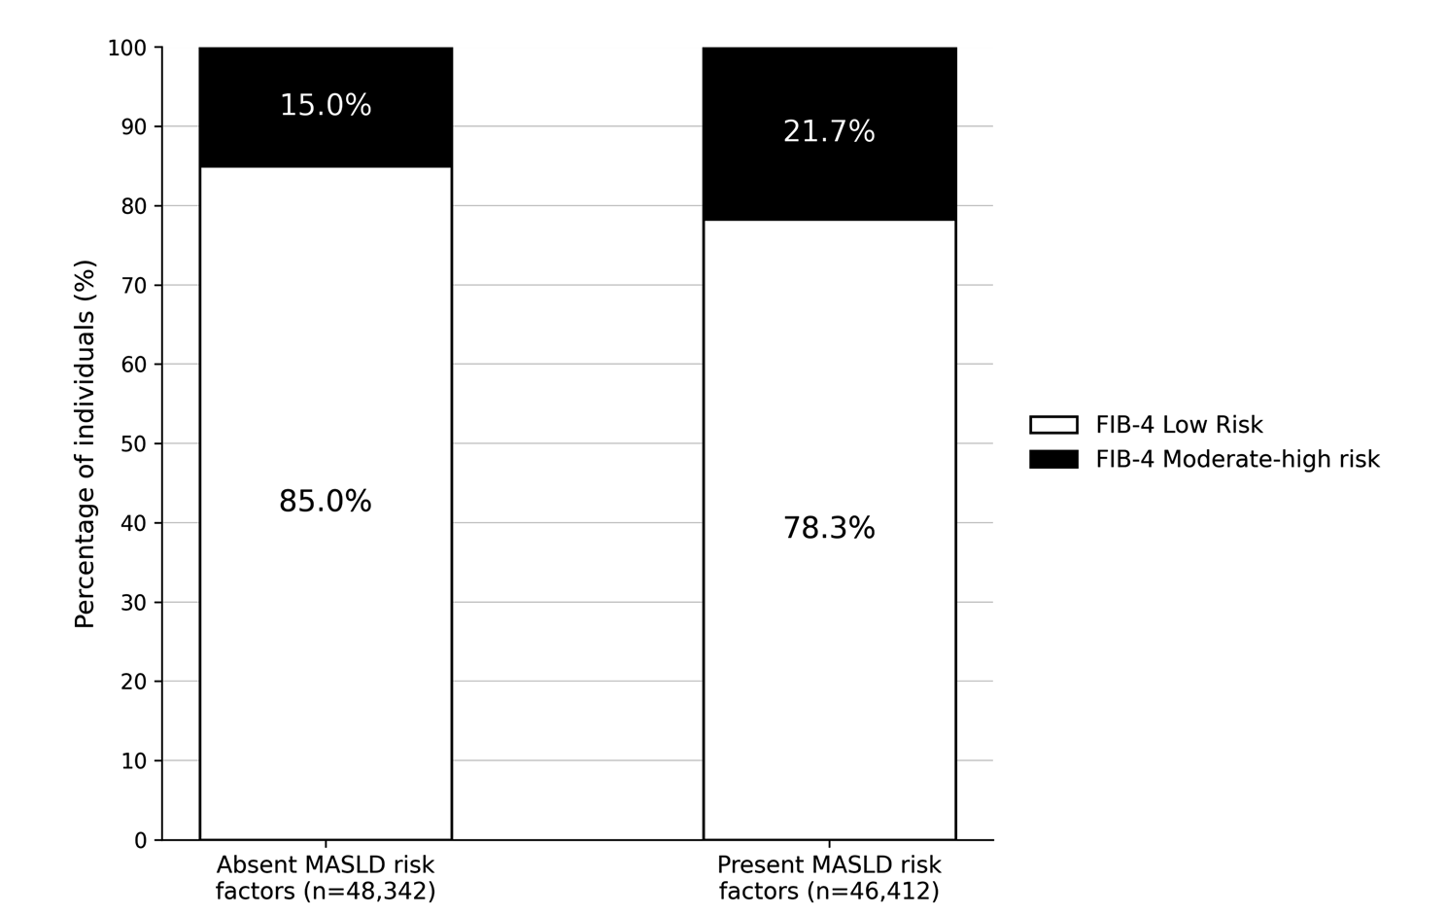

Slide 19

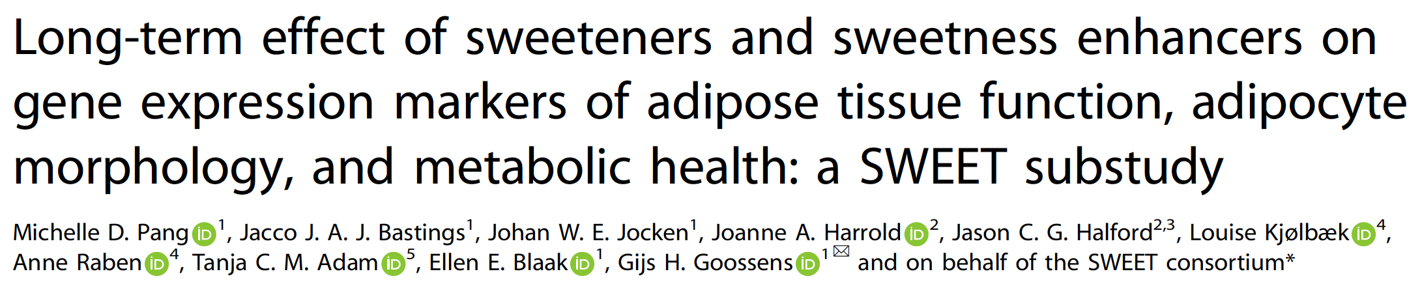
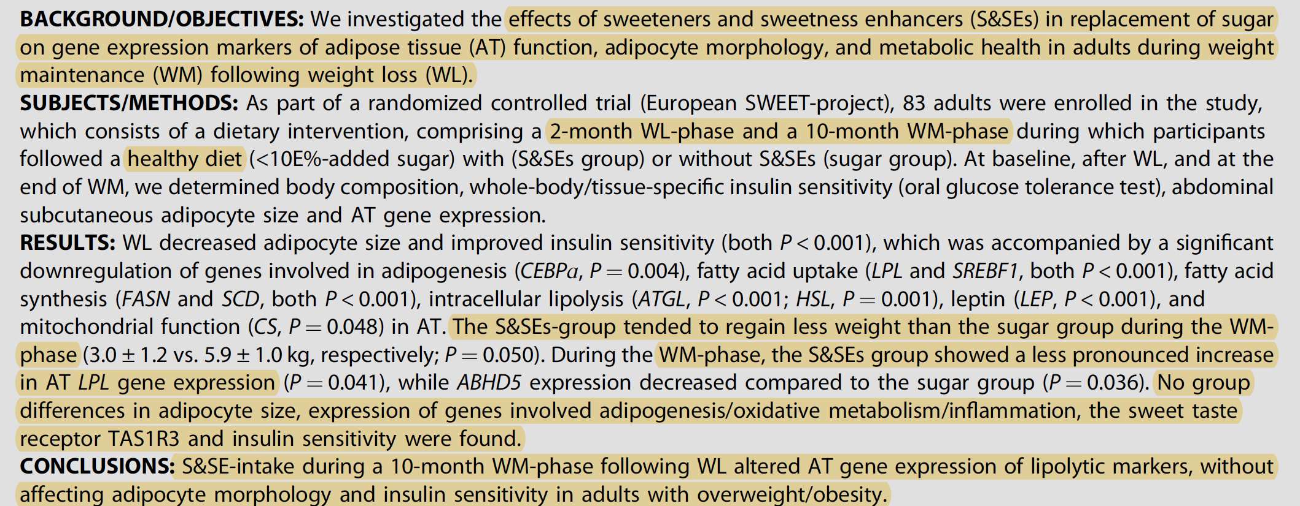

Slide 20


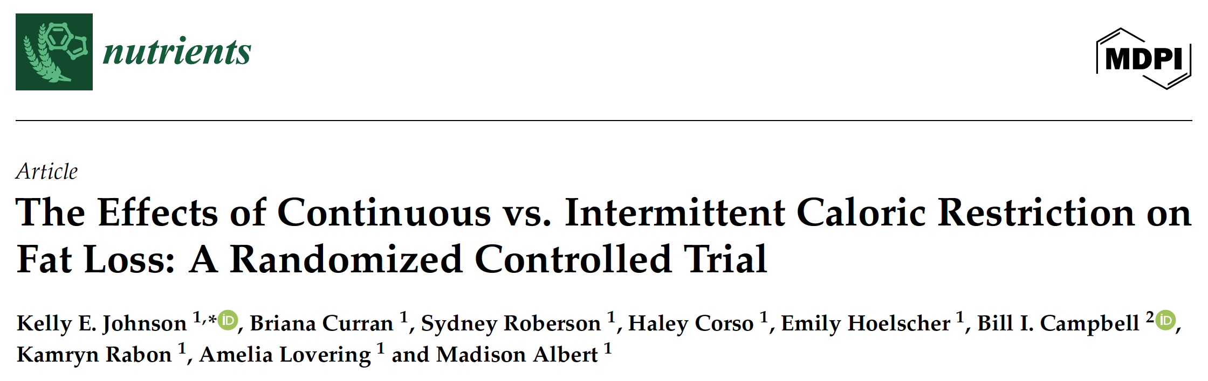
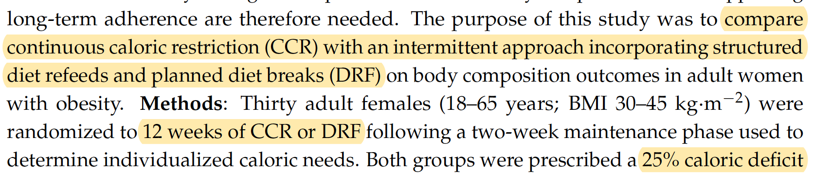
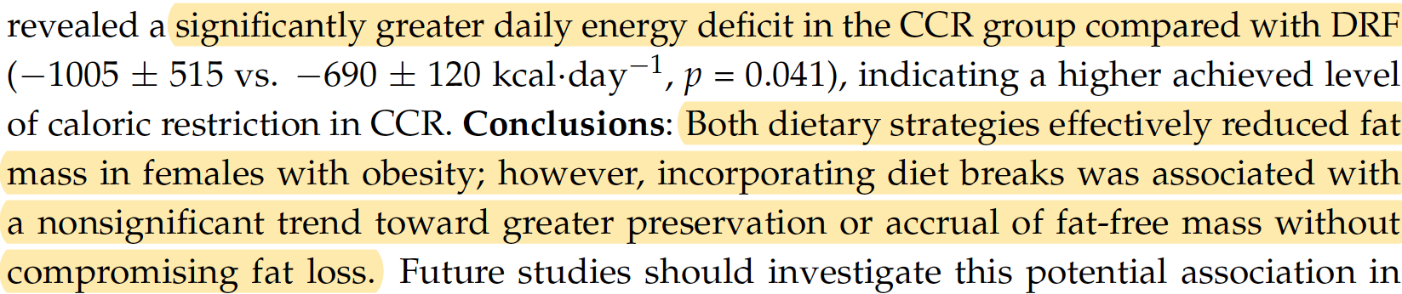

Slide 21
The continuous group actually ended up with a larger calorie deficit than the diet-break group:
CCR: about −1005 kcal/day
DRF: about −690 kcal/day
Yet both groups lost almost exactly the same amount of fat. The authors don't claim this means diet breaks are more efficient—they simply note it as an interesting finding that needs replication.

Slide 22
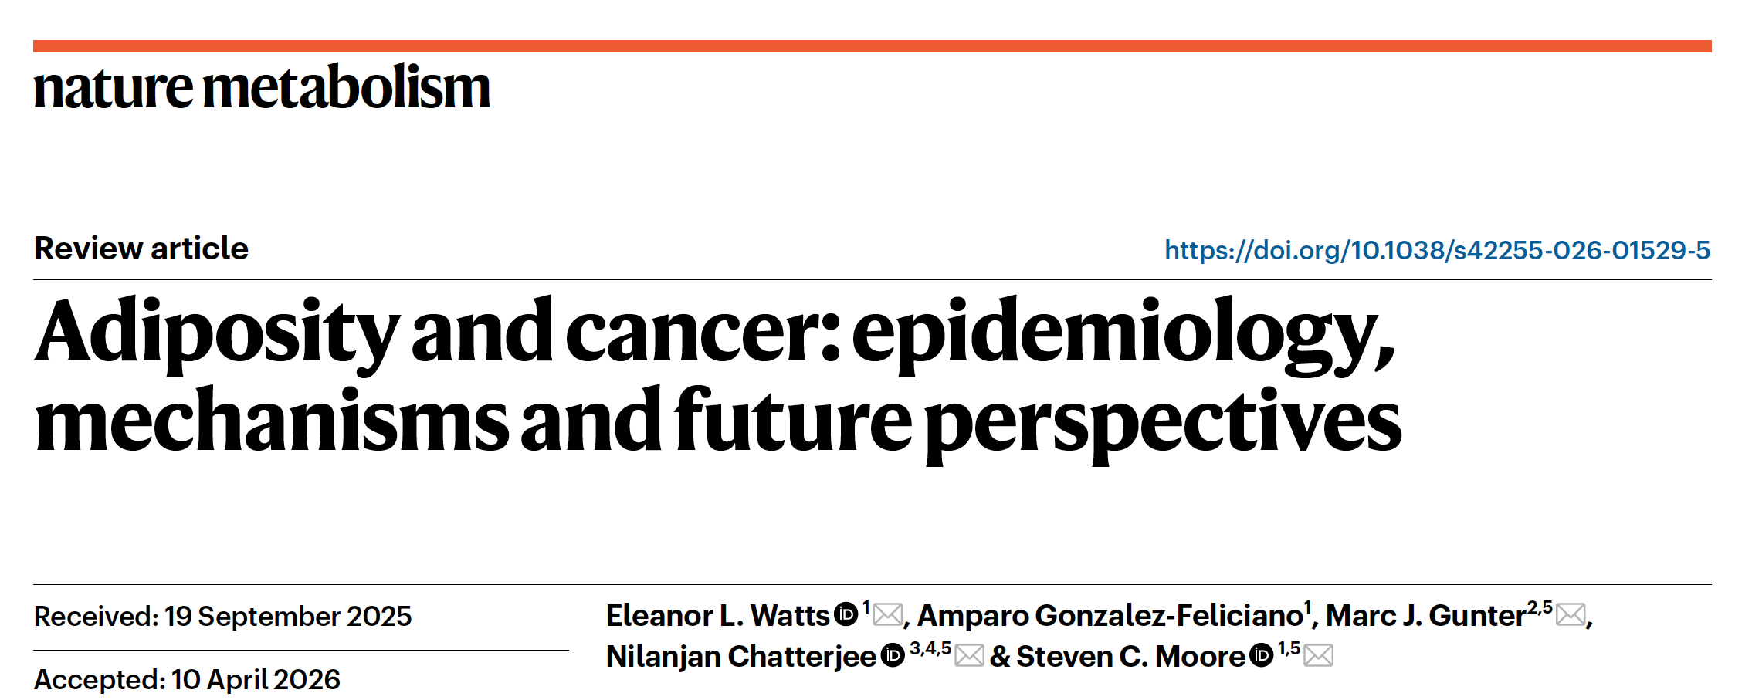

Slide 23
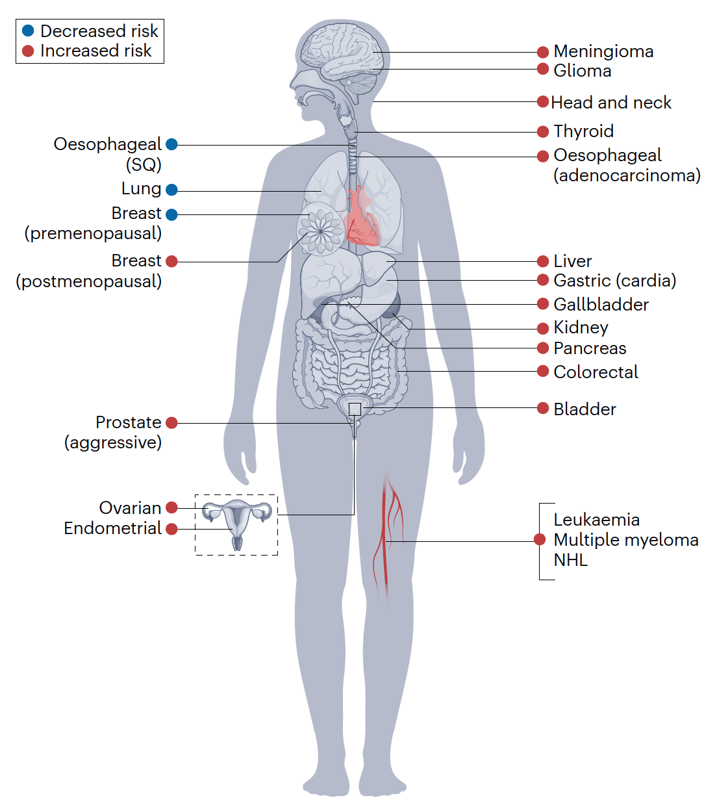
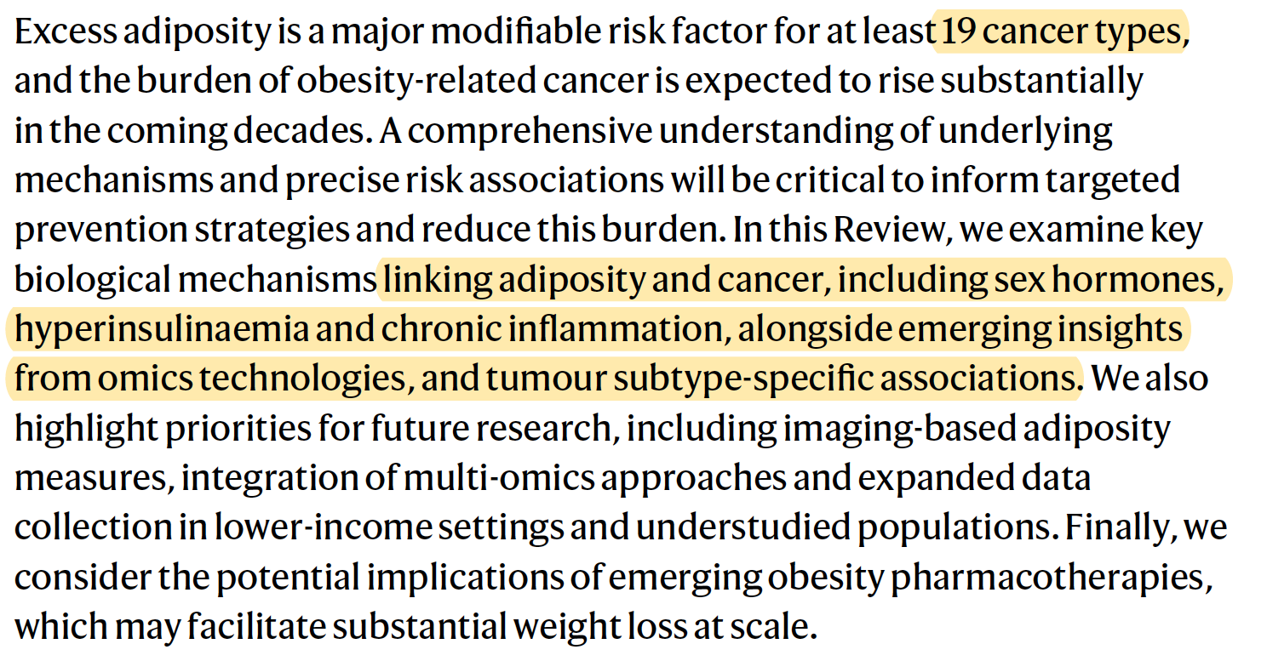
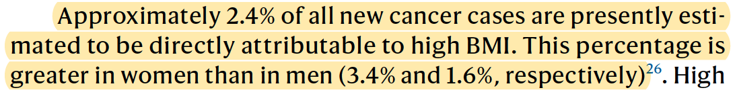

Slide 24
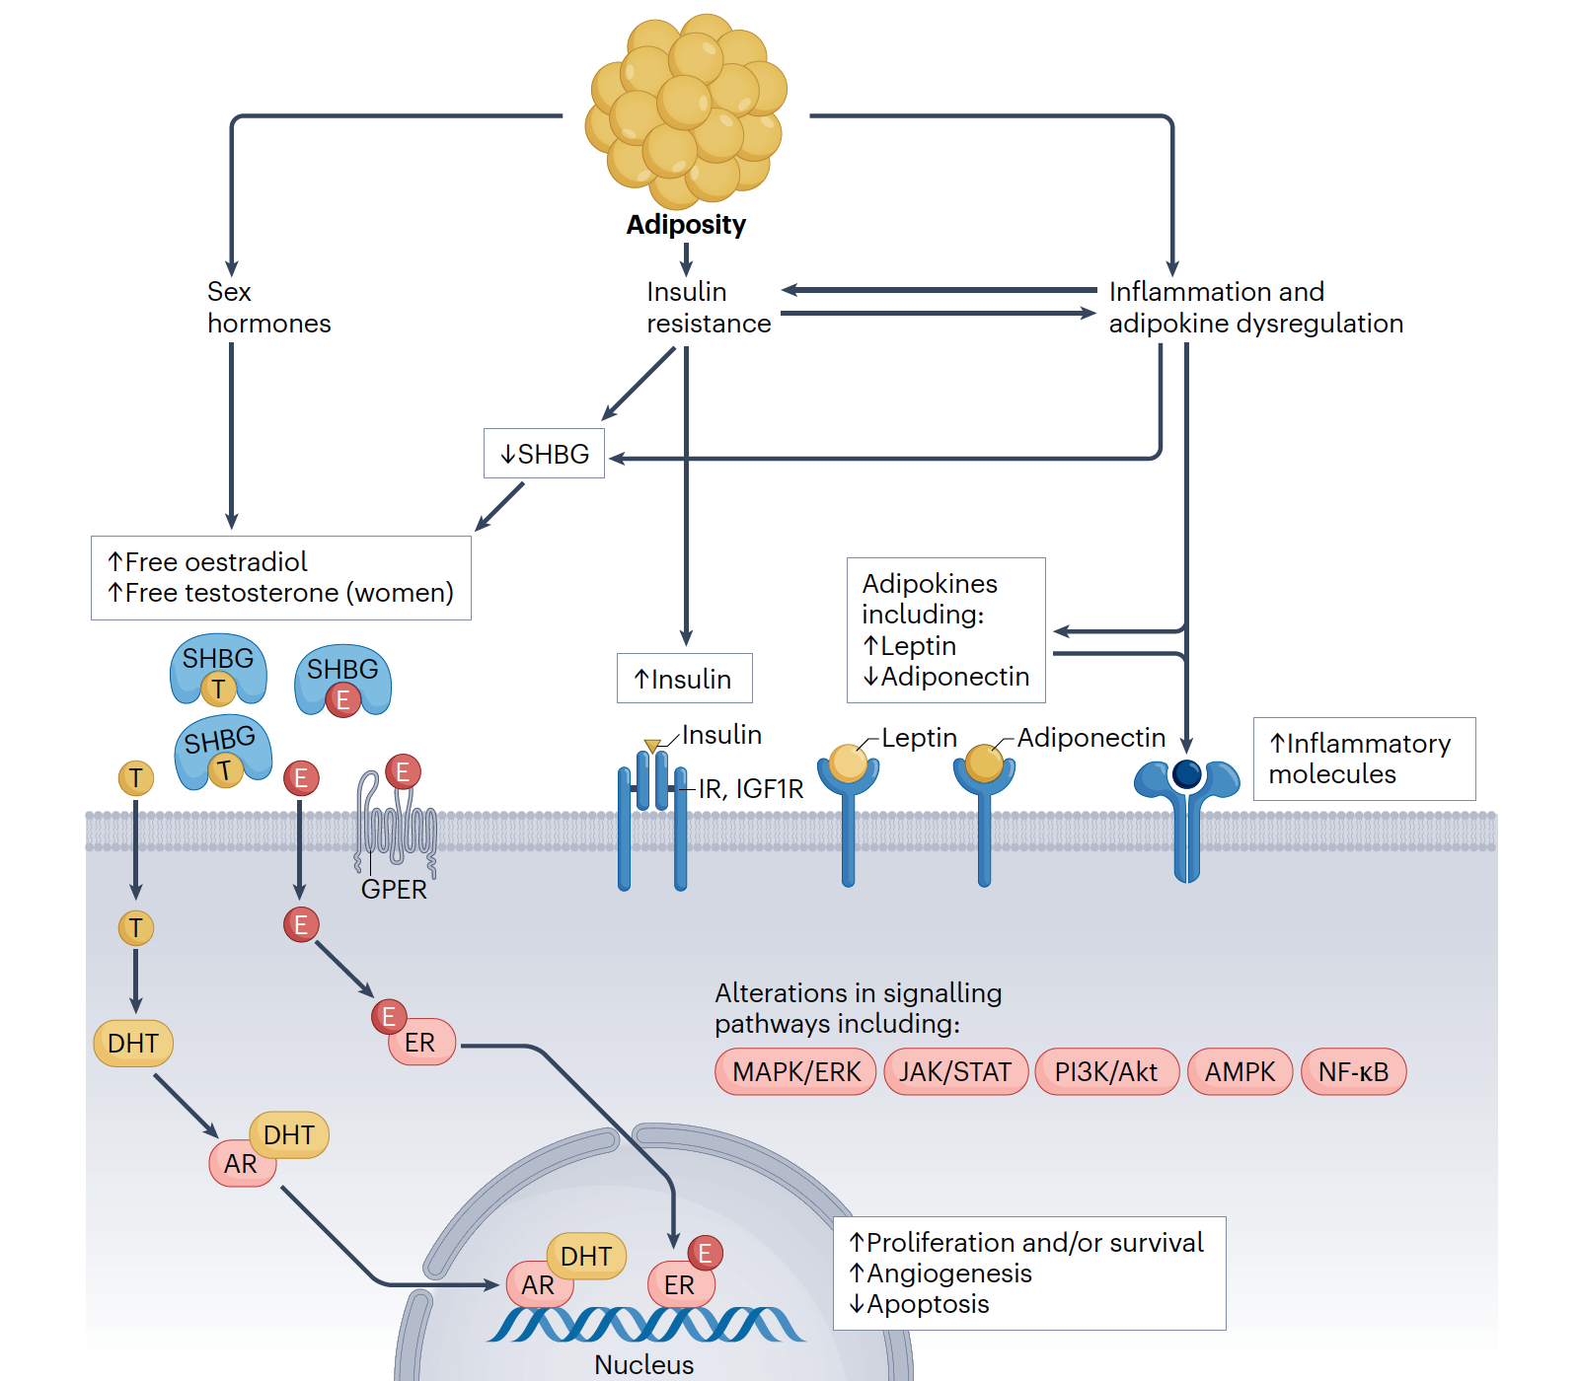

Slide 25
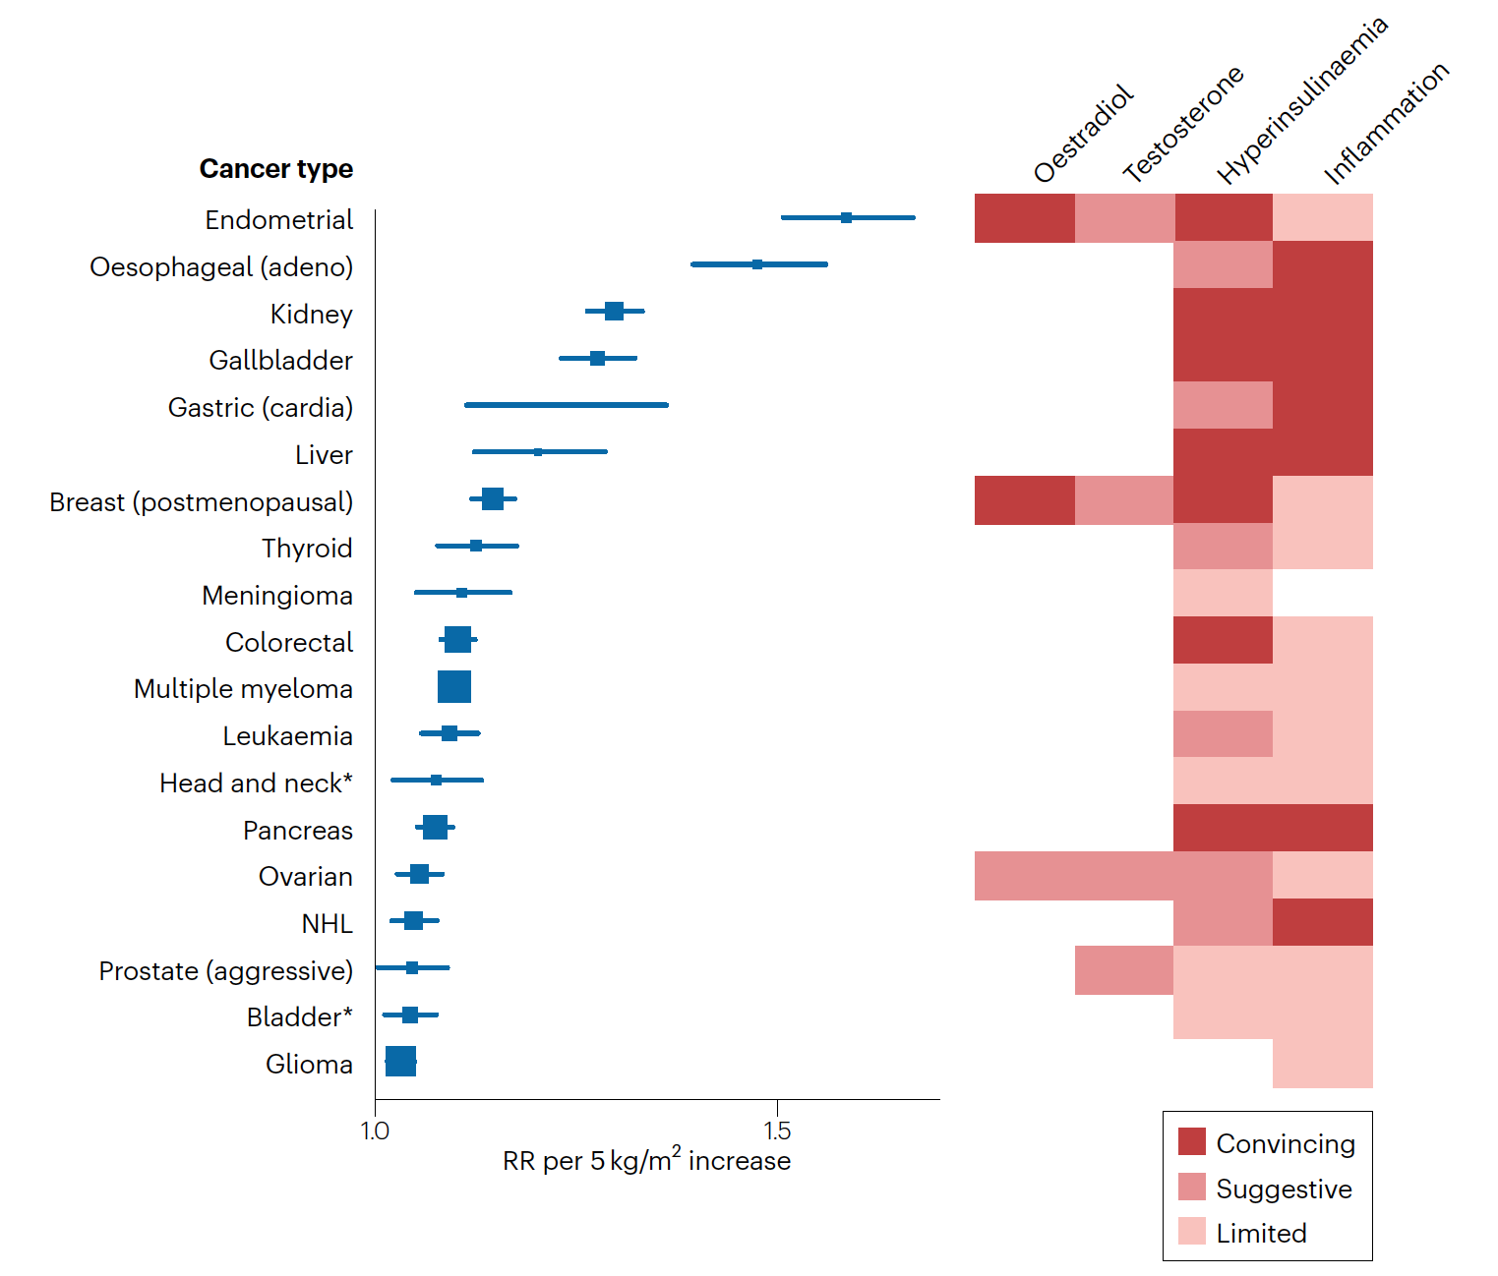

Slide 26
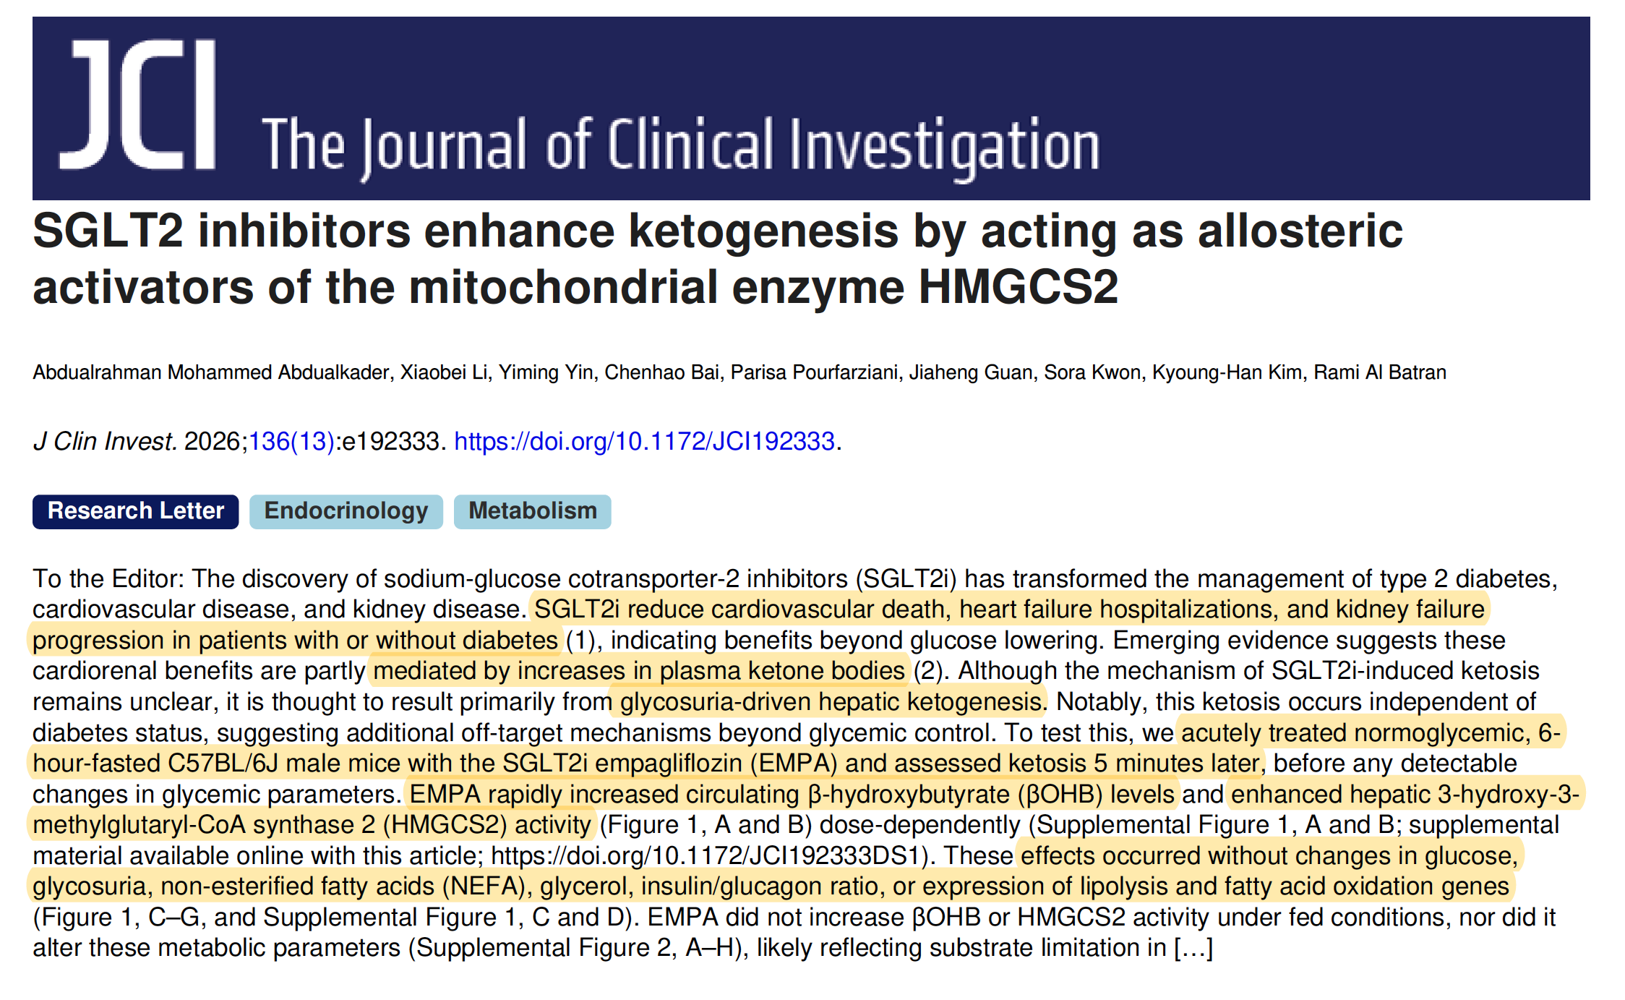

Slide 27
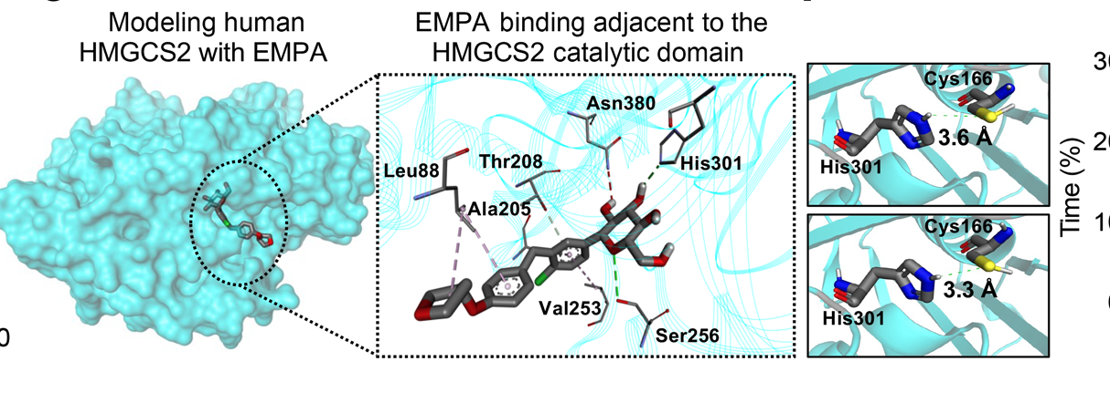

Slide 28

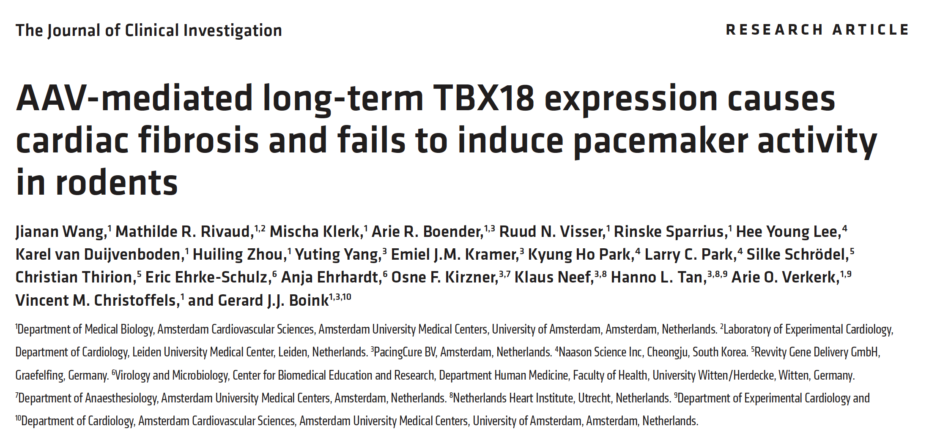

Slide 29
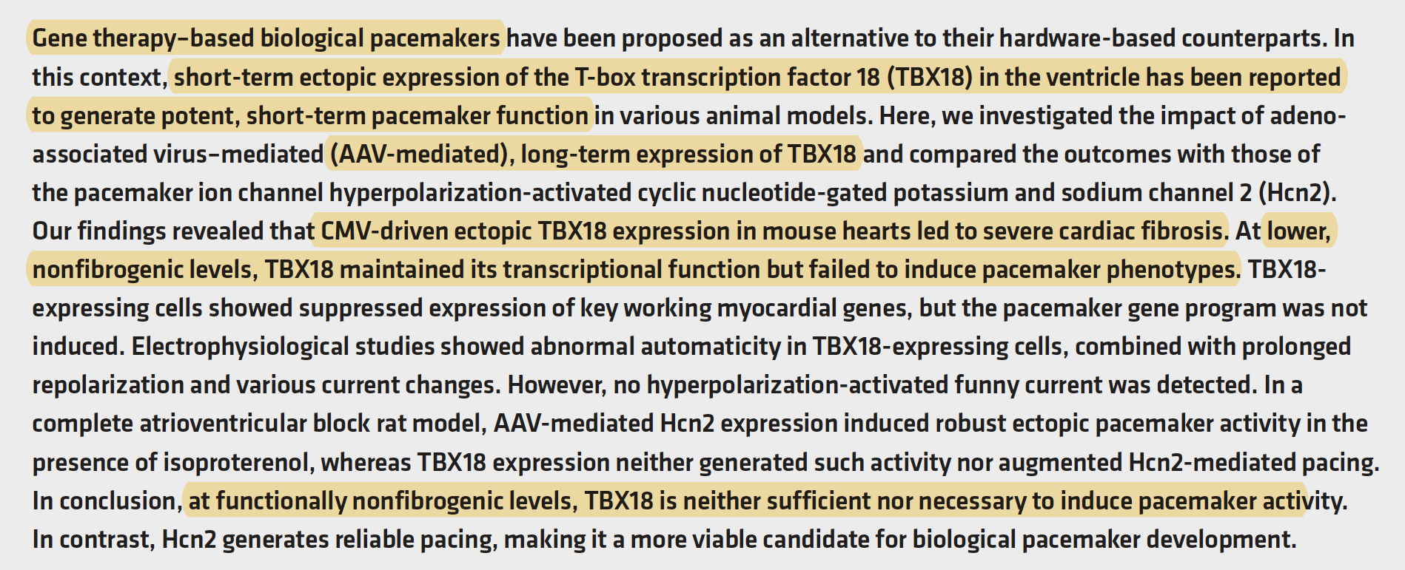

Slide 30
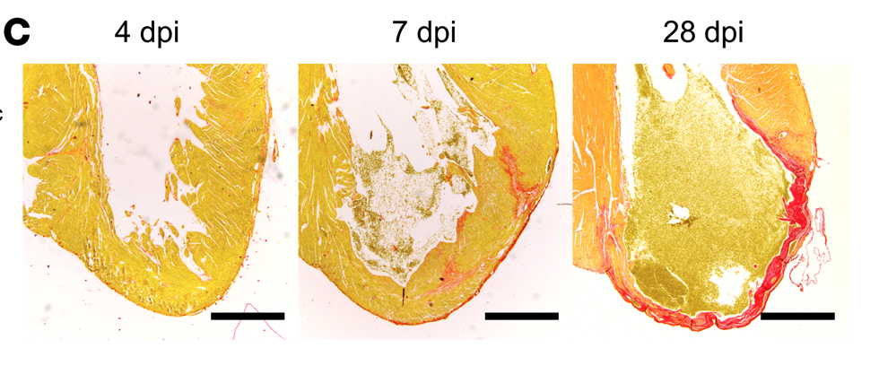

Slide 31
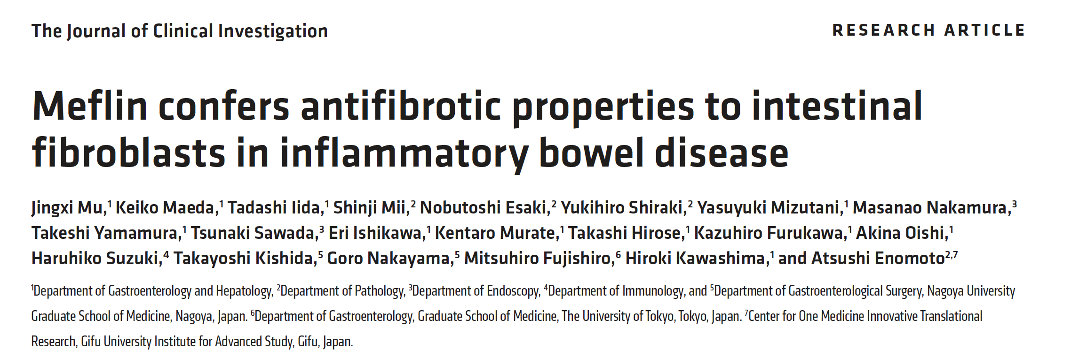

Slide 32
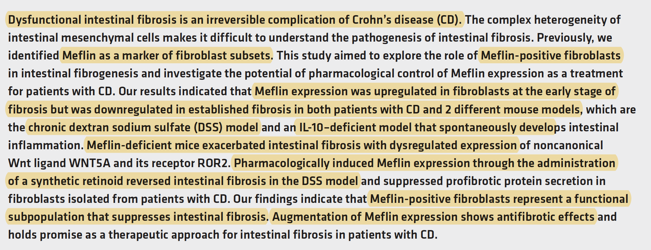

Slide 33
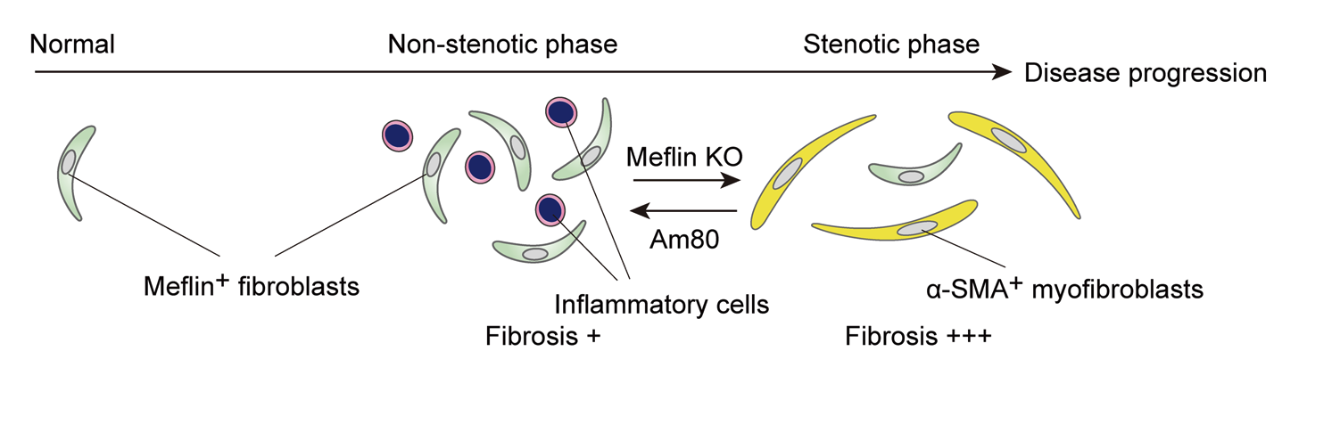

Slide 34
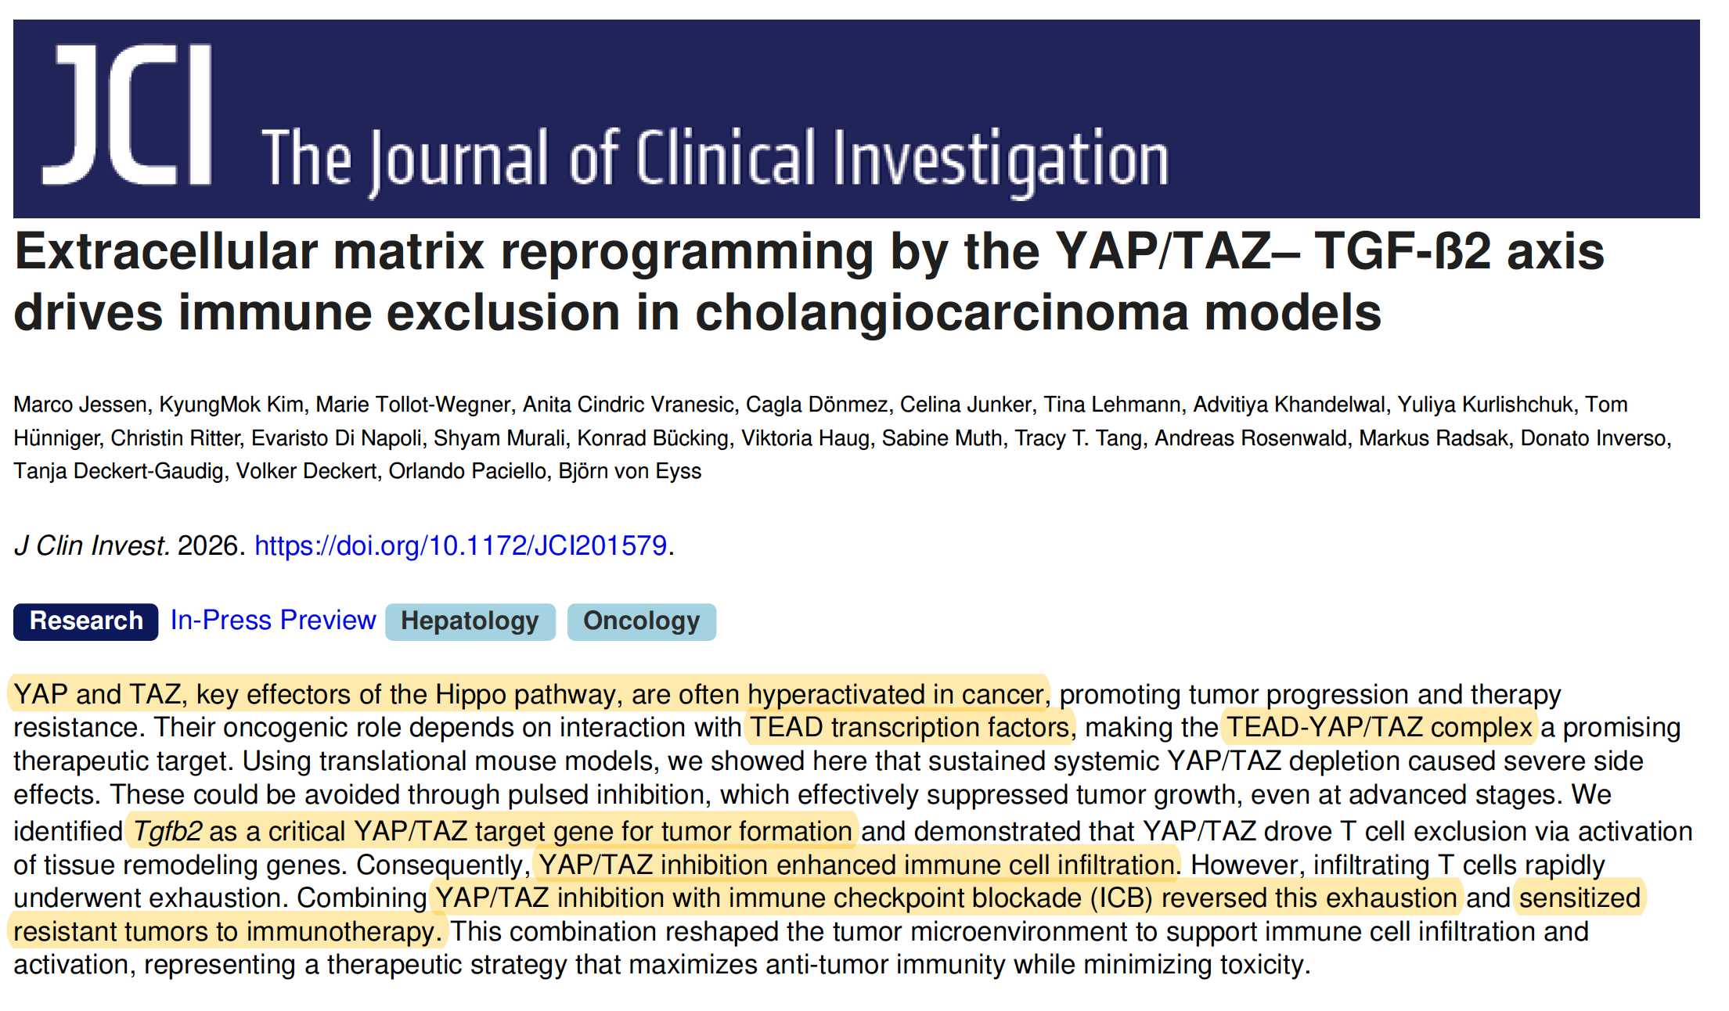

Slide 35
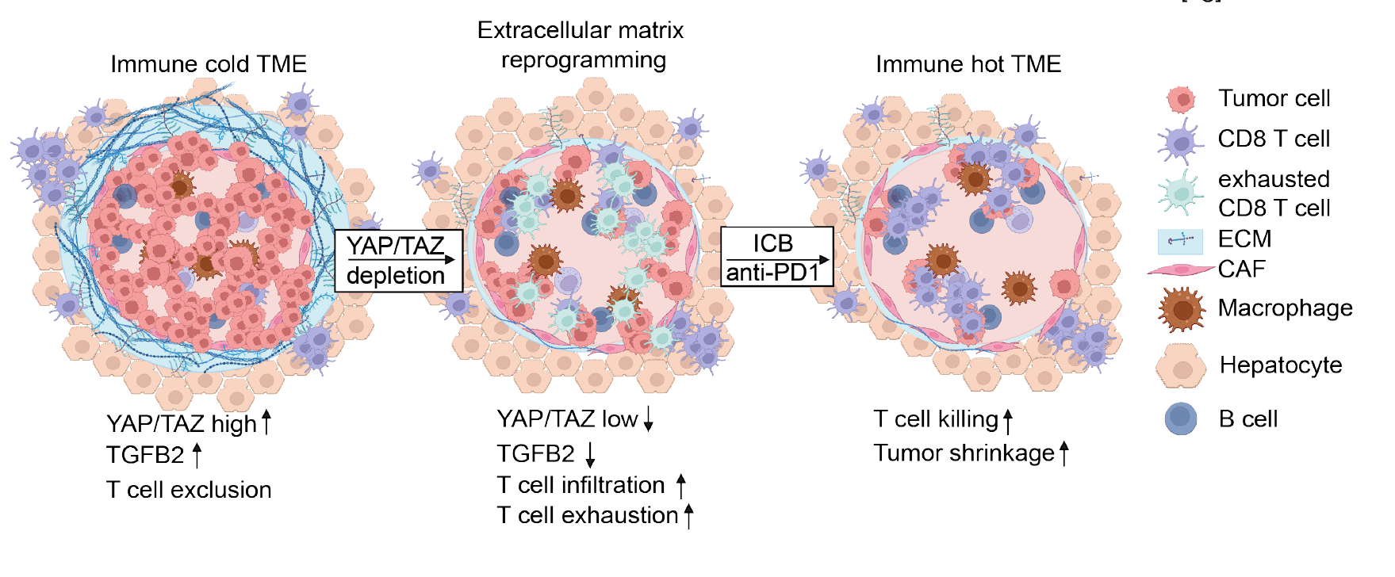

Slide 36

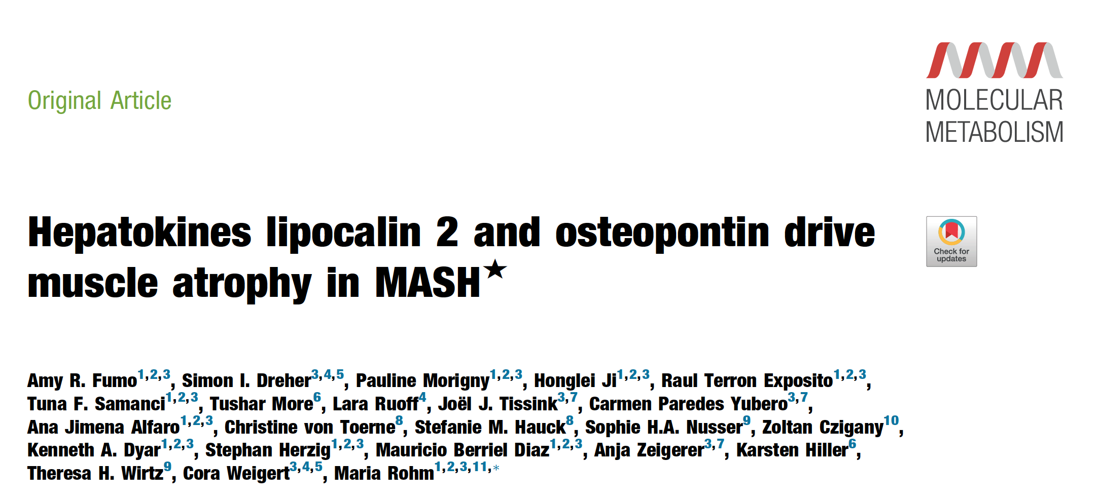

Slide 37
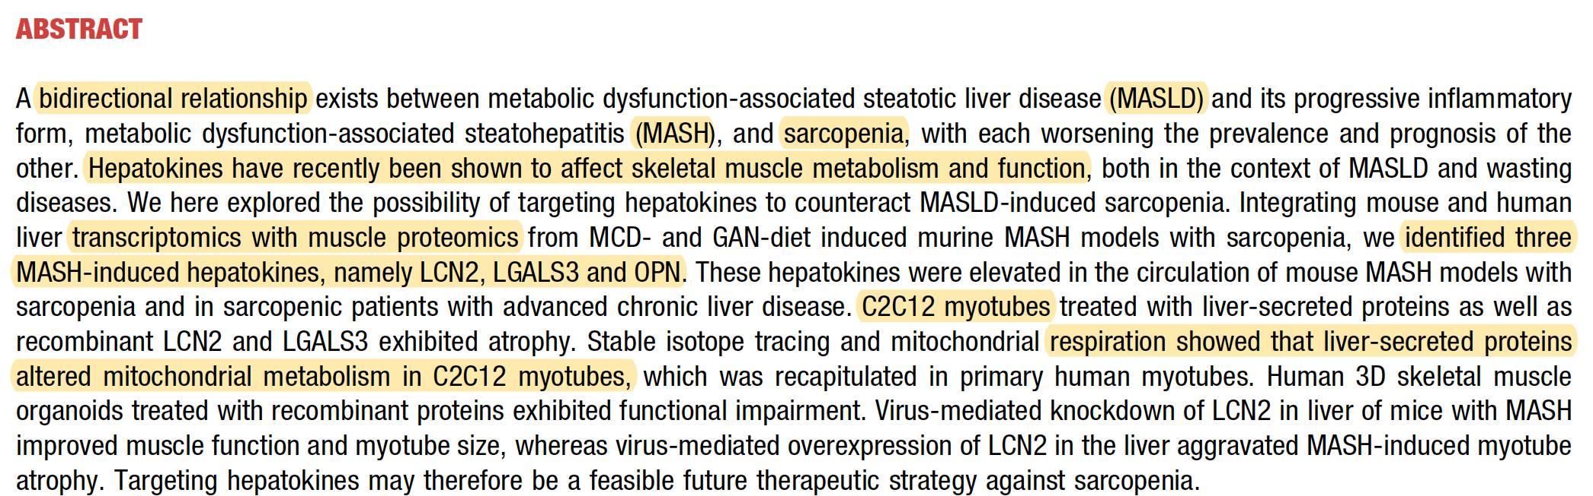
LCN2 (Lipocalin-2)
LCN2 is well established as an adipokine:
expressed by adipocytes
markedly induced in obesity
highly expressed by inflamed adipose tissue macrophages
secreted into circulation
LGALS3 (Galectin-3)
Galectin-3 is strongly expressed in adipose tissue,
particularly by adipose tissue macrophages,
stromal vascular cells,
fibro-inflammatory adipose cells,
OPN (SPP1, Osteopontin)
Osteopontin is one of the best-characterized adipose inflammatory cytokines.
Expression is very high in hypertrophic adipose tissue, crown-like structures,
infiltrating macrophages, activated fibroblasts,
and increases dramatically during obesity.

Slide 38
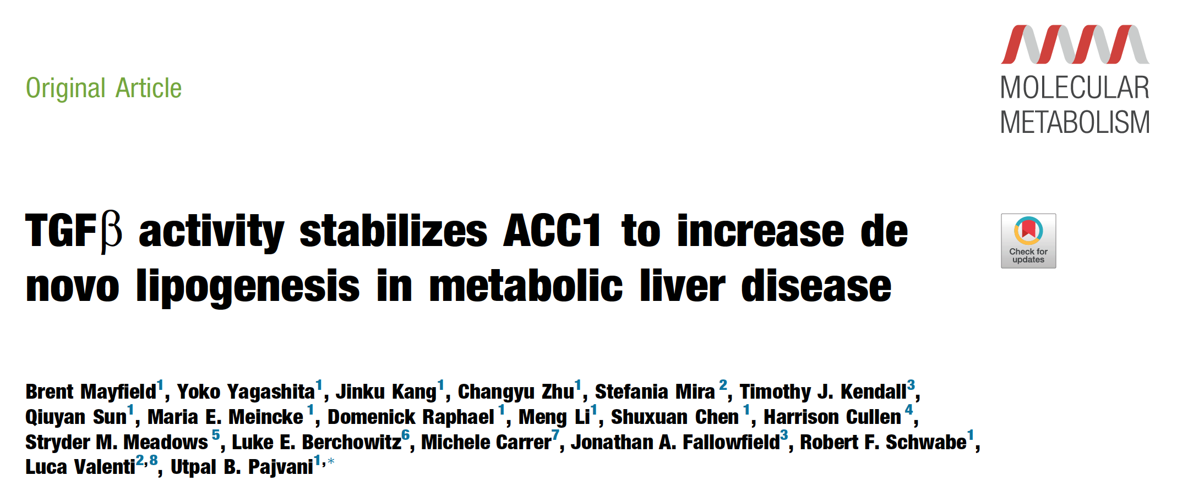


Slide 39

Liver non-parenchymal cells (NPCs) are all the cells in the liver that are not hepatocytes,
the main functional liver cells. While hepatocytes make up about 70–80% of the liver's volume,
non-parenchymal cells comprise a substantial fraction of the total cell population and play essential
roles in immunity, blood flow, tissue repair, and liver homeostasis.

Slide 40



Slide 41


Slide 42


Slide 43


Slide 44


Slide 45



Slide 46


Slide 47



Slide 48


Slide 49
α-cell-derived glucagon is required to maintain healthy β-cells in adult mice.
Exogenous glucagon restores
GLP-1 analogue (exendin-4) does not rescue
Deleting the glucagon receptor (GCGR) only in β-cells has no detectable effect
This suggests glucagon's trophic effects on β-cells are not mediated primarily through β-cell GCGR.
If α-cells lacking glucagon are completely ablated, β-cell function returns to normal.
This suggests that glucagon-deficient α-cells actively produce a harmful signal, rather than simply failing to provide glucagon.

Slide 50




Slide 51


Slide 52


Slide 53




Slide 54


https://www.medscape.com/viewarticle/food-noise-real-phenomenon-deserving-being-treated-2026a1000m45

Slide 55


