Slide 1
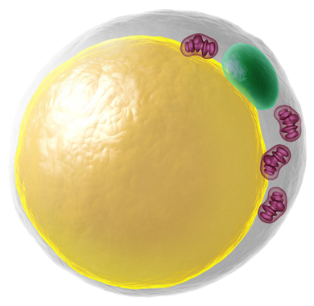
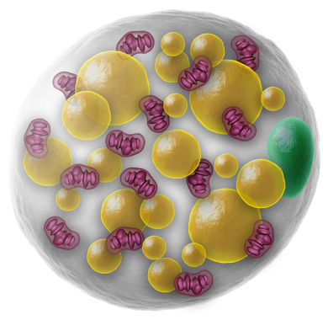
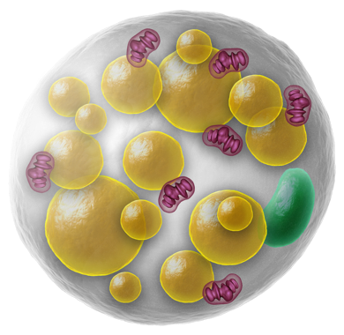
Literature Overview
Touchstone Diabetes Center
UTSW Medical Center 6/1/2026

Slide 2
Monday, June 1
9:15AM – K5.600
Touchstone Center Meeting
Tuesday, June 2
2:35 PM – L4.220
Touchstone Center
Cancer Fibrosis SubGroup Meeting
Wednesday, June 3
9 AM L4.220 - in person
Touchstone Center
Mouse Genetics SubGroup Meeting

Slide 3
Wednesday, June 3
12 Noon – NA6.214 – in person
Department of Molecular Biology Seminar Series
Peter Walter, Ph.D.
Professor & Director, Buck Institute for Research on Aging
"Targeting the Cell’s Stress Pathways for Therapeutic Benefit”
Thursday, June 4
-

Slide 4
Friday, June 5
8 AM – D1.502 - in person
Internal Medicine Grand Rounds
Jatin Vyas, M.D., Ph.D.
Professor of Medicine
Associate Dean for Academic Innovation
Director, Physician-Scientist Programs, Vagelos Institute for Biomedical Research Education
Columbia University
"The Changing Paradigm in Infectious Diseases-Host-Directed Medicine"
12 Noon – D1.502 - in person
Internal Medicine Research Conference
Russell DeBose-Boyd, Ph.D.
Professor of Molecular Genetics
Assistant Dean for Research Advancement
UT Southwestern Medical Center
"Basic Science Limited Submission Opportunities for Early Career Scientists"

Slide 5
New Colleagues:
New Post-Doc:
Woobeen Jo
New Summer Students:
Lauren Yue
Sarayu Sai Veluri
Yatzi Chapa

Slide 6
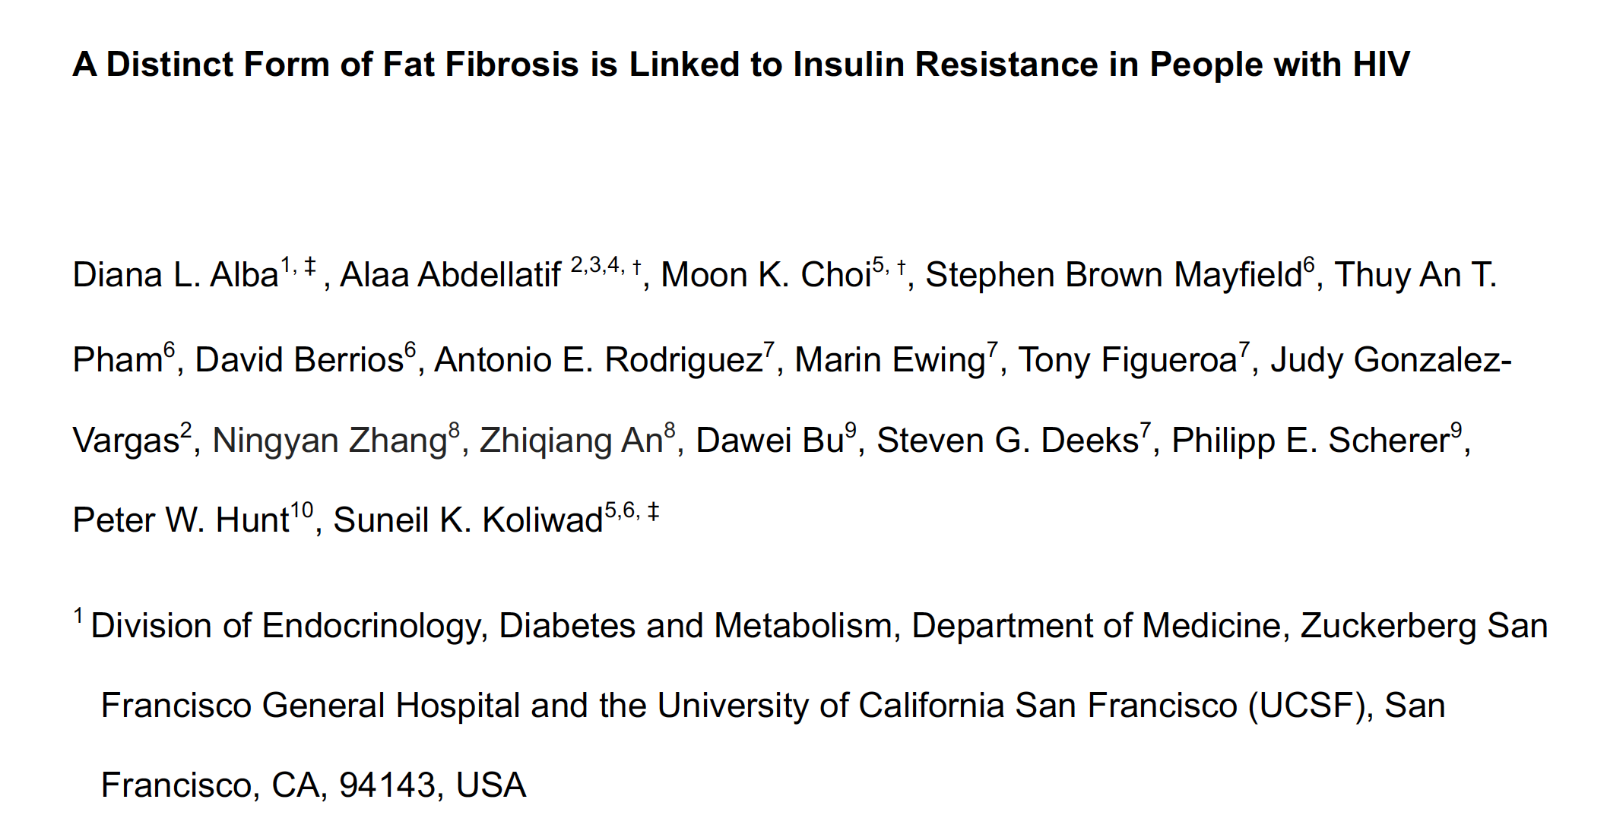
JCI Insight, in press

Slide 7
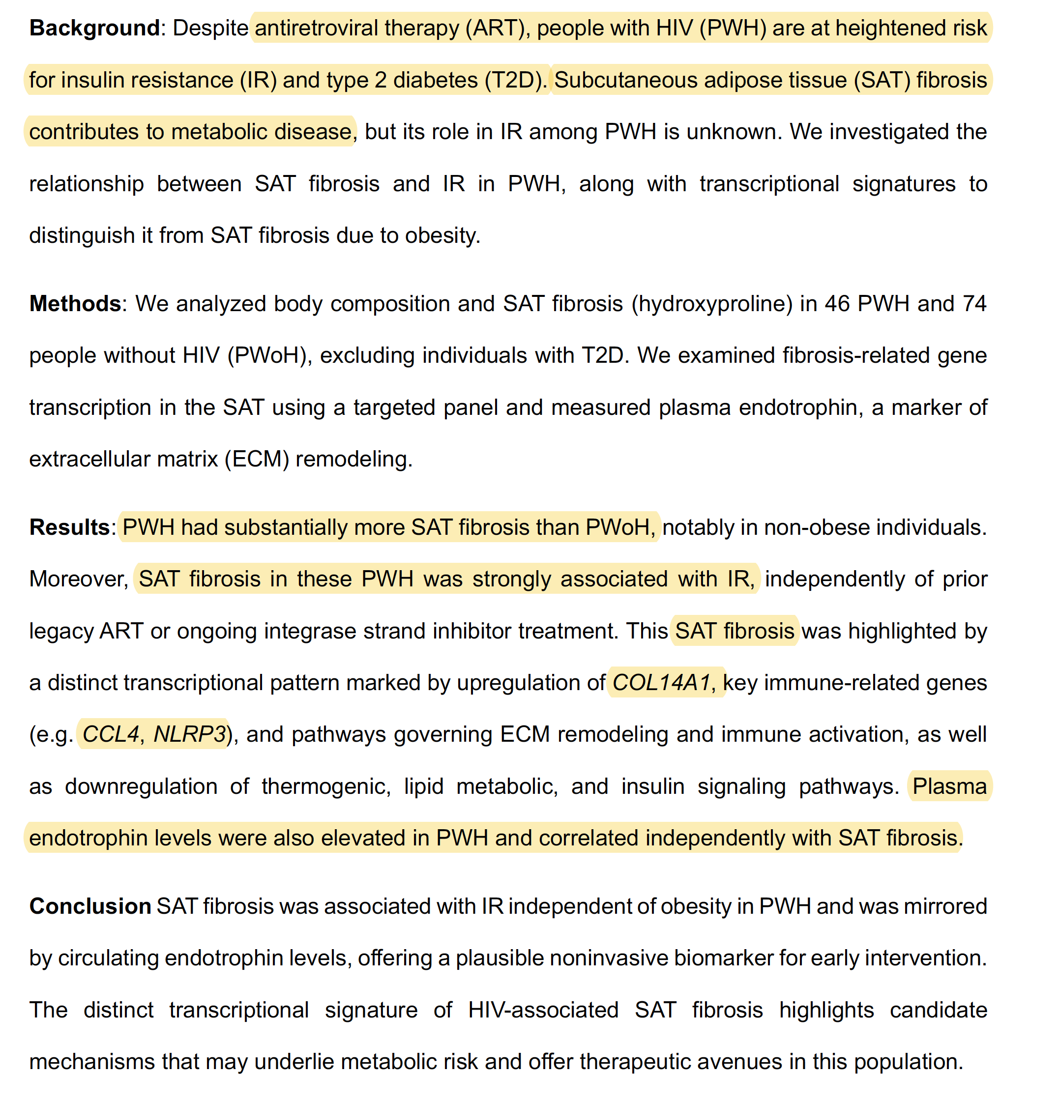

Slide 8
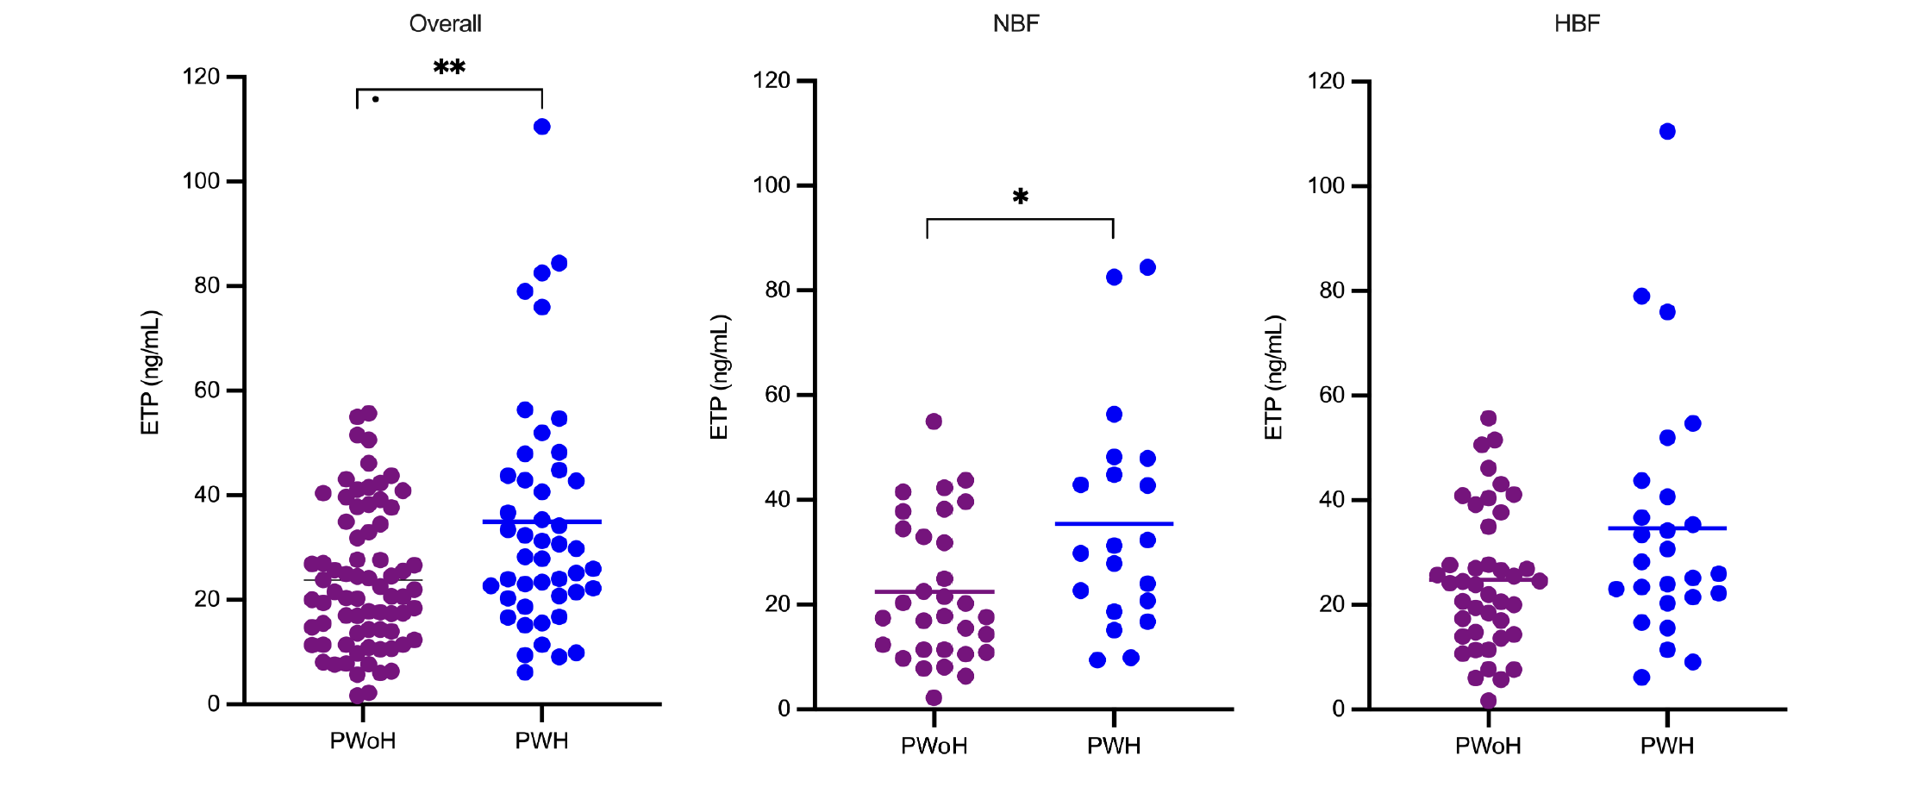

Slide 9

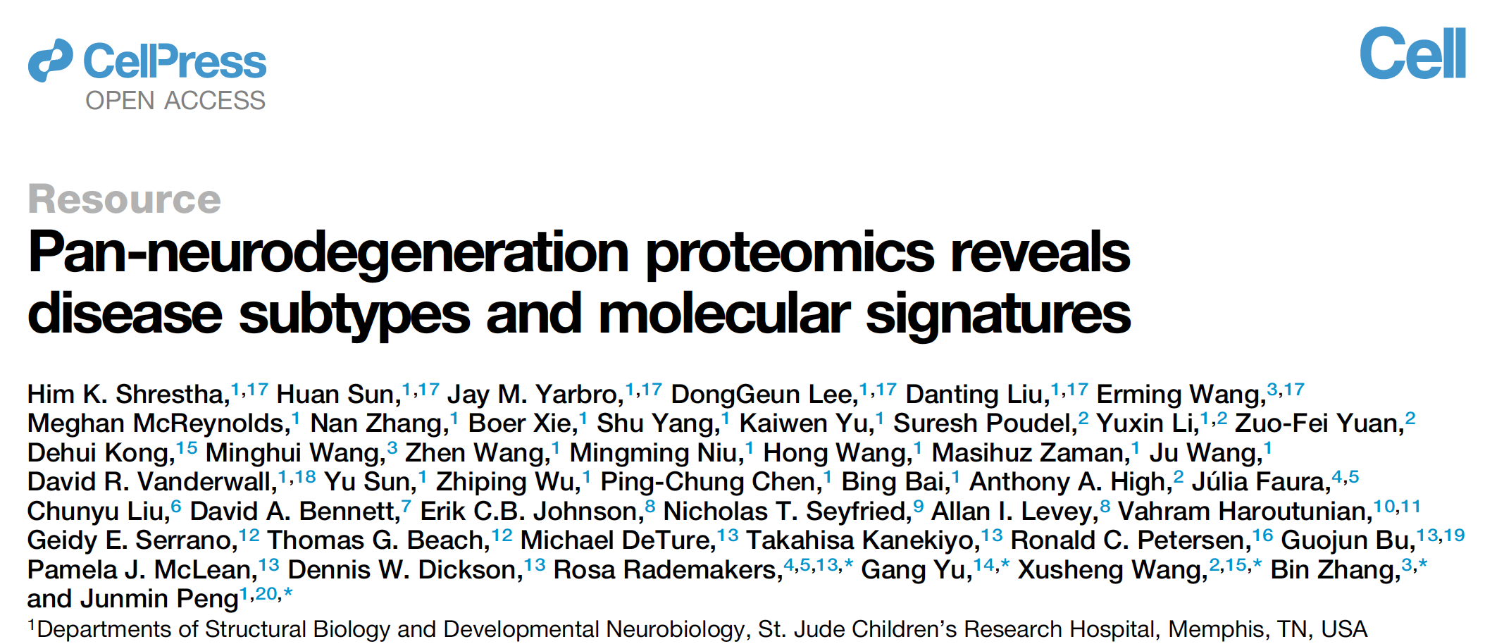

Slide 10
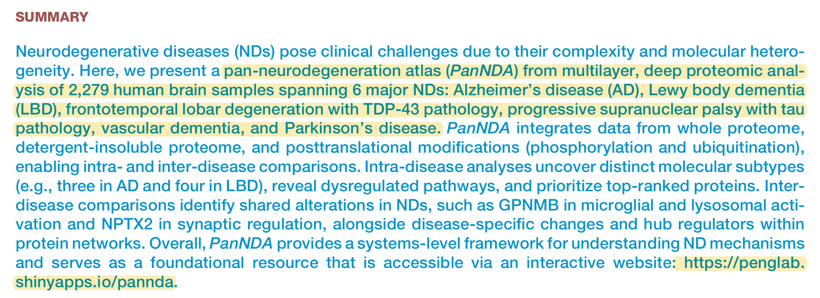
Collagen VI alpha 3? Endotrophin? Gpr75?

Slide 11
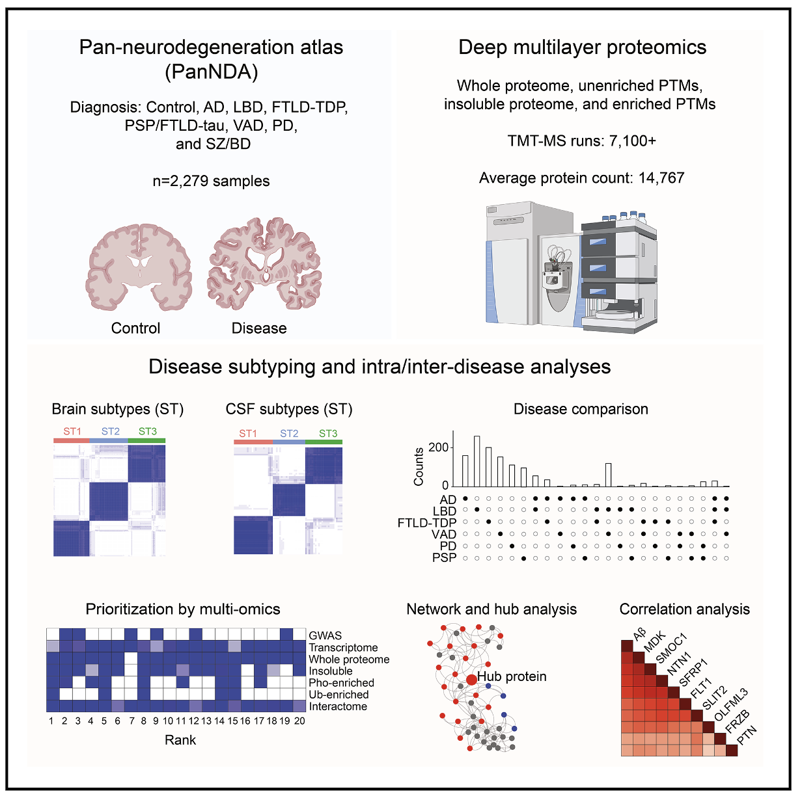
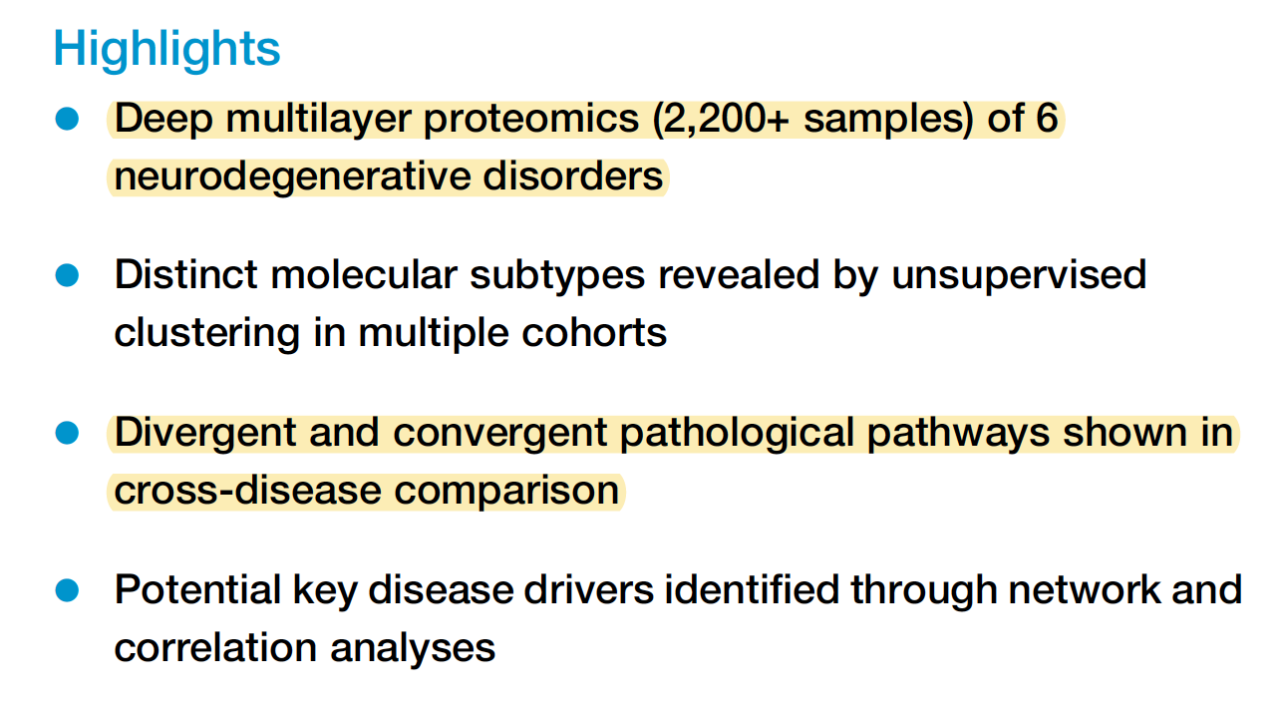

Slide 12

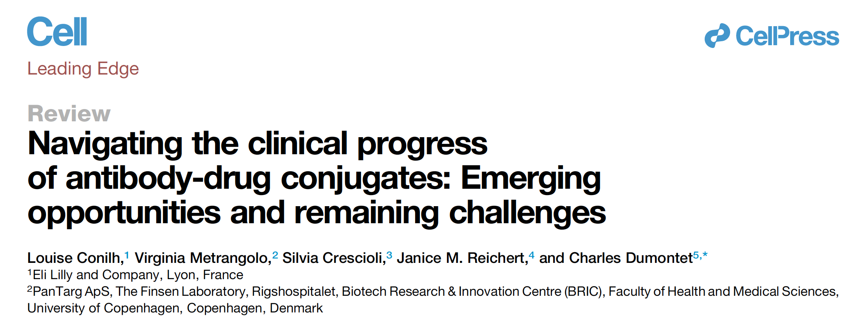

Slide 13
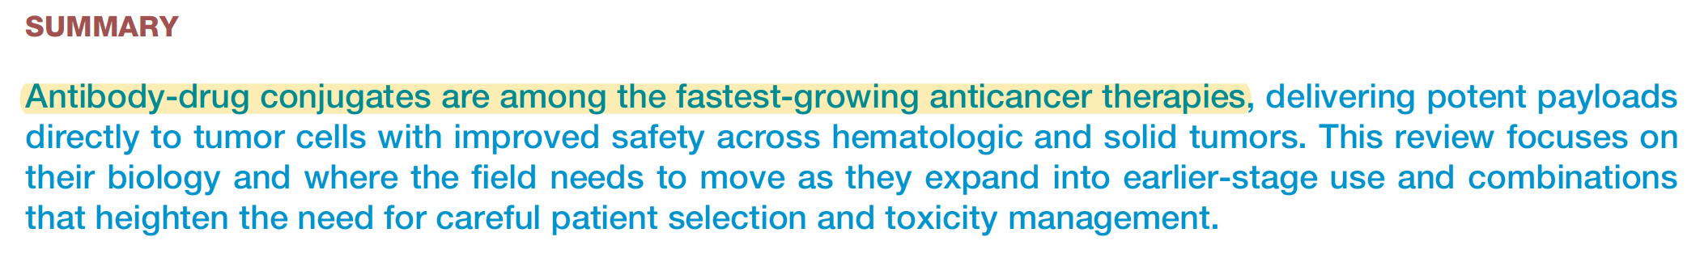
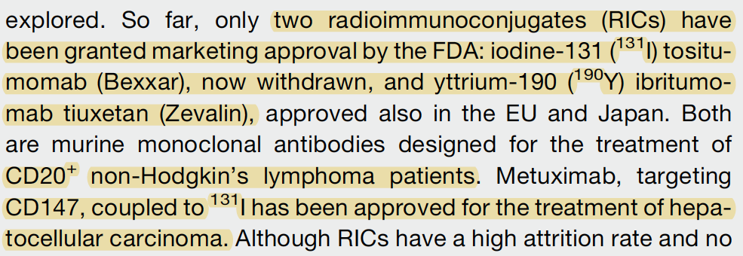

Slide 14
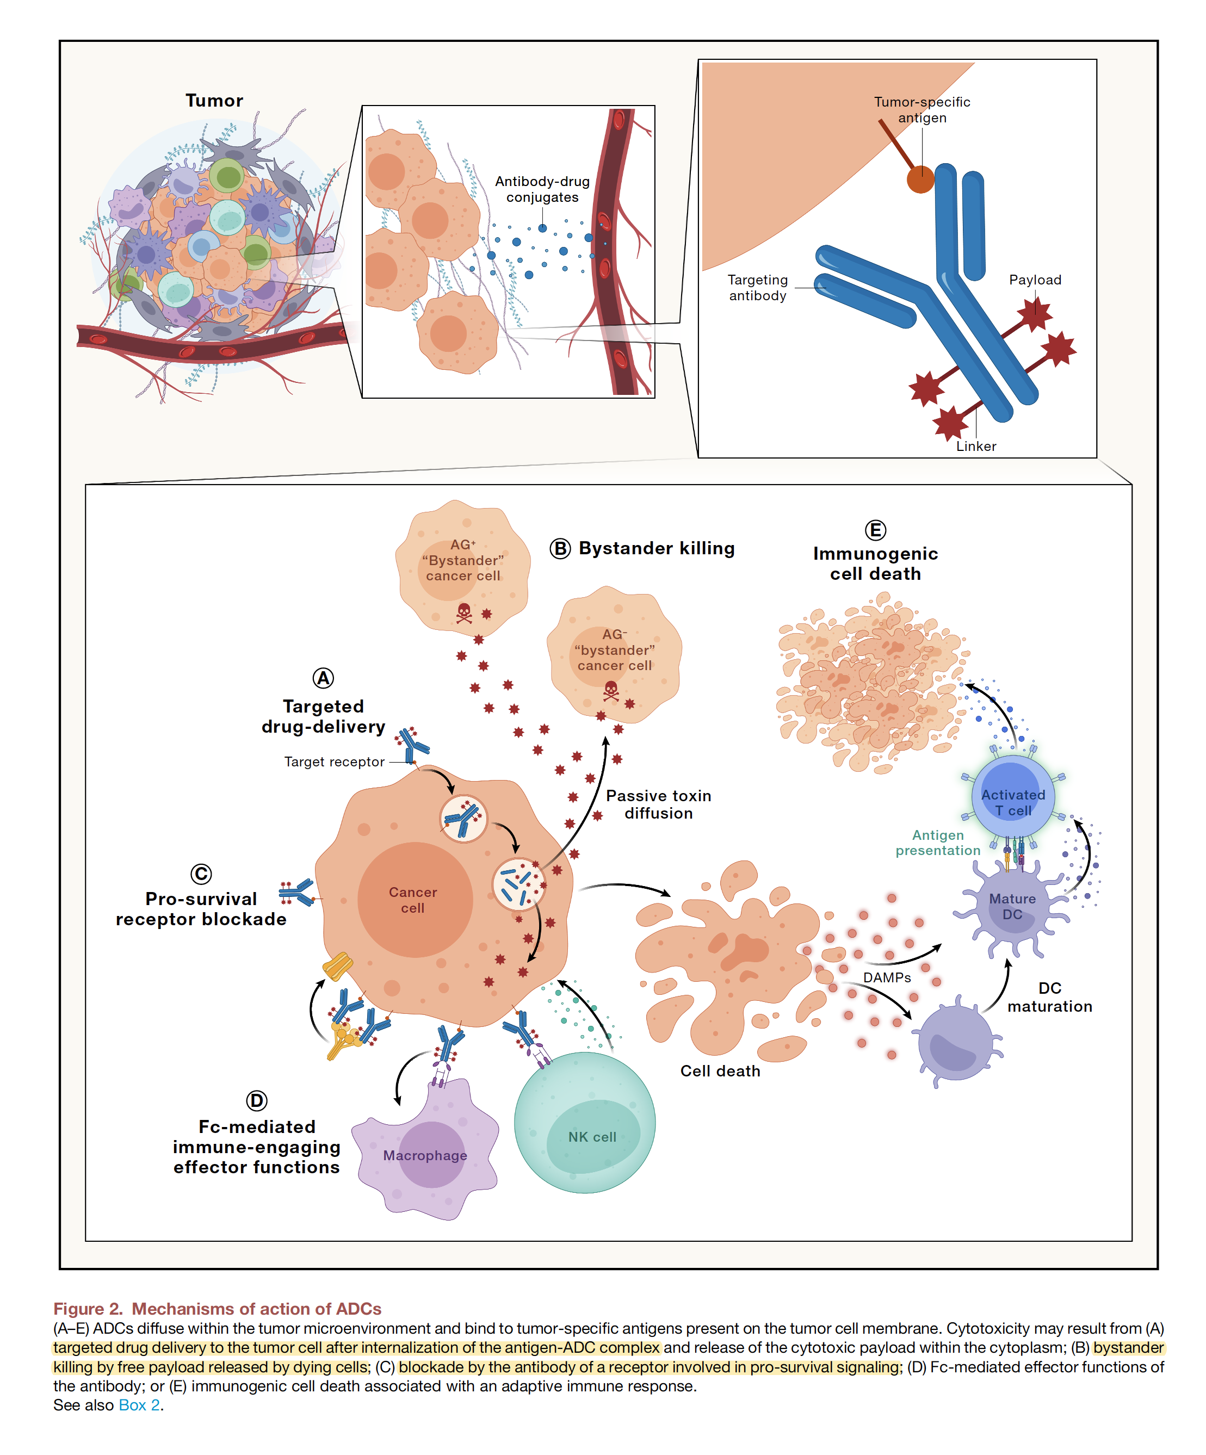

Slide 15
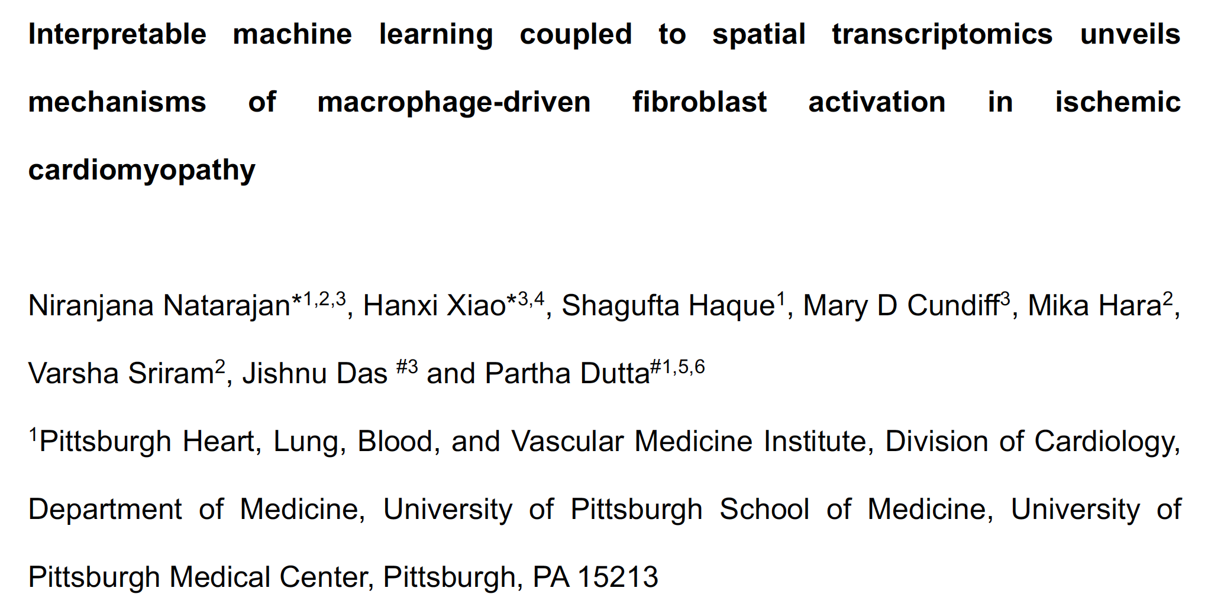

Slide 16
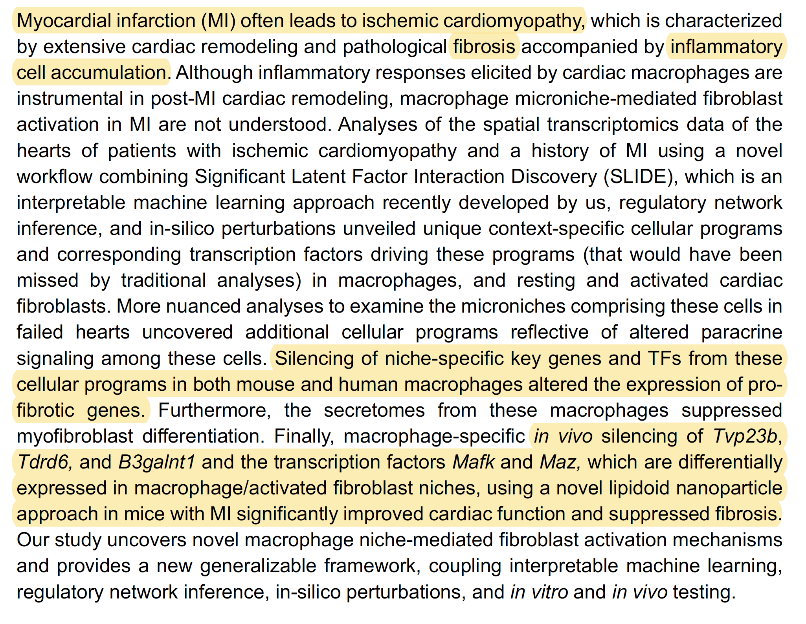

Slide 17
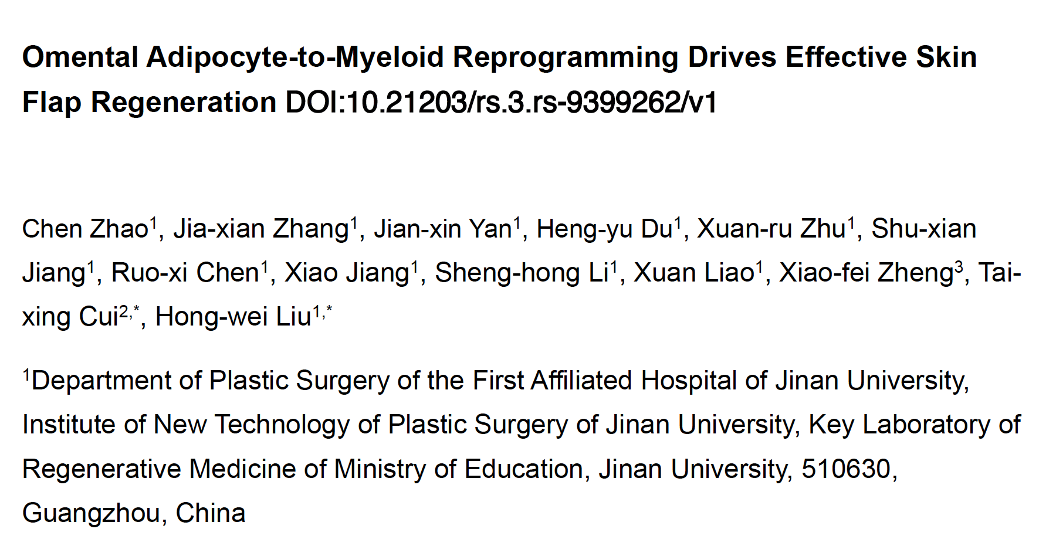

Slide 18
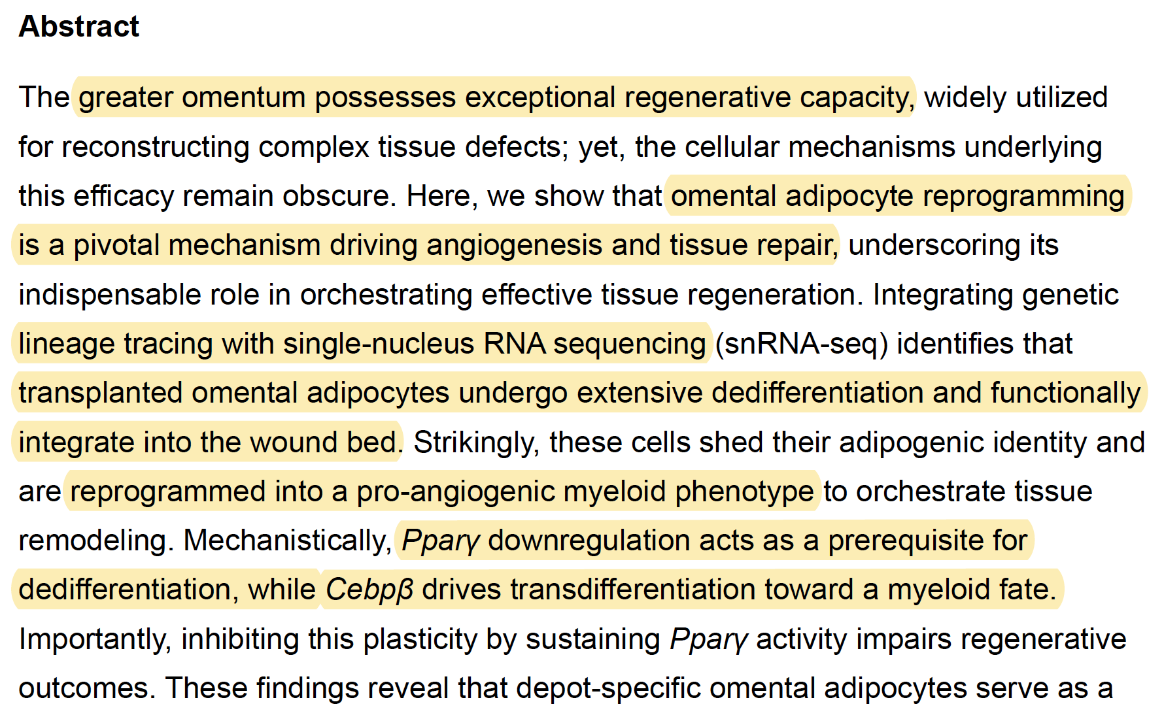

Slide 19
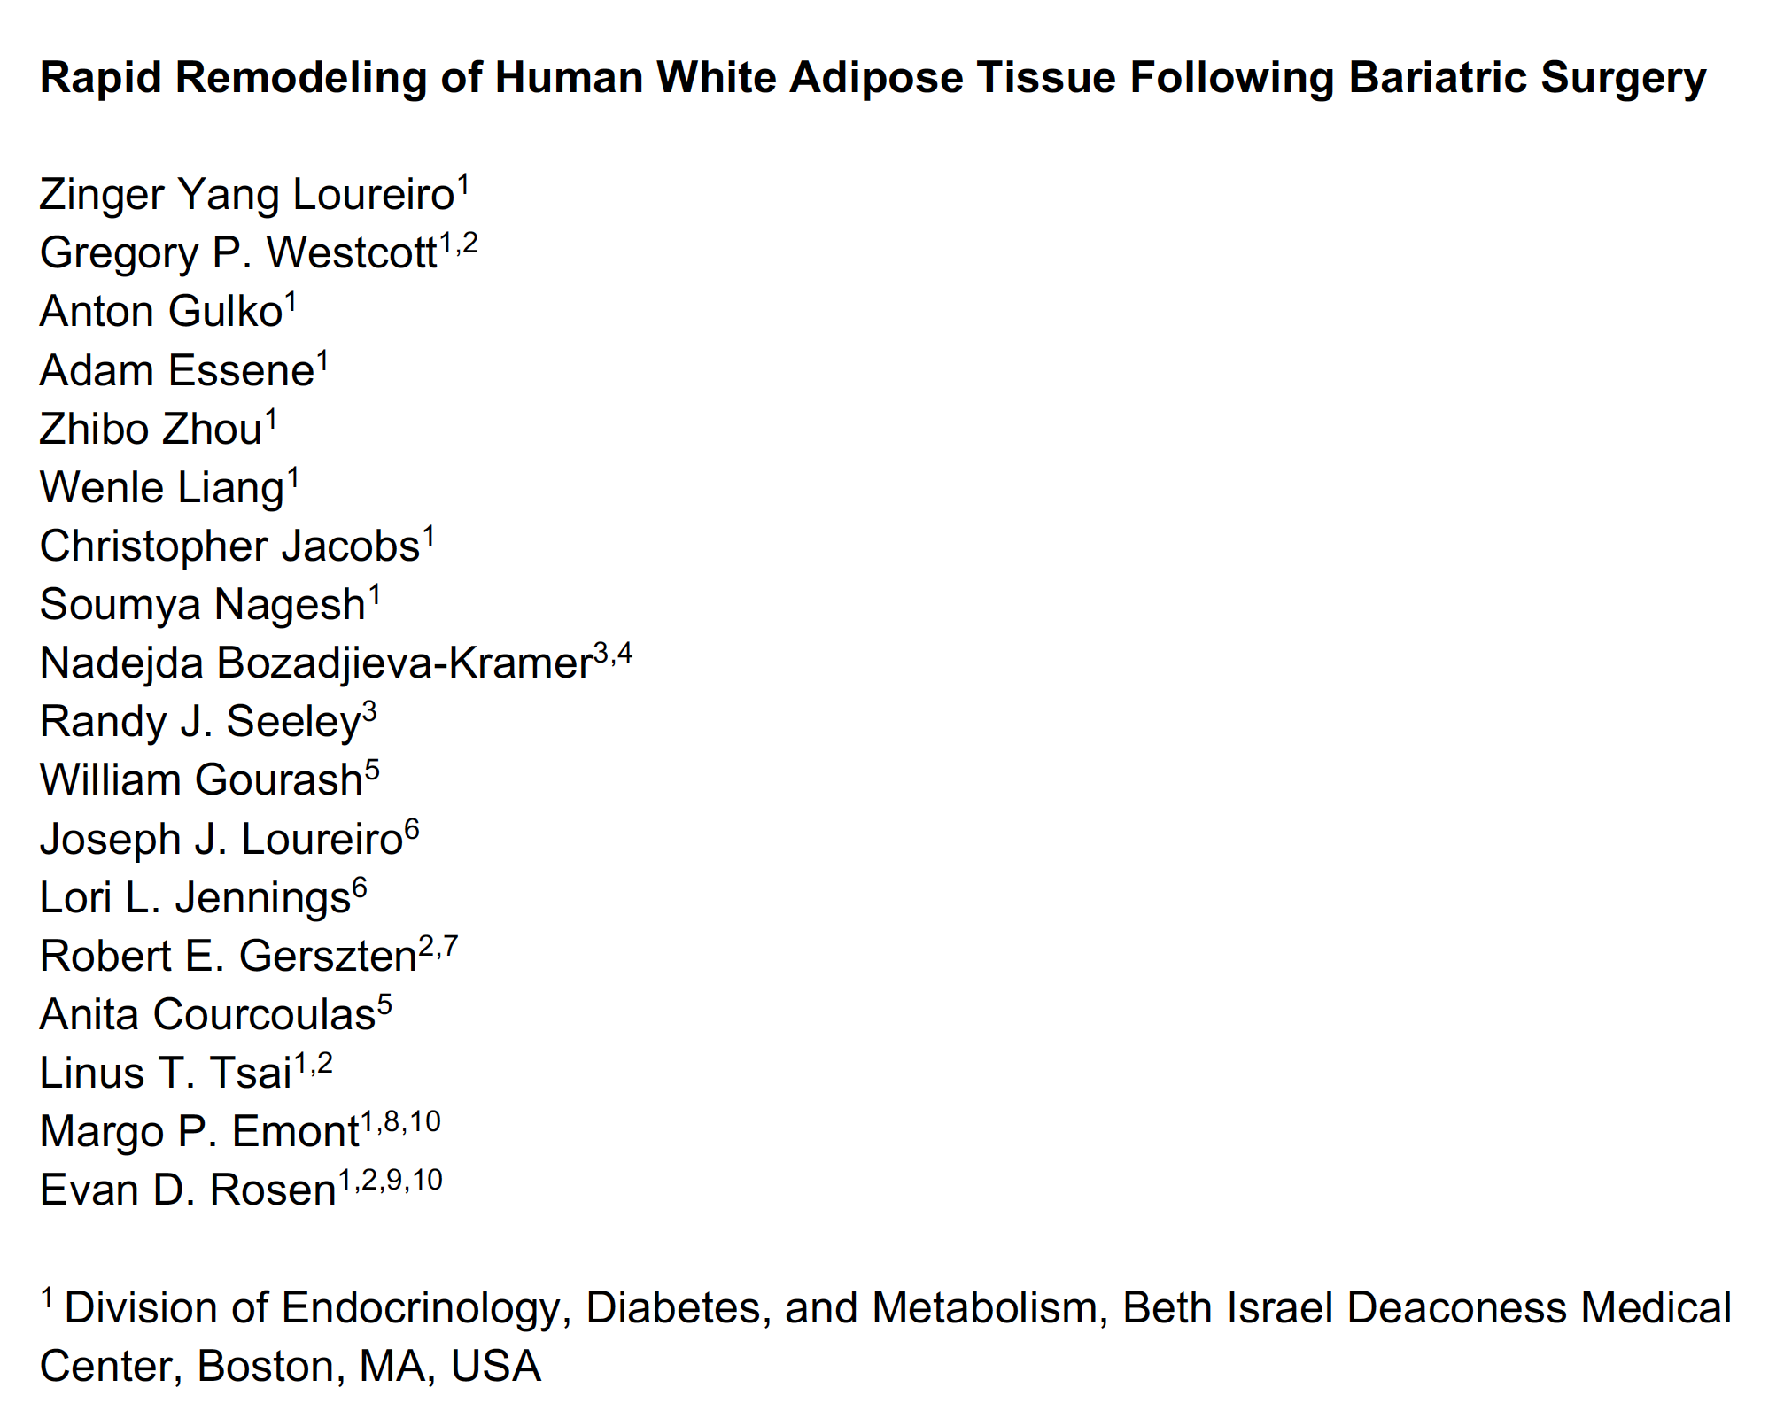

Slide 20
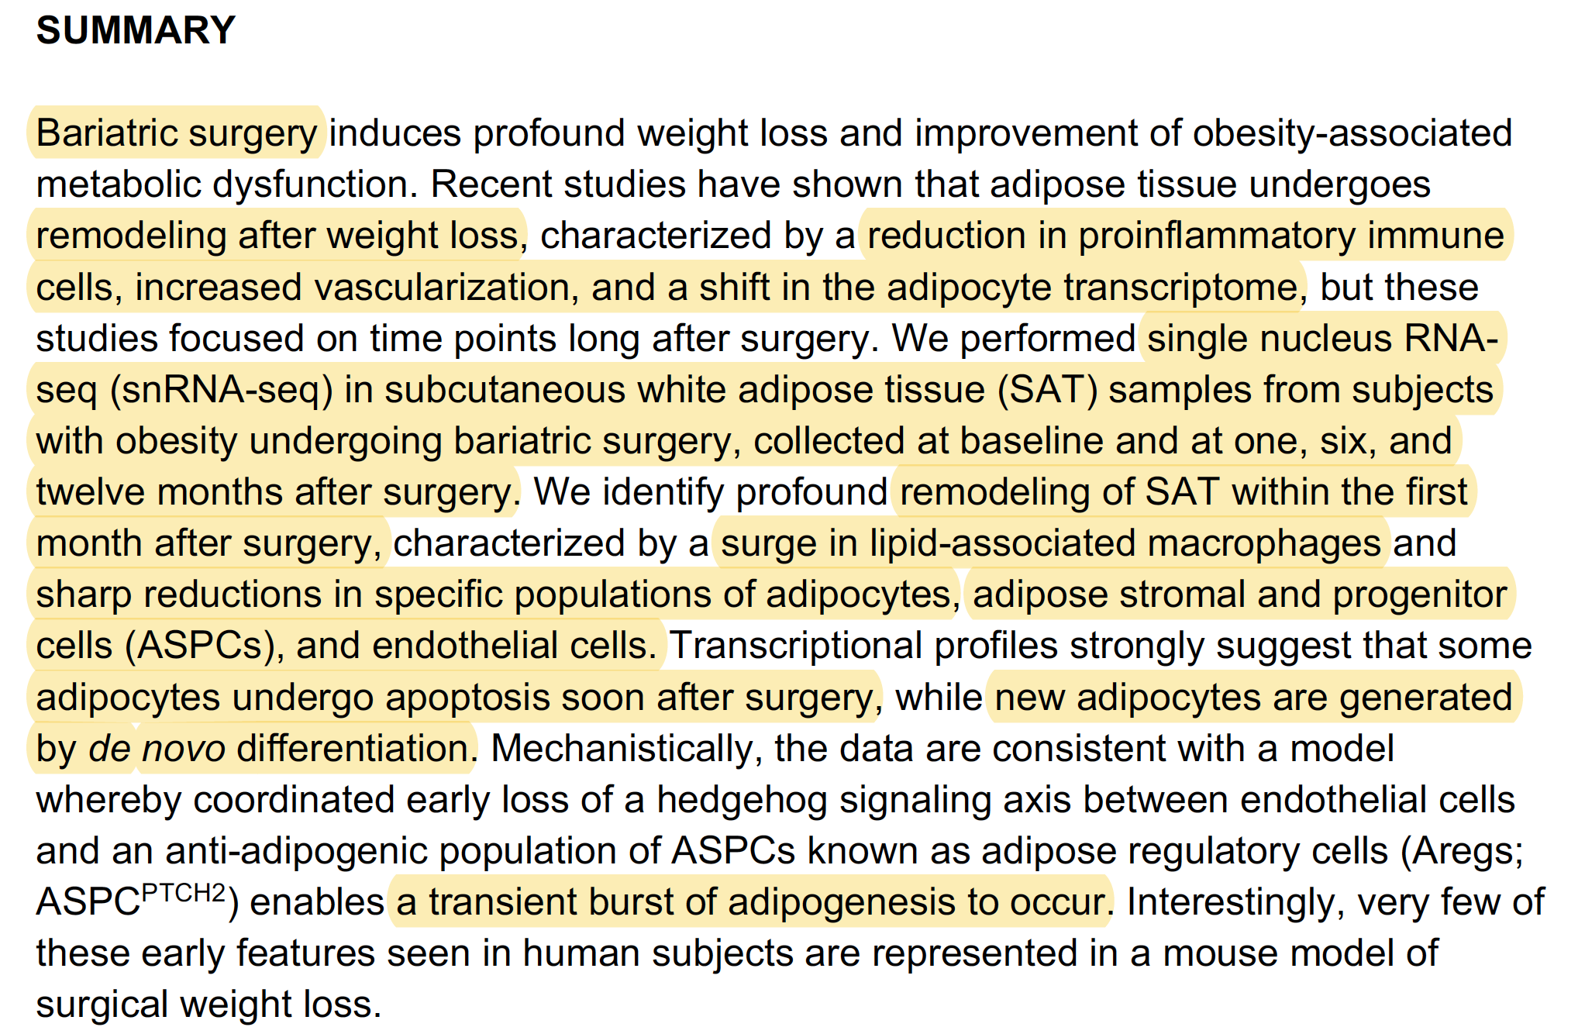

Slide 21
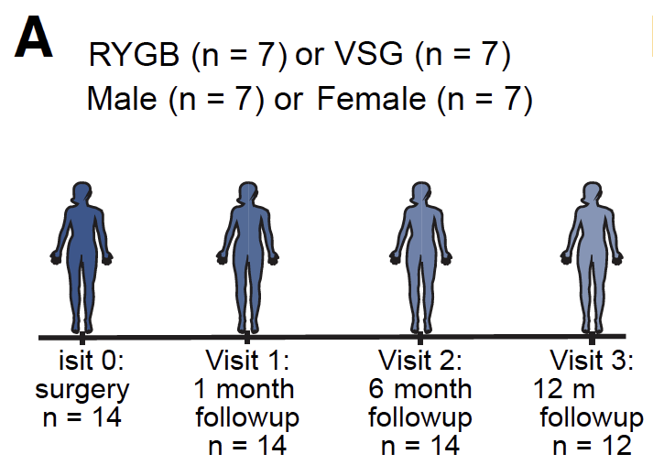
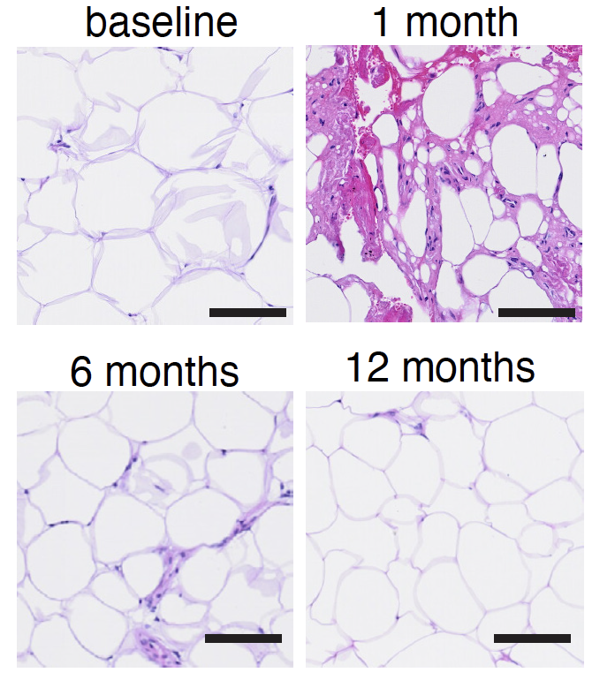
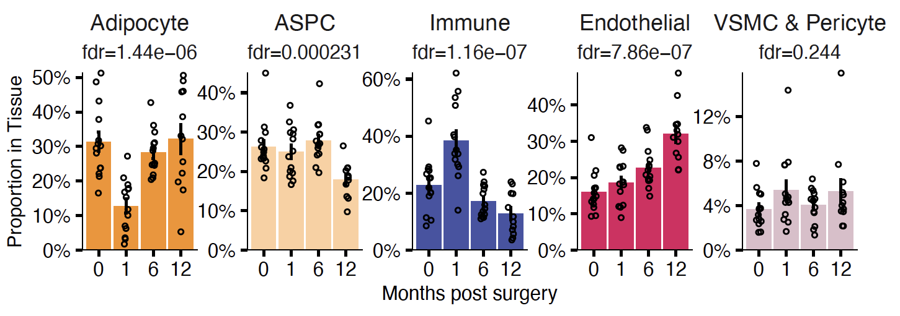

Slide 22
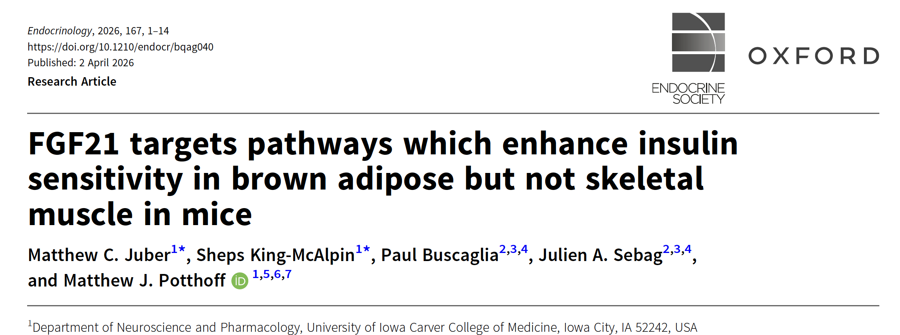

Slide 23
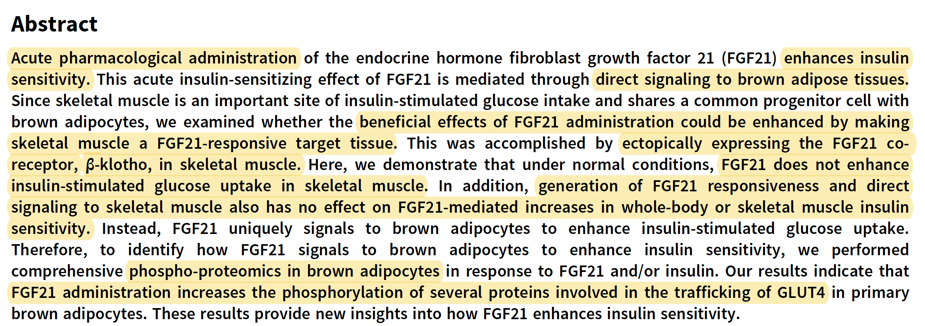

Slide 24
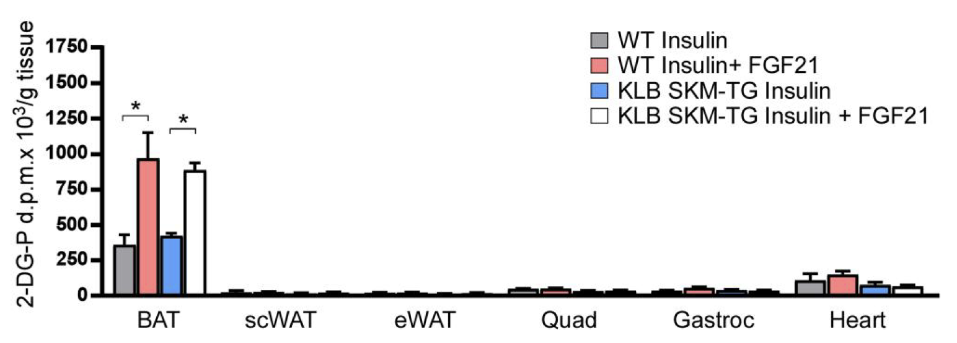

Slide 25
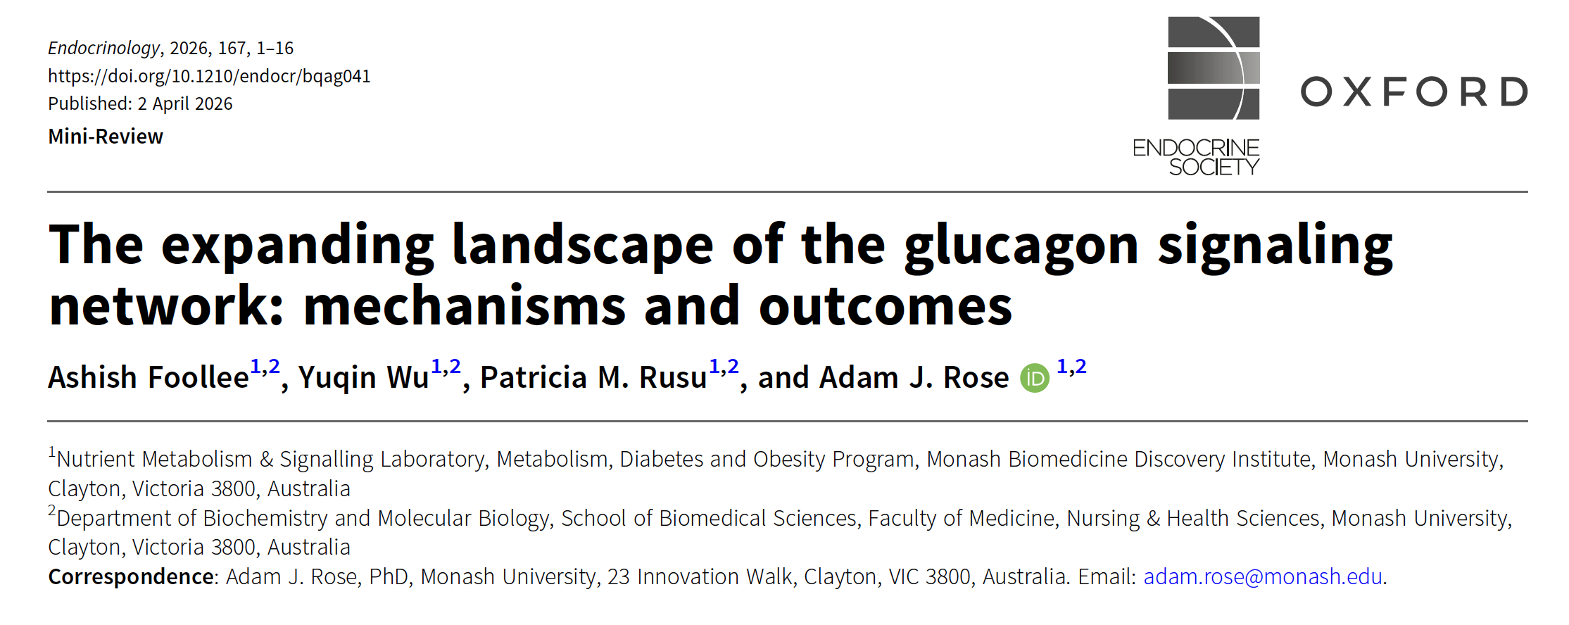

Slide 26
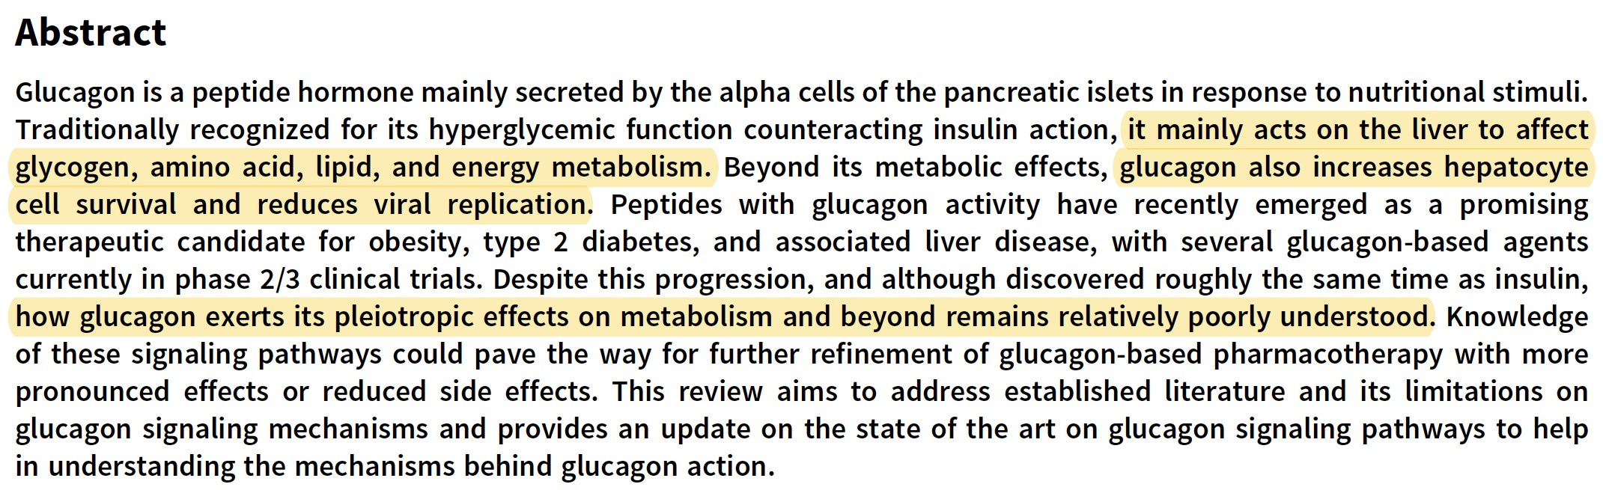

Slide 27
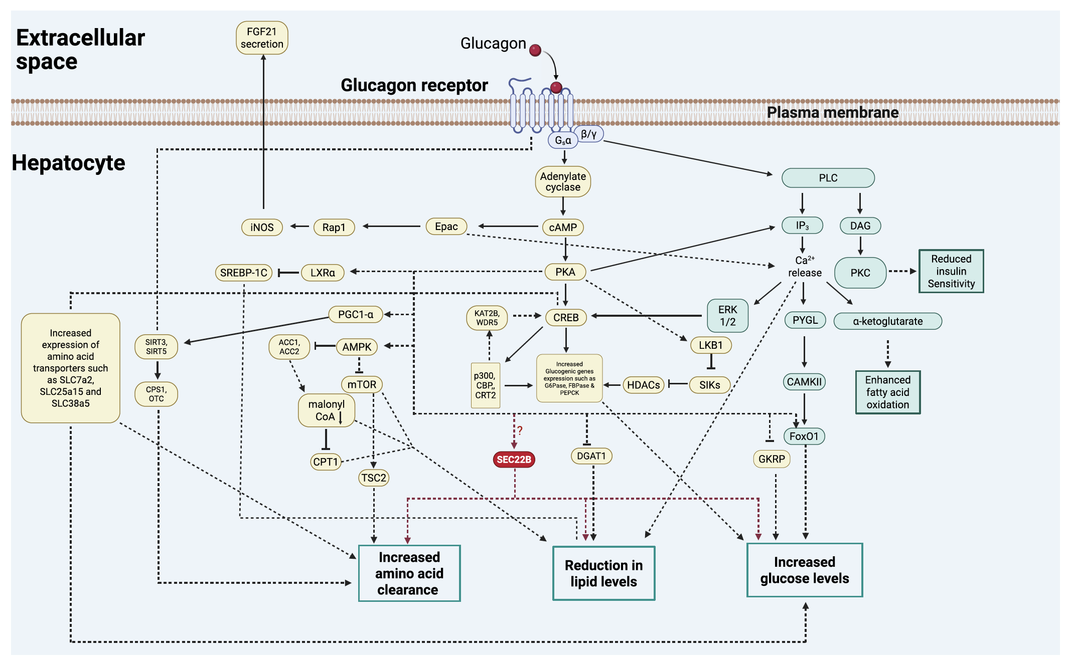

Slide 28
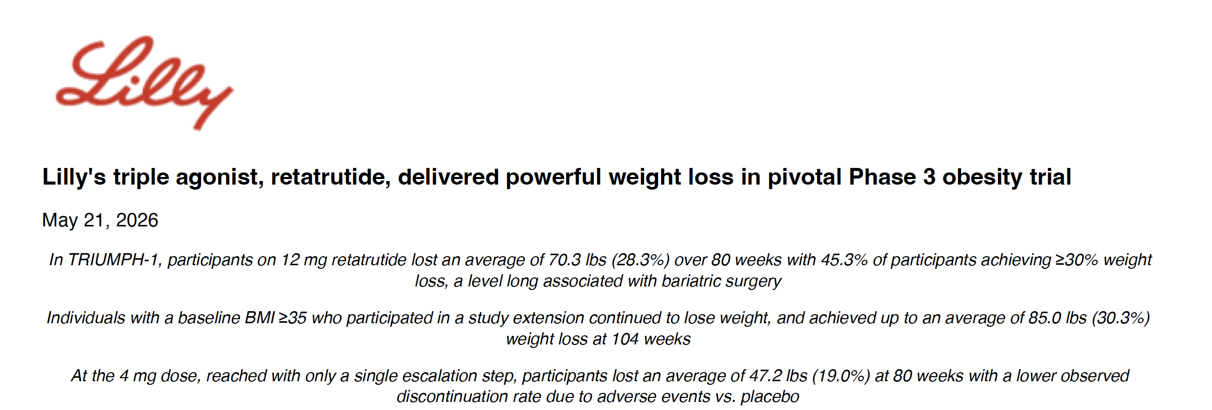

Slide 29
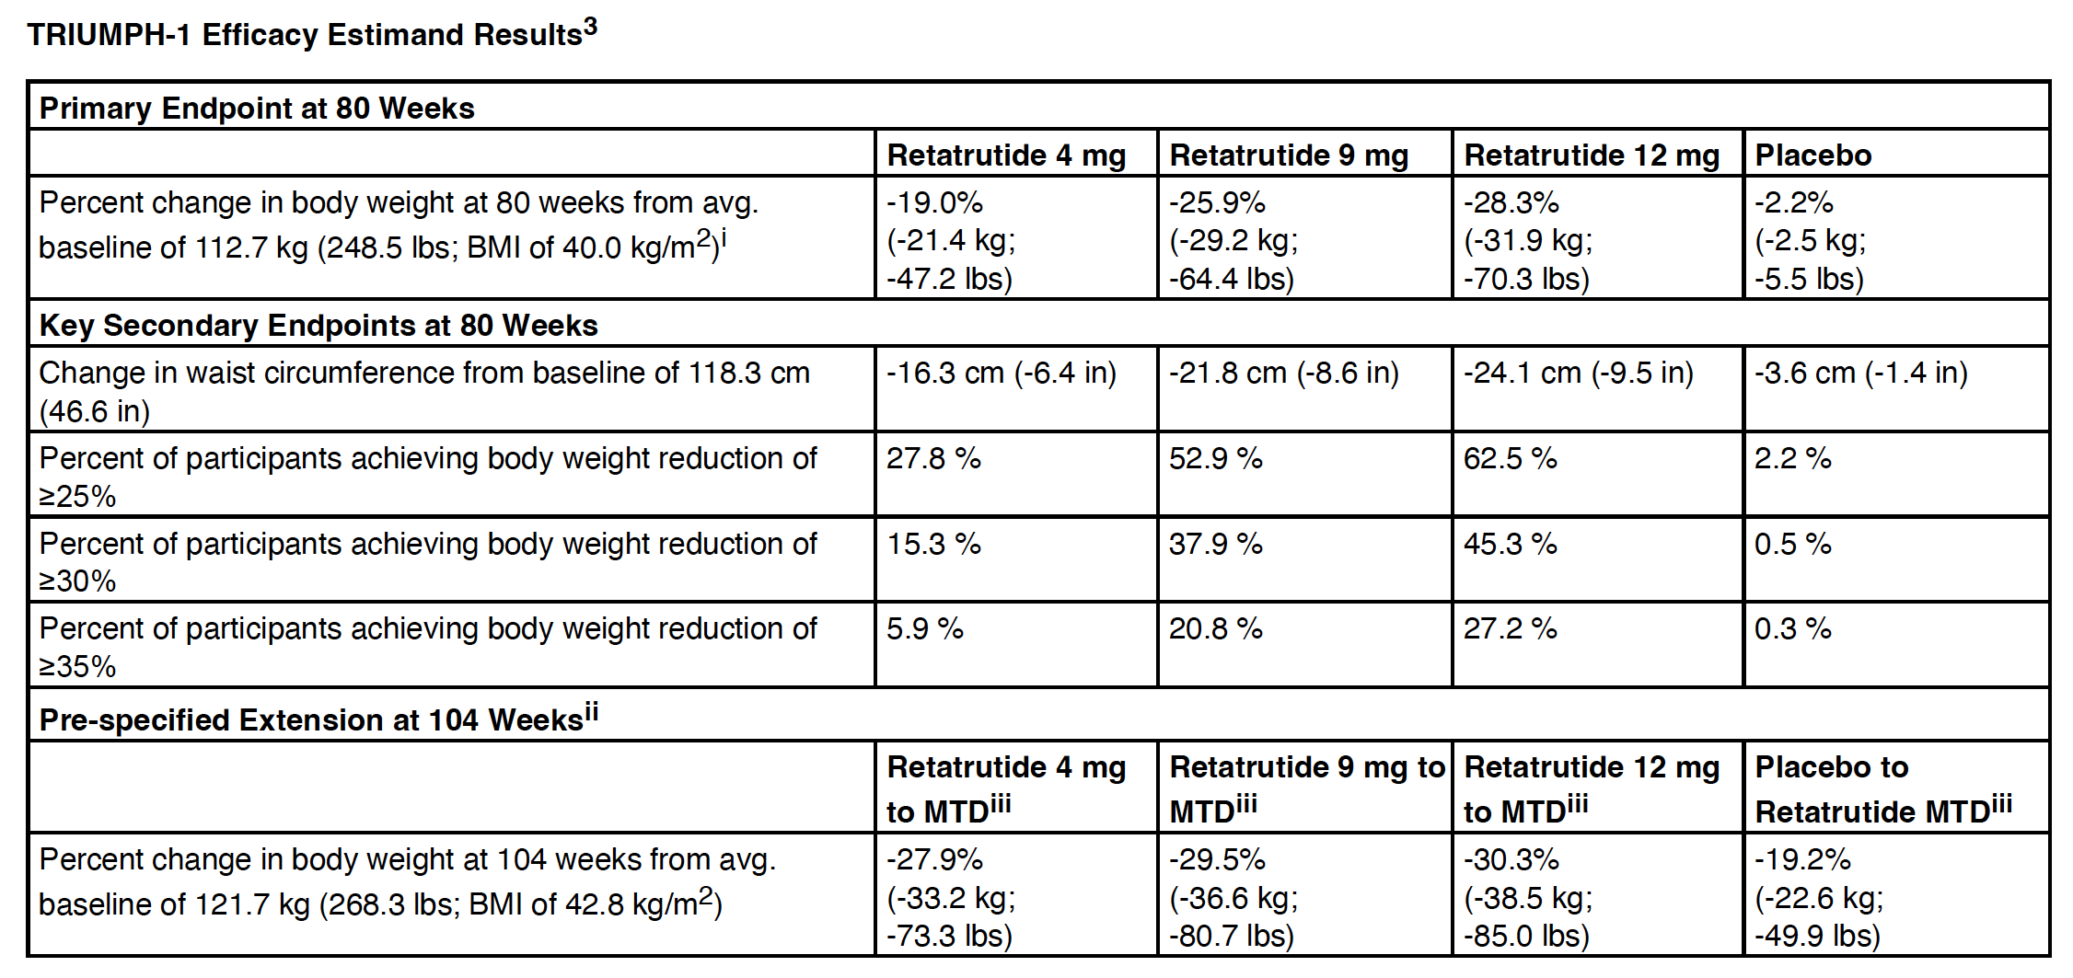

Slide 30
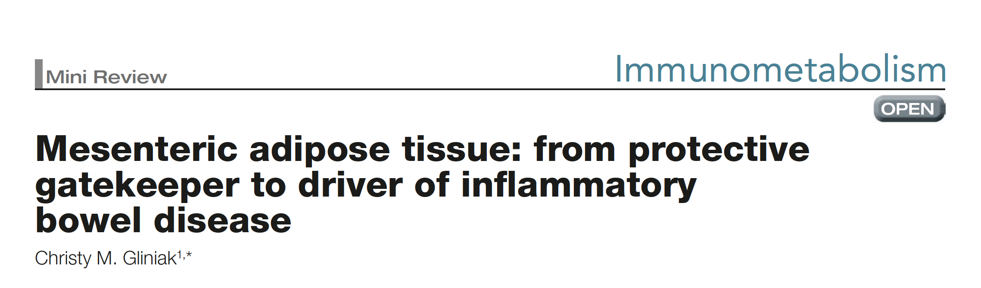

Slide 31
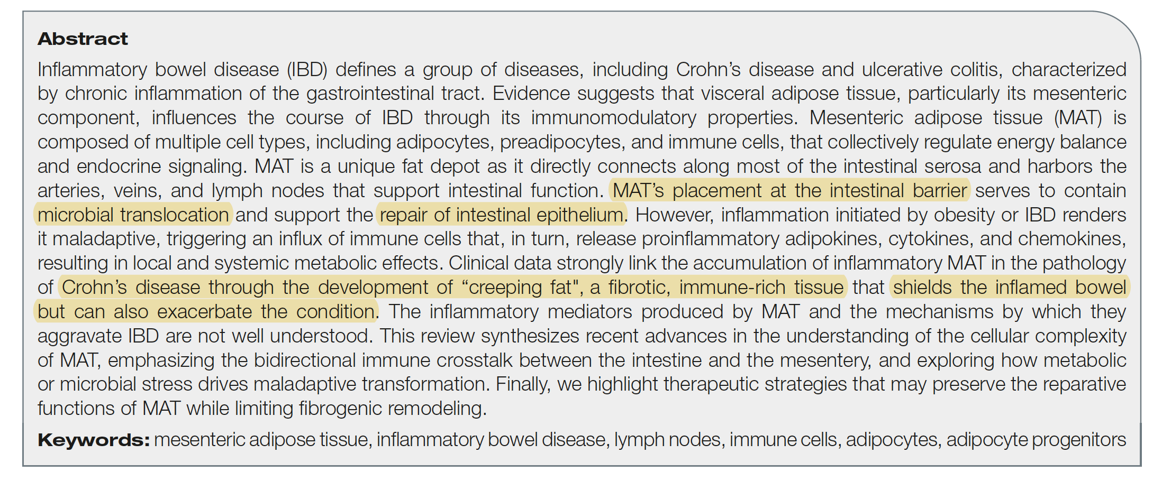

Slide 32
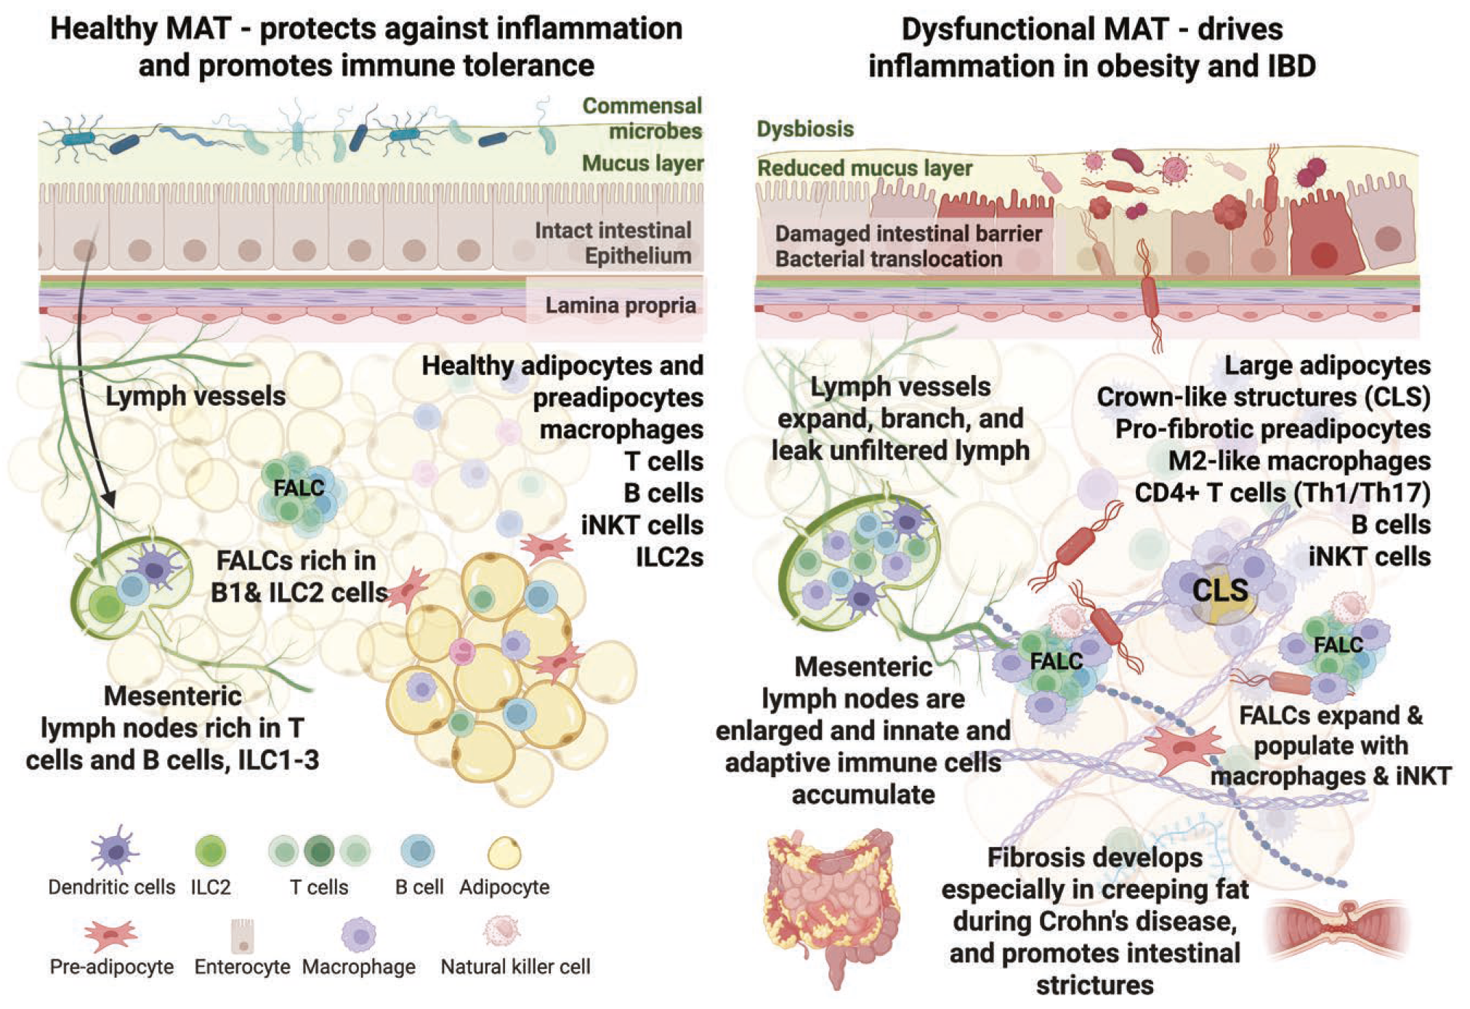

Slide 33


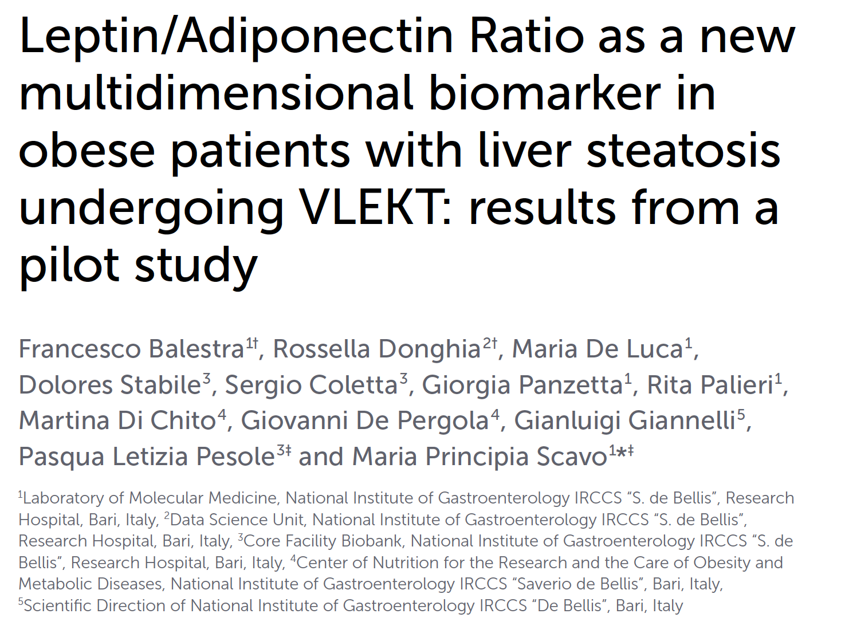

Slide 34
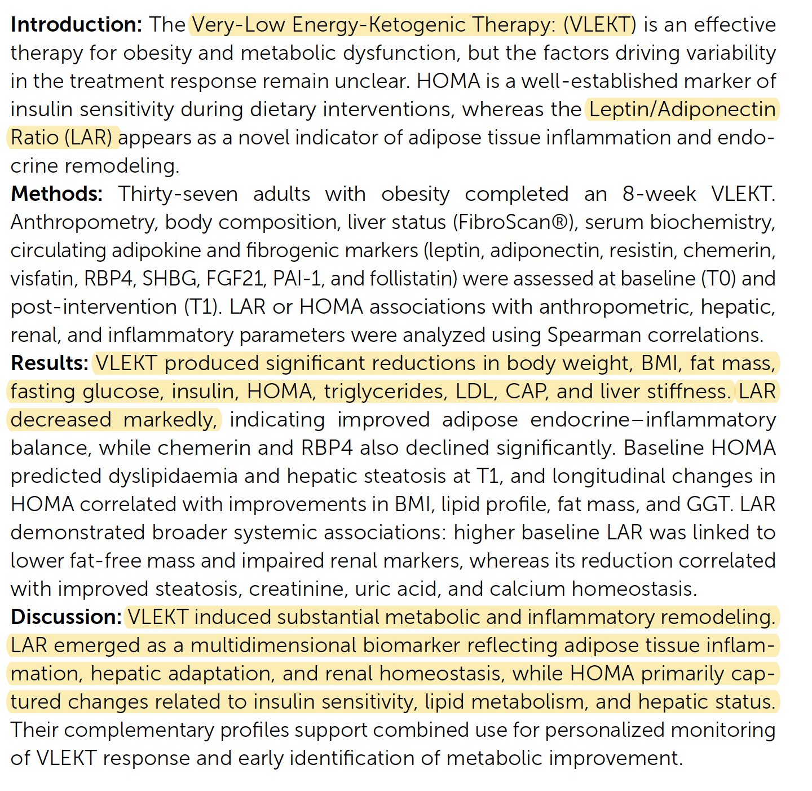

Slide 35
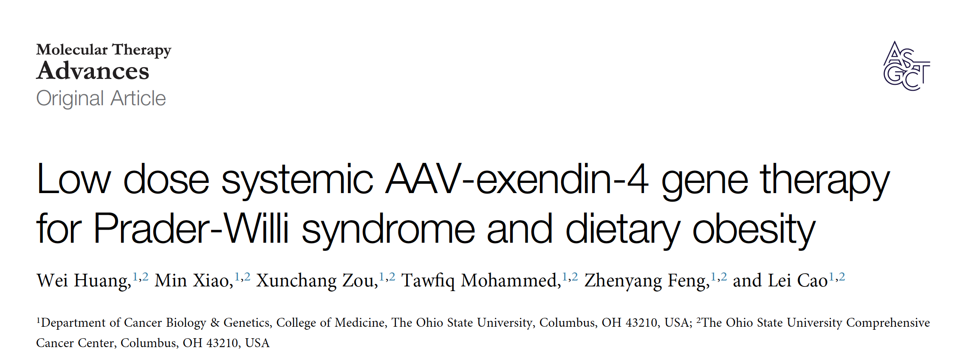

Slide 36
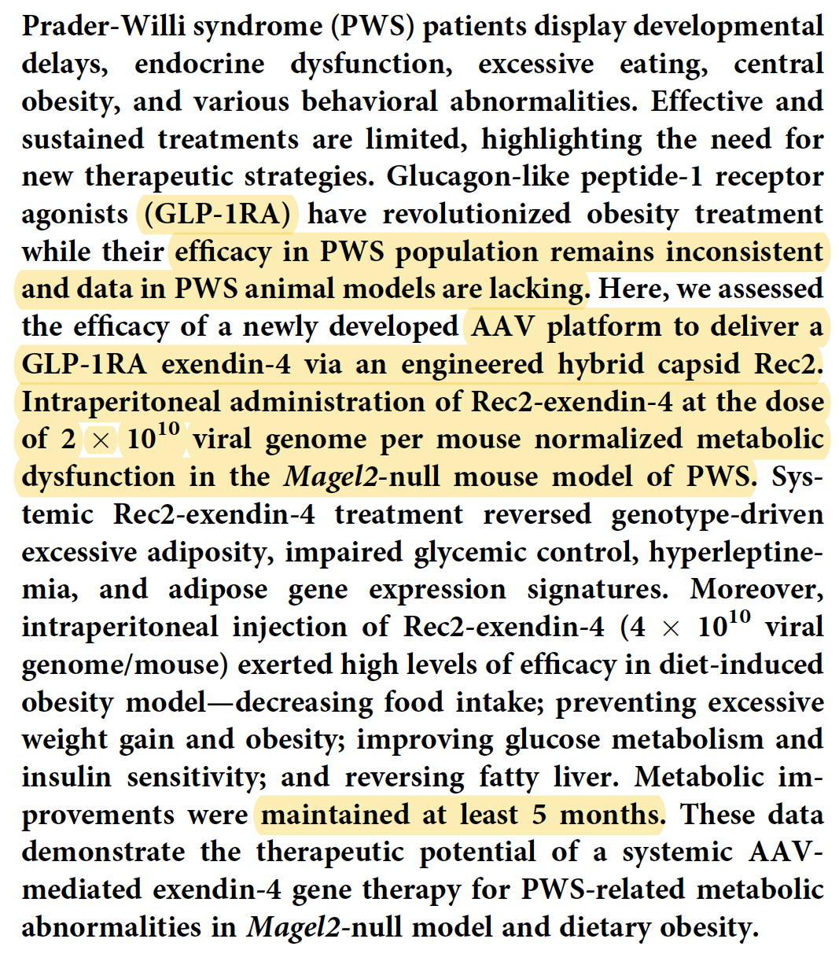

Slide 37
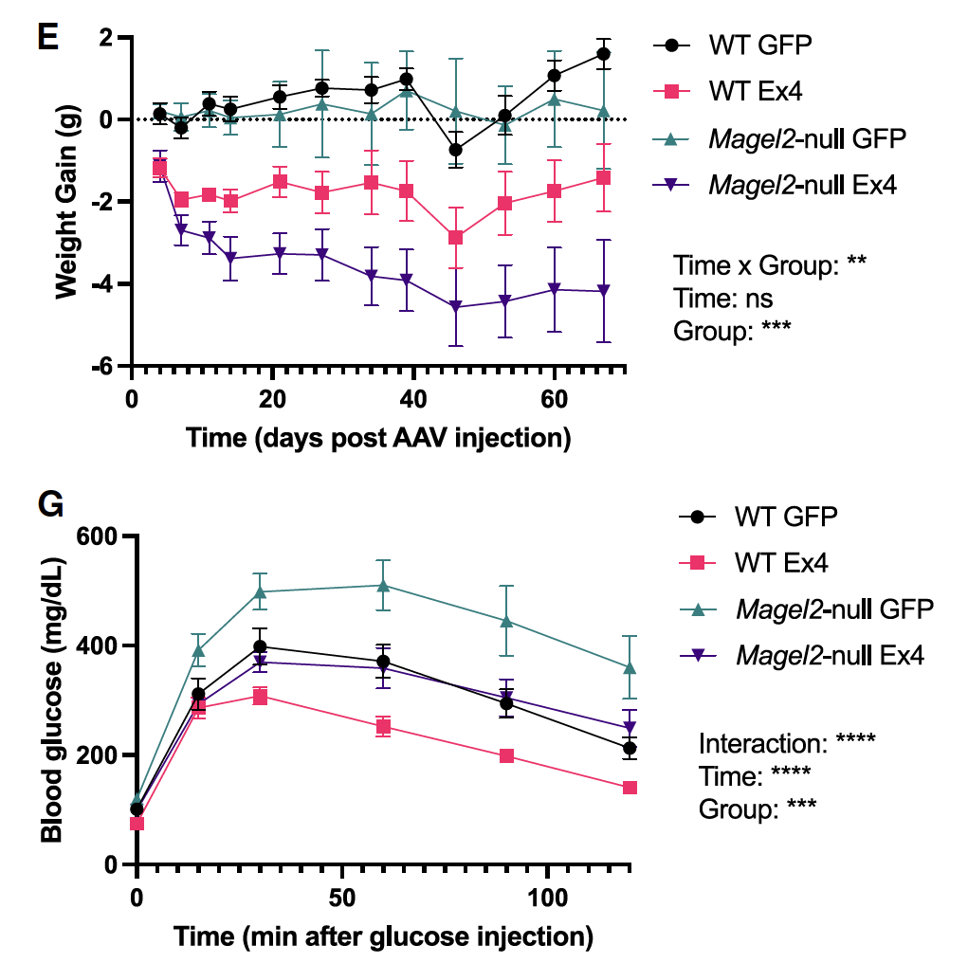

Slide 38
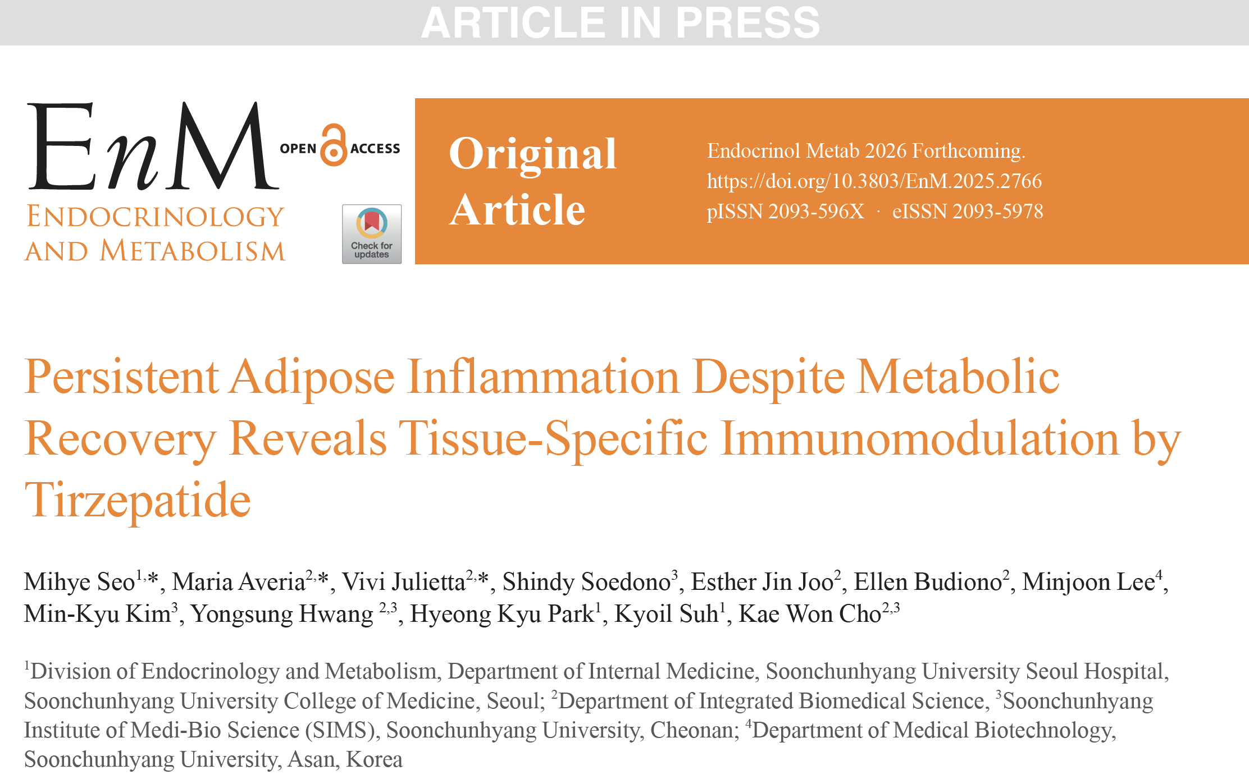

Slide 39
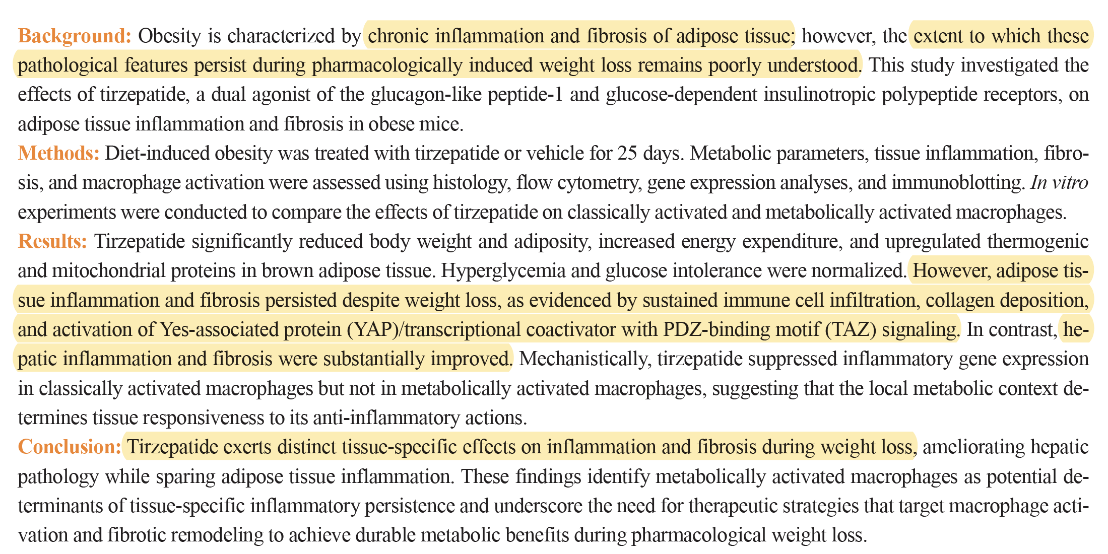

Slide 40



Slide 41
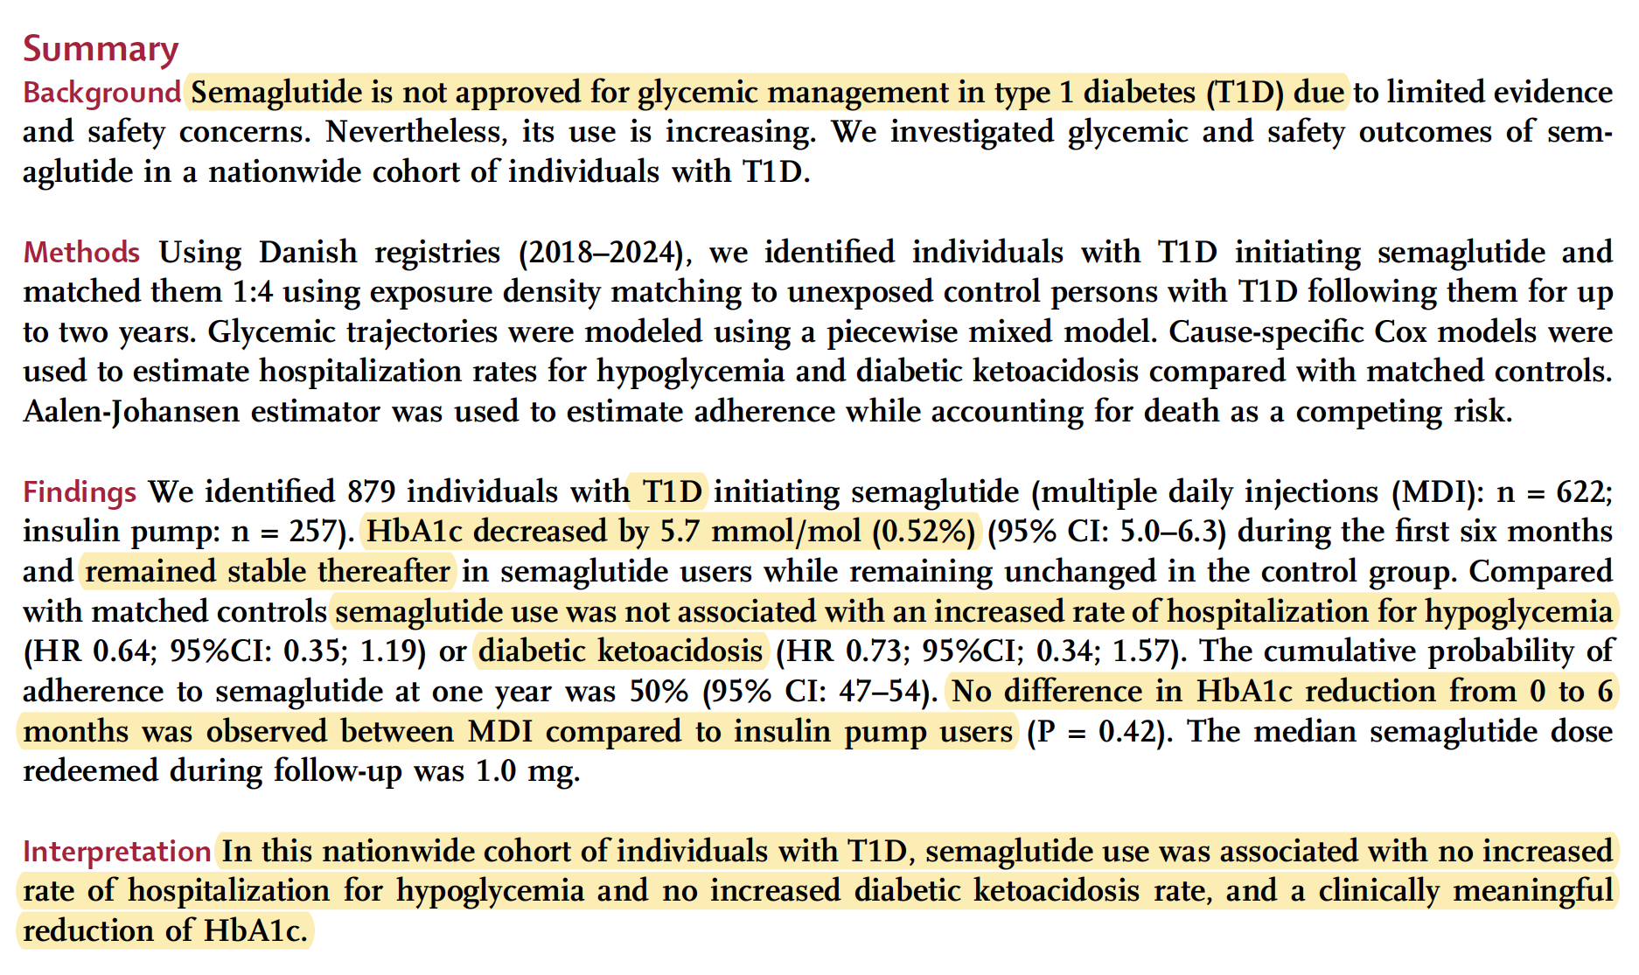

Slide 42
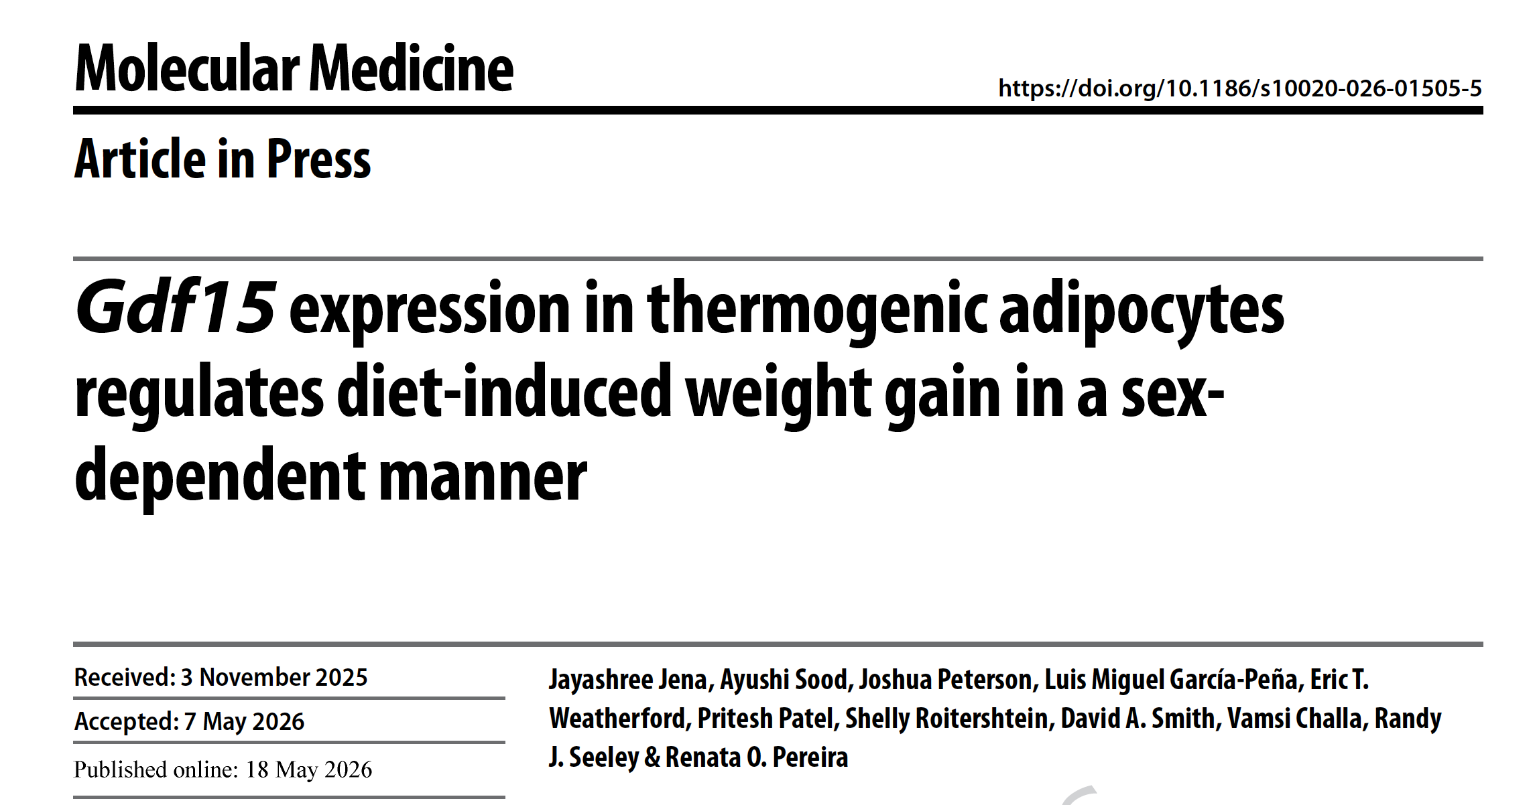

Slide 43
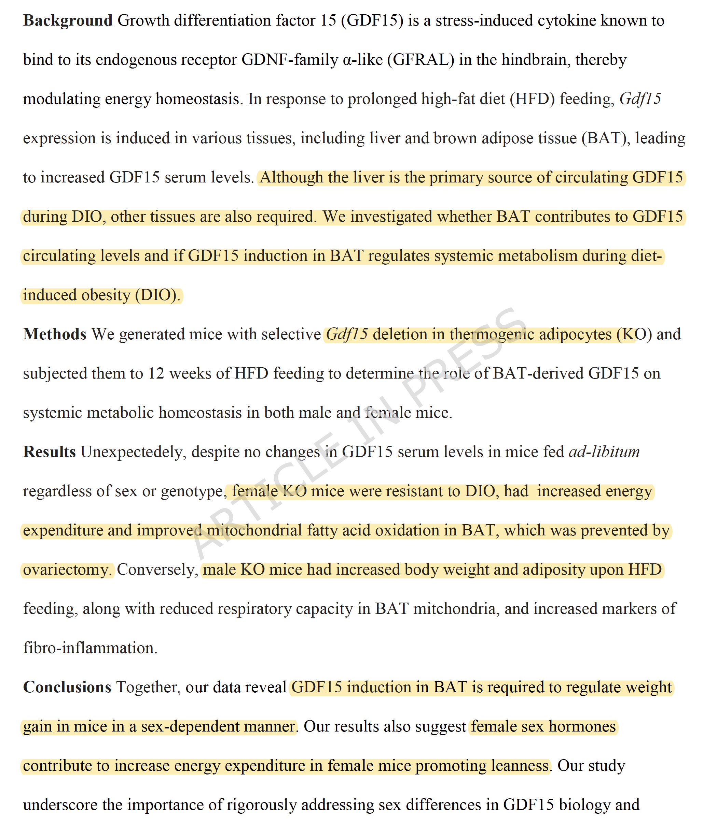
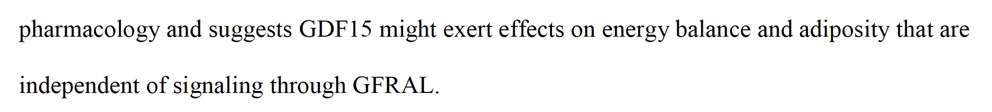

Slide 44

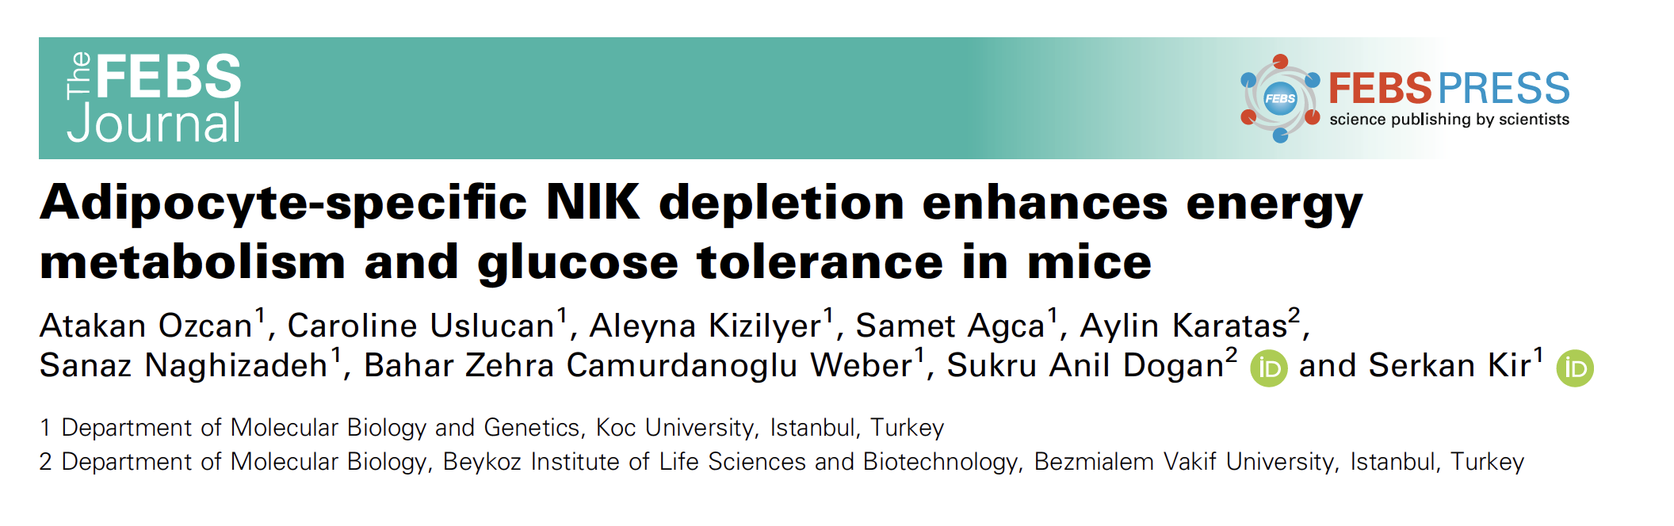

Slide 45
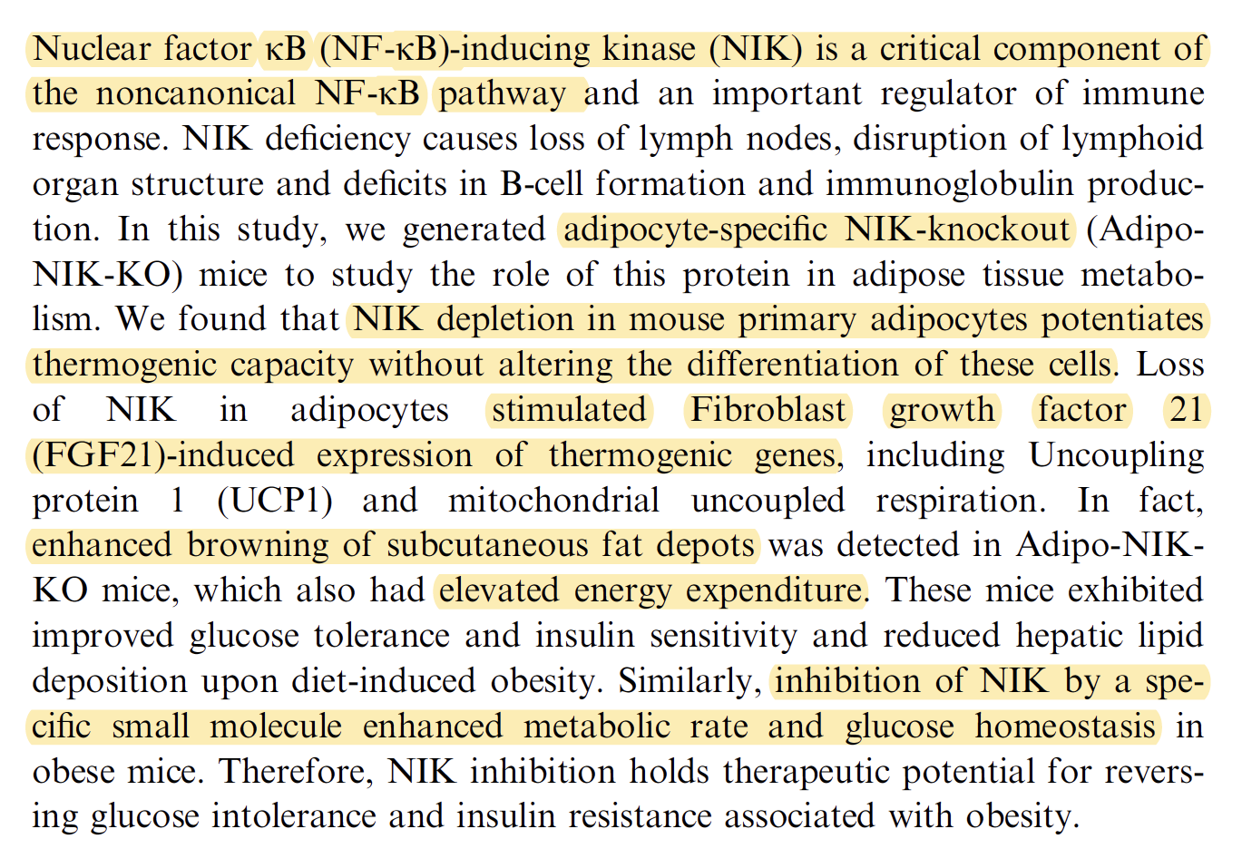

Slide 46
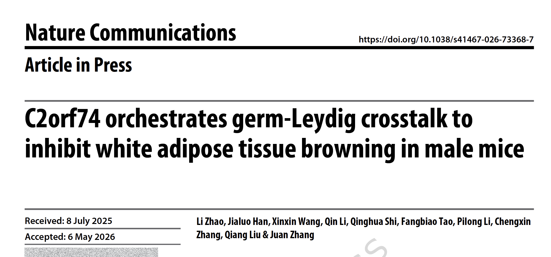

Slide 47
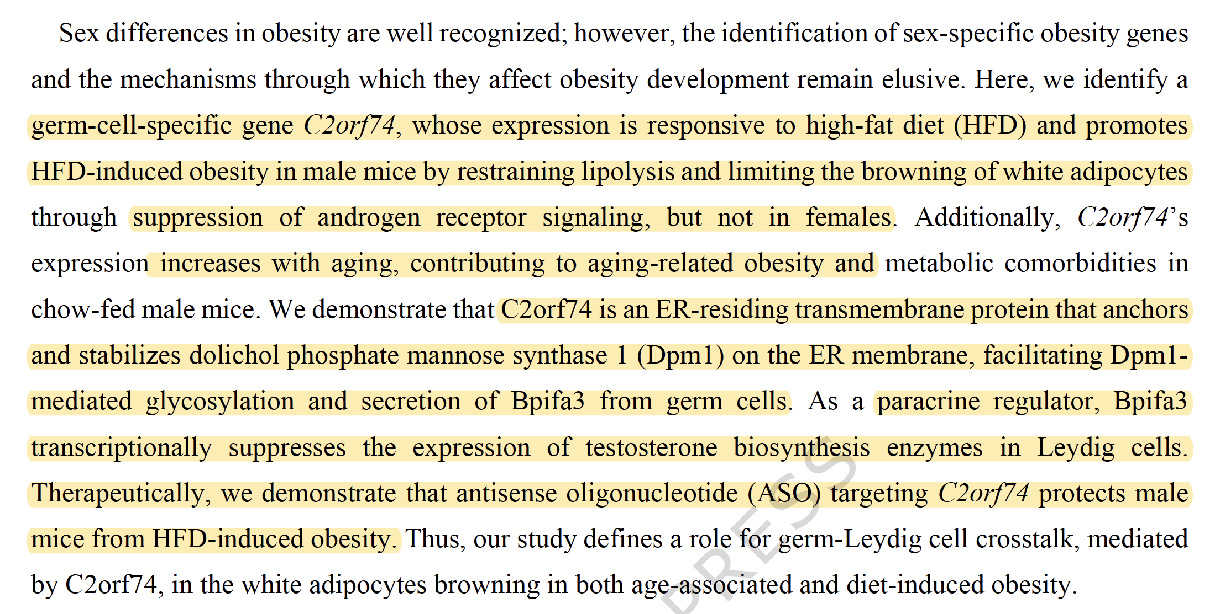

Slide 48
