Slide 1
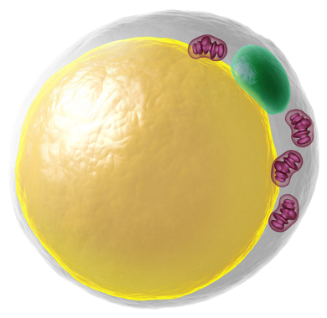
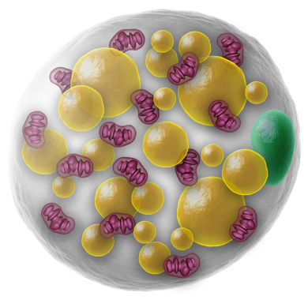
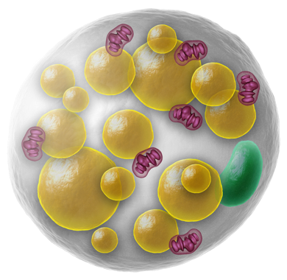
Literature Overview Touchstone Diabetes Center UTSW Medical Center 3/2/2026

Slide 2
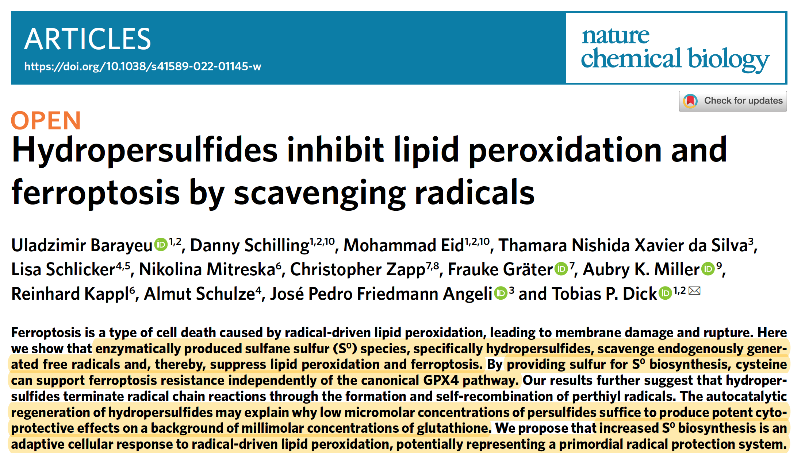

Slide 3
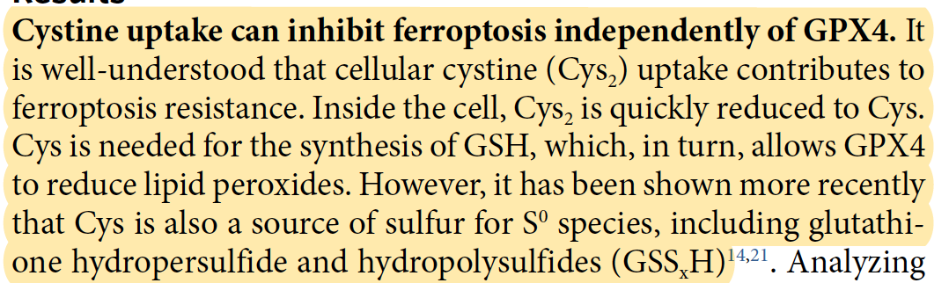
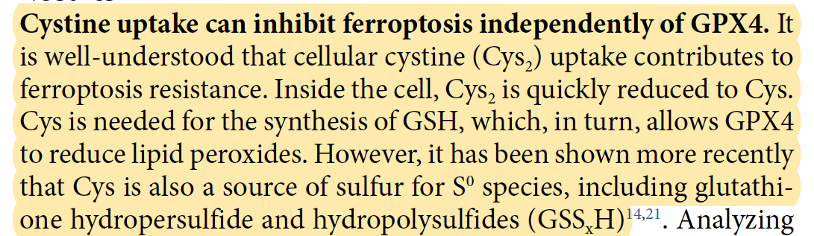

Slide 4
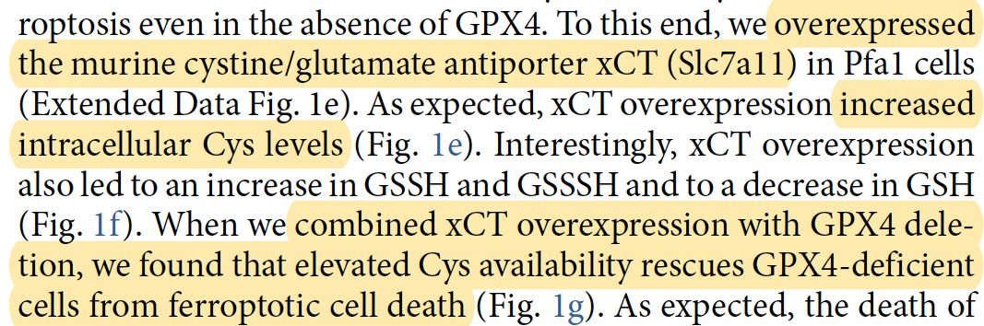
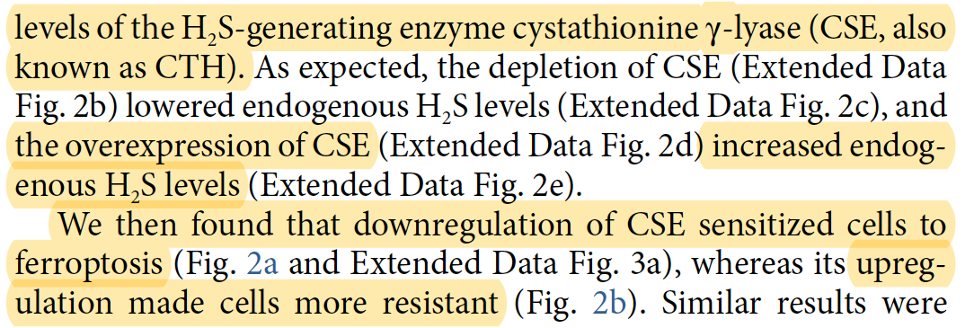
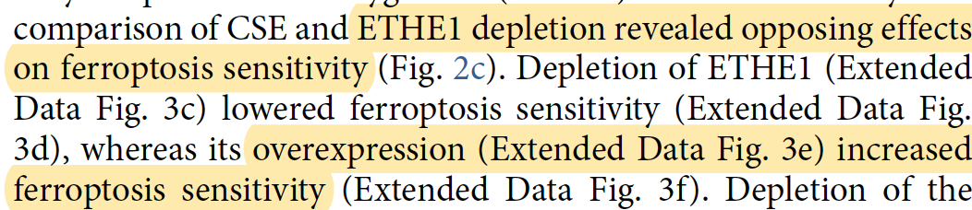

Slide 5



Slide 6
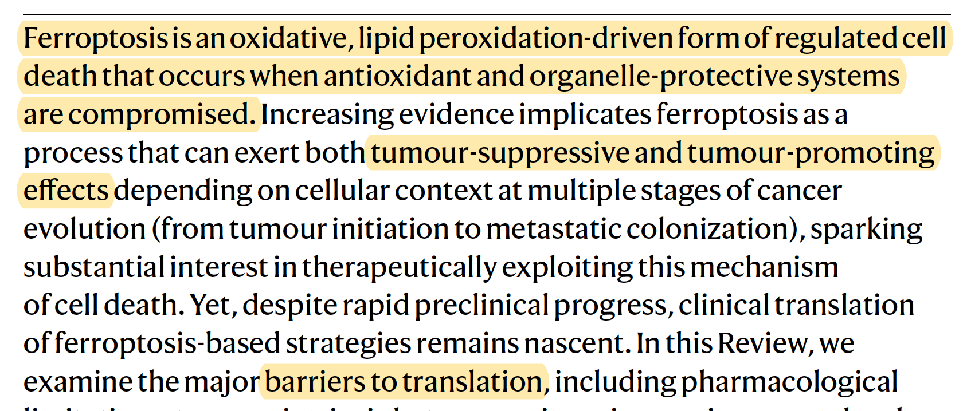

Slide 7
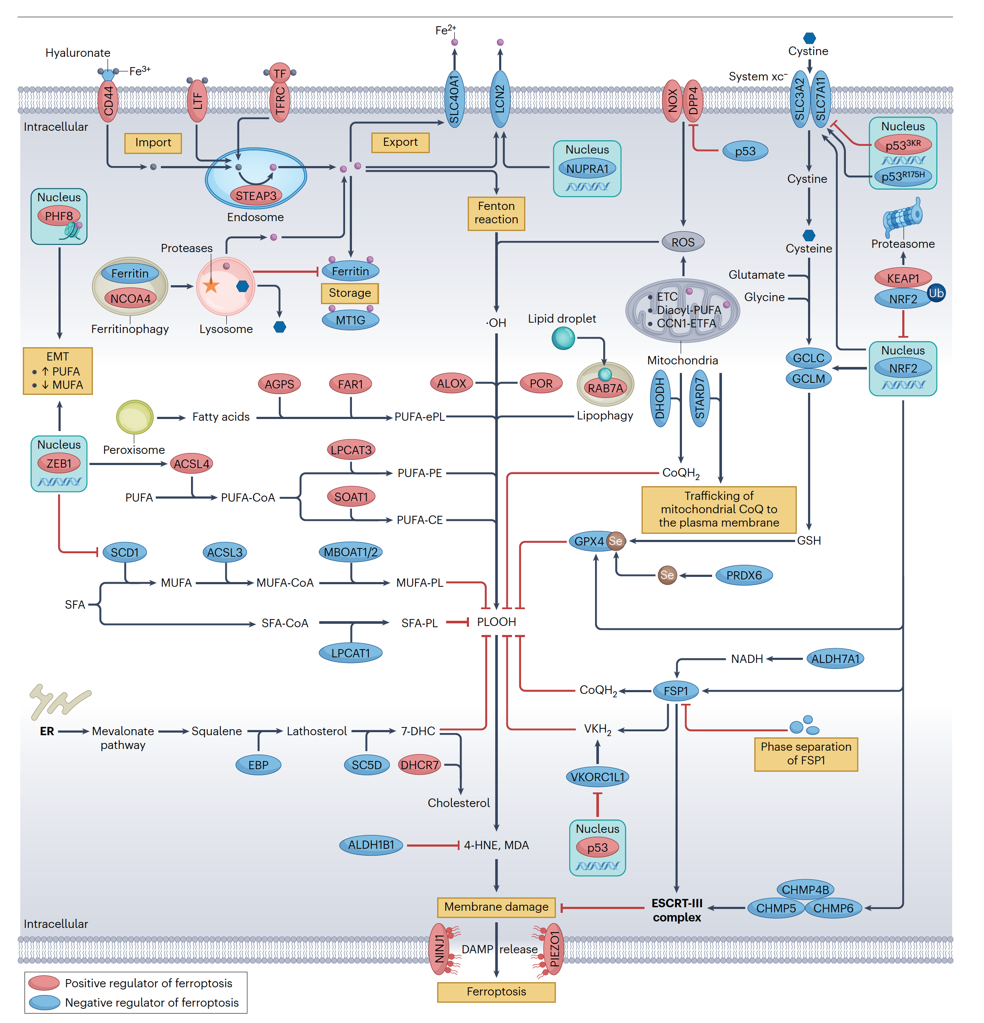

Slide 8




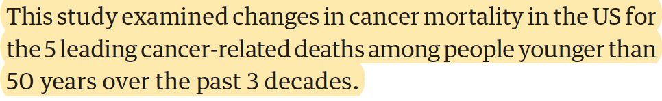

Slide 9
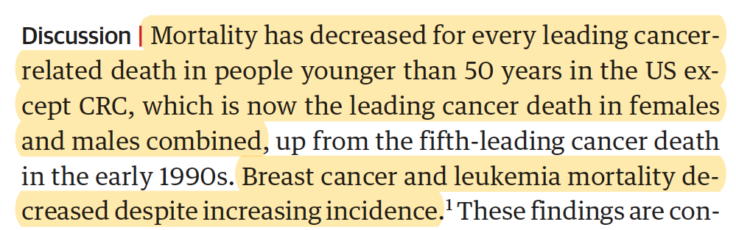
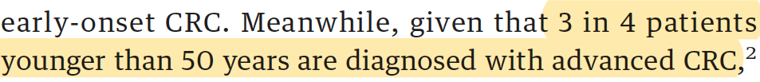

Slide 10
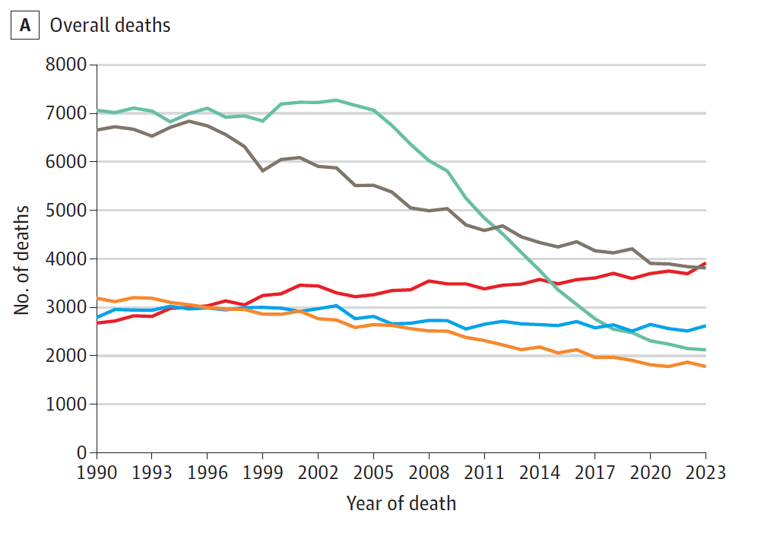
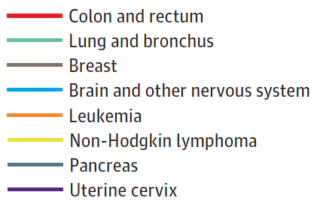

Slide 11
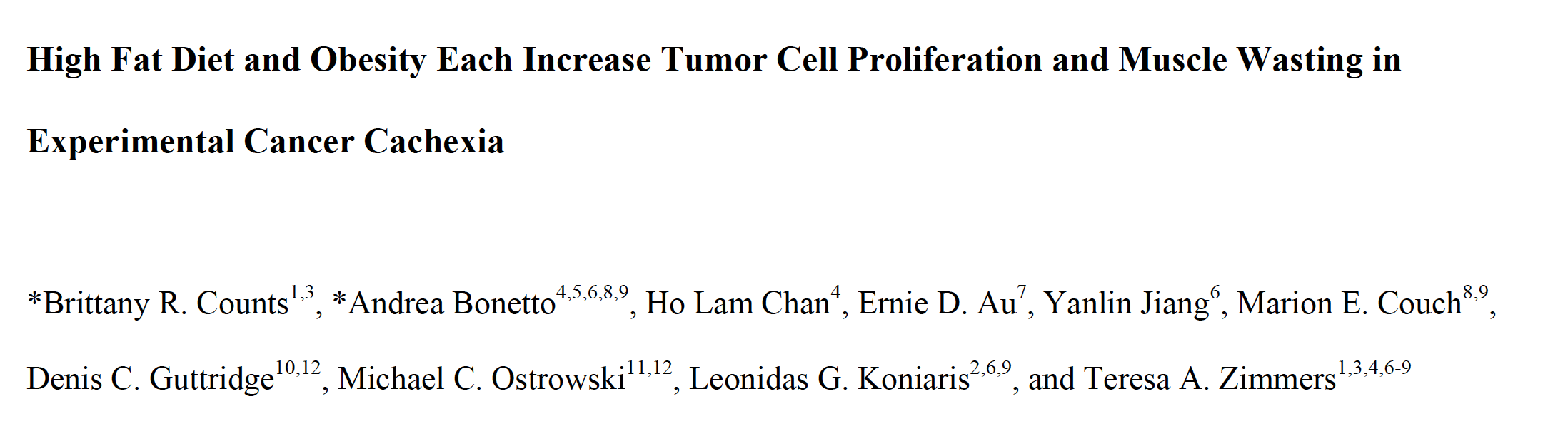
Am J Physiol Cell Physiol. 2026 Feb 21. doi: 10.1152/ajpcell.00545.2025.

Slide 12
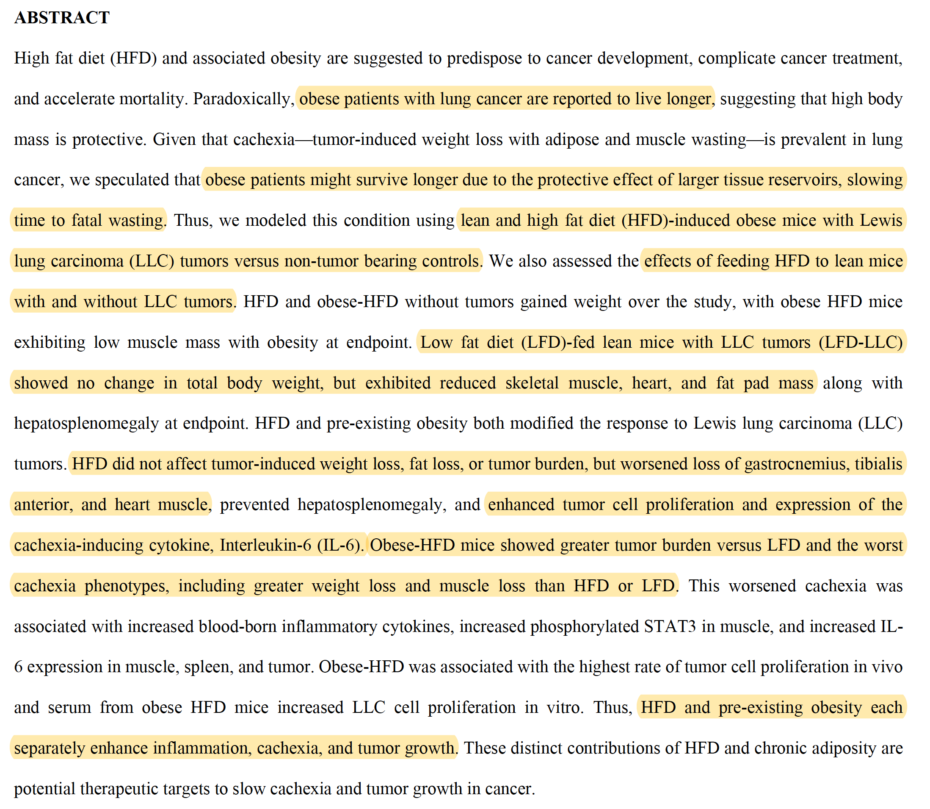

Slide 13
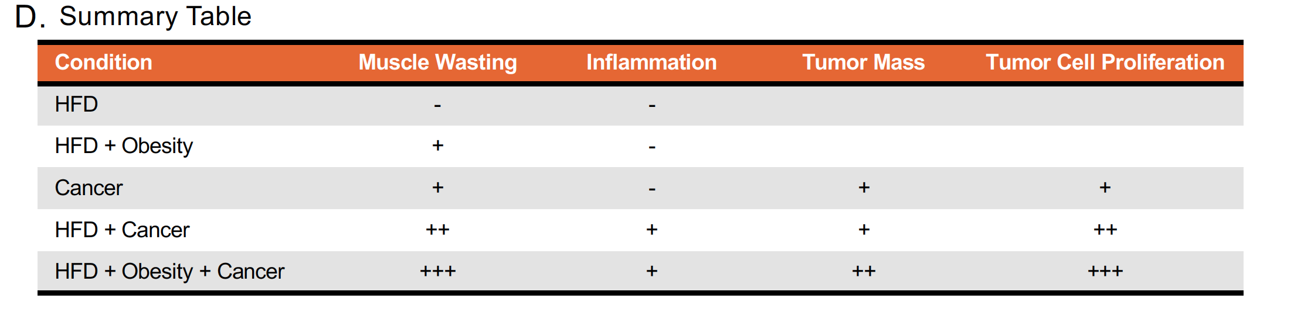
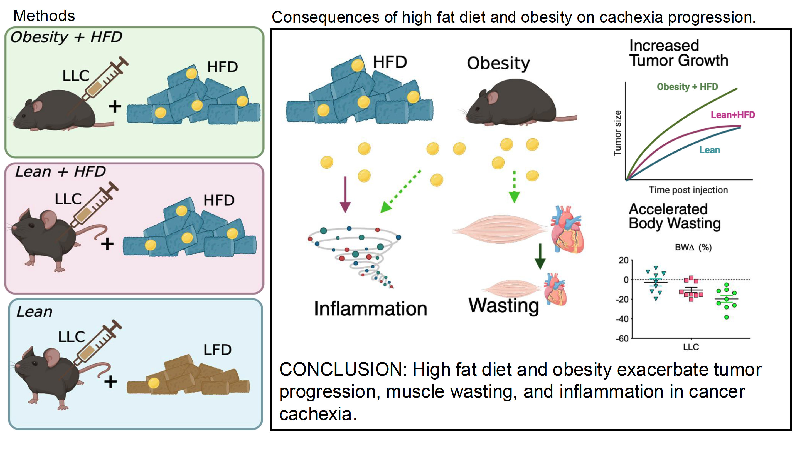

Slide 14
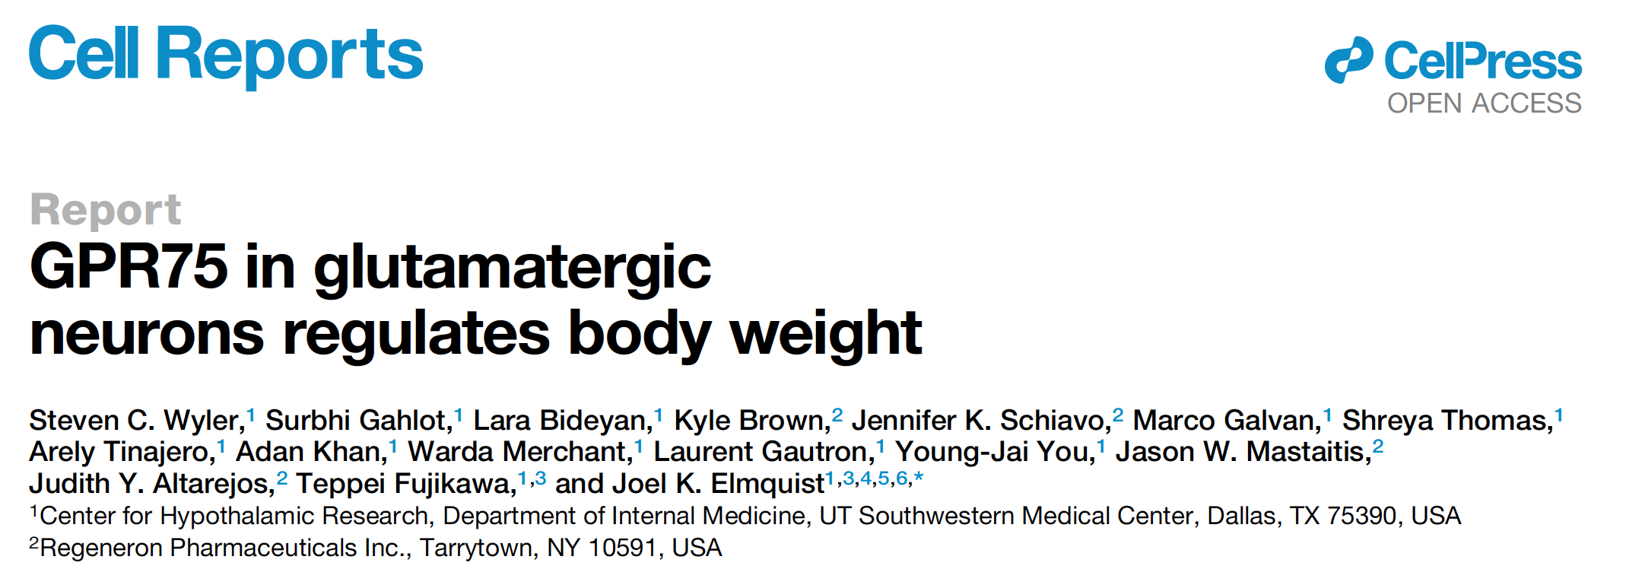

Slide 15
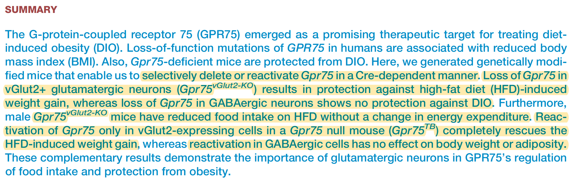

Slide 16
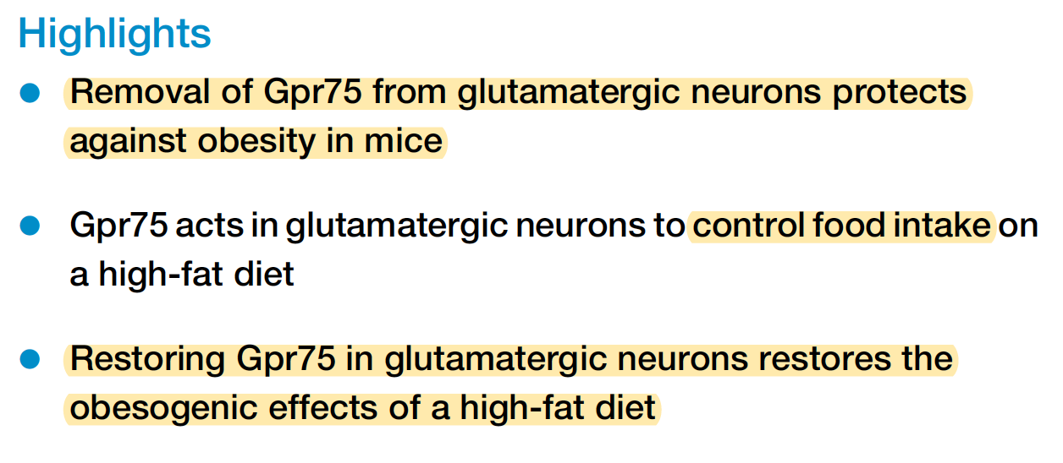
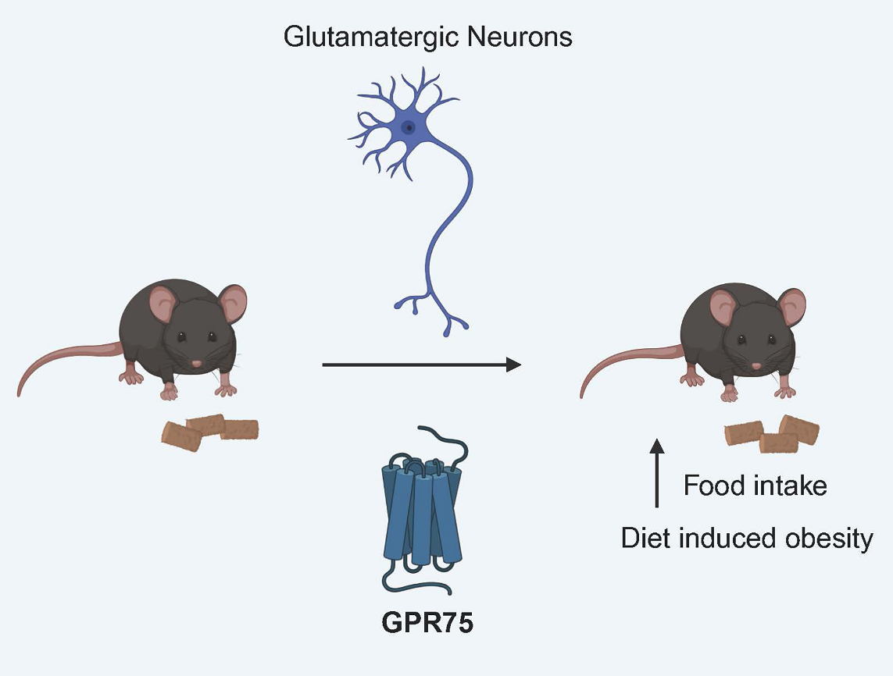

Slide 17


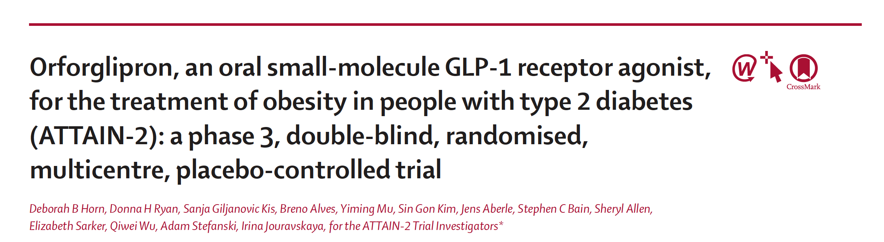

Slide 18
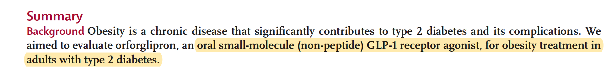
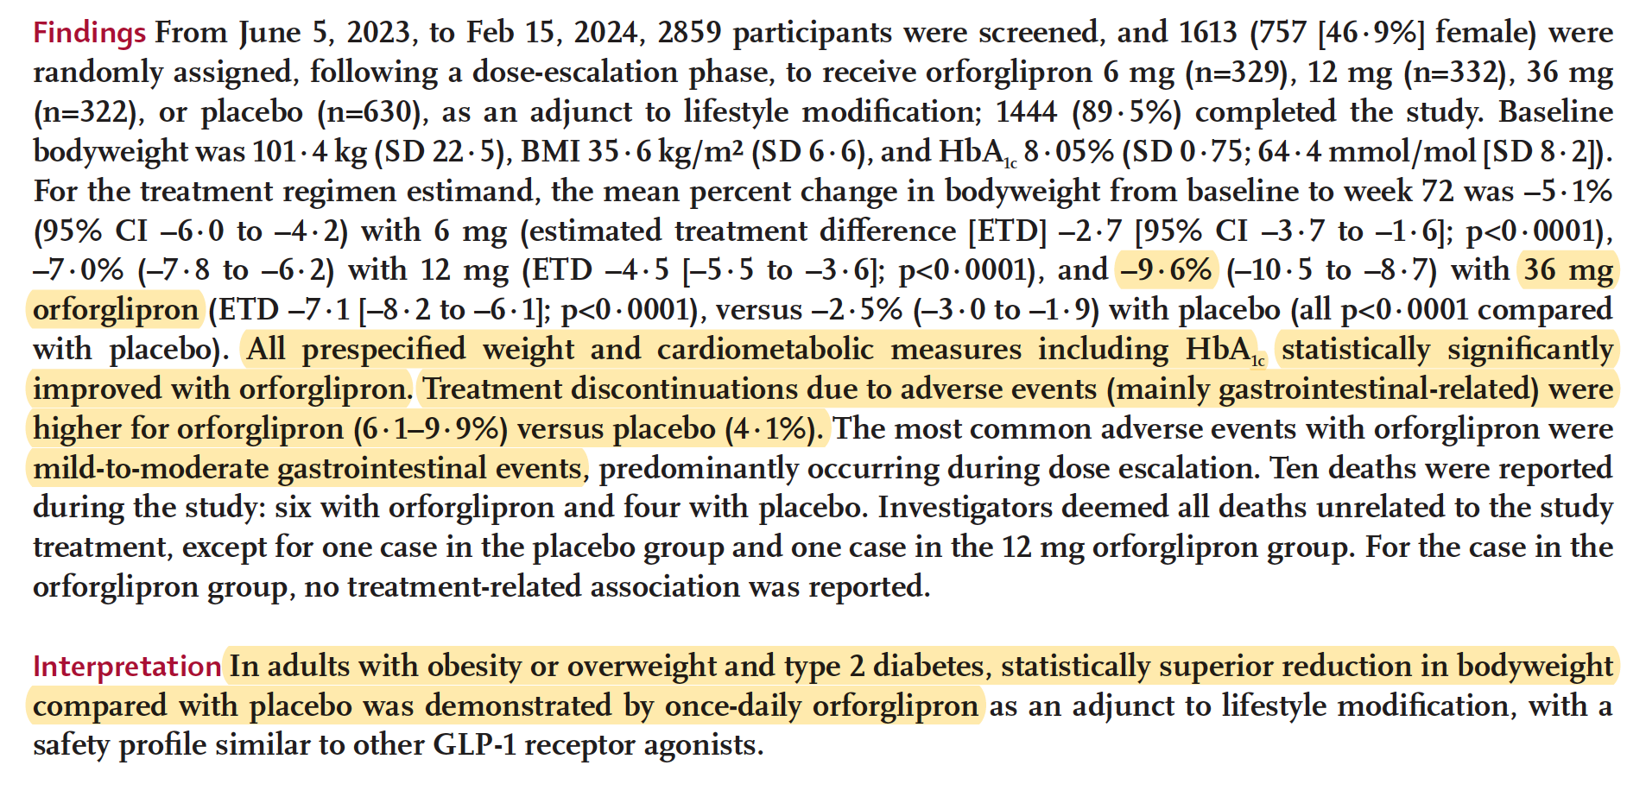

Slide 19
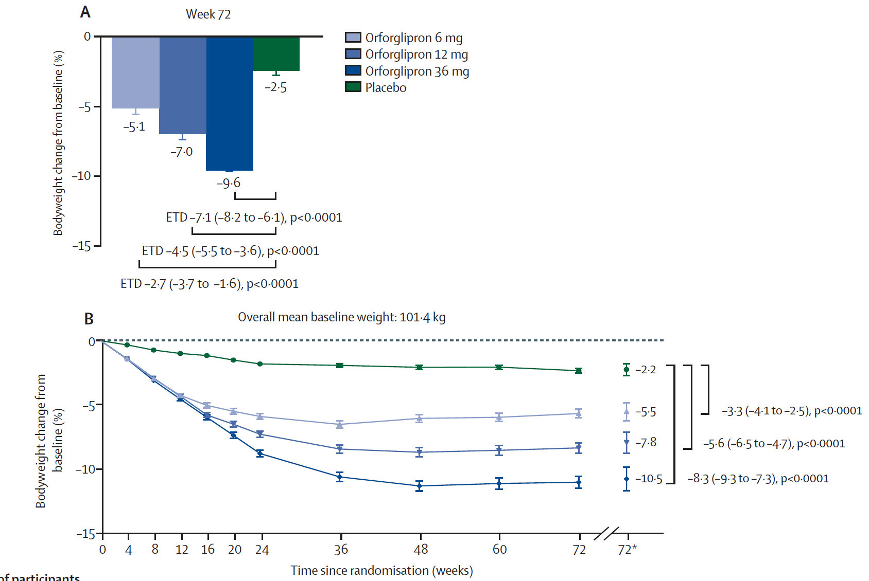

Slide 20
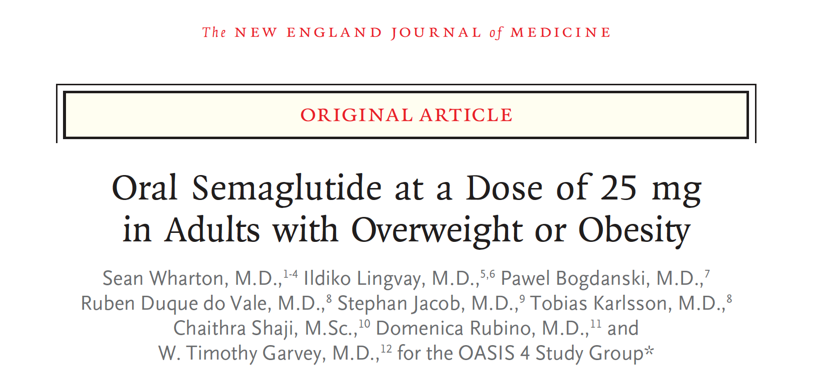

Slide 21
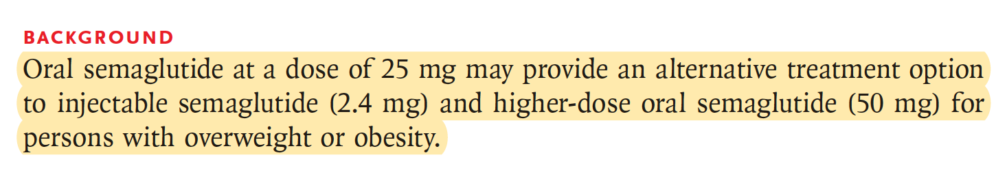
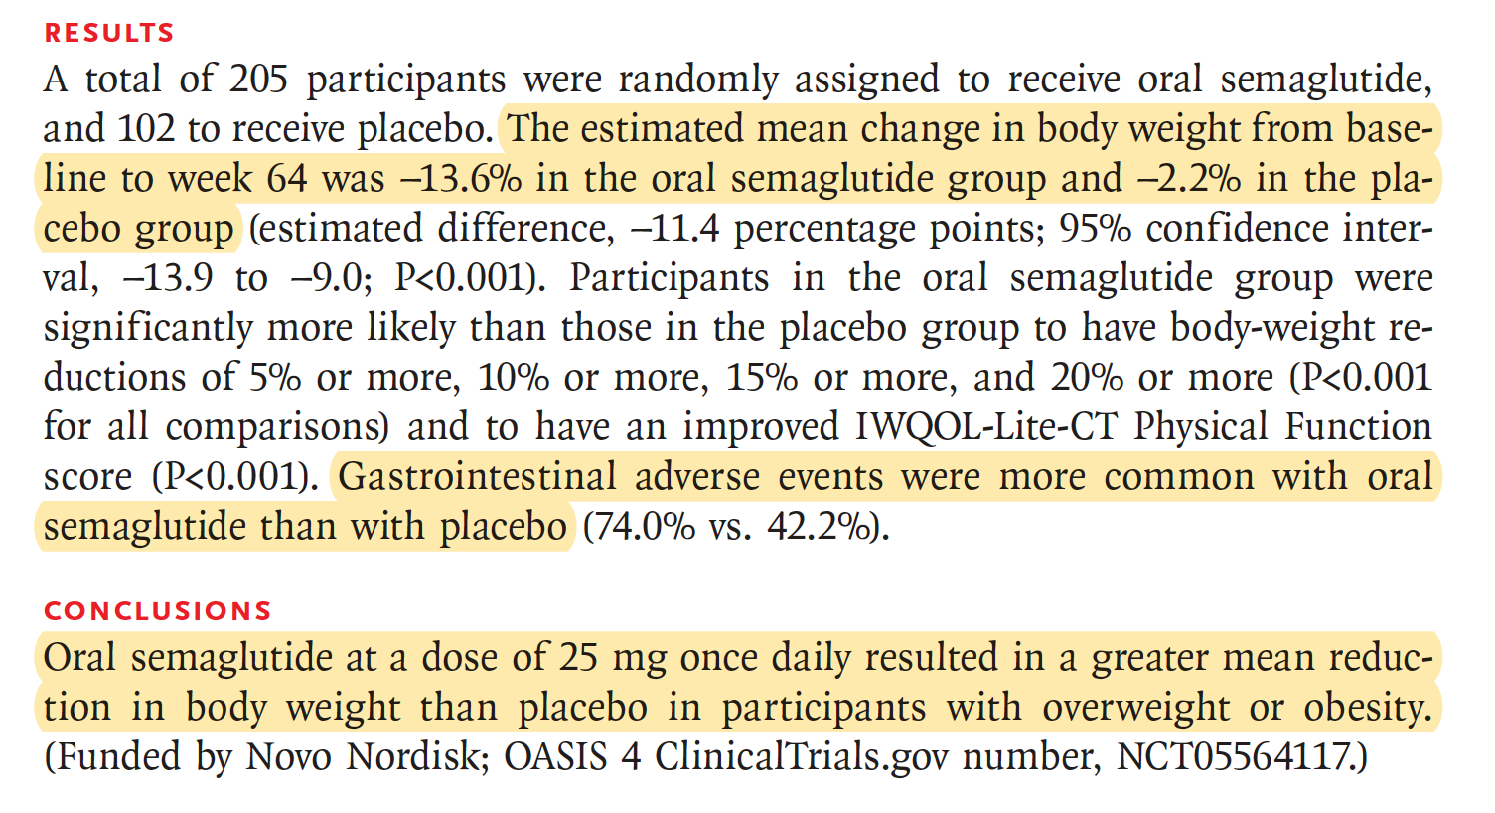

Slide 22
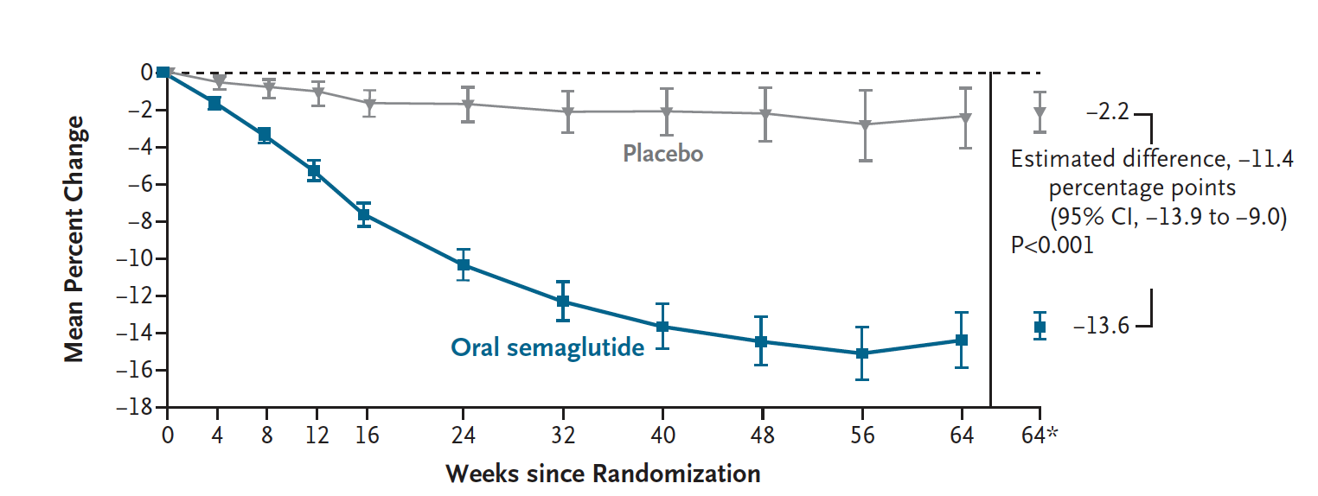

Slide 23
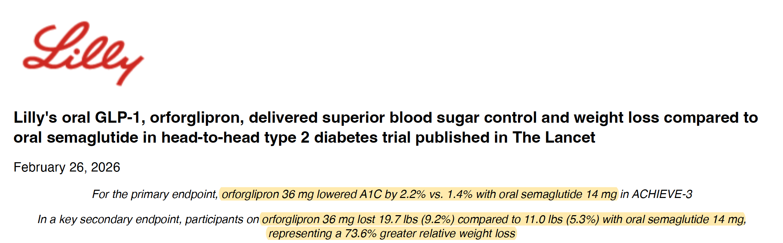

Slide 24



Slide 25
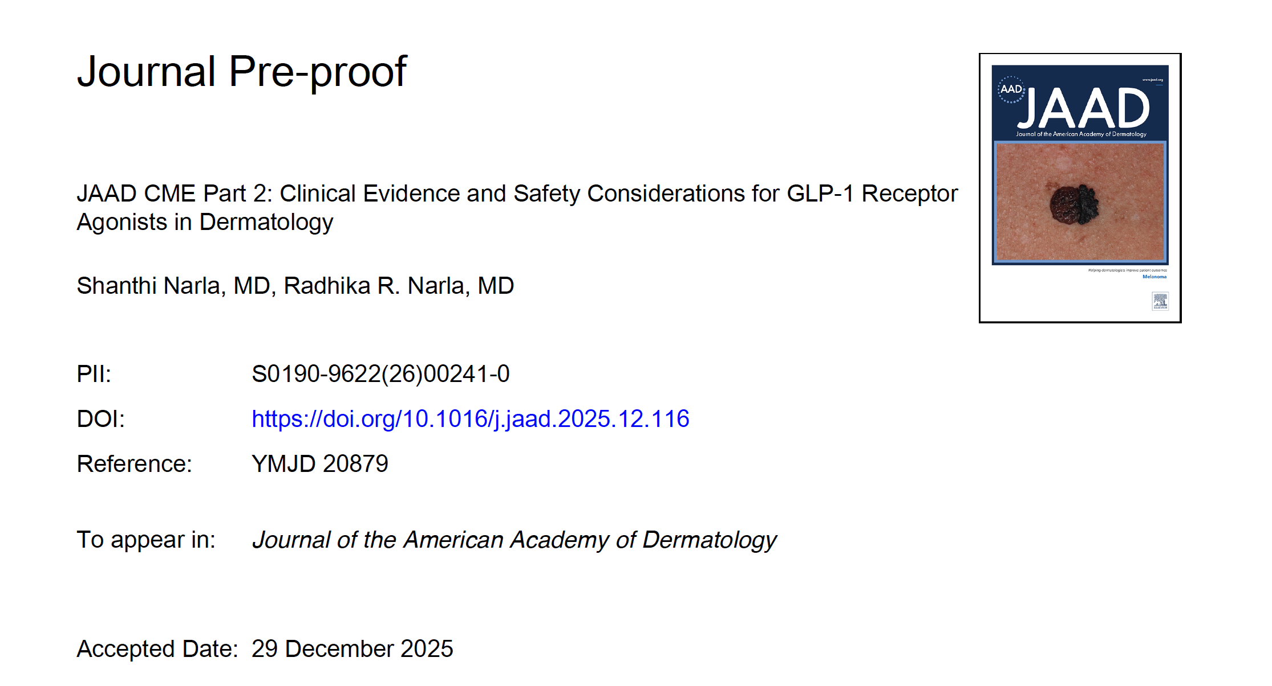
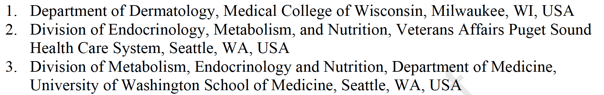

Slide 26
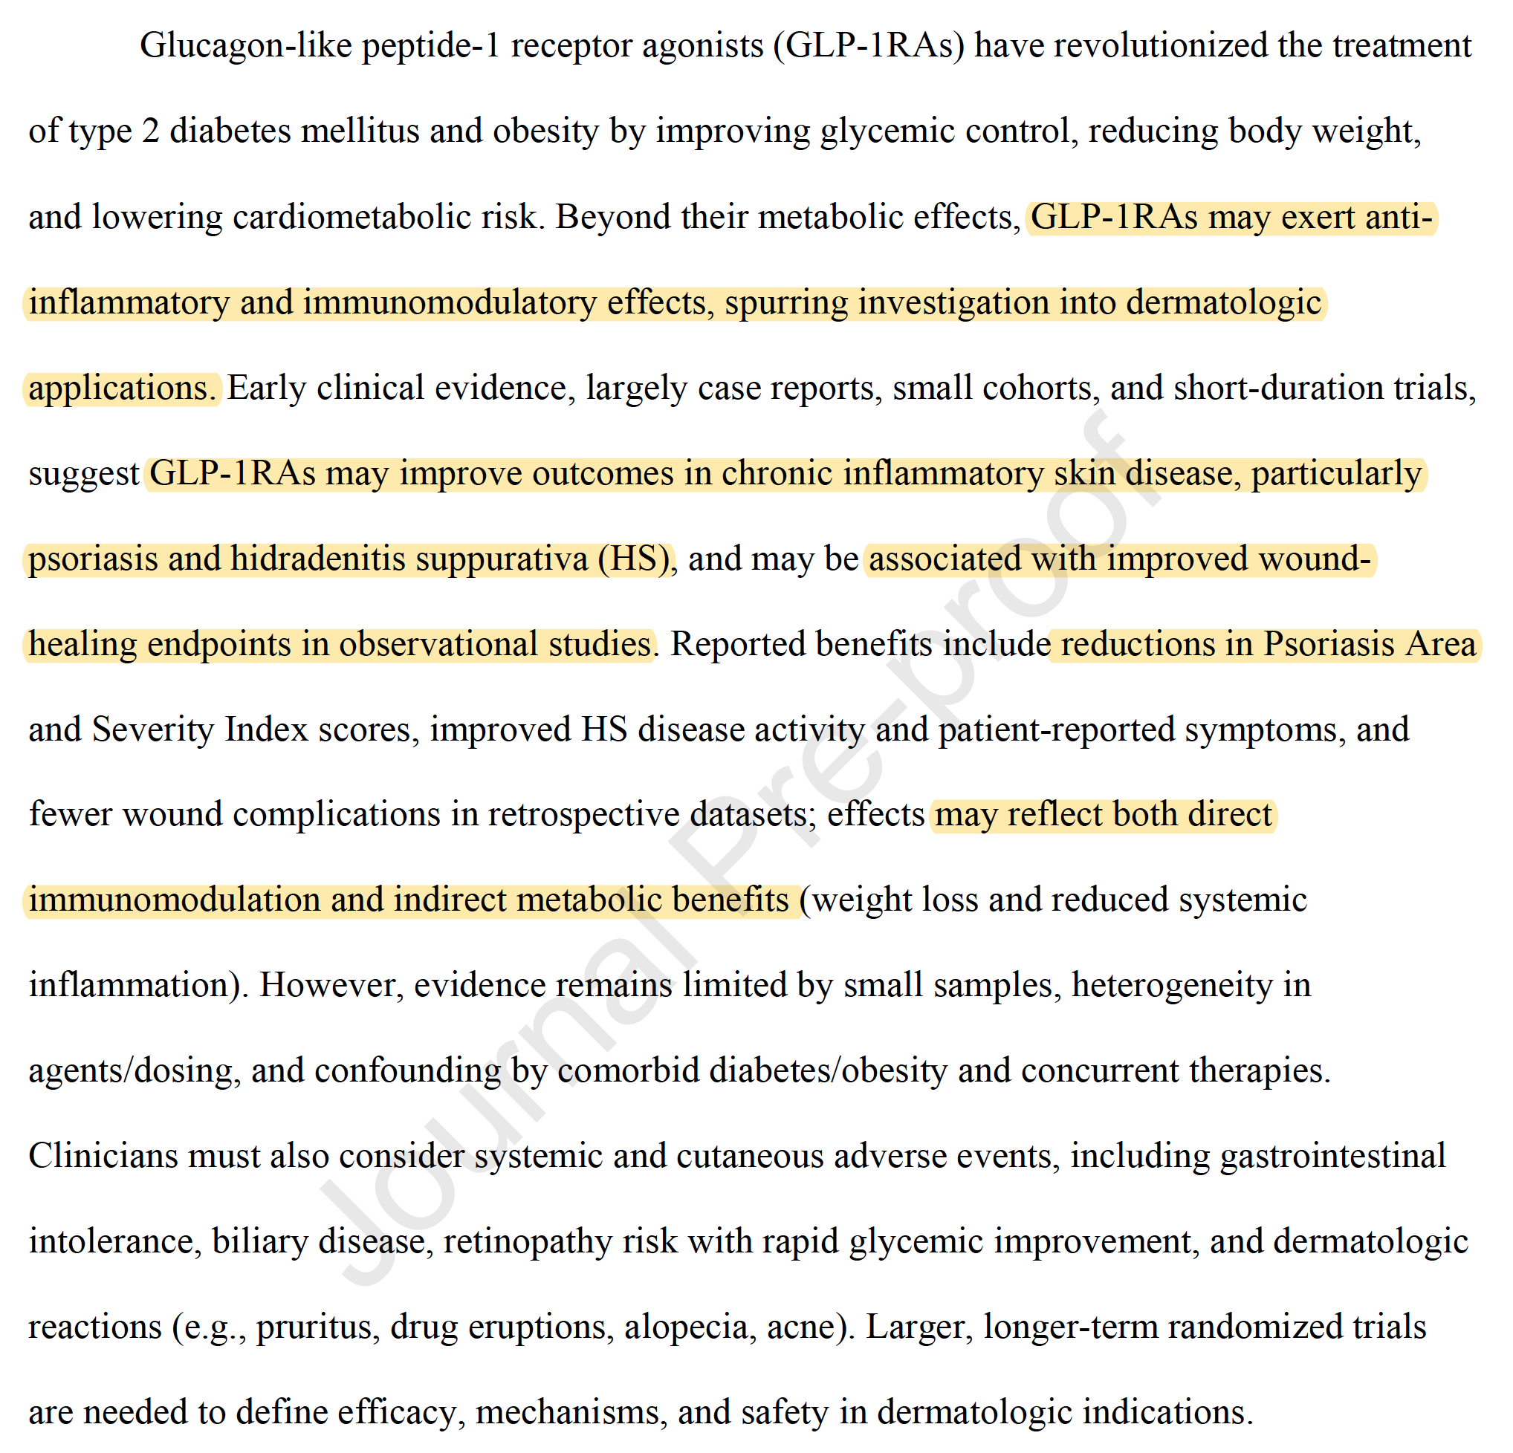

Slide 27
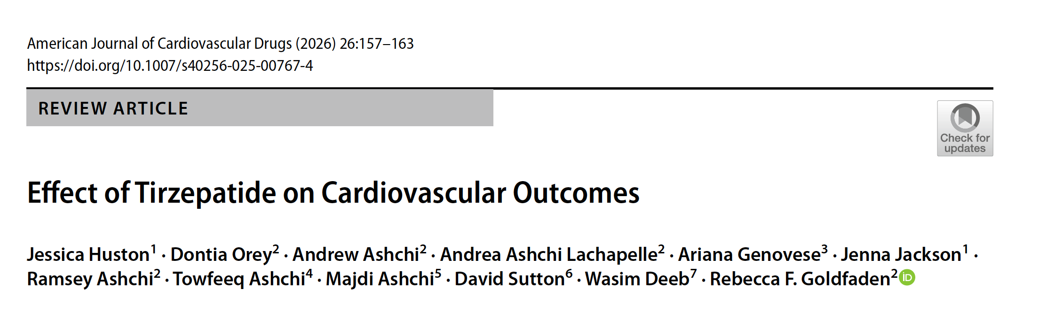
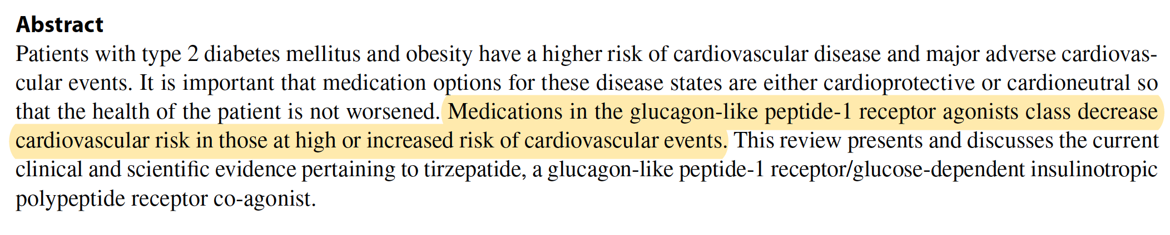

Slide 28
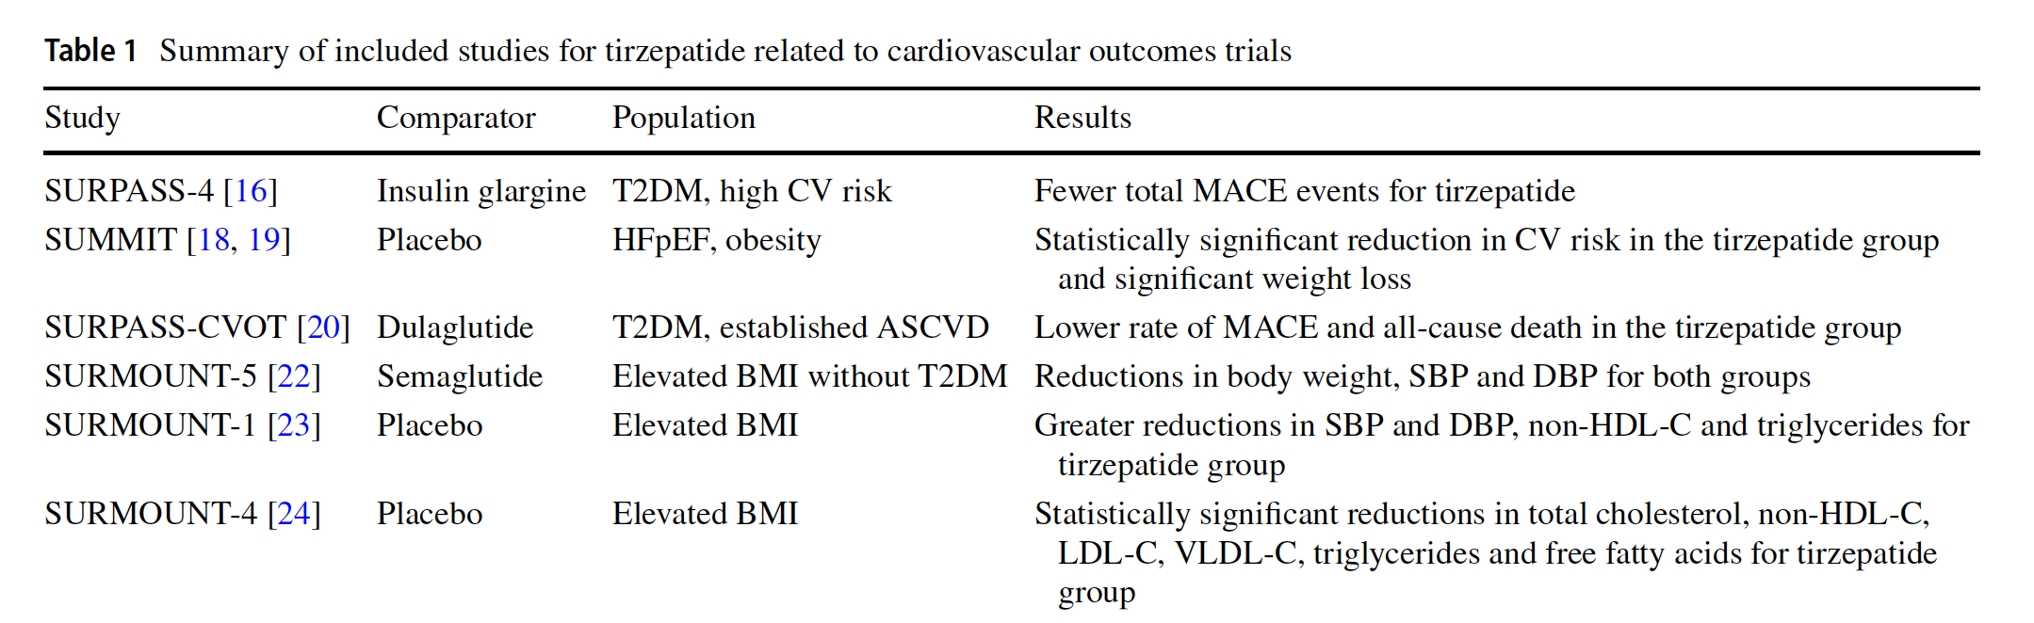
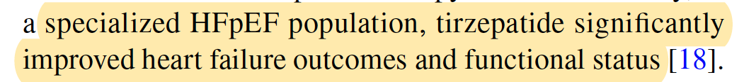

Slide 29
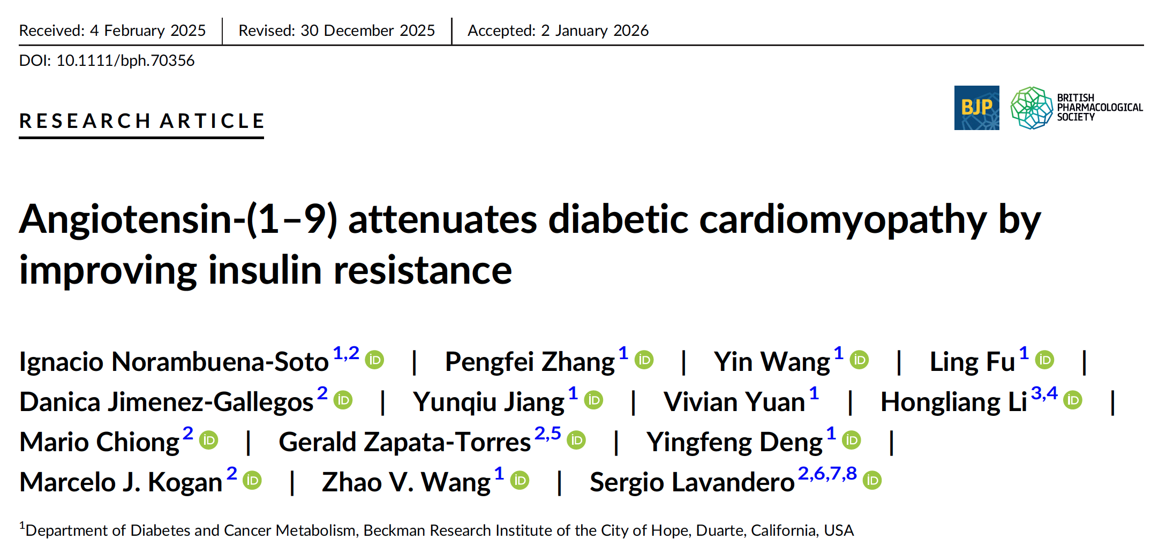

Slide 30
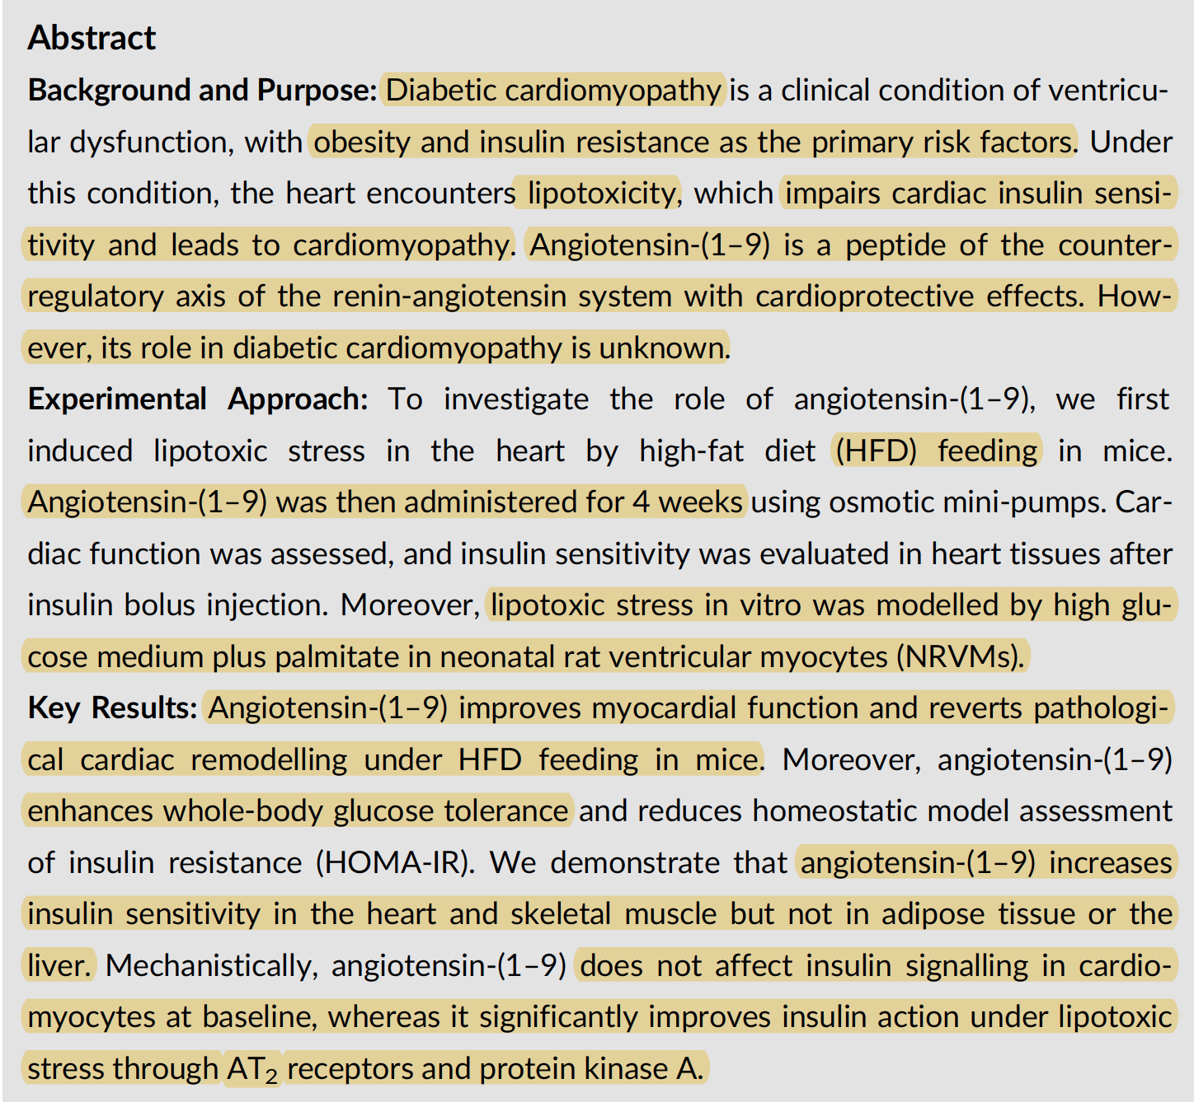
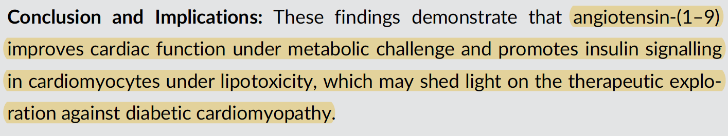

Slide 31
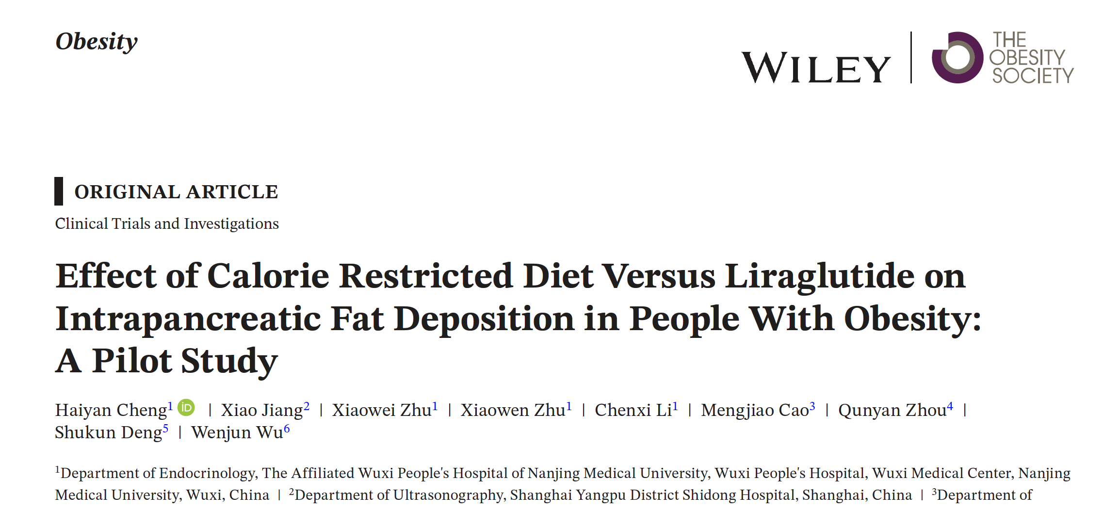
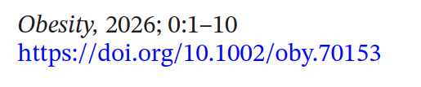

Slide 32
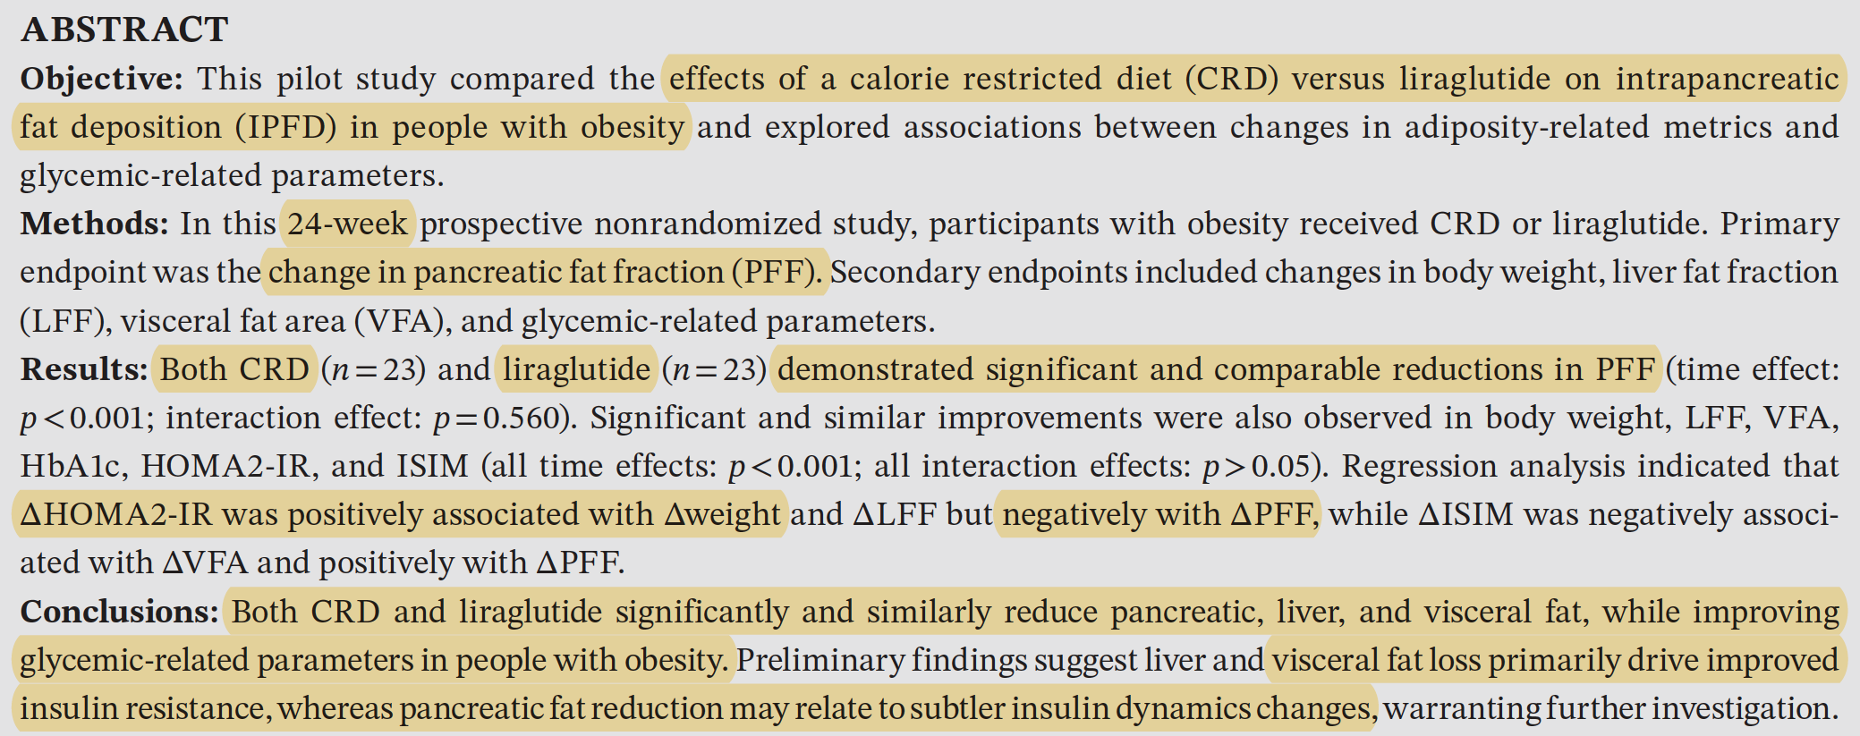

Slide 33
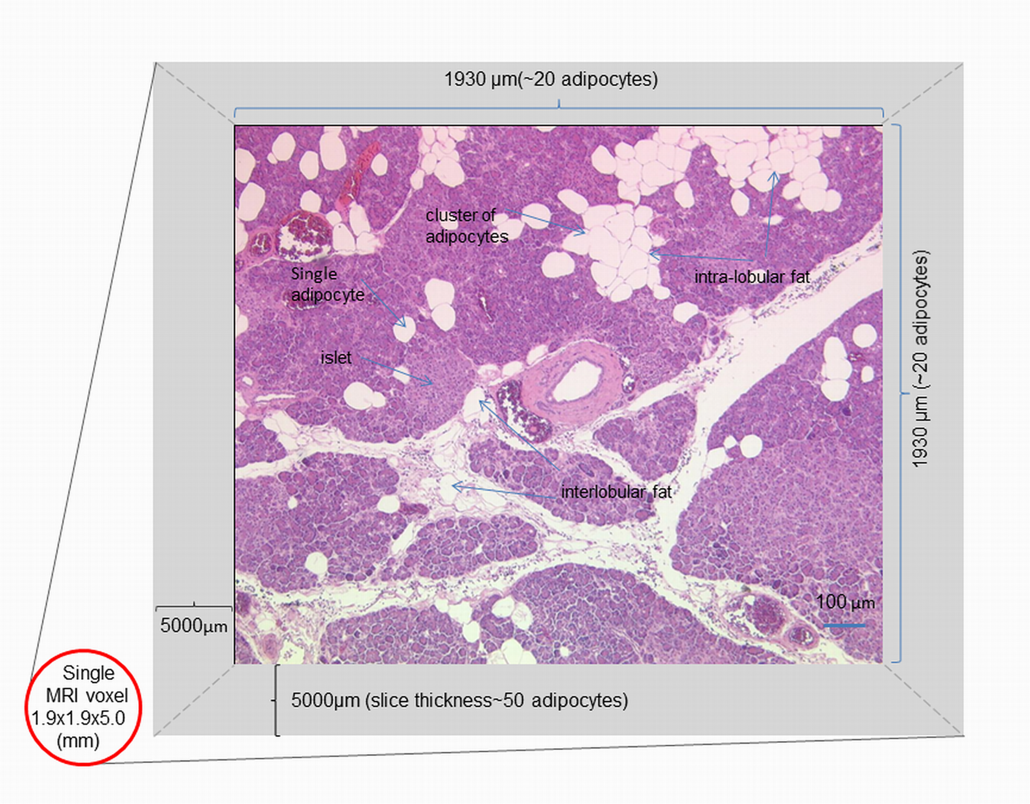
doi: https://doi.org/10.1371/journal.pone.0174660.g002

Slide 34
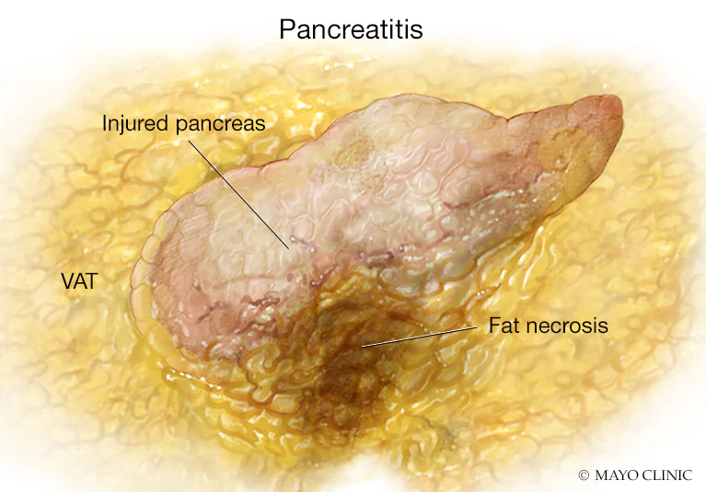
Peripancreatic adipose tissue (PAT) plays a critical role in worsening acute pancreatitis by
acting as a source of inflammation and mediating lipase-induced lipolysis, which triggers
severe necrosis, systemic inflammatory response syndrome (SIRS), and organ failure.
Excess PAT in obesity releases inflammatory adipokines, while local pancreatic lipase
breaks down fat, releasing free fatty acids (FFAs) that damage tissues.

Slide 35
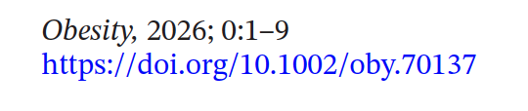
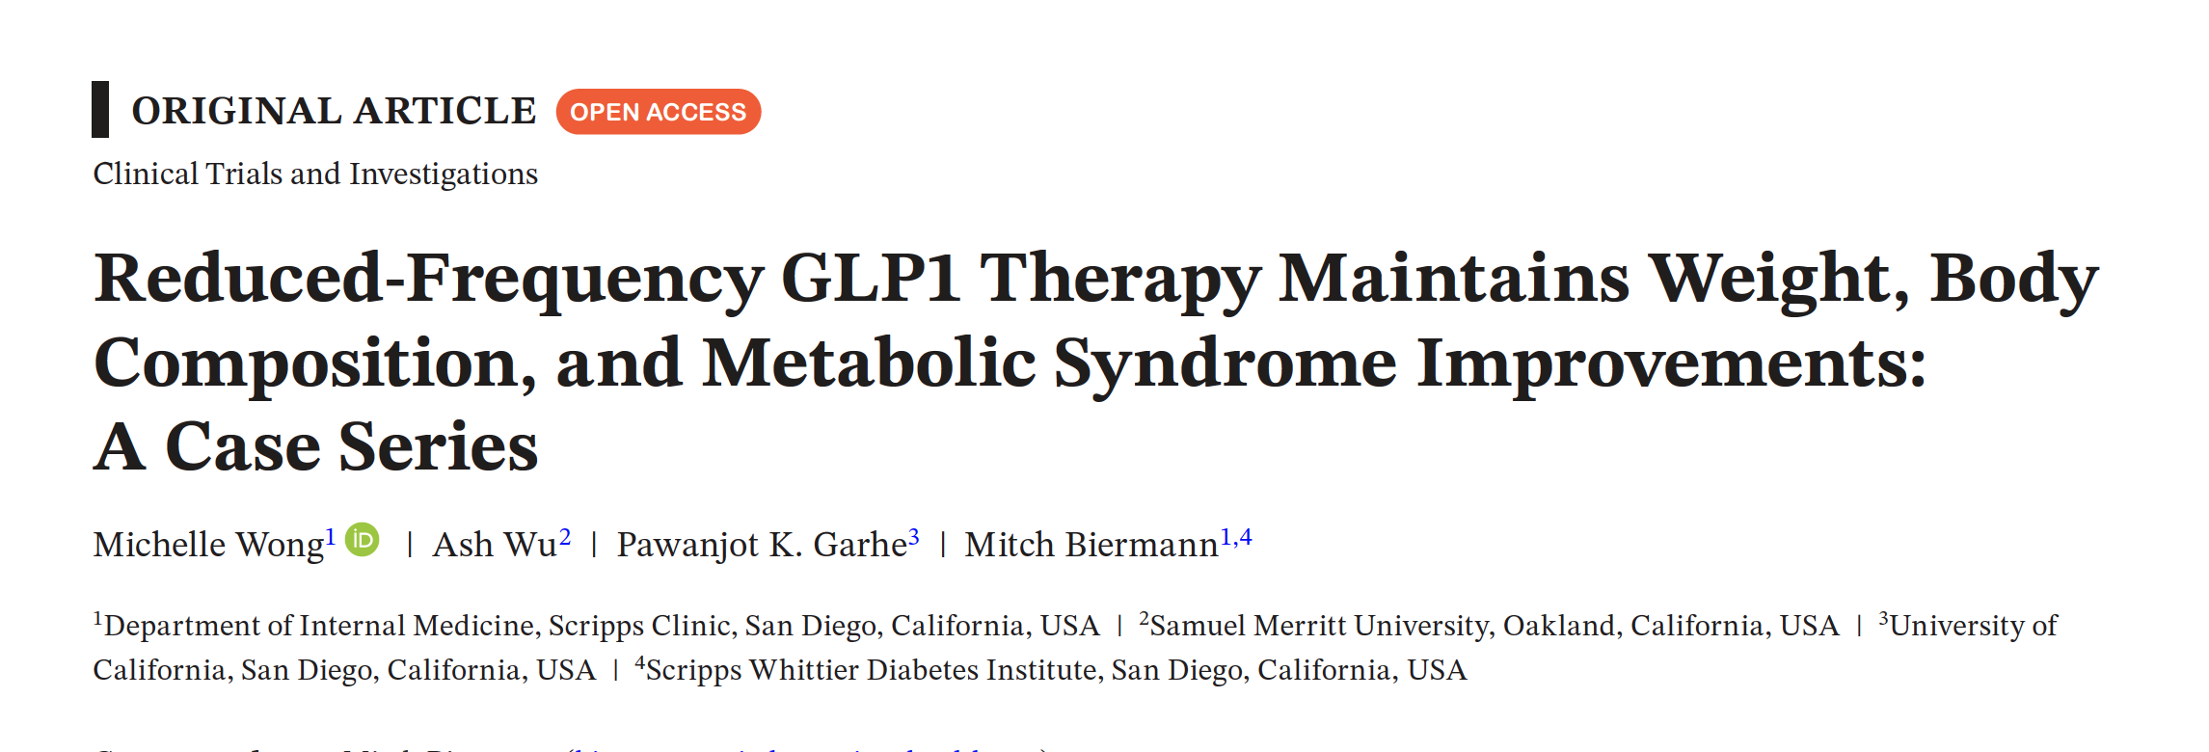

Slide 36


Slide 37




Slide 38

A metabolon is a temporary, physical complex of sequential metabolic enzymes in a cell that facilitates efficient substrate channeling, where intermediate products pass directly between enzymes without diffusing into the cytoplasm.

Slide 39

Acetyl-CoA carboxylase 1 (ACC1) is a rate-limiting cytosolic enzyme that converts acetyl-CoA to
malonyl-CoA, driving de novo lipogenesis (DNL) for fatty acid synthesis.

Slide 40



Slide 41

Acetyl-CoA carboxylase 1 (ACC1) is a rate-limiting cytosolic enzyme that converts acetyl-CoA to
malonyl-CoA, driving de novo lipogenesis (DNL) for fatty acid synthesis.

Slide 42


Slide 43



Slide 44


Slide 45



Slide 46
The mitochondrial dicarboxylate carrier (SLC25A10) supports glyceroneogenesis and gluconeogenesis by transporting malate out of the mitochondria into the cytosol in exchange for phosphate. This malate is converted to phosphoenolpyruvate (PEP), a necessary step for producing glucose and glycerol-3-phosphate (needed for re-esterifying fatty acids).

Slide 47


Slide 48


Slide 49


Slide 50

J Exp Biol. 2026 Feb 11:jeb.251083. doi: 10.1242/jeb.251083

Slide 51


Slide 52


Slide 53


Slide 54


Slide 55


Slide 56


Slide 57


Slide 58


Slide 59


Slide 60

eWAT
Liver
Hypothalamus
Gastroc
Testis
Stomach

Slide 61



Slide 62


Slide 63


Slide 64



Yu-Hua Tseng

Slide 65


Slide 66


Slide 67


Mitohormesis is a biological process where mild, transient stress on mitochondria -
often via low-level reactive oxygen species (ROS) production -
triggers adaptive cellular responses that improve long-term health,
increase metabolic efficiency, and enhance stress resistance

Slide 68



Slide 69


Slide 70


Slide 71


Slide 72


