Slide 1
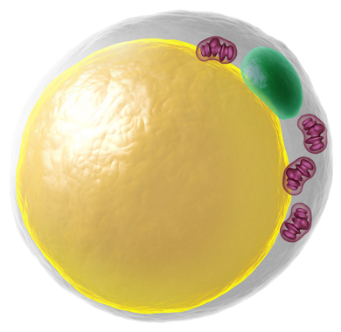
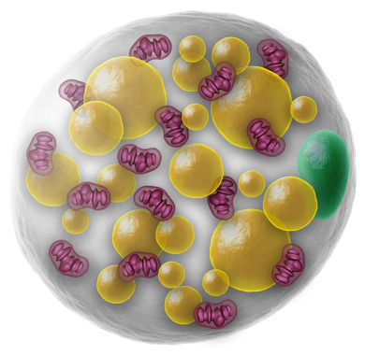
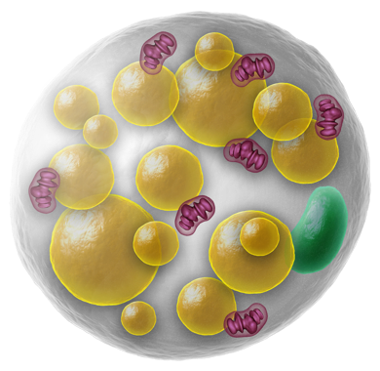
Literature Overview Touchstone Diabetes Center UTSW Medical Center 3/9/2026

Slide 2
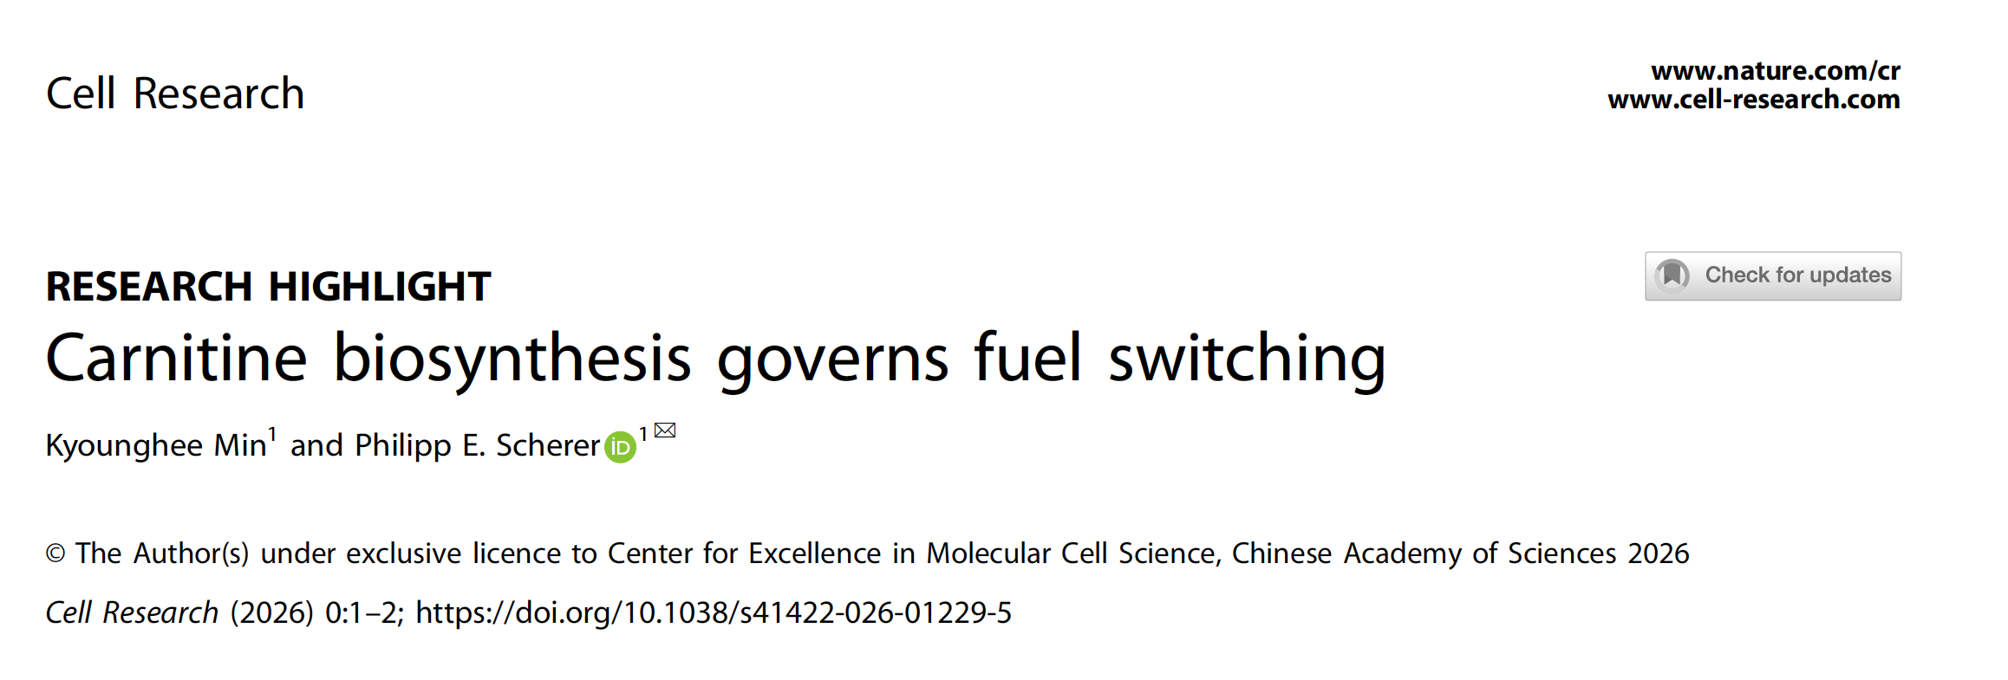
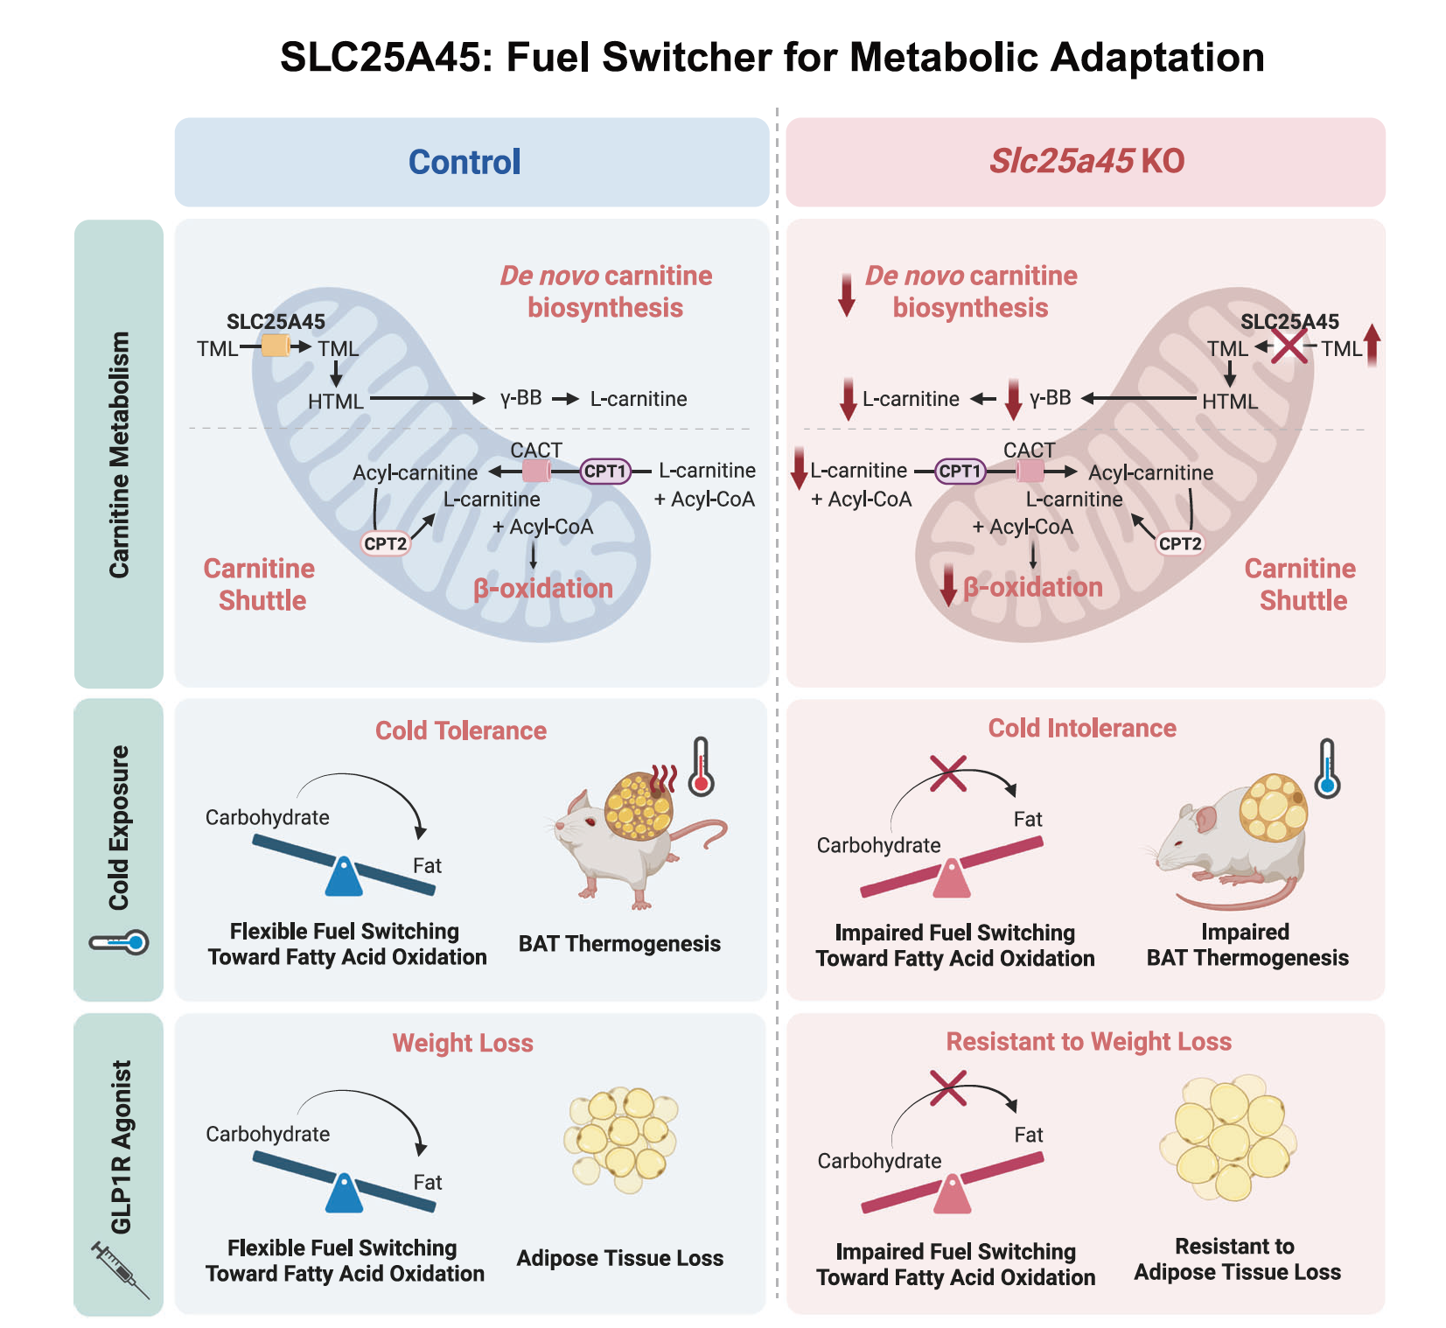


Slide 3



Slide 4

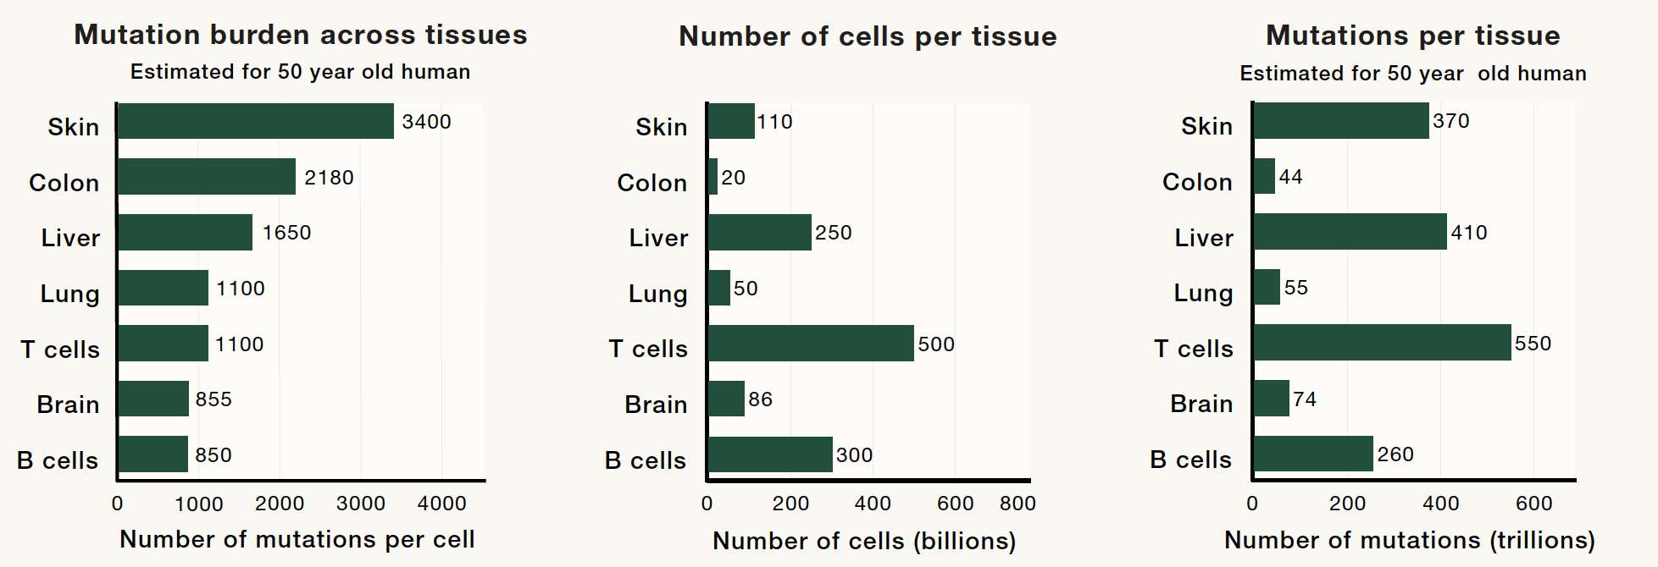

Slide 5



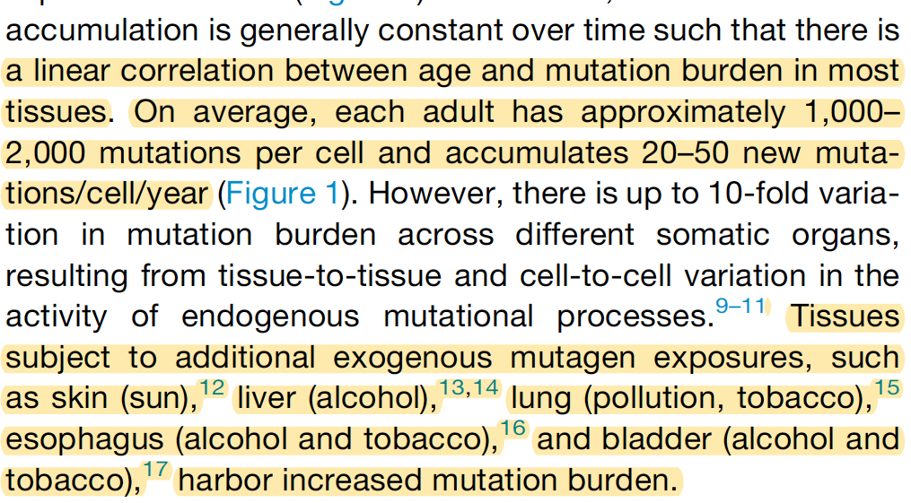

Slide 6
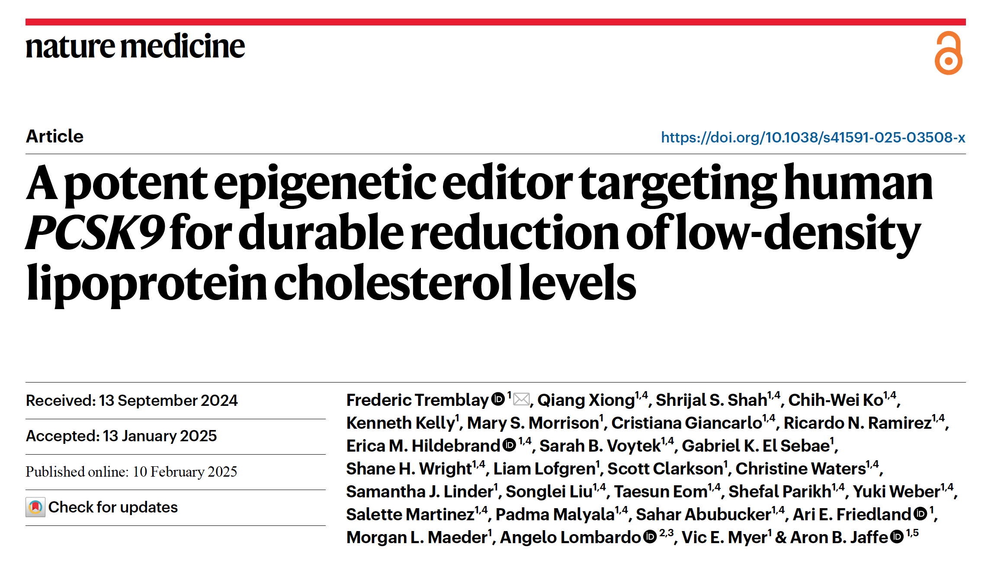

Slide 7
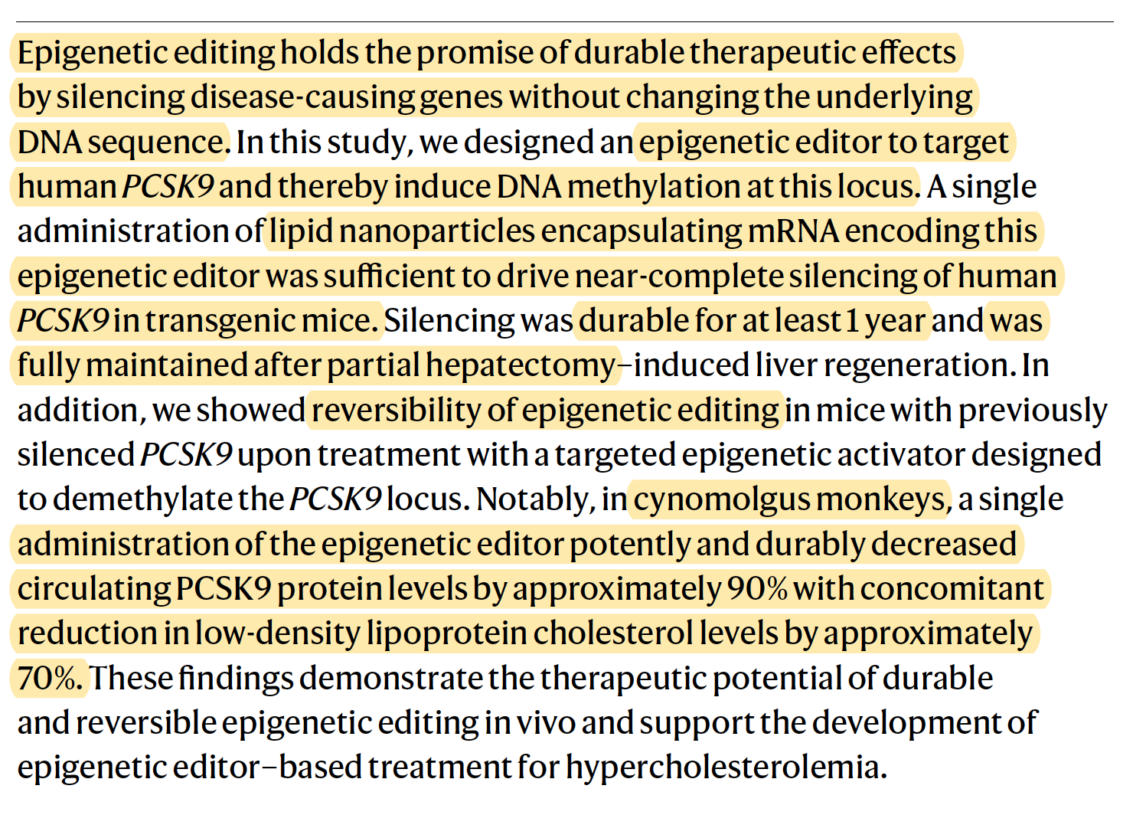

Slide 8



Slide 9
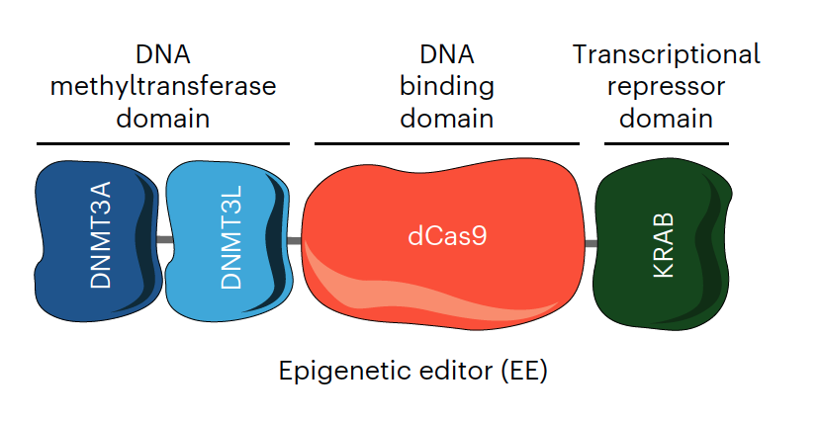

Slide 10
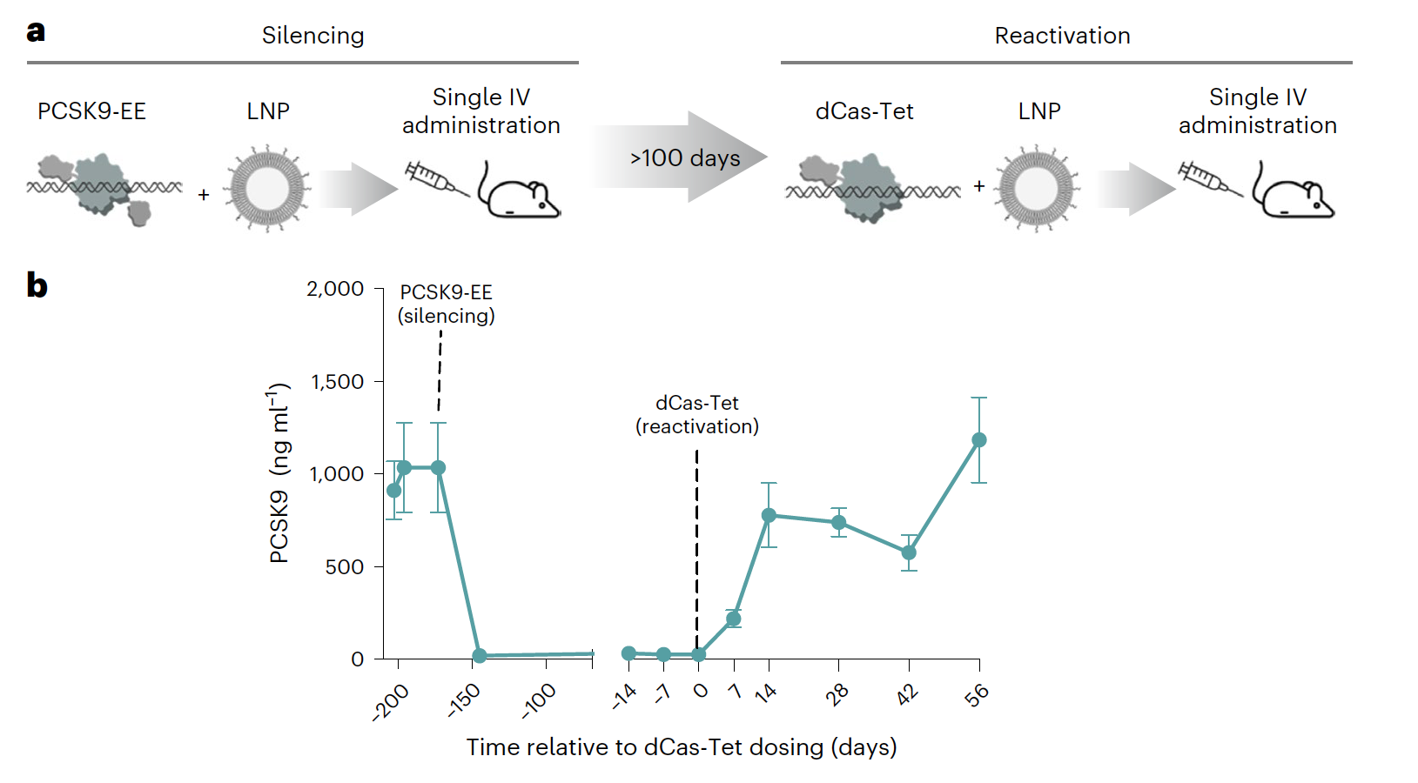

Slide 11




Slide 12
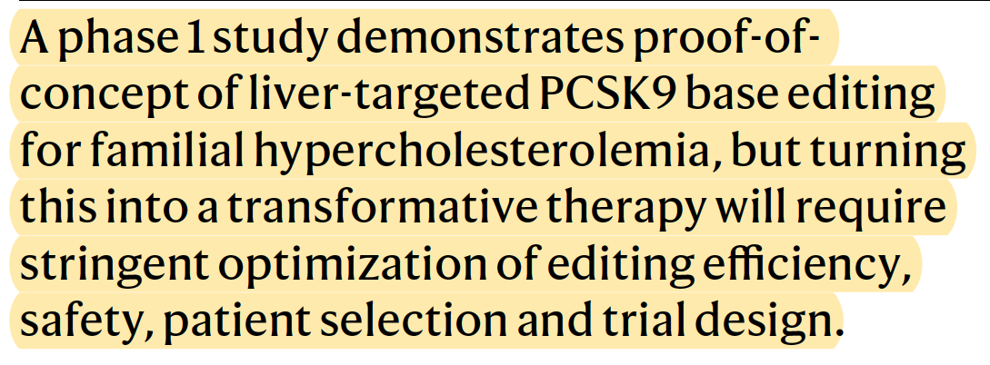



Slide 13


Slide 14
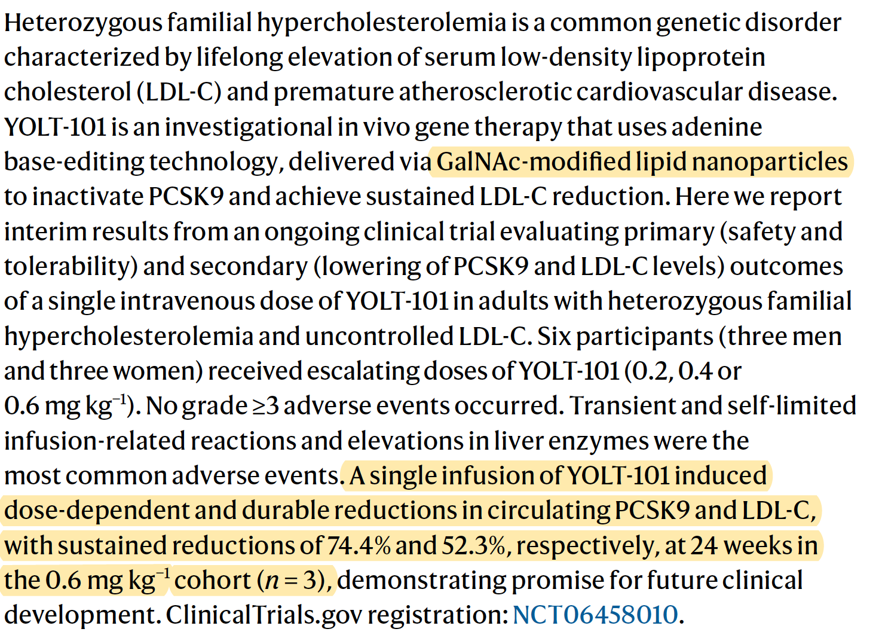

Slide 15
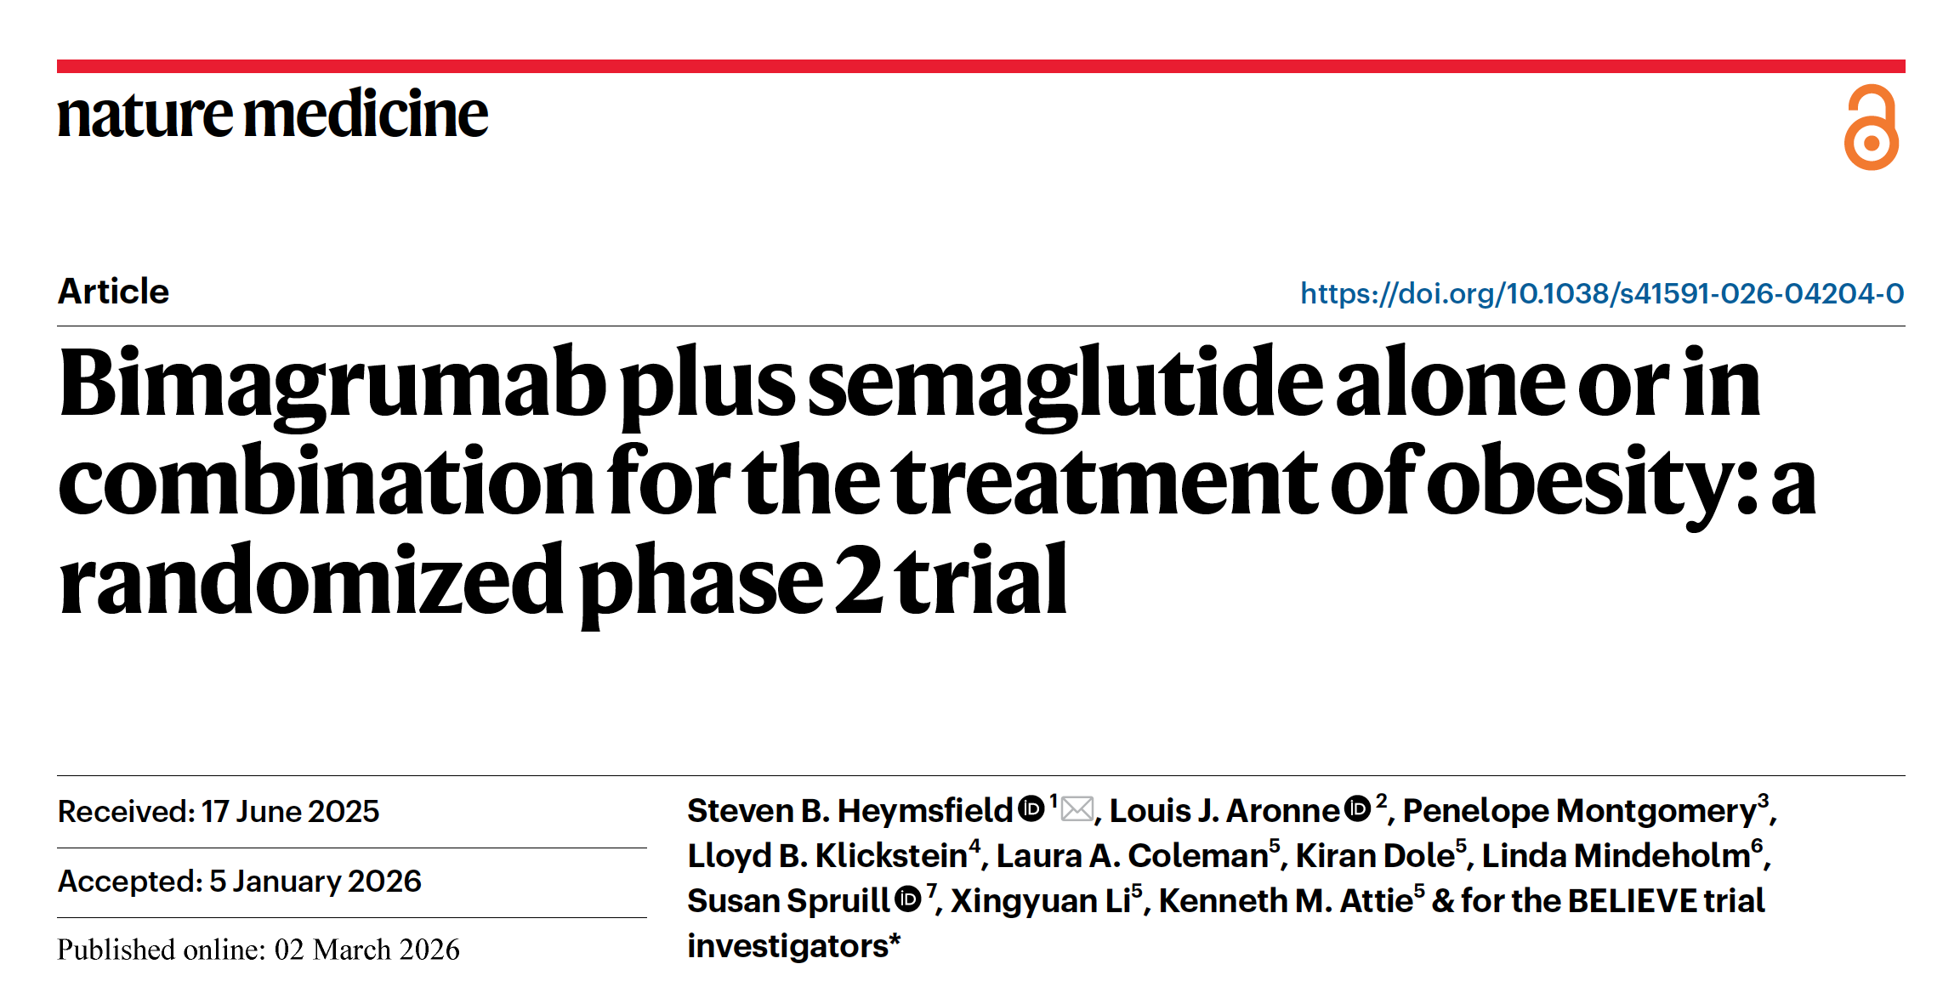
activin type 2 receptor A (ACVR2A) and B (ACVR2B) antagonist bimagrumab

Slide 16
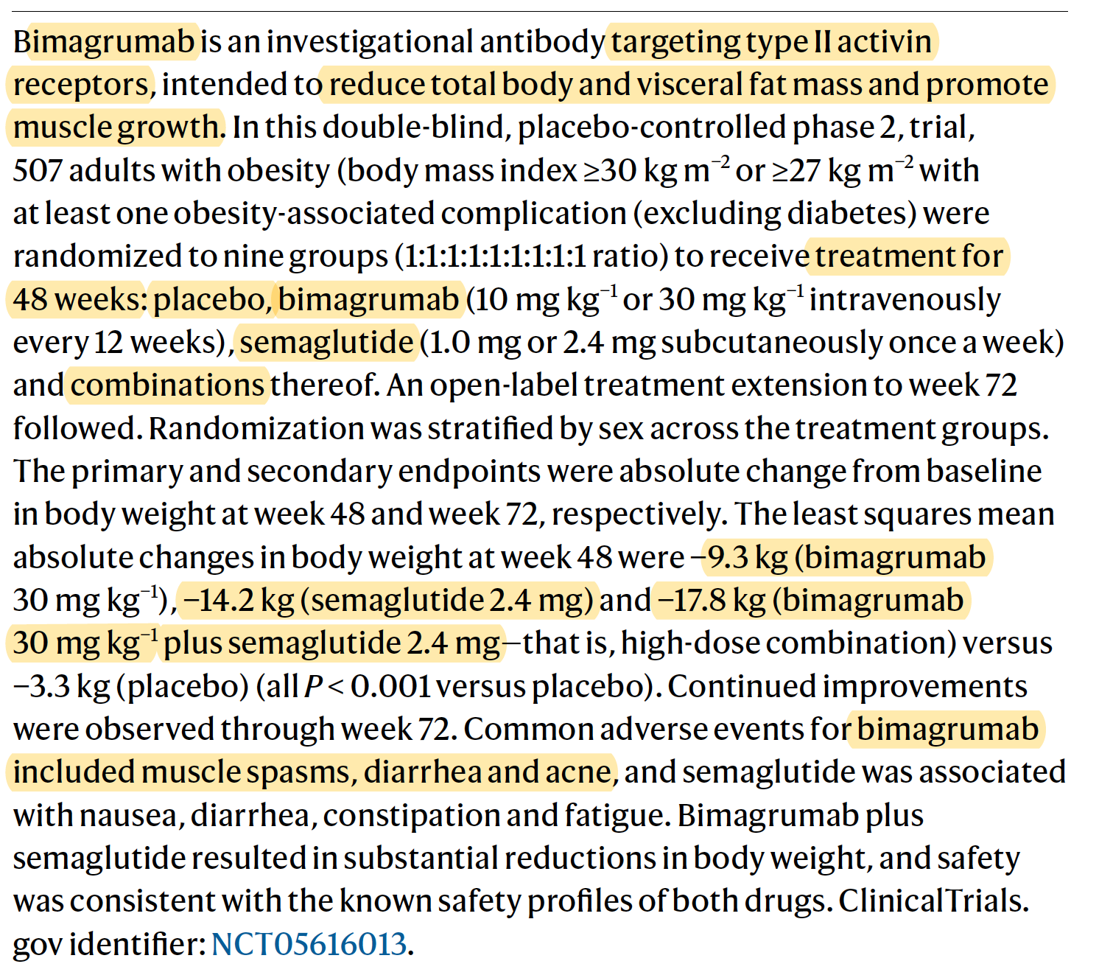

Slide 17

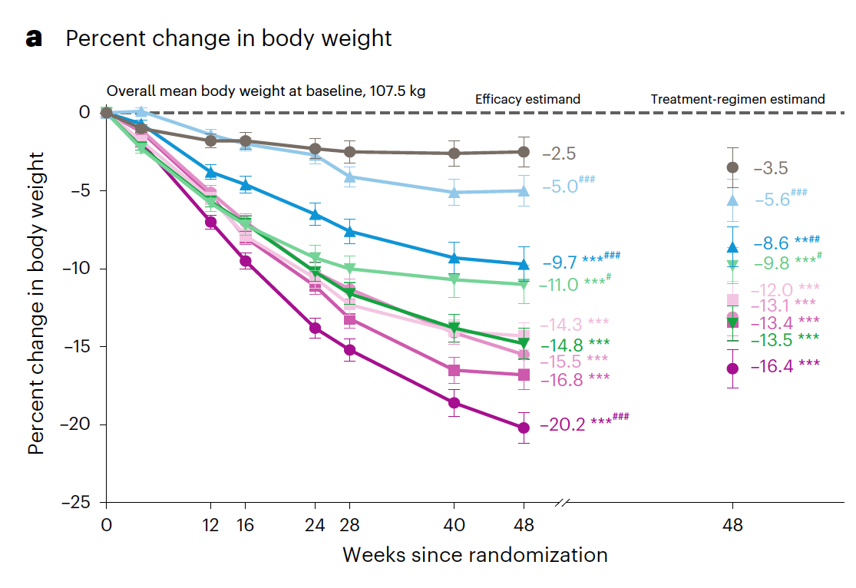
Body
Weight

Slide 18
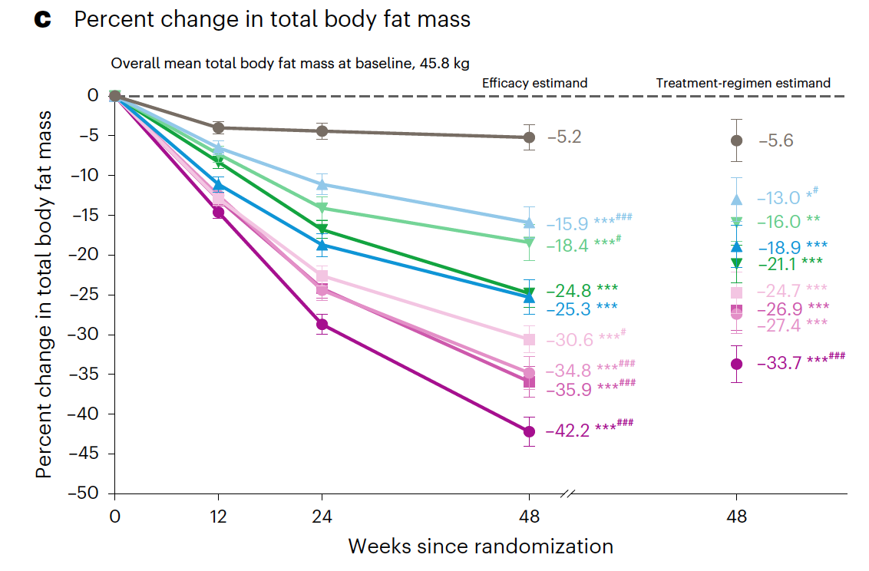
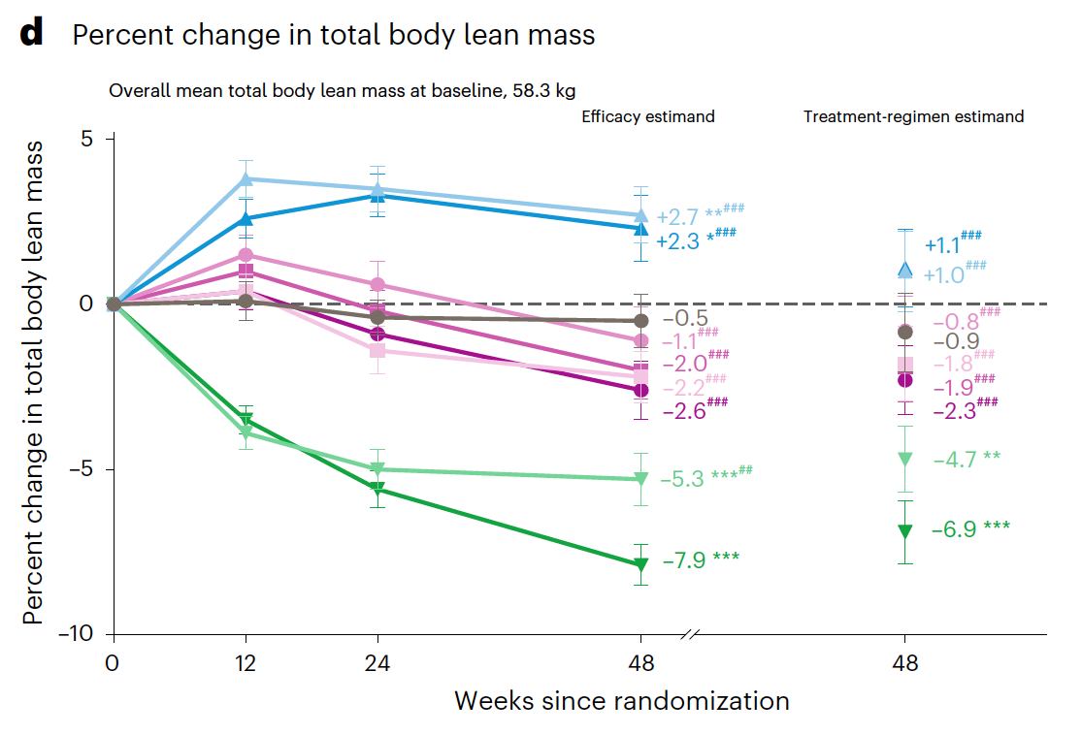
Total Fat Mass
Total Lean Mass

Slide 19
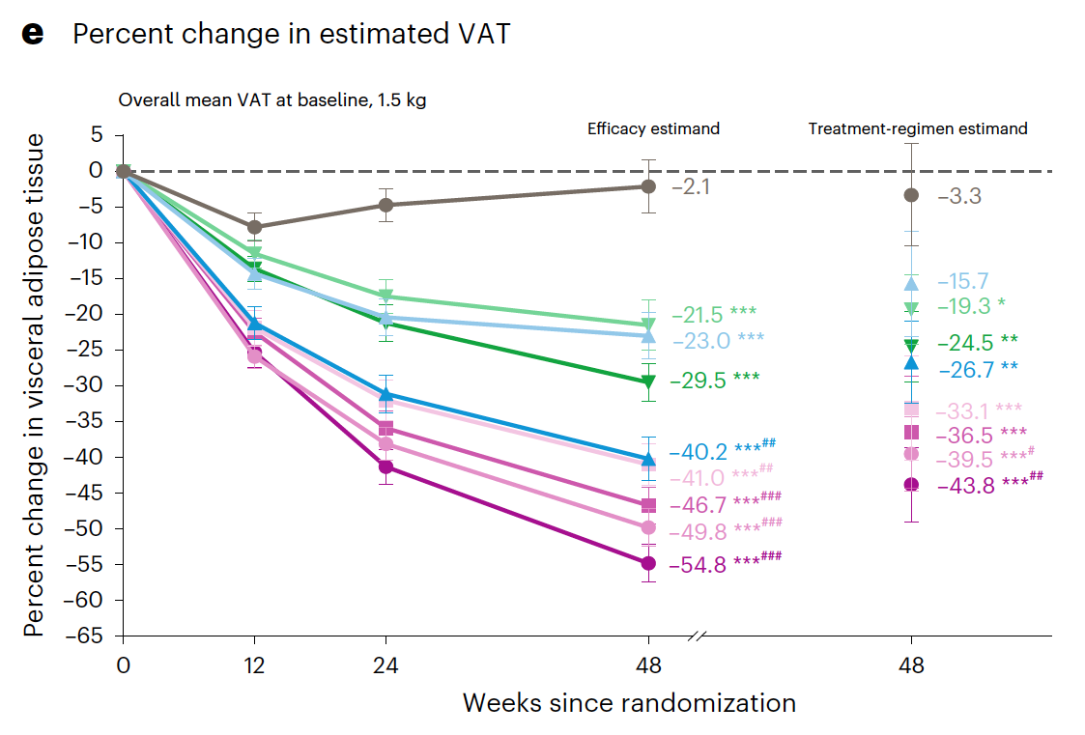
VAT

Slide 20
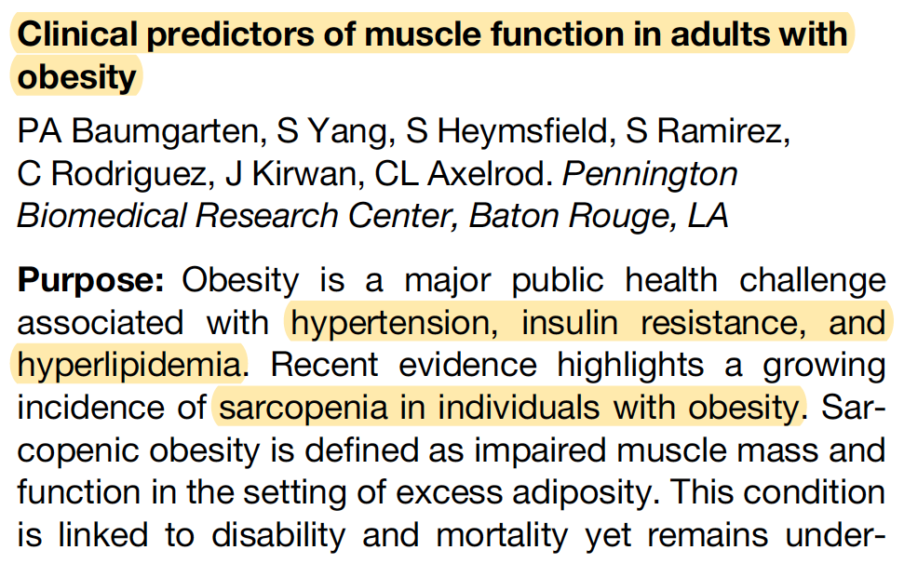
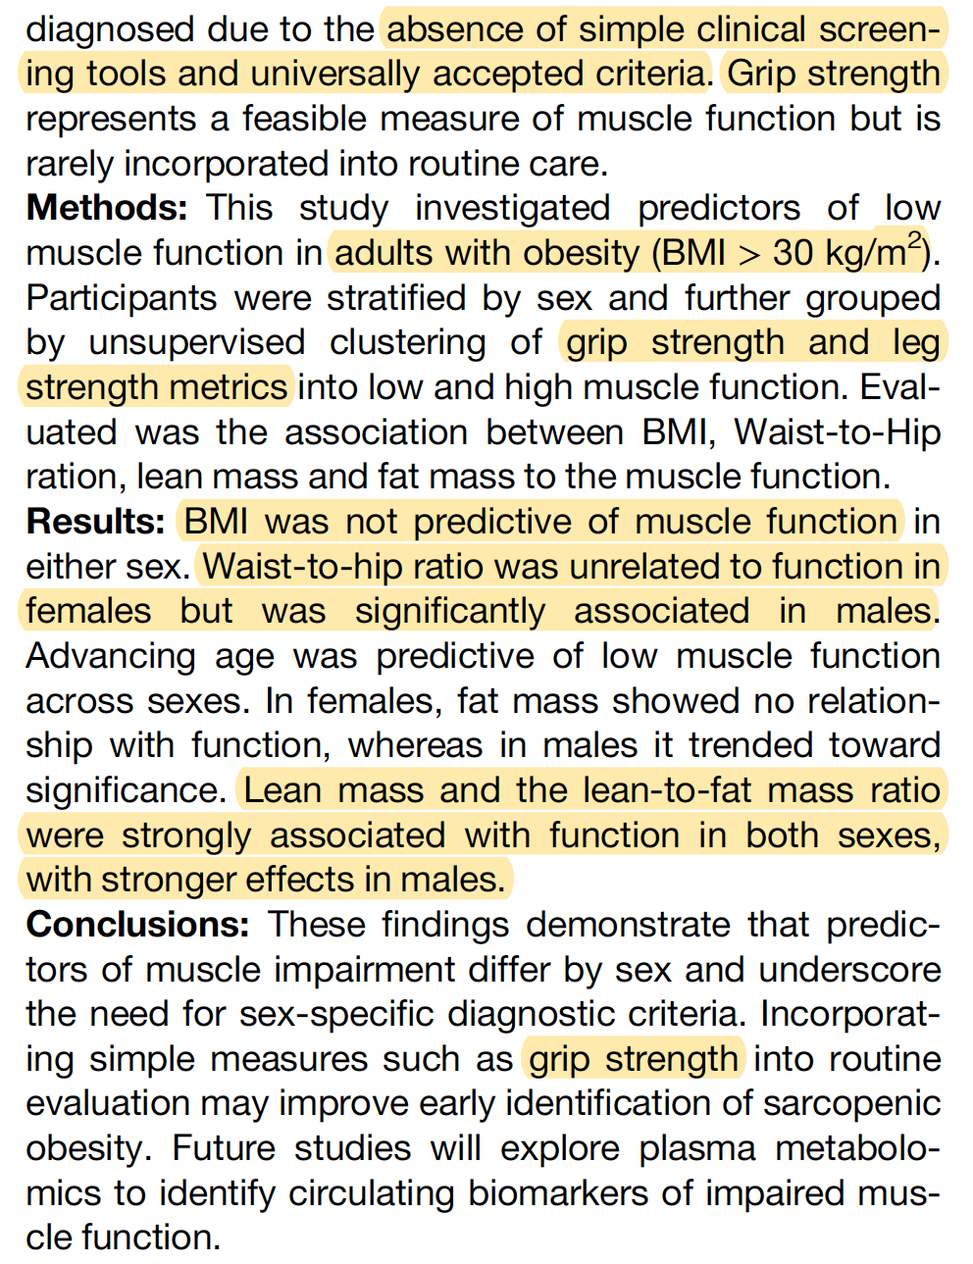

Slide 22
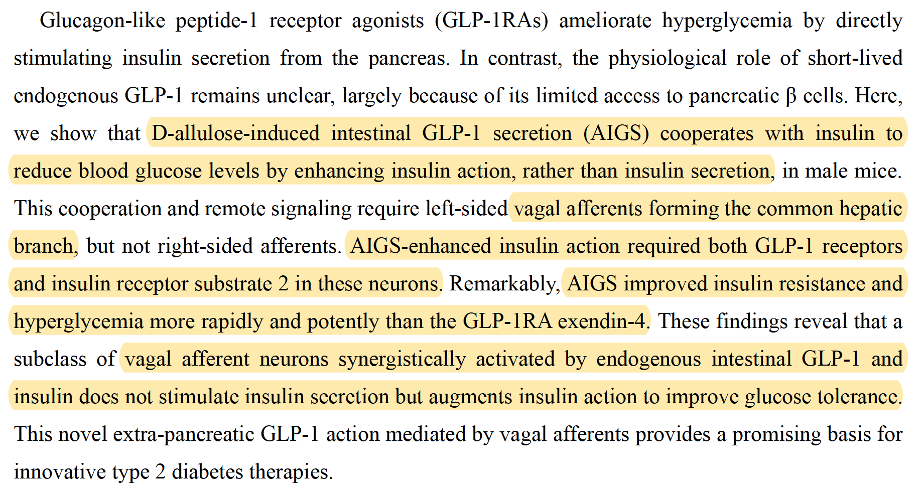
D-Allulose is a rare, naturally occurring monosaccharide sugar—found in small amounts in figs, raisins,
and maple syrup—that serves as a low-calorie (0.2–0.4 kcal/g) sugar substitute.
It offers ~70% of the sweetness of sugar without significantly raising blood sugar or insulin levels,
making it ideal for keto and diabetic diets.

Slide 23

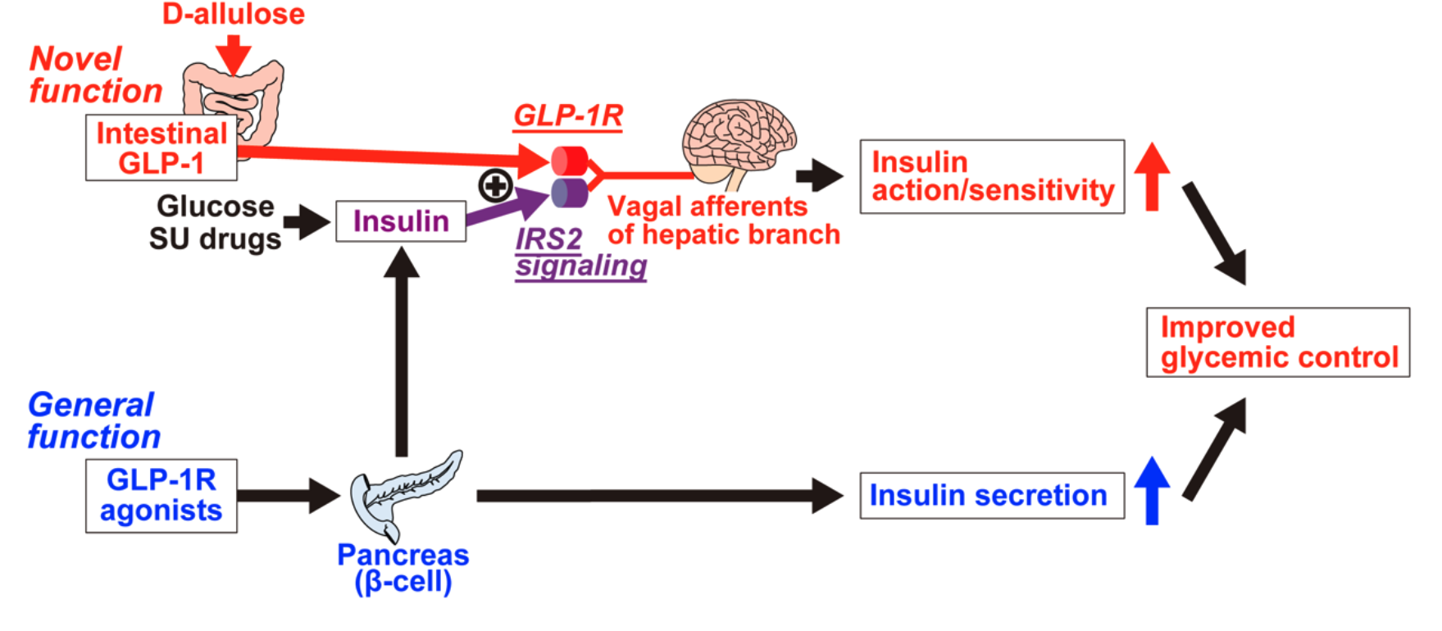

Slide 24

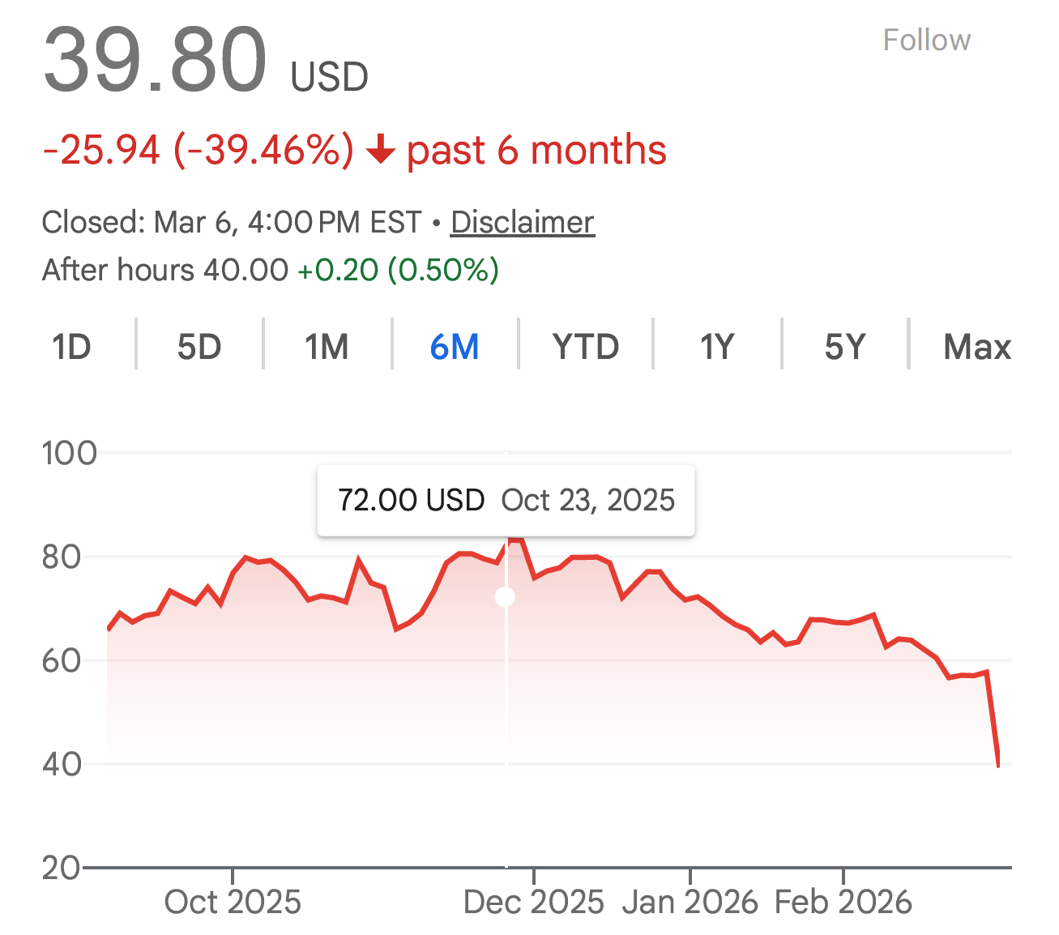

Slide 25



Slide 26


Slide 27

PFKFB (6-phosphofructo-2-kinase/fructose-2,6-bisphosphatase) is a family of bifunctional enzymes
that regulate glycolysis by controlling the levels of fructose-2,6-bisphosphate, a potent activator
of the key glycolytic enzyme PFK-1. It enhances glycolysis and degrades it to block it,
acting as a crucial switch between glycolysis and gluconeogenesis.

Slide 28
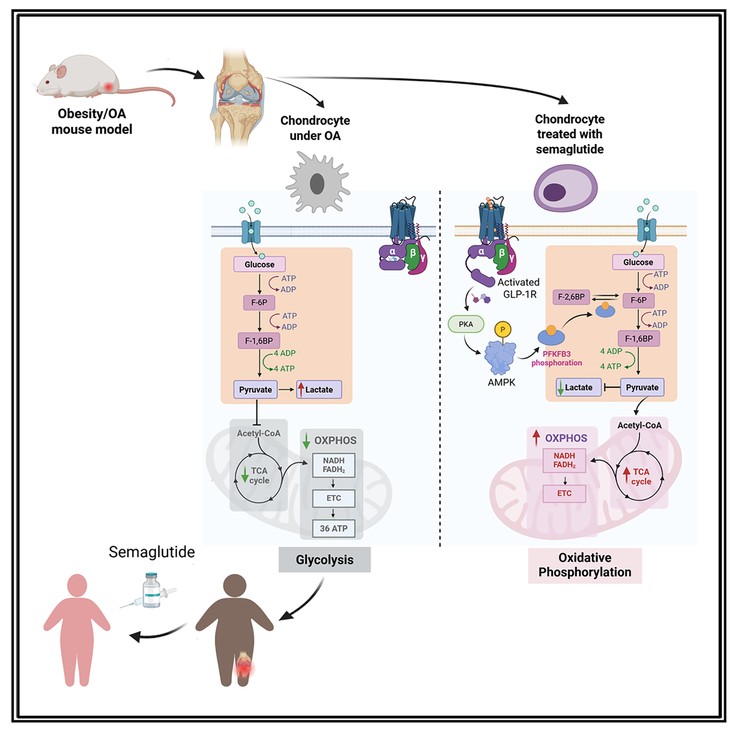
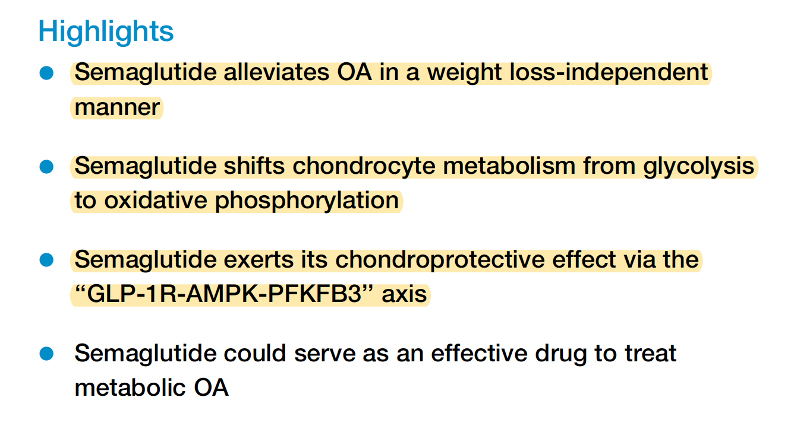

Slide 29
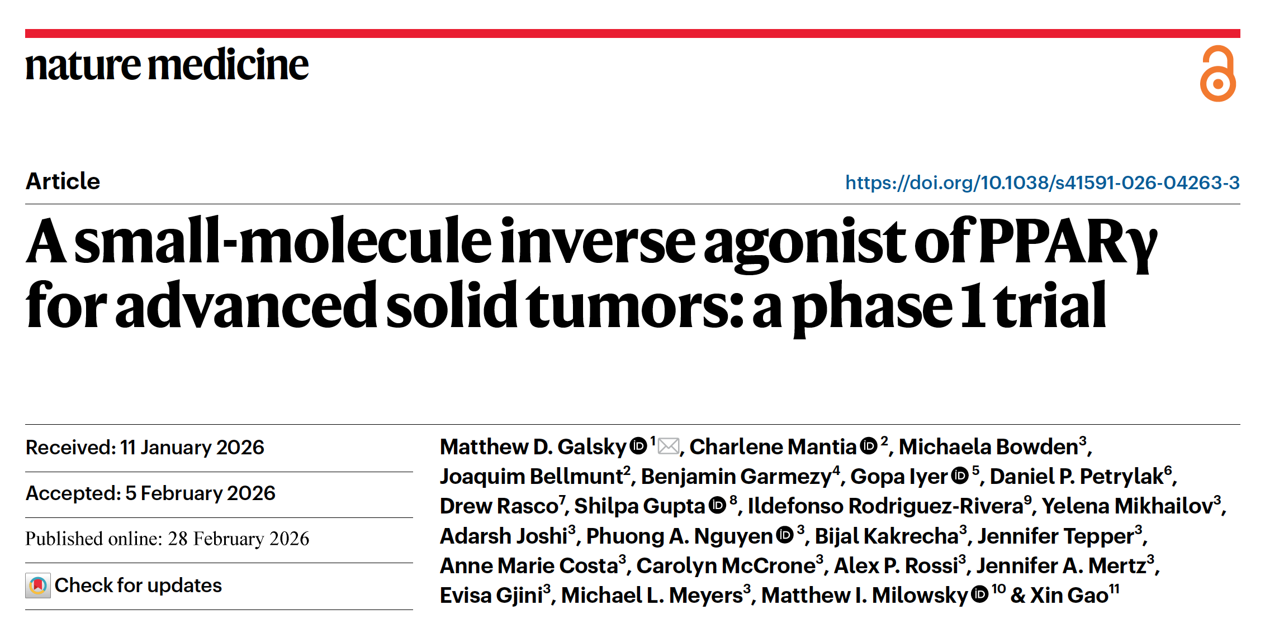

Slide 30
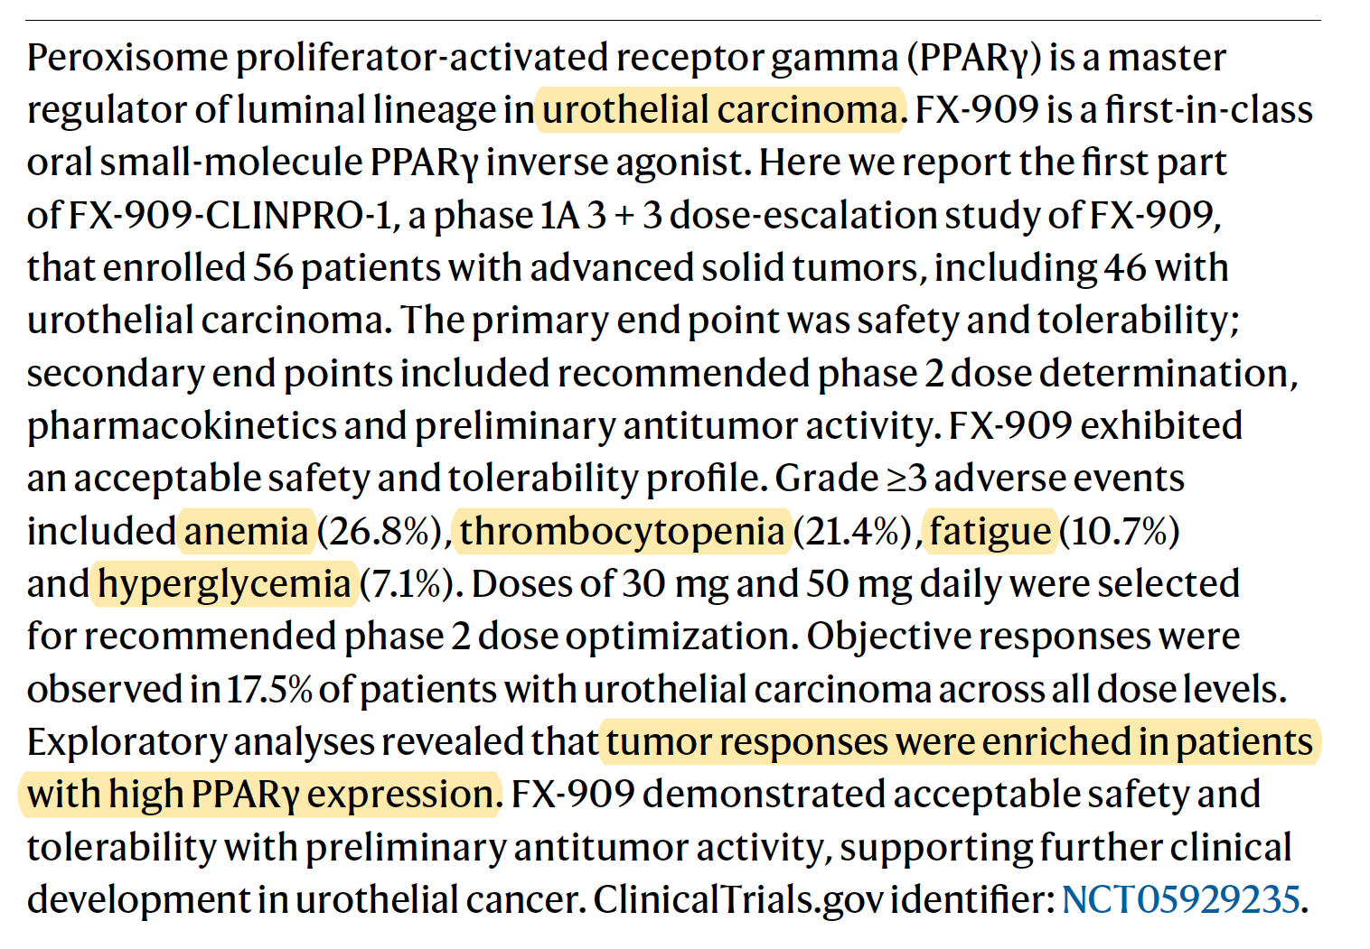

Slide 31



Slide 32



Slide 33
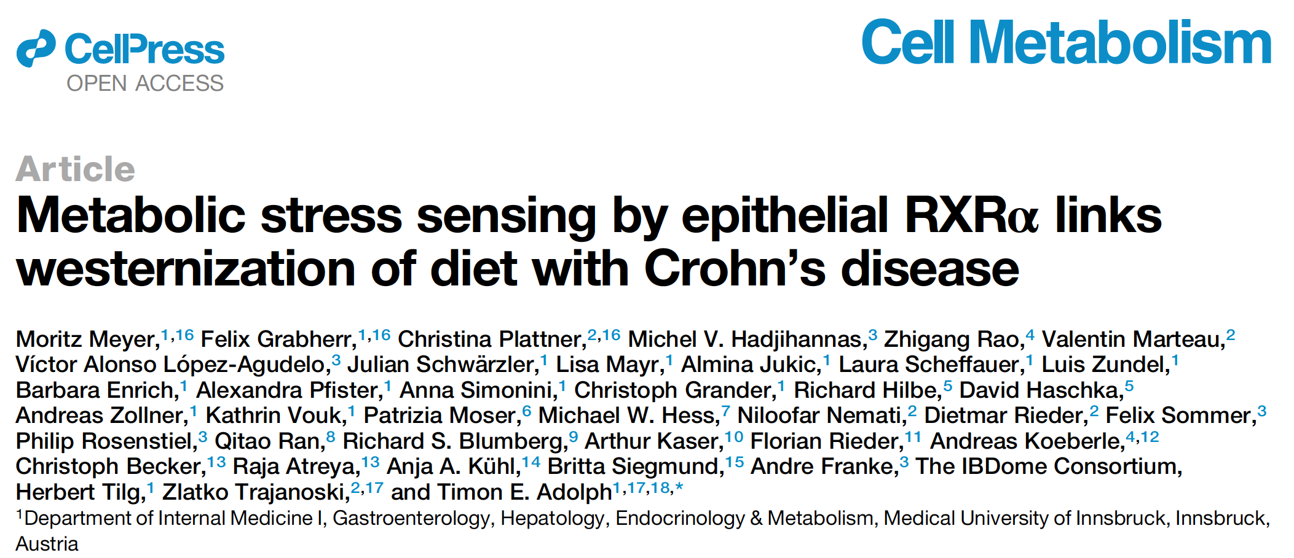

Slide 34


Slide 35
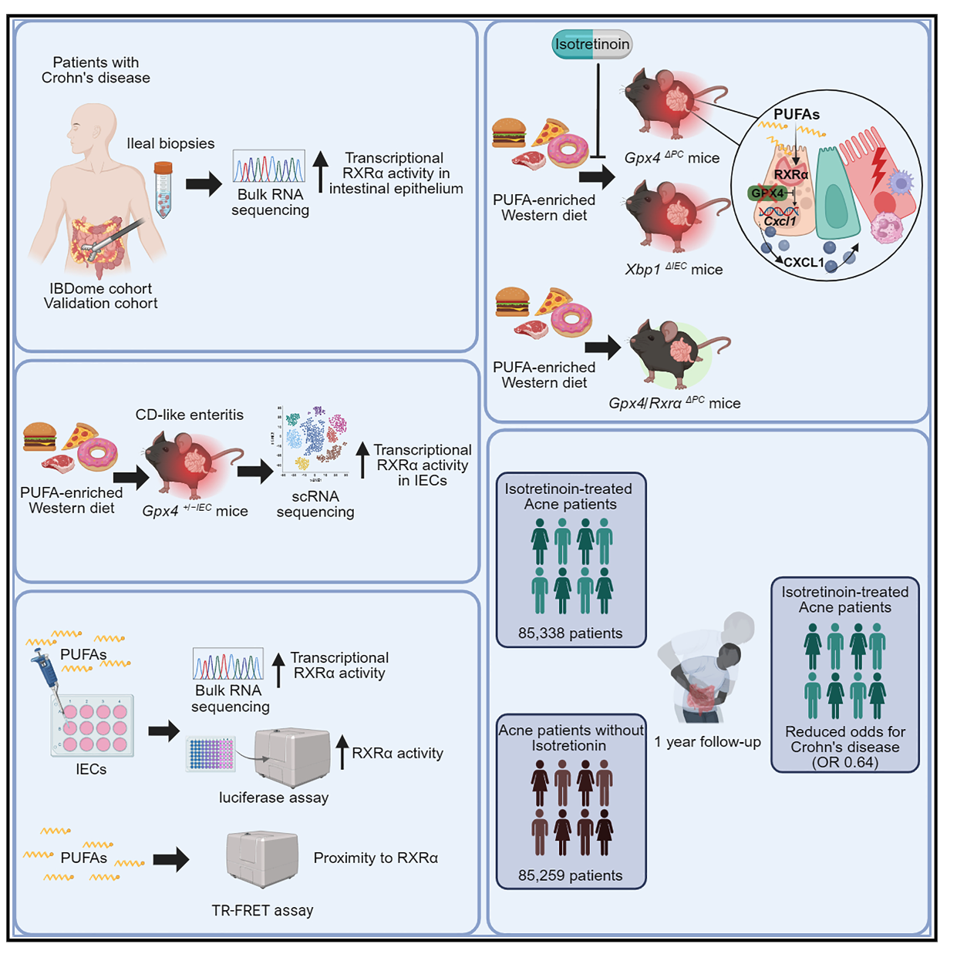
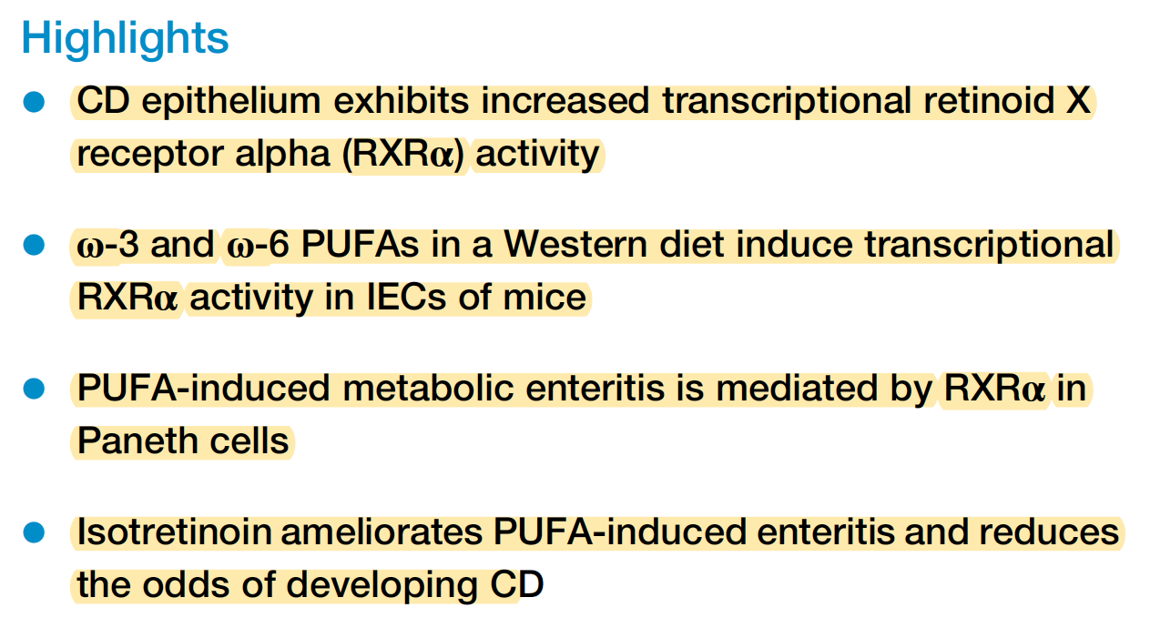

Slide 36
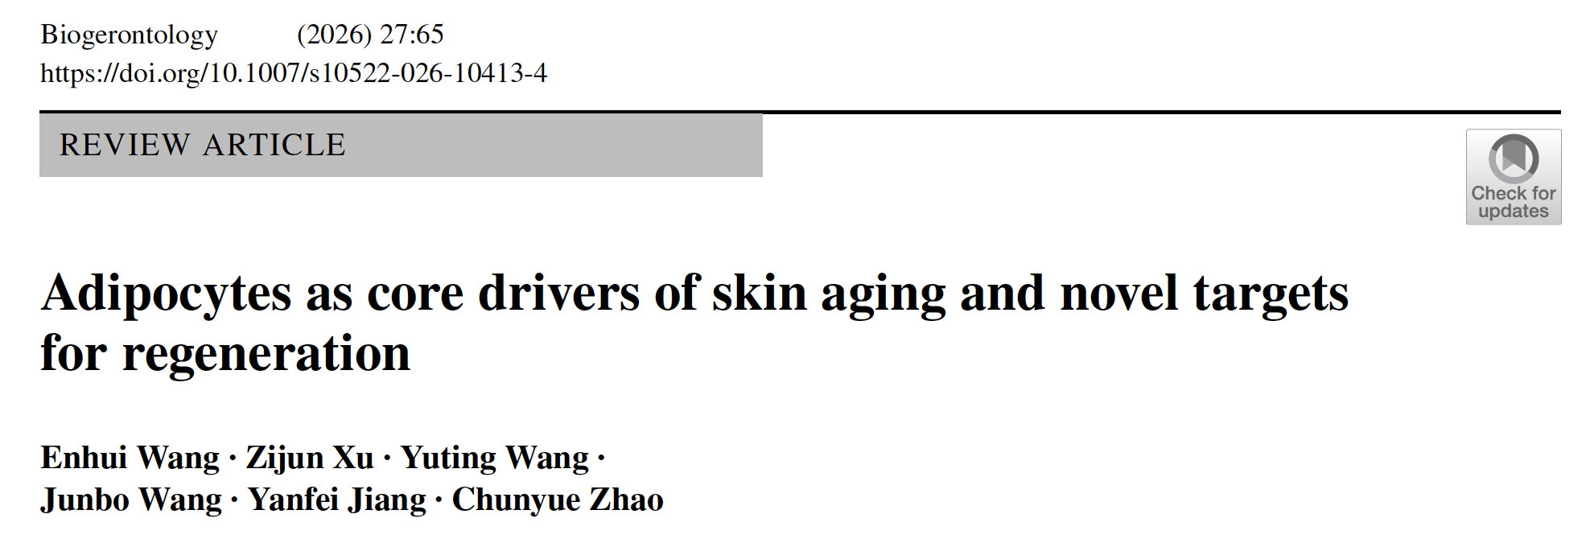


Slide 37
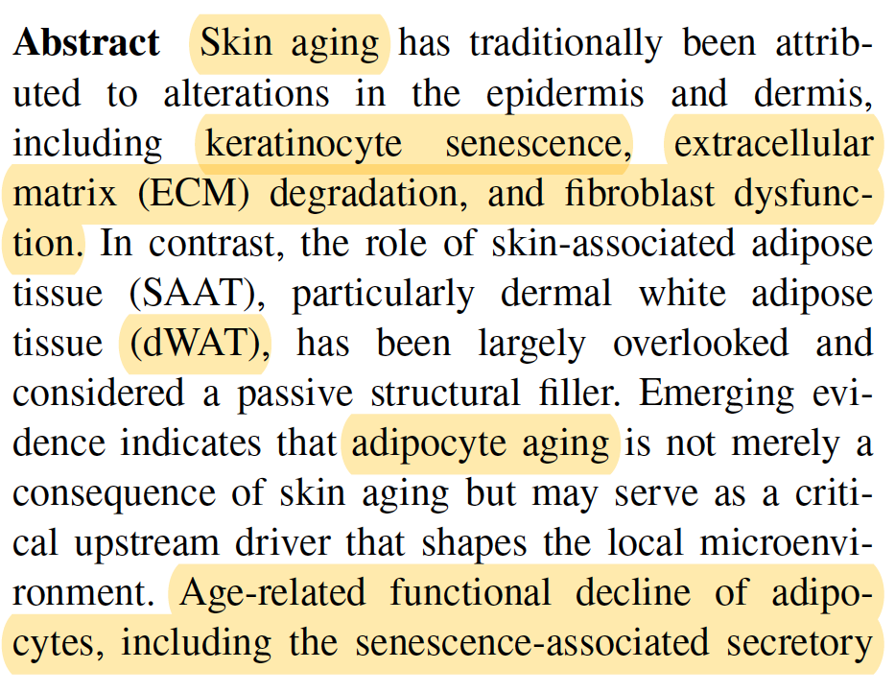
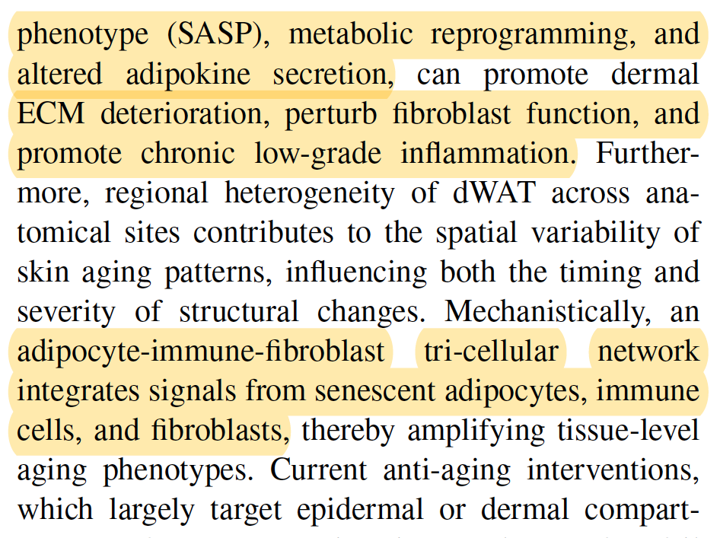

Slide 38
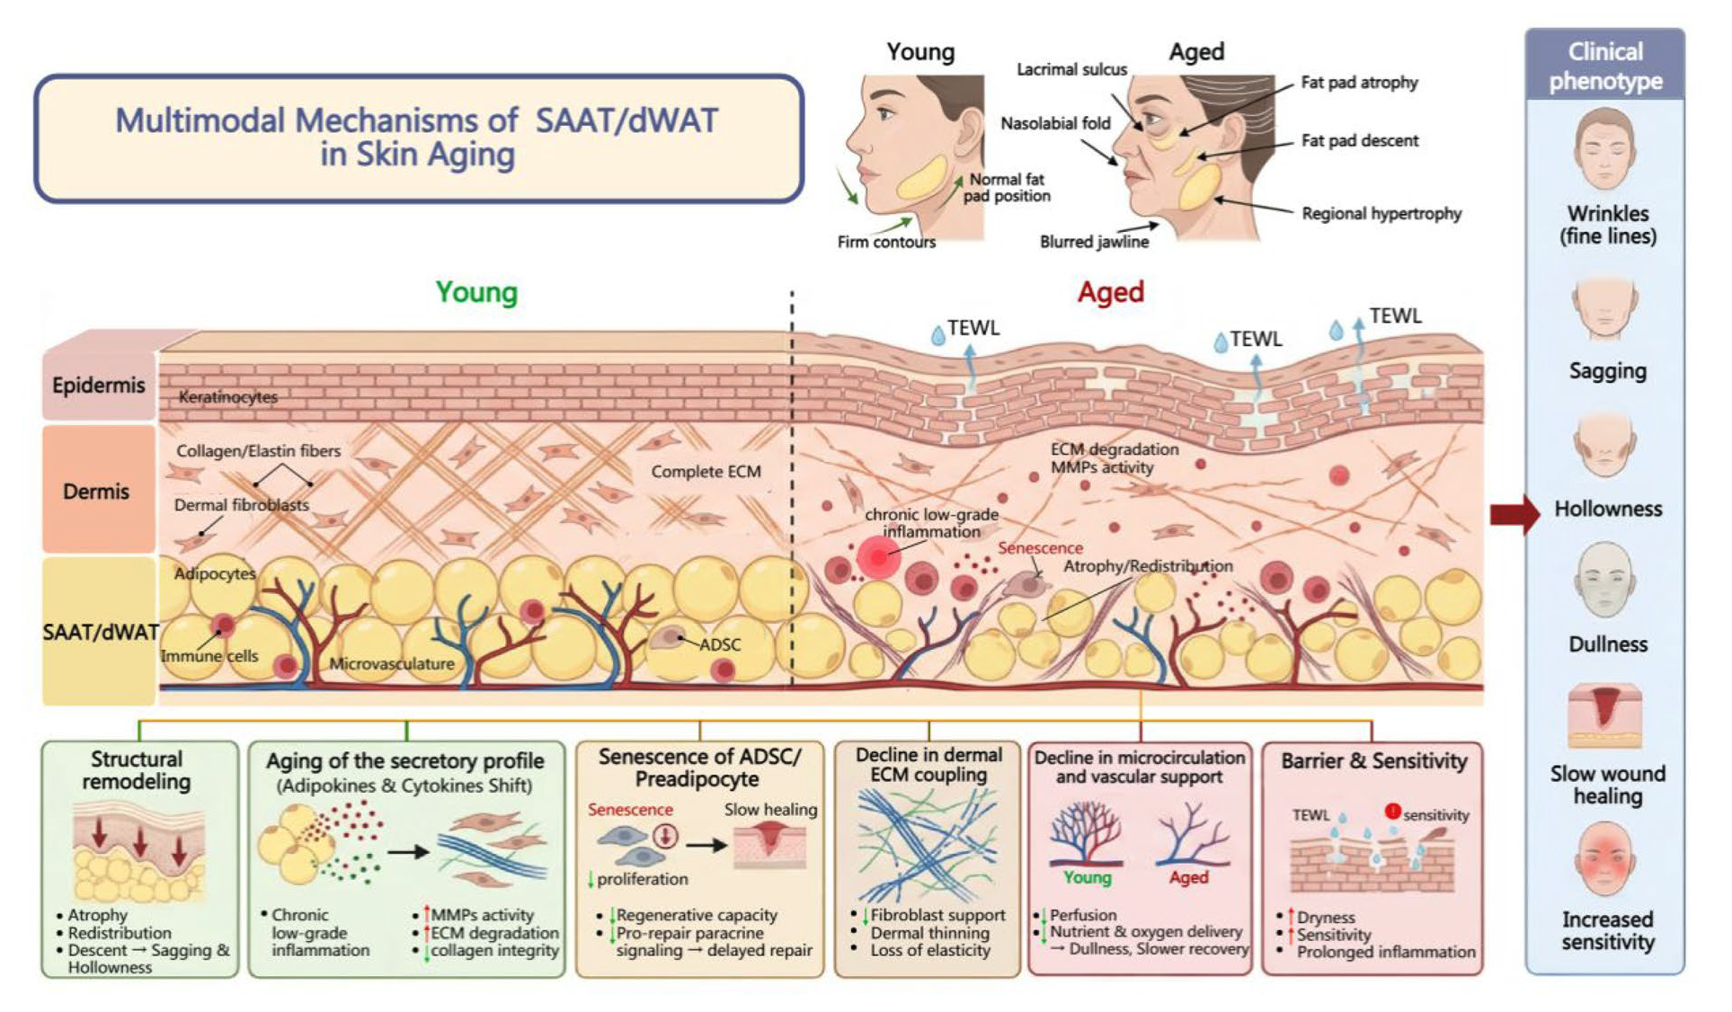

Slide 39
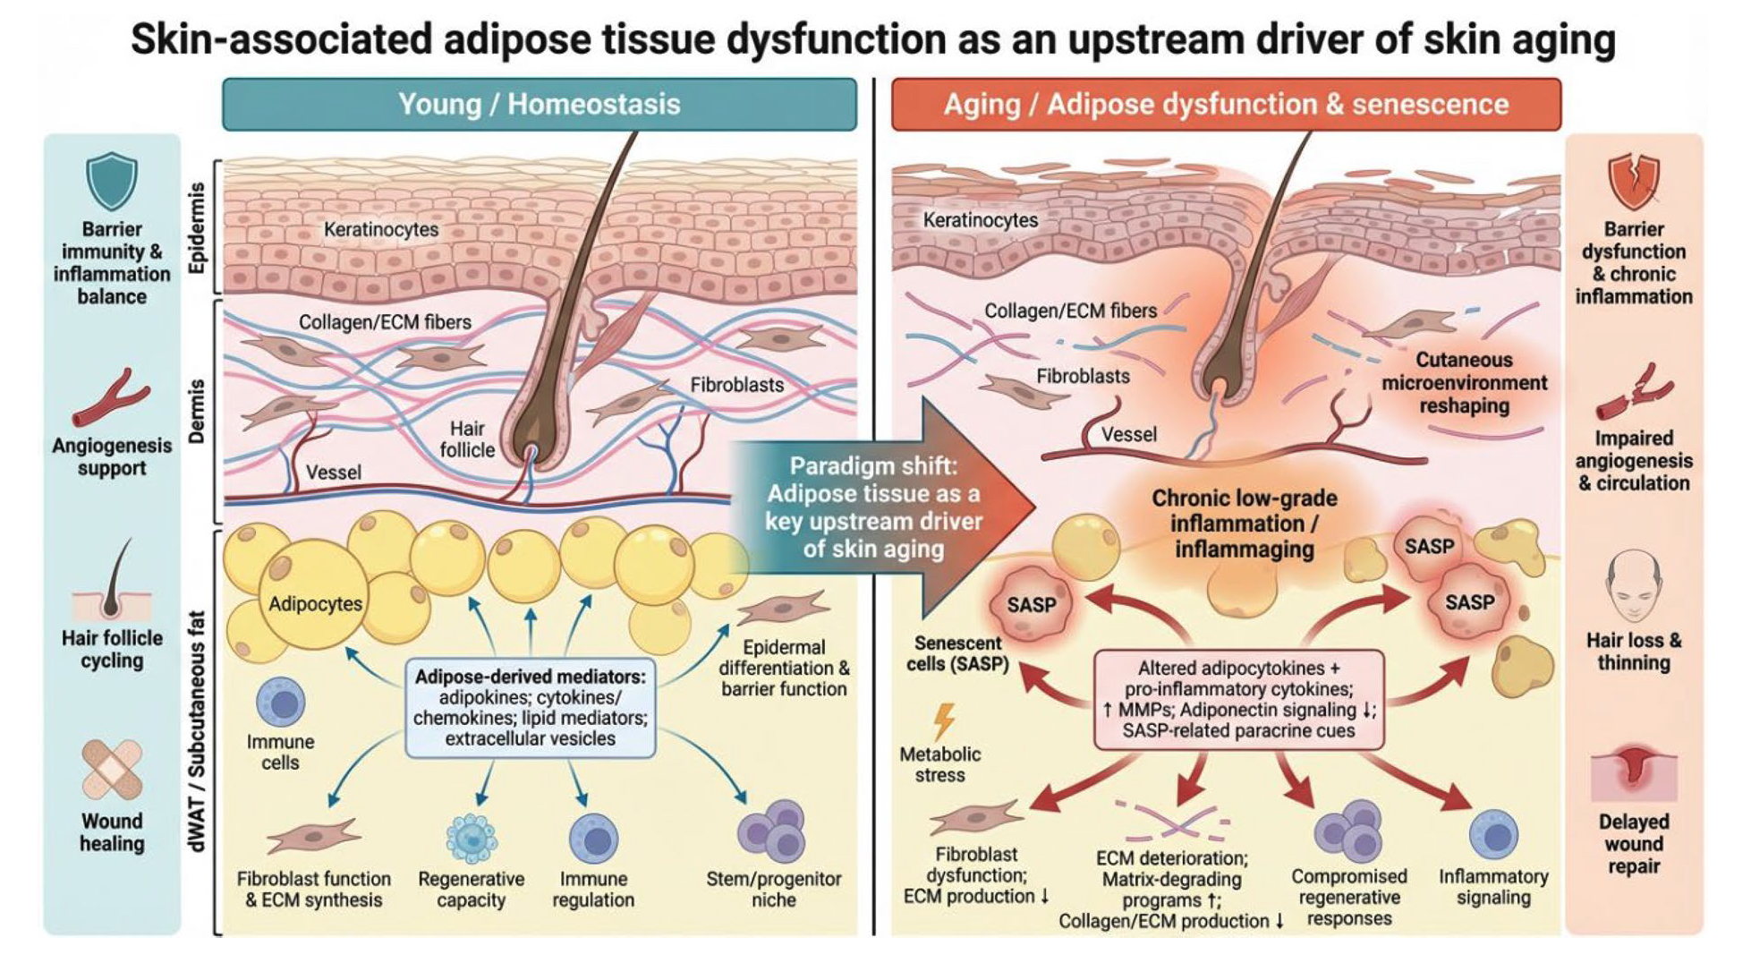

Slide 40
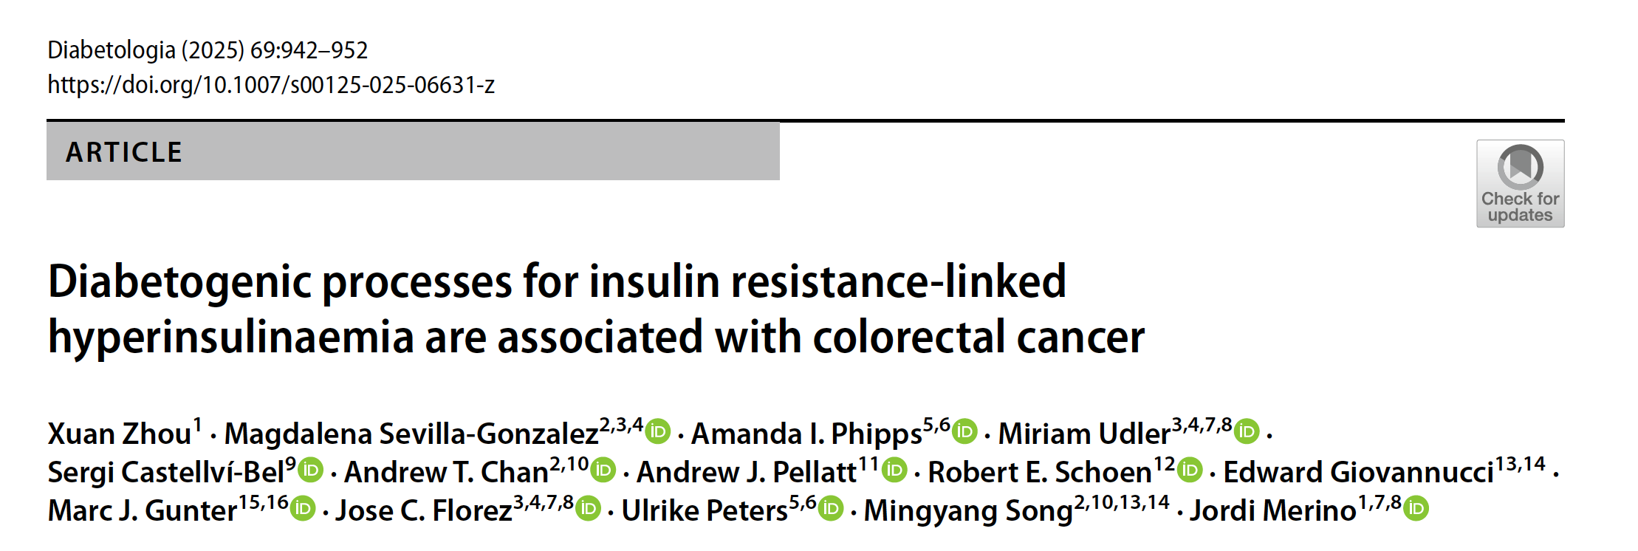

Slide 41
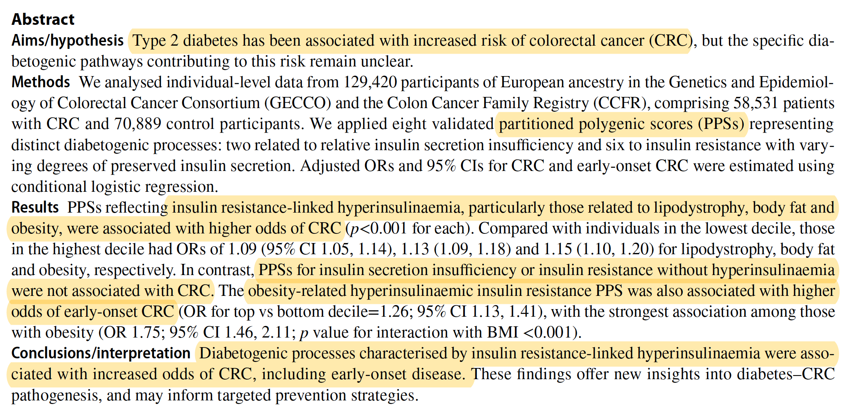

Slide 42
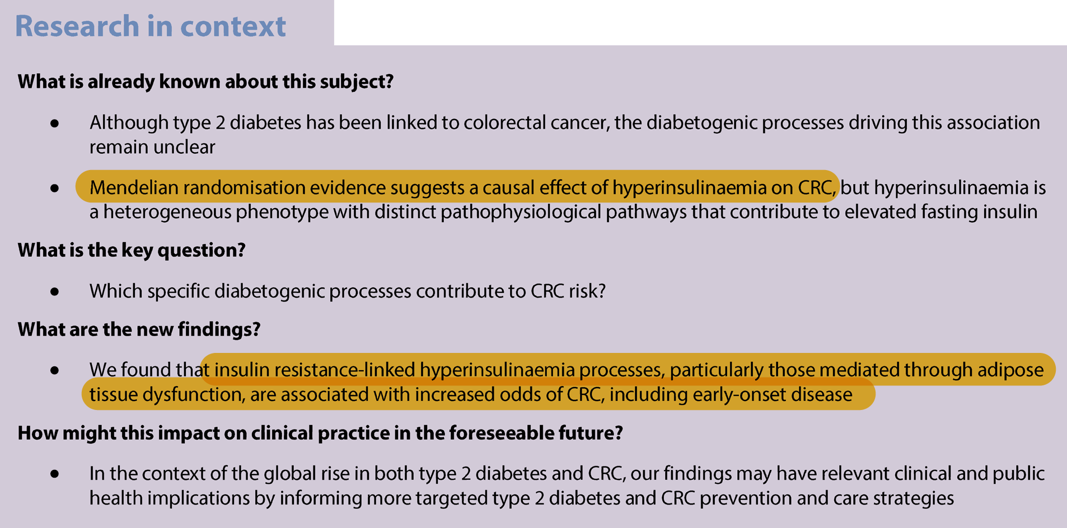

Slide 43




Slide 44


Slide 45


