Slide 1
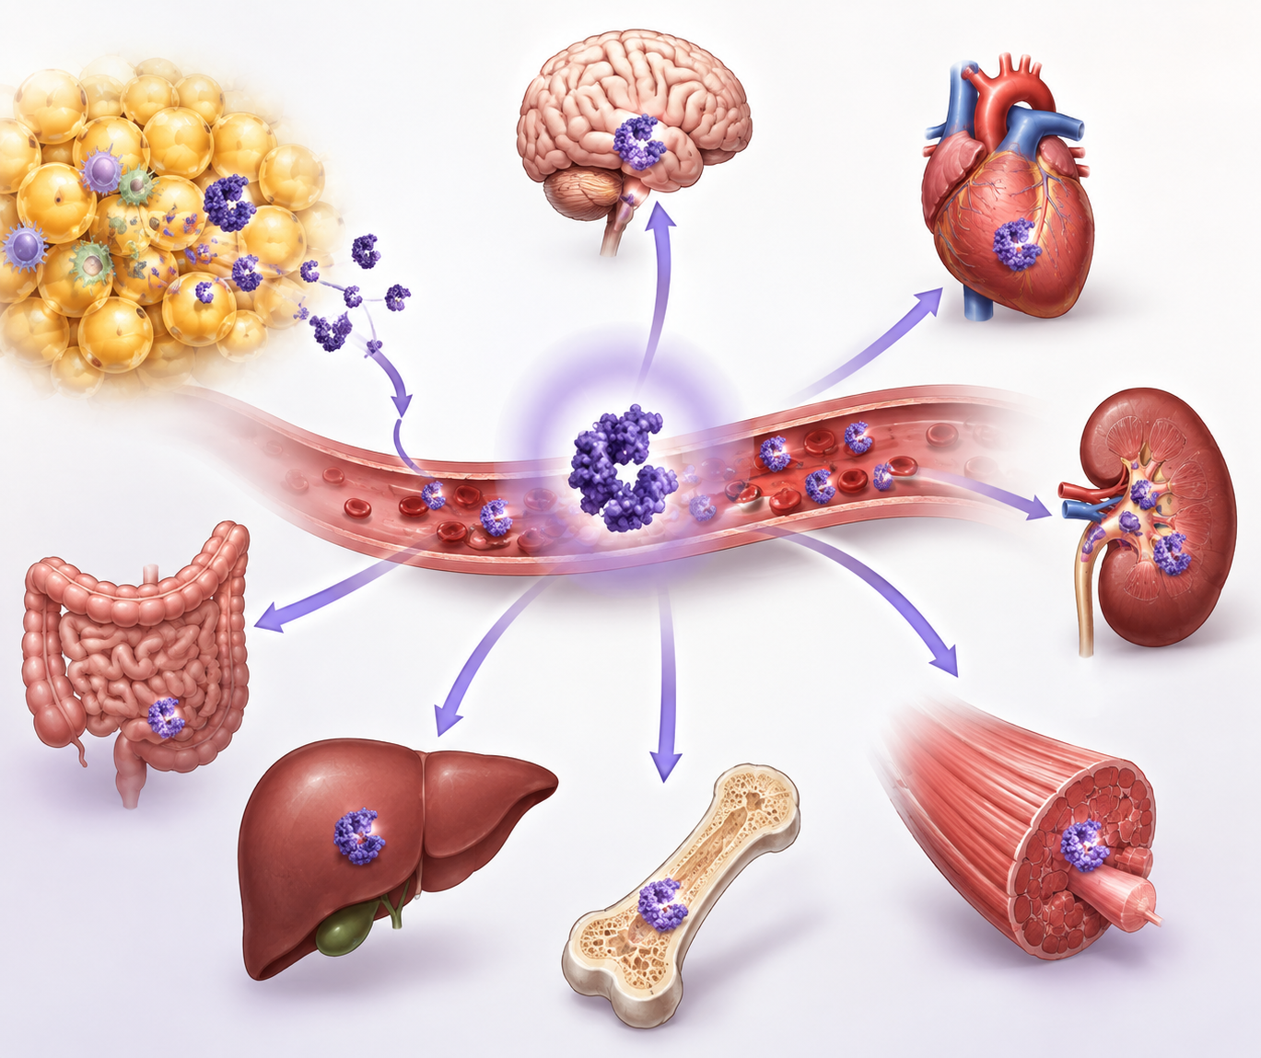
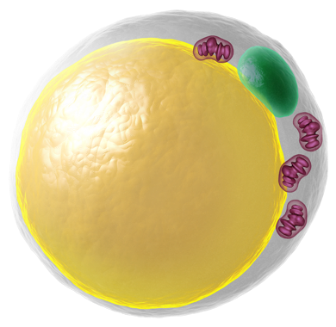
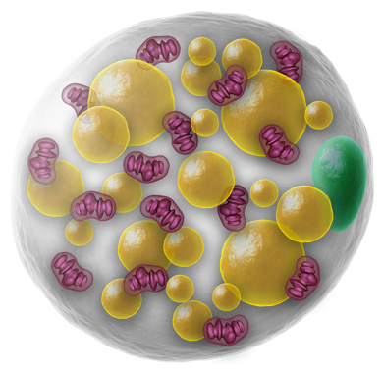
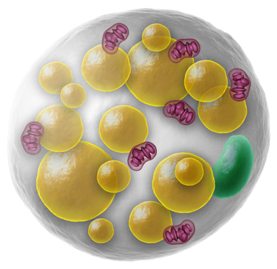
Literature Overview
Touchstone Diabetes Center
UTSW Medical Center 10/19/2026

Slide 2
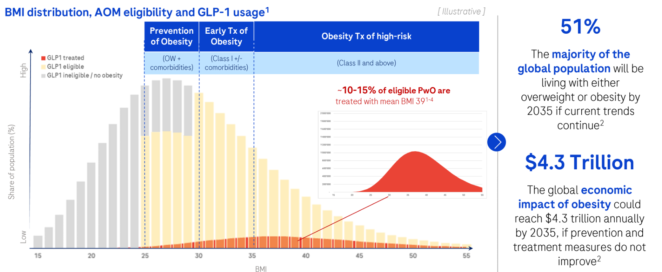

Slide 3
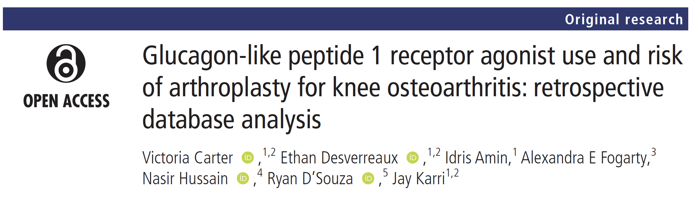
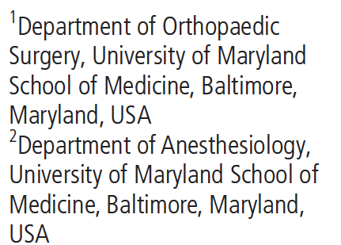

Slide 4
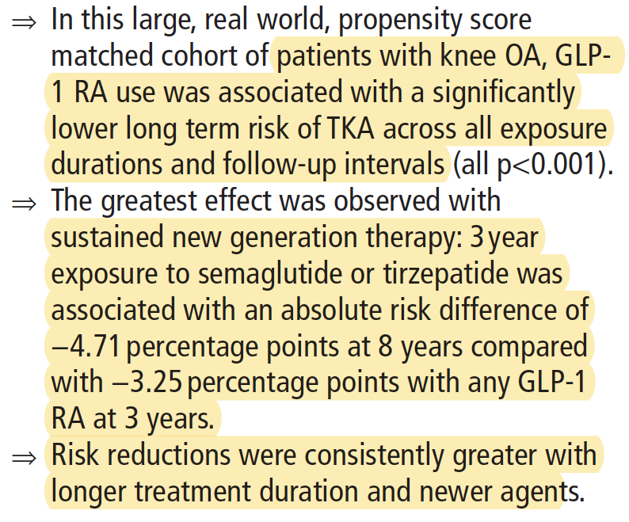
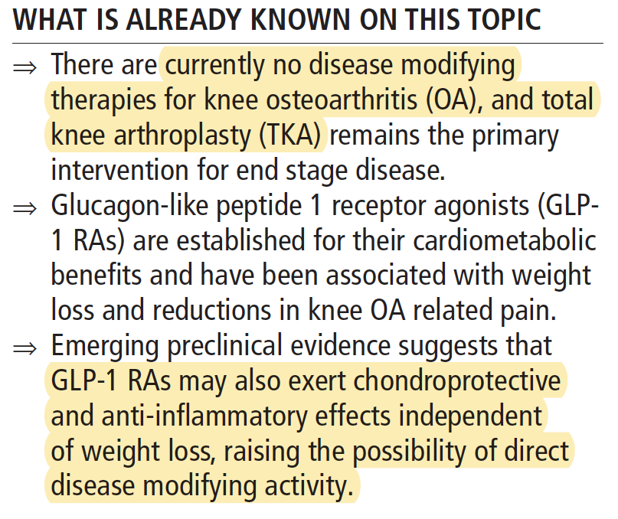

Slide 5
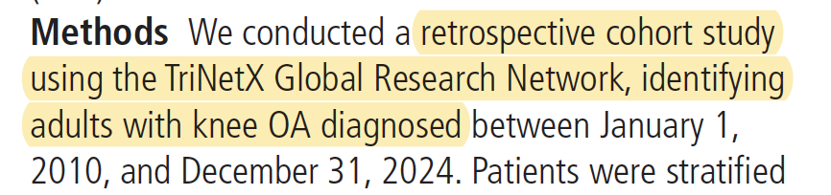
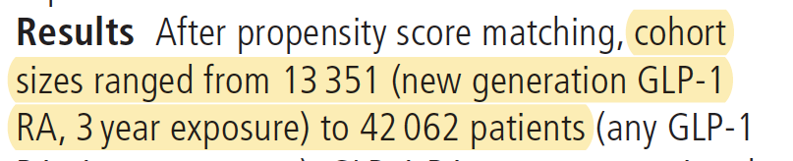
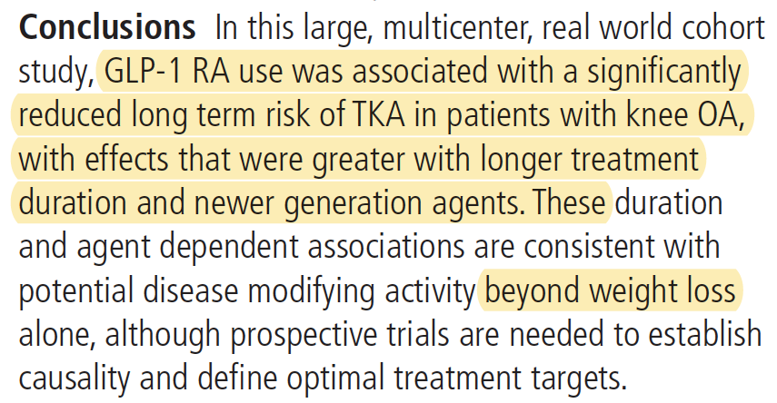

Slide 6
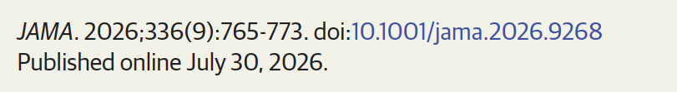
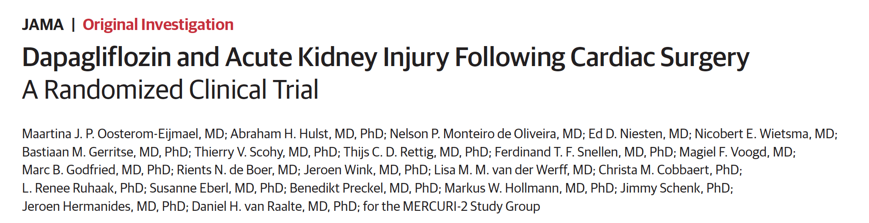
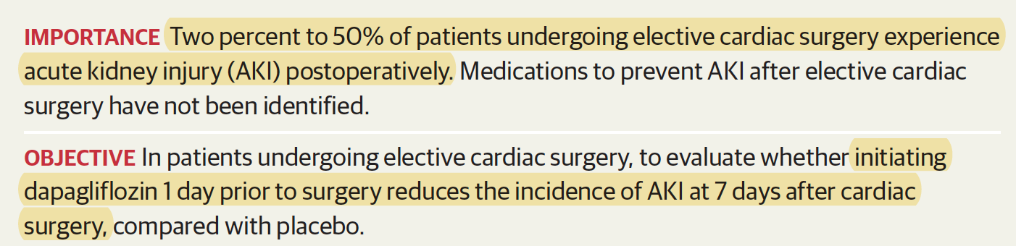
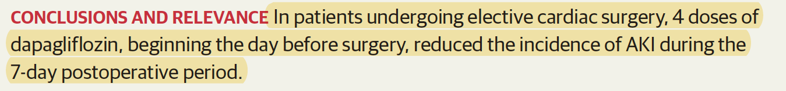
SGLT2 Inhibitors!

Slide 7
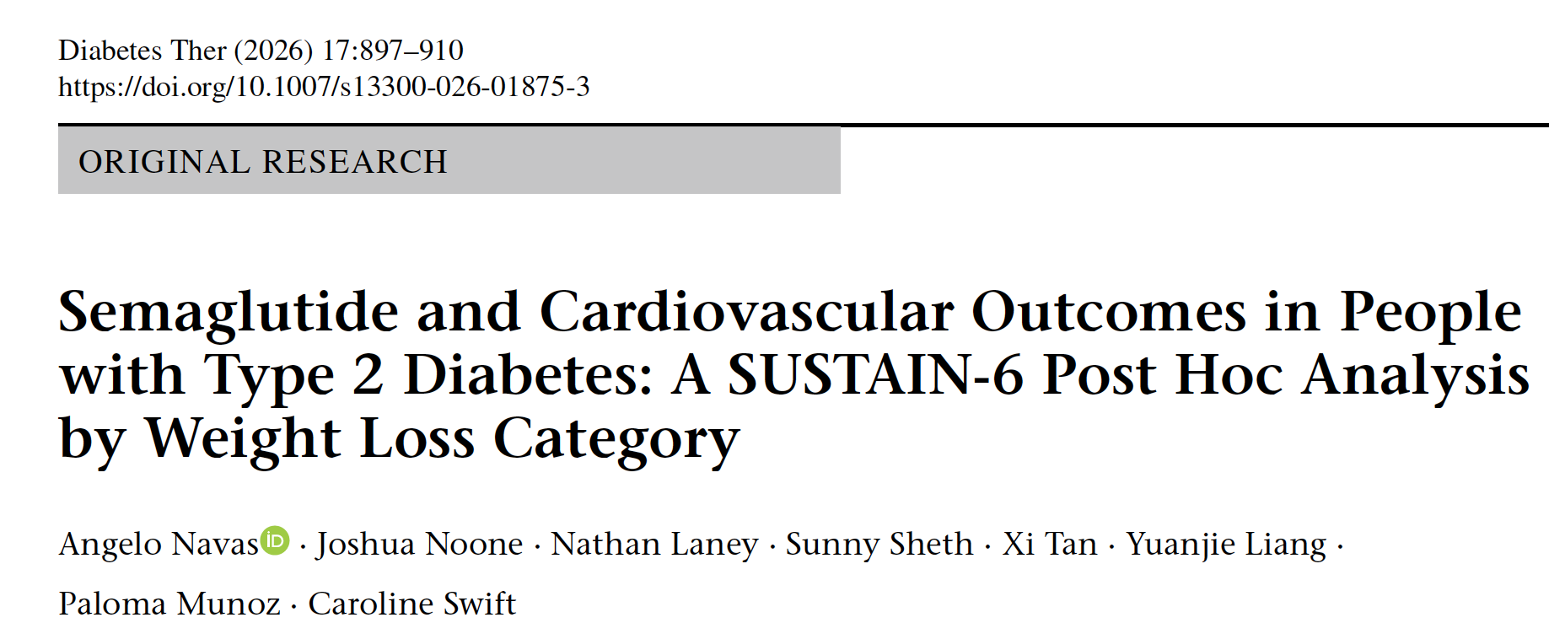

Slide 8
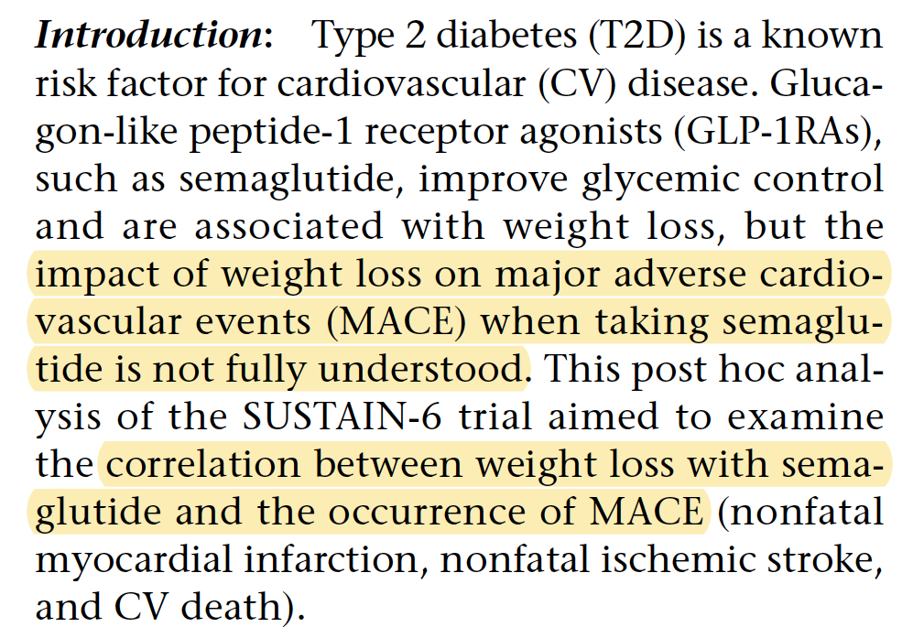
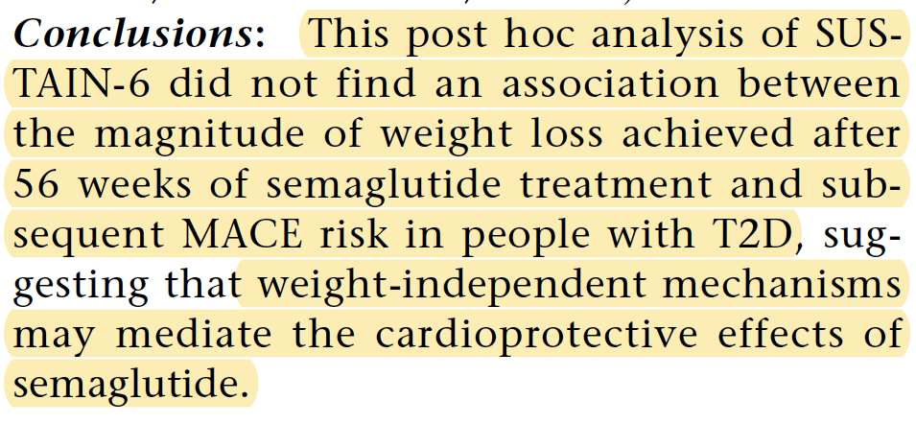

Slide 9

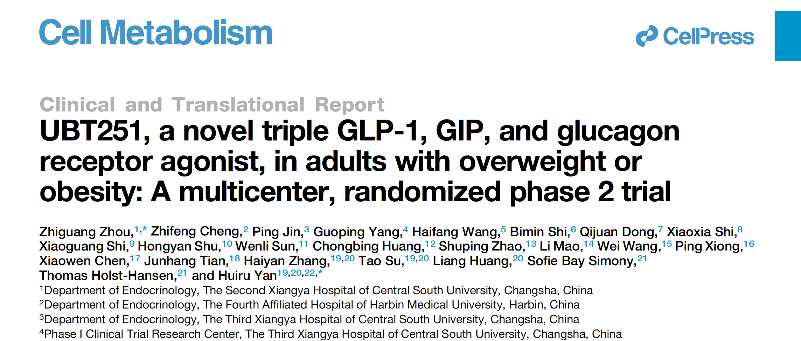
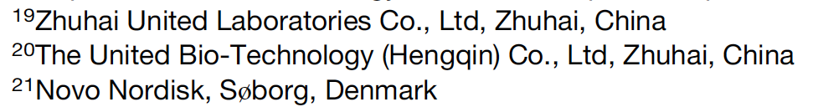

Slide 10
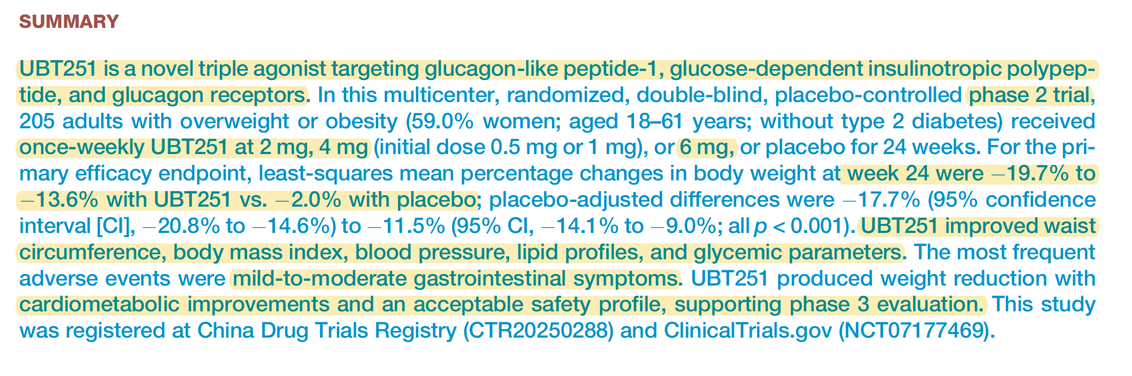

Slide 11
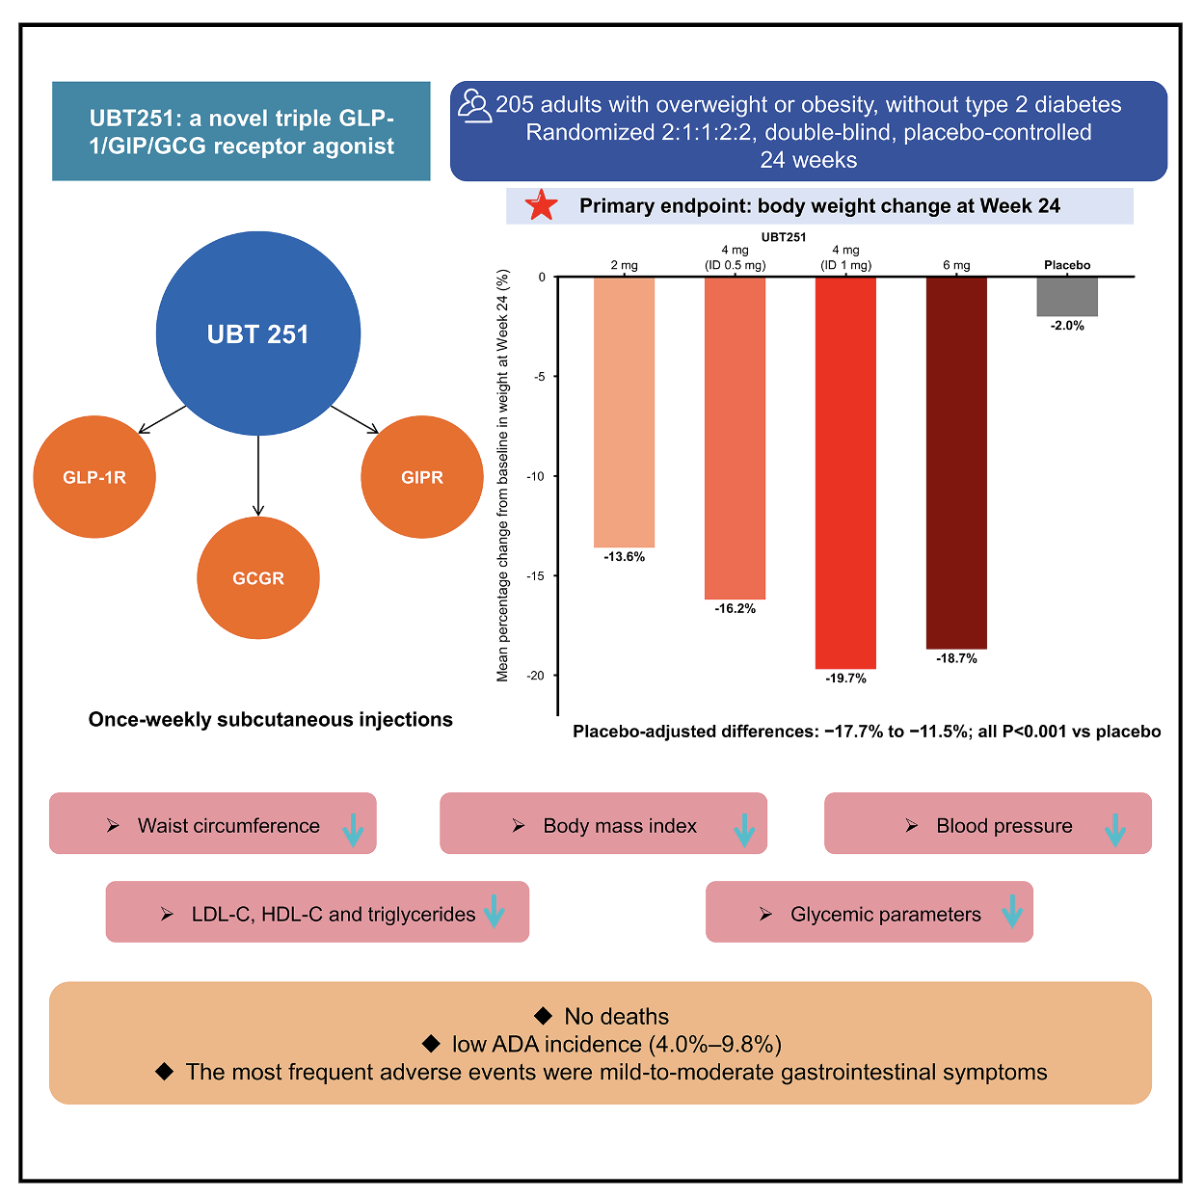
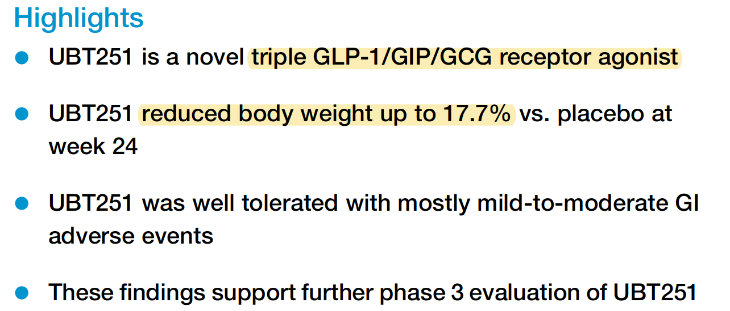

Slide 12
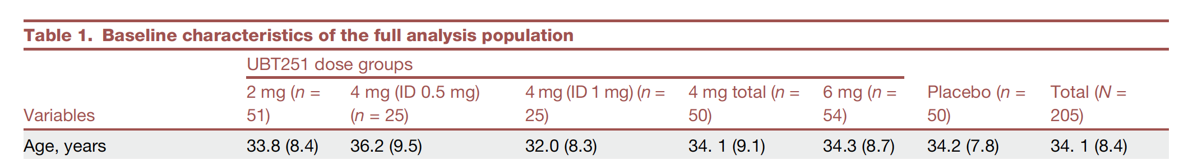
The pulse values in Table 1 are baseline measurements, so they do not show the treatment effect.
This UBT251 paper actually does show an effect—it is easy to miss because the longitudinal data are in
supplementary Table S4. The authors report:
Heart rate increased during treatment and returned toward baseline after discontinuation.
The increase at 6 mg was numerically greater than the 6.7 beats/min reported for retatrutide 12 mg at week 24.
Sinus tachycardia occurred in 7.1% of UBT251 recipients versus 2.0% with placebo.

Slide 13
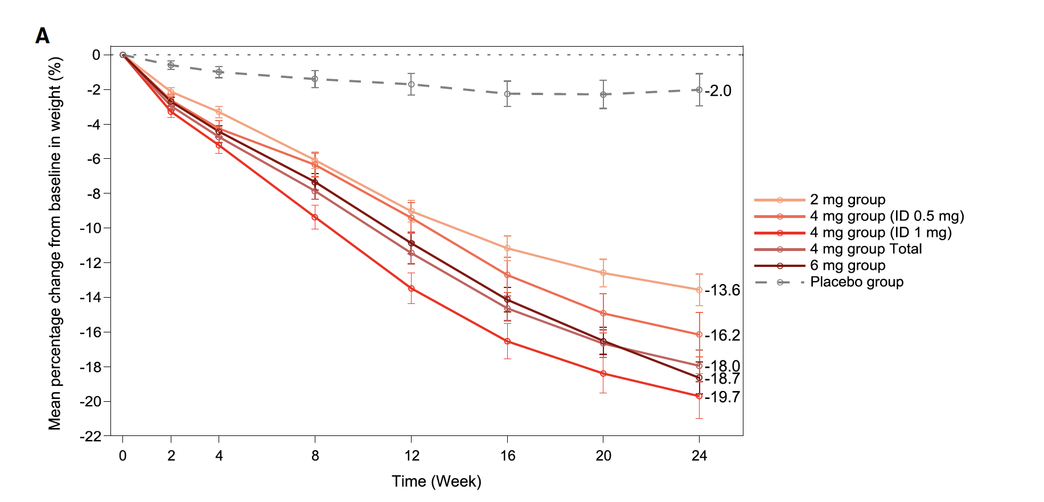

Slide 14
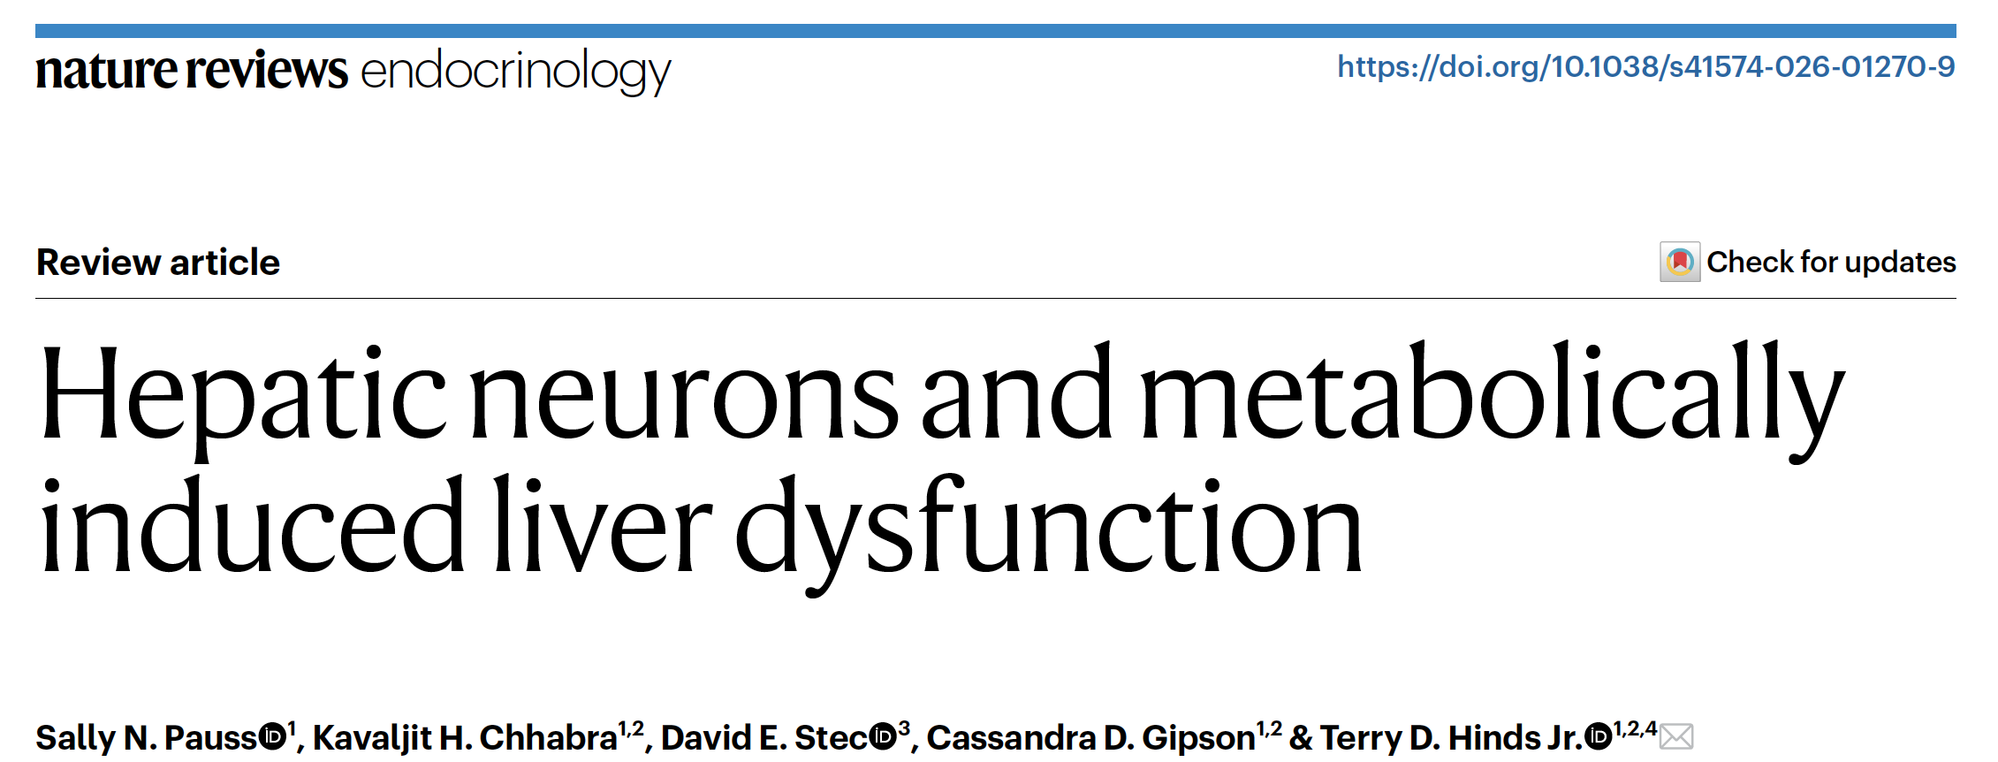

Slide 15
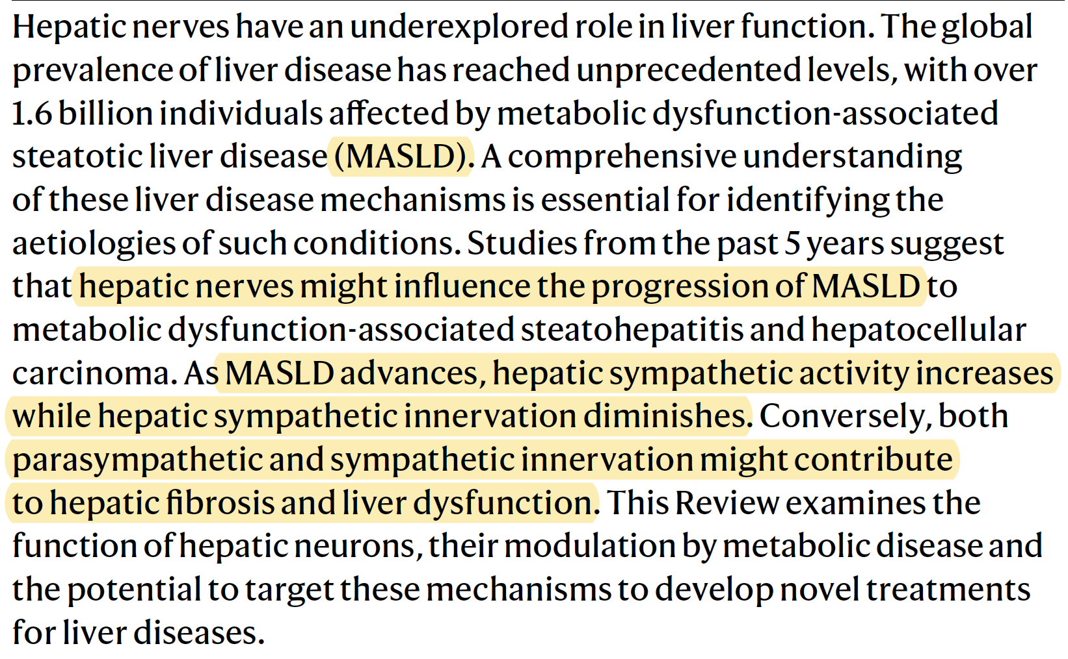

Slide 16
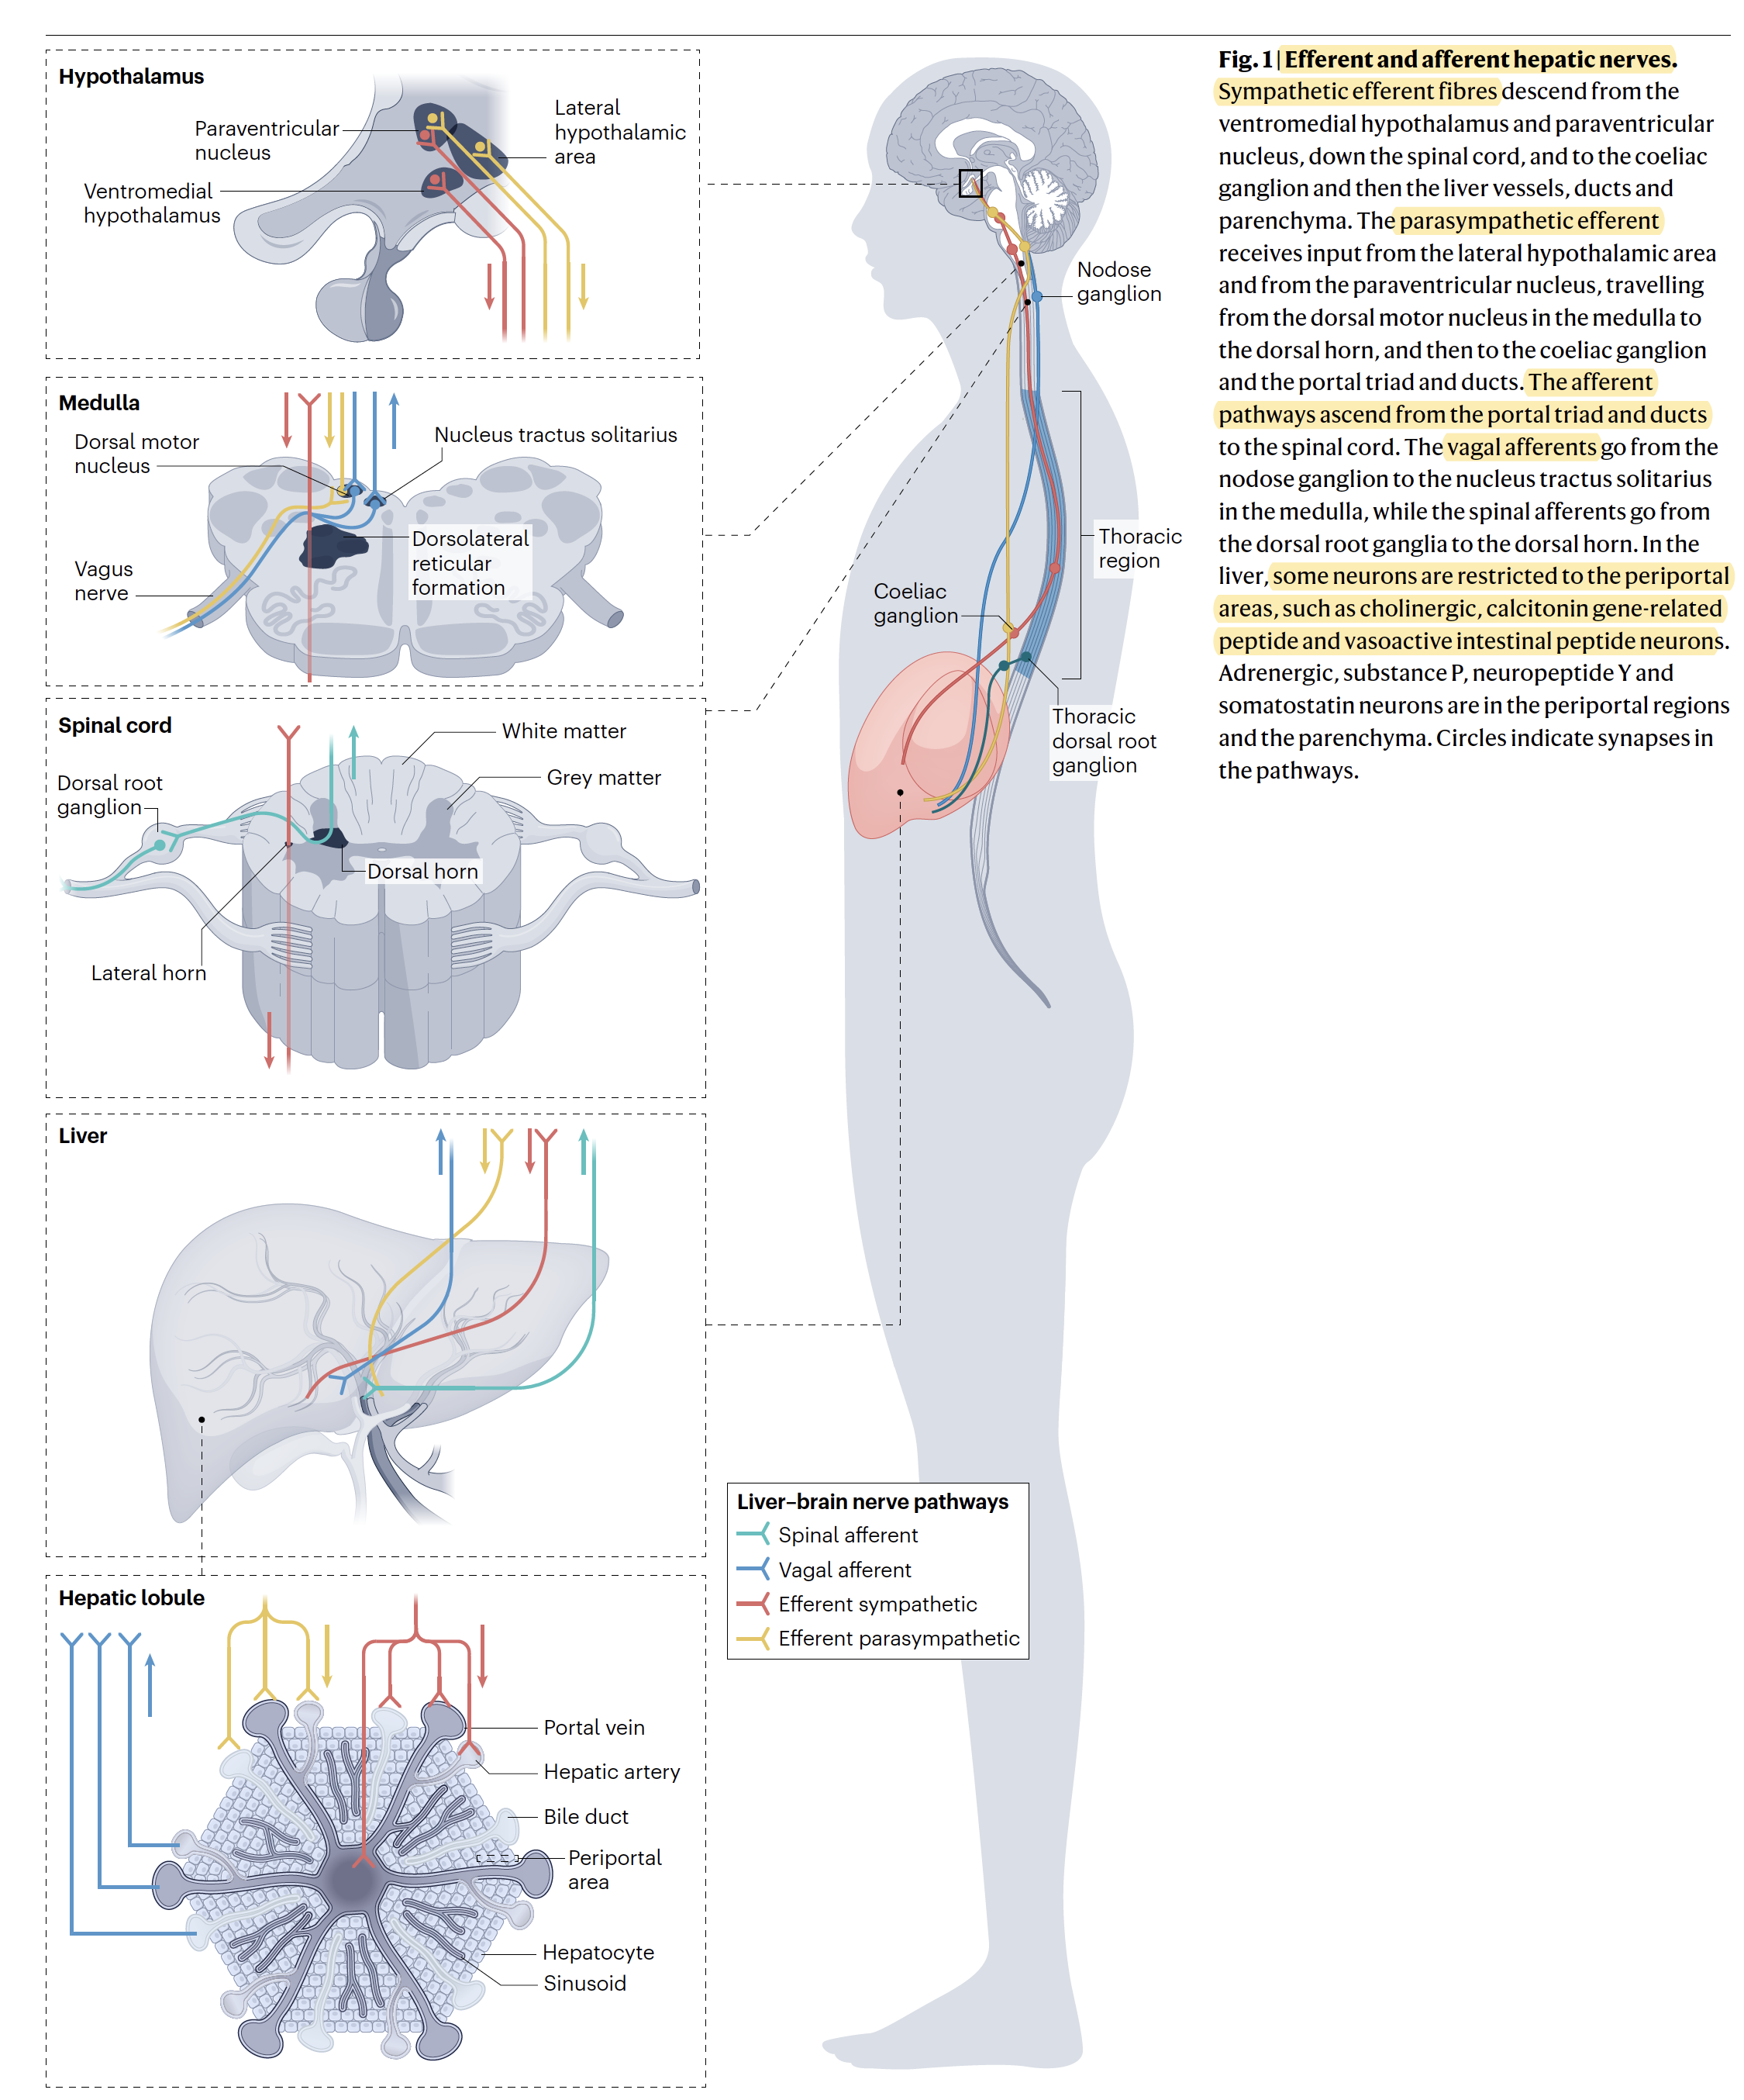

Slide 17
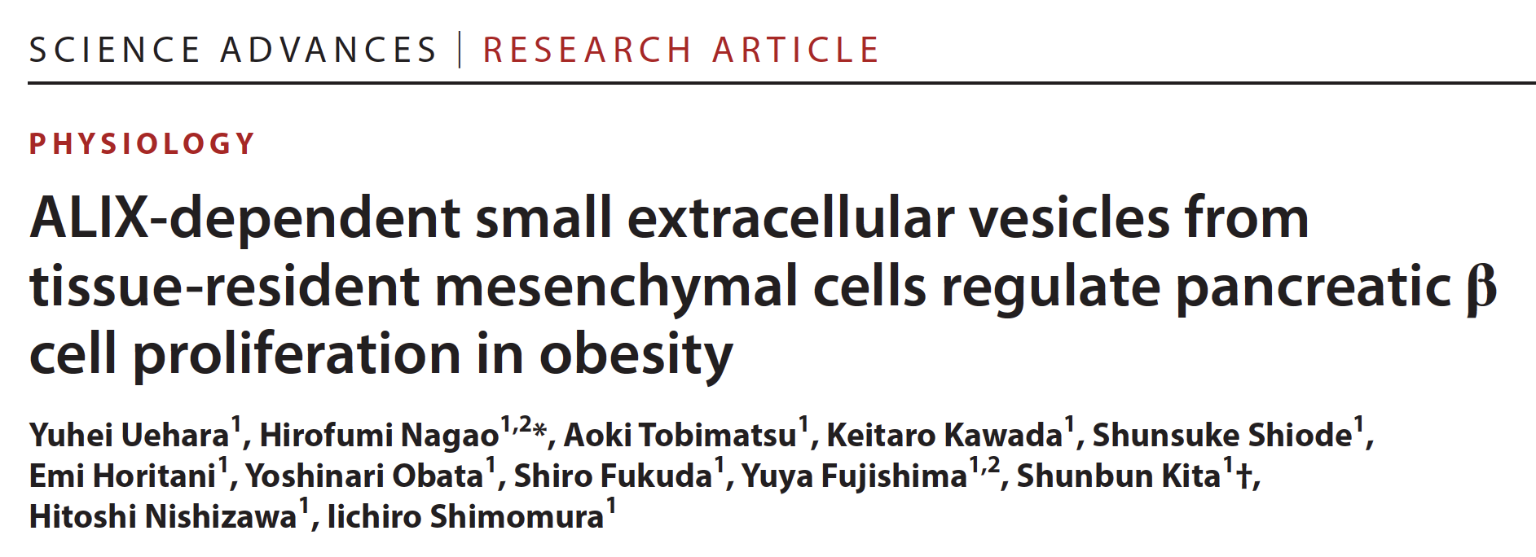

Slide 18
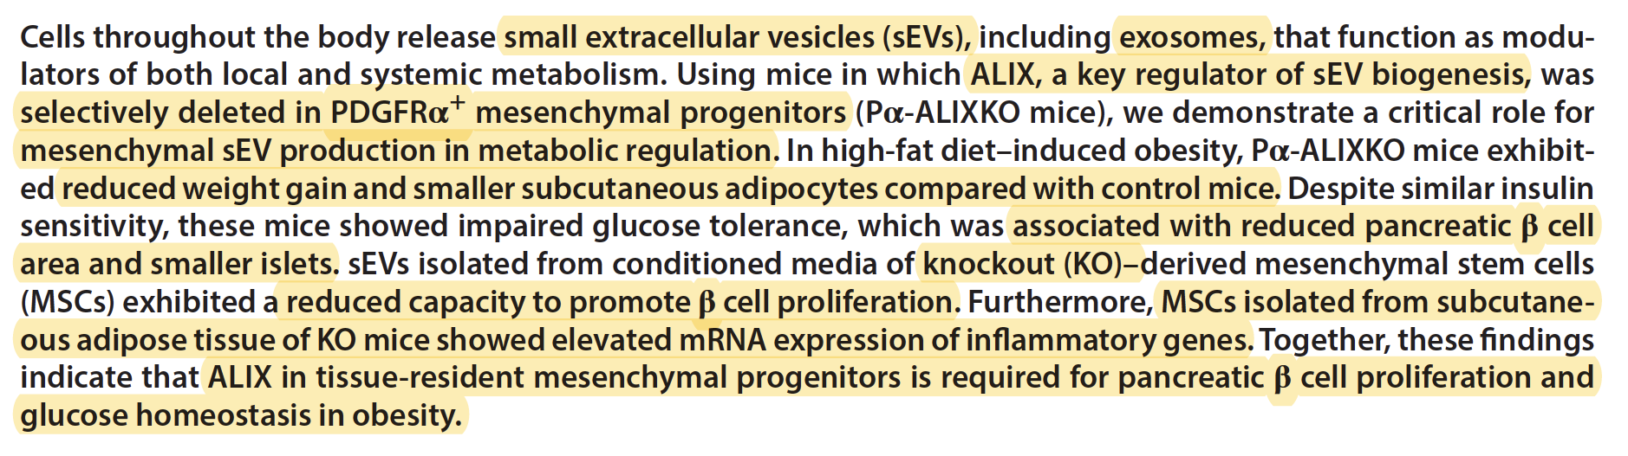
ALIX is a conserved, multifunctional adaptor and scaffold protein
ESCRT Pathway:
ALIX acts as a critical component of the ESCRT (Endosomal Sorting Complex Required for Transport) machinery.
It helps coordinate membrane remodeling events such as:
Intralumenal vesicle formation (multivesicular bodies)
Cytokinesis (specifically the final abscission stage)
Exosome biogenesis and cargo loading (such as syntenin)

Slide 19

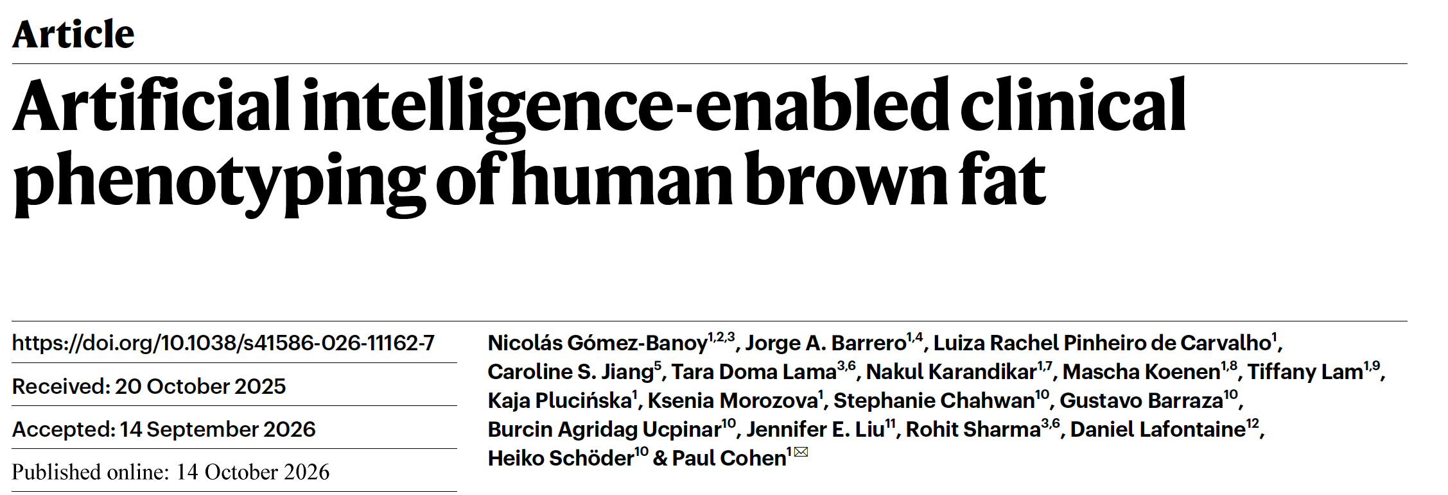

Slide 20
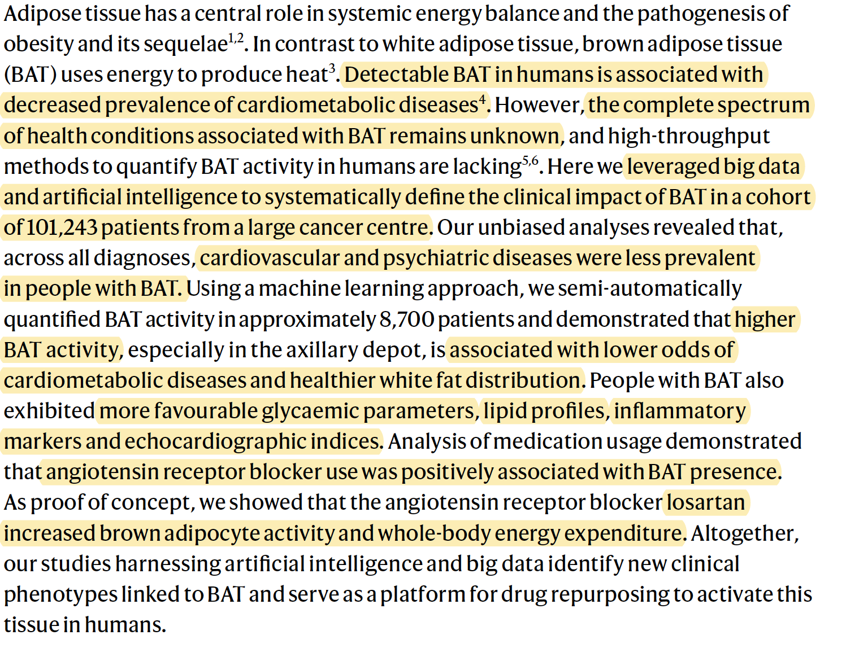

Slide 21
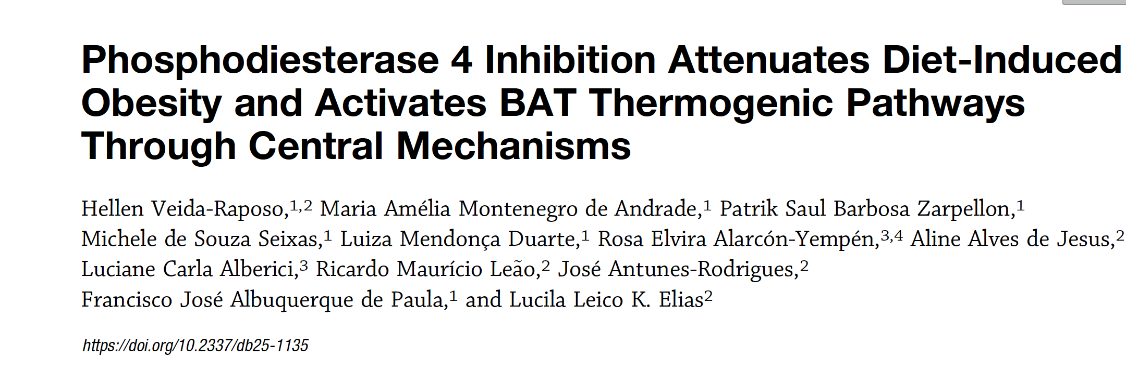

Slide 22
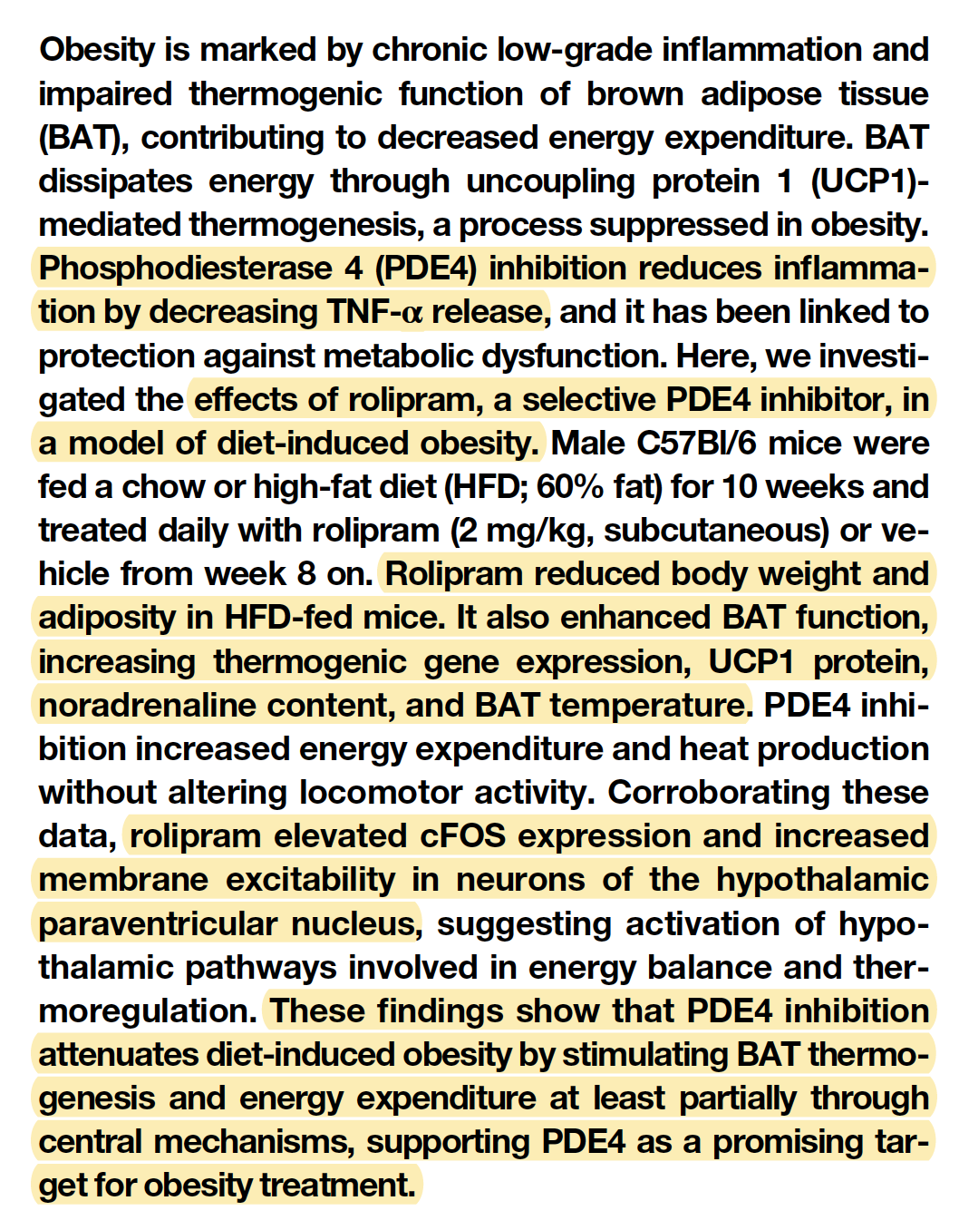

Slide 23
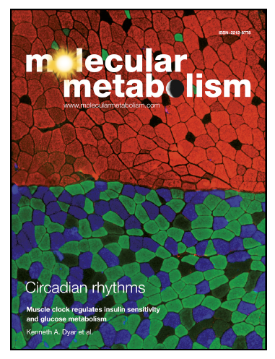
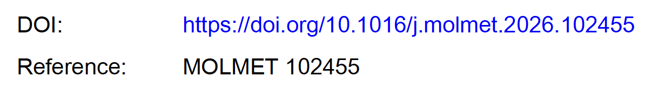

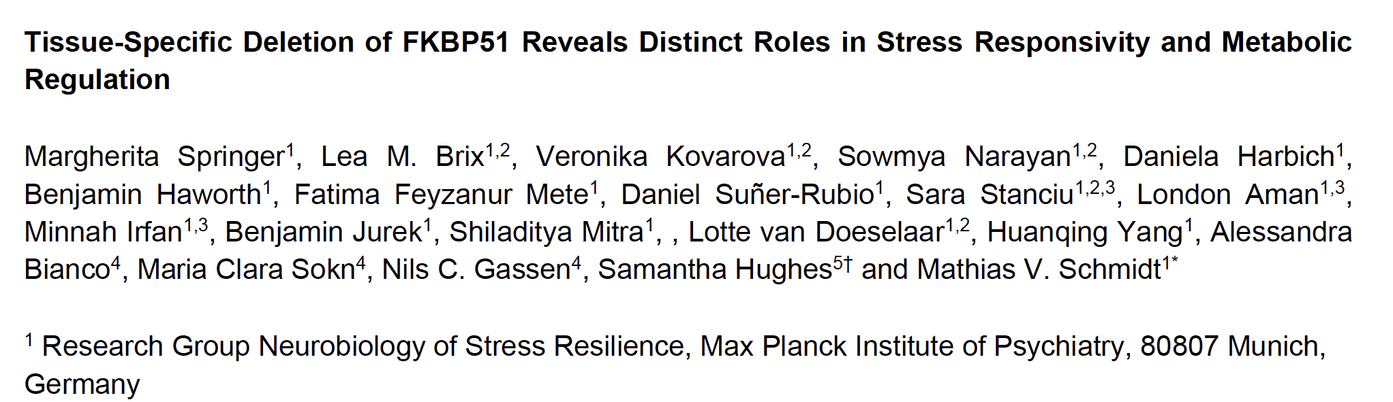

Slide 24
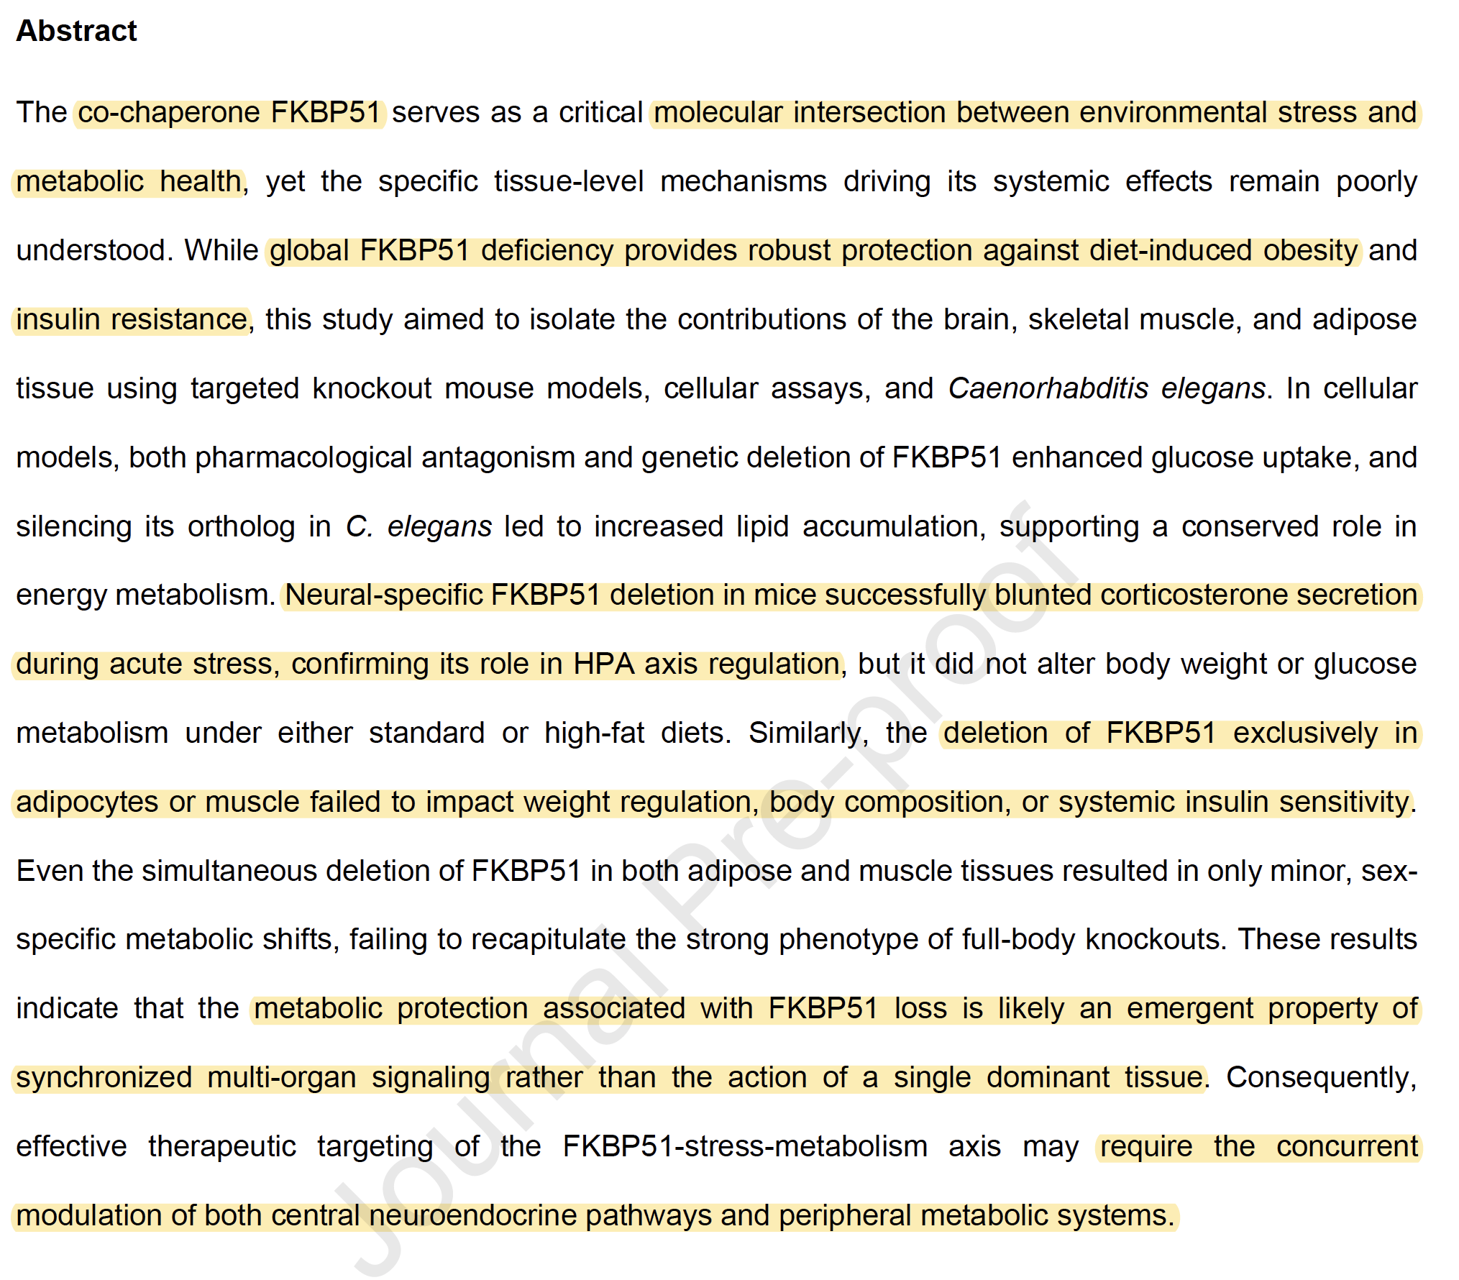

Slide 25
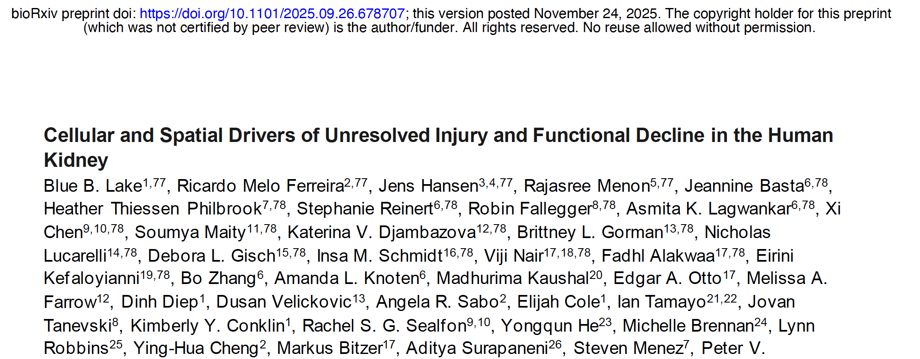
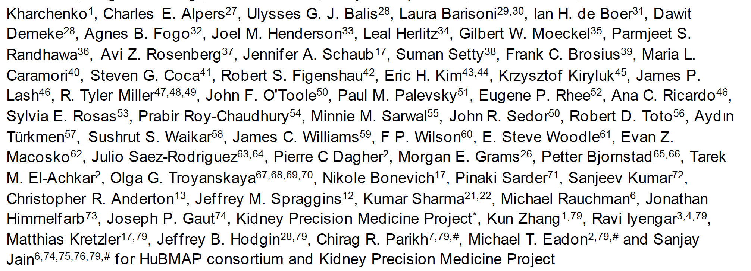

Slide 26
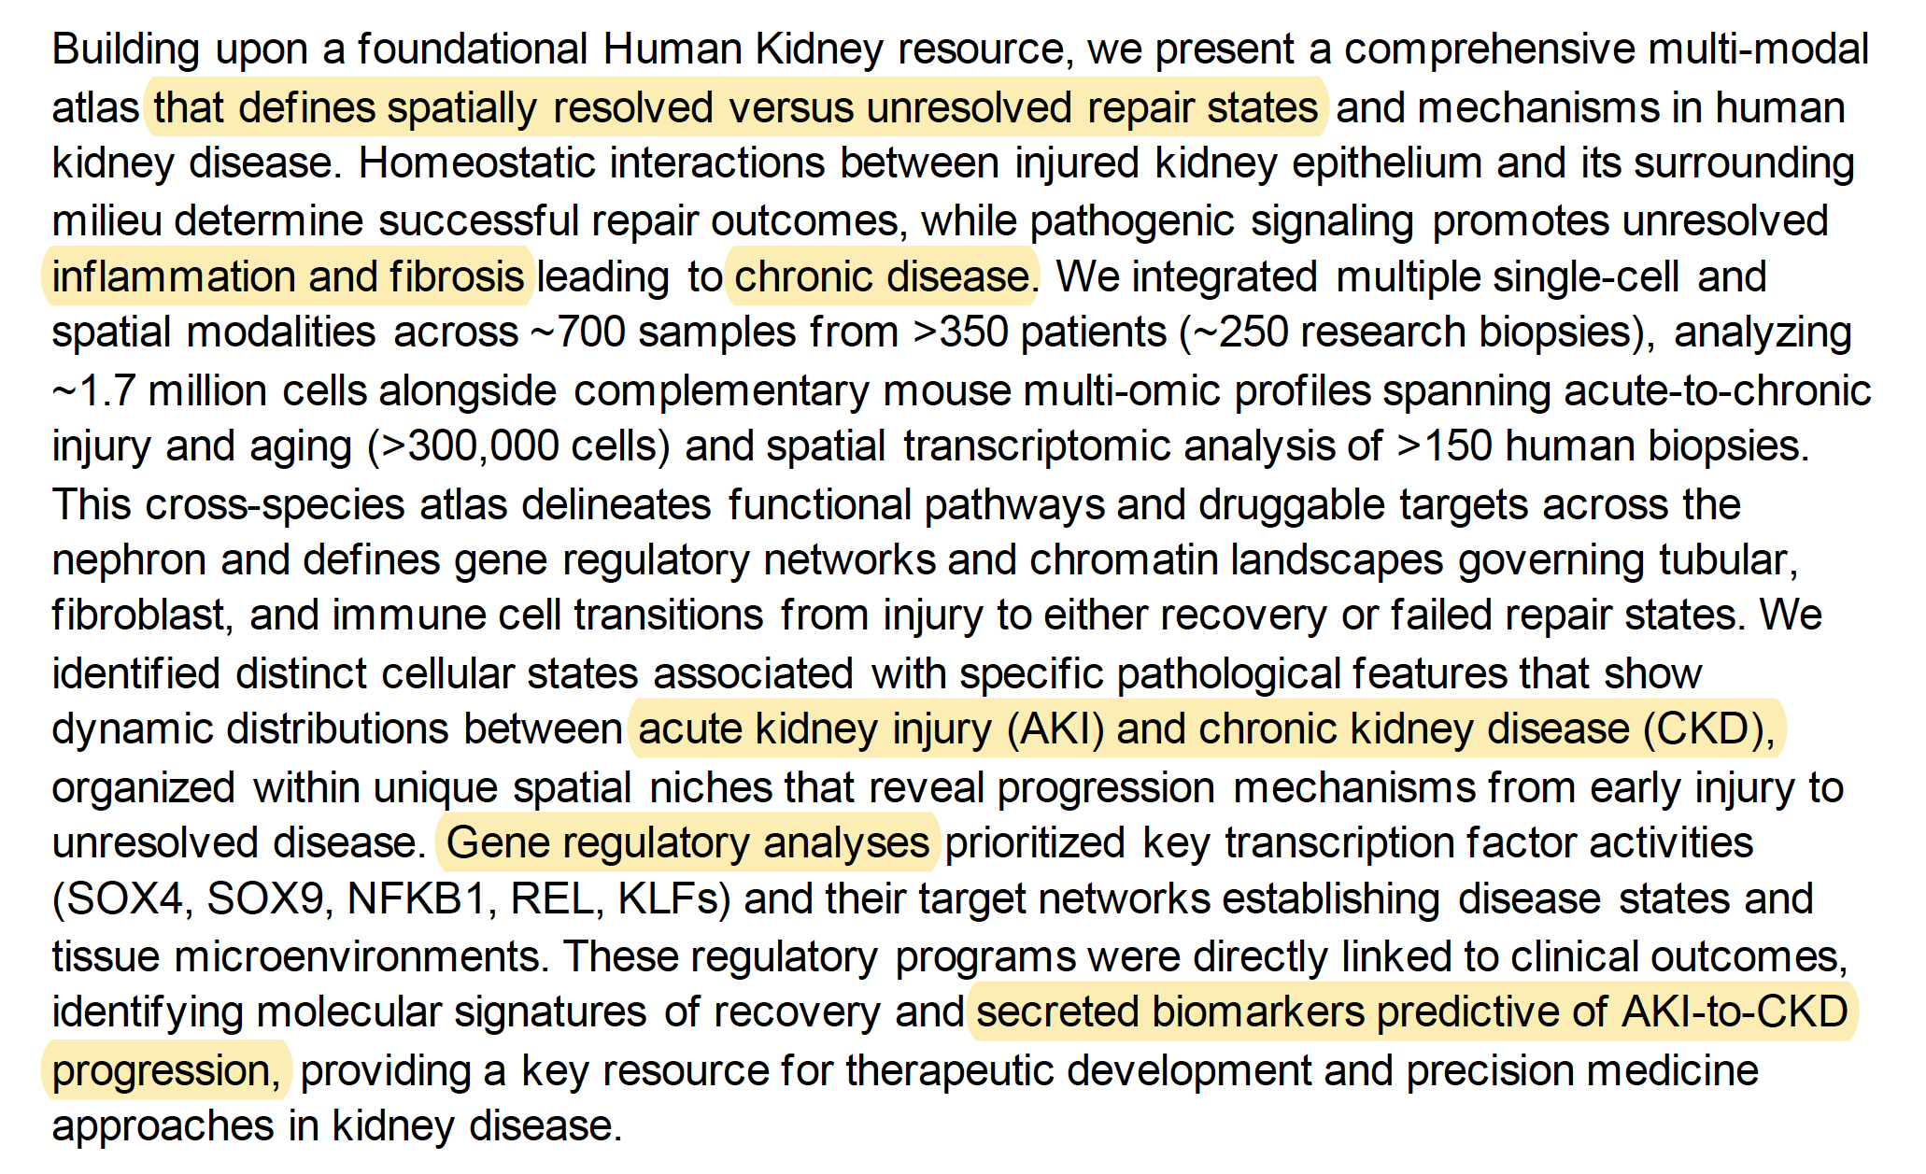
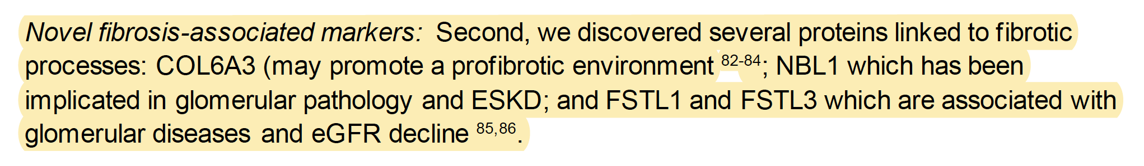

Slide 27
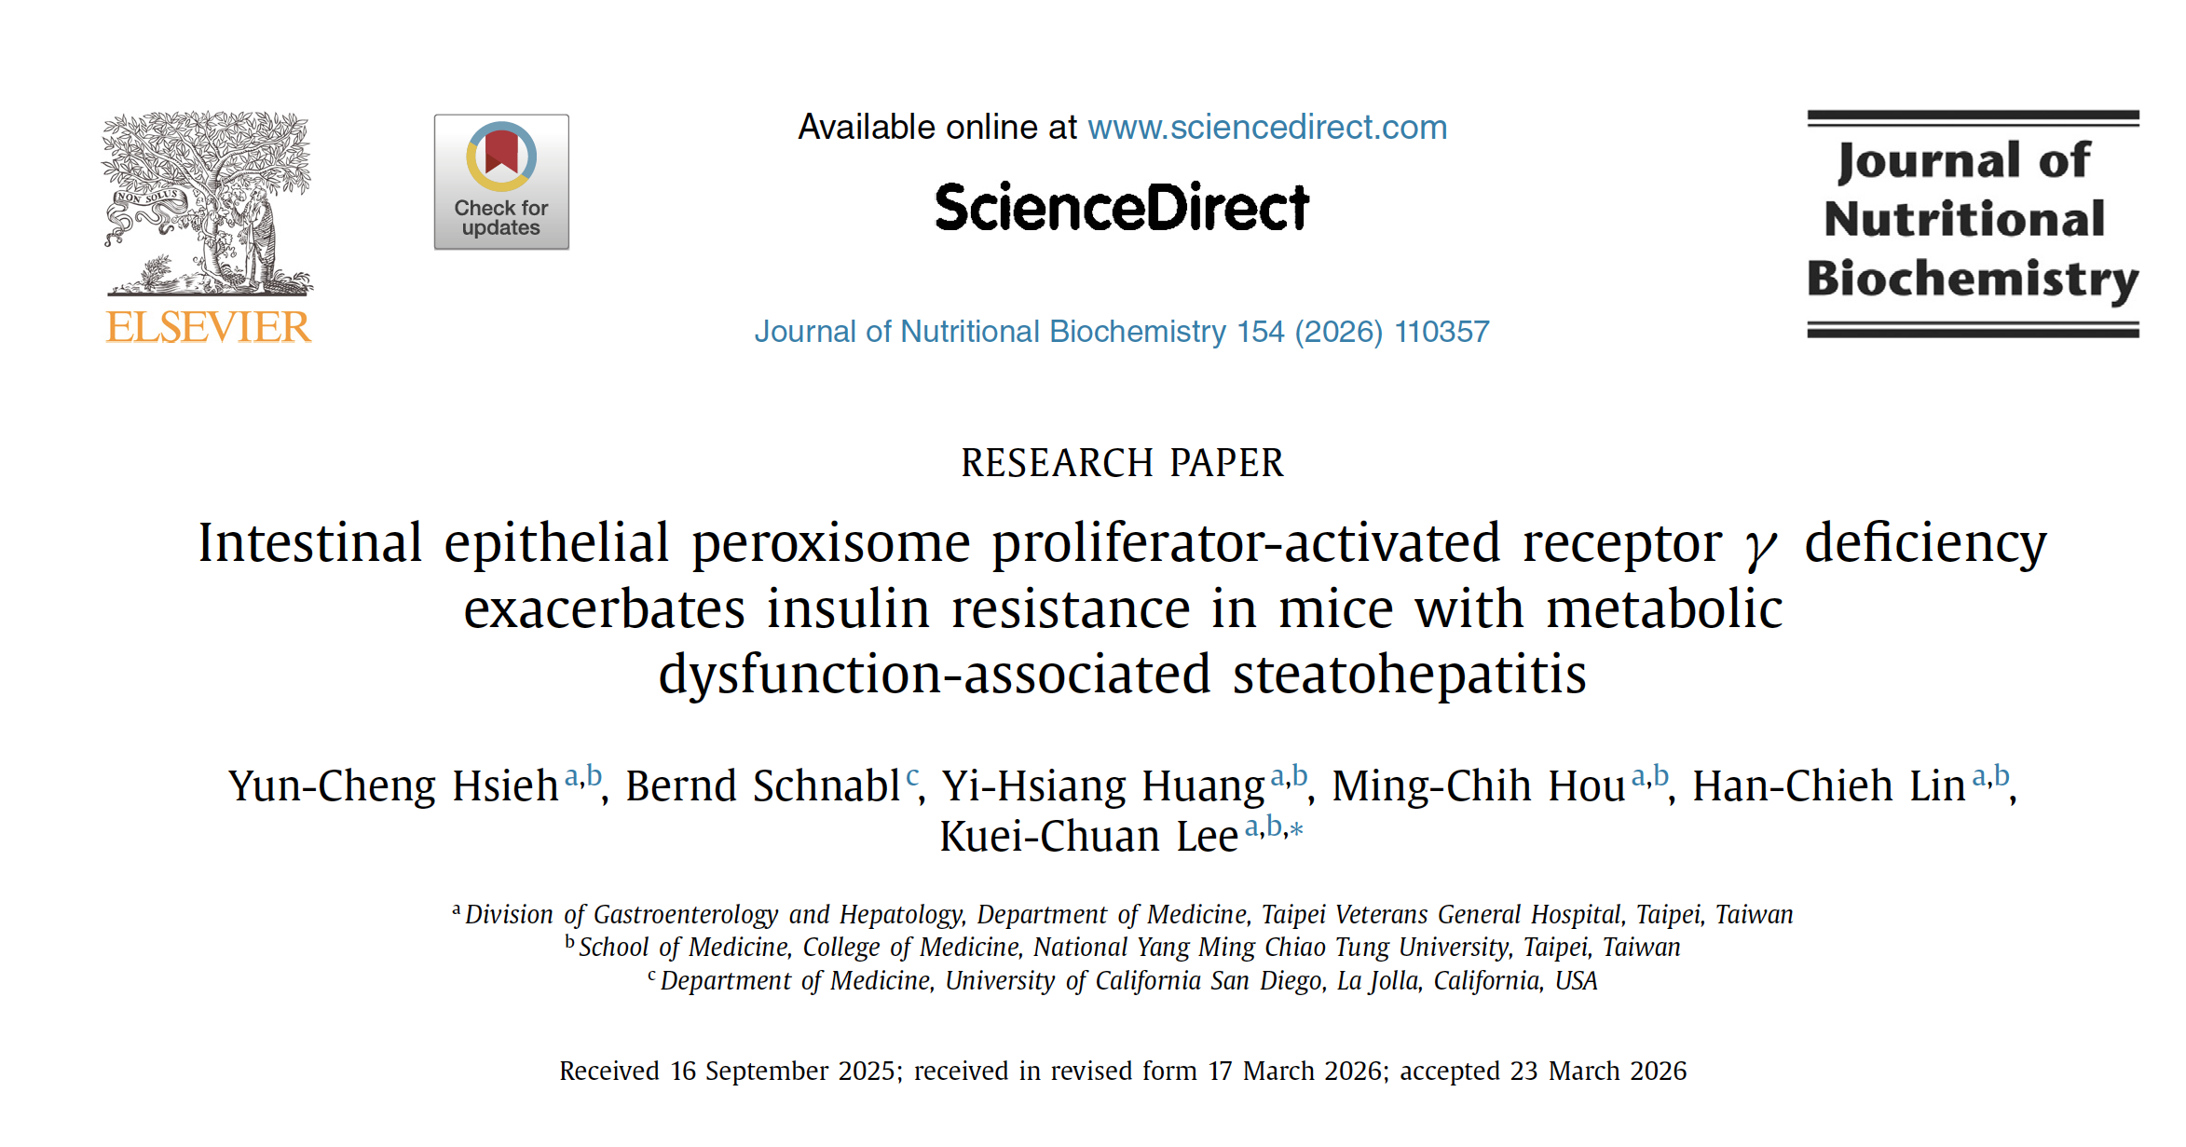

Slide 28
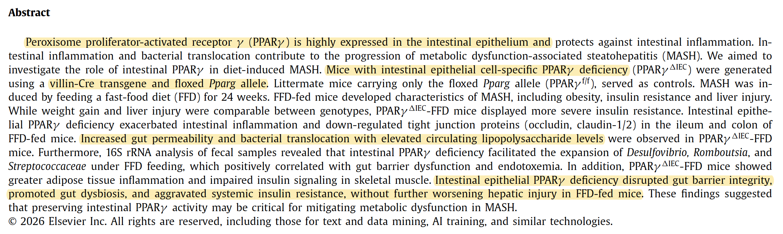

Slide 29
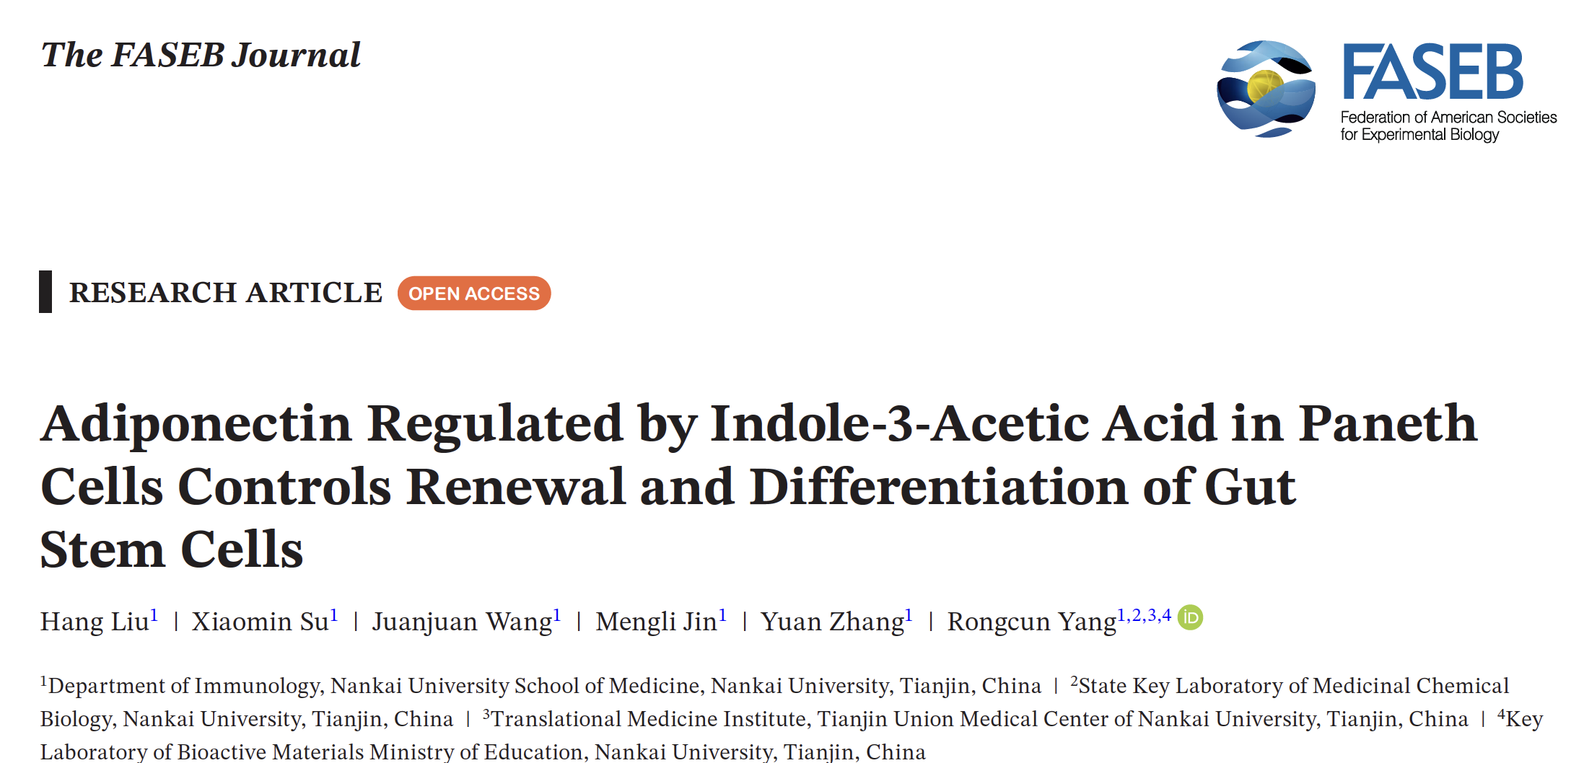
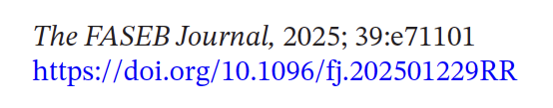

Slide 30
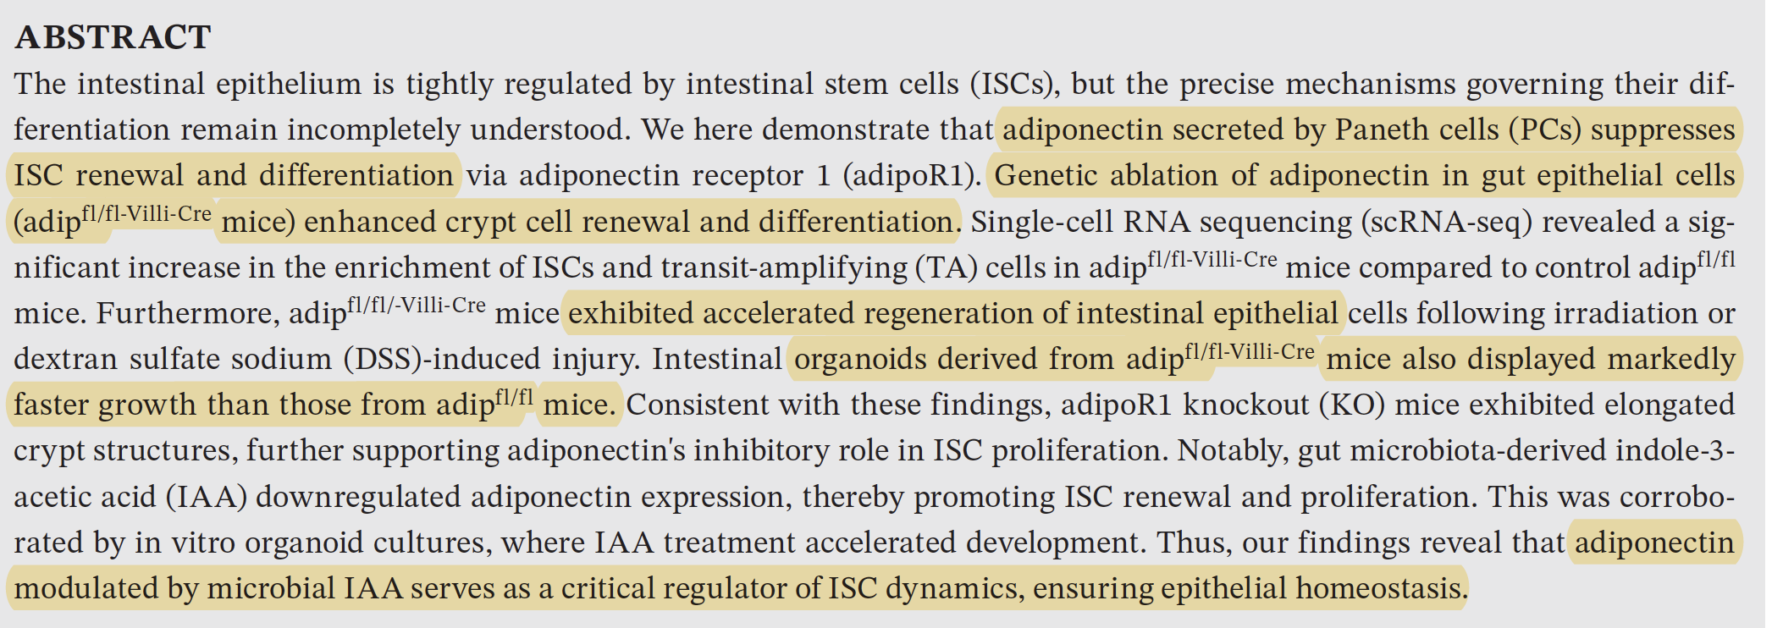
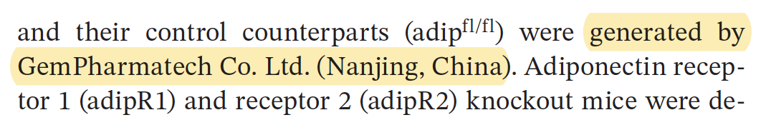

Slide 31
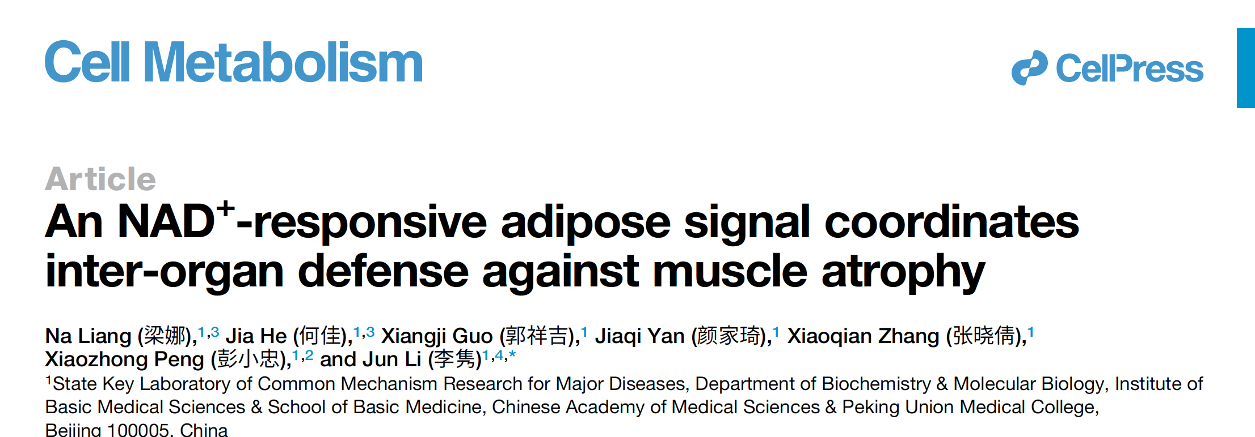

Slide 32


Slide 33



Slide 34


Slide 35

Infliximab is a monoclonal anti-TNFalpha antibody…..

Slide 36


Slide 37


Slide 38



Slide 39


Slide 40


Slide 41


Slide 42


Slide 43




Slide 44





Slide 45




Slide 46


Slide 47


Slide 48


Slide 49



Slide 50


Slide 51



Slide 52



Slide 53

Carnosine is a small dipeptide composed of β-alanine and L-histidine, abundant in skeletal muscle
and certain brain regions. It helps buffer intracellular pH and can protect against oxidative stress and
reactive carbonyl compounds. It is synthesized by carnosine synthase, CARNS1, using ATP.

Slide 54


Slide 55


Slide 56



Slide 57




Slide 58


Slide 59



