Slide 1
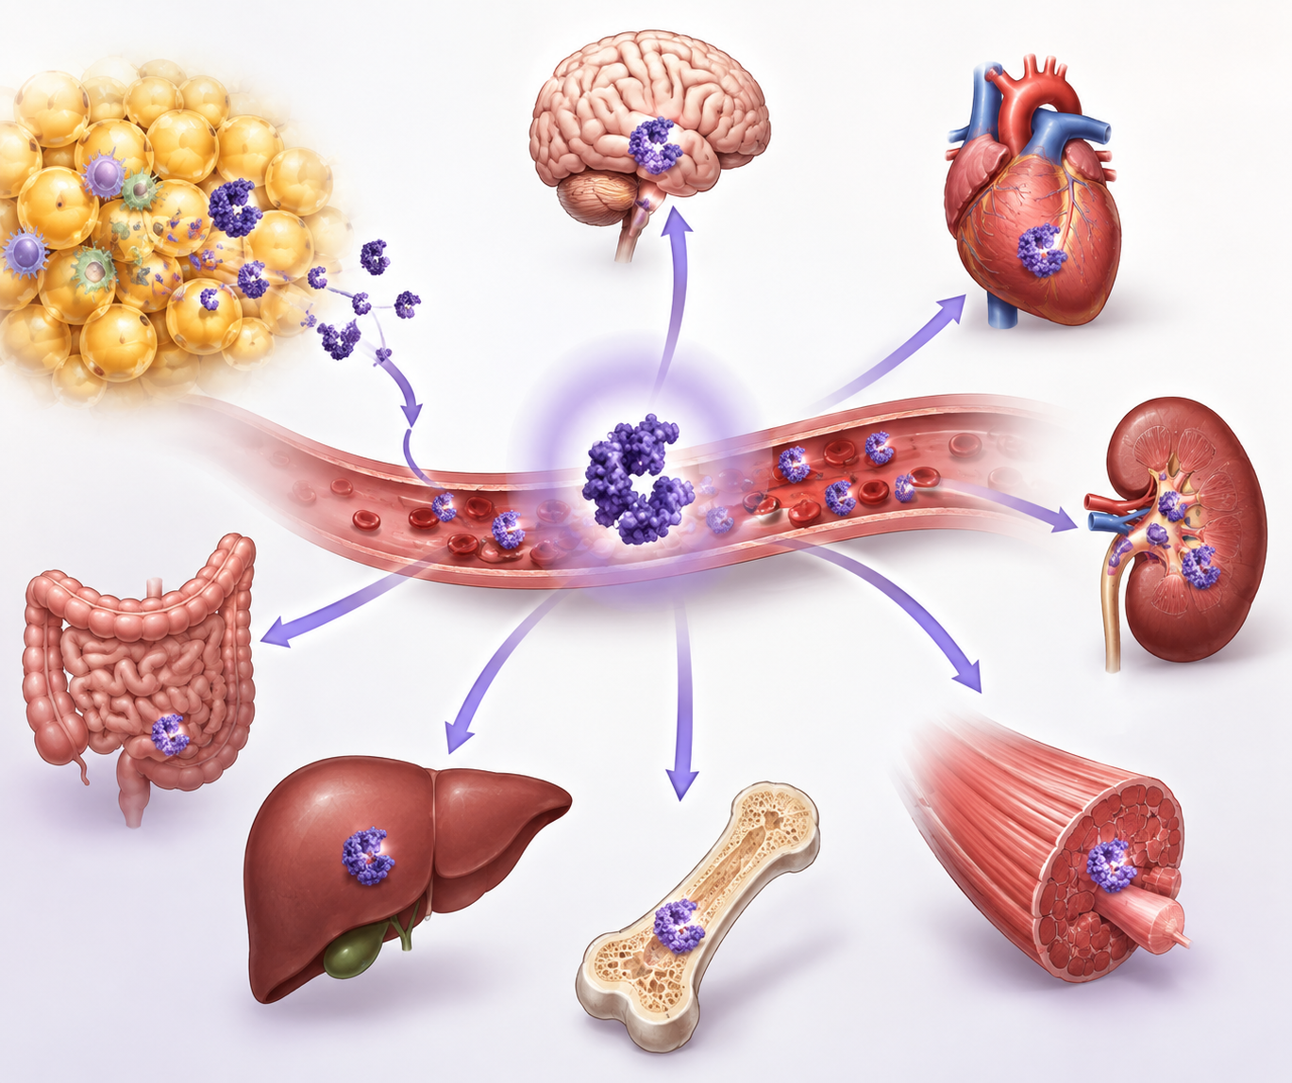
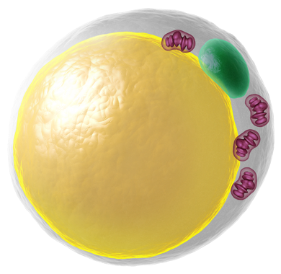
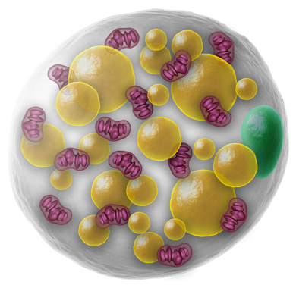
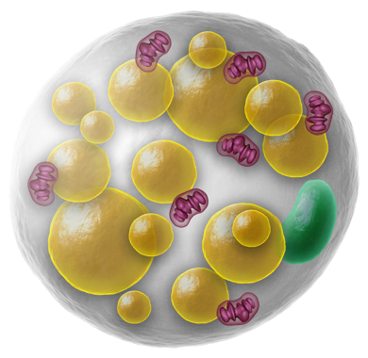
Literature Overview
Touchstone Diabetes Center
UTSW Medical Center 10/26/2026

Slide 2
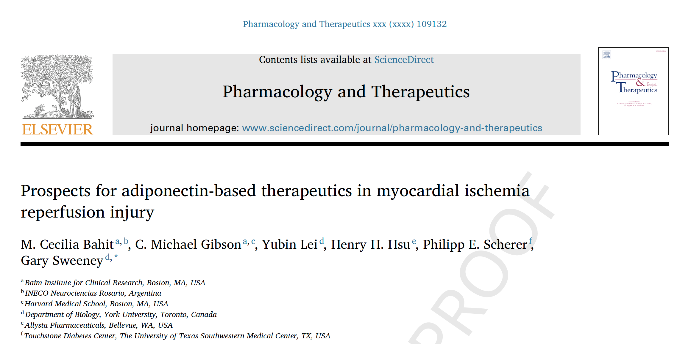

Slide 3
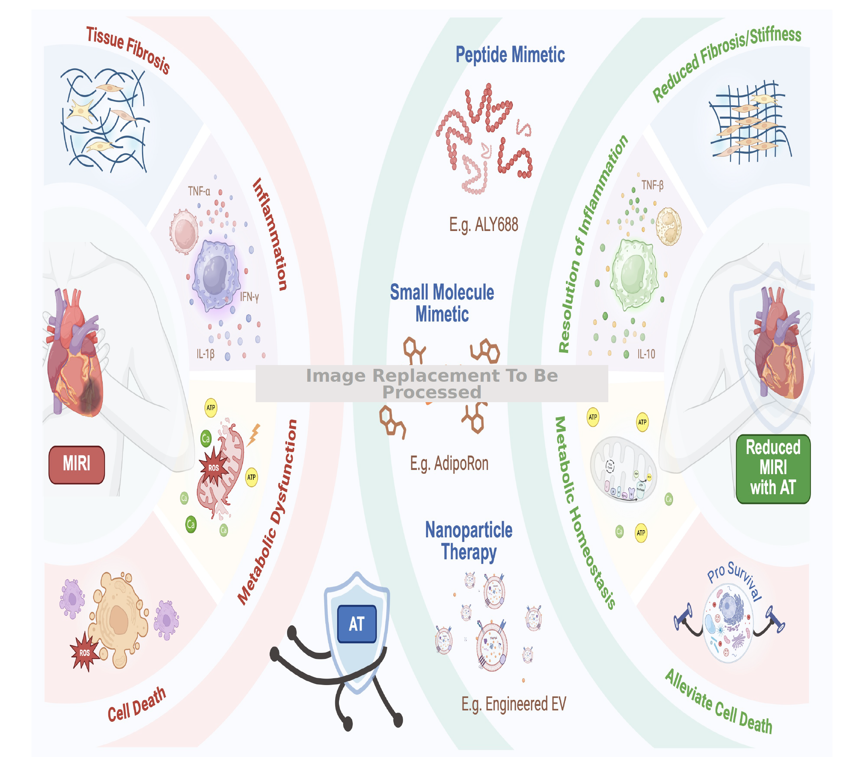

Slide 4
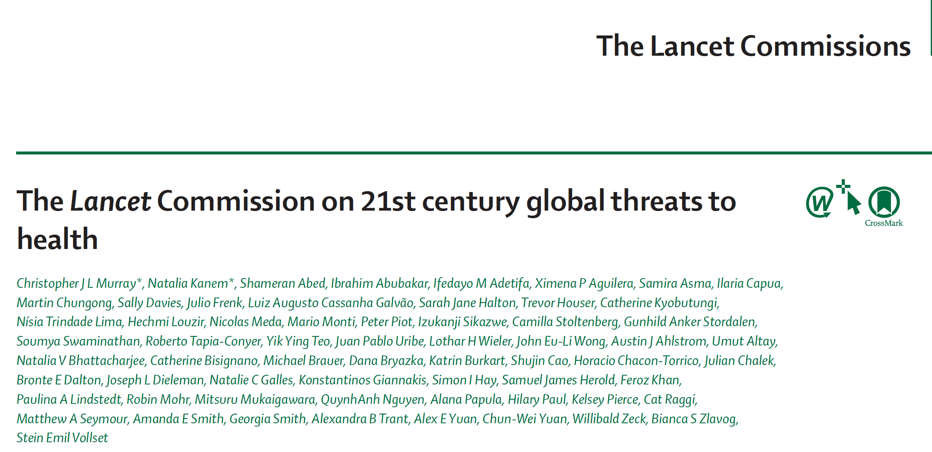


Slide 5
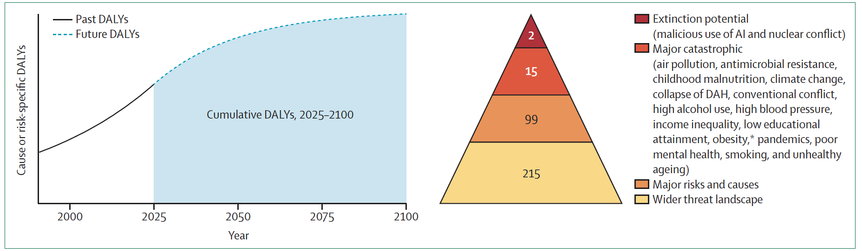

Slide 6
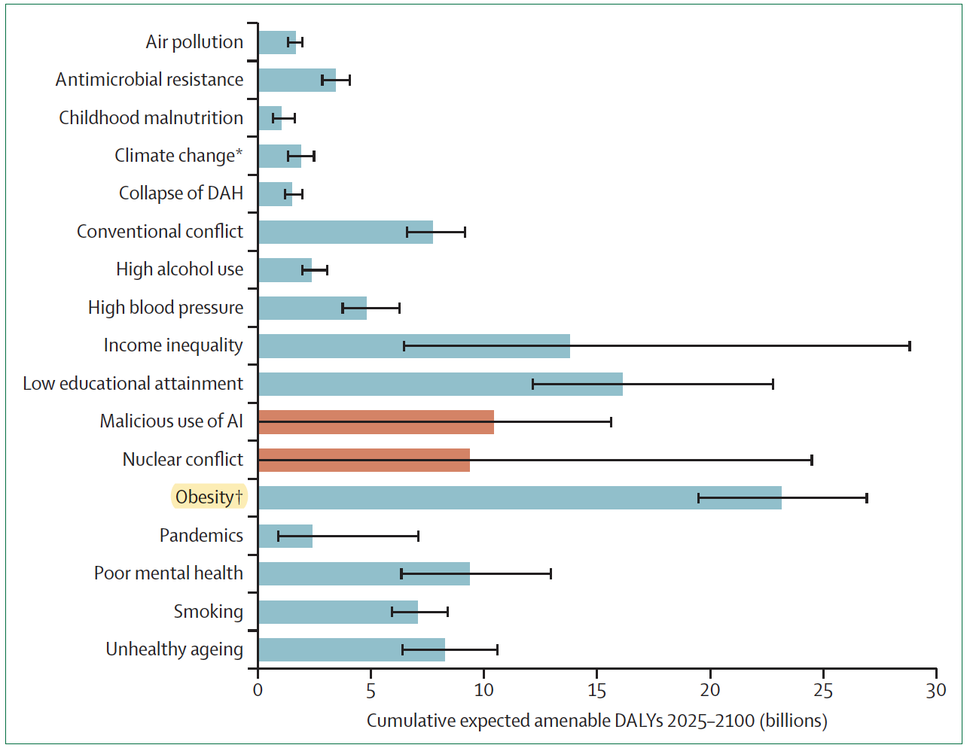

Slide 7

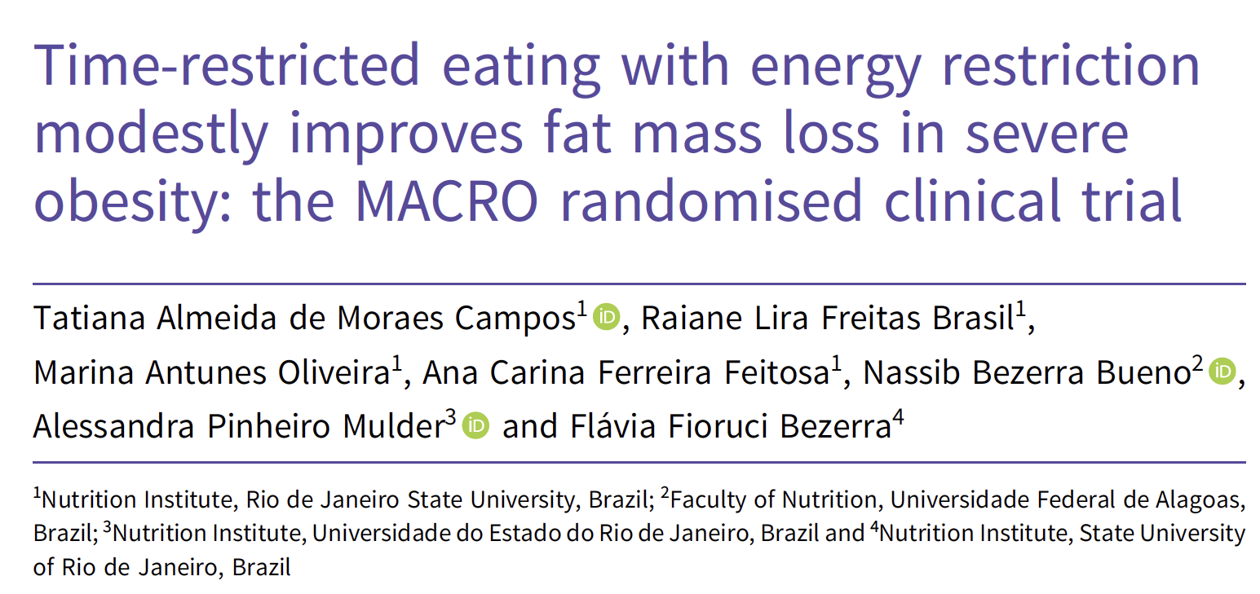
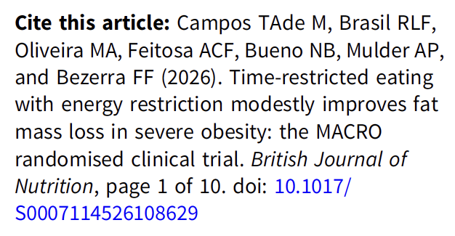

Slide 8
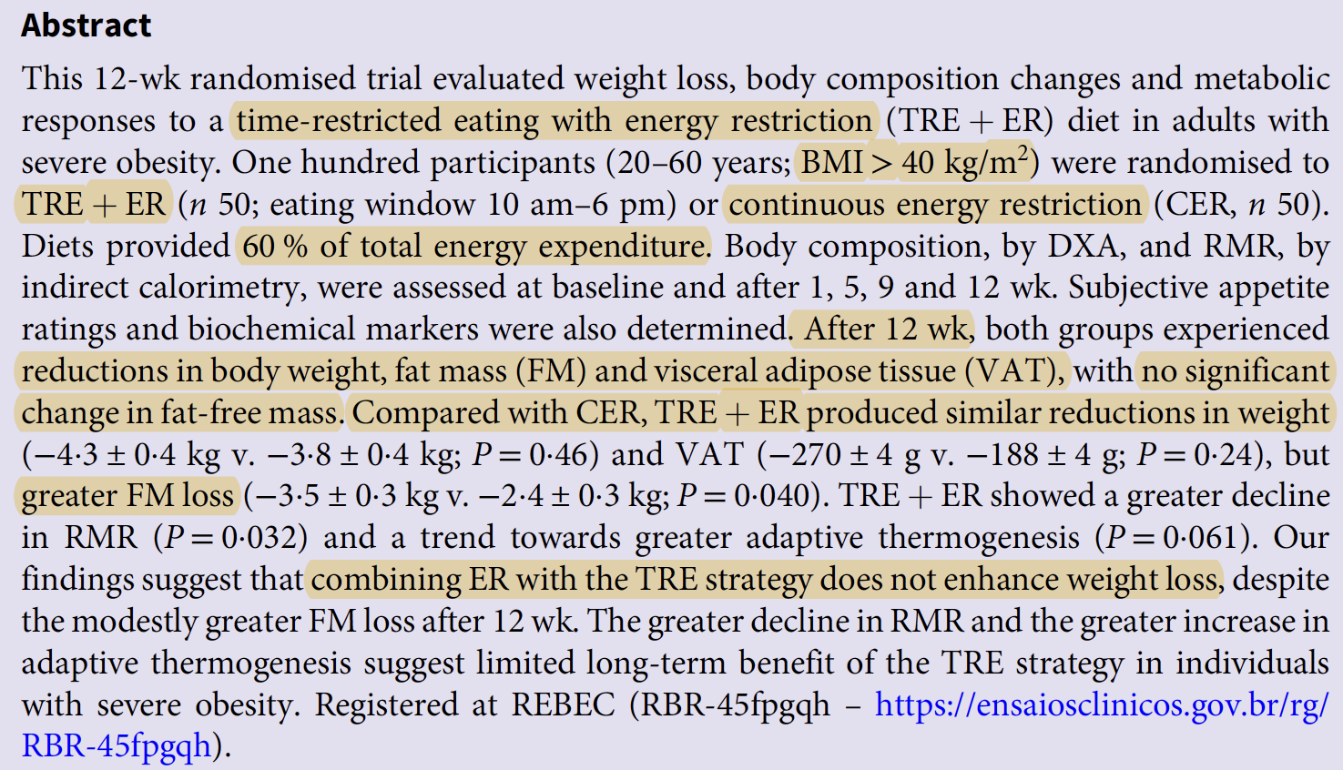

Slide 9
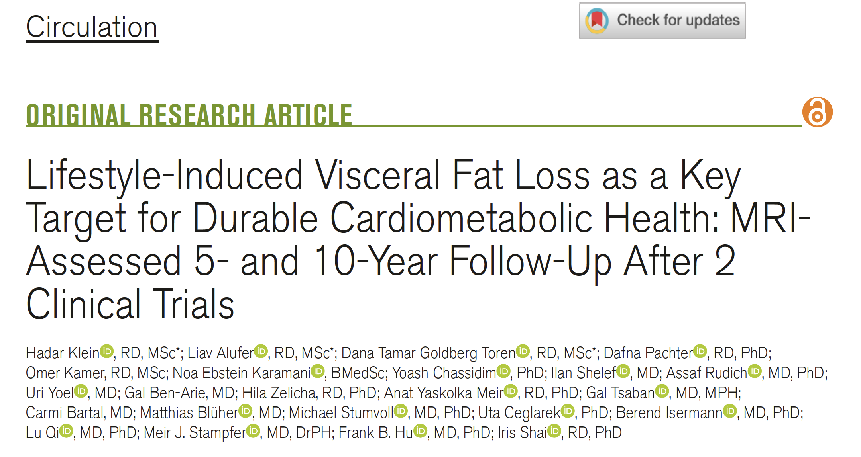

Slide 10
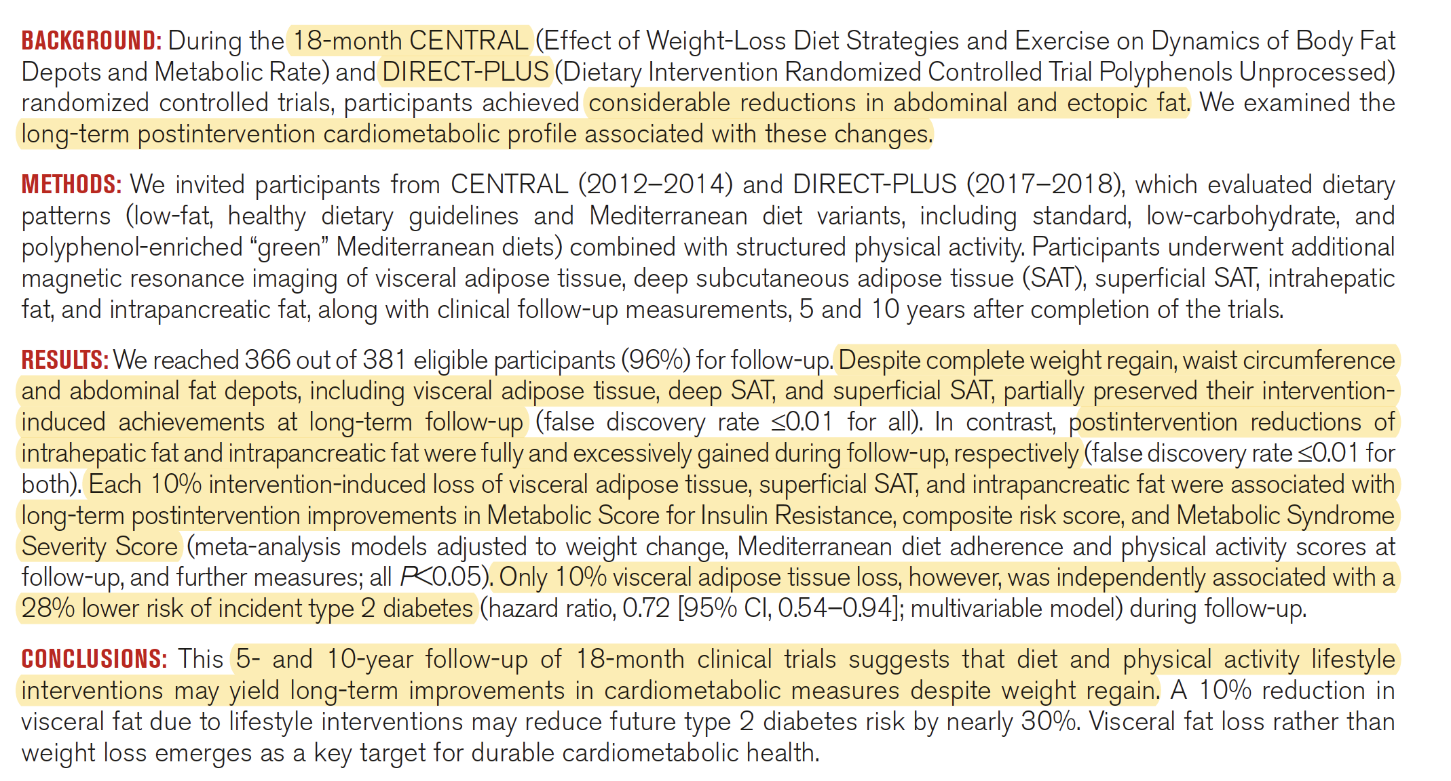

Slide 11

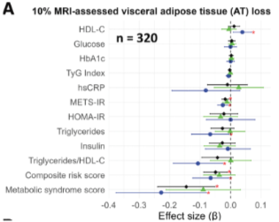
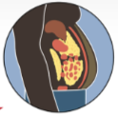
Visceral Adipose Tissue (VAT) Loss Predicts Durable Cardiometabolic Benefits and Reduced Diabetes Risk
Each 10% VAT loss was associated with improvements in cardiometabolic risk indices, and
corresponded to a 28% lower risk of developing type 2 diabetes
KEY RESULTS
9.9% lower TG/HDL-C ratio
10%
=
2.3% lower insulin
resistance (METS-IR)
28% lower diabetes risk
Visceral adipose
tissue
10% visceral adipose tissue loss was independently associated with
improved cardiometabolic measures during follow-up
Klein H et al. Circulation 2026
Notes:
Redrawn from the supplied screenshot. Numerical findings and original forest plot preserved. The forest plot and anatomical illustration remain image elements because source data were not supplied. Source shown in supplied slide: Klein H et al. Circulation 2026.
Formatting: Arial, gold #FFC000 text, exact photographic background from Sample Presentation2.pptx (libfile_53a7fddce0048191a1dc5e36b5ffe4f3). Use this as Philipp Scherer’s default presentation format going forward. Panel A label removed.

Slide 12
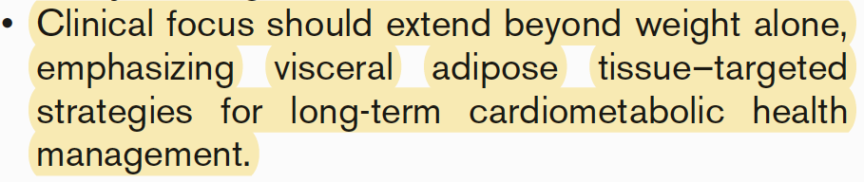

Slide 13
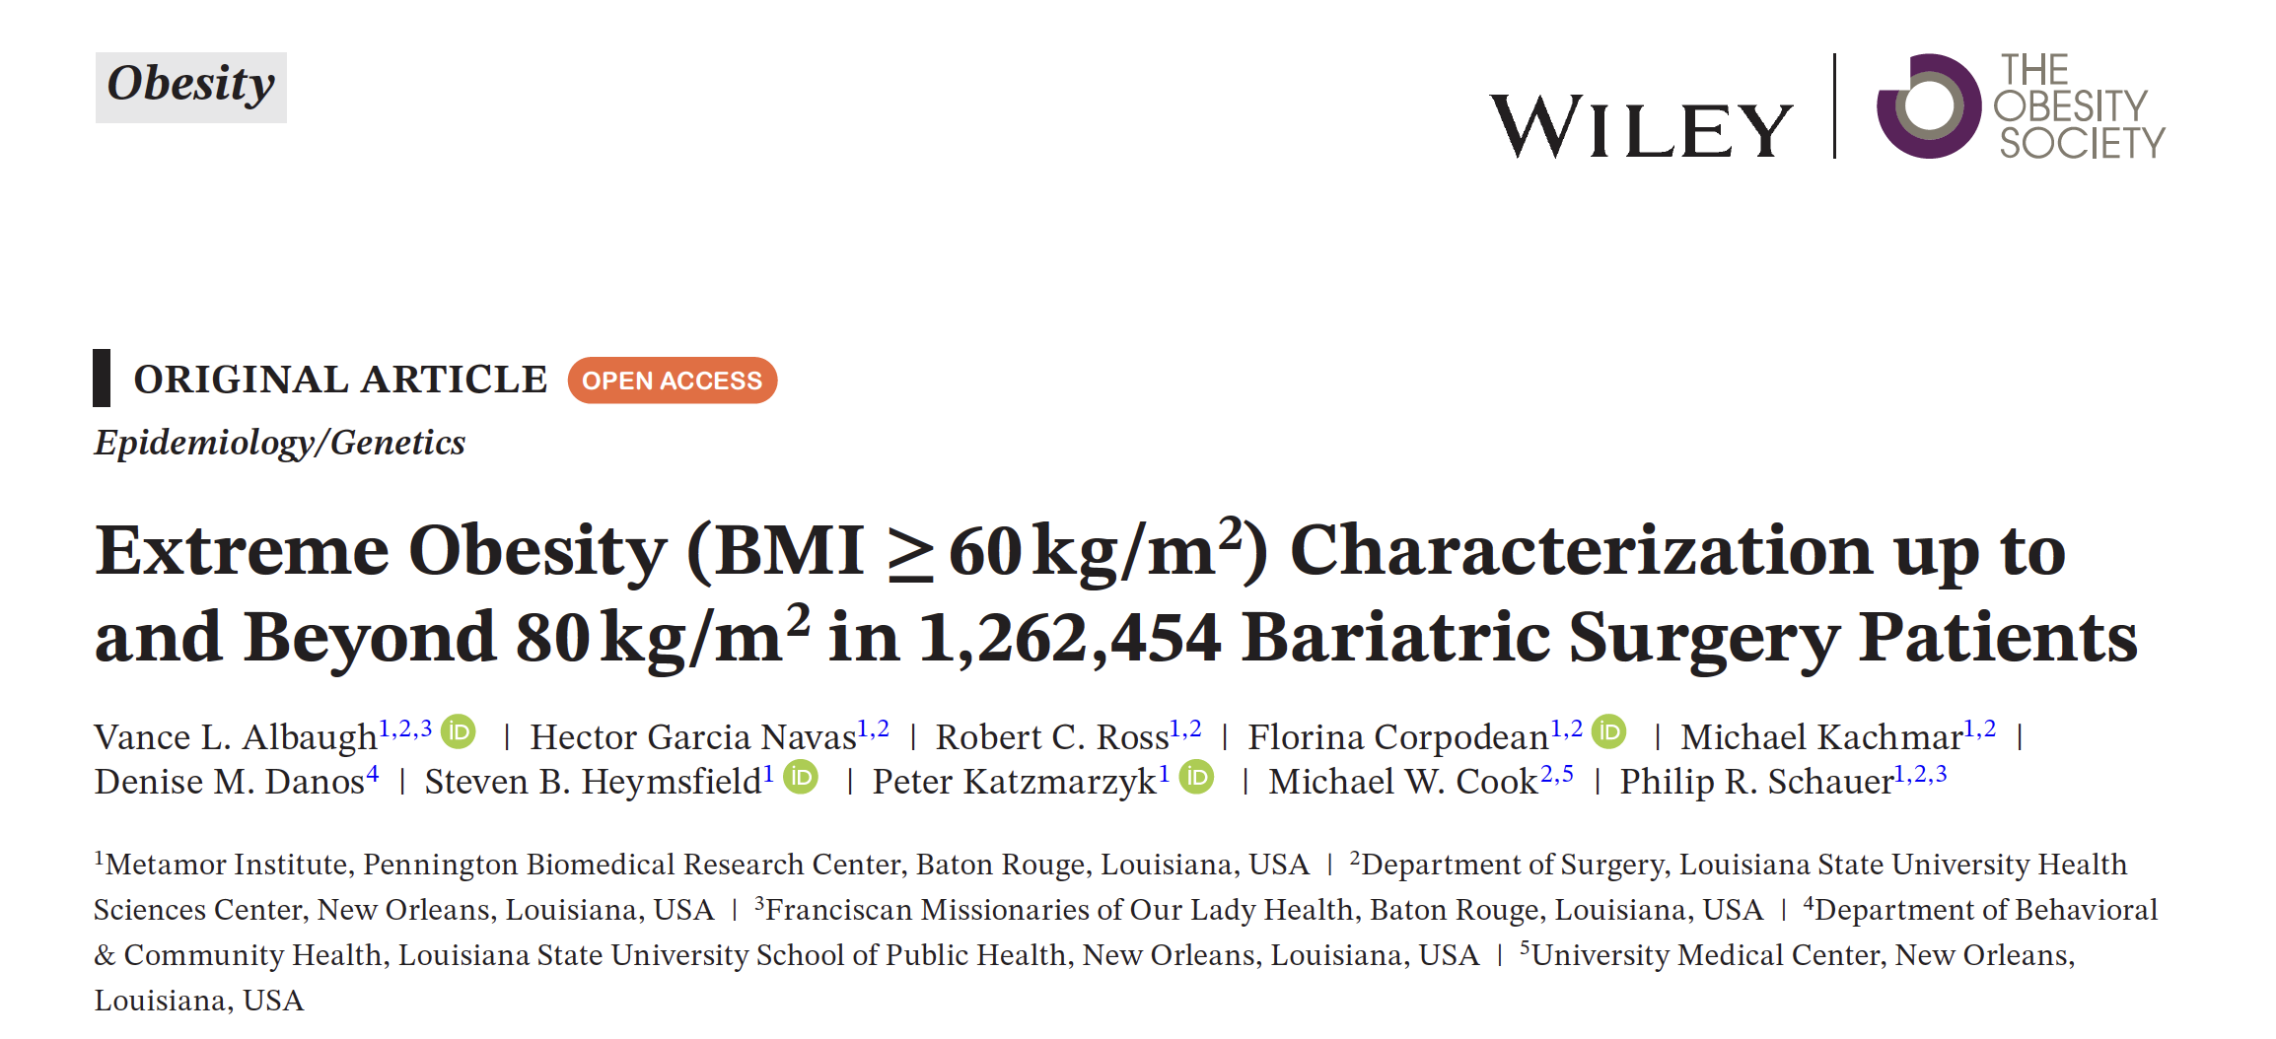
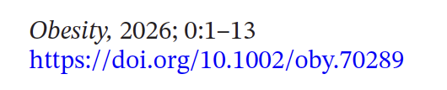

Slide 14
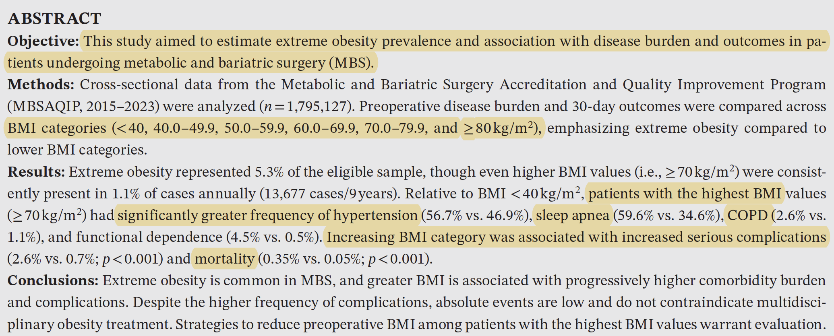

Slide 15
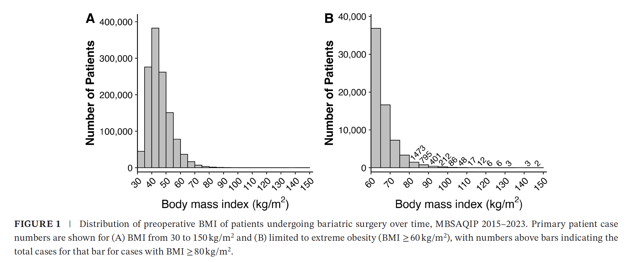

Slide 16
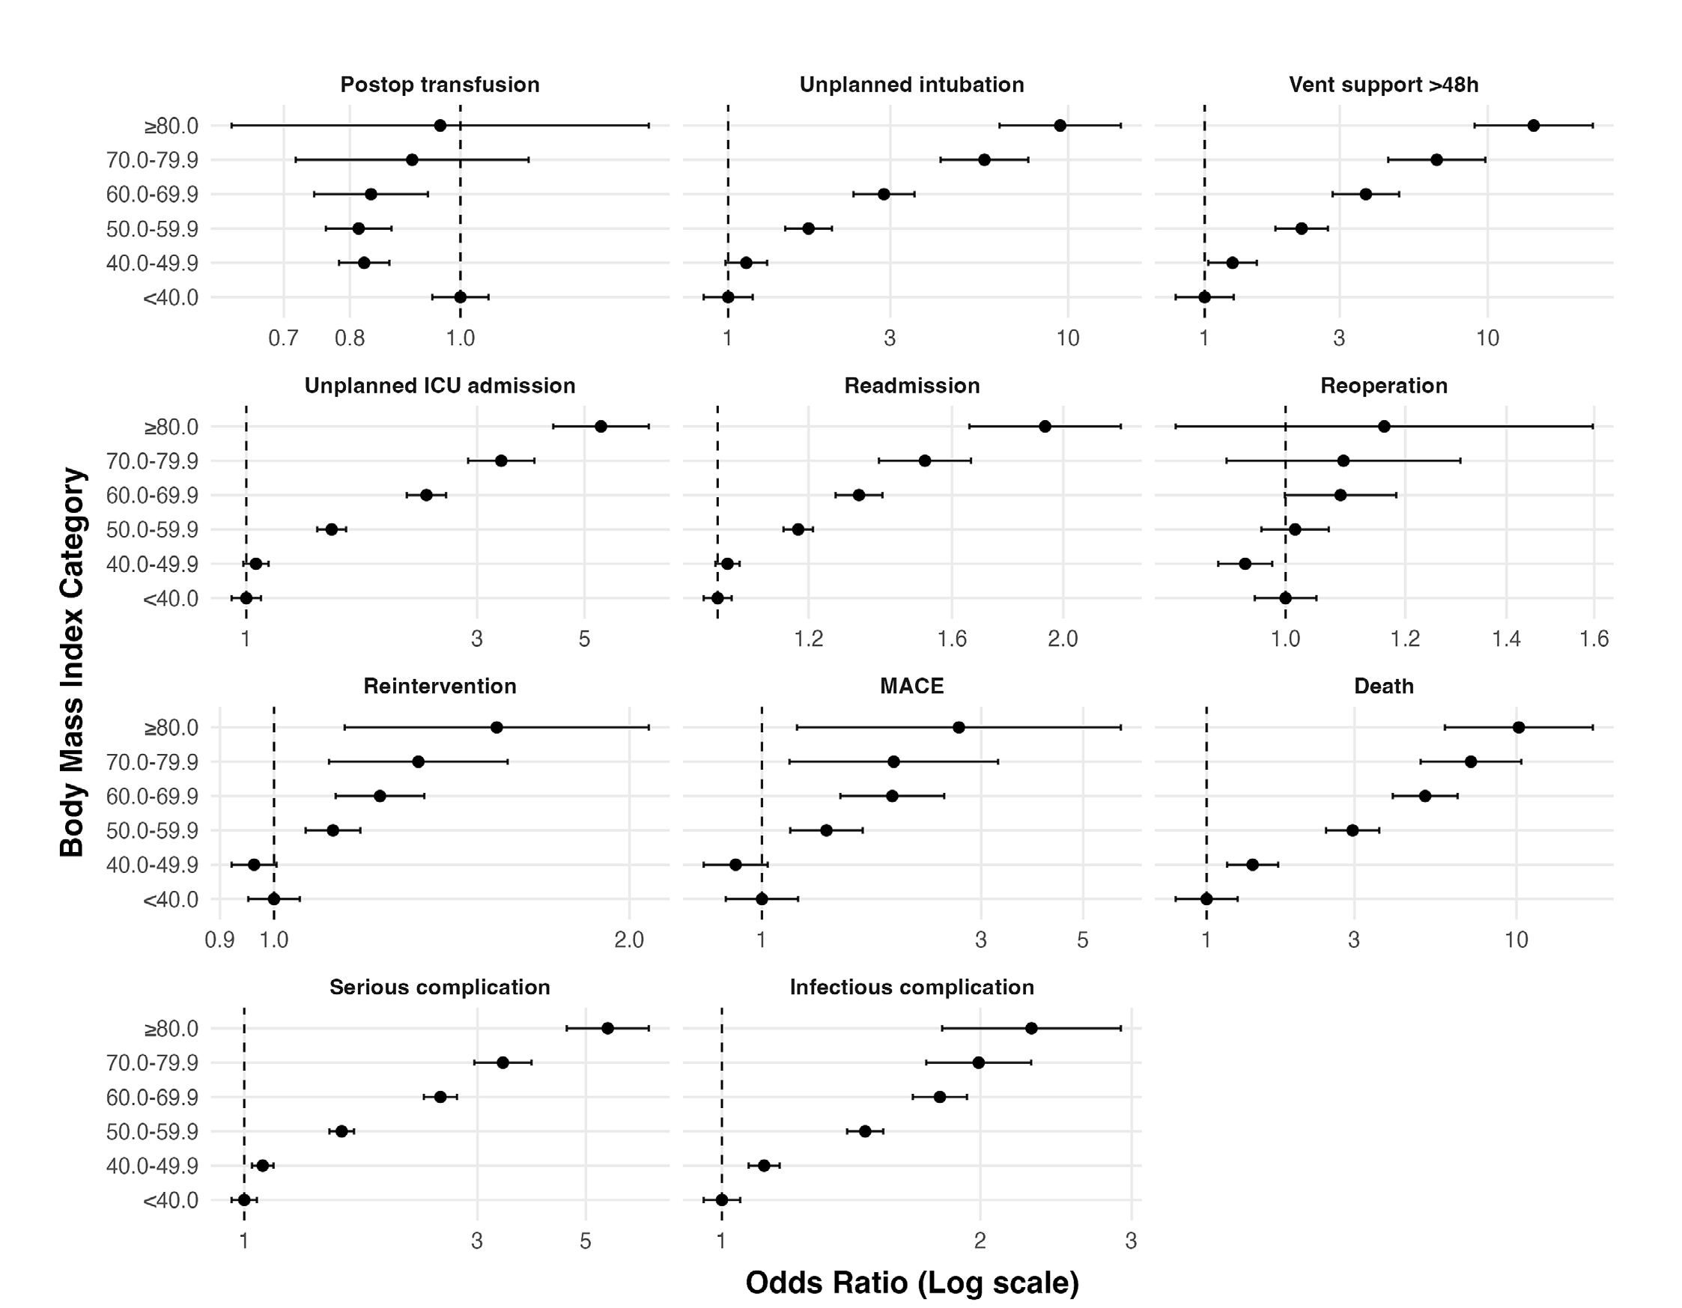

Slide 17
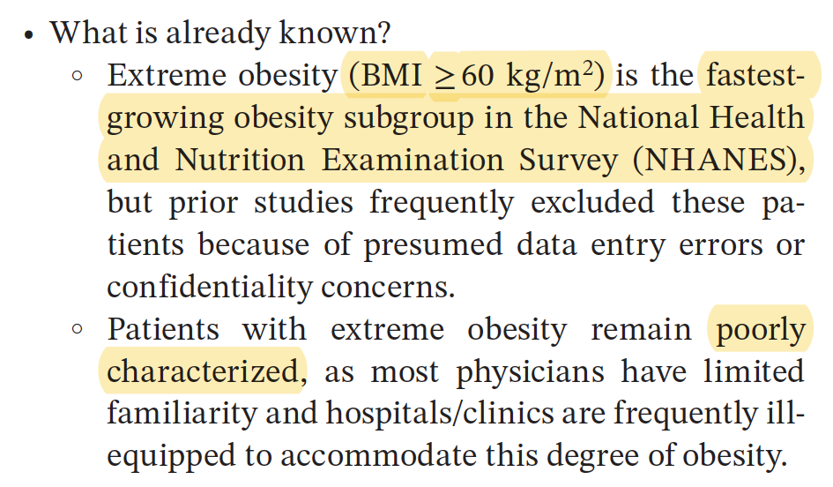

Slide 18
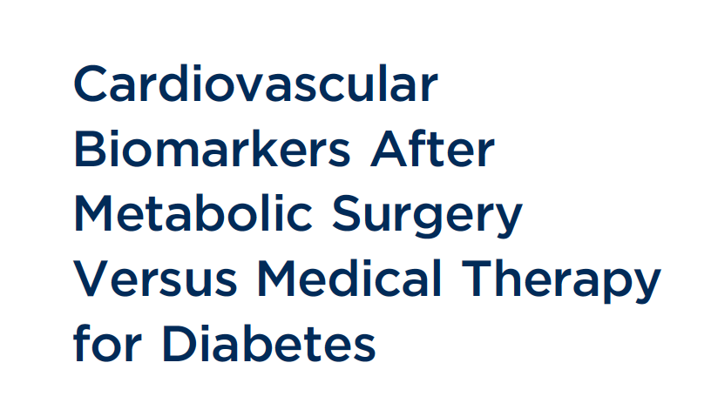
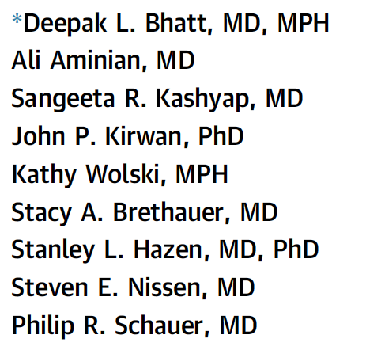
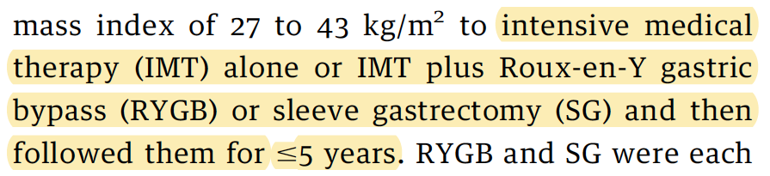
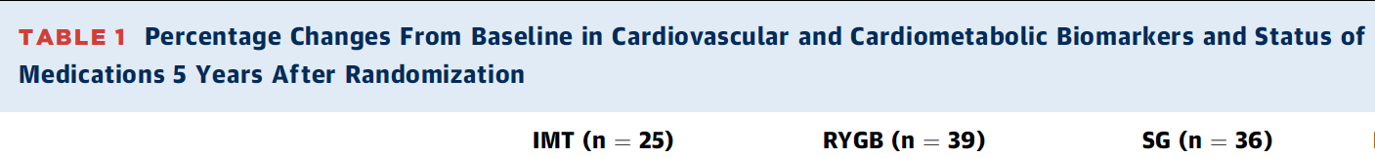
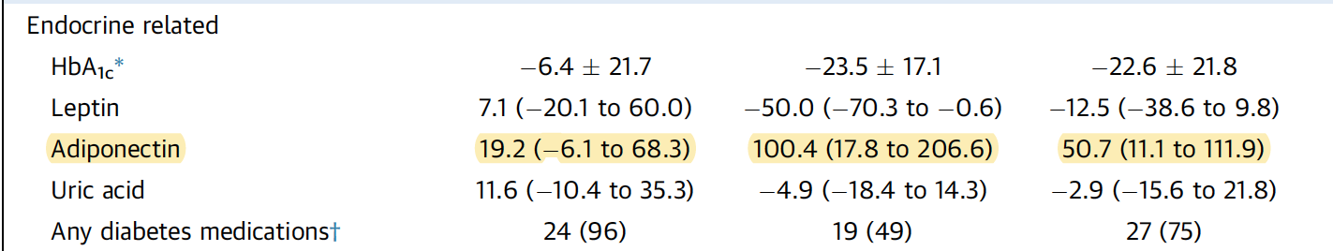

Slide 19
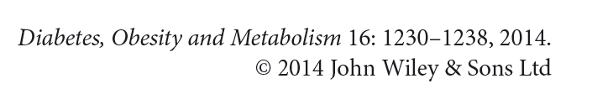
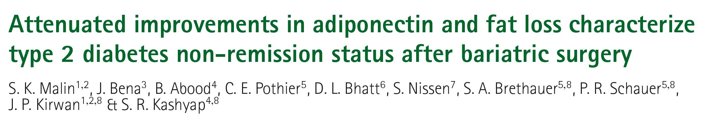
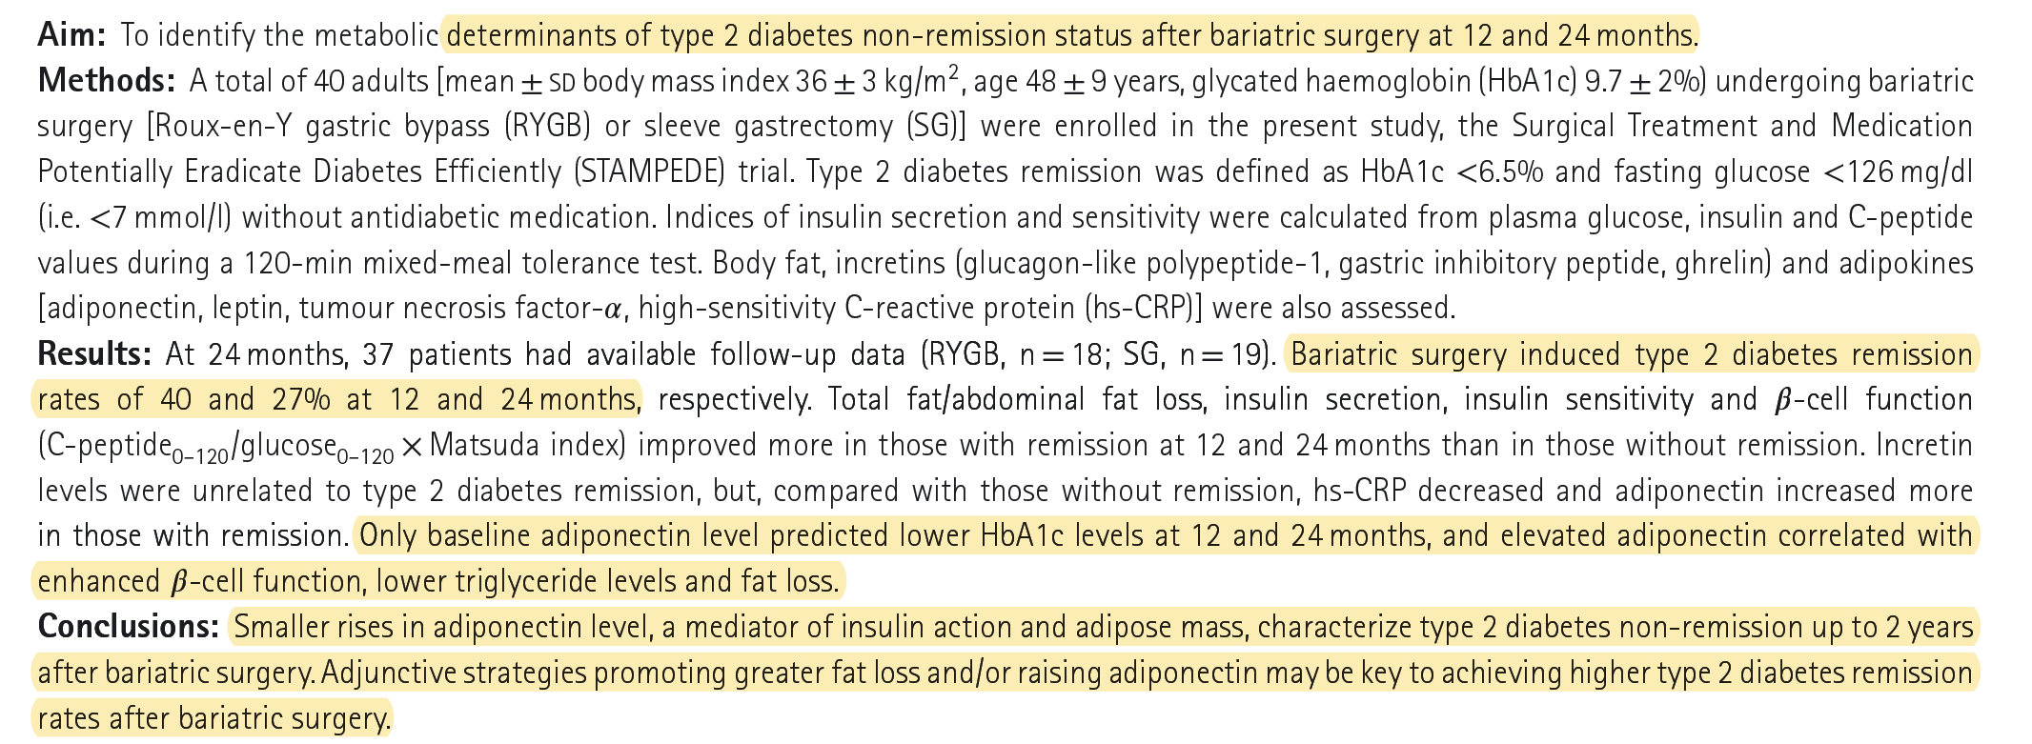

Slide 20

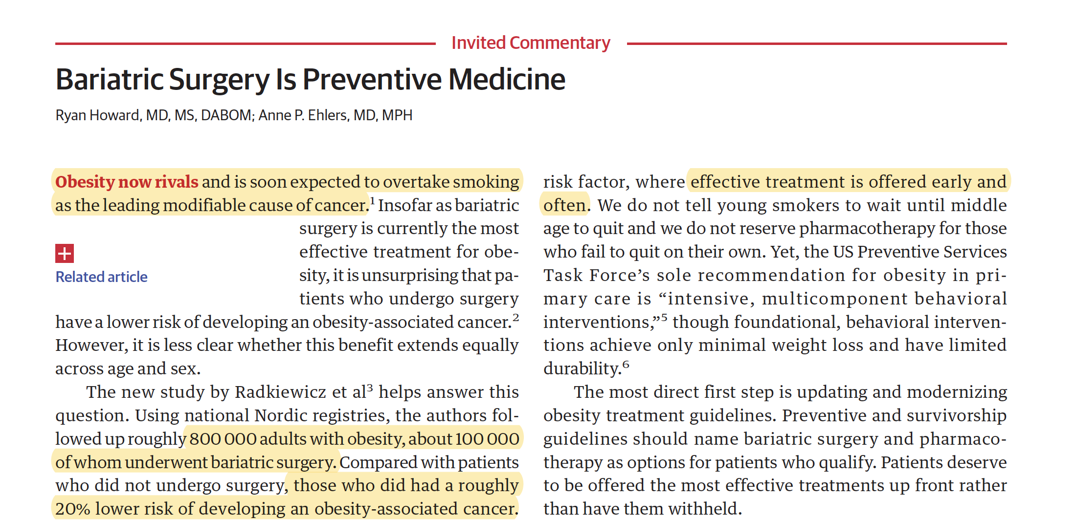

Slide 21
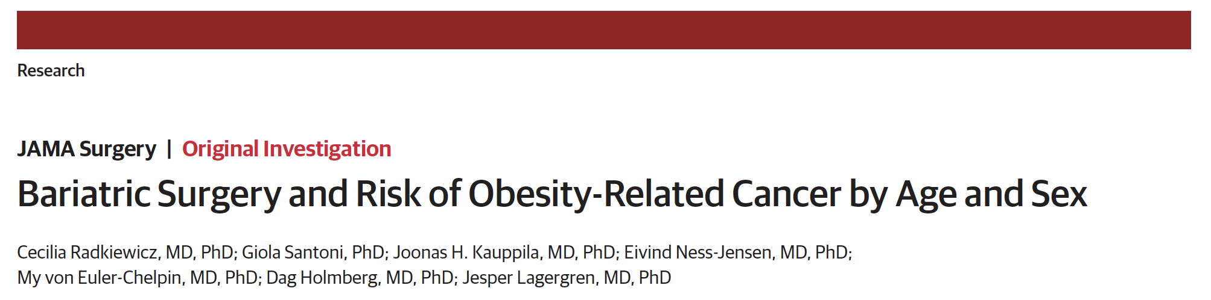

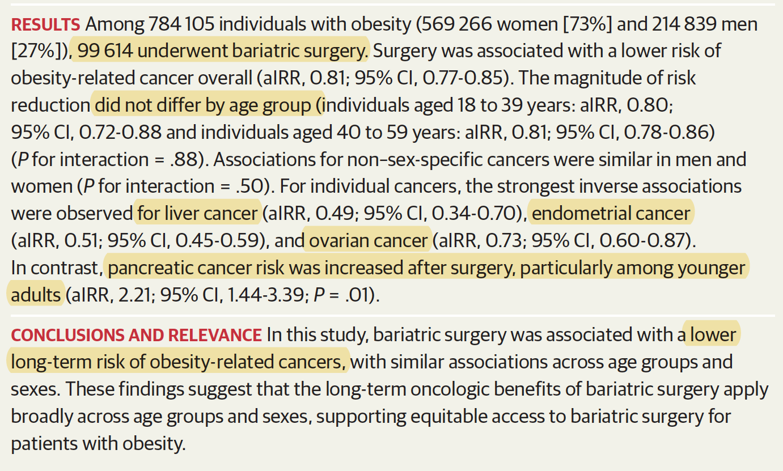

Slide 22
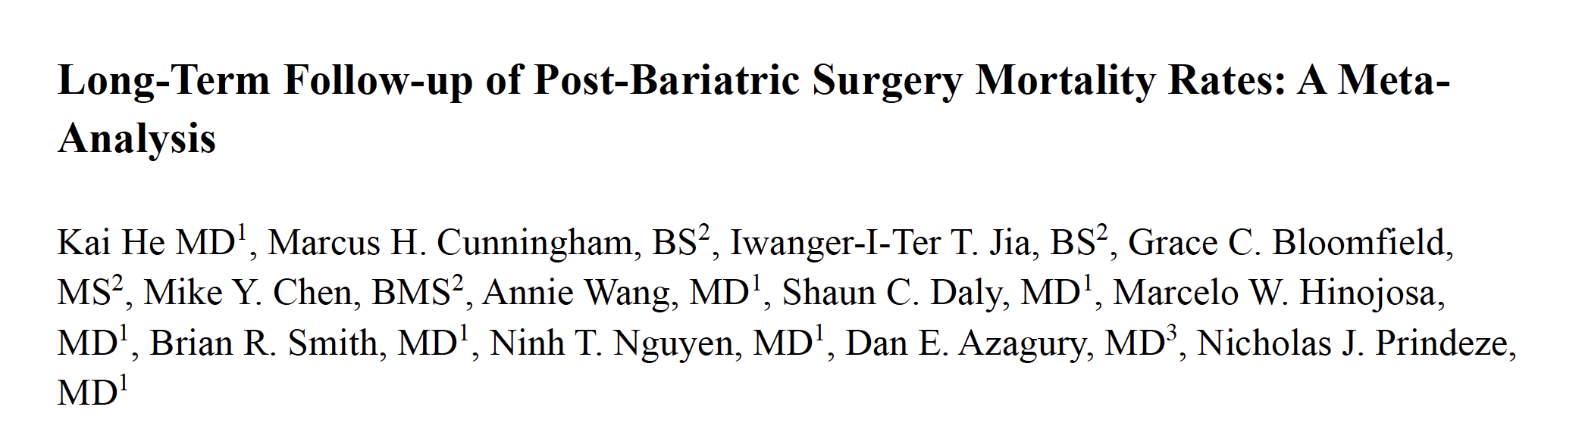
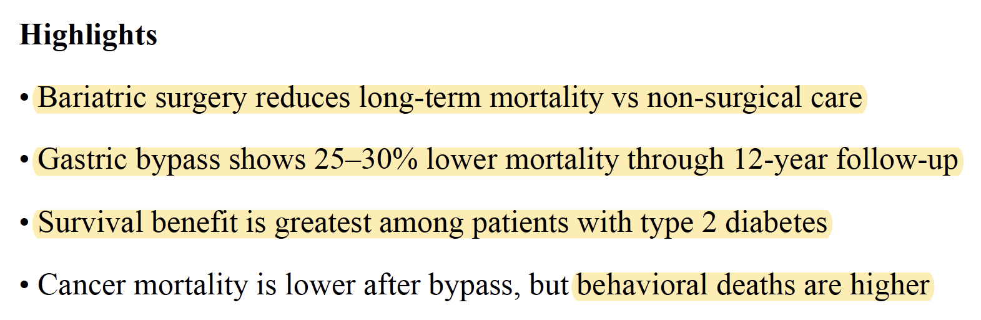
October 2026
Surgery for Obesity and Related Diseases
DOI:10.1016/j.soard.2026.10.009

Slide 23
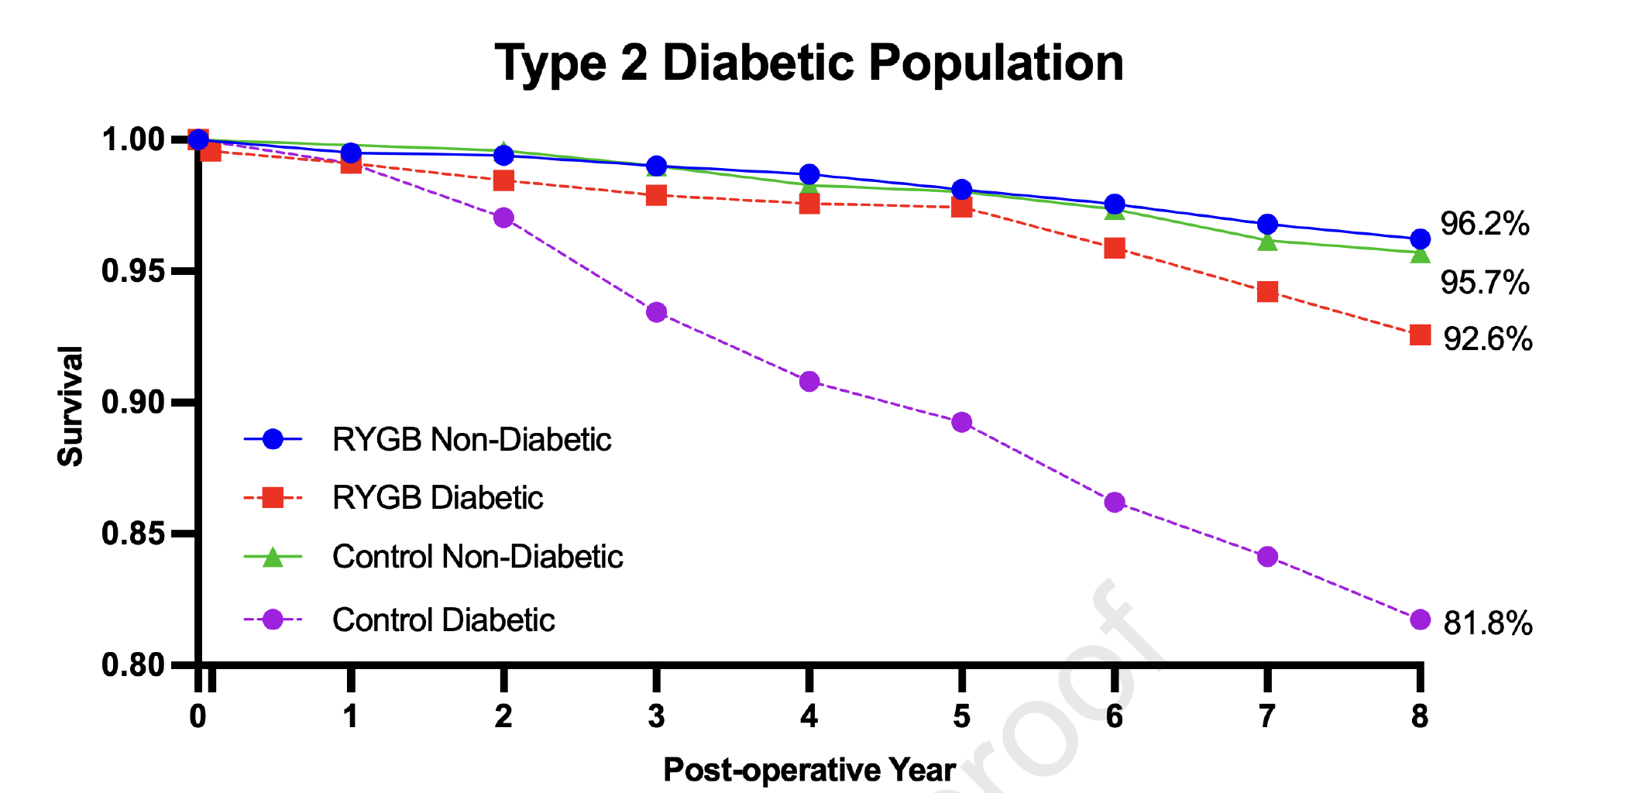

Slide 24

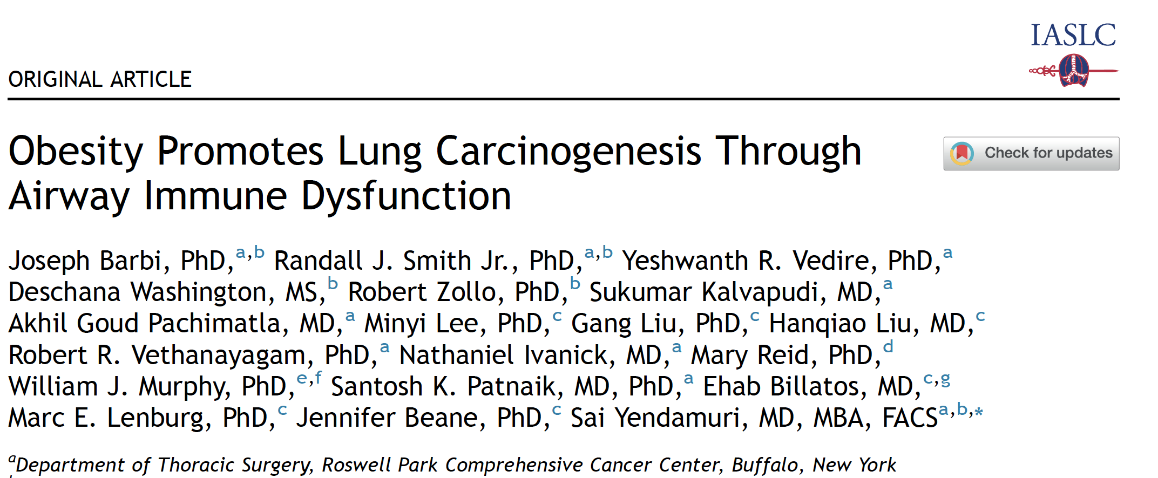

Slide 25
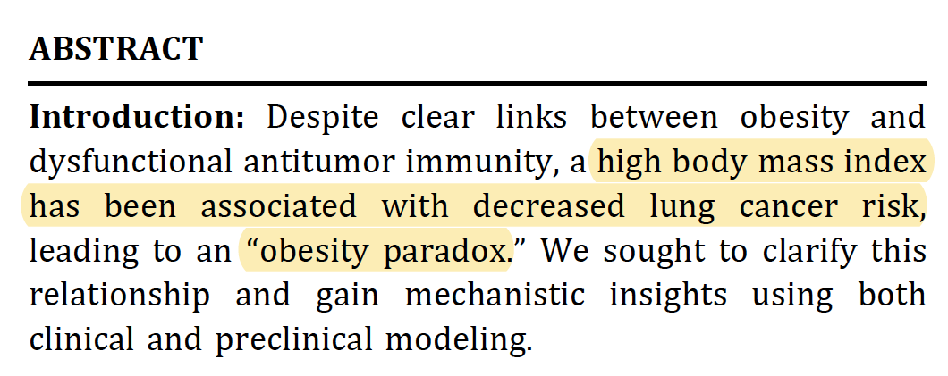

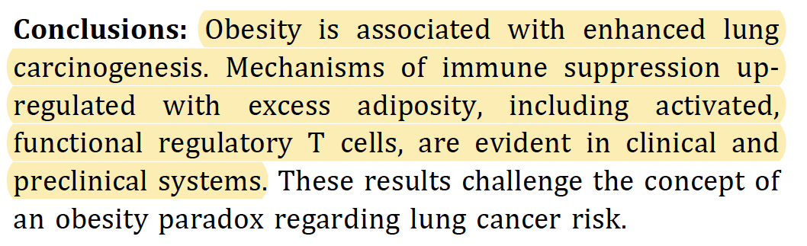

Slide 26
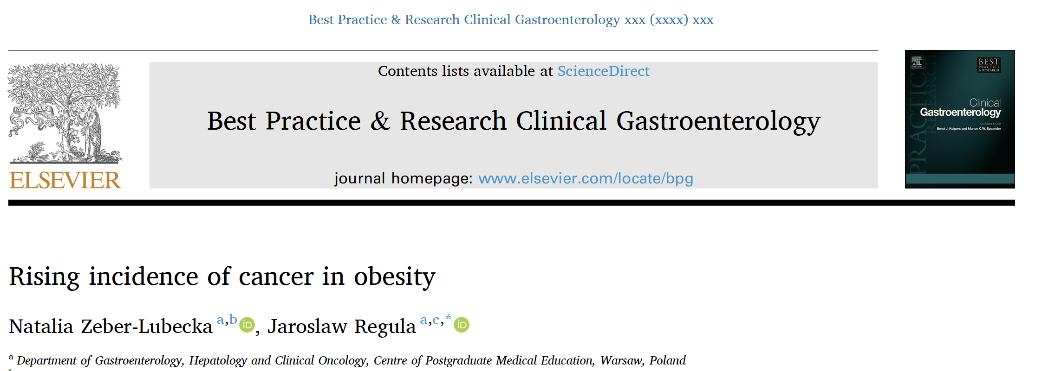
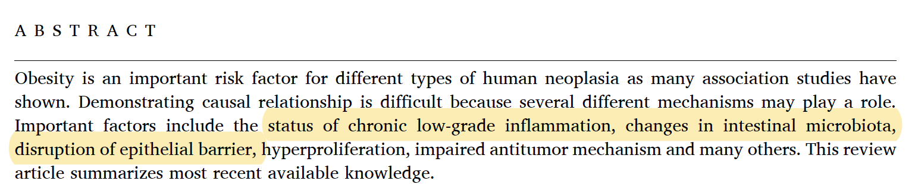

Slide 27
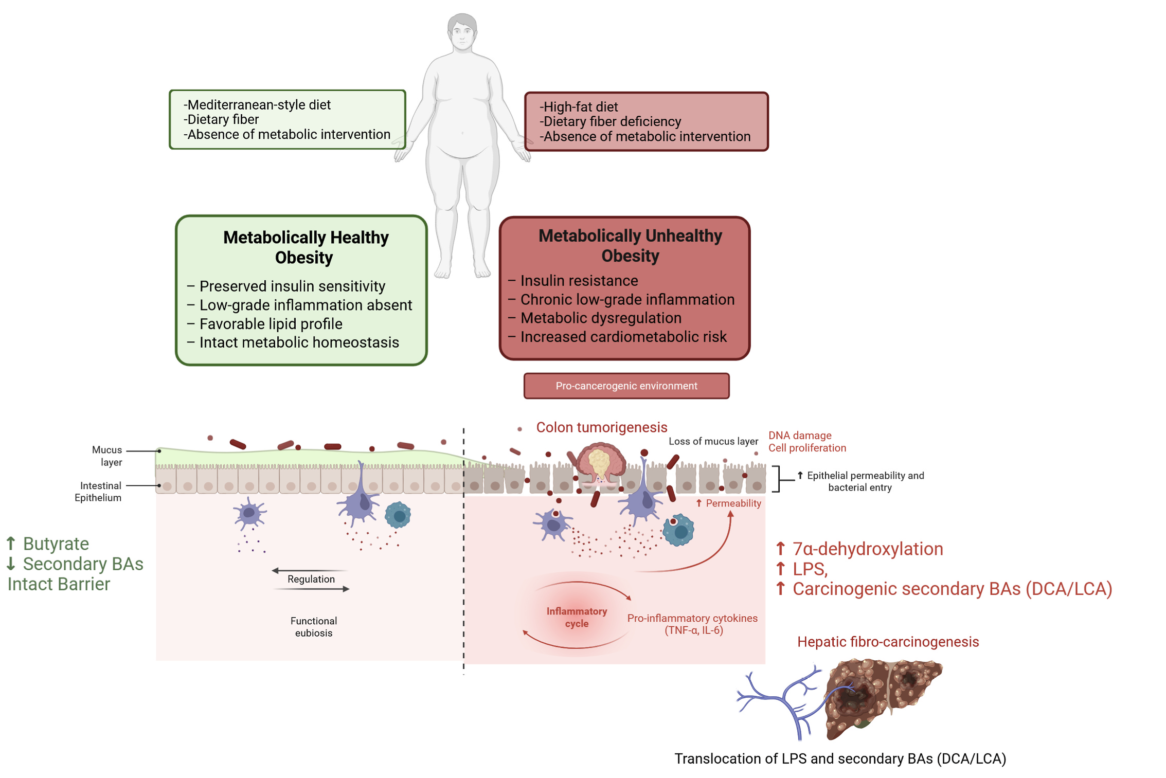

Slide 28

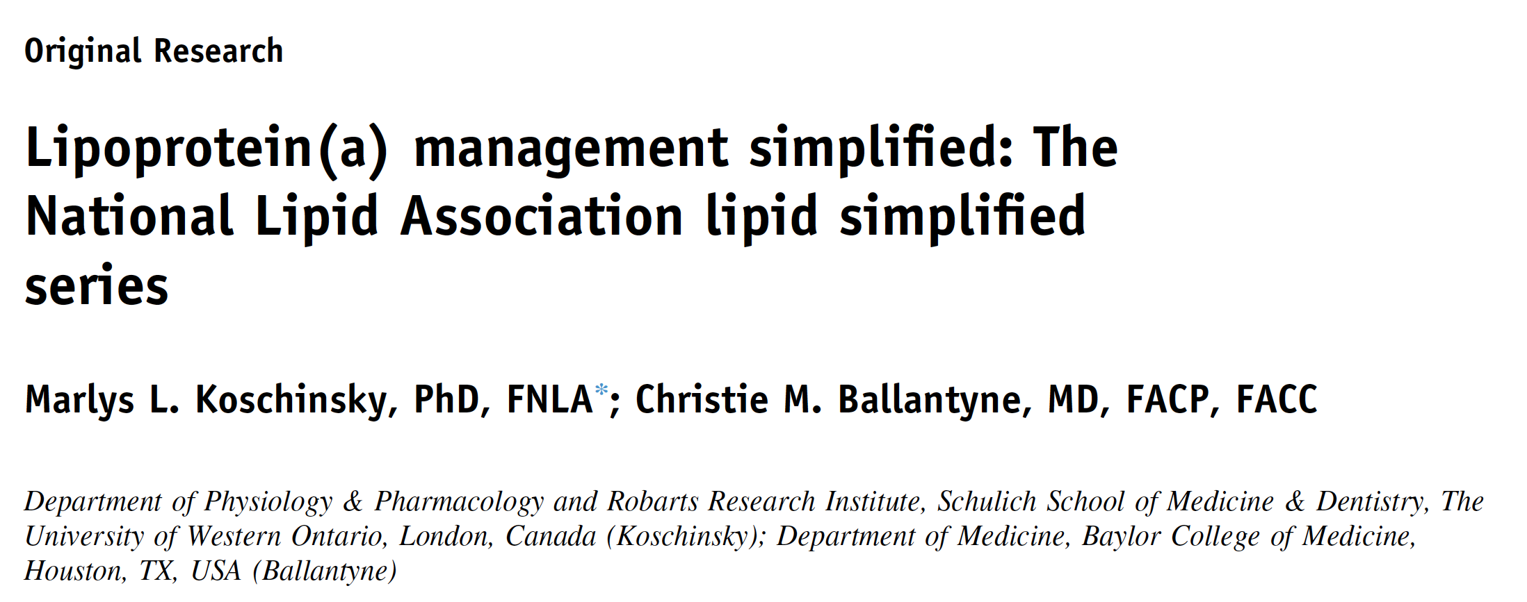

Slide 29
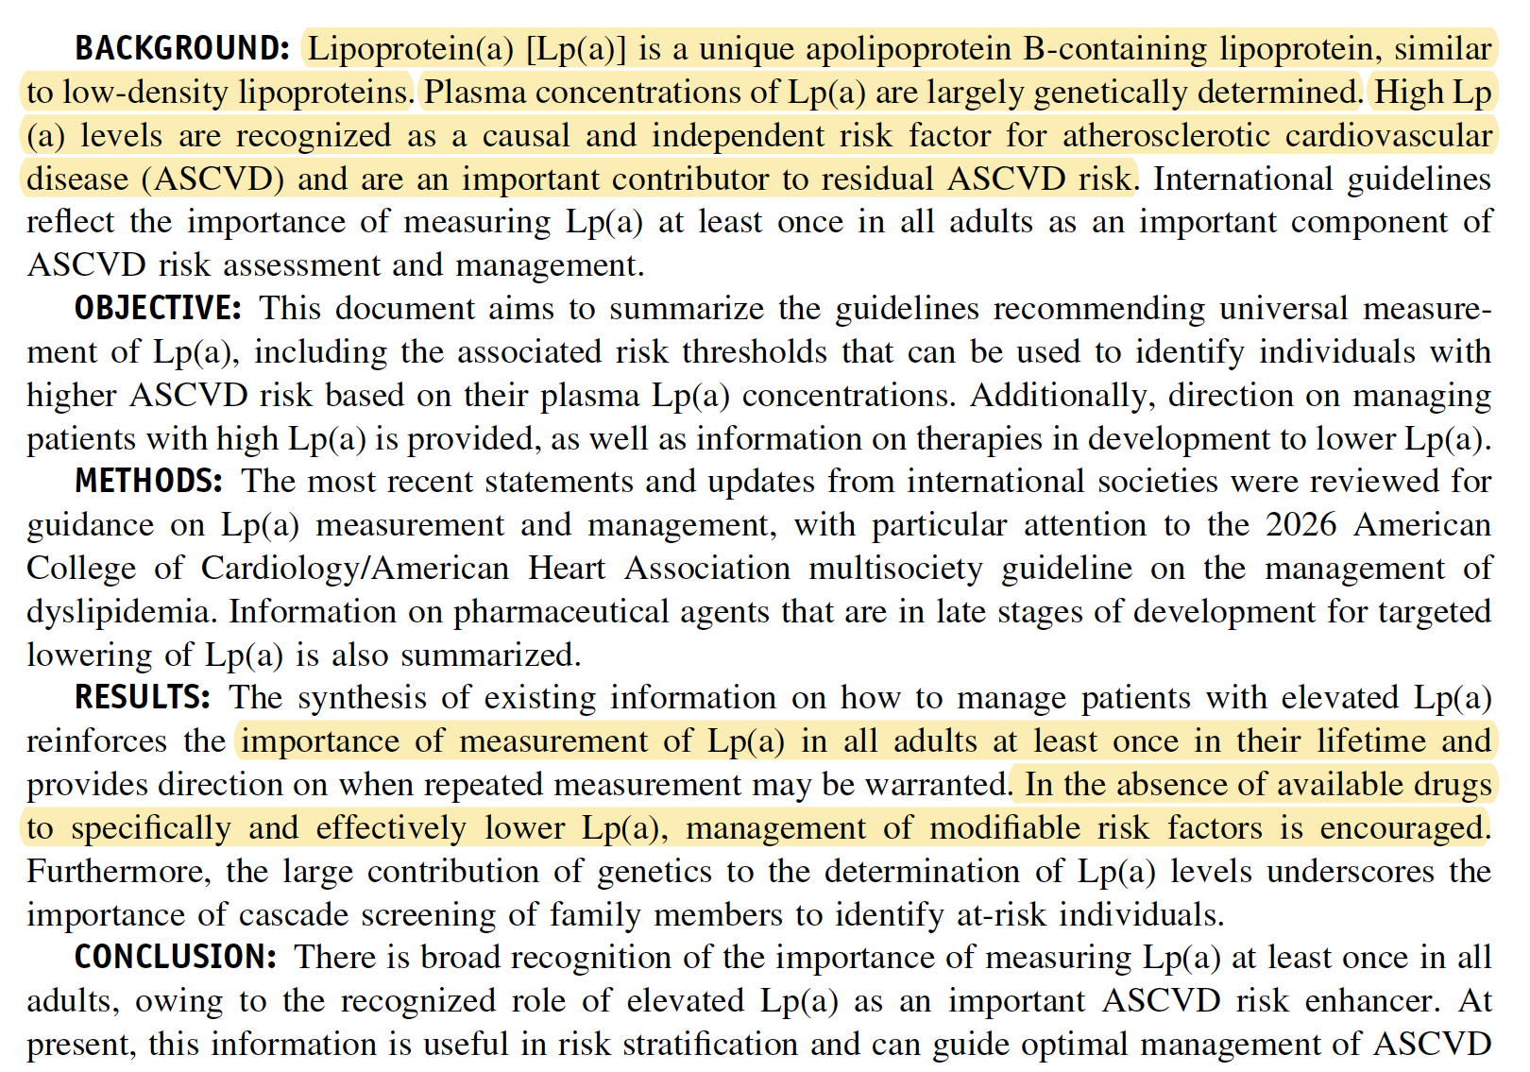

Slide 30
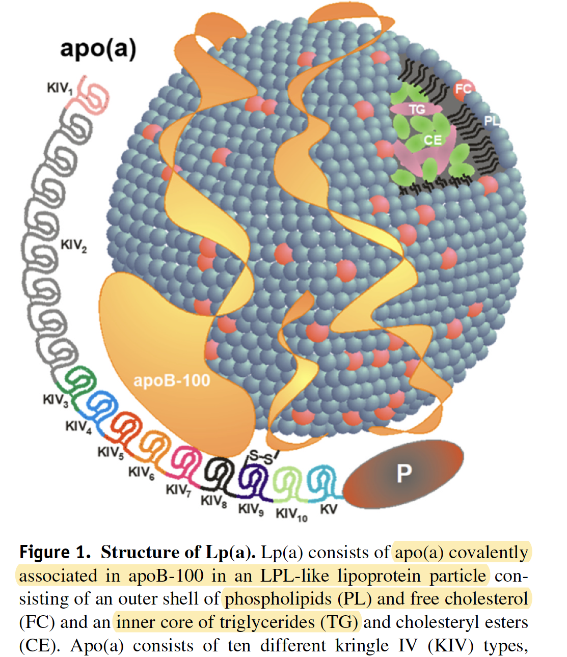

Slide 31
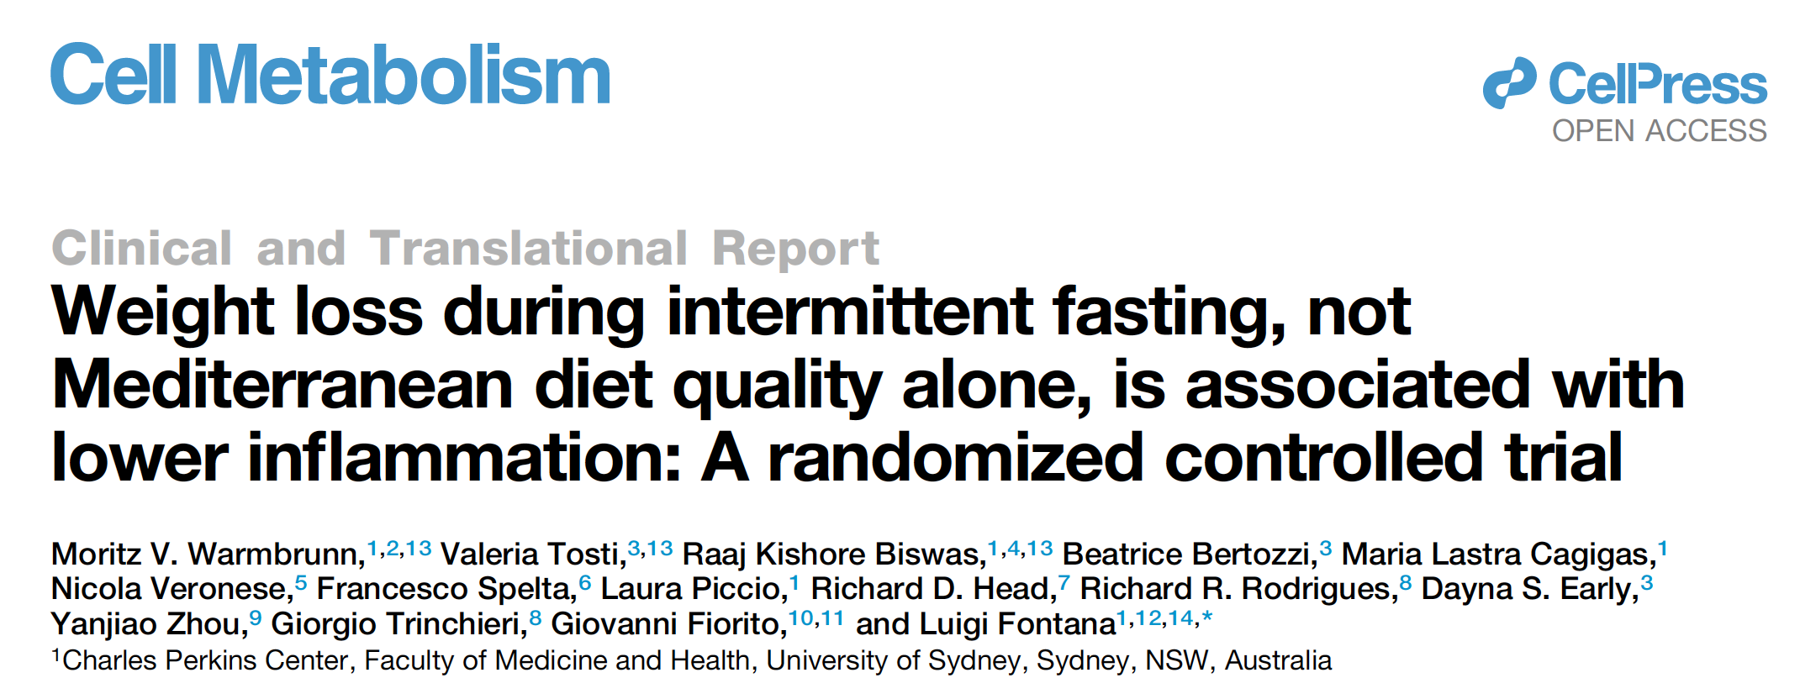

Slide 32
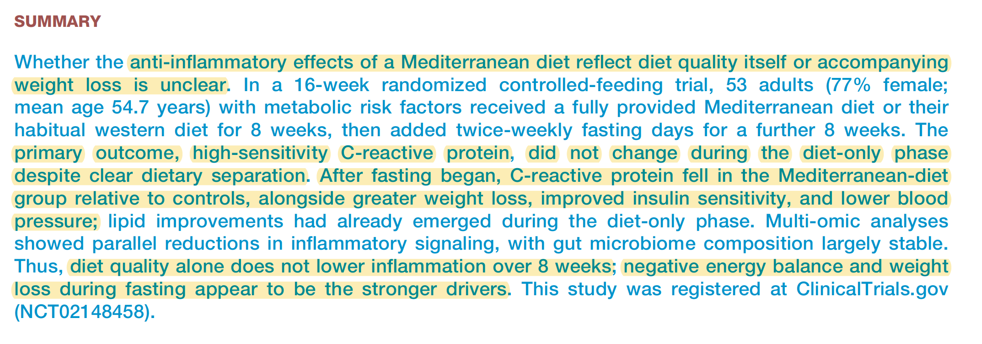

Slide 33
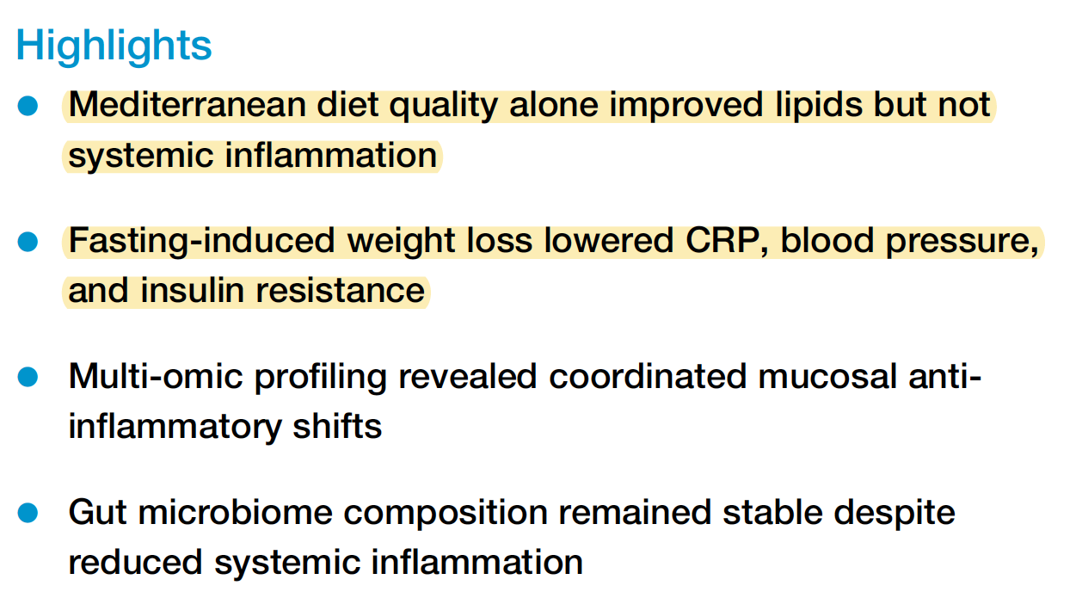
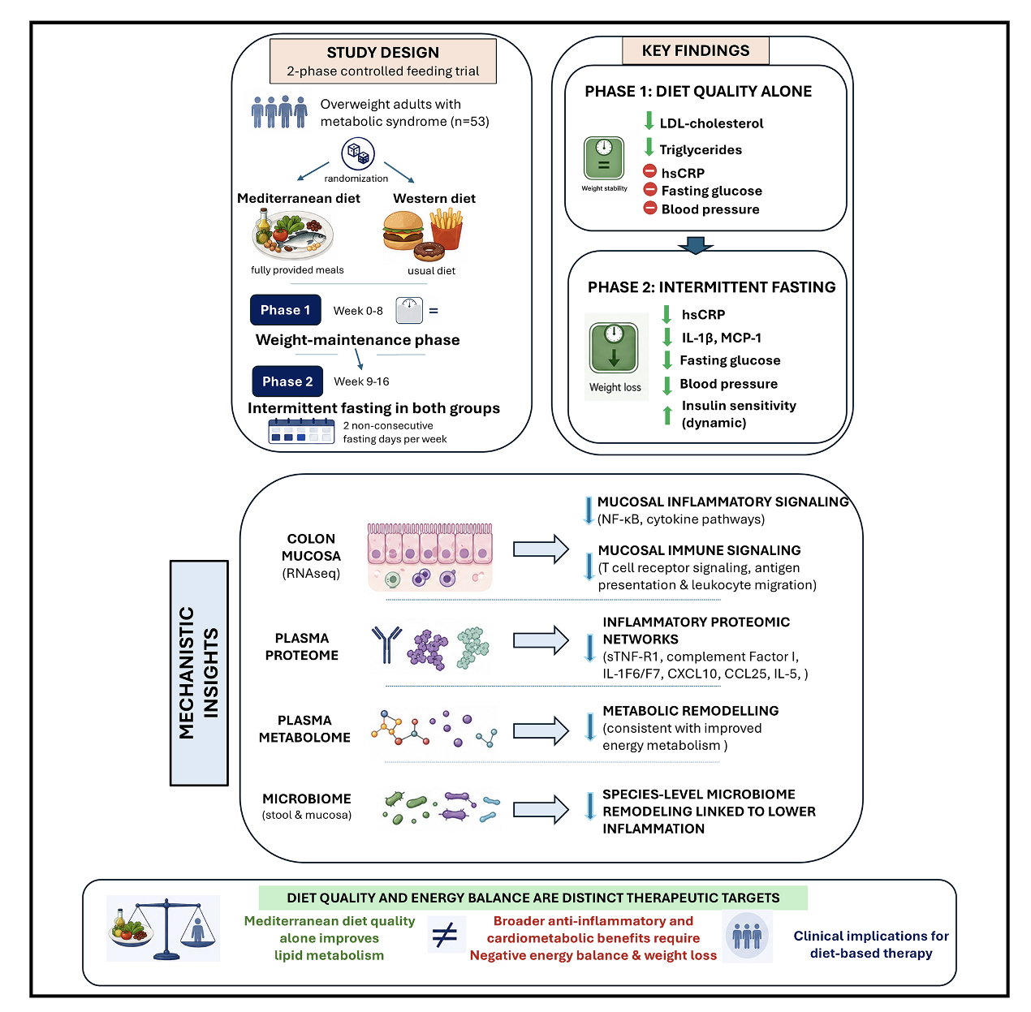


Slide 34



Slide 35


Slide 36


Slide 37


Slide 38


Slide 39



Slide 40




Slide 41



Slide 42


Slide 43


Slide 44


Slide 45


Slide 46



Slide 47


Slide 48



