Slide 1
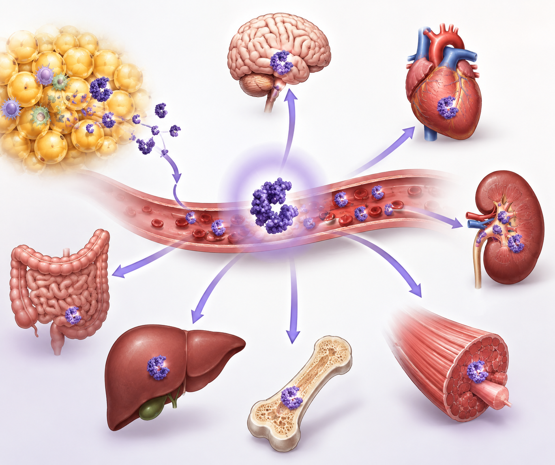
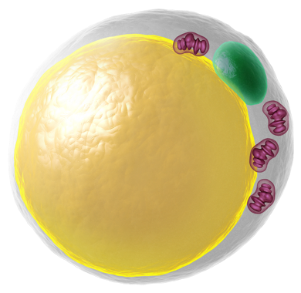
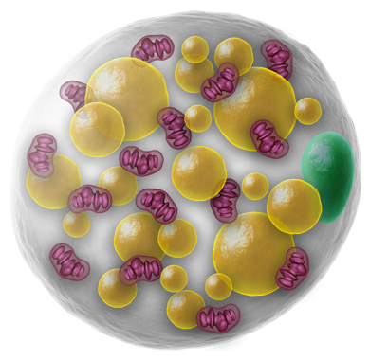
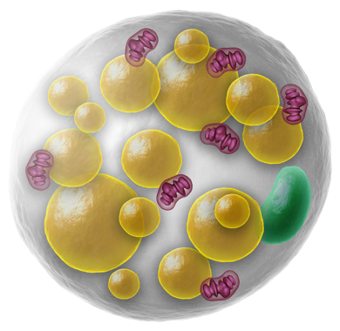
Literature Overview
Touchstone Diabetes Center
UTSW Medical Center 9/14/2026

Slide 2

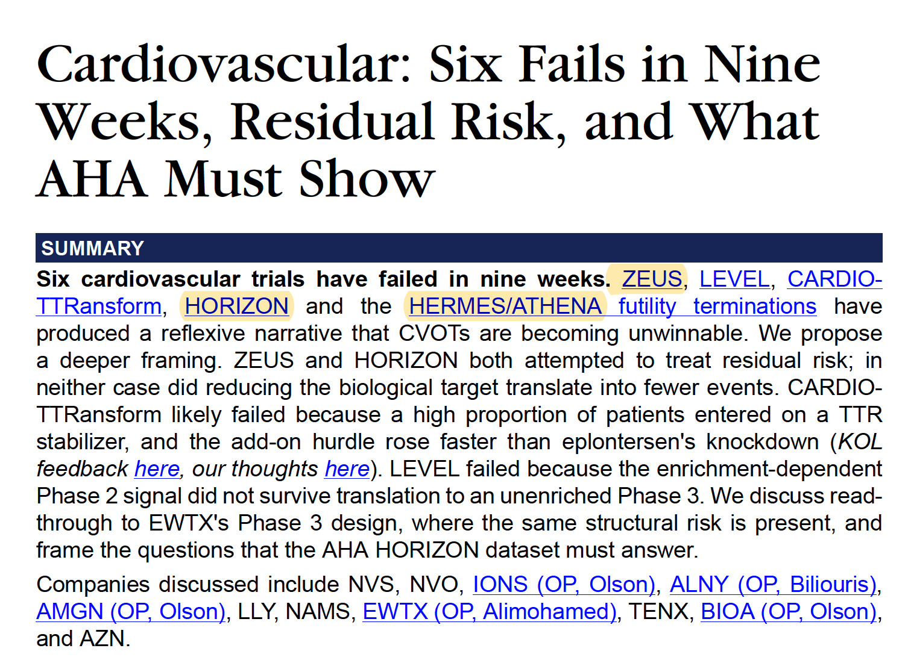

Slide 3
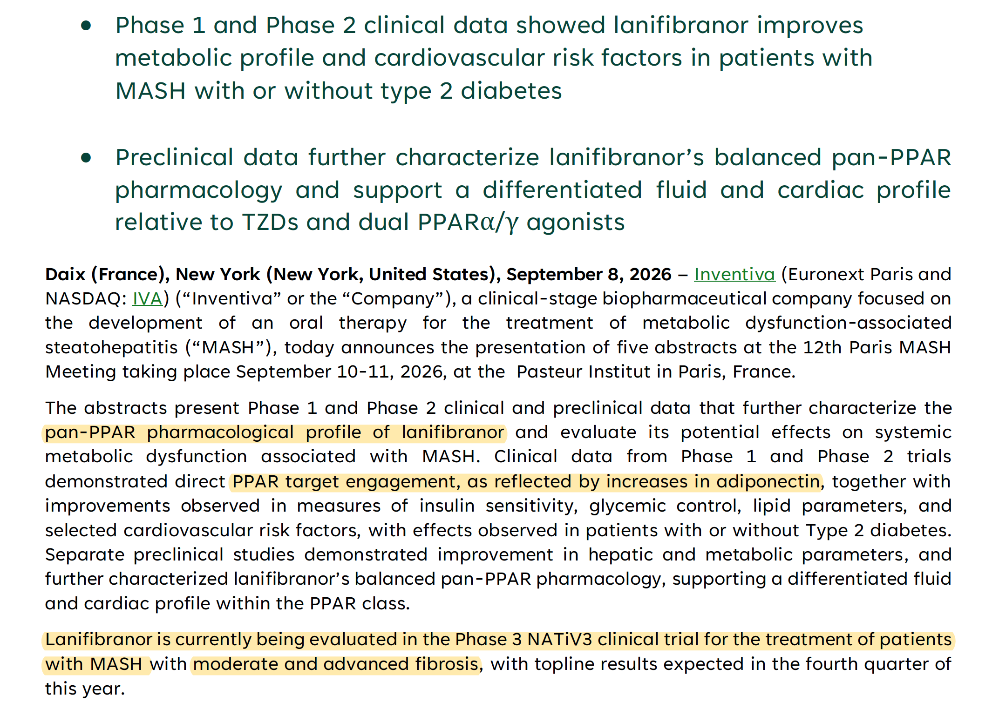

Slide 4

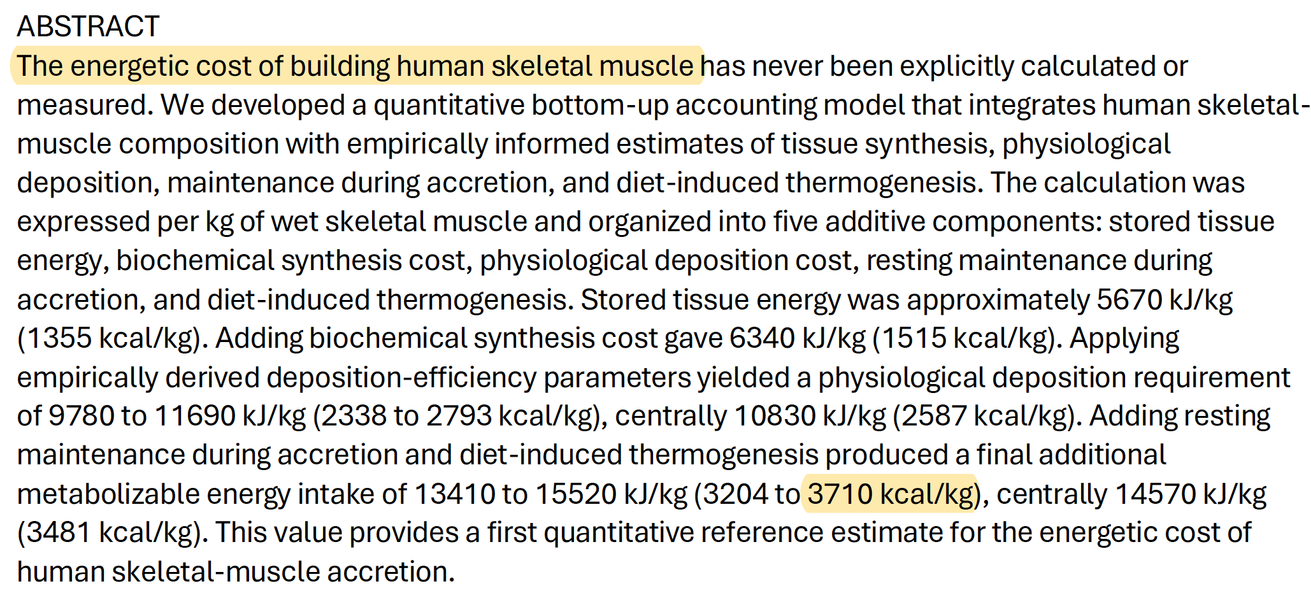
One pound of human adipose tissue contains roughly 3,500 kcal of stored energy.

Slide 5
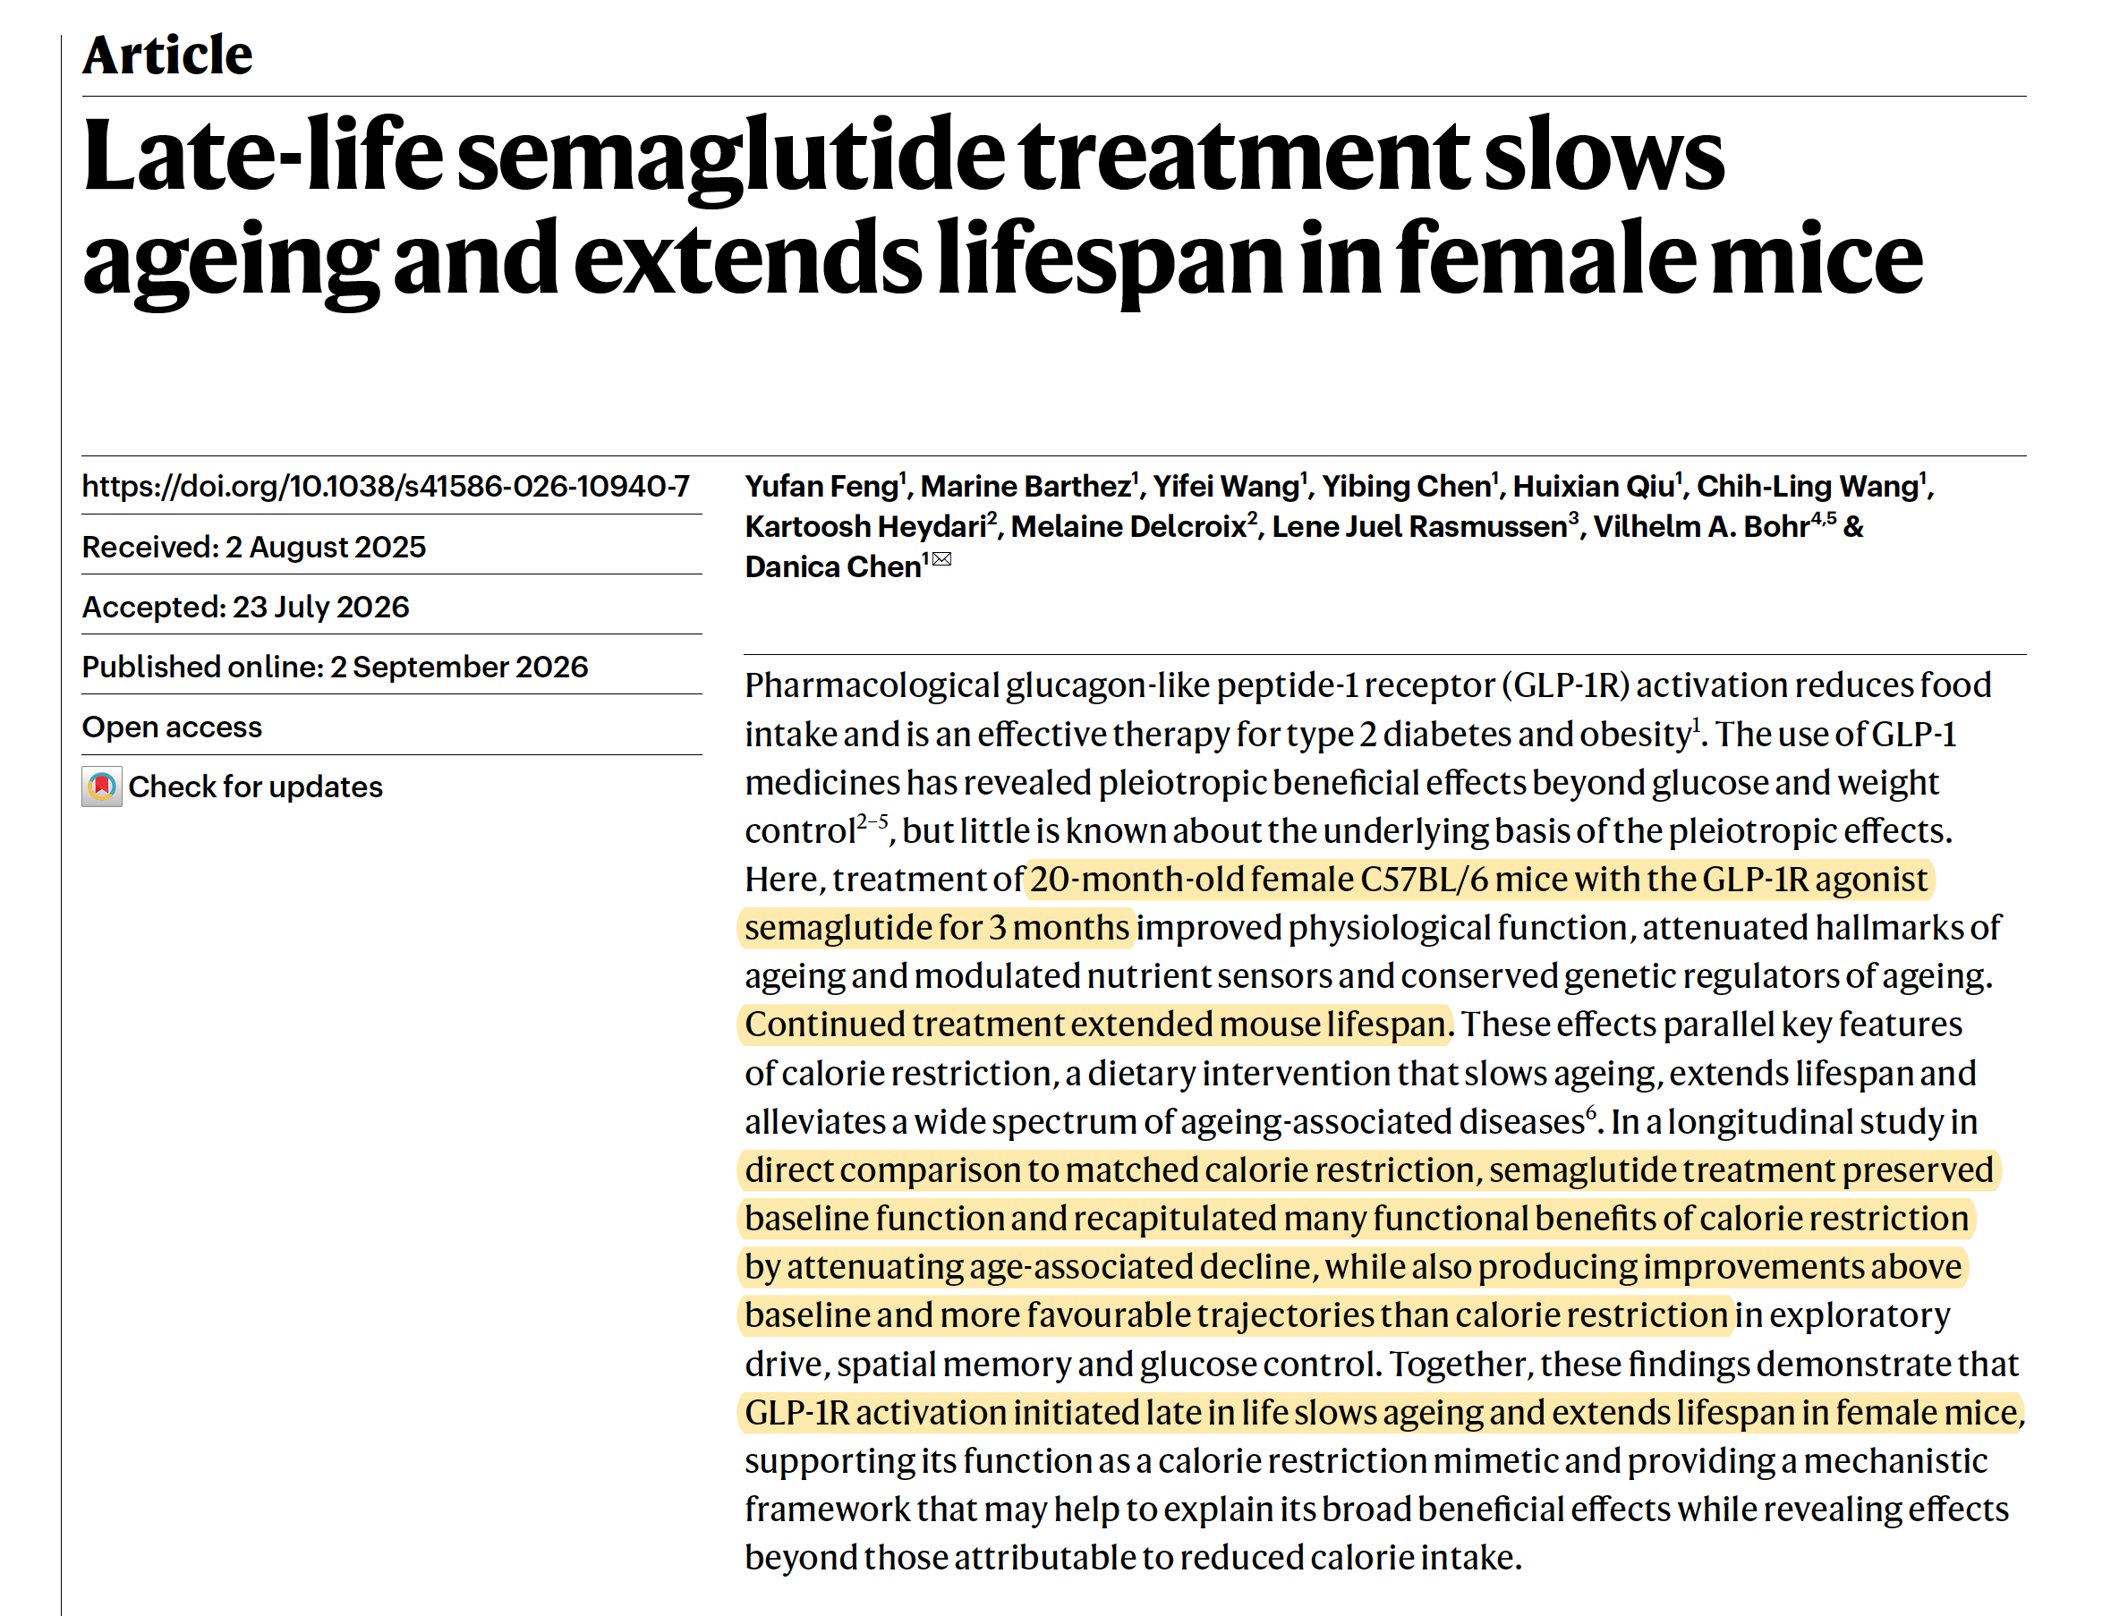


Slide 6
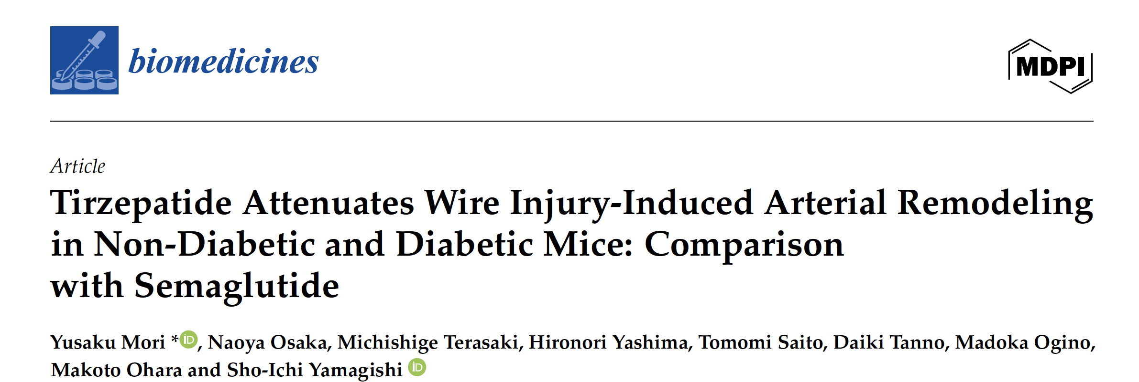


Slide 7
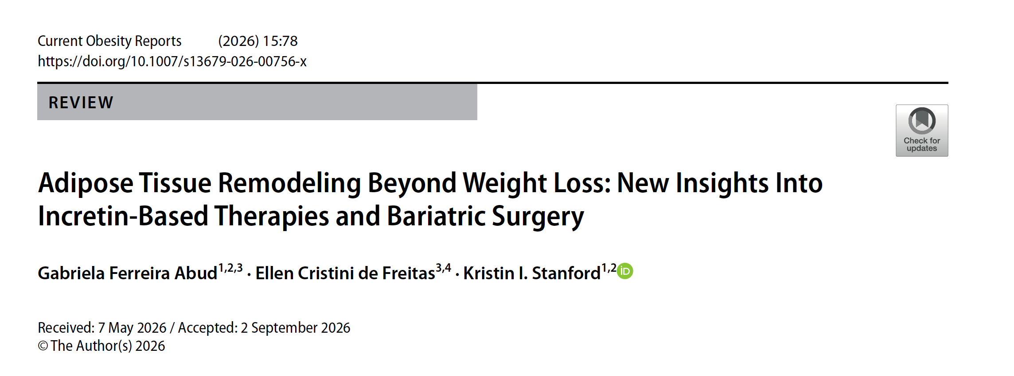
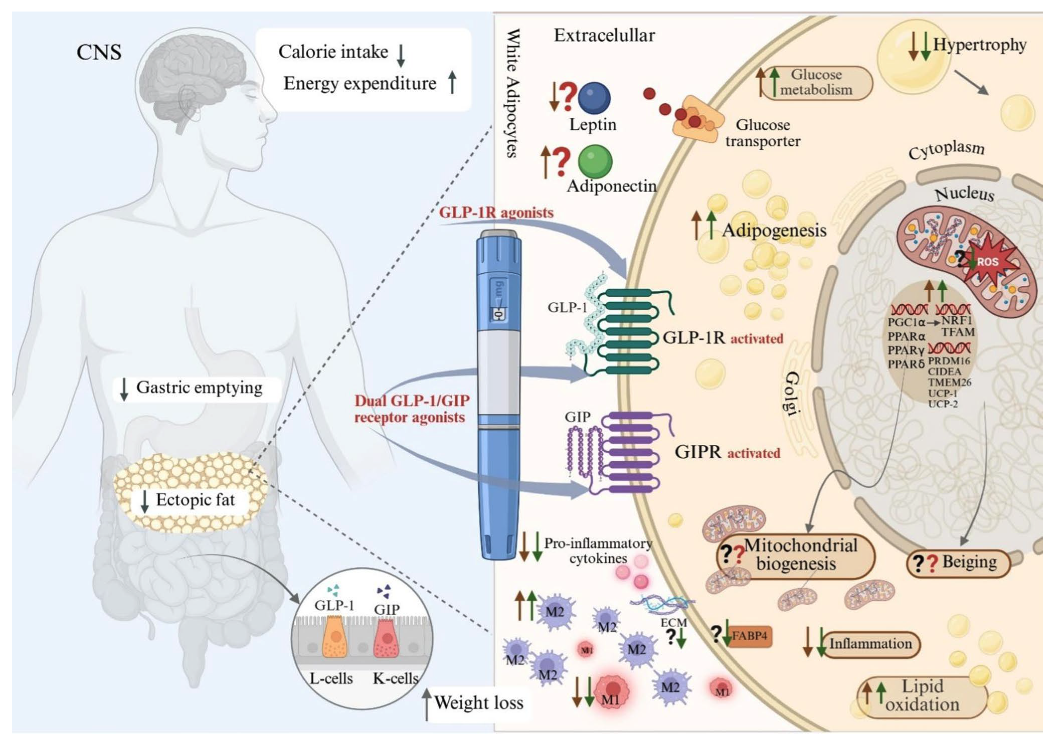

Slide 8

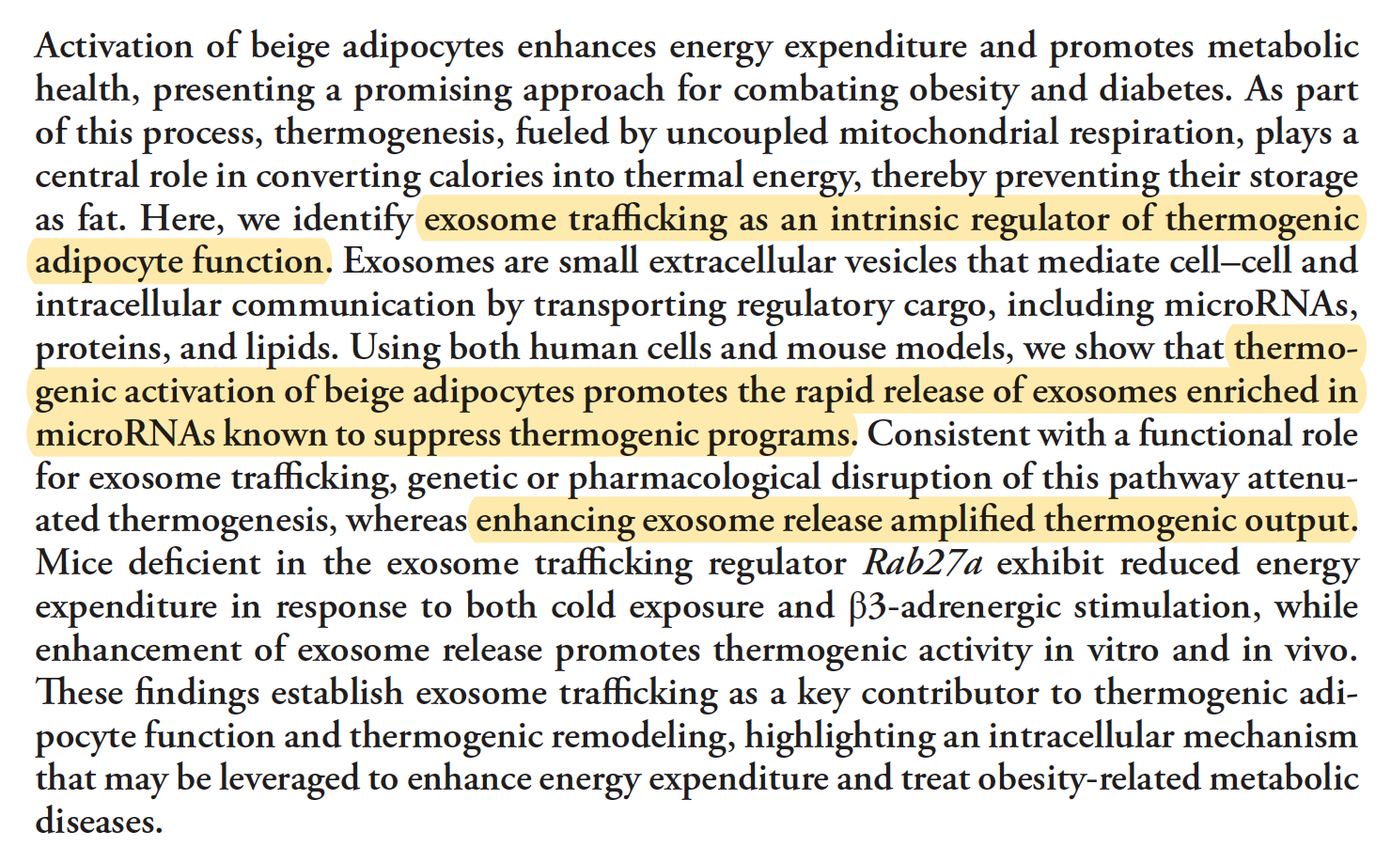

Slide 9


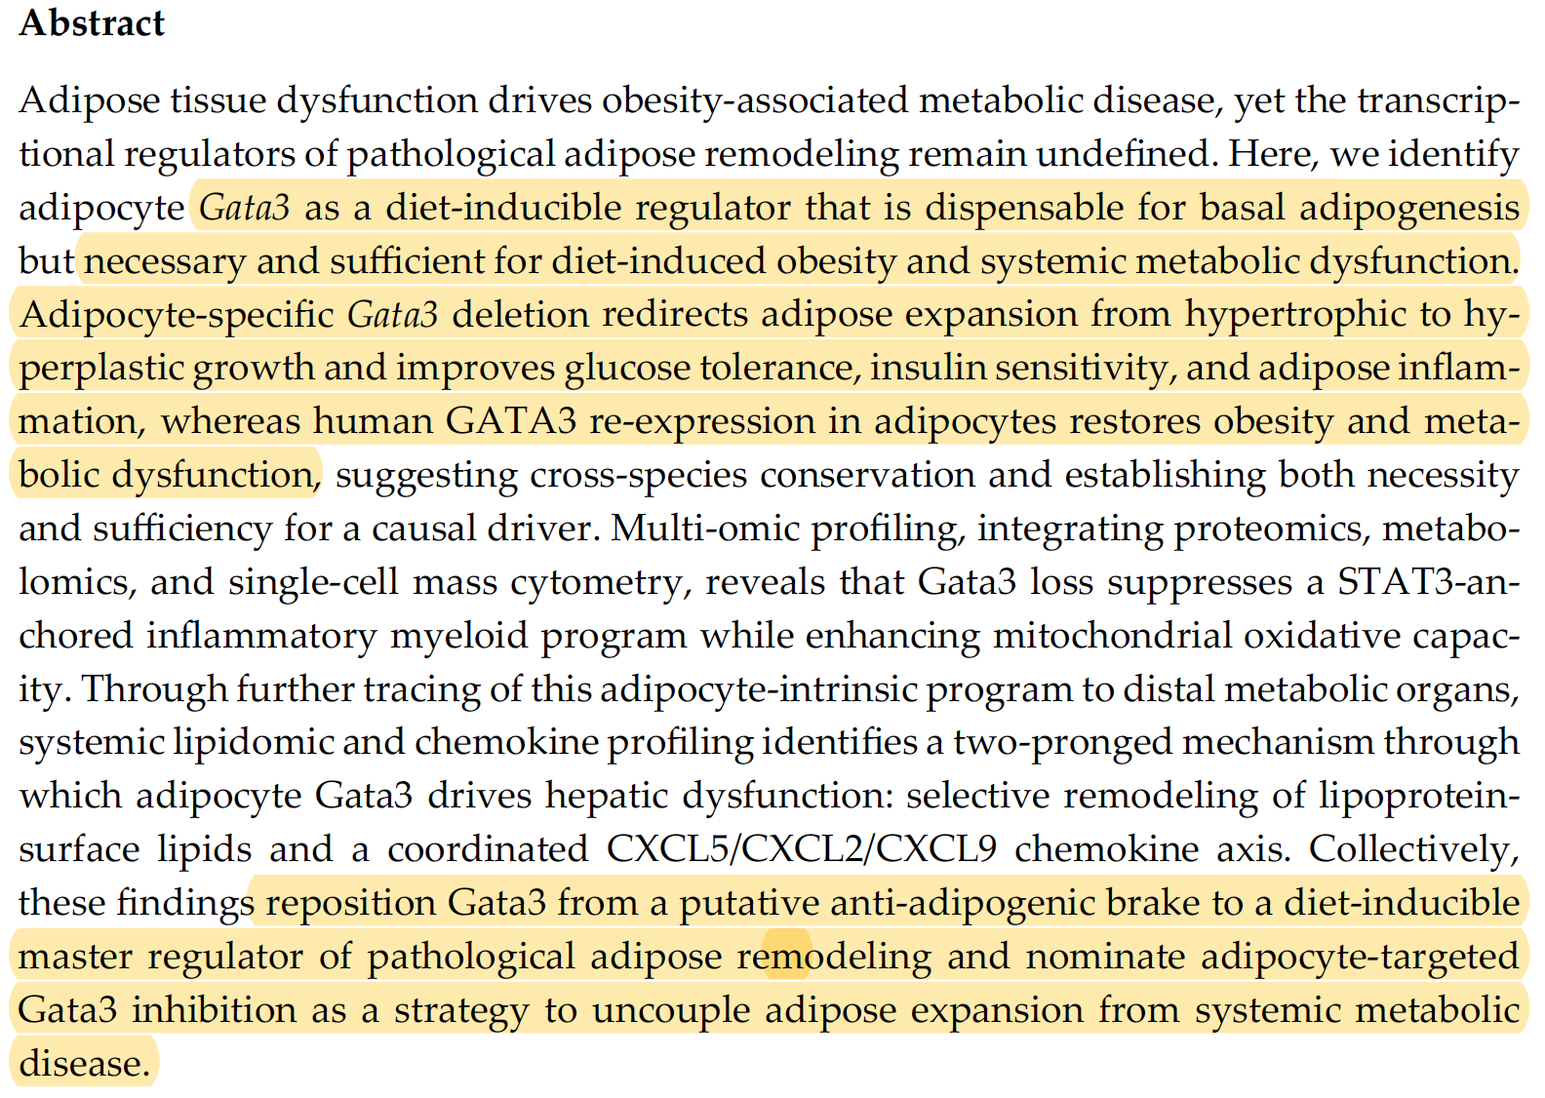


Slide 10
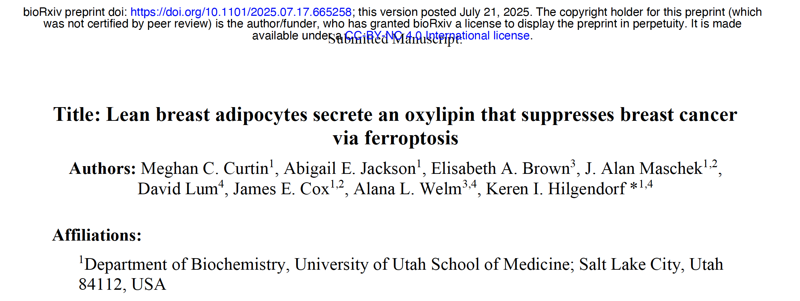

Obesity may promote cancer not only by adding bad adipose signals, but by removing good ones.
That fits remarkably well with an adiponectin/endotrophin framework.
Obese adipocyte transition as at least three simultaneous changes:
adiponectin ↓, protective lipid mediators such as 9S-HODE ↓, and COL6A3/endotrophin signaling ↑

Slide 11

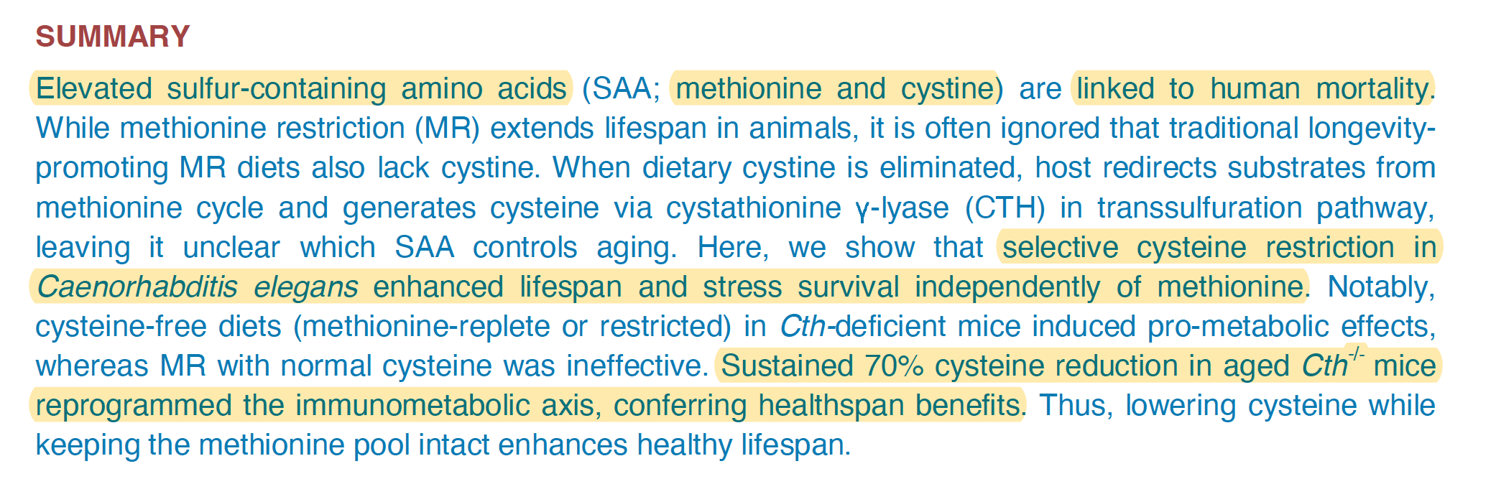

Slide 12
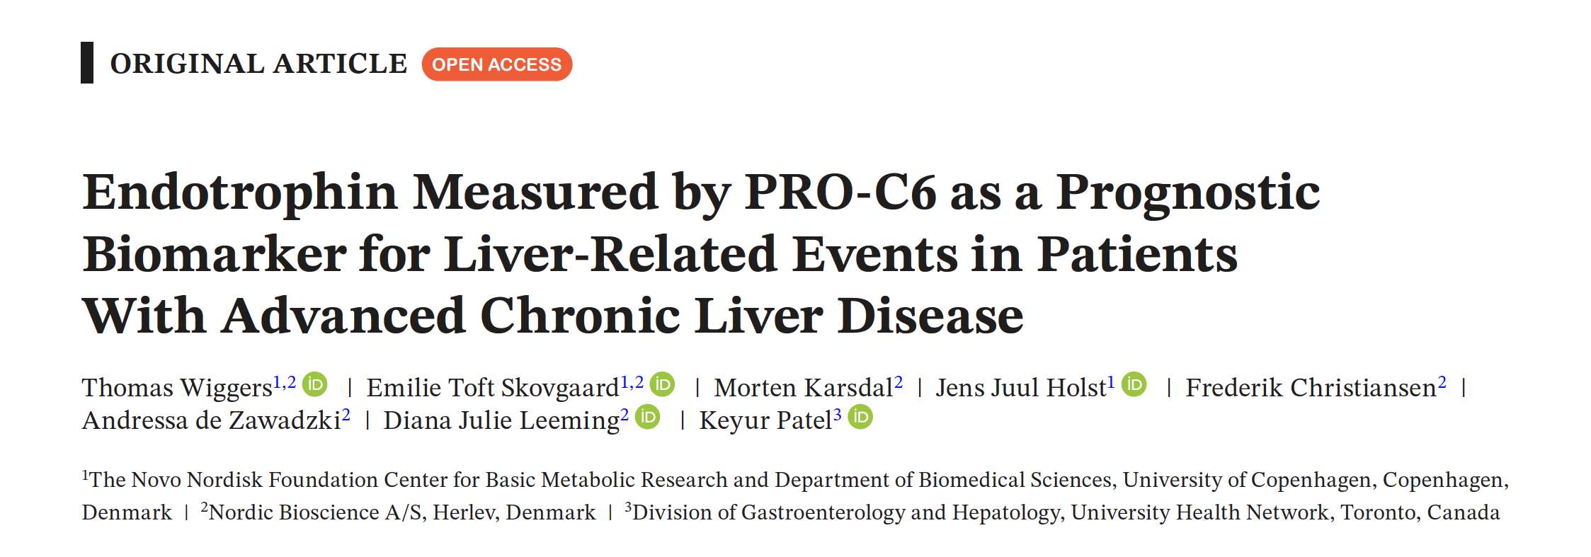

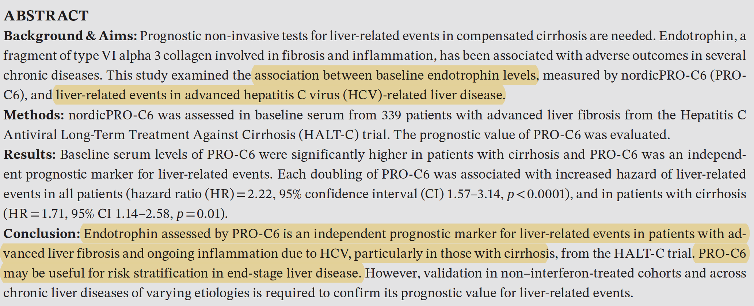

Slide 13


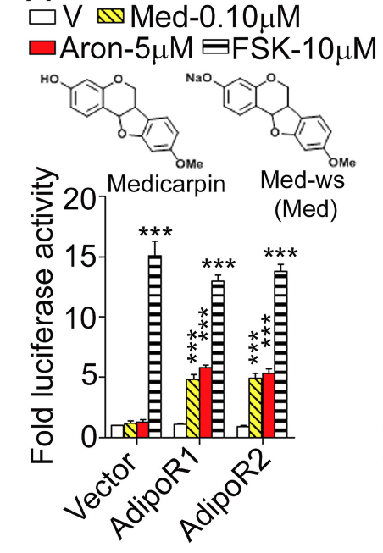



Slide 14
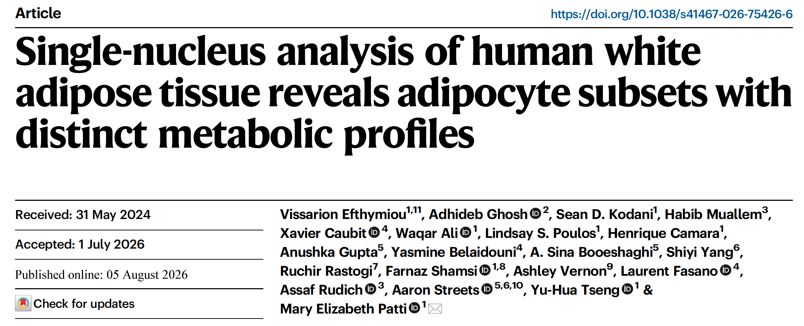


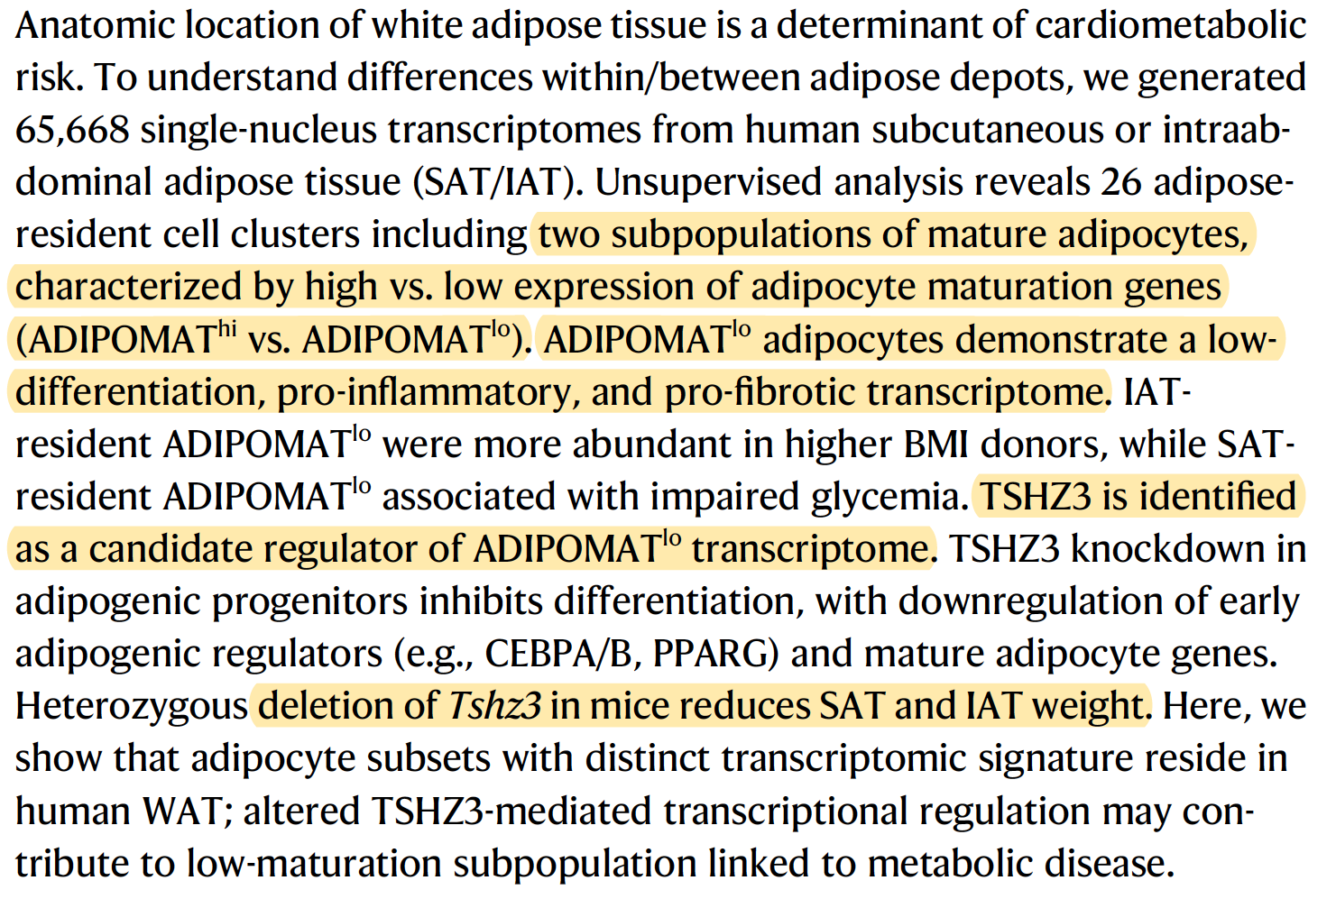
TSHZ3 is a human gene that
encodes the teashirt zinc finger
homeobox 3 protein

Slide 15
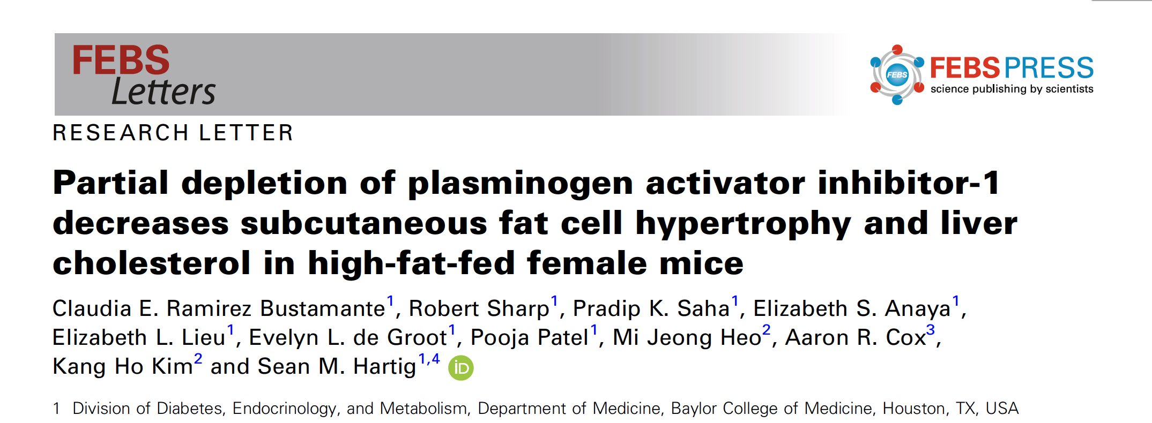

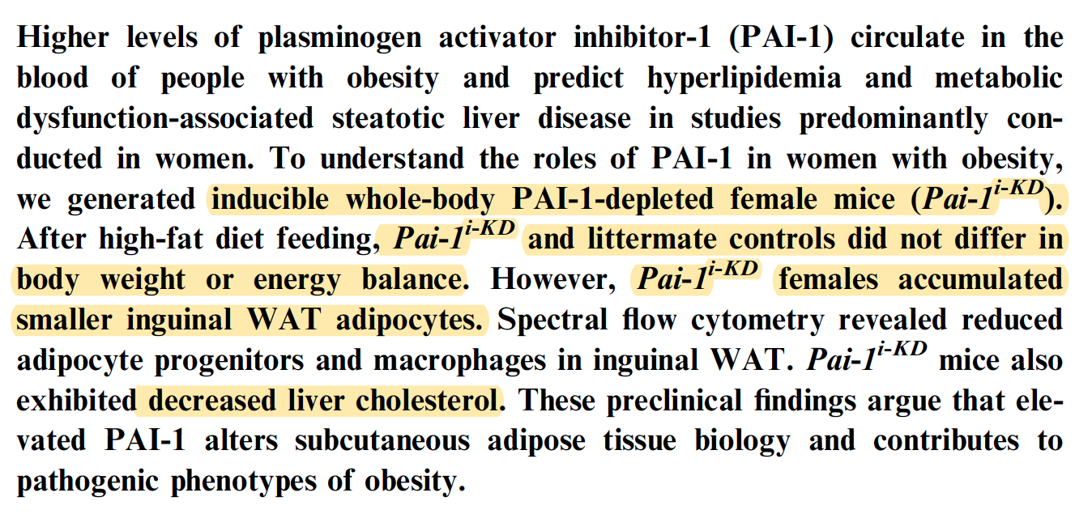

Slide 16
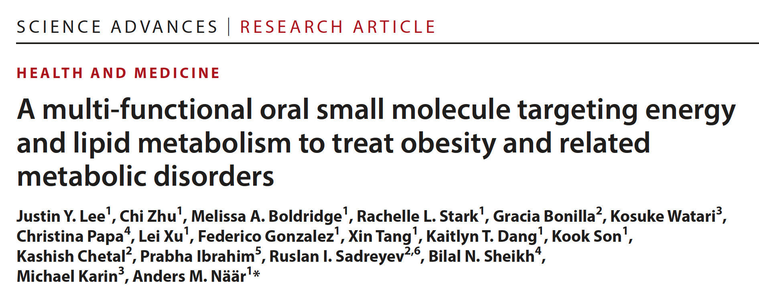

Slide 17

2 gram /day dose
Safety?
Is it really PPAR? Active in PPAR KO mice…
18% greater energy expenditure without reduced intake, hyperthermia, activity,
classical thermogenesis, lean-tissue loss, or an identified energetic sink.

Slide 18
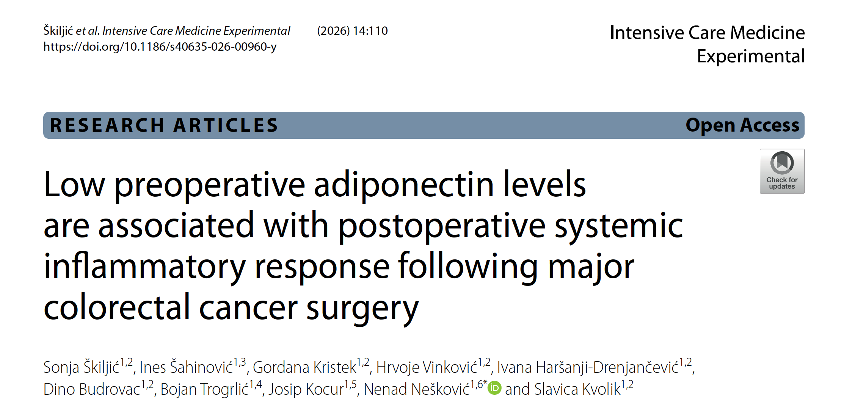

Slide 19
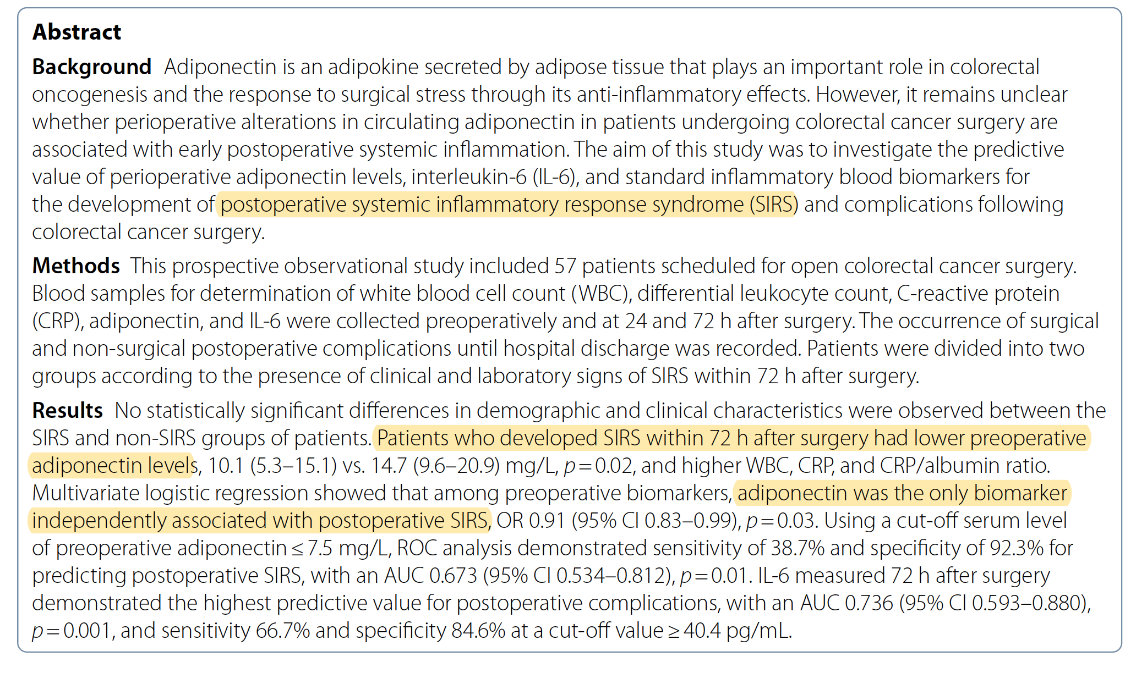

Slide 20


Slide 21


Slide 22
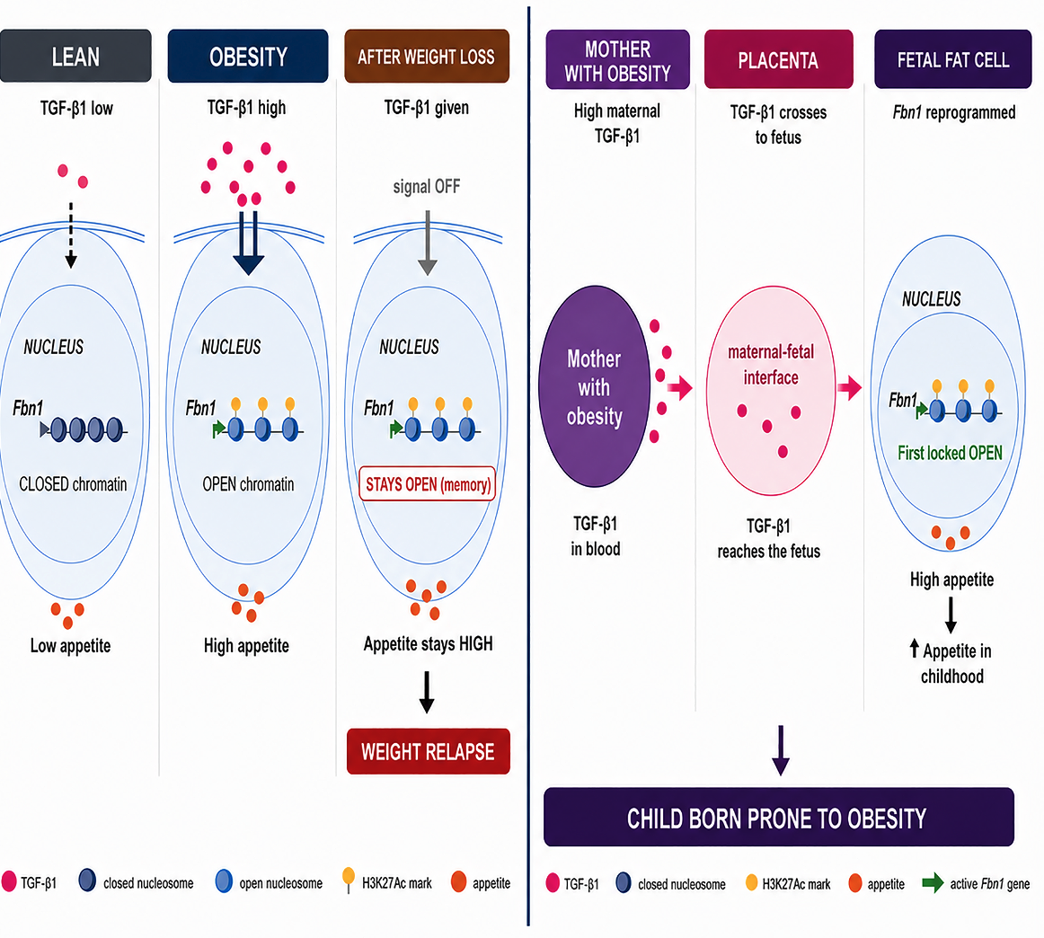
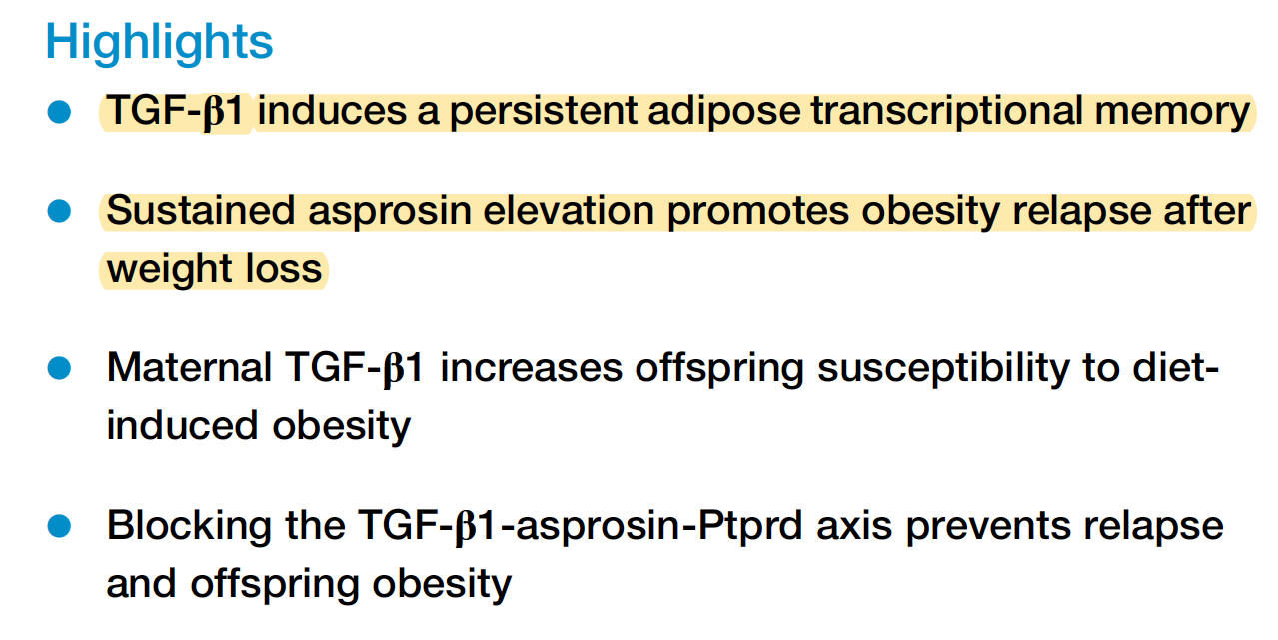

Slide 23
